Slide 1
Contributing to the OpenJDK
Rémi Forax – May 2021

Slide 2
OpenJDK ?
Open source version (in 2006/2007)
of the SUN sources
Used as based for all the Java distibutions
(like the linux kernel vs linux distribution)
  Oracle, RedHat, Azul, Amazon, etc

Slide 3
OpenJDK Licence
GPLv2 + classpath exception
  Linking this library statically or dynamically with other modules is making a combined work based on this library. Thus, the terms and conditions of the GNU General Public License cover the whole combination.
  As a special exception, the copyright holders of this library give you permission to link this library with independent modules to produce an executable, regardless of the license terms of these independent modules, and to copy and distribute the resulting executable under terms of your choice, provided that you also meet, for each linked independent module, the terms and conditions of the license of that module. An independent module is a module which is not derived from or based on this library. If you modify this library, you may extend this exception to your version of the library, but you are not obliged to do so. If you do not wish to do so, delete this exception statement from your version.

Slide 4
JDK releases
before, mammoth releases (every 2 to 3 years)
since jdk 10, 6 month schedules
  September: jdk11, jdk13, jdk15
  April: jdk10, jdk12, jdk14 (2020), jdk16 (2021)
long term stable (LTS) every 3 years
  Currently jdk7, jdk8, jdk11

Slide 5
Where is the source ?
Recently migrated to github (yai !)
  github.com/openjdk/jdk
There are several repositories, one per OpenJDK project
  Update projects (security + some bug fixes)
    jdk-updates (6 month releases)
    jdk8-updates, jdk11-updates, soon jdk17-updates (LTS)
  Exploratory projects
    Amber (Language), Valhalla (VM), Loom(VM),
    Panama foreign + vector (VM), Liliput (VM), etc

Slide 6
Project Mailing Lists
Each project has its own mailing list
    https://mail.openjdk.java.net/mailman/listinfo
  core-lib-dev, awt-dev, hotspot-dev, hotspot-gc-dev, ...
  amber-dev, valhalla-dev, etc
All patches, pull-requests, discussions are on the mailing list
  Pull request discussions use two ways mirroring
  Github ↔ mailing list

Slide 7
Oracle Contributor Agreement
You can not contribute to the JDK without signing the OCA
  A github bot will verify that patch authors have signed the agreement
https://oca.opensource.oracle.com/

Slide 8
Bug databases
Two systems
  External: bugs.java.com/bugdatabase/
    Everybody can enter a bug
      People paid by Oracle filter those bug reports, and transfer the relevant ones into bugs.openjdk.java.net
  OpenJDK: bugs.openjdk.java.net
    Only OpenJDK author can enter a bug

Slide 9
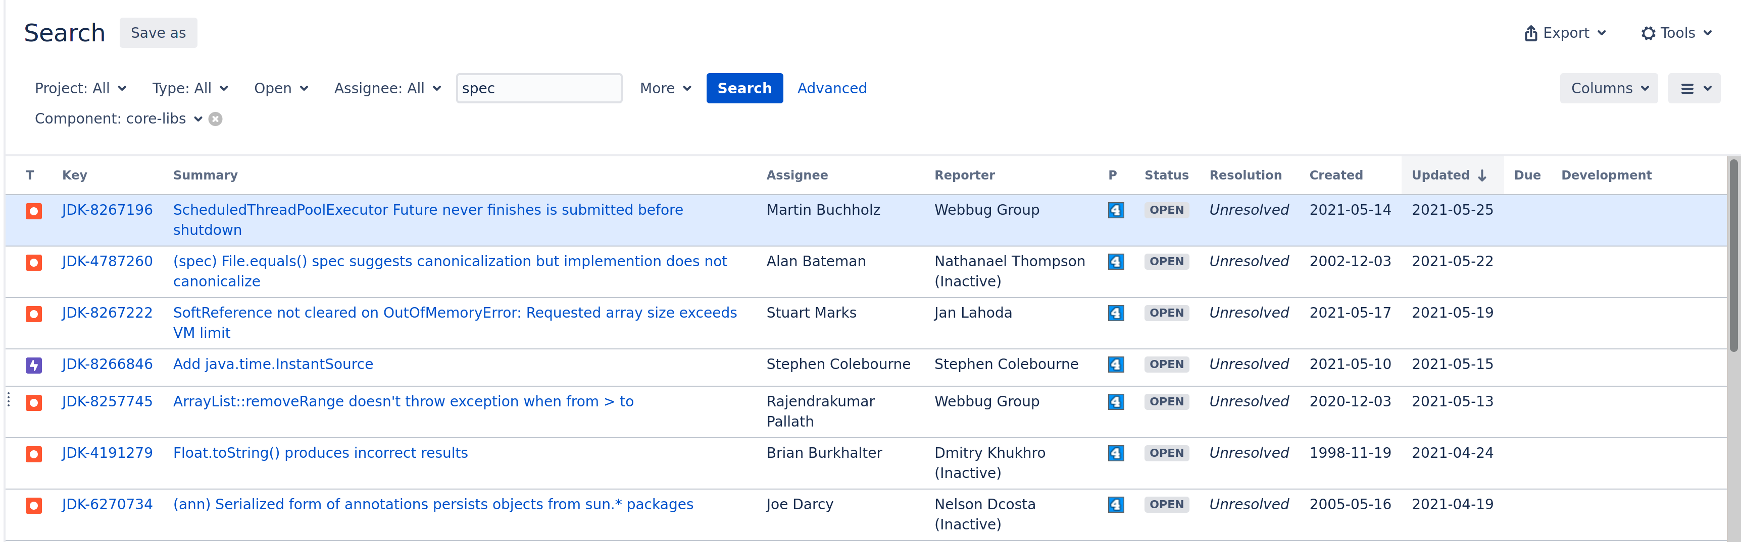
bugs.openjdk.java.net
Jira instance hosted in CA
    Slow in Europe :(

Slide 10
The long march ... to contribute

Slide 11
Contributing using Github
Create remote repositories accessible using git
  and add your public SSH key
Fork an existing openjdk remote repository (using the fork button)
  e.g. from github.com/openjdk/jdk to github.com/forax/jdk
Clone a local copy
  git clone git@github.com:forax/jdk
Build the jdk
  ./configure + make images
Hack the local copy: do the magic
Re-build and test:
  make images + make test

Slide 12
Contributing using Github (2)
… Hack + Re-build
Commit and push the local copy to your remote repository
  git commit + git push
Create a pull request (PR) from the remote copy to the openjdk repository
  pull request buttton on your github repository
A github bot verifies that you have sign the OCA
Associate the PR to the bug
  inside the PR: /issue JDK-XXXXXXX
The PR is reviewed on the mailing list/github
After discussion, the PR is approved or rejected

