Slide 1
Valhalla Nullness Emotion
Rémi Forax
University Gustave Eiffel, Paris, France
IntelliJ Conf - June 2025

Slide 2

Don’t believe what I’m saying !

Slide 3

Valhalla
OpenJDK project
Lead by Brian Goetz and John Rose
Started on July, 2014 !
Valhalla

Slide 4

The primitive world ...

Slide 5

... the class world

Slide 6
Why Valhalla ?
No cost abstraction
  Code like a class, works like an int
CPUs have changed
  Flat representation vs pointer chasing
Primitives are a nuisance
  Arrays, generics, functional interface & stream

Slide 7
Class vs Primitive
have identity
(thus mutability)
have fields,
methods & interfaces
instances are nullable
have encapsulation
no identity
are flattened on stack
/ on heap
may have no integrity
(long on 32bits CPUs)
have a default value
Classes
Primitives

Slide 8
Class vs Value class vs Primitive
have identity
(thus mutability)
have fields,
methods & interfaces
instances are nullable
have encapsulation
no identity
have fields,
methods & interfaces
are flattened on stack
may be flattened on heap
/ may be nullable
may have no integrity
may have a default value
/ no encapsulation
no identity
are flattened on stack
/ on heap
may have no integrity
(long on 32bits CPUs)
have a default value
Classes
Value Classes
Primitives

Slide 9
Stage 1 – Value keyword
JEP 401 : Value Classes and Object
https://openjdk.org/jeps/401

Slide 10
DEMO !
https://github.com/forax/intellij-conf-2025

Slide 11
Benchmarks
Identity class
  Benchmark Mode Cnt Score Error Units
  computeMandelbrot avgt 5 474.451 ± 5.279 ms/op
  computeMandelbrotPrimitive avgt 5 258.706 ± 1.109 ms/op
Value class
  Benchmark Mode Cnt Score Error Units
  computeMandelbrot avgt 5 258.697 ± 1.038 ms/op
  computeMandelbrotPrimitive avgt 5 259.169 ± 1.162 ms/op

Slide 12
A value class
Identity-dependent methods have a new semantics
  ==
    bitwise comparison of each fields
  System.identityHashCode()
    compute the value by hashing each fields
  synchronized(), new WeakRef<>()
    throw new IdentityException

Slide 13
Inheritance & Subtyping
A value class is final
  No subclasses
A value class can implements any interfaces
A value class can inherits abstract
“value enabled” classes
  j.l.Object, j.l.Number, j.l.Record

Slide 14
Strict field initialization
Fields must be initialized before the call to super()
  value class MyInteger {
  private final int value;
  public MyInteger() {
  this.value = value;
  super();
  }
  }
Value enabled abstract class
have the same requirement !

Slide 15
Retrofit value based classes
java.lang: wrapper types are value types
  Byte, Integer, Long, Double, etc
java.util
  Optional, List|Set|Map.of()/copyOf()
java.time
  Month, Year, LocalDateTime, etc
Java 25 : JEP draft Warning for Identity-Sensitive Libraries
  https://bugs.openjdk.org/browse/JDK-8340476

Slide 16
Current state of the implementation
have fields,
methods & interfaces (done)
have no identity (done)
are flattened on stack (done)
may have no integrity (done)
may be flattened on heap (in progress)
may be nullable (in progress)
may have default value (not yet !)
Value Classes

Slide 17
Current state of the implementation
have fields,
methods & interfaces (done)
have no identity (done)
are flattened on stack (done)
may have no integrity (done)
may be flattened on heap (in progress)
may be nullable (in progress)
may have default value (not yet !)
Value Classes

Slide 18
Stage 2 – Nullness emotion
JEP draft : Null-Restricted and Nullable type
https://openjdk.org/jeps/8303099

Slide 19
Flattening on heap ??
Storing an instance of a value class
    value record Complex(double im, double re) { }
  field
    class ComplexBox {
    Complex complex; // can the VM avoid to use a pointer ?
    }
  array
    new Complex[1_024] // can the VM avoid to use pointers ?

Slide 20
Flattening on heap (if small)
Storing an instance of a small value class
    value record MyInteger(int value) { }
  field
    class MyIntegerBox {
    MyInteger complex; // can use 64 bits (32bits + a null byte)
    }
  array
    new MyInteger[1_024] // can use 64 bits here too
Current hardware limit is 64 bits
=> otherwise tearing (several loads/store)

Slide 21
Flattening on heap (if 64bits)
Add nullness emotion ‘‘!’’
  value record MyDouble(double value) { }
  field
    class MyDoubleBox {
    MyDouble! complex; // use 64bits
    ...
    }
  array
    new MyDouble![1_024] // use 64bits

Slide 22
Required to be initialized
Not-null field / array element must be never null
  field : must be initialized before the call to the super constructor
    class ComplexBox {
    Complex! complex; // use 64bits
    ComplexBox(Complex complex) {
    this.complex = complex;
    super();
    }
    }
  array : we need a new syntax
    new Complex![1_024] (/* TODO */)

Slide 23
DEMO !
https://github.com/forax/intellij-conf-2025

Slide 24
Benchmarks
Summing an array of 1_000_000
  Benchmark Mode Cnt Score Error Units
  primitives avgt 5 291,008 ± 0,830 us/op
  identities avgt 5 332,557 ± 1,756 us/op
  nullRestrictedValues avgt 5 291,261 ± 0,752 us/op
  nullRestrictedValueBoxes avgt 5 291,209 ± 1,852 us/op

Slide 25
Null state analysis
3 ½ states
  not-null, maybe-null, unspecified (maybe-null with no warning) + parametric
Null state analysis
  Enhance existing definite assignment analysis
  not-null if
    The expression is known to be not null
    after a null check (explicit or implicit)
  Otherwise maybe-null / unspecified

Slide 26
So it’s like in Kotlin ?

Slide 27
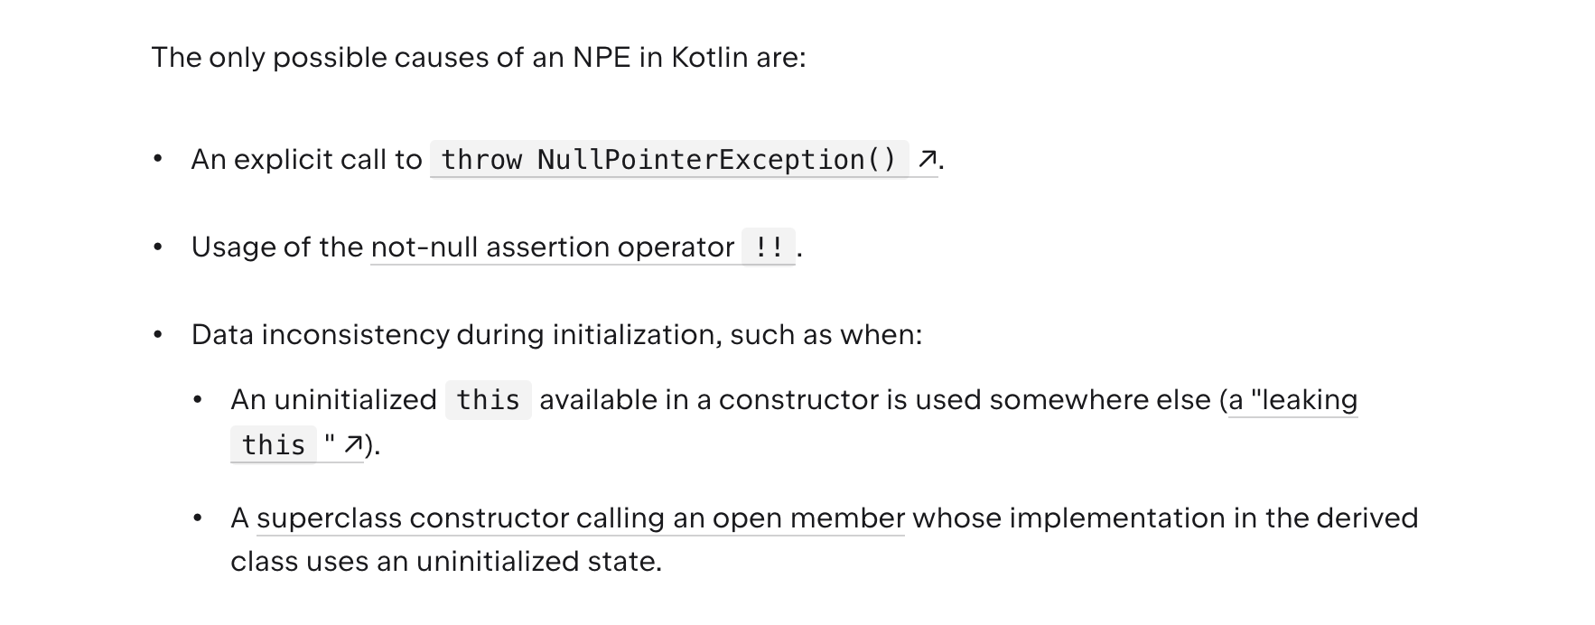
Kotlin semantics uses erasure !
From : https://kotlinlang.org/docs/null-safety.html#nullable-types-and-non-nullable-types

Slide 28
Not-null by default is not an option
Can not use erasure like Kotlin
  The VM has to be sure
Backward compatibility
  Previous code should still compile
    class ComplexBox {
    Complex complex; // can not be a ! by default
    }
  Nullness analysis produces warnings
    And overriding rules are relaxed

Slide 29
How to make it great !
Two ideas ??
  Two states : users can not denote “unspecified”
    if you opt-in (use ‘!’ in the file) to the nullable analysis,
    everything not not-null is nullable
  Inference of local variable nullness
    Only method declarations and fields require nullness emotion
    Also great for migration

Slide 30
Stage 3 – Retrofit Primitives
JEP 402 : Enhanced primitive boxing
https://openjdk.org/jeps/402

Slide 31
Value class vs Primitive
no identity
have fields,
methods & interfaces
are flattened on stack
may be flattened on heap
/ may be nullable
may have no integrity
may have a default value
/ no encapsulation
no identity
are flattened on stack
/ on heap
may have no integrity
(long on 32bits CPUs)
have a default value
Value Classes
Primitives

Slide 32
Value class vs Primitive
no identity
have fields,
methods & interfaces
are flattened on stack
may be flattened on heap
/ may be nullable
may have no integrity
may have a default value
/ no encapsulation
no identity
are flattened on stack
/ on heap
may have no integrity
(long on 32bits CPUs)
have a default value
Value Classes
Primitives

Slide 33
Primitive as value class
Primitive type should behave like value class
One model to rule them all
But we can not fully have int == Integer!
  because of the bytecode format

Slide 34
Fix inconsistencies
Method calls on primitive
  int i = 3; i.toString()
  3.toString() // but parser not to be fixed
Primitive as type argument
  new ArrayList<int>() <=> new ArrayList<Integer!>()
Array reinterpretation
  int[] <=> Integer![]
Overriding with primitive
  int m() can override Integer m()

Slide 35
Value classes as primitives
Some value classes are more like primitive types (Float16, Complex)
  They have a default value
  They allow tearing of components

Slide 36
Value with implicit constructor
Having a default value (all fields are zeroes) bypass encapsulation
  Users should opt-in to an implicit constructor
  value class MyInteger {
  private final int value;
  implicit MyInteger(); // strawman syntax
  MyInteger(int value) {
  this.value = value;
  super();
  }
  }

Slide 37
Value class with a default value
Non-null field / array can be left uninitialized
  class MyIntegerBox {
  private MyInteger! integer; // equivalent to MyInteger(0)
  public Box() {
  // can be empty
  }
  public void foo(MyInteger! integer) { // argument can not be null
  var array = new MyInteger![4]; // initialized with zeroes
  ...
  }
  }

Slide 38
Tearing / Integrity
long and double are not atomically read/write on 32 bits platform
Some value classes allow tearing
  Complex(re, im) // okay
  Range(from, to) // not okay

Slide 39
Value Class with no Integrity
Give up integrity
  Implements the interface LooselyConsistentValue
Example with Complex
    value record Complex(double re, double im)
    implements LooselyConsistentValue {
    ...
    }

Slide 40
Valhalla Rocket Model

Slide 41

Valhalla: The rocket model
Value keyword
Nullness emotion
Retrofit primitives
  Operator overloading ?
Specialized generics

