Slide 1
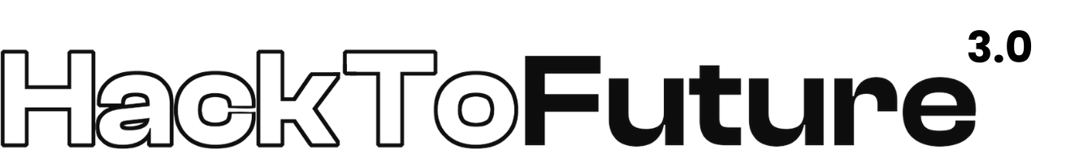
FORBE
Harshith TS
Shivnandu.K
Saketh S
Harishankar.P.P
forbeofficial@gmail.com
Srinivas University Institute Of Engineering and Technology

Slide 2
Decentralized, Secure, and Patient-Controlled Health Records.
T1PS2
In emergencies, fragmented health records delay care by up to 30 minutes due to siloed EHRs and paper systems. Centralized EHRs limit patient control and are breach-prone (15M U.S. records exposed in 2023). Existing standards (FHIR, HL7) lack seamless interoperability, and blockchain solutions face GDPR compliance issues. Need: A secure, patient-owned system for rapid, authorized access in crises.

Slide 3
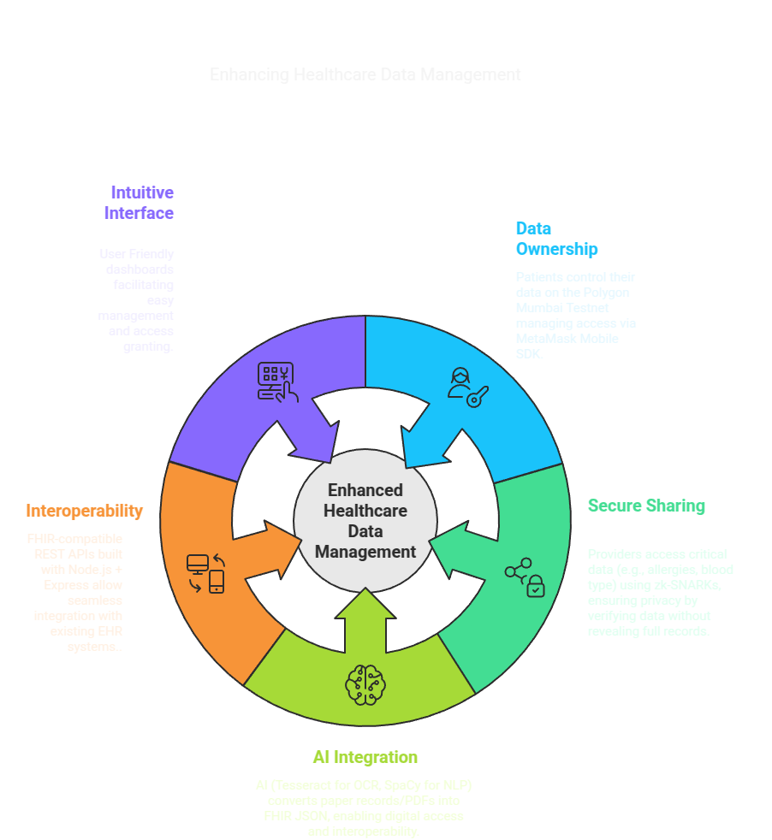
Solution Overview

Slide 4
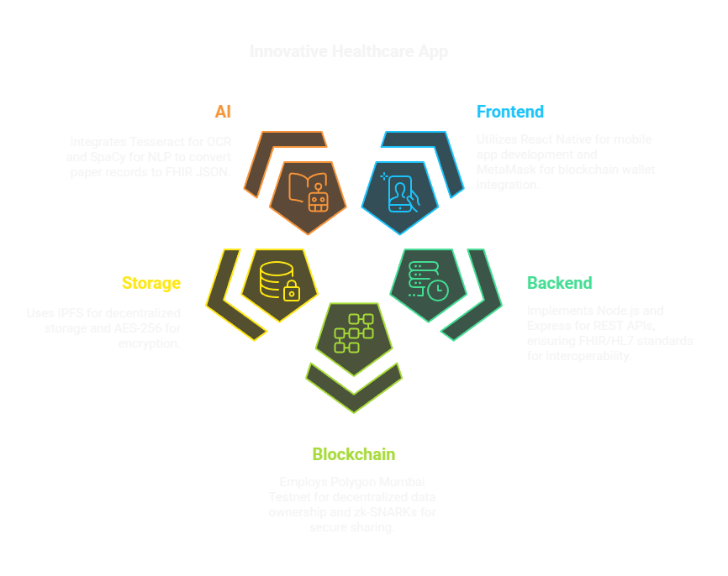
Tech Stack.

Slide 5
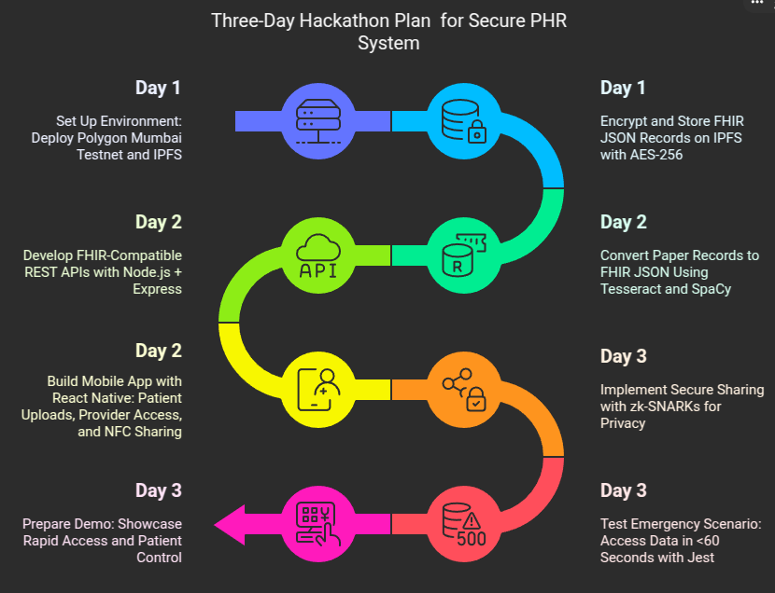
Implementation.

Slide 6
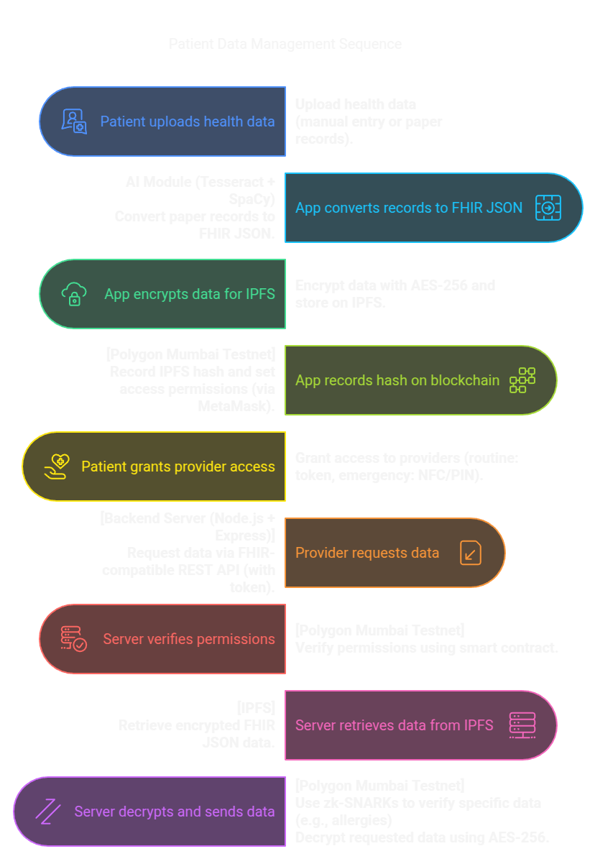
System WorkFlow.

Slide 7
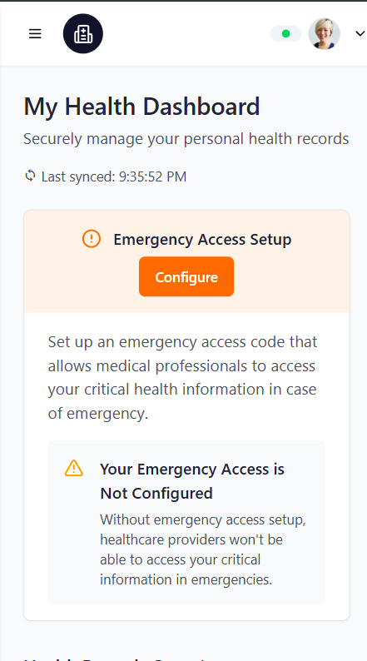
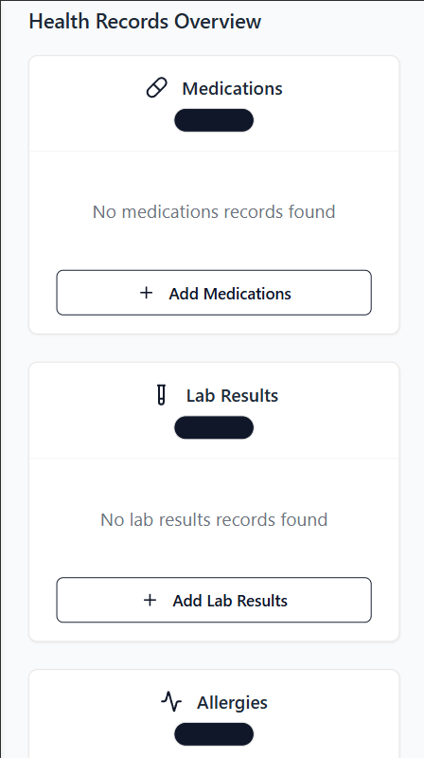
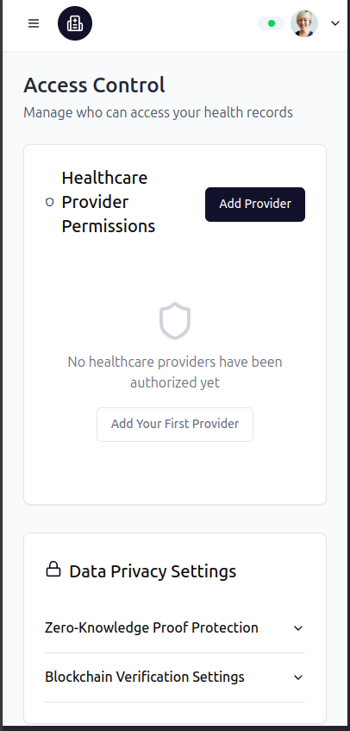
Design and UI.

Slide 8
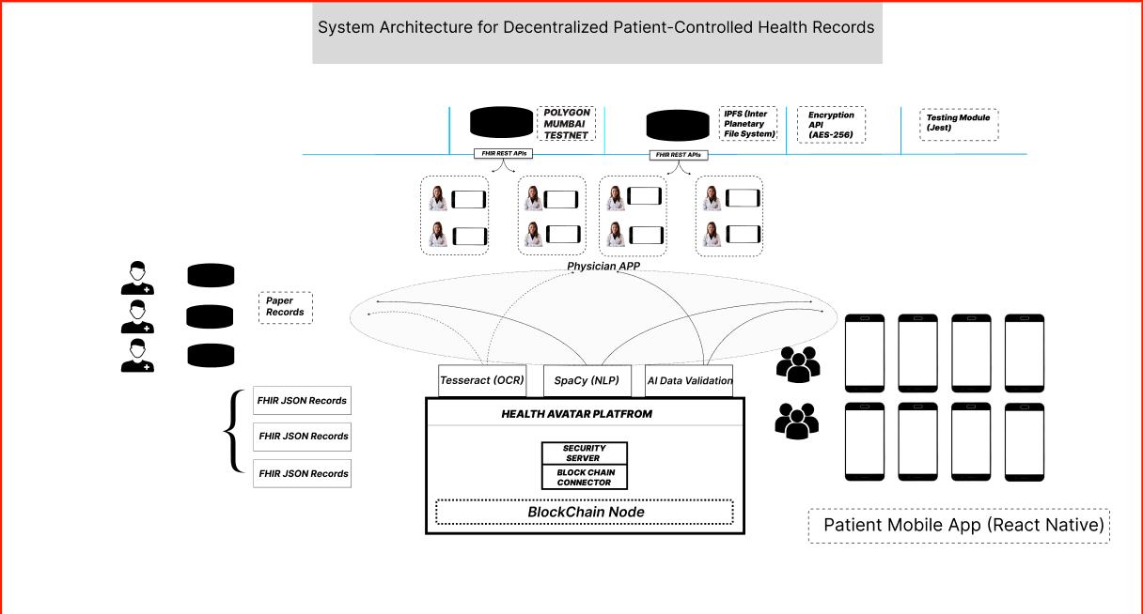
Reference and Conclusion,
Our decentralized PHR system empowers patients with data ownership on Polygon, ensures secure sharing with zk-SNARKs, converts legacy records to FHIR with AI, and enables rapid emergency access in under 60 seconds via a mobile app with NFC sharing.
Fig 1.0 :system architecture for decentralized parental control health record
Kim HJ, Kim HH, Ku H, et al. Smart Decentralization of Personal Health Records with Physician Apps and Helper Agents on Blockchain: Platform Design and Implementation Study. JMIR Med Inform. 2021;9(6):e26230. Published 2021 Jun 7. doi:10.2196/26230
link:https://pmc.ncbi.nlm.nih.gov/articles/PMC8218219/

