Slide 1

Optimal Planning for NTU YouBike Assignment
Operations Research
Final Project
吳驊祐 周成康 陳瑾叡 黃戎僔 吳天冷 李詠如 劉德駿 李宗霖 陳琳瑄
Group A
Notes:
駿：「如果出了問題的話，請到https://reurl.cc/2Z7RZn 下載原始版本。
從自己的電腦打開.pptx，修改完畢後截圖表格。（因為ppt表格沒辦法在共編上正常顯示）
除了表格以外的物件，可以自己直接在共編上修改即可。」

Slide 2
Introduction

Slide 3

Problem
Description
Introduction
Method
Result
Conclusion
(Lunch Time.)
I’d like to have the poke bowl next to GongGuan Station.
It appears that it takes lots of time on traffic without a youbike.
(Amy, a NTU freshman.)

Slide 4
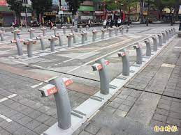
Problem
Description
Introduction
Method
Result
Conclusion

Slide 5
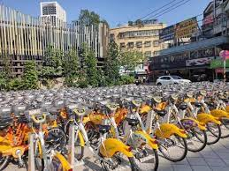

Problem
Description
Introduction
Method
Result
Conclusion

Slide 6

Problem
Description
Introduction
Method
Result
Conclusion
This is youbike company, what may I help you with?
The service is awful! I can’t access available youbike whenever I was in need.

Slide 7
Problem
Description
Introduction
Method
Result
Conclusion
Sorry to hear that. We will improve our service soon.
Ok. Please help users gain access to a youbike when we are in need!

Slide 8

Problem
Description
Introduction
Method
Result
Conclusion
Youbike assignment is an important task.
Around NTU, there are 102 separate Spots where docks sit and 1800 docks in total.
300 ups
Expected bike capacity to meet demand for GongGuan Spot in peak time.
Number of bikes a shipping car could afford.
16 bikes

Slide 9


Problem
Description
Introduction
Method
Result
Conclusion
Youbike assignment is an important task.
Around NTU, there are 102 separate Spots where docks sit and 1800 docks in total.
Large Spots
Small Spots
30%
80%
Percentage of spare docks measured in peak time.

Slide 10
Problem
Description
Introduction
Method
Result
Conclusion
Youbike assignment is a challenging task.
TO-DO List
Meet Real Time demand for each time slot
by scheduling optimal ROUTEs for youbike shipping cars
Such that
Percentage of spared bikes could be Minimized
while
Minimizing all the costs.

Slide 11
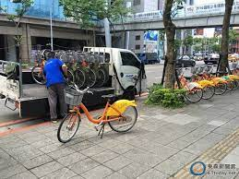
Problem
Description
Introduction
Method
Result
Conclusion
Now the challenge relies on the department of youbike assignment.

Slide 12
01
Content
Introduction
02
Problem Description
03
Method
04
Result
05
Conclusion

Slide 13
Problem Description
Parameters and Decision Variables
Objective Function
Constraints

Slide 14
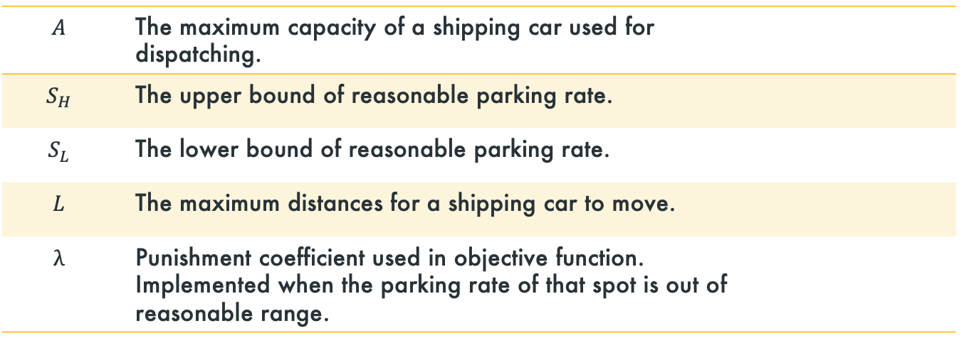
Problem
Description
Introduction
Method
Result
Conclusion
Parameters
Notes:
如果出了問題的話，請到https://reurl.cc/2Z7RZn 下載原始版本。
從自己的電腦打開.pptx，修改完畢後截圖表格。（因為ppt表格沒辦法在共編上正常顯示）

Slide 15
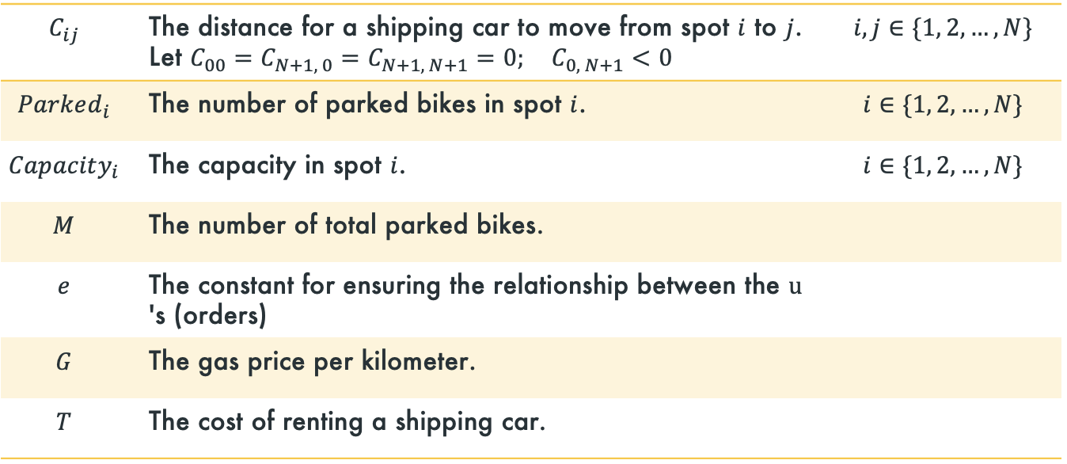
Problem
Description
Introduction
Method
Result
Conclusion
Parameters

Slide 16
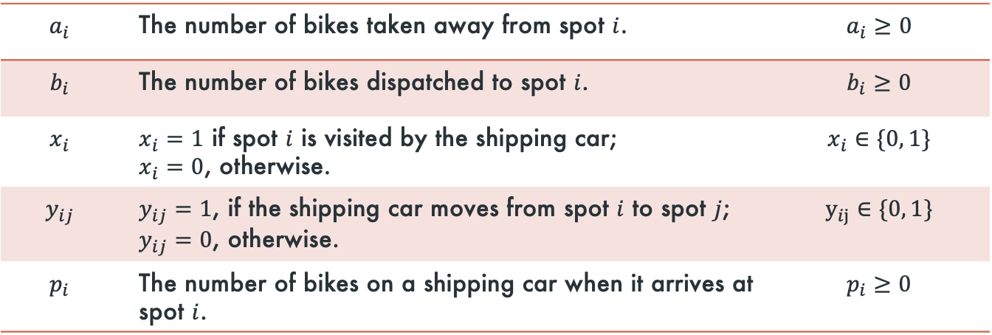
Problem
Description
Introduction
Method
Result
Conclusion
Decision Variable

Slide 17
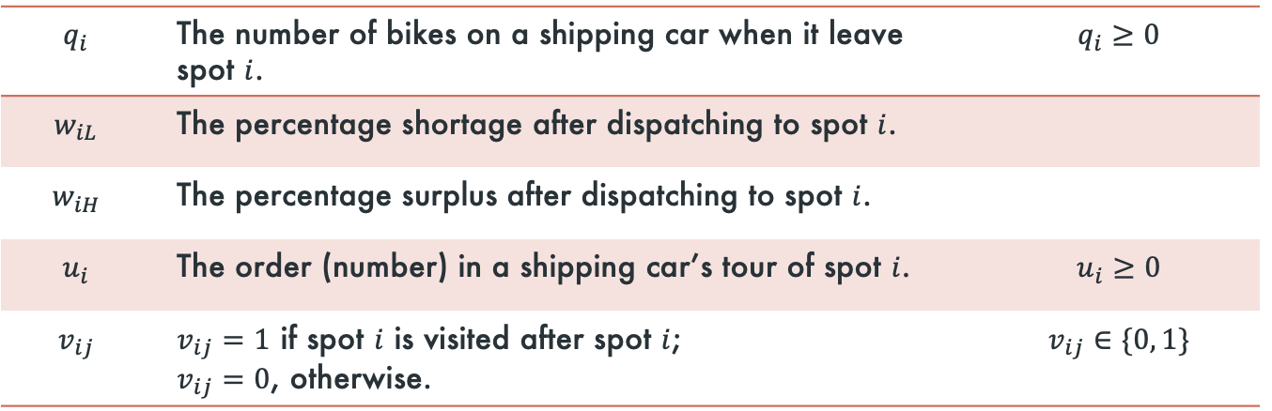
Problem
Description
Introduction
Method
Result
Conclusion
Decision Variable

Slide 18





Problem
Description
Introduction
Method
Result
Conclusion
Illustration
End
N+1
Start
0

Slide 19
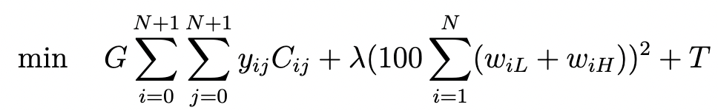
Problem
Description
Introduction
Method
Result
Conclusion
Objective Function

Slide 20



Problem
Description
Introduction
Method
Result
Conclusion
Objective Function
Total Shipping costs.
The gas price per km.

Slide 21
Problem
Description
Introduction
Method
Result
Conclusion
Objective Function
Control for parking rate.
Lower/ upper bound of reasonable parking rate.
A tuning parameter.

Slide 22
Problem
Description
Introduction
Method
Result
Conclusion
Objective Function
A constant value for shipping car rental.

Slide 23
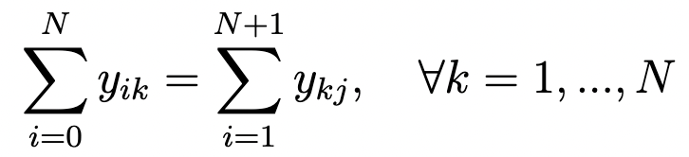
Problem
Description
Introduction
Method
Result
Conclusion
Constraints for Routing
1
For the sake of moving from one spot to another, both spots must be visited.
2
For each spot, arrival implies departure, and vice versa.
3
It is not reasonable for a shipping car to move from a spot to the same one.
4
A shipping car cannot move back to the previous spot.

Slide 24
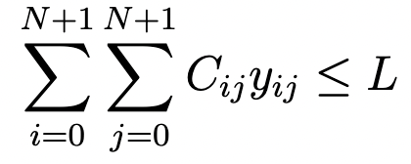
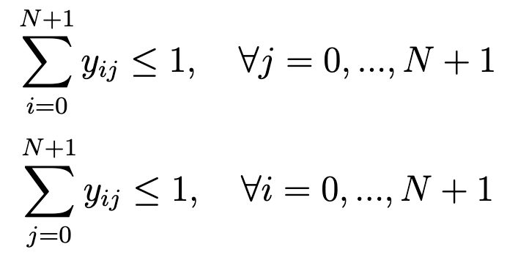
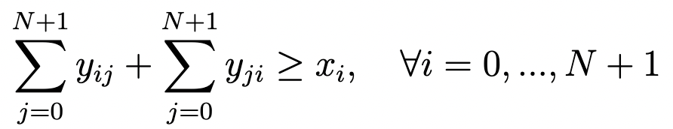
Problem
Description
Introduction
Method
Result
Conclusion
Constraints for Routing
5
A shipping car cannot move for more than the maximum distance.
6
A shipping car can only arrive at / leave a spot once.
7
A visit of a spot implies the arrival at it and / or the departure from it.

Slide 25
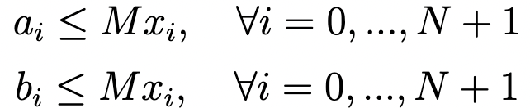
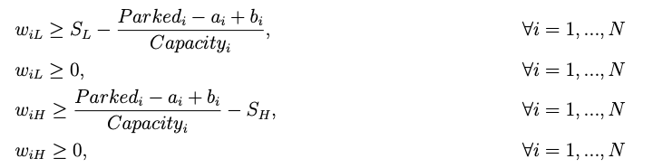
Problem
Description
Introduction
Method
Result
Conclusion
Constraints for Bikes
1
Do not take away bikes and dispatch bikes at the same time.
2
Take away / Dispatch bikes only if a spot is visited.
3
Penalize when there is shortage or surplus.

Slide 26
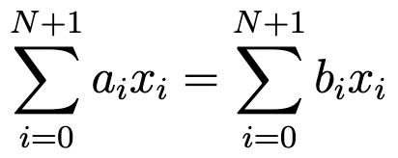

Problem
Description
Introduction
Method
Result
Conclusion
Constraints for Bikes
4
The flow-in must be equivalent to the flow-out for each spot.
5
Dispatch bikes to a spot reasonably.
6
Take away bikes from a spot reasonably.

Slide 27

Problem
Description
Background
Method
Result
Conclusion
Constraints for Shipping Car
1
When a shipping car visit a spot, bikes are either taken away from or dispatched to it. The following equation describes the change in the number of bikes on a shipping car.
2
The number of bikes on a shipping car when leaving a spot must equal to that when arriving at the next one.
3
The number of bikes on a shipping car cannot exceed the maximum capacity of it.
4
The number of bikes dispatched to a spot cannot be greater than that on a shipping car when arriving.

Slide 28



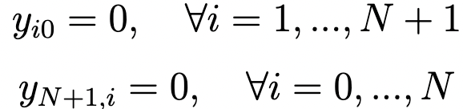
Problem
Description
Introduction
Method
Result
Conclusion
Constraints for Virtual Point
1
No bikes are taken away from and dispatched to Start.
2
No bikes are taken away from End, while it is acceptable to be dispatched to it.
3
A shipping car must visit Start and End.
4
No arrival at Start, and no departure from End.

Slide 29


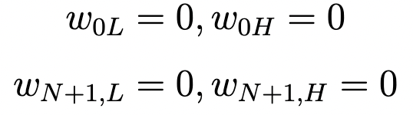
Problem
Description
Introduction
Method
Result
Conclusion
Constraints for Virtual Point
5
No bikes are on a shipping car at Start, and no bikes are leaving End. However, when arriving at End, the presence of bikes is acceptable.
6
No penalty for Start and End.

Slide 30
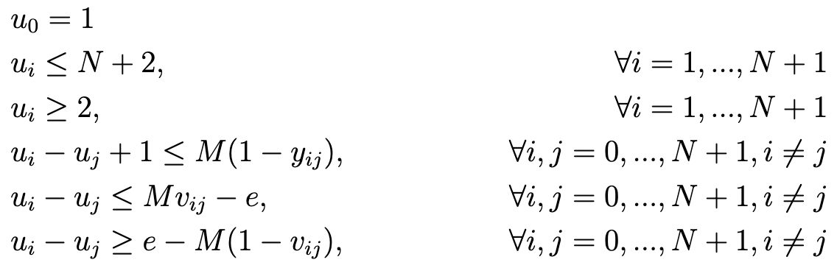
Problem
Description
Introduction
Method
Result
Conclusion
Constraints for Eliminating Subtours

Slide 31
Method
Data Collection and Description
Introduction of Model

Slide 32

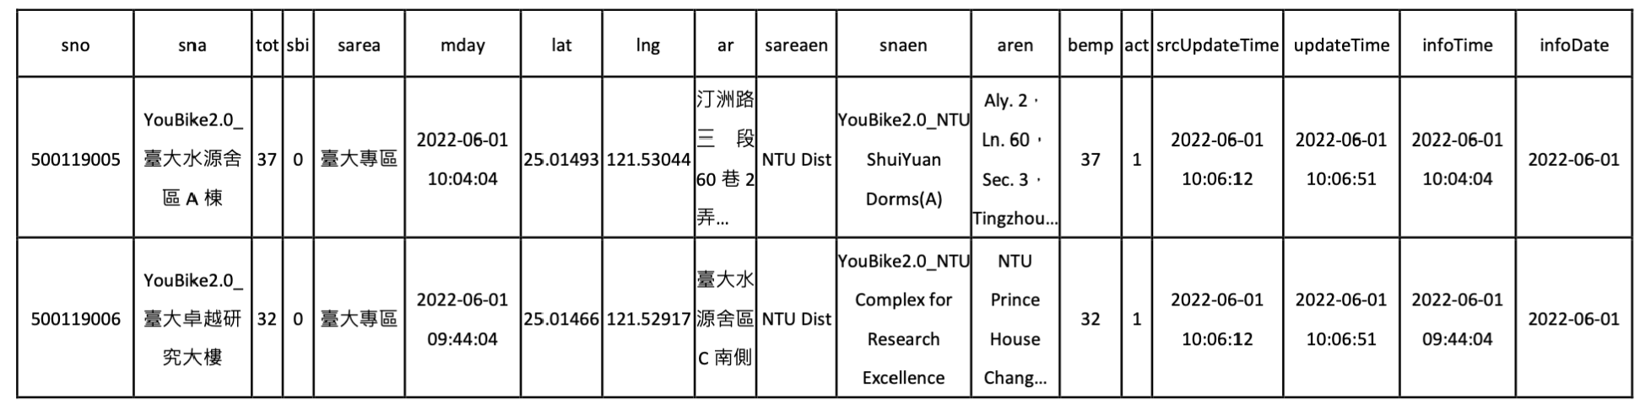
Problem
Description
Introduction
Method
Result
Conclusion
Data Collection and Description
YouBike 2.0臺北市公共自行車即時資訊
https://data.gov.tw/dataset/13799

Slide 33
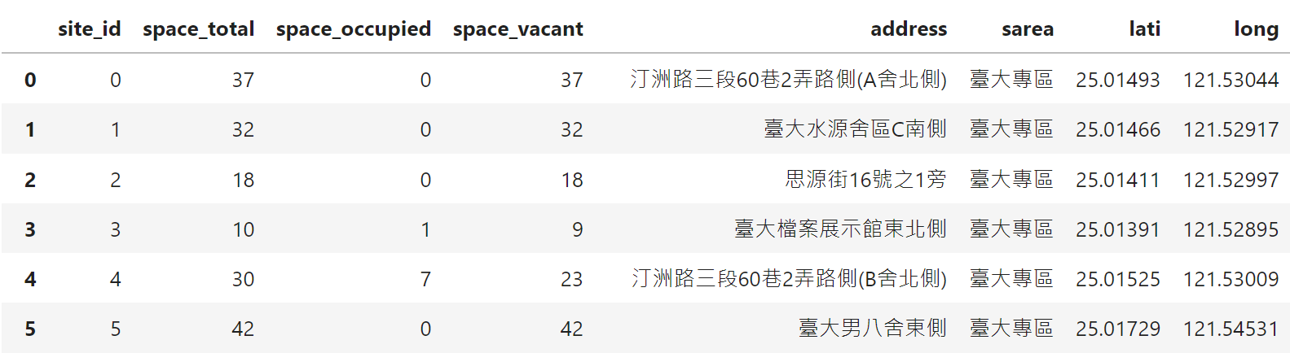
Problem
Description
Introduction
Method
Result
Conclusion
Data Collection and Description
After organizing :

Slide 34
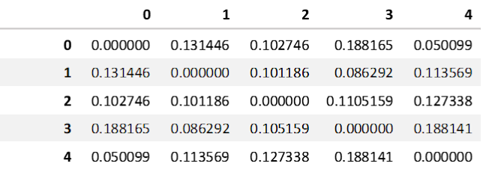

Problem
Description
Introduction
Method
Result
Conclusion
Data Collection and Description
After organizing…
the distances between any two stations
(with only latitude and longitude )
(with Google map API )
UNREALISTIC

Slide 35


Problem
Description
Introduction
Method
Result
Conclusion
Introduction of Models
K means Algorithm
Gurobi Optimizer
An algorithm to classify youbike spots based on their geographically location.
i.e. longitude and latitude.
To find an optimal solution for variables of interests.

Slide 36
Solution Steps
Optimization
Proposal
Clustering
Visualization
Problem
Description
Introduction
Method
Result
Conclusion
According to different number of clusters.
Performance analysis of our program.
Divide spots into groups.
Comparison.

Slide 37
Result
Visualization

Slide 38
Instance 1
6/1 17:00

Slide 39
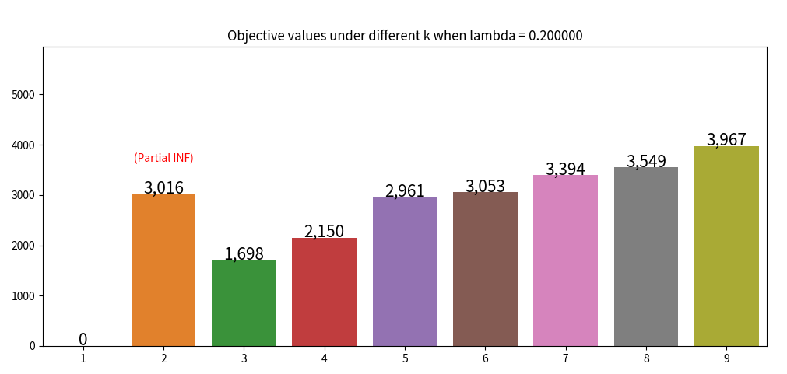
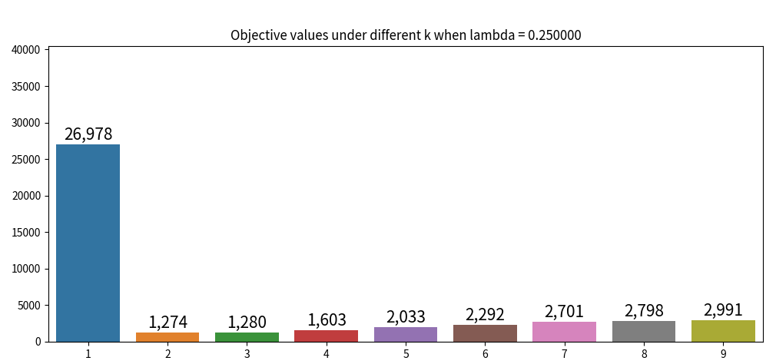
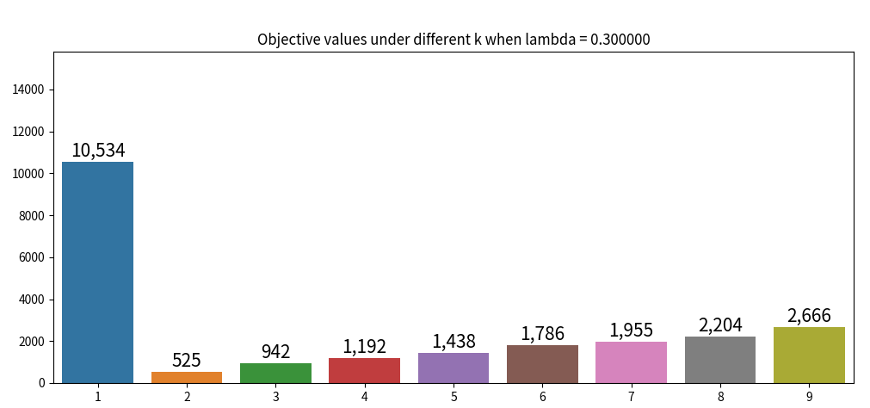
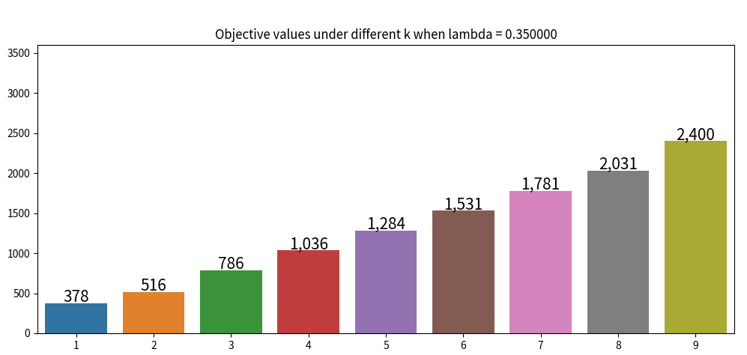
Problem
Description
Introduction
Method
Result
Conclusion
Instance 1
Obj.value
Obj.value
INF
number of cluster
number of cluster
Obj.value
Obj.value
partial INF
number of cluster
number of cluster

Slide 40
Problem
Description
Introduction
Method
Result
Conclusion
Instance 1
Obj.value
partial INF
number of cluster
Fig 1-1. Objective values comparison with λ=0.35

Slide 41
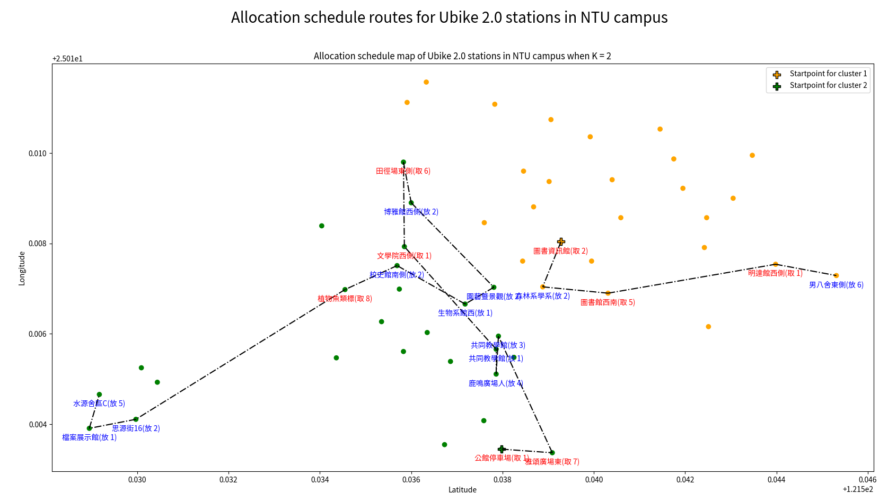
Problem
Description
Introduction
Method
Result
Conclusion
Instance 1
Fig 1-2. The allocation schedule map. Spot labeled red means pick up, while one labeled blue means return.

Slide 42
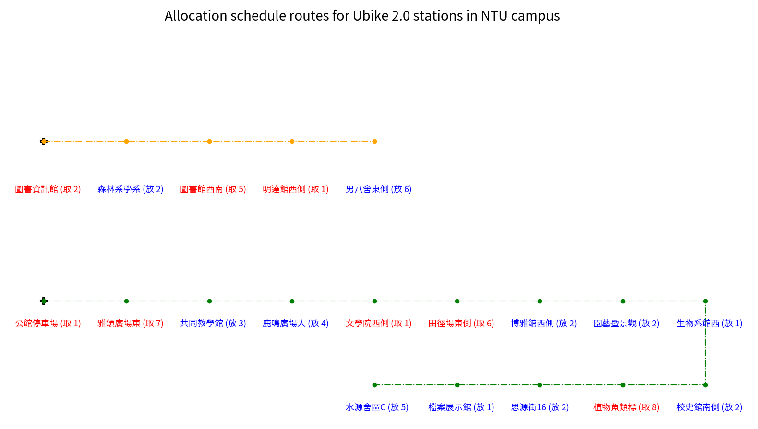
Problem
Description
Introduction
Method
Result
Conclusion
Instance 1
Fig 1-3. The allocation schedule routes for youbike 2.0 stations in NTU

Slide 43
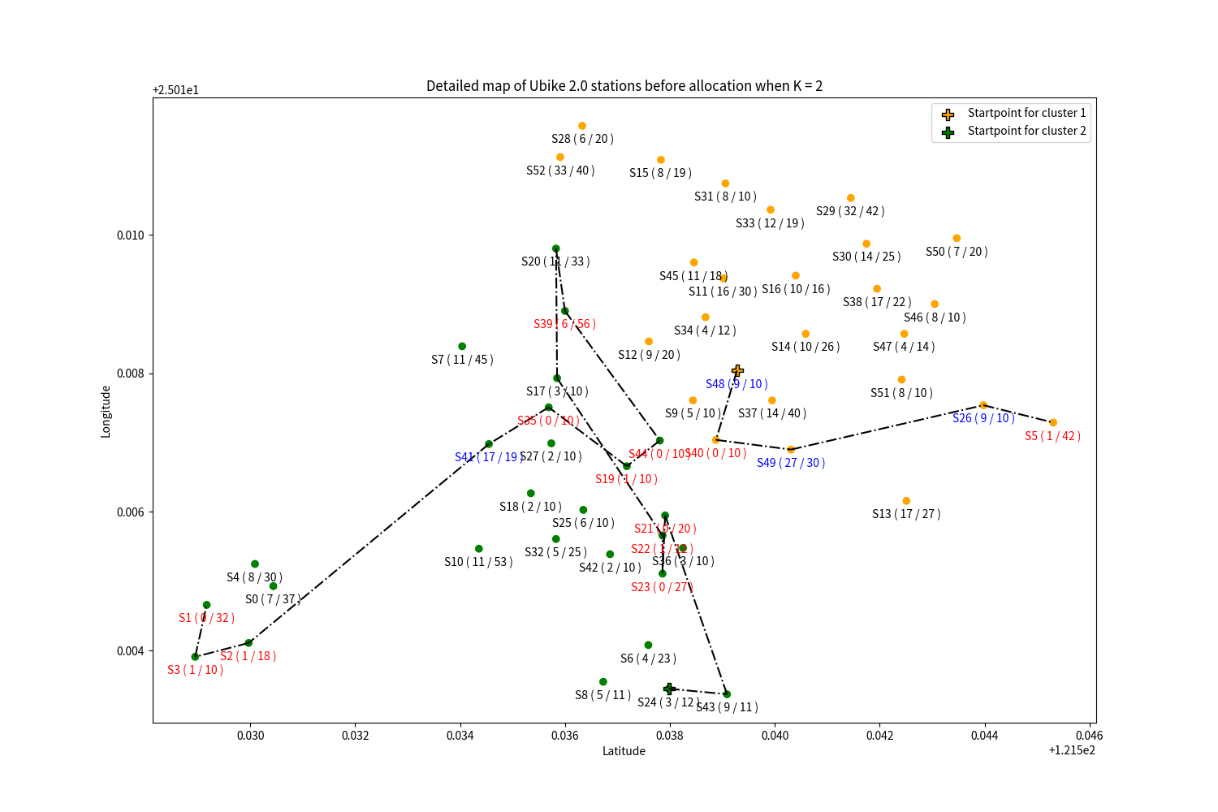
Problem
Description
Introduction
Method
Result
Conclusion
Instance 1
Fig 1-4. Detailed map of Ubike 2.0 stations before allocation

Slide 44
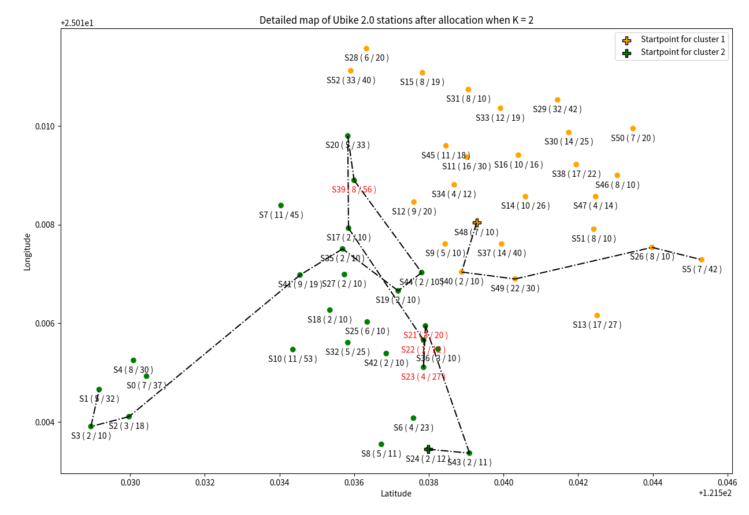
Problem
Description
Introduction
Method
Result
Conclusion
Instance 1
Fig 1-4. Detailed map of Ubike 2.0 stations before allocation
Fig 1-5. Detailed map of Ubike 2.0 stations after allocation

Slide 45
Instance 2
6/3 8:00

Slide 46
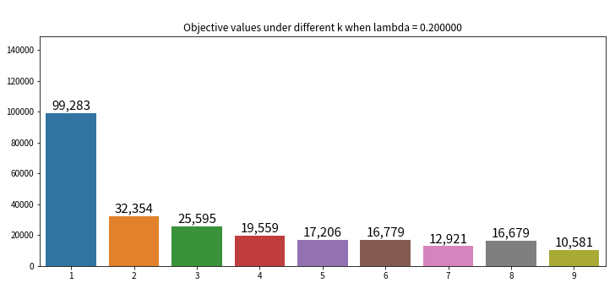
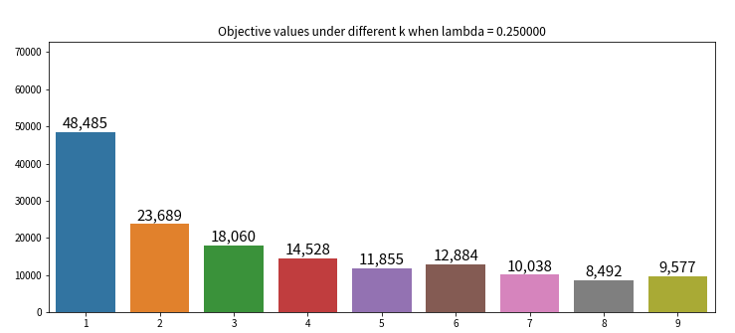
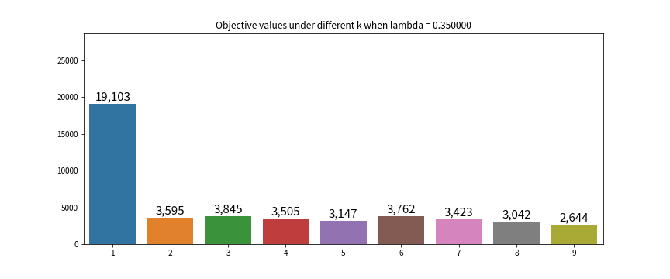
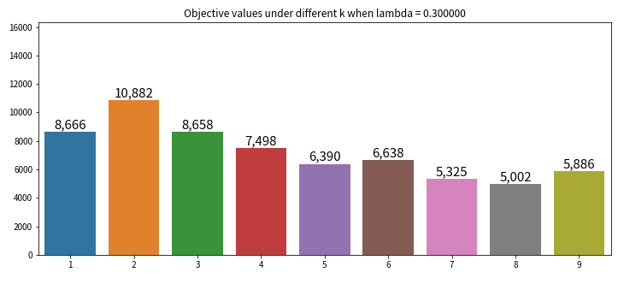
Problem
Description
Introduction
Method
Result
Conclusion
Instance 2
Obj.value
Obj.value
Obj.value
number of cluster
number of cluster
Obj.value
Obj.value
partial INF
number of cluster
number of cluster
inf

Slide 47
Problem
Description
Introduction
Method
Result
Conclusion
Instance 2
partial INF
Fig 2-1. Objective values comparison with λ=0.35

Slide 48
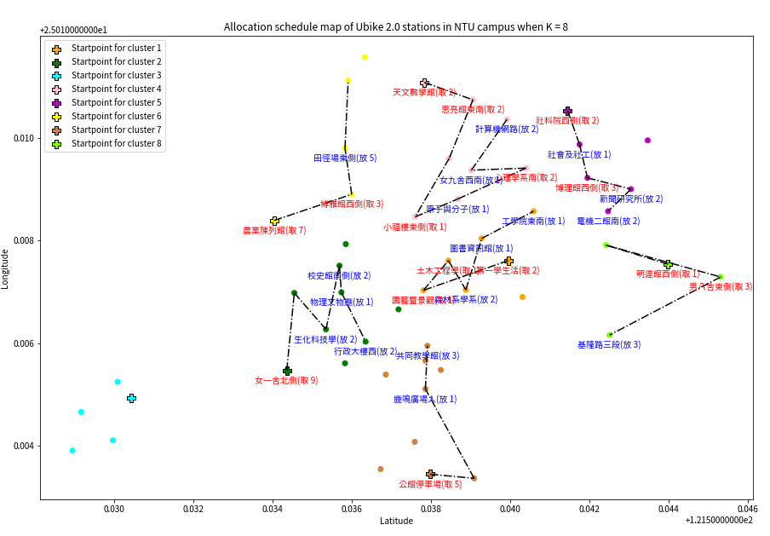
Problem
Description
Introduction
Method
Result
Conclusion
Instance 2
Fig 2-2. The allocation schedule map. Spot labeled red means pick up, while one labeled blue means return.

Slide 49
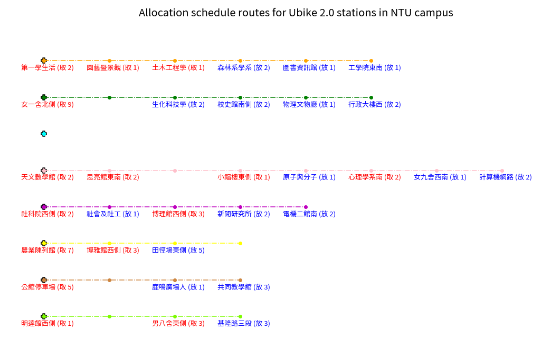
Problem
Description
Introduction
Method
Result
Conclusion
Instance 2
Fig 2-3. The allocation schedule routes for youbike 2.0 stations in NTU

Slide 50
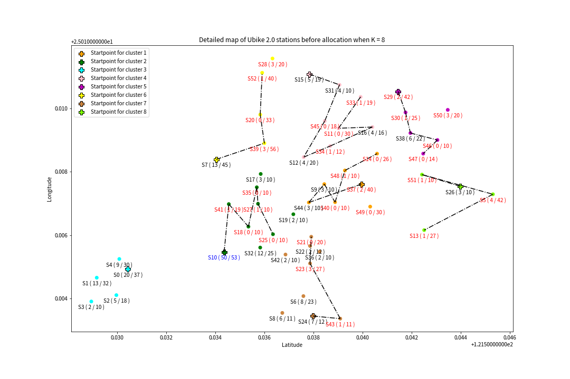
Problem
Description
Introduction
Method
Result
Conclusion
Instance 2
Fig 2-4. Detailed map of Ubike 2.0 stations before allocation

Slide 51
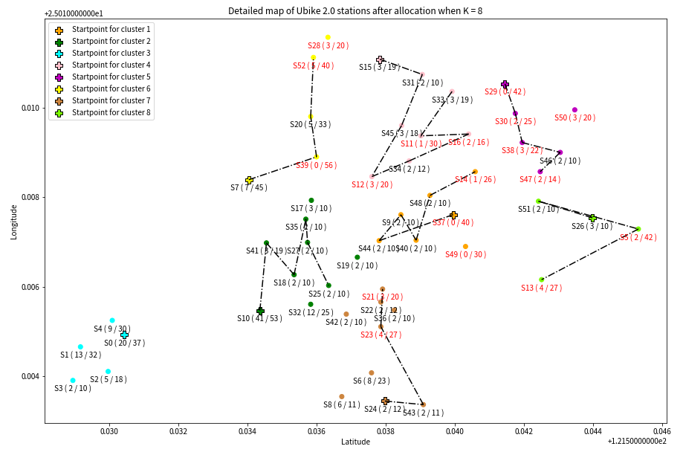
Problem
Description
Introduction
Method
Result
Conclusion
Instance 2
30
18
Fig 2-4. Detailed map of Ubike 2.0 stations before allocation
Fig 2-5. Detailed map of Ubike 2.0 stations after allocation

Slide 52
Instance 3
6/3 10:00

Slide 53
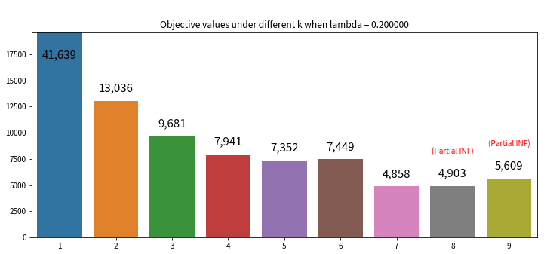
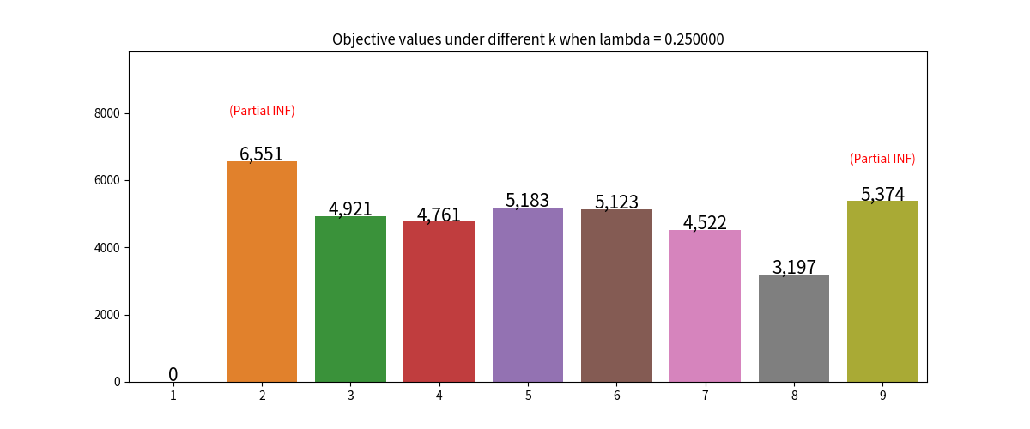
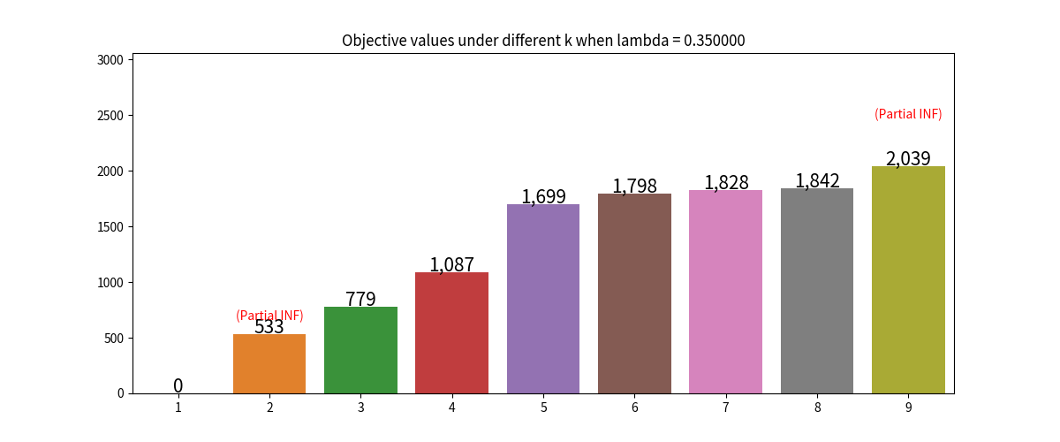
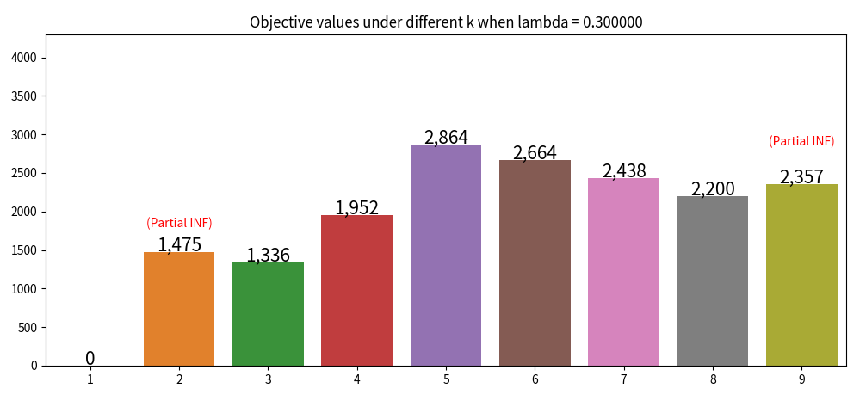

Problem
Description
Introduction
Method
Result
Conclusion
Instance 3
Obj.value
Obj.value
Obj.value
INF
number of cluster
number of cluster
number of cluster
number of cluster
Obj.value
Obj.value
INF
INF
number of cluster
number of cluster

Slide 54
Obj.value
Obj.value
Obj.value
number of cluster
number of cluster
number of cluster
number of cluster
Obj.value
Obj.value
number of cluster
number of cluster

Slide 55
Problem
Description
Introduction
Method
Result
Conclusion
Instance 3
INF
Fig 3-1. Objective values comparison with λ=0.35

Slide 56
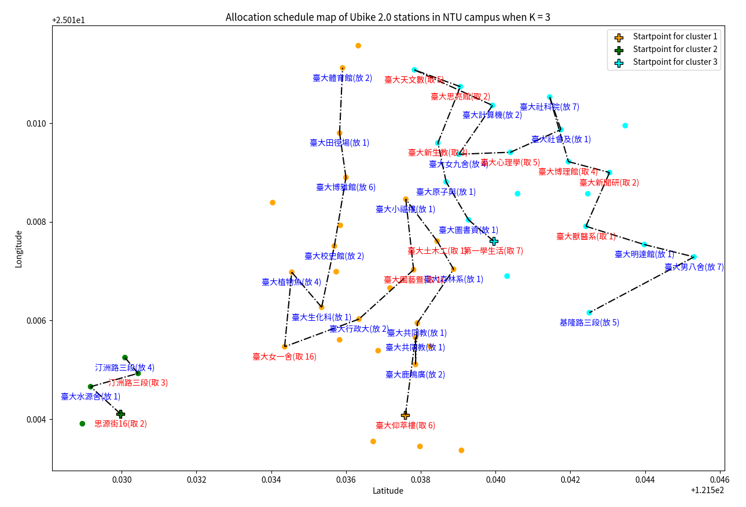
Problem
Description
Background
Method
Result
Conclusion
Instance 3
Fig 3-2. The allocation schedule map. Spot labeled red means pick up, while one labeled blue means return.

Slide 57
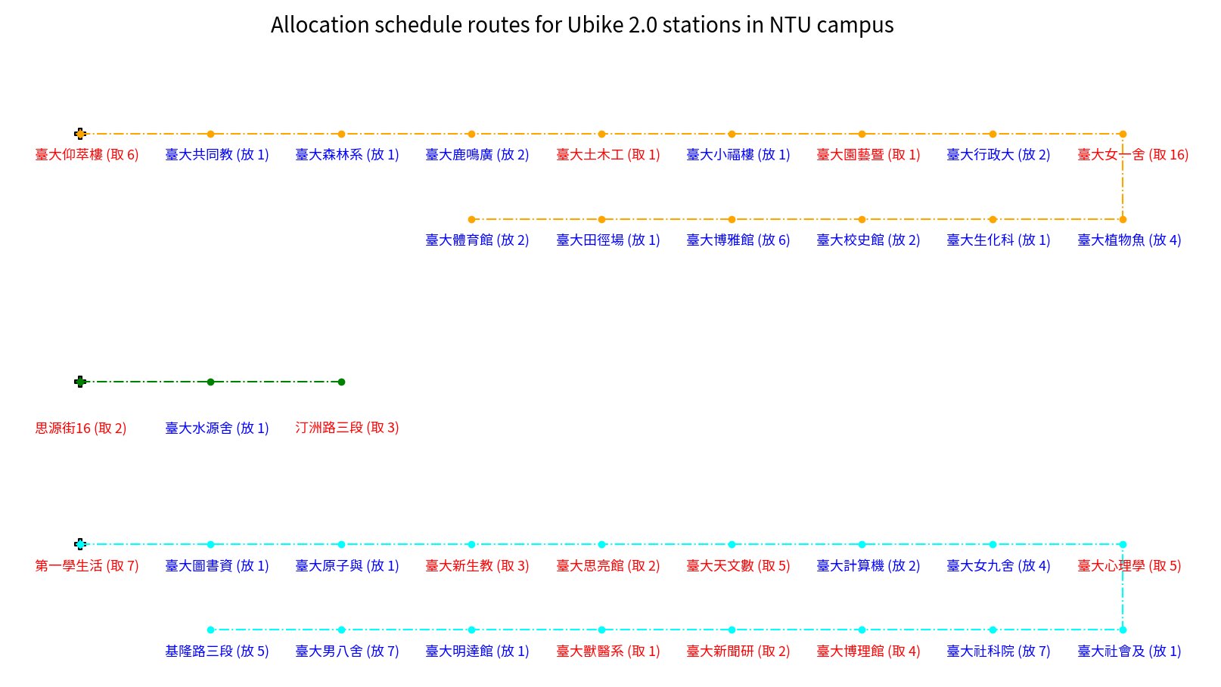
Problem
Description
Background
Method
Result
Conclusion
Instance 3
Fig 3-3. The allocation schedule routes for youbike 2.0 stations in NTU

Slide 58
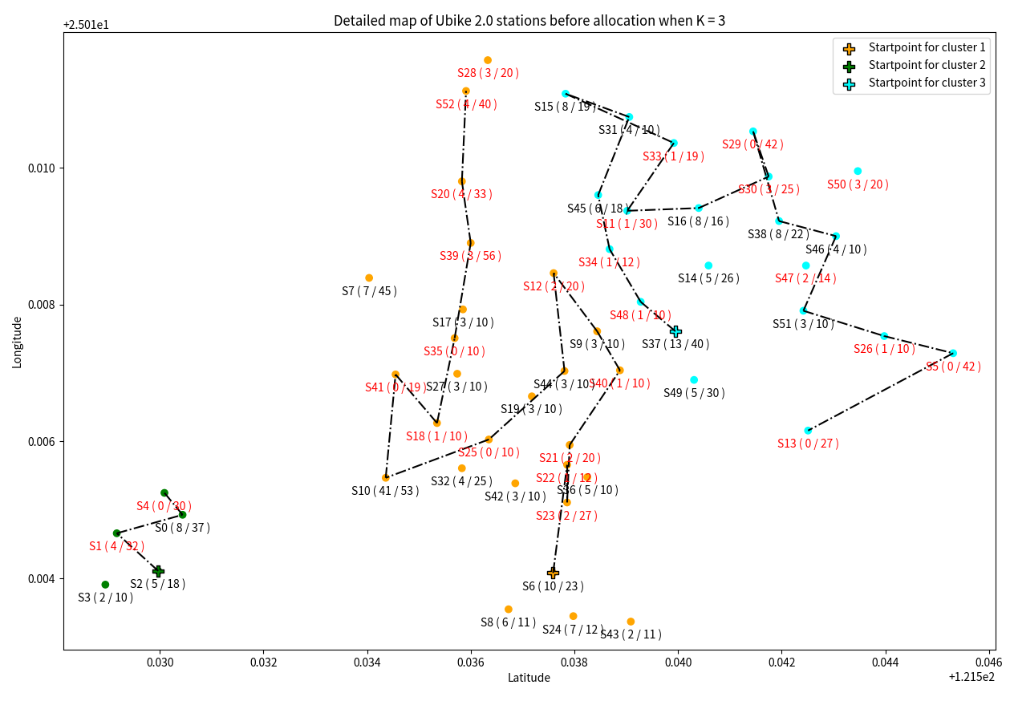
Problem
Description
Introduction
Method
Result
Conclusion
Instance 3
Fig 3-4. Detailed map of Ubike 2.0 stations before allocation

Slide 59
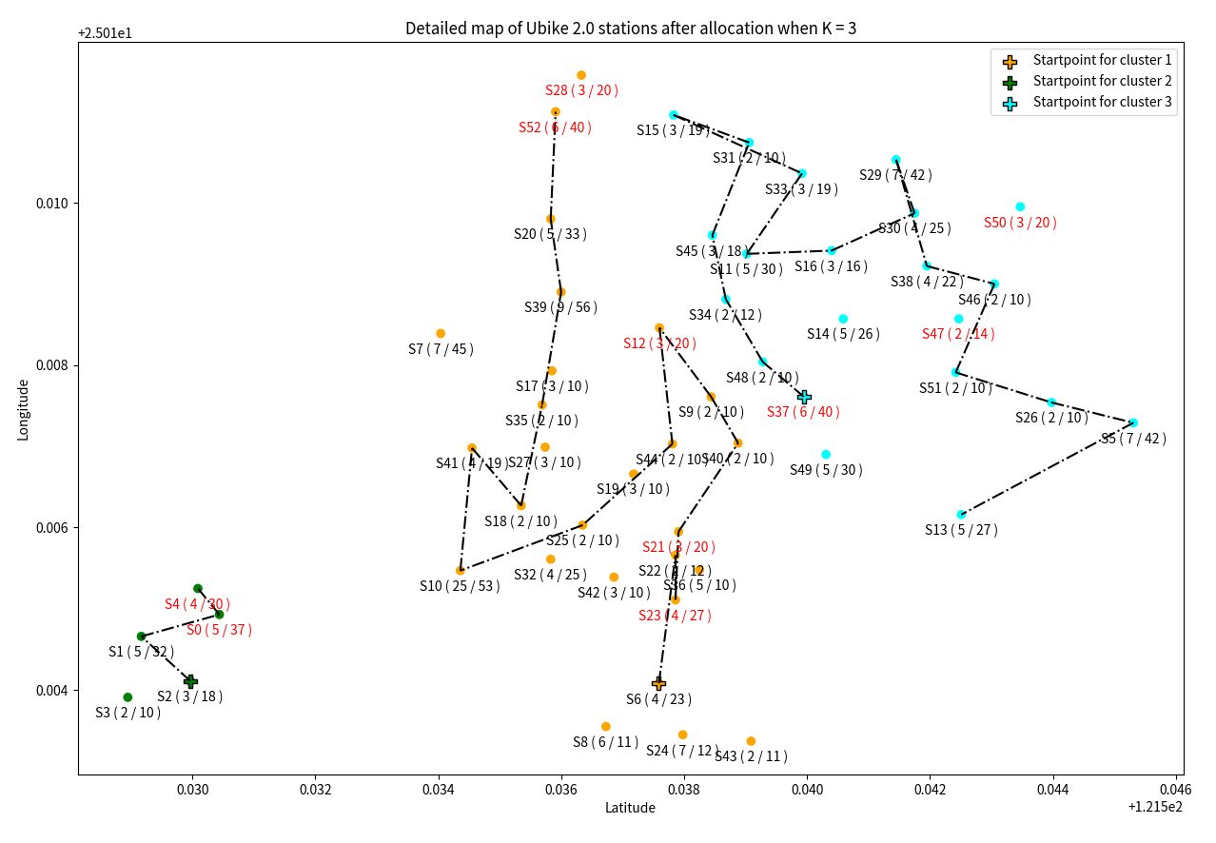
Problem
Description
Introduction
Method
Result
Conclusion
Instance 3
Fig 3-4. Detailed map of Ubike 2.0 stations before allocation
Fig 3-5. Detailed map of Ubike 2.0 stations after allocation

Slide 60
Conclusion

Slide 61



Problem
Description
Introduction
Method
Result
Conclusion
-
+
0
0.5
1
find ( , K)
(which minimize
the objective value)
get ( +0.5)
( -0.5)
make the trade-off
between cost and service
execute and generate the schedule

Slide 62
Different λ in Instance 1
Problem
Description
Introduction
Method
Result
Conclusion
Obj.value
Obj.value
INF
number of cluster
number of cluster
Obj.value
Obj.value
INF
number of cluster
number of cluster

Slide 63
Future work
Problem
Description
Introduction
Method
Result
Conclusion
The real demand without record in collected data.
Each cluster can have more than 1 car.
Predict the car need for next period.
Enable moving bikes from the surplus cluster to the shortage cluster.
Notes:
The transformation from kilometer to dollars.

Slide 64
Thanks
Do you have any questions?
b07801013@ntu.edu.tw
b09705011@ntu.edu.tw
b09705032@ntu.edu.tw
b06b02059@ntu.edu.tw
Please keep this slide for attribution

