Slide 1
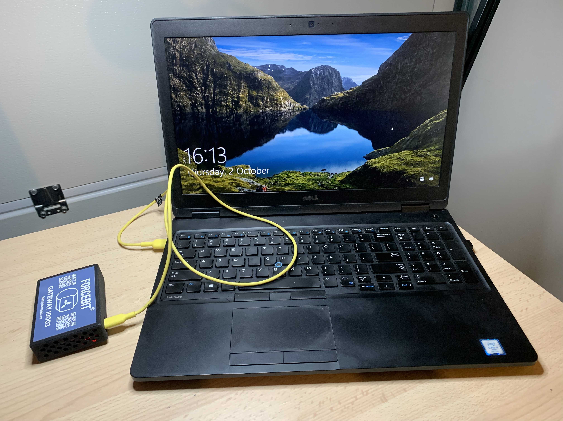
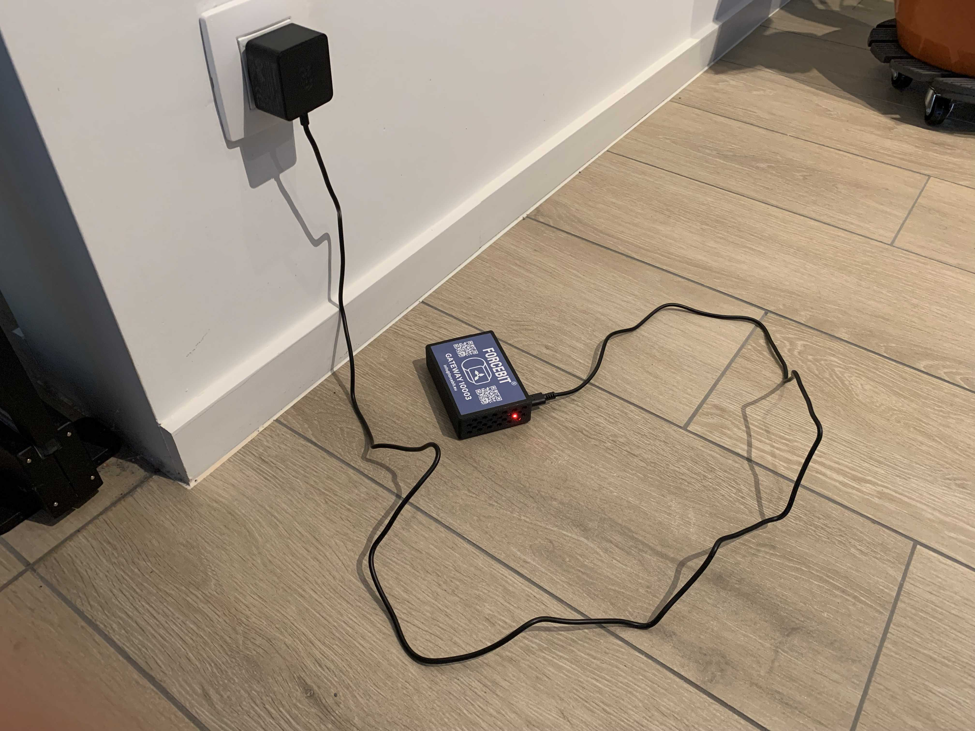
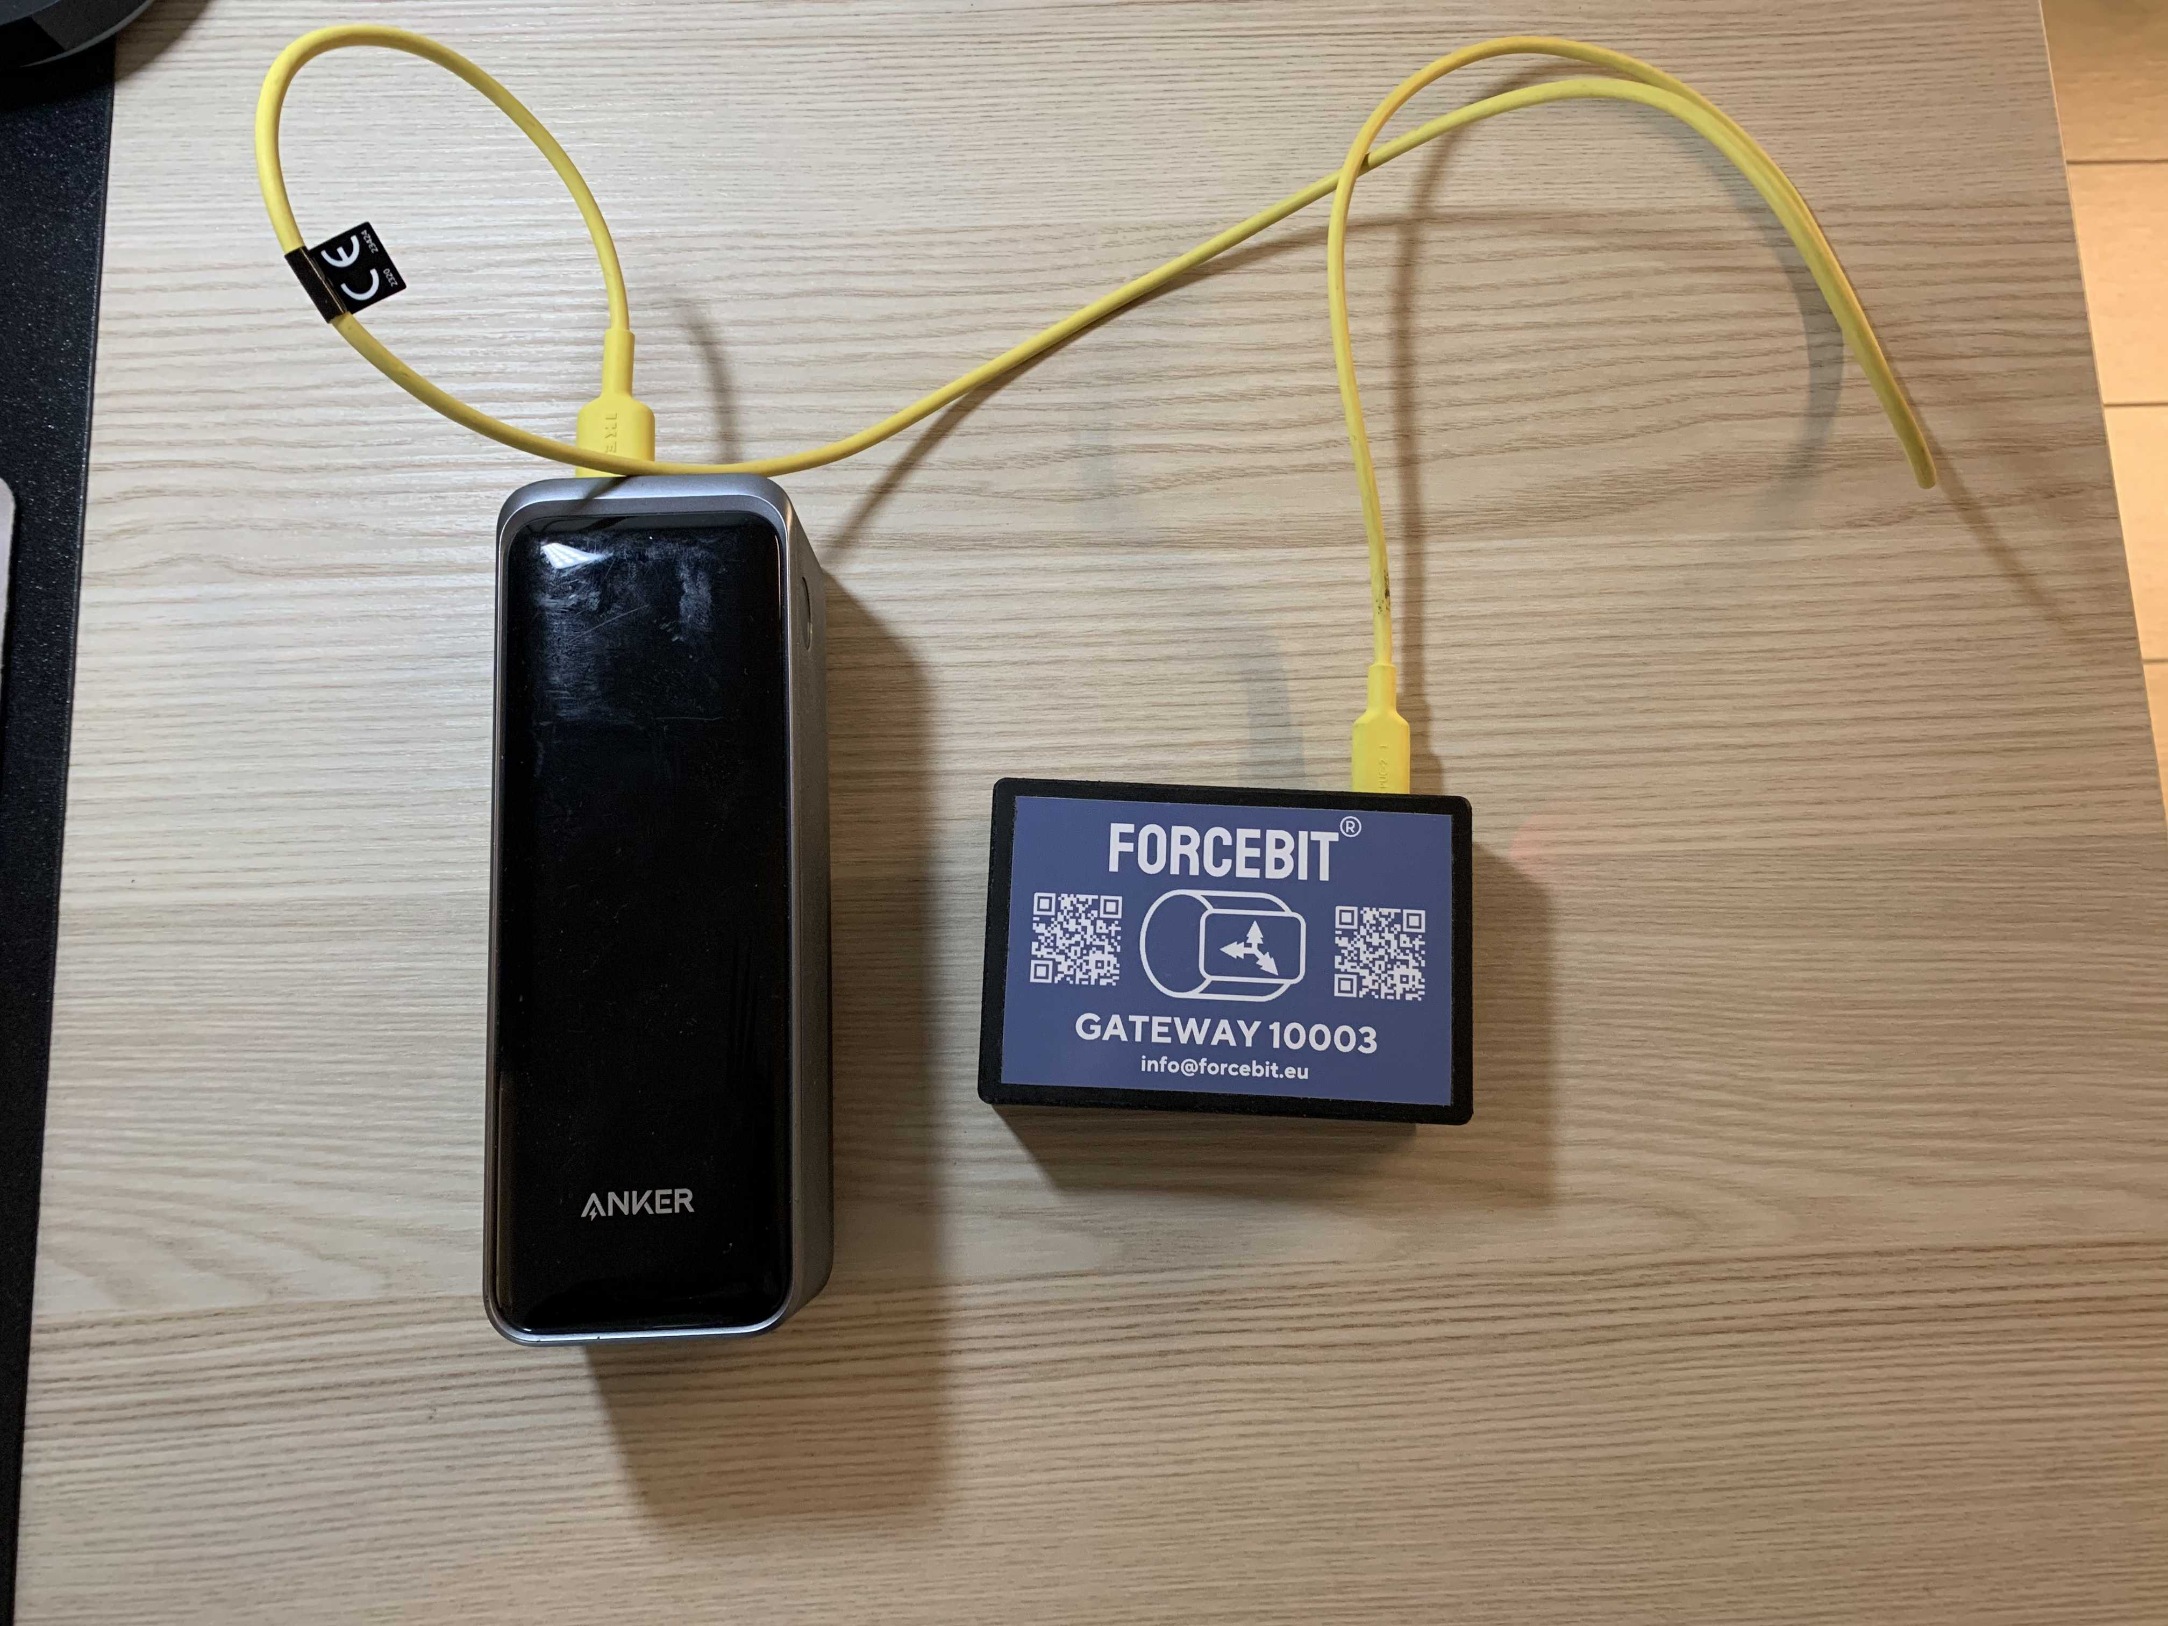


Powering gateway with a PC
Powering gateway with an adapter
Powering gateway with a powerbank
Wrong!
The gateway requires at least 3A (15W) power source.
Correct!
The gateway makes a seamless connection when powered with an adapter.
Correct!
If the powerbank provides 3A (15W) stable connection all the time.

