Slide 1
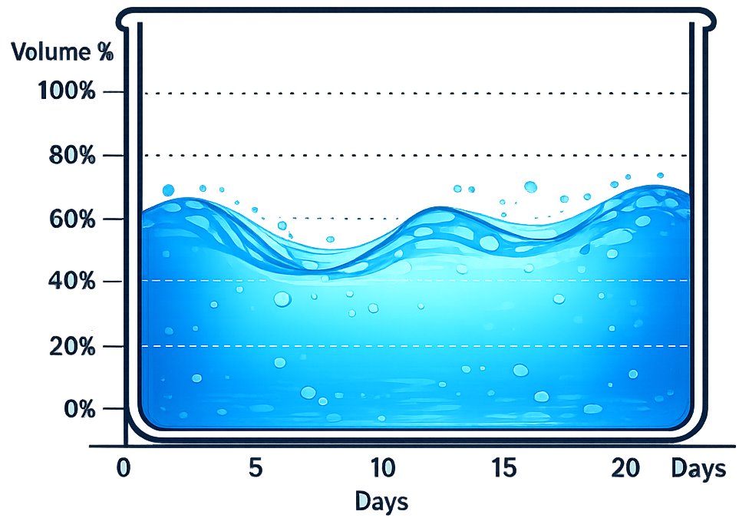
Additional Project
Weather Data Analysis & Rainfall Prediction for Groundwater Management & Overflow prevention in Tank/Well/Pond/Dam
Abhishek Anand
S20230010003
UG-3

Slide 2
Objectives
1. Rainfall Prediction and Forecasting
Develop a predictive model using meteorological parameters (humidity, dew point, barometric pressure, temperature, wind patterns) to forecast rainfall events with sufficient lead time. This enables proactive decision-making for water resource management before rain occurs.
2. Groundwater Level Estimation
Estimate and predict groundwater levels in wells/dams based on historical rainfall data, evapotranspiration rates, soil infiltration, and current storage capacity. This involves modeling the relationship between precipitation inputs and groundwater recharge to understand how quickly water accumulates after rainfall events.
3. Overflow Prevention System
Design an intelligent alert and control system that predicts when wells/dams will reach critical capacity levels based on forecasted rainfall and current water levels. The system should trigger preventive measures before overflow occurs, protecting infrastructure and preventing water wastage or flooding.

Slide 3
Objectives
4. Optimal Pumping Schedule Optimization
Determine the optimal pumping strategy including:
When to pump: Timing based on rainfall forecasts, current water levels, and downstream demand
Pumping speed/rate: Calculate the required flow rate to safely discharge excess water without causing erosion or overwhelming drainage systems
Duration: How long pumping should continue to maintain safe reservoir levels while maximizing water storage
5. Water Resource Management Dashboard
Create an automated decision support system that integrates real-time weather data, groundwater monitoring, and predictive models to provide actionable recommendations for water managers. This includes visualization of current conditions, future projections, and automated alerts for critical thresholds requiring intervention.

Slide 4

Progress achieved so far
Data Loading & Exploration –
Data parsing from provided .txt file into .csv , along with column names and delimiter fixing.
Preliminary data analysis, learning how each feature impacts rain and other weather parameters and their significance [like EMC, ET, Dew Pt., THW, THSW Index]
Further pre-processing like handling missing values, encoding categorical data [ Wind_Dir & Hi_Dir were Object type ] storing wind direction in text format like NE, WNW, SW. I tried to convert it to degrees and then use sin/cos transformation to make direction cyclic so model could make some sense out of the direction and actually benefit in predictions.

Slide 5
Progress achieved so far
2. EDA (distributions, correlations, missing values) –
Performed basic exploratory data analysis, with different kinds of plots & heatmaps to understand the dependence of features with other aspects and with respect to rain [ex – THW = -0.31 higher heat so less rainfall, In_Hum = 0.28 high humidity so high chances of precipitation]
Datetime parsing from separate strings [date, time] to datetime for quick comparison and matching with groundwater level dataset, since both datasets have recorded datapoints at different time so mapped to take hourly average then map based on hour of day.
Merging groundwater data with weather info and then performing preliminary analysis and processing.

