Slide 1

functional programminG with Javascript
Von Davide Valerio | v19.01.2020

Slide 2
Who am I? Davide Valerio, 37, davide.valerio@semabit.ch
 | Theorie | Praxis
2018 – 2020 | Bachelor of Science FHNW in Informatik (2020) | Software Engineer bei der Firma semabit GmbH
2006 – 2018 | Dipl. Techniker/in HF Informatik (2016) | System Engineer für Client, Server und Storage Networking für die Firma Fujitsu Technology Solutions
2004 – 2005 |  | Sachbearbeiter bei der Firma Siemens
1999 – 2003 | Eidg. Fähigkeitszeugnis, Detailhandelsangestellter an der Wirtschaftsschule KV Baden (2003) | Lehre in der Multimedia Abteilung bei der Firma Manor AG

Slide 3
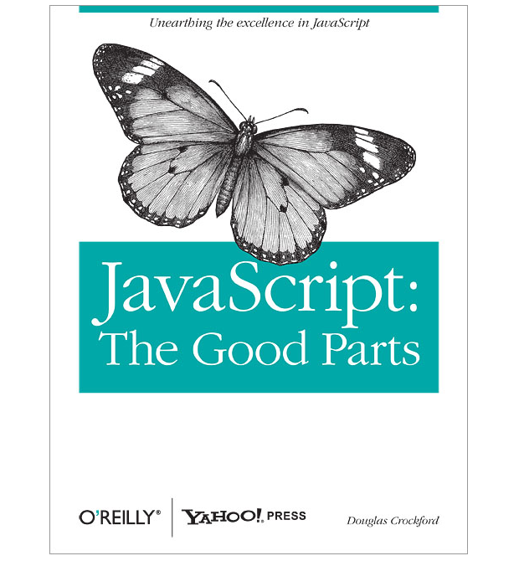
What is this all about?
1. JavaScript
the bad
the ugly
the good
2. Functional programming
Introduction
3. Functional programming with JS
church
Some of the material is based on the Book “JavaScript: The Good Parts“ by
Douglas Crockford.
ISBN: 978-0-596-51774-8

Slide 4
1. Javascript The BAD
== and ===
Block-less Statements
switch Fall Through
…

Slide 5
1. Javascript The Ugly
Scopes
NaN
this and new
…

Slide 6
1. Javascript The Good
Functions
Closures
Object Literal Notation (simple to create objects)
Dynamic Objects
Loose Typing

Slide 7
2. Functional programming introduction
What is a functional programming language?
Wikipedia: „In computer science, functional programming is a programming paradigm where programs are constructed by applying and composing functions…“
Python HOWTOs: „Functional programming decomposes a problem into a set of functions. Ideally, functions only take inputs and produce outputs, and don’t have any internal state that affects the output produced for a given input…“

Slide 8
2. Functional programming introduction
Parallel programming
Lazy Evaluation
Use of pure functions
Recursion
Stateful programming is not intuitive
IO relies on side effects
Pro
Con
Notes:
The JS Event Loop is Single Threaded, but the browser APIs act as separate threads

Slide 9
3. Functional programming with javascript Identity
λa.a
const I = a => a;
I(4); // 4
Notes:
https://www.willtaylor.blog/combinators-and-church-encoding-in-javscript/

Slide 10
3. Functional programming with javascript Kestrel
λab.a
const K = a => b => a;
K(1)(2); // 1
Notes:
https://www.willtaylor.blog/combinators-and-church-encoding-in-javscript/

Slide 11
3. Functional programming with javascript Kite
λab.b
const KI = a => b => b;
KI(1)(2); // 2
Notes:
https://www.willtaylor.blog/combinators-and-church-encoding-in-javscript/

Slide 12
3. Functional programming with javascript cardinal
λfab.ba
const C = f => a => b => f(a)(b);
const addition = (x) => (y) => x + y;
C(addition)(' World ', ' Hello '); // Hello World
Notes:
https://www.willtaylor.blog/combinators-and-church-encoding-in-javscript/

Slide 13
3. Functional programming with javascript cardinal
λf.ff
const C = f => x => y => f(y)(x);
const addition = (a) => (b) => a + b;
C(addition)(' World ', ' Hello '); // Hello World
Notes:
https://www.willtaylor.blog/combinators-and-church-encoding-in-javscript/

