Slide 1
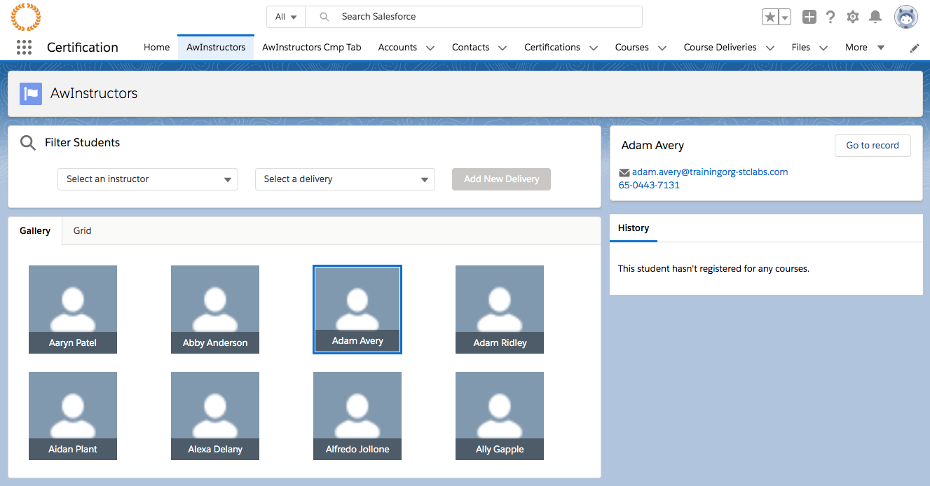
Class Project – Gallery View
*
c-student-detail
c-student-browser
c-student-browser-form
c-student-tile
c-student-tiles
Notes:
NOTE: Recommend memorizing the slide number of this one and using the keyboard shortcut to come back it frequently during class as we start building out the app.
This is our first introduction to the app you will build during this class. You're looking at a page that we'll be building using Lightning App Builder. Observe that we have two columns.
(Animation 1) The entire left column is contained by a component called the student browser.
(Animation 2) The student browser contains a component called student-browser-form. This form will be used to filter our list of students. Now, just looking at those two components, what key fact have we revealed about Lightning Web Components? (Answer: "Composition", or: a component can contain another component)
(Animation 3) We'll have component student-tiles …
(Animation 4) Which contains many instances of a component called student-tile.
(Animation 5) Lastly, we have a component along the right side. What's different about this component? (Answer: It's in its own column. We care because it impacts how we communicate with it.)

Slide 2
Class Project – Gallery View
*
c-student-browser-form
c-student-browser
c-student-detail
c-student-tile
c-student-tiles
Notes:
NOTE: Recommend memorizing the slide number of this one and using the keyboard shortcut to come back it frequently during class as we start building out the app.
This is our first introduction to the app you will build during this class. You're looking at a page that we'll be building using Lightning App Builder. Observe that we have two columns.
(Animation 1) The entire left column is contained by a component called the student browser.
(Animation 2) The student browser contains a component called student-browser-form. This form will be used to filter our list of students. Now, just looking at those two components, what key fact have we revealed about Lightning Web Components? (Answer: "Composition", or: a component can contain another component)
(Animation 3) We'll have component student-tiles …
(Animation 4) Which contains many instances of a component called student-tile.
(Animation 5) Lastly, we have a component along the right side. What's different about this component? (Answer: It's in its own column. We care because it impacts how we communicate with it.)

Slide 3
Class Project – Gallery View
*
c-student-browser-form
c-student-browser
c-student-detail
c-student-tile
c-student-tiles
Notes:
NOTE: Recommend memorizing the slide number of this one and using the keyboard shortcut to come back it frequently during class as we start building out the app.
This is our first introduction to the app you will build during this class. You're looking at a page that we'll be building using Lightning App Builder. Observe that we have two columns.
(Animation 1) The entire left column is contained by a component called the student browser.
(Animation 2) The student browser contains a component called student-browser-form. This form will be used to filter our list of students. Now, just looking at those two components, what key fact have we revealed about Lightning Web Components? (Answer: "Composition", or: a component can contain another component)
(Animation 3) We'll have component student-tiles …
(Animation 4) Which contains many instances of a component called student-tile.
(Animation 5) Lastly, we have a component along the right side. What's different about this component? (Answer: It's in its own column. We care because it impacts how we communicate with it.)

Slide 4
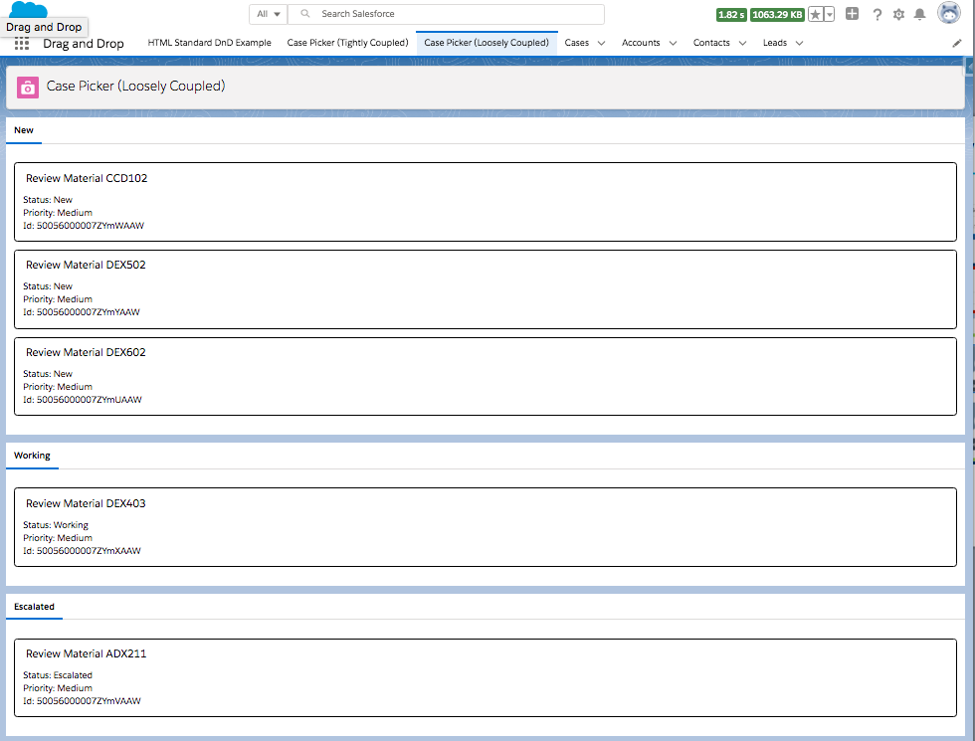

Slide 5
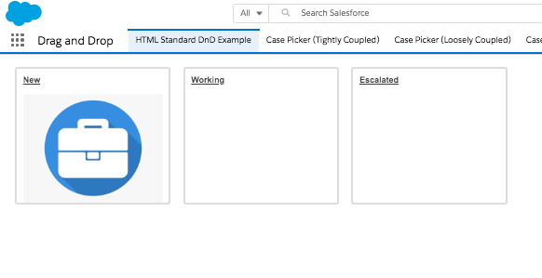
DragAndDropHTMLDemo.page
<div id="source-container” data-role="drag-drop-source">
<div id=
"target-container"
data-role=
"drag-drop-target">
<div id=
"another-target-container"
data-role=
"drag-drop-target">
<img id="home-snapshot"
draggable=”true">

Slide 6
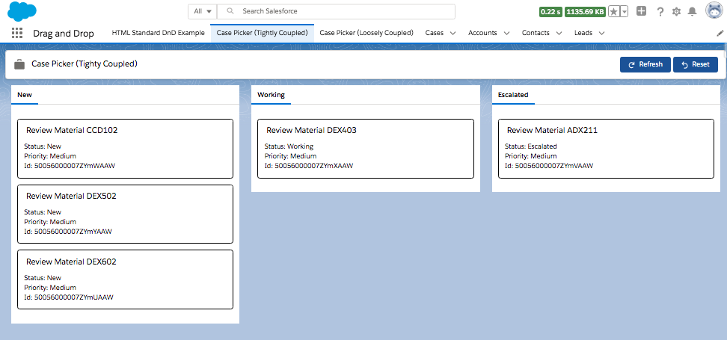
c-case_picker
c-case_item
c-case_list

Slide 7
appPage
c-case_list_for_page
c-case_list
c-case_item

