Slide 1
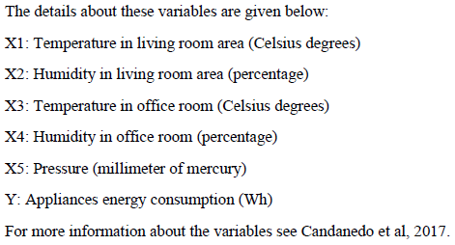
Enhanced EDA Presentation:
Energy Appliances Dataset
Notes:
This presentation applies a dark corporate theme and summarizes the EDA insights using inserted plots from your R workflow.

Slide 2
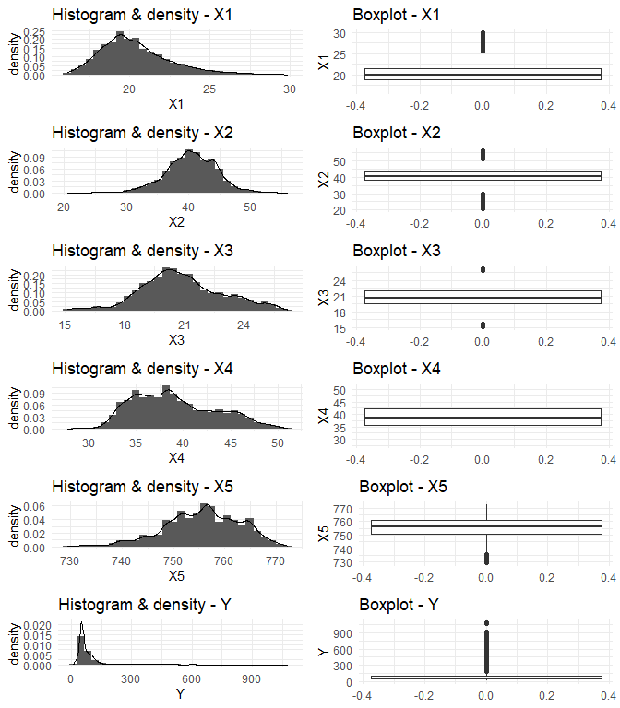
Variables X1, X2,X5 and Y show potential outliers in boxplots. Right skewness is observed in X1,Y distributions. Left skewness is observed in X3 and X5.
Univatiate Analysis
Histogram + Boxplots
Notes:
Histogram + Boxplots — Interpretation:
- Examine distribution and outliers.
- Assess skewness and transformation needs.
- Identify multicollinearity and variable relationships.

Slide 3
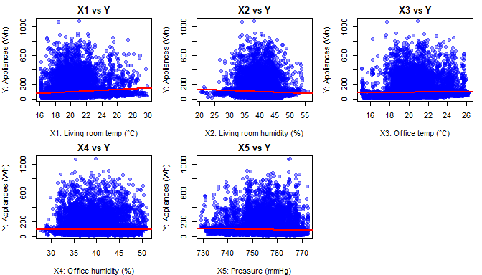
Pairwise Scatterplots scatter plots
Variables X1 and X3 show positive linear relationships with Y. Variables X2,X4 and X5 show weak or non linear relationships with Y.
Notes:
Pairwise Scatterplots — Interpretation:
- Examine distribution and outliers.
- Assess skewness and transformation needs.
- Identify multicollinearity and variable relationships.

Slide 4
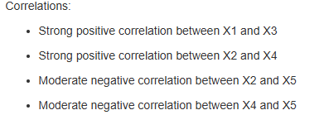
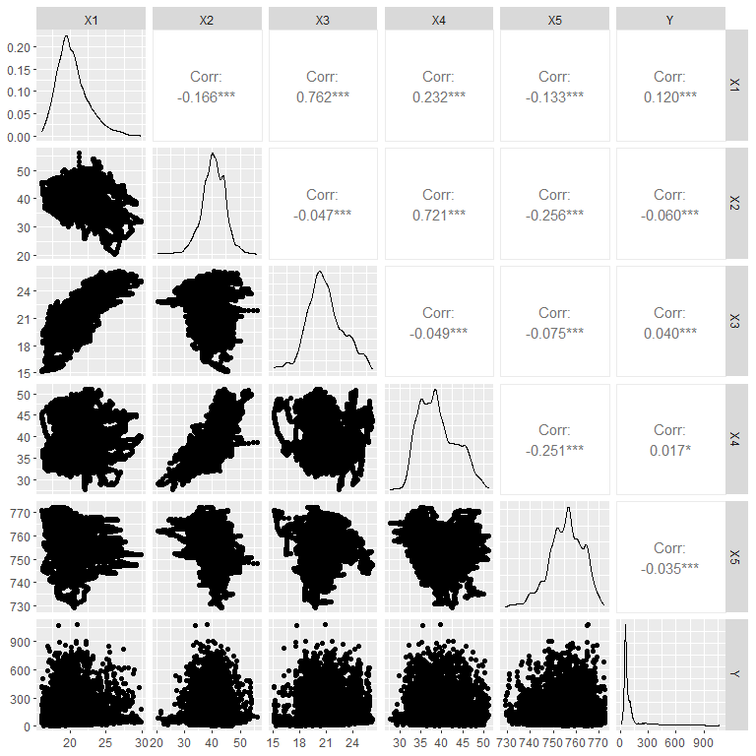
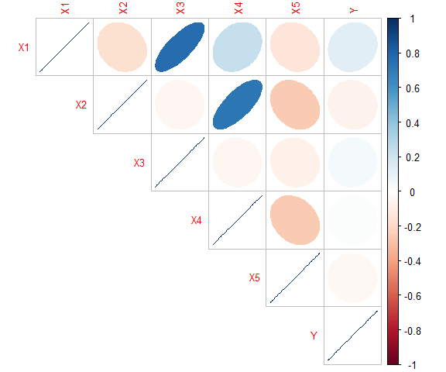
Pairwise Relationships
Correlations
Notes:
Pairwise Relationships — Interpretation:
- Examine distribution and outliers.
- Assess skewness and transformation needs.
- Identify multicollinearity and variable relationships.

Slide 5
Multicollinearity Summary
• High correlations: X1-X3, X2-X4
• VIF values remain high
• Multicollinearity clearly present
Variable | VIF
X1 | 7.980752
X2 | 5.849774
X3 | 5.635613
X4 | 6.552831
X5 | 1.122137
Notes:
VIFs >5 indicate multicollinearity persists even after transformation.

Slide 6
Key Insights
Y is strongly right skewed
Several predictors are correlated
  Variables X1 and X3 show positive linear relationships with Y
  Variables X2,X4 and X5 show weak or non linear relationships with Y
No missing values
Appropriate Transformations are applied next to reduce multicollinearity and improve model stability.
Notes:
The predictors show skewness and strong correlations among X variables.

Slide 7
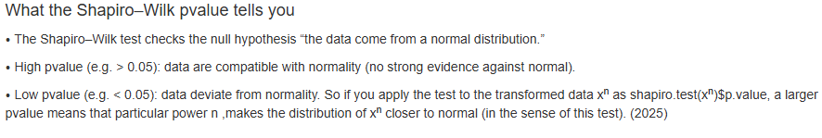

Polynomial Transformations
Polynomial functions x^{n} ;
  0<n<1 on positive skew
  n > 1 on negative skew
Define a Shapiro–Wilk normality score for a given n power
Grid search over n∈[0,2]
Notes:
The predictors show skewness and strong correlations among X variables.

Slide 8
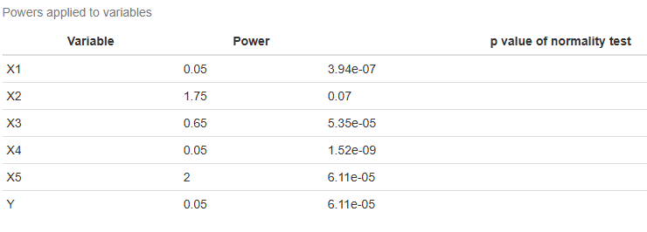
Apply Transformations
Predictor variables are transformed to be near normal distribution without changing their characteristics
Notes:
The predictors show skewness and strong correlations among X variables.

Slide 9
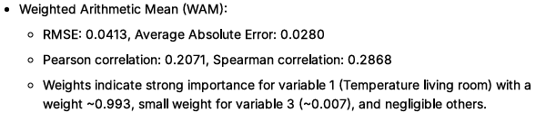
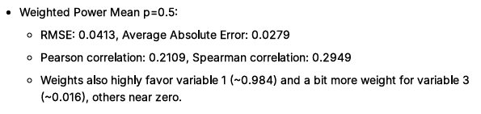

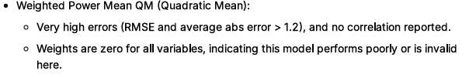
Models Evaluated
Notes:
The predictors show skewness and strong correlations among X variables.

Slide 10
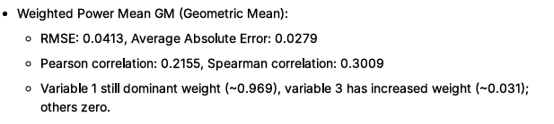
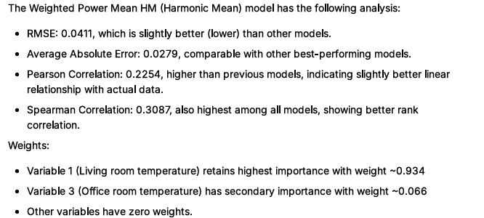
Models Evaluated
Notes:
The predictors show skewness and strong correlations among X variables.

Slide 11
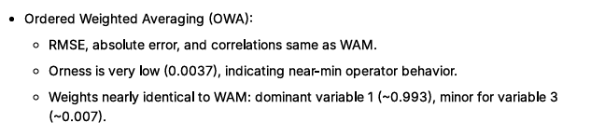
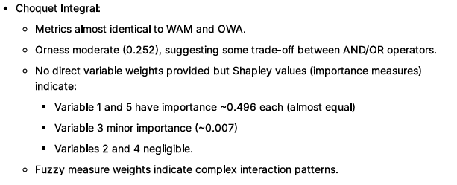
Models Evaluated
Notes:
The predictors show skewness and strong correlations among X variables.

Slide 12
Optimum Model Recommendation
Weighted Power Mean HM outperforms marginally in all error and correlation metrics, indicating better fit on the data
Choquet Integral provides richer interpretability with balanced importance between temperature and pressure, reflecting nuanced interactions
For purely predictive performance and simplicity, Weighted Power Mean HM is optimal
For interpretability and capturing interaction effects, Choquet Integral is preferable.
Overall, the Weighted Power Mean HM should be the first choice focusing on prediction accuracy, while Choquet Integral suits those valuing variable interaction understanding alongside good accuracy
Notes:
The predictors show skewness and strong correlations among X variables.

Slide 13
Feature Importance
Variable | Weightage
X1: Temperature in living room area(Celsius degrees) | 0.936
X2: Humidity in living room area (percentage) | 0
X3: Temperature in office room (Celsius degrees) | 0.066
X4: Humidity in office room (percentage) | 0
X5: Pressure (millimeter of mercury) | 0
Temperature in living room and overall office influence energy use of appliances significantly.
Notes:
The predictors show skewness and strong correlations among X variables.

