Slide 1
猜拳小遊戲
B06603029 王愷

Slide 2
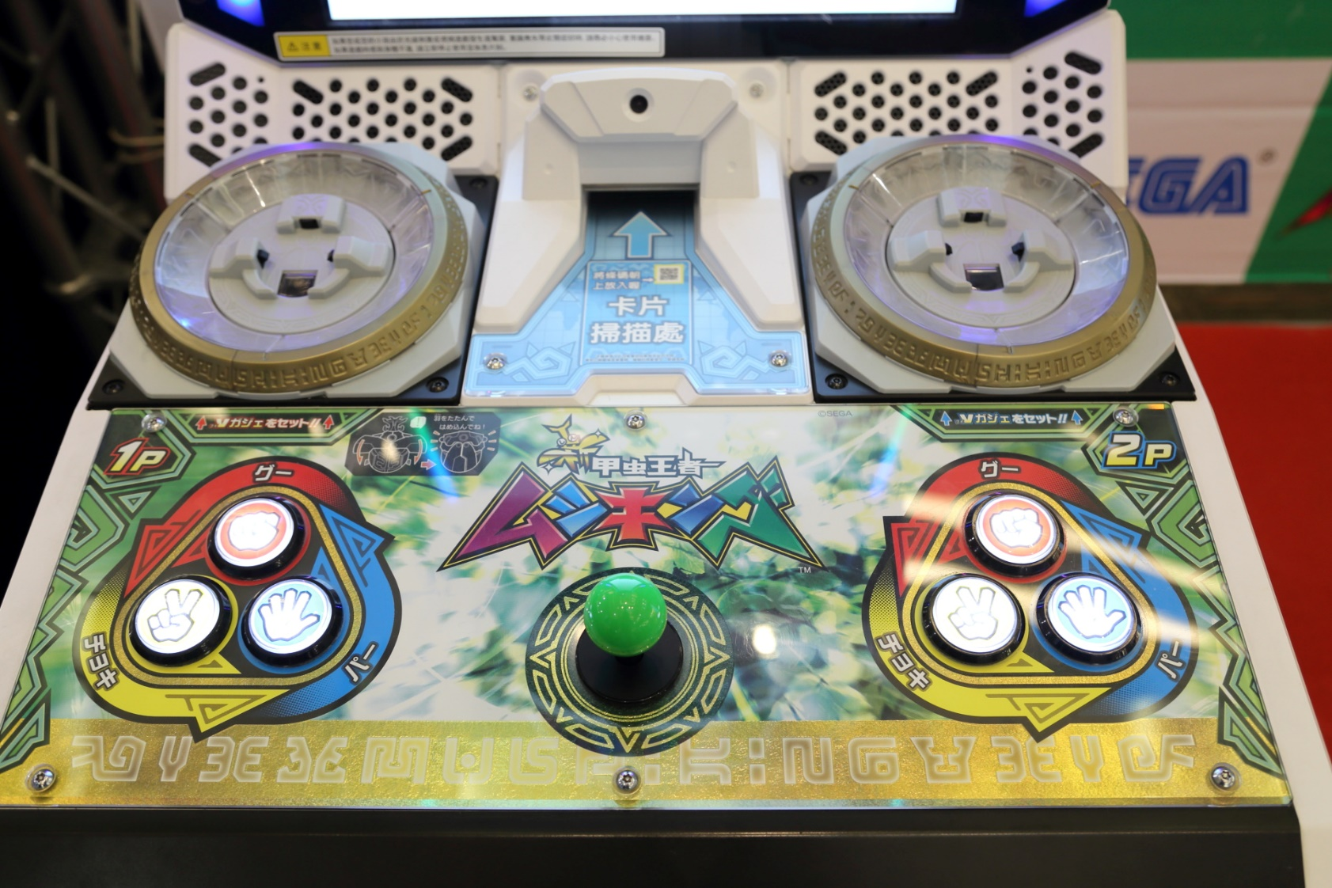
動機

Slide 3
玩家出拳
while( playerhp* computerhp>0)
{
string str = Console.ReadLine();
int i = int.Parse(str);
string result;
if (i == 1)
{
result = "剪刀";
}
else if (i == 2)
{
result = "石頭";
}
else if (i == 3)
{
result = "布";
}
else
{
Console.WriteLine(“請輸入1個1-3範圍的數");
continue;
}
Console.WriteLine("你出了{0}", result);

Slide 4
電腦出拳
Random ran = new Random();
int a = ran.Next(1, 4) ;
string cpresult="";
if (a == 1)
{
cpresult = "剪刀";
}
else if (a == 2)
{
cpresult = "石頭";
}
else if (a == 3)
{
cpresult = "布";
}
Console.WriteLine("電腦出了{0}", cpresult);

Slide 5
判定輸贏
if (i == a)
{
Console.WriteLine("平手");
}
else if (
i == 0 && a == 1
||
i == 1 && a == 2
||
i == 2 && a == 0
)
{
Console.WriteLine("你失去一點生命");
playerhp--;
}
Else
{
Console.WriteLine("電腦失去一點生命");
computerhp--;
}
Console.WriteLine("玩家生命值:{0}",playerhp);
Console.WriteLine("電腦生命值:{0}",computerhp);

Slide 6
判定輸贏
if (playerhp<1 )
{
Console.WriteLine("\n 很可惜 請再接再厲");
}
if (computerhp<1 )
{
Console.WriteLine("\n 恭喜你!你贏了!");
}

