Slide 1
計算機程式設計 作業一 Computing Time Value of Money
財金一 許靖 B09703009

Slide 2
題目: Computing Time Value of Money
What Is the Time Value of Money (TVM)?
The time value of money (TVM) is the concept that money you have now is worth more than the identical sum in the future due to its potential earning capacity. This core principle of finance holds that provided money can earn interest, any amount of money is worth more the sooner it is received. TVM is also sometimes referred to as present discounted value.
Understanding Time Value of Money (TVM)
The time value of money draws from the idea that rational investors prefer to receive money today rather than the same amount of money in the future because of money's potential to grow in value over a given period of time. For example, money deposited into a savings account earns a certain interest rate and is therefore said to be compounding in value.
https://www.investopedia.com/terms/p/presentvalue.asp

Slide 3
動機+構想解說: Computing Time Value of Money
背景介紹
---初會財金系大一必修
---初會期中不能用財務計算機，所以只能查表
想解決的問題
---查表容易對錯
---查完表在去程以本金的時候容易按錯計算機

Slide 4
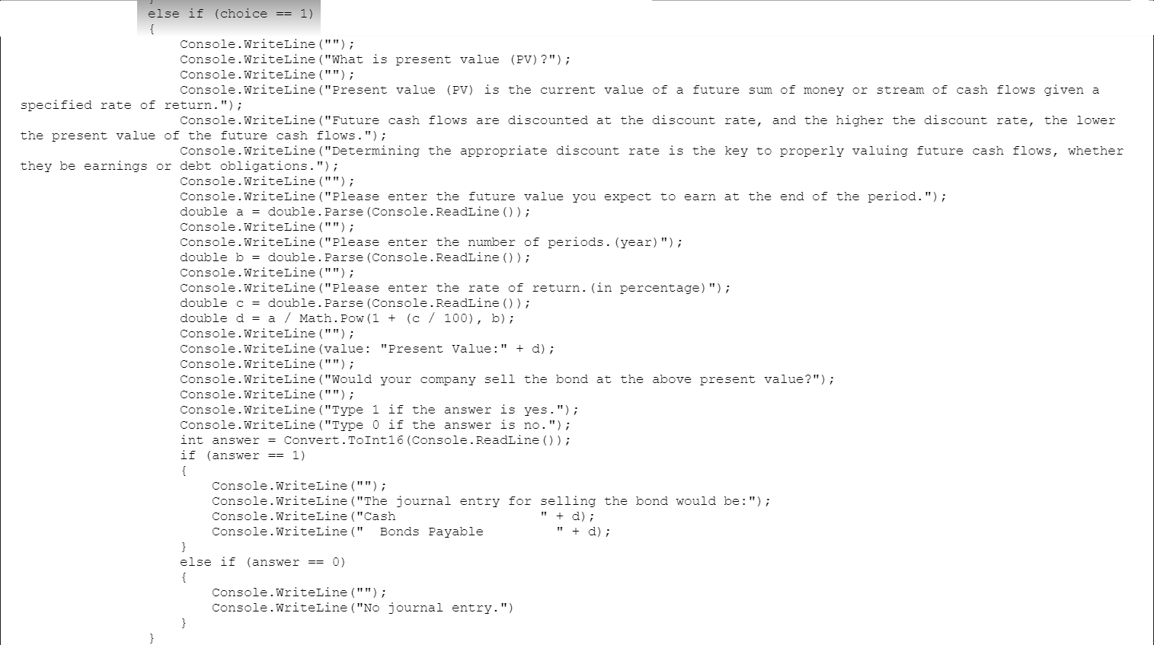
程式設計規劃: Computing Time Value of Money ---Present Value of 1

Slide 5
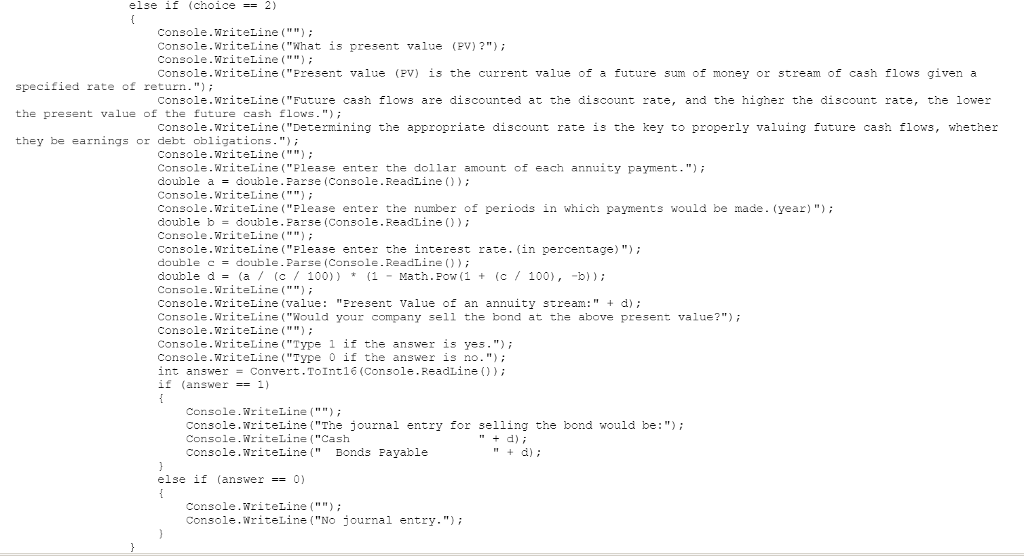
程式設計規劃: Computing Time Value of Money ---Present Value of annuity

Slide 6
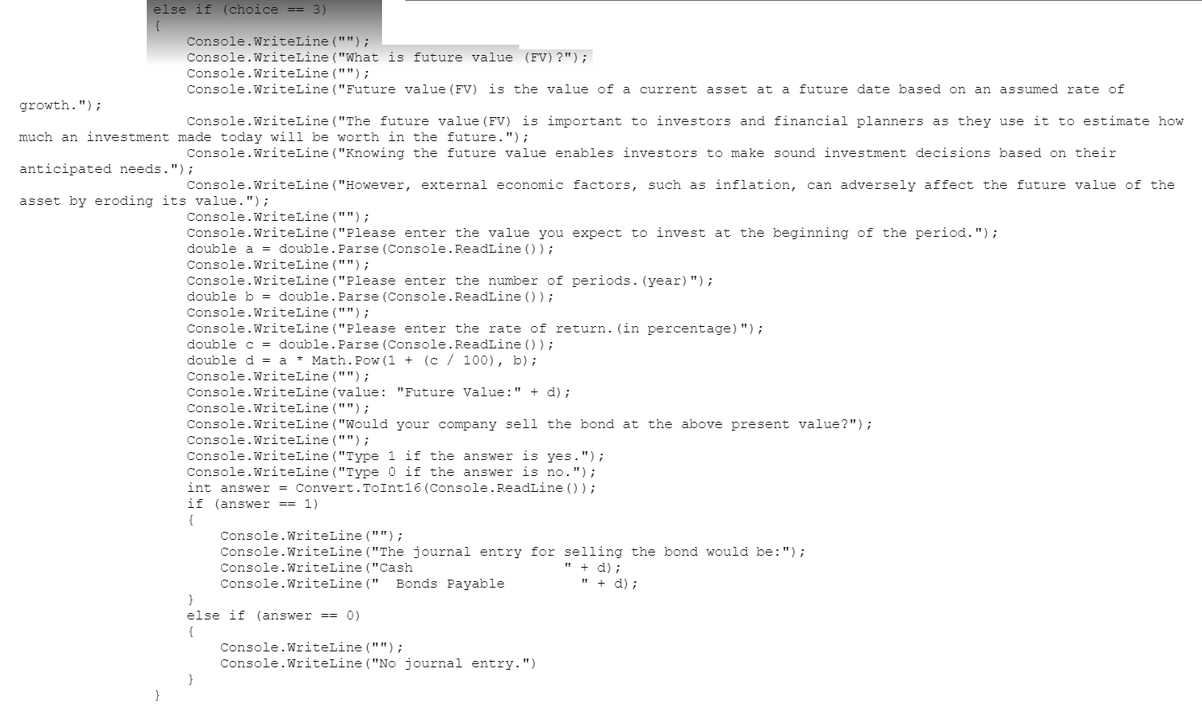
程式設計規劃: Computing Time Value of Money ---Future value of 1

Slide 7
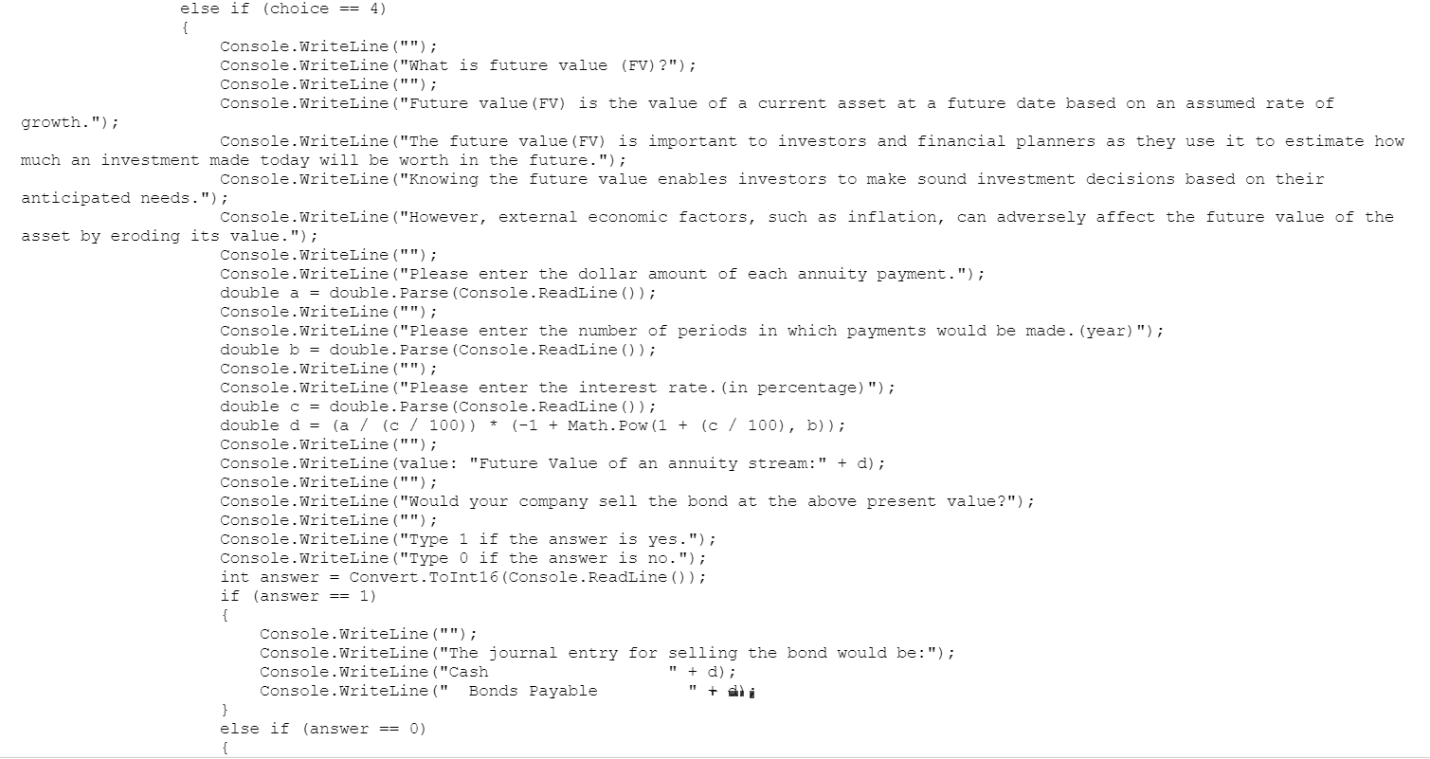
程式設計規劃: Computing Time Value of Money ---future value of annuity

