Slide 1
HW1 Introduction
B07901062 陳泊均

Slide 2
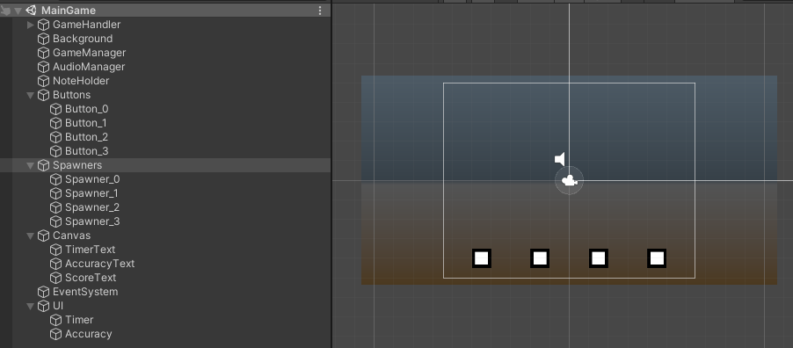
Workspace

Slide 3
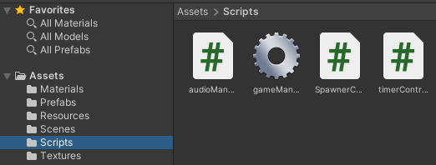
Assets

Slide 4
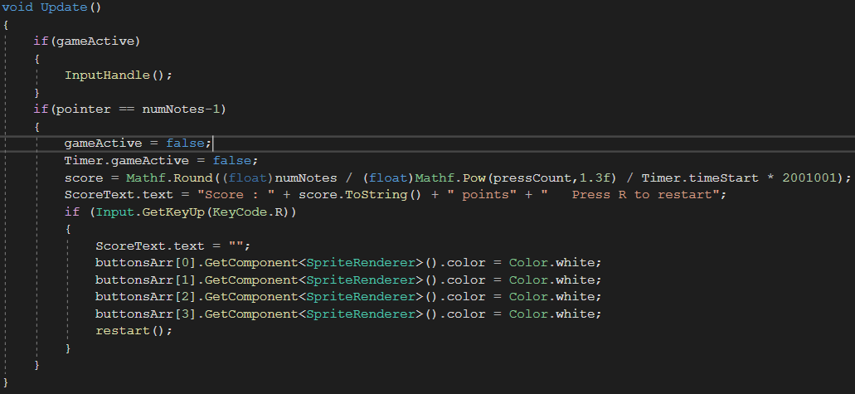
Update()

Slide 5
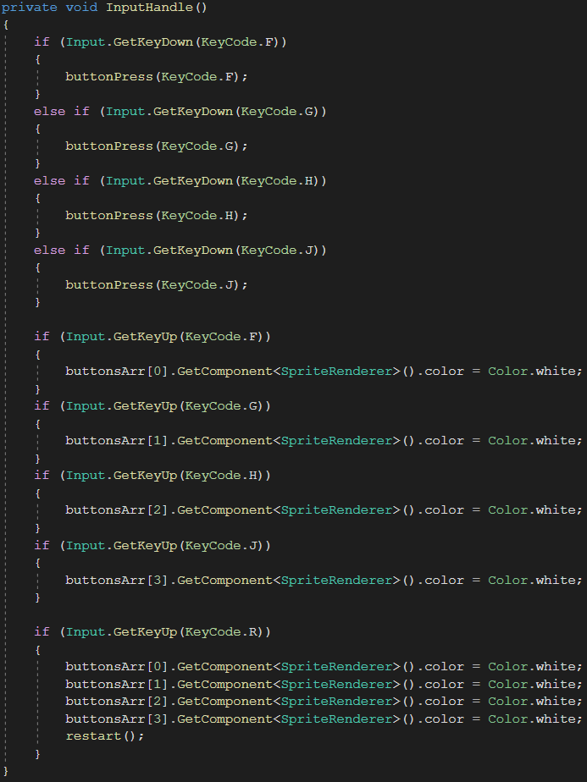
Input Handling - 1

Slide 6
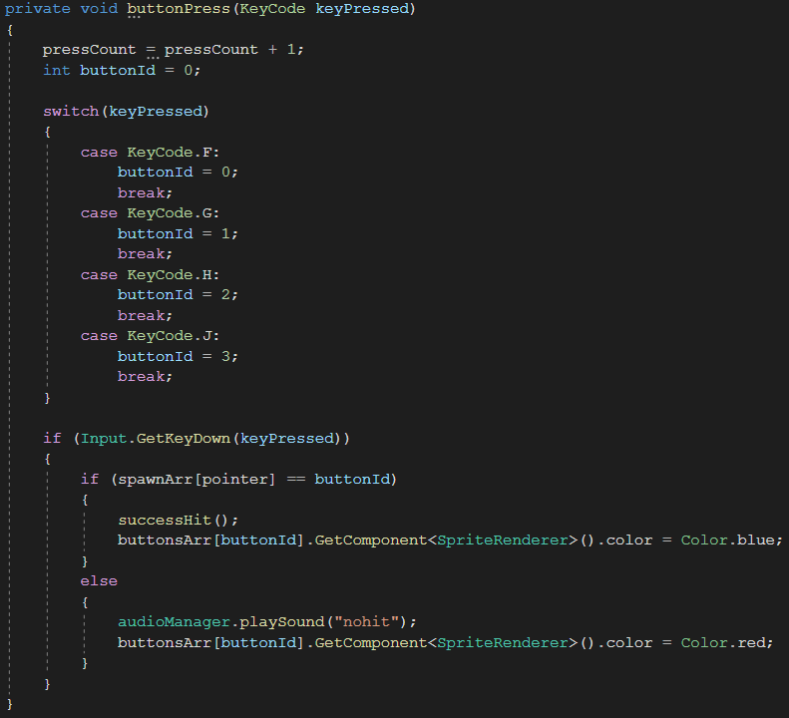
Input Handling - 2

Slide 7
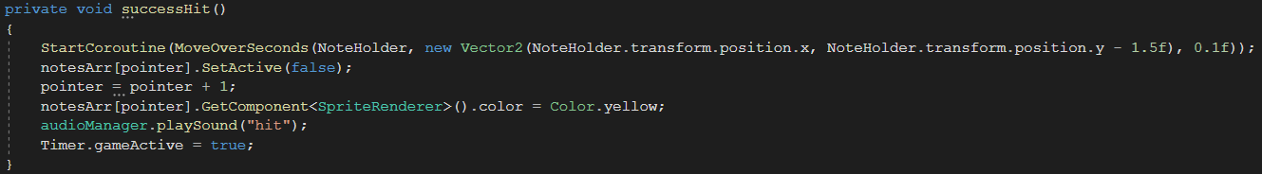
Successful Hit

Slide 8
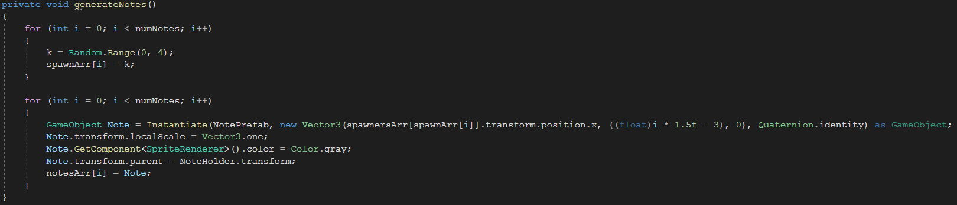
Generate Notes

