Slide 1
IoT-Solar-Panel-Network
VLSI Design Lab., Konkuk Univ.
Draftsman, Robinus Fuser.
Aug. 2015.

Slide 2
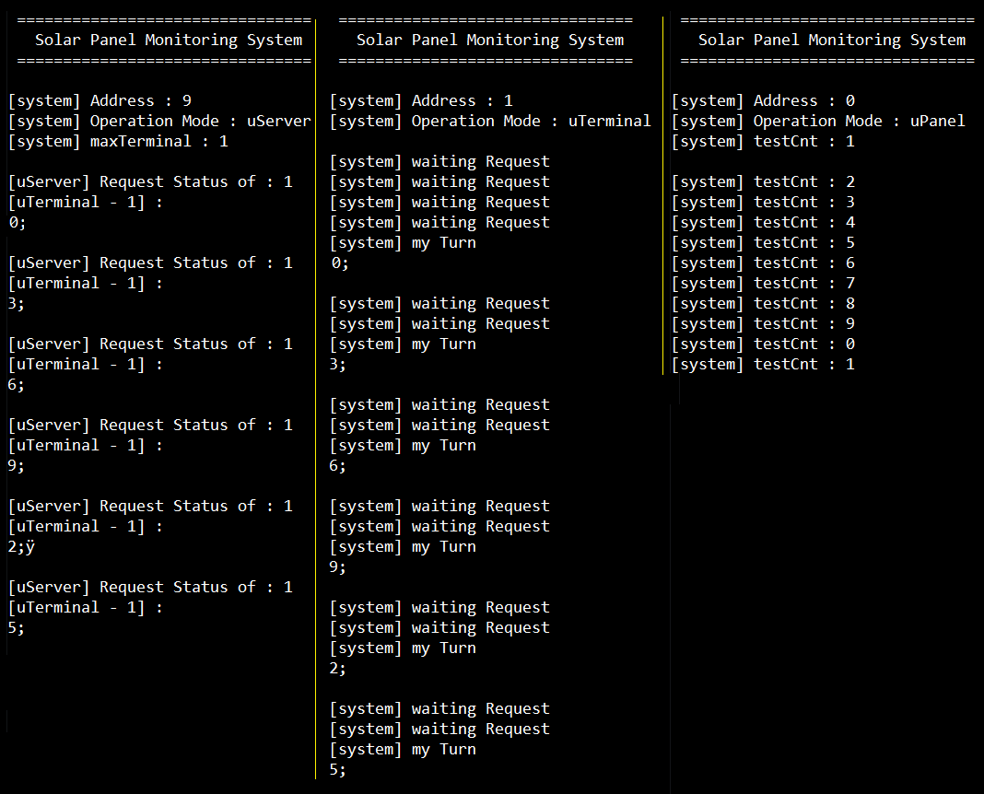
Demo Program Result
uServer
uTerminal
uPanel
Prototyped 3 boards already does have the proper program inside their flash for the demonstration.
So it is recommended to just play it and monitor it before you re-program when you are trying to study and improve the codes, or preparing another documentation of this project.

Slide 3

IoT Solar Panel Network
uart[0] – for Debug
may connect to pc
All the Baud Rate for UART
is currently 9,600 !!
uart[3] –
mcu to Zigbee Module
uServer
uTerminal
uPanel
uTerminal
uPanel
uart[1]
– RS485 [A, B] Pair

Slide 4
Network Flow Chart – in brief
uServer
uServer counts “addr”
uServer
uTerminal
“addr” sent to RS485 Line. uServer waits : while(1)
uTerminal
uTerminal
uTerminal
Every uTerminals received “addr”
uTerminal
uPanel
A single uTerminal (which the “addr” matched) sends ‘:’ to its Target Zigbee Pair, uPanel
uTerminal
uPanel
Every uPanels have been collecting its data already,
so immediately returns its data when received ‘:’
uPanel indicates the end of transmission with ‘;’
uServer
uTerminal
uTerminal transmits the received data from uPanel to RS485 line
But all the other uTerminals DOES NOT RESPONSE as this is not “addr”
The occupancy of the line ends up with the last byte 0xFF
uServer
uServer prints out what received on UART0 (desktop-PC)

Slide 5
Network Flow Chart – in Detail
RS485 : not(RE) & DE is hard-wired (same electrical node)
Start of Transmission via RS485 : not(RE) = ‘1’ & DE = ‘1’
End of Transmission via RS485 : not(RE) = ‘0’ & DE = ‘0’
This Transmission sequence is implemented by UART1_SendByte(unsigned char Data)
Automatically occupies and release the line controlling not(RE) & DE at the same time
1. [uServer] sends “addr” to RS485 Line and wait till the result from uTerminal (which ends with 0xFF)
“addr” equals internal (uint)txHolder which counts from [1 to maxTerminal]
2. [uTerminal] Every uTerminals received “addr” via RS485
But only when “addr” matches its own address configured by dip switch starts communication.
Sends “:” to Target Zigbee Module // start of Zigbee Communication
3. [uPanel] Zigbee Module received ‘:’
Then sends out its collected data to Zigbee Module
Finnaly sends out ‘;’ to Zigbee Module to indicate the end of the transmission
4. [uTerminal] Received data from Zigbee which ends with ‘;’
Then hands over this received data to RS485 Line, this string ends with 0xFF
5. [uServer] Received the data from uTerminal via RS485 Line including 0xFF at the end of stream.
- Prints out received data to UART0 (desktop-PC)
- Counts up “addr” and sends this “addr” again to RS485. Iteration.

Slide 6
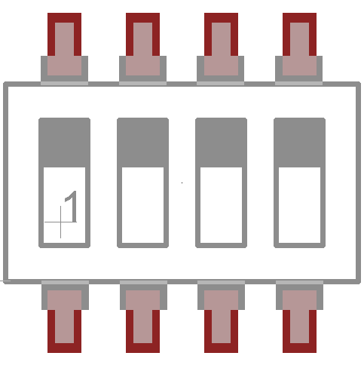
Working Mode Selection
dip[3] dip[2] dip[1] dip[0]
Zigbee Config. [1111]
uServer [1mmm] { 0b000 ≤ 0bmmm ≤ 0b111 }
mmm == Maximum uTerminal
uTerminal [0nnn] { 0b000 ≤ 0bnnn ≤ 0b111 }
nnn == uTerminal Address
uPanel [0000]

Slide 7
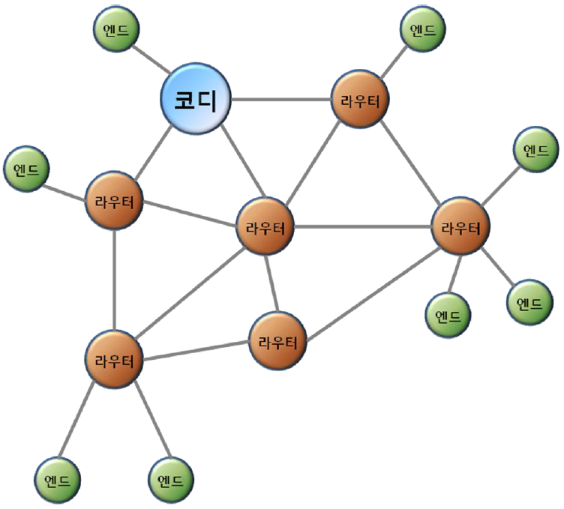
Zigbee Network
Operation Modes
: Router, Coordinator,
End Point
Bandwidth : 2.4GHz
Interface : UART, USB, I2C, I2S

Slide 8
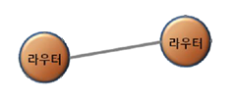
Zigbee Configuration dip[1111]
* Interface of Zigbee Tranceiver Module : UART(Current Baud Rate 9600, the rate can be re-configured)
- Transmit and Receive Commands, Response, Character Data via UART between IoT Board and Zigbee Module
* The Command Set is called “AT+COMMAND”
* Factory Default Mode : Router, Operation Mode (Byte Communication)
* We might only use : Point to Point Router Mode
Operation Mode @reboot… “TARGET NON” or “TARGET OK”
[1] Command Mode : Enter “+++”
[2] Set Operatin Mode : Enter “AT+SETROUTER” ( cf. “AT+SETCOORD” )
[3] Set Terget Device : Enter “AT+SETTARGETFFFFFFFFFFFFFFFF” ( IEEE Address 16bits )
[4] Restart and Operate : Enter “ATZ” ( Soft Reset )
[cf. Operation Mode >> Command Mode : +++ ][Command Mode >> Operation Mode : ATO ]
IoT Project
0 |  | 001 551 000 00C 1CC3 | uServer
 |  | uTerminal | uPanel
1 |  | 001 551 000 00C 1CC0 | 001 551 000 00C 1CC2

Slide 9
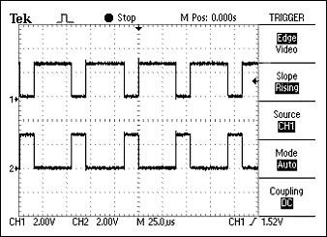
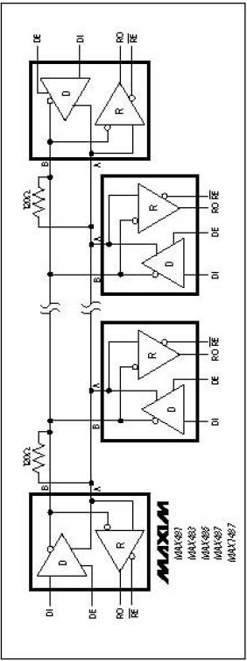
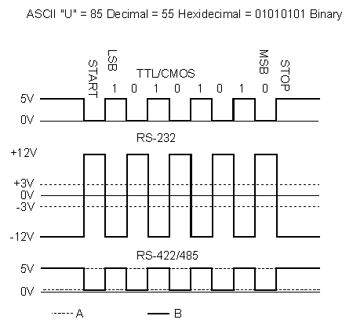
RS485 Communication
Differential Signaling for Noise-Robustness
Need Resource(Comm. Line) Distribution Policy
Non-Crosswiring ( A to A, B to B )
(cf. in RS232, Tx to Rx, Rx to Tx)
nRE(0) : Read Enable (Rx)
DE (1) : Data Enable (Tx)

Slide 10
@uServer dip[1mmm]
@Zigbee Config. Mode
dip[1111]
Define Maximum uTerminal Numer with dip[2 downto 0]
Count Index++ (Idx == uTerminal Address, ex. 1, 2, 3,.. 1, 2, 3)
- then Send “addr” to RS485 Comm. Line
- Tx Access Authority turned to “addr”
Recovers Authority to RS485 when Receiving [Byte 255]
Type and Monitor with Hyper Terminal
Use AT+COMMAND
UART0 – PC
UART3 – Zigbee
@uTerminal dip[0mmm]
@uPanel dip[0000]
Wait till “addr” is given over RS485 Comm. Line
Send “:” via Zigbee - Start Zigbee Comm.
- Data Receiving “;” from Zigbee - End of Zigbee Comm.
Send [Data received from Zigbee] over RS485 Comm. Line
- RS485 Tx Access Authority Ends with [Byte 255]
Dormant till the next “addr” via RS485 Comm. Line
Generate Data to Send (ex. ADC)
Received “:” via Zigbee
- Send Data, ends with “;”
* Dormant till next “:”, gathering Data

Slide 11
ADC
Power-on ADC module by setting PCONP[12]
Select the mode of the pin P0.23 as AD0.0 by setting PINSEL1[15:14]
Enable ADC module and start A/D Conversion by setting AD0CR[21] & AD0CR[26:24]
Check conversion DONE flag by reading ADDR0[31]
If DONE is set(1), ADC conversion for this channel[0] is finished.
Read the RESULT from ADDR0[15:4]
Constraint : The voltage bias (offset) and the swing-range is not optimized.
Current successfully readable DC level is [ 1.2v ~ 3.0v ]
But ADC from MCU is working fine. This is a mere problem from H/W side.

Slide 12
Improvements
When additional 2 boards come, test the functionality with 5 boards ( 2 uTerminal – uPanel pairs )
ADC : Additional example Code will be offered with the Current IoT uVision Project
- Then you might add the functionality to the current version.
For debugging purpose, each device, and each communication waits the response forever.
- for realistic implementation, each device should recover to the next step incase of comm. failure.

