Slide 1



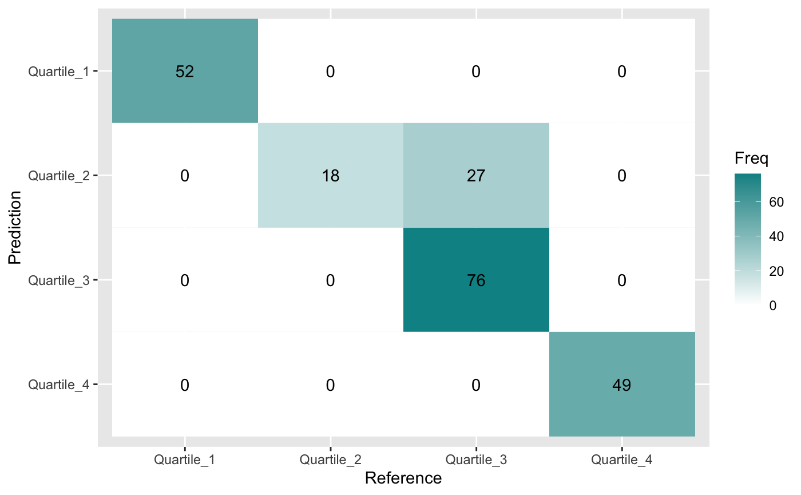
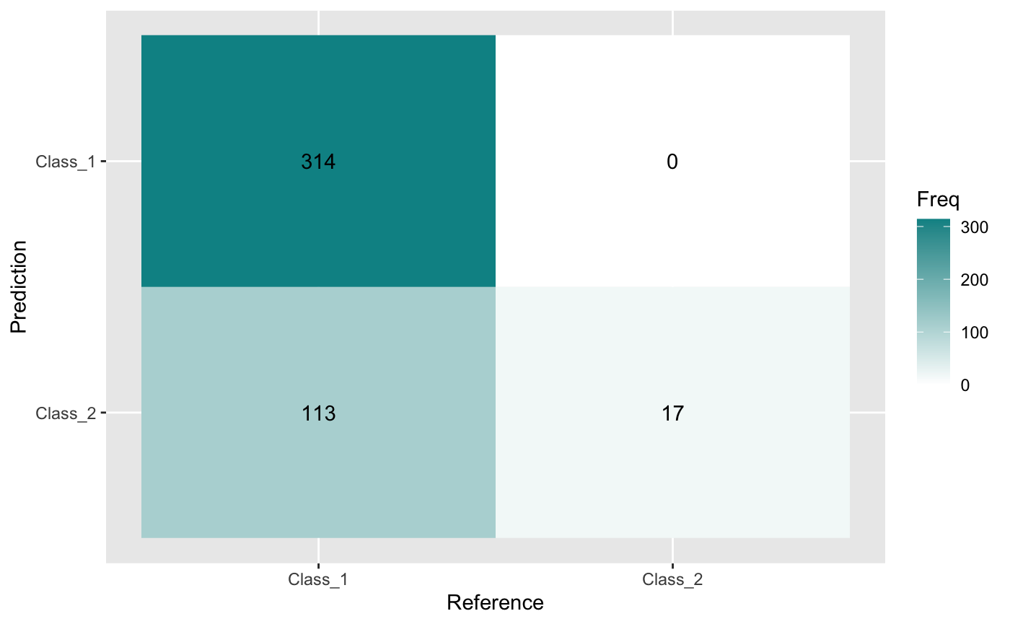
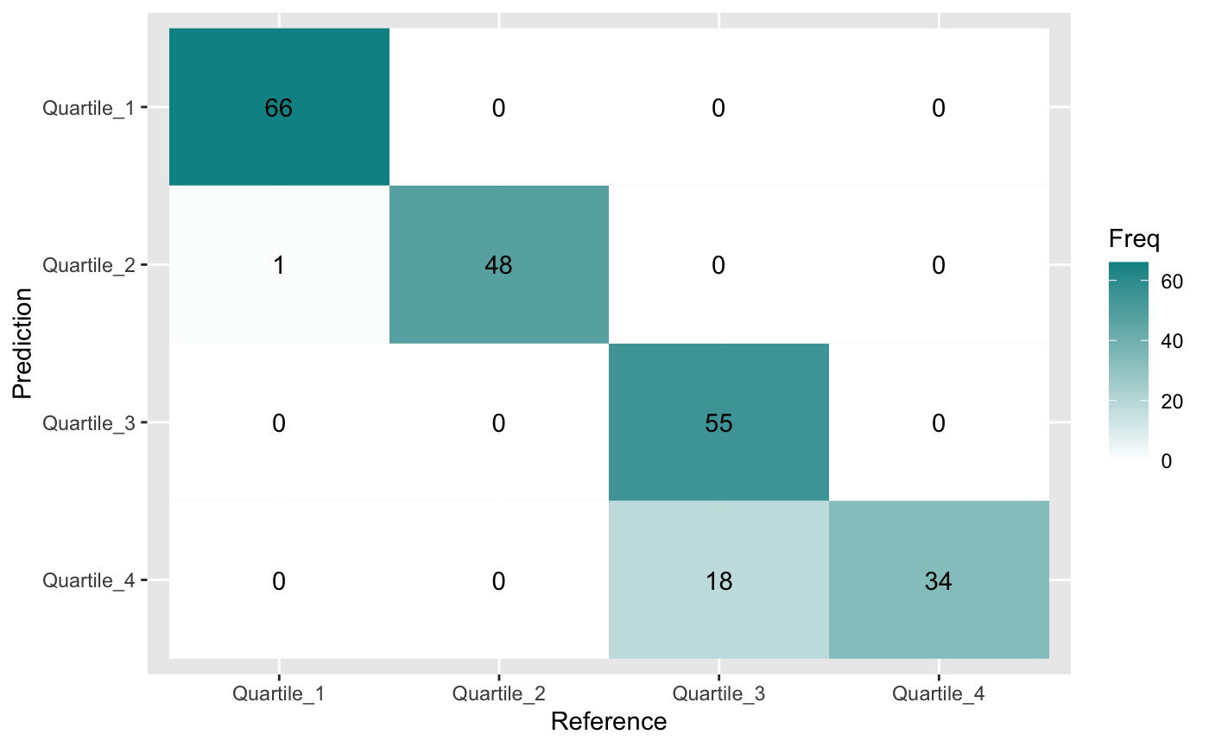
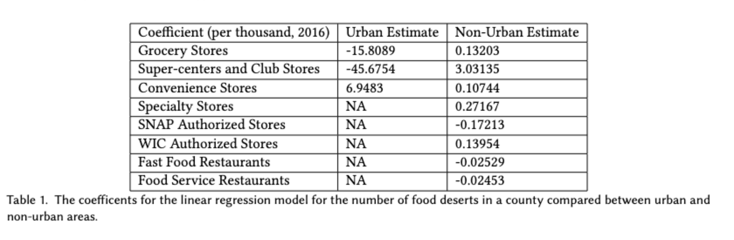
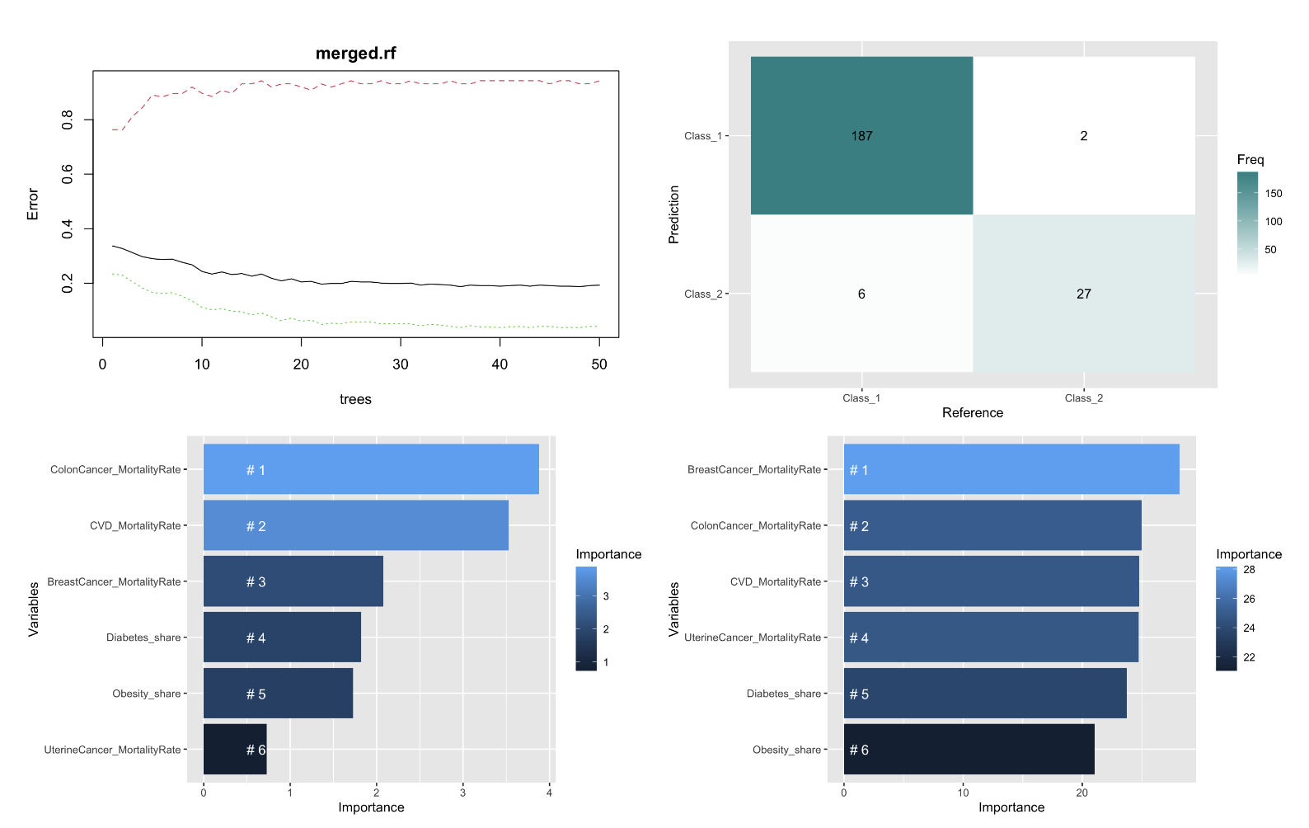
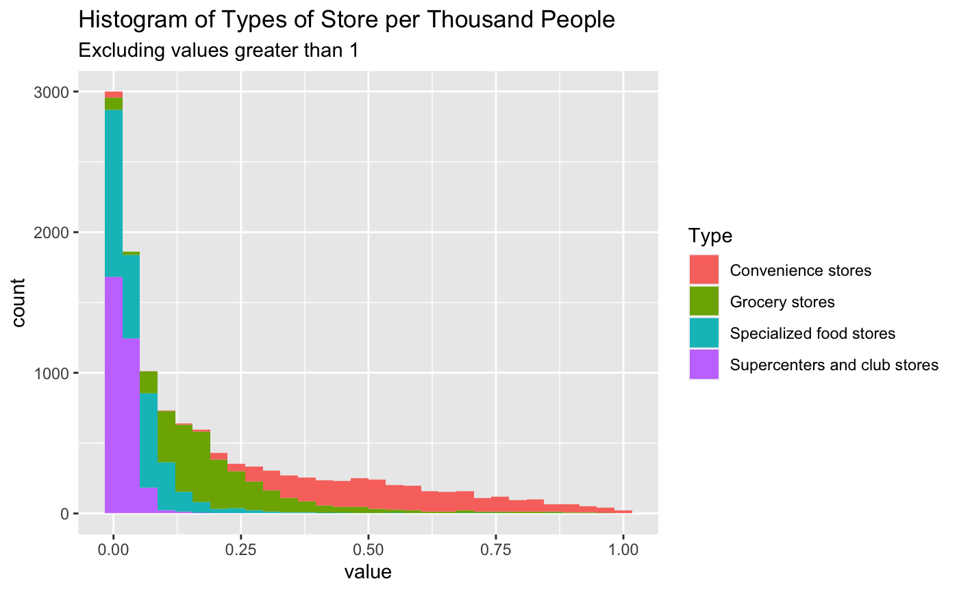
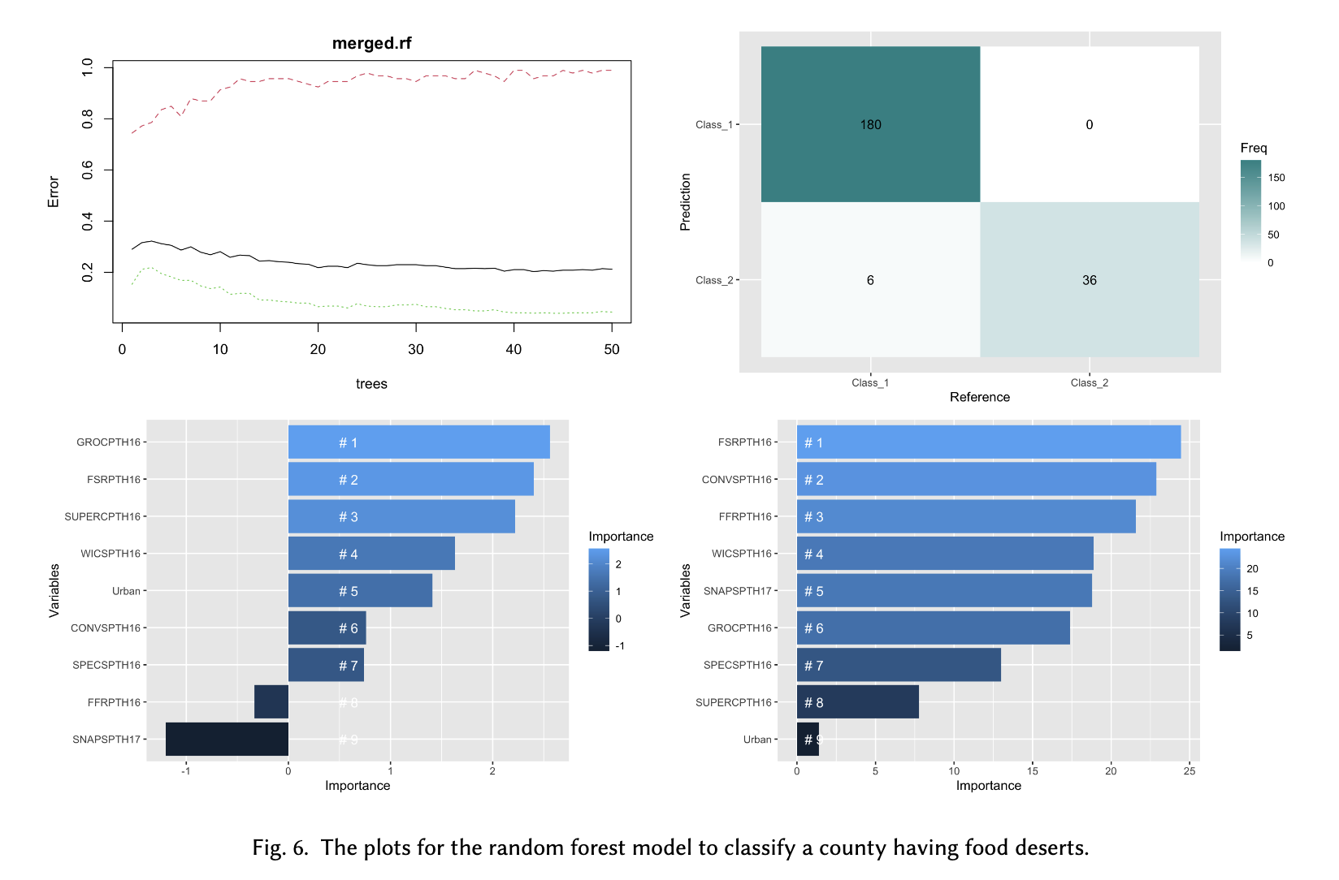
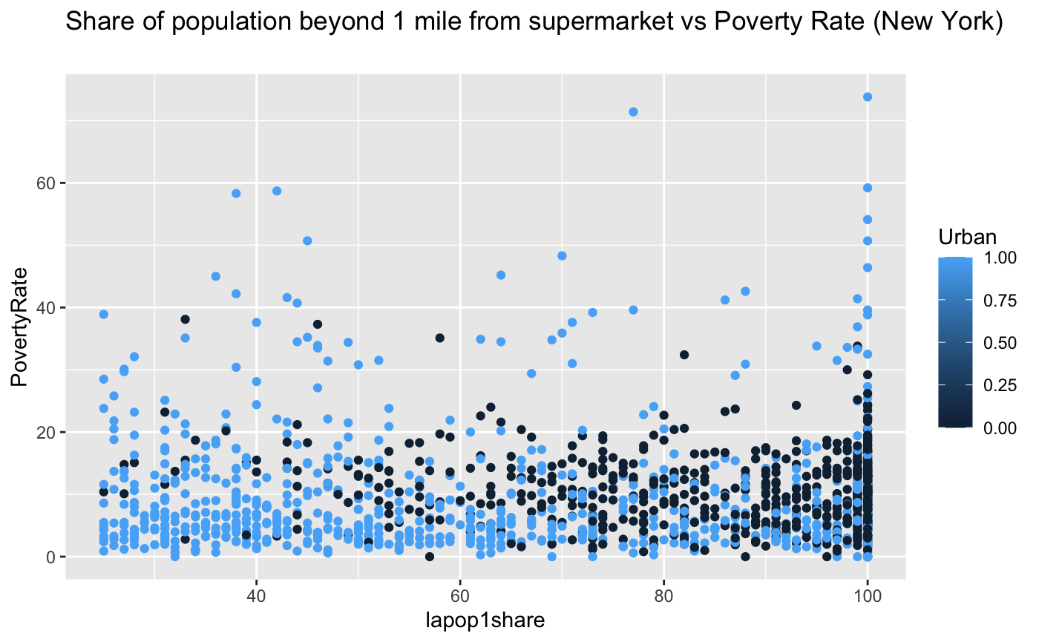
Analyzing US County Level Food Deserts' Demographics, Food Access, and Diet Related Disease Prevalence
Morgan L. Ford fordm2@rpi.edu
¹Rensselaer Polytechnic Institute, Troy, NY, United States,
Abstract
Models
23.5 million Americans live in food deserts[1]. Many Americans also live with diet related health conditions. This poster will examine a potential relationship between access to grocery stores and access to healthy foods at grocery stores, the differences between urban and non-urban food deserts, the relationship between population demographics and food deserts, and the relationship between food deserts and the prevalence or mortality rates of diet-related health conditions. I hypothesis that food deserts are less likely to have a variety of healthy foods in their limited food sources compared to areas that are not food deserts. I also hypothesize that food desert communities are more likely to be at risk for diet related health issues than than areas that are not food deserts.
Demographics SVM
Quality of Life KNN
A support vector machine model was model to classify if a county that was a food desert or not, using the variable that flagged if a tract that flagged at low access for 1 mile for urban areas and 10 miles for non-urban areas, and the following demographic variables about population income and ethnicity.
It performed with 74.55% accuracy and the confusion matrix is below.
A knn model was created with 72.3% accuracy to classify food deserts based on length of life. Another knn model was created with 94.15% accuracy to classify food deserts based on quality of life. The respective confusion matrices are below.
Introduction
According to the USDA, a food desert is defined as an area that has either:
A poverty rate >= 20%
A median family income <= 80% of the median family income (urban areas)
A median family income <= 80% of statewide median family income (nonurban areas)
and at least 500 people or 33% live further than:
Urban: 1 miles from nearest large grocery store
Rural: 10 miles from nearest large grocery store
Diet related health conditions include:
Type 2 Diabetes
Heart Disease
Obesity
Breast, Colon, and Uterine Cancers
Access Linear Regression
A linear regression model was created to examine feature importance and to examine the difference between urban and non-urban areas. The urban linear model is likely overfit due to the lack of data. The non-urban linear model performs with residual standard error of 0.3614 and multiple R-squared of 0.04345. This model may also be overfit, but does perform with relatively low error.
Health Random Forest
A random forest classifier was made with 50 trees and 3 variables tried at each split to see if it was possible to correctly classify a county as having 33% or more food desert tracts based on the prevalence of obesity and diabetes as well as the mortality rates of cardiovascular disease, breast, colon, and uterine cancers. It performed with 94.1% accuracy.
The Data
Food Environment Atlas
- County level data about types of accessible food
Food Access Research Atlas
- Census tract level data about access to food
US Health Map
- Variety of data about health conditions
EDA
Access Random Forest
A random forest classifier was made with 50 trees and 3 variables tried at each split to see if it was possible to correctly classify a county as having 33% or more food desert tracts based on the food environment. It performed with 97.3% accuracy.
The most important factors for accuracy: colon cancer mortality rate and cardiovascular disease mortality rate.
Conclusion
By t-test alone, my hypothesis is disproven. However, from the models that I have generated, I find there to be a significant link between food deserts, food access, quality of life, and diet-related health conditions.
The most important factors for accuracy: the number of grocery stores, food service restaurants, and convenience stores.
Note:
When creating urban and non-urban linear models, a county was counted as urban if the percent of urban census tracts in the county was higher than 50%.
When classifying entire counties as food deserts, a county would be classified as a food desert if 33% or more of the census tracts in the county were food deserts.
Sources:
https://www.ers.usda.gov/webdocs/publications/45014/30940_err140.pdf
http://www.ers.usda.gov/Publications/AP/AP036/
https://www.ers.usda.gov/data-products/food-environment-atlas/
https://www.ers.usda.gov/data-products/food-access-research-atlas/
https://www.cdc.gov/chronicdisease/resources/publications/factsheets/nutrition.htm

