Slide 1




Establishing a Strategy for Enterprise Data Quality
Barry Williams
Principal Consultant
Database Answers Ltd.
Ark Conference
1st April 2008
Notes:
I am a Principal Consultant with Database Answers Ltd
For the past (almost) 3 years I have been Data Architect with the London Borough of Ealing
Therefore I will be wearing two hats during the course of this Presentation
One for my experience at Ealing and one for previous experience.
The Legal people at Ealing suggested a Homburg would reflect the spirit of Ealing Council
Seems to be people of substance, ‘man about town’ with flair and style
but that reflected their desire and not reality !
I found a wonderful ‘Menswear’ shop called Alfred Sayers, which has been in Ealing for 120 years
They told me a Homburg would cost £120, and recommended a Panama Hat at £39.95p.
I thought about Alec Guinness in classic Ealing Comedies like The Man in the White Suit, Lavender Hill Mob and Kind Hearts and Coronets
A Panama seemed the right choice.
The Google Baseball Cap (at Credit Suisse when Google launched) and now Android

Slide 2
Establishing a Strategy for Enterprise Data Quality
Overview
Identifying the Infrastructure
Setting a Quality Control Initiative
Developing Plans to enrich Quality
Getting Started
Notes:
Google Cap
DQ is very important –
Gartner says “Fortune 1000 enterprises lose more money due to data quality issues than they spend on DW and CRM”
Forrester “In recent discussions, not one out of 30 companies expressed confidence in their Customer Data”
TDWI says “DQ Problems cost American businesses more than $600 billion dollars a year”
Identifying the Infrastructure (10 Slides) – Start 9:40 am- Data Architecture
Based on my fifteen years experience
Focus in particular on DQ Data Architectures
Data Metrics
Setting Quality Control Initiative (7 Slides) – Start 9:50 am - Tools
Data Arch helps us to choose Tools
Let’s look in detail at aspect of choosing Tools
Developing plans to enrich Quality (10 Slides) – Start 10:00 am – Engage with the Business
Focus on Business view of Data
Data Platform
Importance of an Enterprise Data Model
Getting started (7 Slides) – Start 10:10 am – Combine Organisation and Technology
Look now at Organisation aspects and how technology and business must be combined
Business Drivers
Roles and Responsibilities
Data Quality Audit

Slide 3
Establishing a Strategy for Enterprise Data Quality
What is Data Quality ?
TDWI says …
Wikipedia says …
  Many things
  Good enough (!!)
Barry says …
  “Fit for Purpose”
Notes:
Google Cap
TDWI says :-
“Data quality is a complex concept that encompasses many data management techniques and business-quality practices,
applied repeatedly over time as the state of quality evolves, to achieve levels of quality that vary per data type and seldom aspire to perfection.”
Wikipedia says :-
“Data is high quality “if they are fit for their uses”
“Achieve degree of excellence” (GIS Glossary)
“Covers the state of completeness, validity, consistency, timeliness and accuracy that makes data appropriate for a specific use” (BC Govt)
High quality if “Good enough” – which at first sounds bad but then you realize it’s acceptable.
RBW’s Definition – “Fit for Purpose”
Eg Council Tax are not so concerned with gender and Date of Birth, whereas Social Service are very concerned, and need to have 100% confidence in the data.
This leads to the idea of specific Systems being the authority for specific Data Items, and the Custodian of those Systems being the Owner or Data Steward.
Called “System of Record”
The remainder of my Presentation will discuss the implications of Data being “Fit for Purpose” and if it’s not, how do we achieve it.
As we will see, this will involve both technical aspects and organizational aspects.
BUT, as we move towards establishing Data Marts, we need join values and get consistent PIs,
Therefore we need all data to be 100%.
In other words, if the purpose is Data Marts or Data Warehouses, then DQ has to be 100% across the board.

Slide 4
Establishing a Strategy for Enterprise Data Quality
1. Identify the Infrastructure
  The Framework
  As-Is and To-Be
  Roles for Everybody
Notes:
The time is probably about 9.45 pm
Both Google Cap and Panama Hat
Framework
Two aspects – data-related and organisation-related
Both must be in sync.
As-Is and To-Be
Migrating from now to future preferred state
Roles
Everybody has to agree and understand their roles
Let’s turn now to the topic of Data Architectures …

Slide 5
Establishing a Strategy for Enterprise Data Quality
Fifteen Years Experience
Barclays (1993)
Barclays (1998)
Centrica (2001)
Cisco (2003)
Ealing (2005-2008)
Notes:
Google Cap
Barclays (1993) From 1 System to 1 System in batch
Simple migration from a commercial system to a new replacement system
Involved cleaning-up Customer data, products and orders, (invalid dates) – my first realisation that people will always enter bad data.
Required Users/Owners, Signoff/Cleanup,transformation – I was introduced to vulgar addresses.
Barclays (1998) From 6 Systems to 1 System in real-time
Migration from Product-oriented Systems to Customer-facing O-O approach as part of a move to ‘Single View of ‘ Customer-friendly strategy
Centrica From 30 Systems to 1 System in batch – overnight loading
Corporate Data Admin
30 Systems holding Customer Data
Systems Data Quality Audit for AA
CDI and CMI with clean-up en route
Cisco From 15 Systems to 1 System in batch – one at a time
Limited Scope – migrating Customer and Products data from 15 Eastern European countries
to a single Corporate Data Warehouse. Eg Polish , to UK Comma in money to full stop, and Polish Job Titles to Corp std
Validate dates – starting, ending, etc.
Realise some DQ Rules are common sense (start end end dates) and some are business-specific (eg Job Titles Ref Data)
Ealing From 6 Systems to 1 System in batch for Debtors Data Mart and batch and real-time for SMPL
Data Architect – Corporate concerns, eg CMI, DPA, Debtors Data Mart requiring consolidation across 8 Systems.
Street Environment – focussing on Service-specific data issues - from 4 Systems to 1 System in real-time (with PDAs)
including batch validation of Schedules
and real-time cleanup, eg PDA readings outside Ealing – look wrong but are acceptable – need user sign-off.

Slide 6
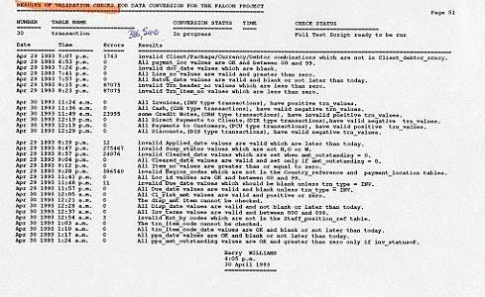
Establishing a Strategy for Enterprise Data Quality
Starting out at Barclays Bank (1993)
Notes:
Google Cap
This was my first formal experience in Data Quality.
I was very lucky because it was a great opportunity where I was presented with a Problem and asked to come up with a Solution.
The Solution I produced involved many features that are always important in DQ Projects.
These include Data Owners, User Involvement and sign-off, Incremental advances, a Library of Validation Rules in English and SQL , and so on.
This Report shows :-
Date and Time of Run
Error count
Test Description
For example, ‘orphans’ – Client Debts without a Client.

Slide 7
Establishing a Strategy for Enterprise Data Quality
From Experience to Infrastructure
Framework
Data Governance
Data Quality Architecture
Data Quality Metrics
Tools
Notes:
Both Google Cap and Panama Hat
1) Data Governance
Top-down, SOPs
Enterprise Standards
2) DQ Architecture
From basic to advanced and real-time
DQ Metrics and Criteria
Users/roles/results/
Fields/metrics/Reqd Stats
3) Profiling
A great way to understand the data
4) Data Owners
Must get buy-in
Provide time and commitment
Define/agree rule
5) Choose Tools
Can waste a lot of time in manual work, and by choosing the wrong tool.
My experience is to start small and migrate to a more powerful Tool with a clear objective
idea of where you want to get to – this also helps the business case
Data Profiling is a good start because you get familiar with the data and the kinds of errors.
We’ll come back to this later

Slide 8
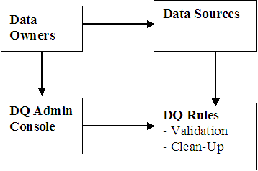
Establishing a Strategy for Enterprise Data Quality
Basic Data Quality Architecture
An Entry-Level System
Rules in SQL
Notes:
Both Google Cap and Ealing Hat
Entry-level
Based on my first exp 15 years ago at Barclays Bank
DIY – no tools – clear scope and limited budget
Rules in SQL
Start small, evolve, become familiar with data
Same approach as later at Cisco – clearly defined scope (and deliverables) with no real extension.
And at Ealing (change Hats) (and at Haringey beforehand) – as a starting-point and Proof-of-Concept

Slide 9
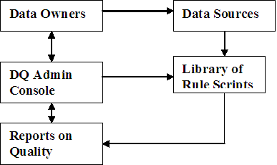
Establishing a Strategy for Enterprise Data Quality
Intermediate DQ Architecture
Add Library of Scripts
Produce Reports
Notes:
Google Cap
Centrica
British Gas and the AA
30 Systems holding Customer data
Required Enterprise Data Model
Create Library of Scripts to check Rules
The Library held Standards
– eg Customer Categories, Default Dates, Rules for checking against Corporate LOV’s
Build up Reports with User Sign-Off
Reports included Audit findings, sign-off by Users
Leading to agreed level of DQ

Slide 10
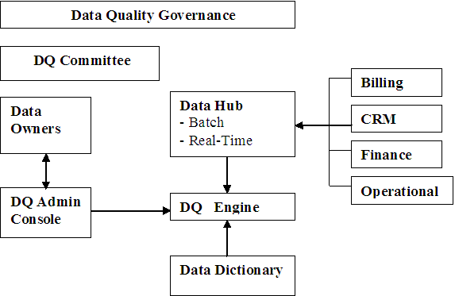
Establishing a Strategy for Enterprise Data Quality
Advanced DQ Architecture
Within Governance Framework
Notes:
Ealing Hat
At Ealing (and at Haringey)
Multiple Applications with Single View of Customers
Data Hub is linked to a Customer Master Index
The Data Quality Engine is a more powerful Tool, such as Data Flux
A Data Dictionary essential – published over Intranet for sign-off and reference
Rules for Validation and Transformation

Slide 11
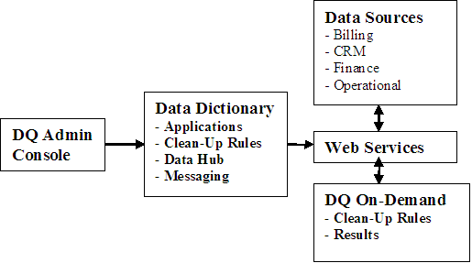
Establishing a Strategy for Enterprise Data Quality
Tomorrow’s DQ Architecture
Web Services-based
Notes:
Ealing Hat
We can see some elements of the future in the present and extrapolate
The DQ Professional wants to say “My Data is over there, Analyse it and give me the Results”
This a big jump from 1993 and reflects Web Services and even Web 2.0 approach.
We are using Web Services in our SMPL Performance Reporting Mobile Application at Ealing which transmits data to a Consolidated Database.
Data Quality in real-time … is our next topic …

Slide 12
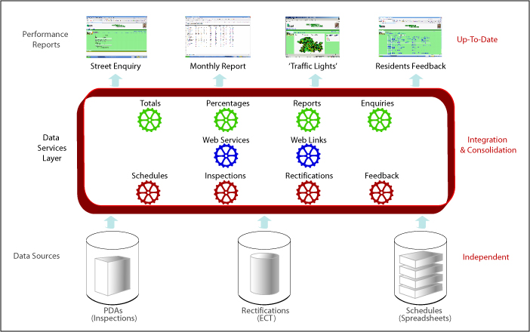
Establishing a Strategy for Enterprise Data Quality
DQ Real-Time System
Validate in Batch
Validate Data on Entry
Notes:
Ealing Hat
Validate in Batch
Every 3 months we load Schedules as batch data into the Database
We validate for reasonableness (eg volumes within predicted ranges) and specifics like dates
Also Validate Data on Entry
The data is checked in Real-Time when it’s added to the Database – eg that location is in Ealing because Inspectors sometimes park outside.
PDA with GPS locations outside Ealing
Perception by politicians is as important as reality, which needs to be taken into account

Slide 13
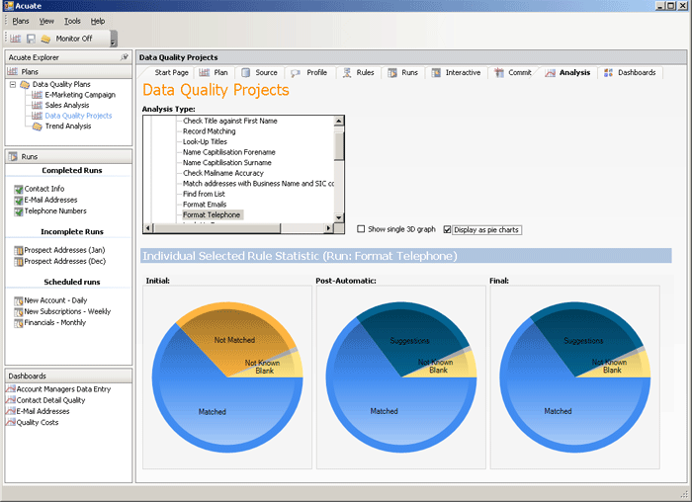
Establishing a Strategy for Enterprise Data Quality
A Data Quality Dashboard
Notes:
Ealing Hat
This dashboard is from a company called Acuate
It is a vision of the Future and shows what is just around the corner.
I use my Web Site to demo State-of-the-Art and this is one of the facilities.
The 3 circles show the effect of automatic matching for a DQ Test Run
2 = 3 (post-automatic=final)
This brings us to the topic of Metrics …

Slide 14
Establishing a Strategy for Enterprise Data Quality
Data Quality Metrics
What Makes a Good Metric ?
Clear and Agreed Definition
Easy to Measure
Relevant to the Business
Notes:
Ealing Hat
A Dashboard needs metrics
eg Customers – “How many Customers do we have ?”
Clear Definitions – eg “What exactly is a Customer ?”
At Centrica, a Customer could be anyone who showed an interest – eg call for details of special offers
“Need to count Customer Ids and match duplicates
However, a Report in the Government Computing Magazine in January , 2004, states :-
No Government anywhere in the world has successfully introduced and maintained an authenticated Unique Identifier for each Citizen.
Many claim success but cannot provide hard evidence.
In the UK, there are 81million NI numbers but only 60 million eligible citizens”.
Easy to Measure
Matching name and addresses
Need ability to store aliases
Relevant to the Business
Eg in Ealing, people drop-in, phone, email, respond to “Contact Us” on the Web Site
But how important is it to the business to match them ?
Fraud detection can make it important
SMPL Performance Reports are based on KPIs which need clean data, which we will see later.
Now let’s turn to Setting a Quality Control Initiative, which includes Choosing Tools …

Slide 15
Establishing a Strategy for Enterprise Data Quality
2. Setting a quality control initiative
Establish the Objectives
Define the Data Quality Architecture
Top-Down and/or Bottom-Up
Choose Tools or DIY …
Notes:
The time should be about 9.50 am
Ealing Hat
Objectives of the Initiative
Establish the mindset
Get started and establish sound foundation
Define some specific results - % overall data quality or Customer Matching and % duplicates
Quick Wins - Current problems – where does the shoe hurt ?
eg Chief Exec – “What is Ethnic Breakdown in Ealing ?”, “How many people work for Ealing Council ?”
This highlighted the need for standards, such as Classifications of Ethnic Origins, Work basis
– Full-Time, Part-Time, Contract, Agency Staff, Temporary, and so on.
DQ Architecture
Help define Requirements
Reqmts help evaluate Tools and Vendors
Let’s look at some Tools …

Slide 16
Establishing a Strategy for Enterprise Data Quality
Tool Vendors – DIY
Suitable where :-
Limited Scope
Simple DQ Rules
Templates are usable
Notes:
Google Cap
I have done it myself at some major organisations, including the AA, Barclays Bank, Cisco and Ealing.
For example, at Cisco, I was migrating Customer data from 15 European countries to one Corporate Oracle Database
Therefore Templates was clearly the correct approach.
In fact, one Template for a generic Customer, taking data from Access Databases, commercial Packages, Excel spreadsheets and so on.
I used Oracle’s PL/SQL to translate commas in Polish money to full stops in UK money.

Slide 17
Establishing a Strategy for Enterprise Data Quality
Tool Vendors – Niche Players
Ab-Initio (Data Profiling)
InfoShare (Customer Matching)
InSource (Data Warehousing)
Notes:
Google Cap
Ab-Initio
- in wide use for profiling, which is a very important function.
- eg at the AA – ranges of Membership Start and End Dates.
Change to Ealing Hat
InfoShare (London)
Very useful at Ealing for Customer Matching
“Single Citizen View” - http://www.infoshare.ltd.uk/solutions/single_citizen_view.html
Case Studies are available for Local Authorities
InSource (Reading)
Gets ticks in lots of boxes
Business Rules
De-Duping
Repository
Single Version of the Truth
*** Web Form Innovator ****
Plus Based in Reading

Slide 18
Establishing a Strategy for Enterprise Data Quality
Tool Vendors - Gartner
Gartner’s Leaders Quadrant
  DataFlux
  Data Foundations (‘Cool Vendor’)
  IBM
  Trillium
Notes:
Ealing Hat
At first, I thought ‘Great, let’s choose the Leaders’.
Then I realised Gartner speaks to the needs of its subscribers, who are
Blue Chips with appropriate budgets such as £250K for DQ Software.
Niche players have a lot to offer under the right circumstances.
There might be more of those than Blue-Chips Vendors !
Getting started is better with Niche players.
The Leaders are not Niche players and Niche players are not Leaders
However, Niche players do have a part to play – eg InfoShare
– cost and functionality tailored exactly to the need. – eg Customers and De-duping.
Early Adopters not catered for by Magic Quadrant
Gartner Leader’s Quadrant
DataFlux (a Leader) - we had discussions at Ealing for Proof-of-Concept work, but too expensive
Business Objects and Cognos volunteered.
Data Foundations (a ‘Cool Leader’)
Gets ticks in lots of boxes - Universal Data Hub, MDM Methodology, Ref Data Mgt.
Flexible Data Model and a Registry (ISO 11179 compatible with MetaData Registry)
Change to Google Hat
Trillium (a Leader)
– used at Centrica for Customer Name and Address matching

Slide 19
Establishing a Strategy for Enterprise Data Quality
Tool Vendors DQ-as-a-Service
Boomi
SalesForce and Business Objects
SalesForce and Informatica
Talend
Notes:
Ealing Hat
DQ-as-a-Svc
A very interesting option for the future
It means that vendors offer DQ Hosted Service
Available as a Subscription Service
You can sign-up and get some hands-on experience very easily and quickly and FREE (eg SalesForce.com)
People are even talking about Data-Governance-as-a-Svc
DQ plus associated SOPs
There is a Data Governance Institute - http://datagovernance.com/
Boomi
- The newest kid on the block
I had a guided tour an iMeeting / Global Conference
But if every sale requires personal attention than sales potential is limited
SalesForce and Business Objects
SalesForce and Informatica
an interesting combination
I worked with SalesForce at Cisco 4 years ago and they are dominant in the SaaS Space
I also came across another British company called Kognitio offering a
FREE Data Discovery exercise
You could get started with this free exercise for Data Profiling, and then sign up for a period of 6 or 12 months.
They are based in Bracknell and Marlow.
What we are seeing here is the ‘Open’ option where we can use Web Services to link ‘Engines’ together
This leads us to “Open Source” Tools (and Talend) …

Slide 20
Establishing a Strategy for Enterprise Data Quality
Tool Vendors – Open Source
Talend – Chinese
  Data-Integration-on-Demand
SQL Power - Canadian
  geared to Data Warehousing
Notes:
Ealing Hat
Open Source is Cheap to buy and install
This option is for people who are prepared to take on more of the Support burden.
Professional Support is available on a commercial basis but it stops short of the ‘hand-holding’ provided by the Enterprise products.
Talend – have a Chinese Office
(and two in California)
- They say “first provider of open source data integration software “
- “150,000 downloads and winning awards”
- USP is Open Source, they say it’s DQ-on-Demand but 180Mb download for DQ-a-a-Svc
- Looks interesting but 180Mb for download doesn’t seem like DQ-a-a-S
- Uses Ingres as a Database, whereas most Open Source use MySQL
SQL Power - Canadian
offers a download option so that you can started without incurring any costs.
Gets ticks in DW boxes
But poor support to get started instal to Nokia !!!
Typical of Open Source – for people ready to spend more time to save money
They offer Dashboard, Data Modelling and Data Profiling – let’s look at that -
Good Blog http://blogs.zdnet.com/BTL/?p=4880

Slide 21
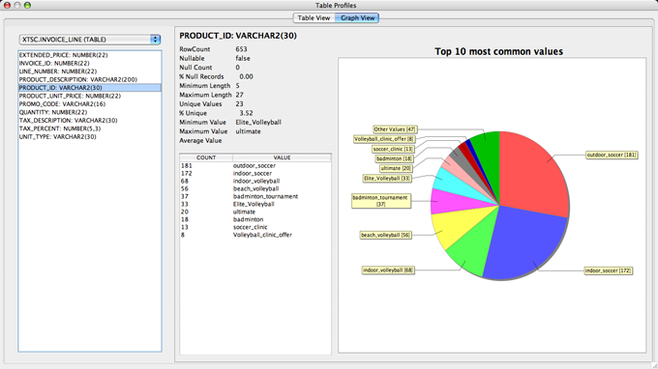
Establishing a Strategy for Enterprise Data Quality
Tool Vendors – SQL Power Data Profiling
Notes:
Ealing Hat
An excellent example of a Data Profiling analysis
Which shows the power of the technique
Helps with Data Validation and Data Cleaning
The Pie-Chart on the right shows the relative frequencies of Product Categories
Red upper right ‘Outdoor Soccer’ [181]
Blue lower right ‘Indoor Soccer’ [172]
In passing, a varchar(30) is not a good Product ID, therefore we should consider having an
Enterprise Data Model to provide a foundation
But this analysis shows very valuable profiling results

Slide 22
Establishing a Strategy for Enterprise Data Quality
3. Developing plans to enrich the quality
Data Quality is an Enterprise Issue
Top-level Support
Data Governance
Master Data Management
Customer Data Integration
Notes:
The time should be about 10.00 am
Ealing Hat
Top-level
Board of Directors + Champion
Governance
SOPs that must be agreed at top-level then rippled down
Master Data Management (MDM)
A common reqmt for Products, Suppliers,Ref Data “A Single View of Things of Interest”
CDI
Leads to MDM
Visible results – everybody understands and describing some duplicates brings the lessons home, such as 17 Bevans.
Need to engage with the Business and a Data Platform is very important …

Slide 23
Establishing a Strategy for Enterprise Data Quality
The Plans
Determine Your Data Platform
Establish the Roadmap
Agree Business View of Data
QA is a stethoscope
Notes:
Ealing Hat
Platform
Priorities - For example, Reference Data, Products, Customers, and so on.
EDM, publish, migrate
See next slide …
Roadmap
Vital, need to know where you are going – ie your desired end-state or ‘To-Be’ situation
How do we get there from here ? What is our ‘As-Is’ – present % Good Data ?
Accountability
Who does what – Roles and Responsibilities
Stethoscope
Monitor key points
An organisation is like an organism
We need to have a view in order to decide where to use the Stethoscope
A Business View requires of the Data leads us to the need for a Data Platform,
So let’s look at that …

Slide 24
Establishing a Strategy for Enterprise Data Quality
The Data Platform
Each Stage builds on the previous one
5) BI Data Mart
4) Customer
Services
3) Customer
Master Index
2) Services
- Directorate
- Service Name
1) Properties
- Gazetteer
Notes:
Ealing Hat
Reference Data underpins the Foundation
Properties (Gazetteer)
Services (LGSL)
Customer (CMI)
Customer Services
BI Data Mart
This supports analysis –
who takes many services ?
Which services are most popular ?
Any expensive services not really used
eg ambulances available 24x7 but rarely used
The Objective of the Data Platform is to establish a foundation for clean quality data
Feeding into the Platform is data from various Sources
Coming out is unified Data of a Clean Quality.
Because you can’t integrate it if it’s not Clean

Slide 25
Establishing a Strategy for Enterprise Data Quality
Single View of the Customer
Requires Quality to Consolidate Data
Needs Customer Data Integration Software
eg InfoShare, DataFlux (MDM/CDI)
Customer
- Date
- Standard Debt Type
- Amount
Business
Rates
Council Tax
Housing
Benefits Overpayments
Parking
Fines
Rent
Arrears
Notes:
Ealing Hat
Consolidate data
Eg Joe Bloggs, Joey Bloggs, Joseph Bloggs. Mr J Bloggs and so on.
Ealing Film Studios – Alec Guinness who was born Alec Guinness de Cuffe in Marylebone, London, April 1914.
His mother was Agnes Cuffe but there is no father's name on his birth certificate.
His last name was changed twice before he reached the age of fourteen.
For Public Consumption he was called Alec Guinness
Between 1938 and 1941 he played 34 roles in 23 plays – therefore had 34 different names
In 1941 he enlisted in the Royal Navy (as Alec Guinness ?) a landing-craft operator
In 1951, he starred in “The Man in the White Suit” made at Ealing Studios (but no white hat)
On Official documents he would be Alec Guinness Cuffe or Alec Guinness de Cuffe
In Ealing, we have many Polish and Somali residents.
Different nationalities makes it different to match names of individuals.
There are many Arabic and Indian names – where the son can have the same name as the father.
and associated date of birth with name is necessary for uniqueness.
Sometimes, mothers move house but don’t want to be traced so give a different name, or register children with different names
We found 17 versions of John Bevan – when you show it to users it makes a big impact.
Need Global ID and CMI – Customer Master Index
CDI software
Limit to how far you can go with DIY Tools
In the diagram, Customers are referred to as Business Owners, Council Tax Residents, HB Claimants, Vehicle Owners and Tenants.
Different IDs
Therefore, we need the ability to have aliases ‘also known as’
In other words, the software we use has to allow us to define our matching Rules.
This is a category of DQ Tools called De-Duping and I have a page on my Web Site listing some products.

Slide 26
Establishing a Strategy for Enterprise Data Quality
Framework for Performance Management
Participants
Directors, Managers, Business Partners,etc.
Performance Reporting
Traffic Lights
Key Performance Indicators
BVPIs
Drill-Down
Reports, etc.
Data Quality Standardisation Layer
Enterprise Data Model
Single View of the Customer
LGSL, Master Data Management, etc.
Notes:
Ealing Hat
Participants
Have input to standards process
eg Debtors Data Mart – “What is a Debtor ?”
eg Spurs pay about £1 million in Haringey
In Ealing we issue Parking Tickets and these represent Debts at some point which has to be defined
Performance Reporting –
Merge to common Reporting Platform
DQ Std Layer
Supports mapping from many (dirty) sources to one (clean) target
Enterprise Data Model is very important …

Slide 27
Establishing a Strategy for Enterprise Data Quality
Enterprise Data Model
Comprehensive, Generic and Unique
A Standard way to integrate Customer Data
Over 200 Entities in 14 Functional Areas
Defines Data Standardisation Layer in SOA
Notes:
Ealing Hat
This background shows the impetus to have an EDM created
It cost about £500,000 for Atos Origin
Motivation was the requirement for a consistent approach to Clean Data which was the end-result

Slide 28
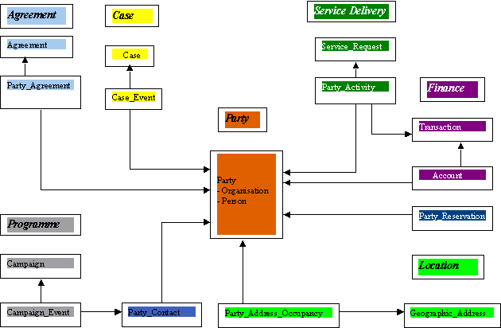
Establishing a Strategy for Enterprise Data Quality
Enterprise Data Model
Notes:
Ealing Hat
- On Ealing Web Site – Search for “Enterprise Data Model”
- Contact me if interested on email address given on the Web Site or at the end of this Presentation

Slide 29
Establishing a Strategy for Enterprise Data Quality
EDM Diagram Extract
Customer Area
Property Area
Service Delivery Area
Customer
- Organisation
- Person
Geographic_Address
(Std = Gazetteer LLPG)
Service Catalogue
(Std=LGSL/IPSV)
Customer_Address_Occupancy
Service_Request
Notes:
Ealing Hat
This diagram shows clearly the importance of Good Data because you can only consolidate data which matches.
“Apples and Oranges”
For example, standards for Customer Addresses requires clean data that can be matched.
This gives you an idea of how the Model is constructed and the implications for DQ.
Clean and consistent- Addresses, Customers, Services etc.
Data which is “Fit for Purpose” for the “Things of Interest”
ie “A Single View of the Things of Interest”

Slide 30
Establishing a Strategy for Enterprise Data Quality
Data Standardisation Layer
CRM
- Customer Profiles
- Good/Bad Customers
Self-Service Portal
- Enquiries
BI Data Marts
- Social Services
- Street Environment
- BVPIs, KPIs
DATA QUALITY LAYER
- Mapping from Vendor-specific to Ealing Standards,(LGSL, e-GIF, Ethnic Origins, etc.)
- Customer Master Index, Enterprise Data Model
Services
- ERDMS File Plan
- LGSL / IPSV (Govt Standard)
Customers
- Matches
Customer Histories
- Links to LOBs
Reference Data
- Ethnic Origins
- Vehicle Makes and Models
Data Quality Audit
- Data Profiling
- Gazetteer Validation
Lines of Business (LOBs)
Notes:
Ealing Hat
The Data Quality Layer clarifies the role of the Enterprise Data Model
Below the DQ Layer there are many Data Sources
Above it there is only one (view of the Things of Interest)
The DQ Layer includes Mapping and application of Business Rules
Let’s turn now to look at Getting Started on the Road to Success …

Slide 31
Establishing a Strategy for Enterprise Data Quality
Determine the Standards
Easy where defined
LGSL /IPSV, BVPIs
Aim for Buy-In
Create Glossary for Mapping
Look for obvious Data Leaders
    eg Social Services for Ethnic Origins
Notes:
Ealing Hat
- Local Government is lucky
Publish initial Standard values and
Set-up Data Governance starting with accepted Procedures for approving changes to Standards.

Slide 32
Establishing a Strategy for Enterprise Data Quality
4. Steps in Getting Started
Identify Business Drivers
Decide Roles and Responsibilities
Agree Overall Timetables
Consider Data Quality Audit
Notes:
The time should be about 10.10 pm
Ealing Hat
These Steps will estabish a Strategy for Enterprise DQ
A substantial undertaking
“Data Quality is an Enterprise Issue”
It requires commitment over the long haul
Success requires Results at regular intervals
Starting with “Quick Wins” is a good idea and should look at easy-to-address problems everybody agrees about
A recent Report from the Audit Commission on DQ in Liverpool City Council emphasises the importance of DQ in Performance Indicators
Liverpool has a Performance Management Database (PMD) and
The Audit Commission recommends training and in DQ “identification of staff with DQ Responsibility which should be specified in Job Descriptions”.
URL - http://www.liverpool.gov.uk/Images/tcm21-116883.pdf
I am currently doing this with our new SMPL Street Management Performance Reporting System

Slide 33
Establishing a Strategy for Enterprise Data Quality
Identify Business Drivers
Over 200 Legacy Systems
300,000+ customers
  Ethnic Origin Breakdown ?
  Customers receiving multiple Services ?
Need Single View of the Customer
Standards are essential for BI
Notes:
Ealing Hat
These are some of the Factors at Ealing which drive a need for good quality data and standardised Reporting
They also drove the development of the EDM
Customers are a good starting-point
They are recorded in many different Systems

Slide 34
Establishing a Strategy for Enterprise Data Quality
Roles and Responsibilities
Senior Management
Line-of-Business Managers
Data Stewards
DQ Professionals
Notes:
Ealing Hat
Senior Management
Look for a Business Champion
Publicly support the DQ Initiative
Provide Funding
Resolve Issues
Remove Roadblocks
Line-of-Business Managers
Champion the Cause
Articulate the DQ Benefits
Ensure staff buy-in
Data Stewards
Drive specific Requirements
Provide Feedback
Participate in UAT Activities
DQ Professionals
Maintain Data Dictionary
Plan and administer DQ Tasks
Implement Business Rules for Cleansing, De-dup’ing
Support Data Stewards
Run day-to-day DQ operations

Slide 35
Establishing a Strategy for Enterprise Data Quality
Identify Business Champions
With Vision
Evangelists
High-Profile Service
Successful Track-Record
Notes:
Ealing Hat
- I have been working with a Director at Ealing for the past 18 months who has all these characteristics
We were able to make excellent progress and arrive at a point where we could say “Look at what we have achieved”
Without getting bogged down in time-consuming meetings, discussions of approaches and even cost-justifications.
Now we are building on the foundation to extend the Application to other areas
All data has the same characteristics – location, date and time, staff id, observations and follow-up – eg Parking and Abandoned Vehicles
Therefore the approach of a Library of Data Quality Validation routines is perfect.
The Director had a Vision which included this foundation and I shared the Vision and was able to implement it.

Slide 36
Establishing a Strategy for Enterprise Data Quality
Agree an Overall Timetable
One Year Targets
Three months Targets
Quick Wins
Road Map
Notes:
Ealing Hat
Agree an Overall Timetable
One Year to achieve consistent DQ across the board
With SMPL we are achieving this – adding Parking KPIs after one year
Three months to obtain buy-in at the working level
Quick Wins – what has the Chief Exec asked for and not (easily) been given ?
Need a Road-Map to decide “How do we get there (“To-Be”) from Here (“As-Is”)

Slide 37
Establishing a Strategy for Enterprise Data Quality
Decide the Approach
Top-Down and/or Bottom-Up
POC or ‘Feasibility Study’
Management Involvement
Success Criteria
Notes:
Ealing
Launch with slogan “Data Quality is an Enterprise Issue”
Almost any Data Quality work has Enterprise implications – eg Gender standards, and Flag_YN with Y/N instead of 0 or 1.
Proof-of-Concept Benefits are it’s Hands-On with Deliverables and leaves a Foundation
But it addresses a limited and clearly-defined Scope
A Feasibility Study, on the other hand, has a broader scope but is theoretical and doesn’t address some very serious issues of involvement and commitment.

Slide 38
Establishing a Strategy for Enterprise Data Quality
Consider a Data Quality Audit
Sell the Importance
Can use SQL
Data Profiles suggest Standards
Obtain Buy-In from Data Owners
Slice down the Organisation
Notes:
Ealing Hat
Consider Starting with a DQ Audit
Sell as the first Step in an important Enterprise-level Commitment
Limited Scope – eg can use SQL
Include Profiling to suggest Standards
Identify Benefits (Deliverables) – eg Ethnic Origin breakdown or HR Headcount
Determine Dependency on people in key positions
Obtain buy-in from people affected
Data Owners can get defensive
It’s like a slice down the organisation
Think of Data Quality as using a Stethoscope –
Understand the organism, the ranges of the data and thresholds for quality
Can get started FREE by asking vendors for trials or advice
Eg Send sample files to DQ Now for free Audit

Slide 39
Establishing a Strategy for Enterprise Data Quality
Contact Details
Barry Williams
  info@barryw.org
Database Answers Web Site
  www.databaseanswers.org/data_cleansing.htm
Community of DB Professionals
  Databaseanswers.ning.com
Notes:
Google Cap and Ealing Hat
Thank you for your time
I hope you found my Presentation thought-provoking
Feel free to email me
Comment on my Data Cleansing page
Join my Community (like a Facebook for Data Management Professionals) – to build up Best Practice in key areas
What would you like ?
1) A Tutorial based on today’s Presentation with Templates that you could use
2) Vendor hands-on demos
3) an Online Checklist and self-assessment facility to help “As-Is”
4) Strategy for Global Enterprise Data Management ?
Good luck with your Data Quality Projects and keep in touch

