Slide 1




Data Standardisation in the Public Sector
BI in the Public Sector - Ark Conference
Barry Williams
Principal Consultant
Database Answers
10th May 2006

Slide 2
Data Standardisation in the Public Sector
Overview
Business Drivers
Getting Started
Framework for BI and Performance Mgt
Enterprise Data Model
Data Standardisation Layer

Slide 3
Data Standardisation in the Public Sector
Business Drivers
Typical Organisation has over 200 Legacy Systems
300,000+ customers
  Ethnic Origin Breakdown ?
  Customers receiving multiple Services ?
Need Single View of the Customer
Standards are ESSENTIAL for BI

Slide 4
Data Standardisation in the Public Sector
Getting Started
Identify Business Champions
Decide the Approach
Determine the Standards
Data Quality Audit

Slide 5
Data Standardisation in the Public Sector
Getting Started (a)
Identify Business Champions
  With Vision
  High-Profile Service
  Successful Track-Record

Slide 6
Data Standardisation in the Public Sector
Getting Started (b)
Decide the Approach
  Top-Down and/or Bottom-Up
  POC or ‘Feasibility Study’
  Management Involvement
  Success Criteria

Slide 7
Data Standardisation in the Public Sector
Getting Started (c)
Determine the Standards
  Easy where defined
    LGSL /IPSV, BVPIs
  Look for obvious Data Leaders
    eg Social Services for Ethnic Origins
  Create Glossary for Mapping
  Aim for Buy-In

Slide 8
Data Standardisation in the Public Sector
Getting Started (d)
Data Quality Audit
  Sell the Importance
  Prepare a Business Case
  Carry out Enterprise-wide
  Data Profiles suggest Standards
  Obtain Buy-In from ‘Data Stewards’

Slide 9
Data Standardisation in the Public Sector
Framework for Performance Management
Participants
Directors, Managers, Business Partners,etc.
Policies and Procedures
Best Practice
Contract Terms and Conditions
Job Specifications
Rules and Regulations
Etc.
Performance Reporting
Traffic Lights
Key Performance Indicators
BVPIs (Cognos Metrics)
Drill-Down
Reports, etc.
Data Standardisation Layer
Enterprise Data Model
Single View of the Customer
LGSL (Cognos Decision Stream), etc.

Slide 10
Data Standardisation in the Public Sector
Single View of the Customer
Requires Standards to Consolidate Data
Needs Customer Data Integration Software
  eg DataFlux - www.dataflux.com/Implementations/CDI.asp
Customer
- Date
- Standard Debt Type
- Amount
Business
Rates
Council Tax
Housing
Benefits Overpayments
Parking
Fines
Rent
Arrears

Slide 11
Data Standardisation in the Public Sector
Building the Data Foundation
Each Stage builds on the previous one
5) BI Data Mart
4) Customer
Services
3) Customer
Master Index
2) Services
- Directorate
- Service Name
1) Properties
- Gazetteer

Slide 12
Data Standardisation in the Public Sector
Enterprise Data Model (EDM)
Comprehensive, Generic and Unique
A Standard way to integrate Customer Data
Property with Gazetteer, Services with LGSL
Over 200 Entities in 14 Functional Areas
Defines Data Standardisation Layer in SOA
Provides Foundation for Data Marts

Slide 13
Data Standardisation in the Public Sector
EDM Diagram Extract
Customer Area
Property Area
Service Delivery Area
Customer
- Organisation
- Person
Geographic_Address
(Std = Gazetteer LLPG)
Service Catalogue
(Std=LGSL/IPSV)
Customer_Address_Occupancy
Service_Request

Slide 14
Data Standardisation in the Public Sector
Data Standardisation Layer
CRM
- Customer Profiles
- Good/Bad Customers
Self-Service Portal
- Enquiries
(SOA Tibco Portal Builder)
BI Data Marts
- Social Services
- Street Environment
- BVPIs, IEG Returns
DATA STANDARDISATION LAYER
- Mapping from Vendor-specific to Ealing Standards,(LGSL, e-GIF, Ethnic Origins, etc.)
- Customer Master Index, Enterprise Data Model
(SOA Tibco Smart Mapper and Master Data Management)
Services
- ERDMS File Plan
- LGSL / IPSV (Govt Standard)
Customers
- Matches
Customer Histories
- Links to LOBs
Reference Data
- Ethnic Origins
- Vehicle Makes and Models
Data Quality Audit
- Data Profiling
- Gazetteer Validation
Lines of Business (LOBs)

Slide 15
Data Standardisation in the Public Sector
Mapping from Vendor to BI Data
Example from Street Environment Services
 |  |  | BI Data Mart
Vendor Code | LGSL Code | Service | BVPI
STC | 580 | Litter | BV199a
GRA | 584 | Graffiti | BV199b
FP | 588 | Fly-Posting | BV199c
FLY | 587 | Fly-Tipping | BV199d

Slide 16
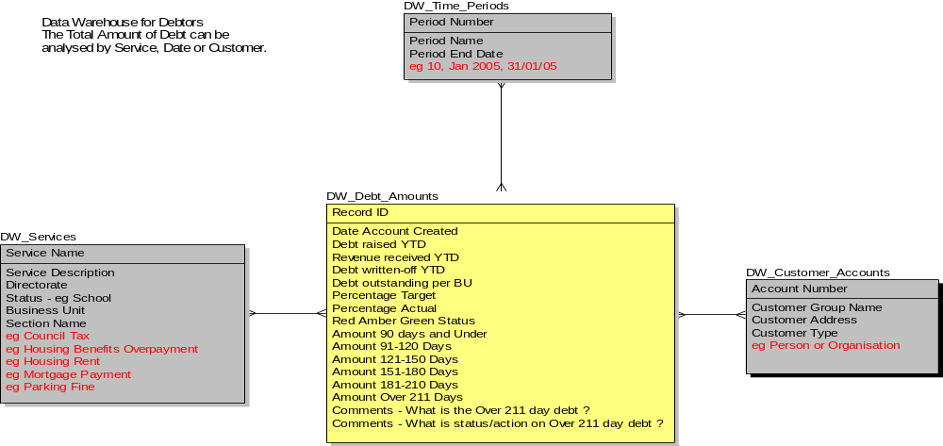
Data Standardisation in the Public Sector
Debtors Warehouse Star Schema

Slide 17
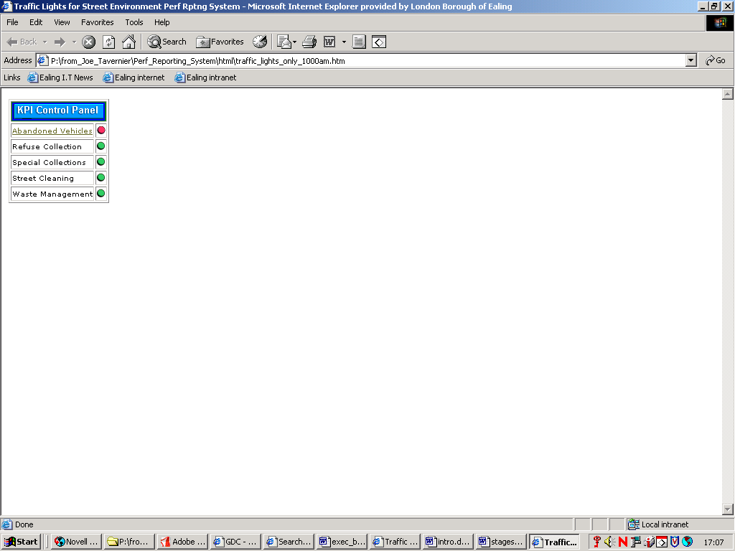
Data Standardisation in the Public Sector
Top-Level KPI Control Panel (1)
Clickable Control Panel showing Traffic Lights

Slide 18
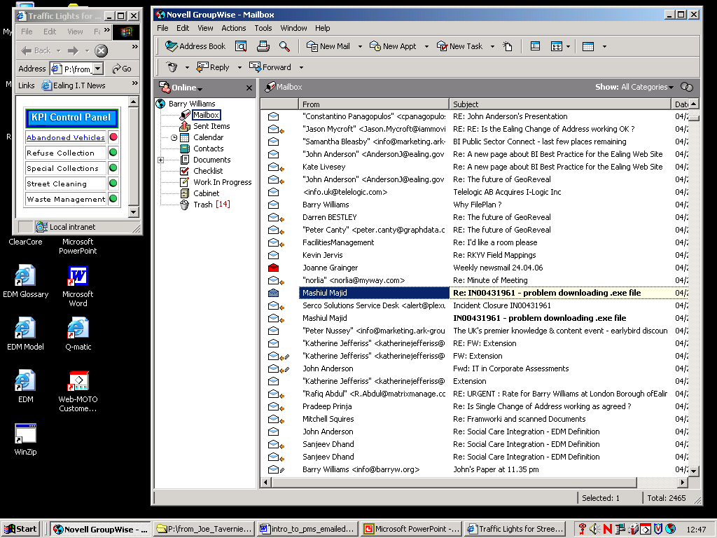
Data Standardisation in the Public Sector
Top-Level KPI Control Panel (2)
Clickable Control Panel is in left-hand corner

Slide 19
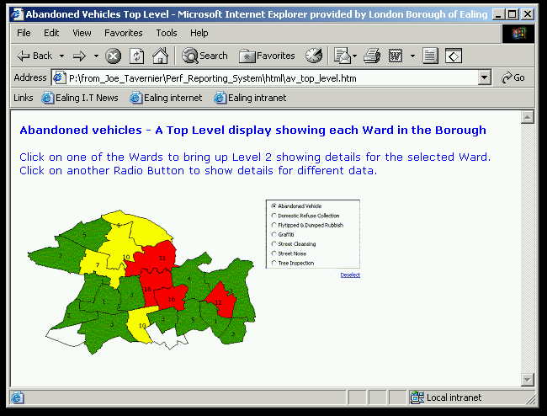
Data Standardisation in the Public Sector
Area-Level Display
LB Ealing Licence no. LA100019807 2006

Slide 20
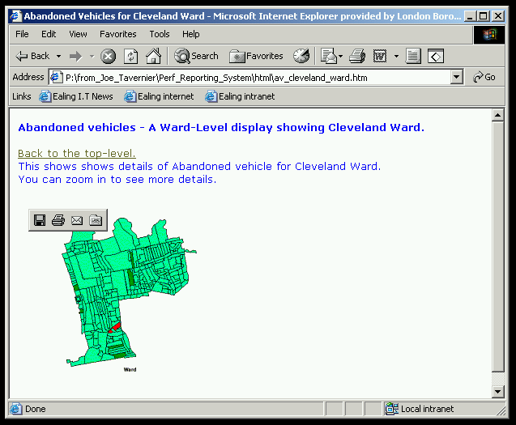
Data Standardisation in the Public Sector
Local Area-Level Display
LB Ealing Licence no. LA100019807 2006

Slide 21
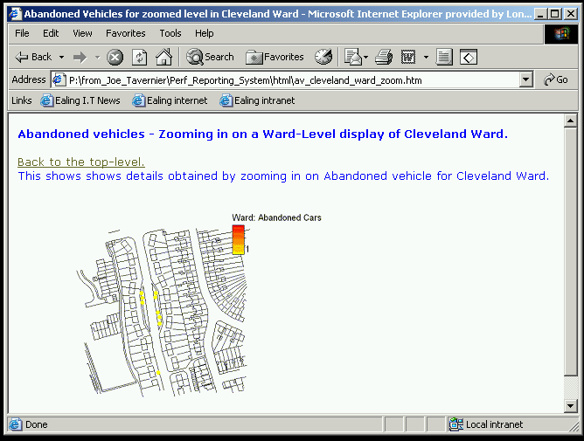
Data Standardisation in the Public Sector
Street-Level Display
LB Ealing Licence no. LA100019807 2006

Slide 22
Data Standardisation in the Public Sector
Next Steps
Add to Customer Master Index & CRM
Define Templates for Proof of Concepts
Create KM Communities of Practice
Formalise Standardisation of Best Practice

