Slide 1
EEEE 381-03 Electronics 1
Fall Semester 2161
Dr. Ivan Puchades

Slide 2
Course Instructor
Dr. Ivan Puchades
Department of Electrical Engineering
Office: 9-3173
Telephone: (585) 475-7294
E-mail: ixpeme@rit.edu
Office Hours:
M,W,F 11AM-12PM
M,W,F other times (set appointment by email)

Slide 3
Course Schedule
Course Schedule:
Section 03 MWF 3:00-3:50 pm GLE-2580
Lab: Varies
https://people.rit.edu/lffeee/eeee381Lab.html
You must pass both the lab and the lecture portion of the class independent of the other, in order to pass the course. Laboratory attendance is mandatory. Turning in Laboratory Reports is mandatory. No exceptions.

Slide 4
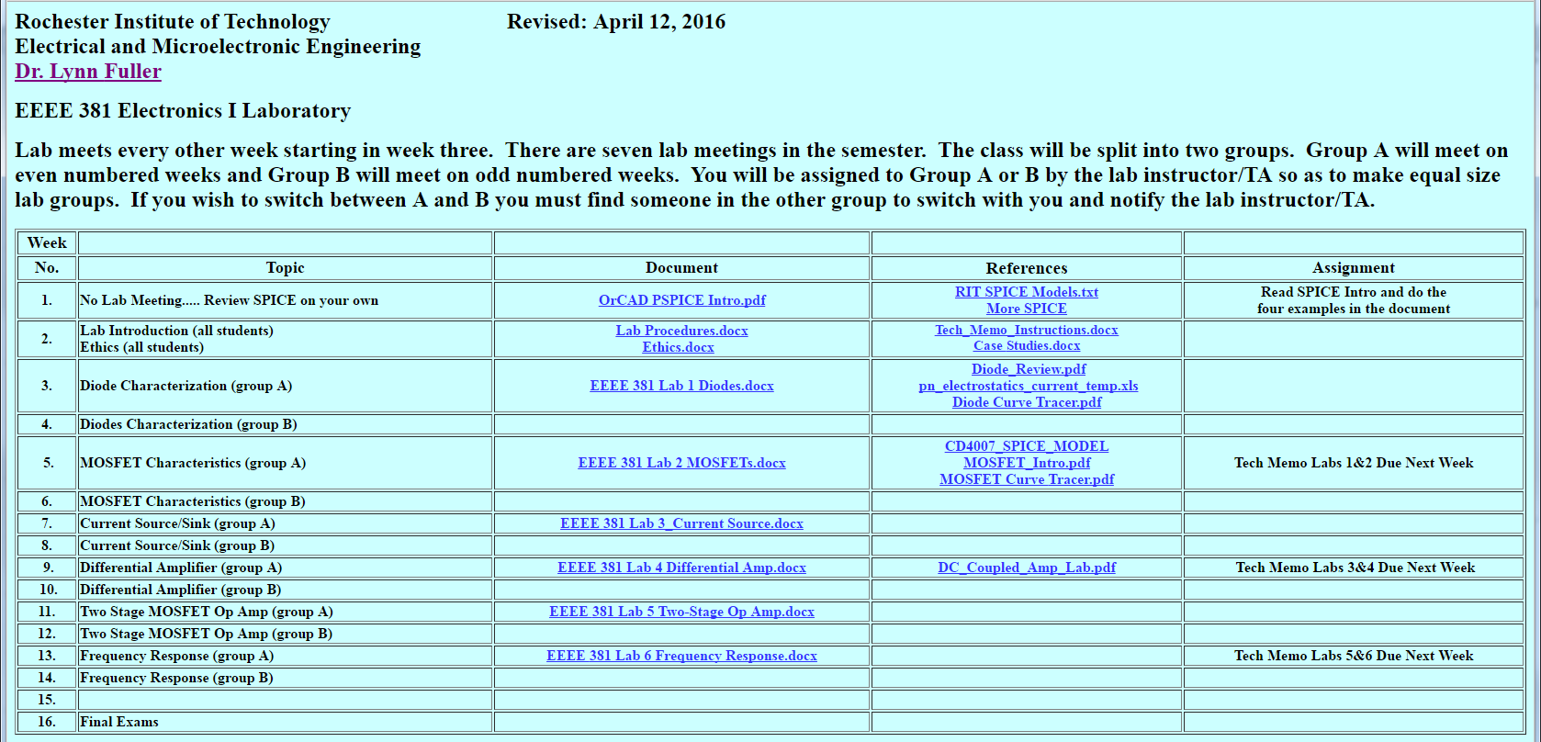
Electronics 1 Lab

Slide 5
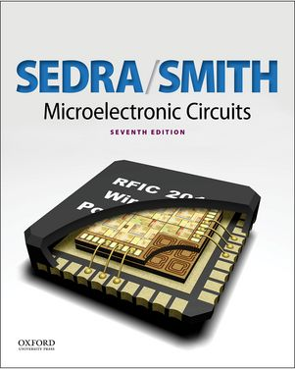
Course Textbook
Required Textbooks: Microelectronic Circuits, Seventh Edition, Sedran/Smith, Oxford University Press, 2015

Slide 6
Grading
Grading
Homework, Quizzes …………… 15%
Laboratory..................................... 20%
3 tests …………………3* 15% = 45%
Final …………………………….. 20%
Professor’s Discretion…………… ?
Tentative Test Dates:
1. Week 5 – 50 minutes
2. Week 9 – 50 minutes
3. Week 13 – 50 minutes
Final – 2 hours

Slide 7
Homework, quizzes and attendance
Announced throughout the quarter.
Doing the homework can improve the final grade.
Attending class can greatly improve final grade.

Slide 8
Grading Policy
Grading Policy
Neatness, organization and format count! Sloppy or haphazard work will not be accepted.
There will NOT be make-up exams, quizzes or homeworks.
Homework will NOT be accepted for grading after the posted due dates.
Individual and original efforts are expected for all work. Efforts of multiple students will result in equally divided scores for the submitted work.
If you find that you have missed an exam you have 24 hours to contact the professor to explain the reason - otherwise it will be recorded as a 0. There is no extra credit.

Slide 9
EE381 HOMEWORK FORMAT GUIDELINES
GENERAL: NEATNESS AND ORGANIZATION WILL BE GRADED. THE SAME GUIDELINES SHOULD BE FOLLOWED FOR EXAMS.
- ALL HOMEWORK IS TO BE HANDED ON ENGINEERING GRAPH PAPER OR PLAIN WHITE PAPER (8.5 inch x 11 inch).
- NUMBER EACH PROBLEM INCLUDING CHAPTER IT COMES FROM
- HIGHLIGHT EACH FINAL ANSWER WITH A BOX AND INCLUDE APPROPRIATE UNITS.
- INCLUDE YOUR NAME ON EVERY PAGE
- ALL PROBLEMS SHOULD BE TURNED IN, IN ORDER!
- IF WORK IS NOT LEGIBLE, IT WILL NOT BE GRADED
- CROSS OUTS ARE NOT ACCEPTABLE. USE A PENCIL AND ERASER OR PEN AND WHITE-OUT. (Green-out?)

Slide 10
EE381 HOMEWORK FORMAT GUIDELINES
- PRESENT SOLUTION IN A FORMAT THAT PROCEEDS FROM LEFT TO RIGHT, TOP TO BOTTOM. IF ORGANIZATION OF SOLUTION IS NOT CLEAR, PROBLEM WILL NOT BE GRADED.
- PROVIDE A CONCISE DESCRIPTION OF YOUR METHOD OF SOLUTION. IF NONE IS PROVIDED, NO PARTIAL CREDIT WILL BE AFFORDED.
- PROVIDE AN APPROPRIATELY LABELED CIRCUIT DIAGRAM. IF CIRCUIT IS MODIFIED, INCLUDE MODIFIED DIAGRAM(S).
- MAKE SURE ALL PAGES ARE ATTACHED TO EACH OTHER SECURELY. STAPLES ARE A CLASSIC WAY TO DO THIS.
-REMEMBER- HOMEWORK ASSIGNMENTS ARE NOT JUST ABOUT LEARNING TO DO THE PROBLEM. IT IS ABOUT LEARNING TO PRESENT YOUR WORK SO OTHERS CAN UNDERSTAND WHAT YOU DO - A VALUABLE SKILL IN THE WORKPLACE.
Things to remember
1) Re-Draw the Circuit on your homework sheet.
2) Show all work.
3) Final answer should be in decimal form.
4) Final answers should be boxed.
5) Your name should be on every page.
Answers to the odd problems are in the back of the book. Sometimes the book is wrong.

Slide 11
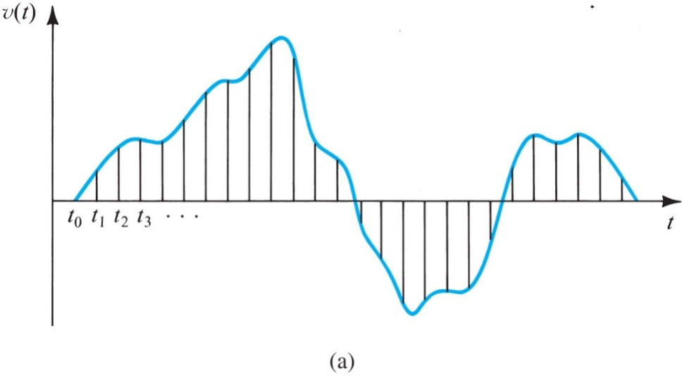
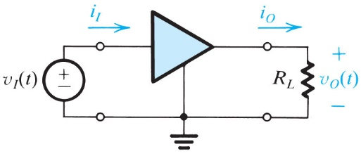
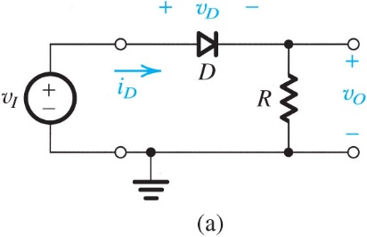
Course Topics
Digital vs. analog signals; signal conditioning, notation; amp concepts
Ideal diode, junction diode I-V characteristics, temperature coefficient
Diode Terminal Characteristics
Diode circuit analysis methods
Diode models, equivalent circuits
Zener diodes; voltage regulation
Rectifying diode circuits

Slide 12
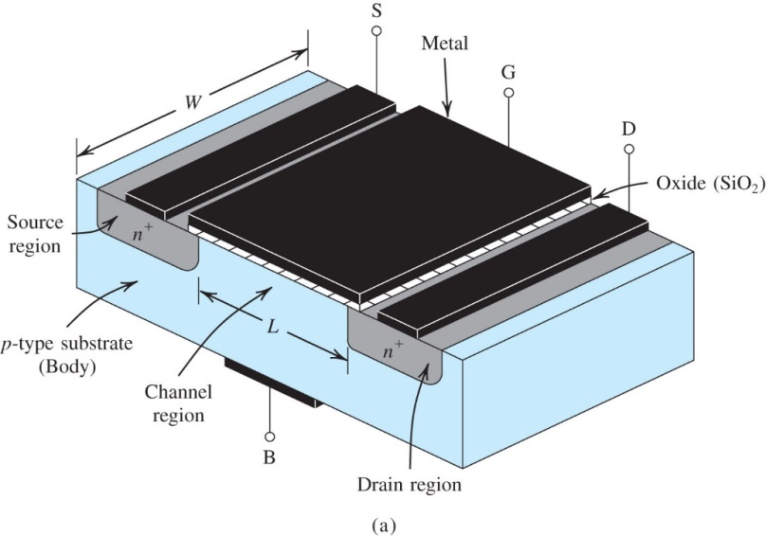
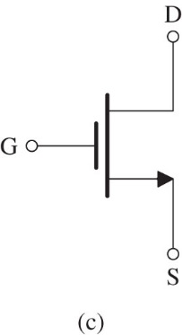
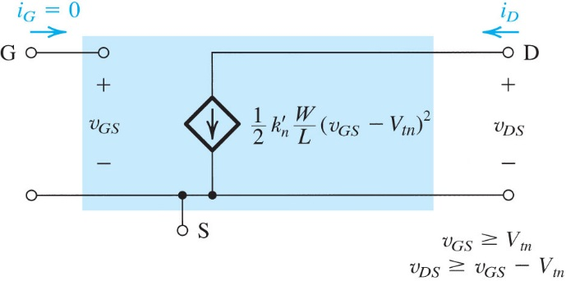
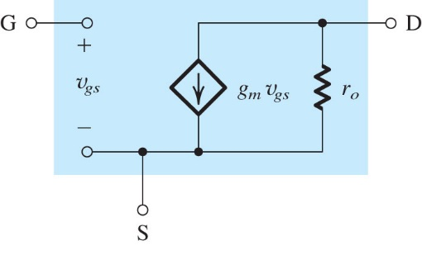
Course Topics (cont’d)
Metal-Oxide-Semiconductor Field-Effect Transistor (MOSFET) ,I-V characteristics
DC analysis of MOSFET circuits; use of MOSFET as an amplifier
DC biasing of MOSFET circuits
Small-signal MOSFET models, small-signal analysis
Simplified NMOS circuit symbol to be used when the source is connected to the body or when the effect of the body on device operation is unimportant.
Large-signal, equivalent-circuit model of an n-channel MOSFET operating in the saturation region.
Small-signal, equivalent-circuit model of an n-channel MOSFET.

Slide 13
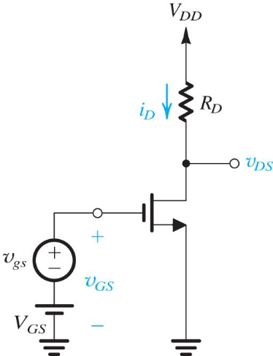
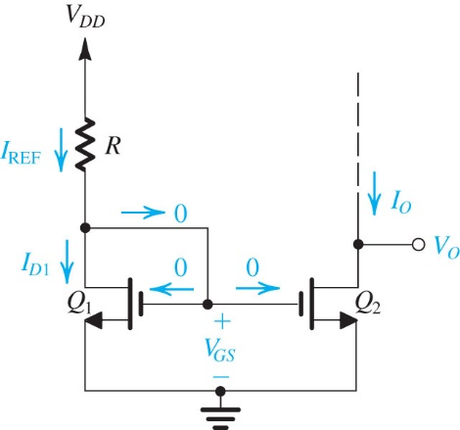
Course Topics (cont’d)
Single transistor amplifier configurations: common source
Common source with source resistance
Common gate
Common drain (source follower)
Active loads; cascode configuration
DC biasing of MOSFET IC designs (current sources, current mirrors)
DC biasing of MOSFET IC designs (advanced sources and mirrors)

Slide 14
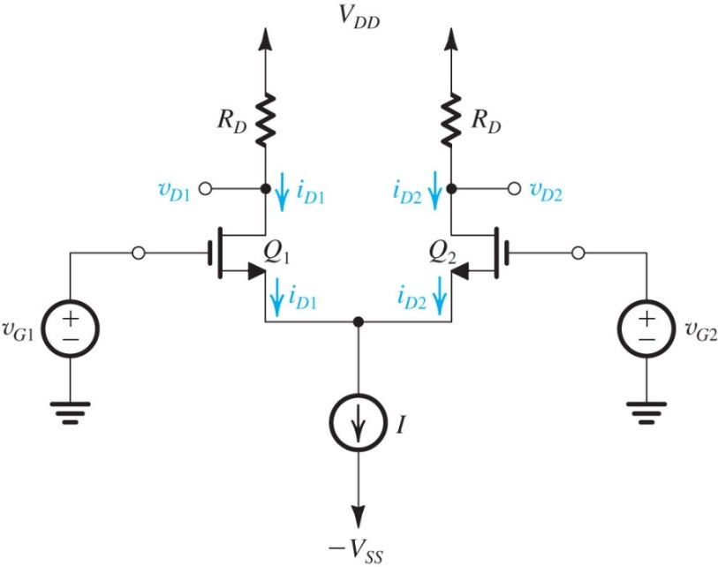
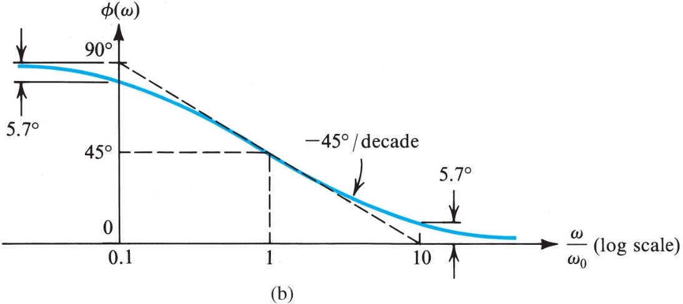
Course Topics (cont’d)
Differential amplifier basics
Differential amplifier mismatch and offset
Differential amplifiers with active loads
Multistage amplifiers and Two Stage CMOS Op Amp Preview
Frequency Response: Transfer Functions, Bode plots

Slide 15
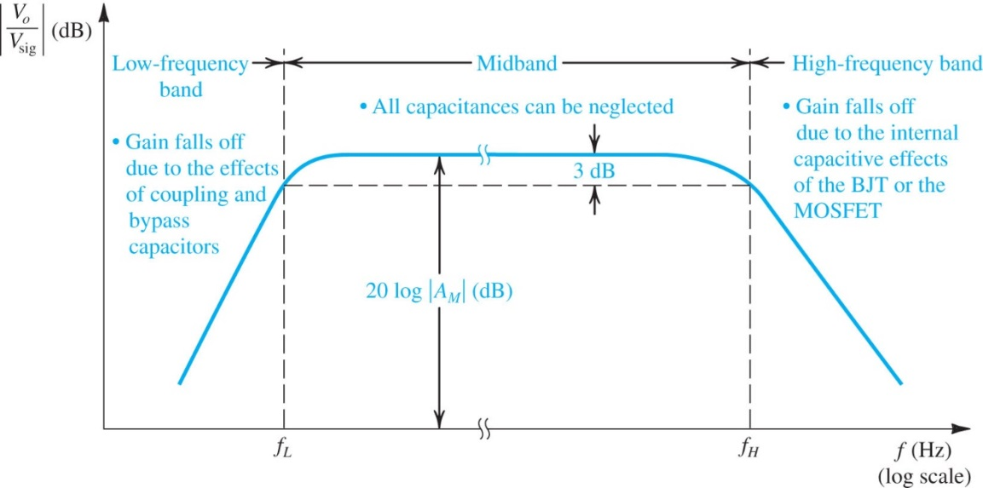
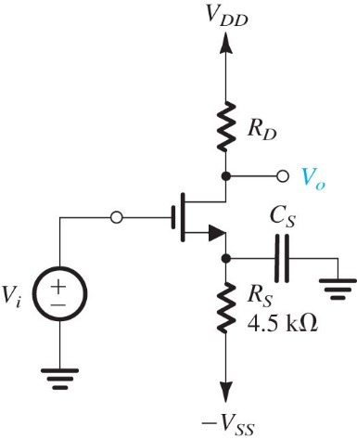
Course Topics (cont’d)
Time constant methods -- low-frequency response
Low-frequency response analysis cont'd
High-frequency MOSFET model
Time-constant methods -- high-frequency response; Miller effect
CS high-frequency response
CG high-frequency response, high-frequency response of cascode amplifier
CD high-frequency response; CD-CS and CD-CG cascade high-frequency response
Differential amplifier high-frequency response
CMOS Multistage amplifier frequency response
The Two Stage CMOS Op Amp

Slide 16
Academic Honesty
Course Policy on Academic Honesty
KGCOE Honor Principles: RIT Engineering faculty, staff and students are truthful and honorable, and do not tolerate lying, cheating, stealing, or plagiarism.
All members of our community are expected to abide by these principles and to embrace the spirit they represent. We each have a responsibility to address any unethical behavior we observe; either through direct discussion with the offending party, or by discussion with an appropriate faculty or staff member. Allowing unethical behavior to continue unchallenged is not acceptable.
Rochester Institute of Technology does not condone any form of academic dishonesty. Academic Dishonesty falls into three basic areas: cheating, duplicate submission and plagiarism (refer to http://www.rit.edu/kgcoe/advising/handbook.pdf pages 19-20 for more information).

Slide 17
Academic Honesty
Throughout EE-381 the following specific conditions exist in regards to academic honesty:
Course Element | Specific Conditions
Homework: Graded and Ungraded | Student collaboration is encouraged. However, the final product that is turned in must be your own work. All homework sets must be completely documented in regards to references used (books other than the course textbook, web sites, etc.) and assistance obtained from individuals other than the course instructor. Proper documentation would include source, date, and extent of information gained through that source.
Exams and Quizzes: In-class and Take-home | Individual exercise; collaboration of any kind is disallowed
Team Project | All team members expected to participate fully; one submission required from each team
Individual Project | Individual assignment; collaboration of any kind is disallowed
Laboratory Assignments | All team members expected to participate fully; one submission required from each team

Slide 18
Academic Dishonesty
Any act of Academic Dishonesty will incur the following consequences. After notifying and presenting the student with evidence of such misconduct, the instructor has the full prerogative to assign a lower grade, including an “F” for the offense itself or for the entire course. If after careful review of the evidence, the instructor decides that the student’s actions are indeed misconduct and warrant a penalty, the instructor will add a letter to the student’s file in his or her home department (copy to the student, Department Head and the Dean) documenting the offense. Depending on the seriousness of the offense, the student may also be brought before the Academic Conduct Committee of the College in which the offense occurred, and may face academic suspension or dismissal from the Institute. The student has the right to appeal any disciplinary action as described in section D17.0 “Academic Conduct and Appeals Procedures” and D18.0 “RIT Student Conduct Process” of the Institute Policies and Procedures Manual.

Slide 19
EEEE 281 Introduction Circuits I and Electrical Engineering
Dr. Ivan Puchades

Slide 20
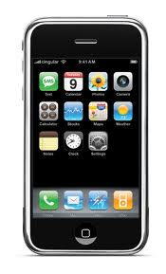
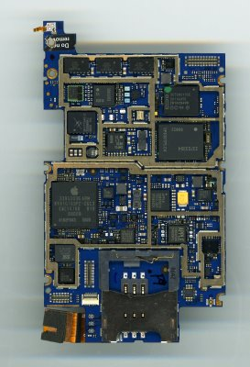
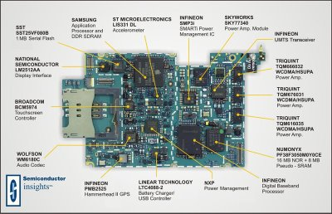
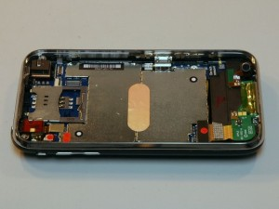
Circuits

Slide 21
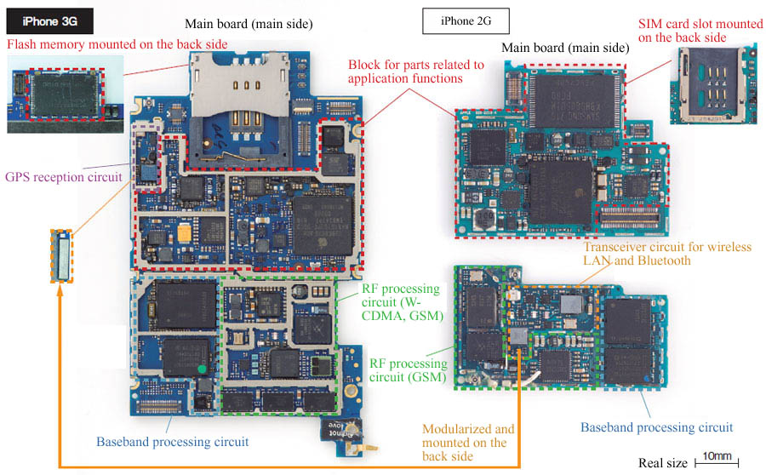
RF components (green)

Slide 22
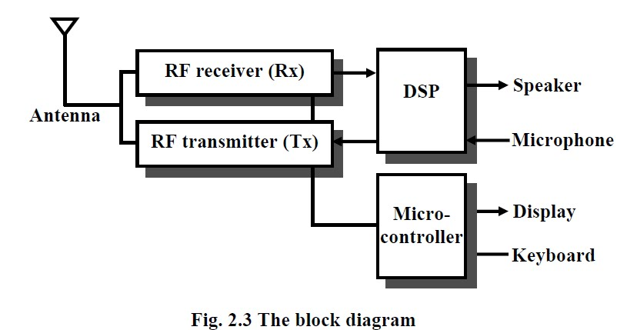
Block diagram

Slide 23
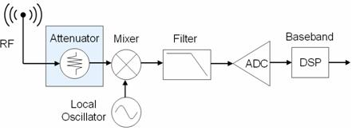
RF Receiver Block Diagram

Slide 24
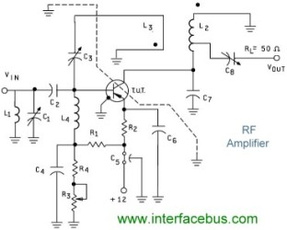
RF Receiver Amplifier Schematic

Slide 25
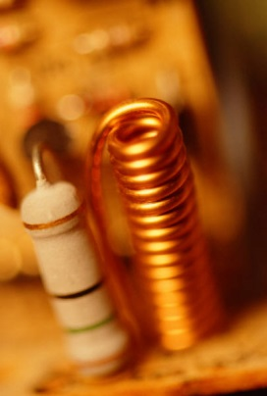
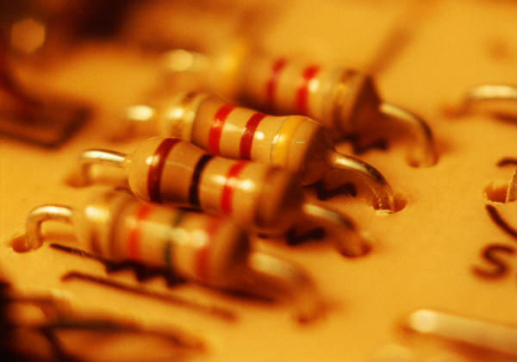
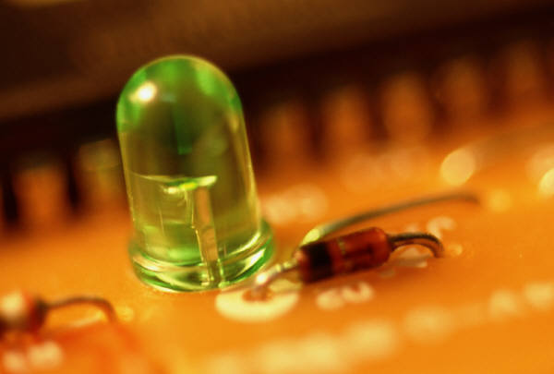
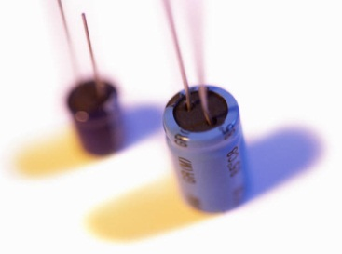
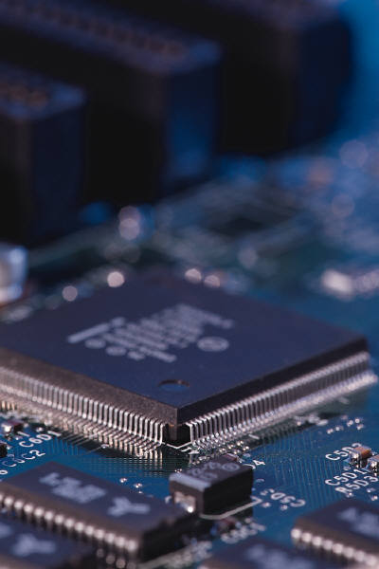
EE “layers”
Devices
Single elements
Resistors, capacitors, inductors
Diode, LED, MOSFET, BJT and more
Semiconductors
Can be engineered
Electrons, holes and photons
Electronic Circuits
Interconnection of devices
Digital/analog circuits, RF, microwave
NOR, NAND, MUX, DEMUX , ADC, DAC, OPAMP, VCO …
Systems
Combination of circuits
Digital signal processing

Slide 26
Assignment
Read Chapter 1:
Basic Concepts

