Slide 1
Administering Active Directory with Powershell
https://github.com/foremann/Projects/tree/master/AD_Demo
https://github.com/Duffney/ImprovedActiveDirectory
Nate Foreman
nkforeman@gmail.com

Slide 2
Why use Powershell with Active Directory?
Quickly and easily manage tens, hundreds, thousands of AD objects with simple one-liner commands and customizable feedback
Framework for daily automation to keep your environment clean and healthy
Less challenging than using LDAP queries and third-party tools
No more monotonous clicking!

Slide 3

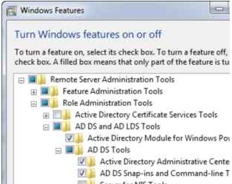
Dependencies
Recommend Powershell v5 installed but v3 will work
Active Directory Module bundled with Remote Server Administration Tools (RSAT)
Some form of Active Directory rights or a virtual environment

Slide 4
Before you start…
Use caution when running a cmdlet that isn’t a get. If you do use a set cmdlet, make sure to use the parameters –whatif to test or –confirm if you want to approve any changes.
Always have an escape plan with any change you make. For example, if you are going to disable 1,000+ computer accounts export these computer names to a file first that you can easily import back into a session to re-enable them.
You will never harm anything by running get commands!

Slide 5
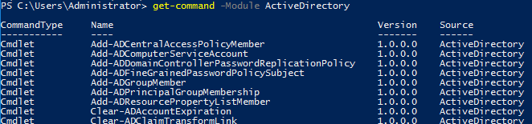
Import the Active Directory module
To start using the Active Directory cmdlets you must import the module containing them (Note on v5 it should already import)
If you want the module to load automagically on each new session you can put it inside your .profile or one of the locations found in $env:PSModulePath
To list all available cmdlets from the module, you can run

Slide 6
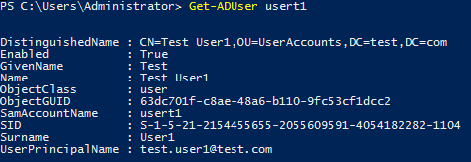
Finding user accounts
Get-ADUser will return the user object specified by samaccountname
In the above example, take note of the DistinguishedName, Enabled, ObjectClass, and SamAccountName properties. DistinguishedName contains the OU the user object is a member of. ObjectClass states it is a user account.
This may seem like an underwhelming amount of data returned…

Slide 7
AD object properties
AD get commands only return a small amount of properties by default, as pulling everything would certainly defeat the purpose of ‘speedy’ interaction.
Get-ADUser has a parameter called ‘-properties’ that allows you to specify which properties to return. A simple ‘-properties *’ will return ALL available properties of that object. If you want to only return a set of properties on top of the default, ‘-properties lastlogontimestamp,modified’. Note, if you pipe the object to Select-Object, you must have specified the properties to select in the properties parameter or it won’t know to pass them.

Slide 8
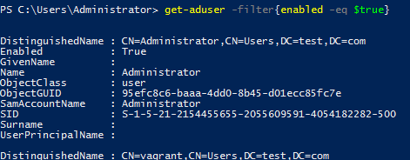
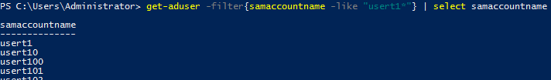
Using the filter
The ‘-filter’ parameter of Get-ADUser is used to find partial matches, objects meeting a certain criteria, or to evaluate a logic statement.
Syntax for this is Get-ADUser –filter{property –condition value}
If you want to return partial matches, you must use the wildcard character, an asterisk

Slide 9
Filter comparison operators
To master the filter you must understand Powershell’s comparison and logical operators and what data types they apply to…
Operator | Definition | Usage
-eq | Equals | Samaccountname –eq “bford”
-ne | Not equals | Samaccountname –ne “bford”
-ge/le | Greater/Lesser than or equal to | Modified –ge $Date
-gt/lt | Greater/Lesser than | Modified –ge $Date
-like | Like (supports wildcard search) | Samaccountname –like “bfor*”
-notlike | Not like (supports wildcard) | Samaccountname –notlike “*b*”

Slide 10
Filter logical operators
Just like if/else and where statements, Get-ADUser supports logical operators in the filter.
Operator | Definition | Usage
-and | Both statements evaluate to true | (samaccountname –like “bob1*”) –and (enabled –eq $true) All accounts beginning with “bob1” that are enabled
-or | At least one statement is true | (samaccountname –like “bob1”) –or (samaccountname –like “bob2”) Any accounts that are “bob1” or “bob2”

Slide 11
Complex filters
Once you’ve grasped comparison and logical operators you can write advanced one-liners… return all enabled accounts with username “usert1” or any usernames like usert3. Since both are true they are returned.
Why is only the first condition returned in this statement below?

Slide 12
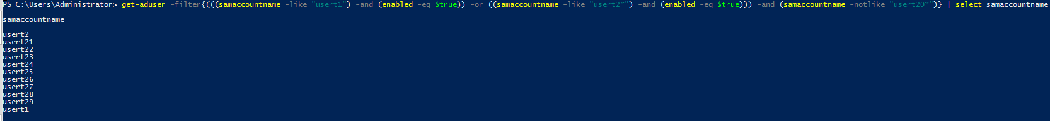
Parenthetical expressions
In the previous slide you may have noticed some filter expressions are wrapped in parentheses. Just like in math, Powershell has an order of operations. (((This is evaluated first)This is evaluated second)This is evaluated last)
Return all enabled accounts with username usert1 or like “usert2*”, but not any accounts like “usert20*”. Notice “usert20” is missing from the list as it did not meet logic.

Slide 13


Piping to other cmdlets
Now that you know how to fetch a user object, you can perform the same operations on them as you can in ADUC or ADAC. To pass the user account to another cmdlet you use the pipe character ‘|’.
Unlock the account
Reset the password
Move the object
Modify the account’s properties
Disable the account

Slide 14

Whatif and confirm
When running cmdlets that use write permission (modify) you can specify the whatif parameter to see what would happen if it ran. The confirm parameter will ask your permission to proceed before taking action. While confirm may not be necessary and more of a headache if you’re taking action on multiple users, I always encourage you to use whatif to verify you are targeting the correct objects.

Slide 15

Credentials
If your Active Directory rights are not given to the account you open Powershell with, you will need to run the set cmdlets using those alternate credentials. You can pass the username and password to the cmdlet using the Credential parameter.
To save your credentials to a variable to re-use for the PS session:
To ask for your credentials for one-time use (via parenthetical exp.):

Slide 16
Working with other domains and forests
If you are managing multiple domains in a forest or multiple forests, you can specify which domain you are targeting with each cmdlet using the Server parameter, which accepts the FQDN as input.
Expire password for usert1 on the domain T1 in forest TEST.COM, and also ask for the credentials for that domain:

Slide 17
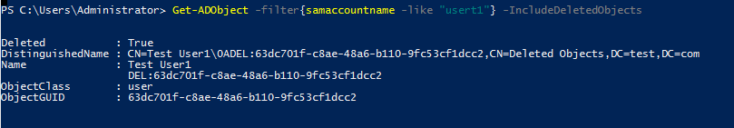
Restoring objects from recycle bin
Using the AD recycle bin if enabled in your environment is extraordinarily simple with Powershell. However, instead of Get-ADUser we use the similar cmdlet Get-ADObject with the mandatory parameter IncludeDeletedObjects:
To restore, pipe the object(s) to the Restore-ADObject cmdlet

Slide 18
Computer objects
The Get-ADComputer cmdlet is used to query computer objects and uses the same filter concept and properties behavior as Get-ADUser.
To find all enabled computers running Windows Server 2016:

Slide 19
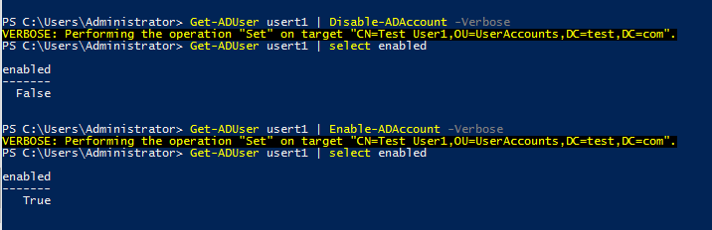
Disable or enable accounts
Regardless of whether users or computers, the Disable-ADAccount and Enable-ADAccount are used to accomplish this task.
Notice I also specified the Verbose parameter, which outputs what the action did. Not all cmdlets have output by default, making it difficult to know if it even did anything.

Slide 20
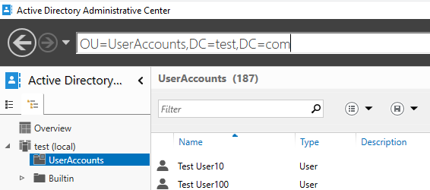
Moving AD objects
Object movement is done with Move-ADObject cmdlet and providing the target OU or CN’s DistinguishedName to the TargetPath parameter. To easily find a DN I use ADAC for the pleasing tree view.
Move all accounts beginning with “B” to the “UserAccounts” OU and confirm each move

Slide 21
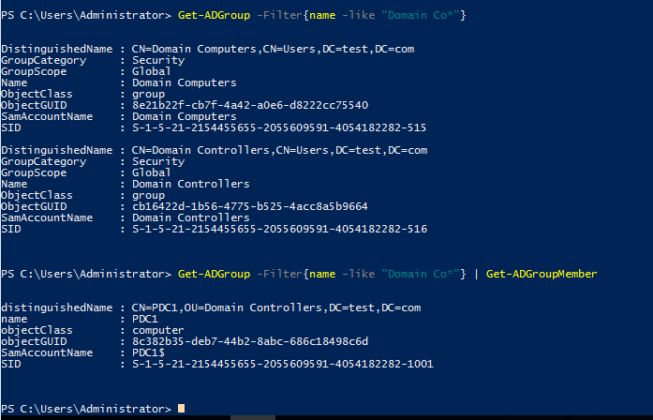
Getting groups
Get-ADGroup supports filtering and properties parameter. You can pipe this to Get-ADGroupMember to grab the user objects that are members of the group too.

Slide 22
Adding members to groups
Add-ADGroupMember accepts user, computer, and group objects for membership to the Members parameter. Note, you cannot pipe objects to this cmdlet.

Slide 23

Property shortcut
On the previous slide I used a get cmdlet that had the same output if I had done ‘| select-object members’. Parenthetical expressions allow us to call a property of objects that are produced from cmdlets. In below example I only want the usernames of all accounts containing “1”, not their other properties liked enabled status or DN.
Note, if you are calling a property that is not returned by default, you must specify it in the Properties parameter.

Slide 24
Improved Active Directory Module
The IAD Module contains many AD automation functions to aid in audit requirements in enterprises or general upkeep. All below functions were written using cmdlets and concepts found inside this presentation.
Disable-IADInactiveComputers
Disable-IADInactiveUsers
Empty-IADComputersContainer
Move-IADDisabledComputers
Move-IADDisabledUsers
Move-IADEnabledComputers
Move-IADEnabledUsers
https://github.com/Duffney/ImprovedActiveDirectory

Slide 25
Questions?

