Slide 1
Parallel Matrix Multiplication using OpenMP
Xitong Liu
ELEG652

Slide 2
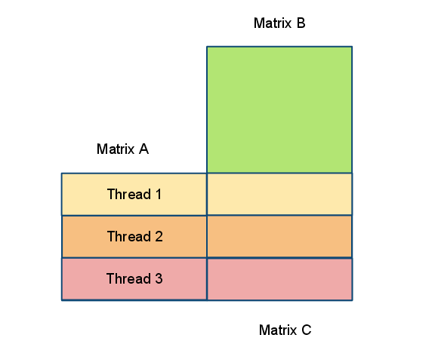
Data Partitioning
Well Defined algorithm
Statically Assign Workload
No data exchange between threads
Evenly Divided Workload

Slide 3
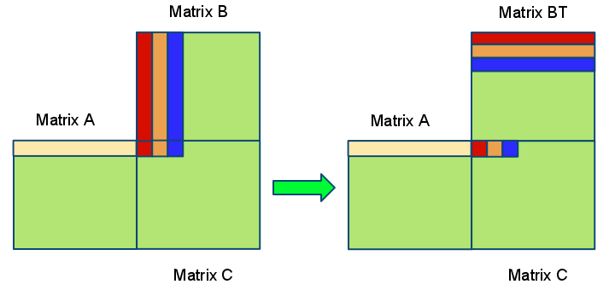
Utilize Cacheline

Slide 4
Vector Operation
DO I = 1, N
DO J = 1, N C(I,J) = 0.0
V_ACC = [0]
DO K = 1, N , 4
V_OPA = __builtin_ia32_loadups(A(I,K))
V_OPA = __builtin_ia32_loadups(BT(I,K))
V_ACC = V_ACC +
__builtin_ia32_mulps(V_OPA + V_OPB)
ENDDO
C(I,J) = V_ACC
ENDDO
ENDDO
x86 Built-In functions provided by GCC, directly translated to SSE instructions
Operate at vector with size 4 ( 128 bits per XMM register, 4 float numbers)

Slide 5
More Optimization
Loop Unrolling
Scheduling
Software Pipelining

Slide 6
Ultimate Optimization: ILP
Instructions were not organized as expected, even for the built-in functions
Registers were not well utilized
it only use 2 XMM registers, while 16 in total available
most of the intermediate data were exchanged between memory and registers
ASM optimization based on –O0 code

Slide 7
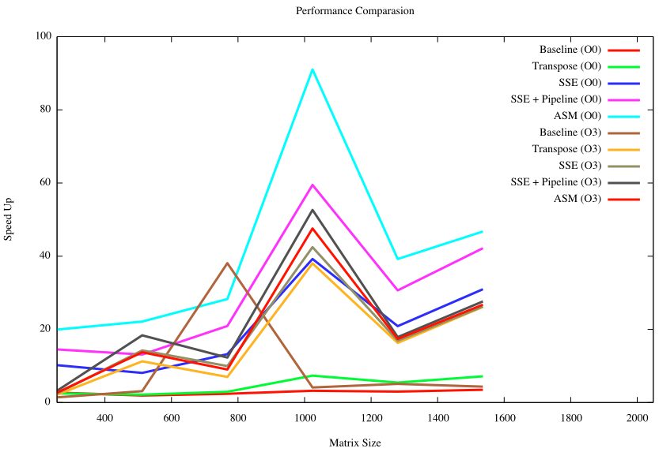
Result Analysis

Slide 8
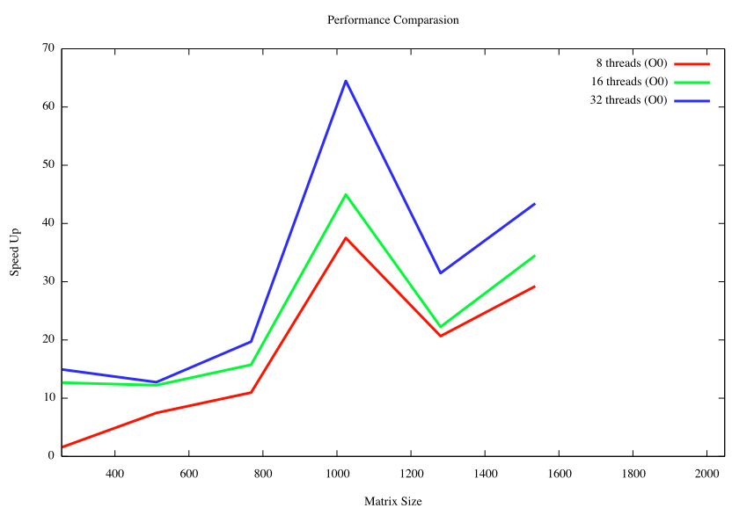
Results Analysis

