Slide 1
arte y astronomía
Jaime Forero (je.forero@uniandes.edu.co)
Departamento de Física
Universidad de los Andes
CBU Astronomía Popular Octubre 2015

Slide 2
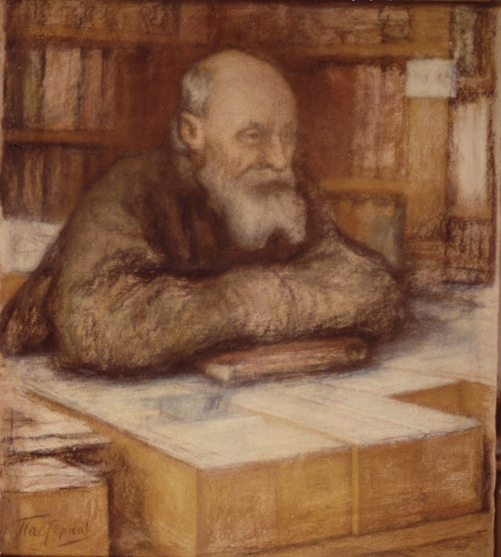
https://en.wikipedia.org/wiki/Nikolai_Fyodorovich_Fyodorov#/media/File:Pasternak_fedorov.jpg

Slide 3
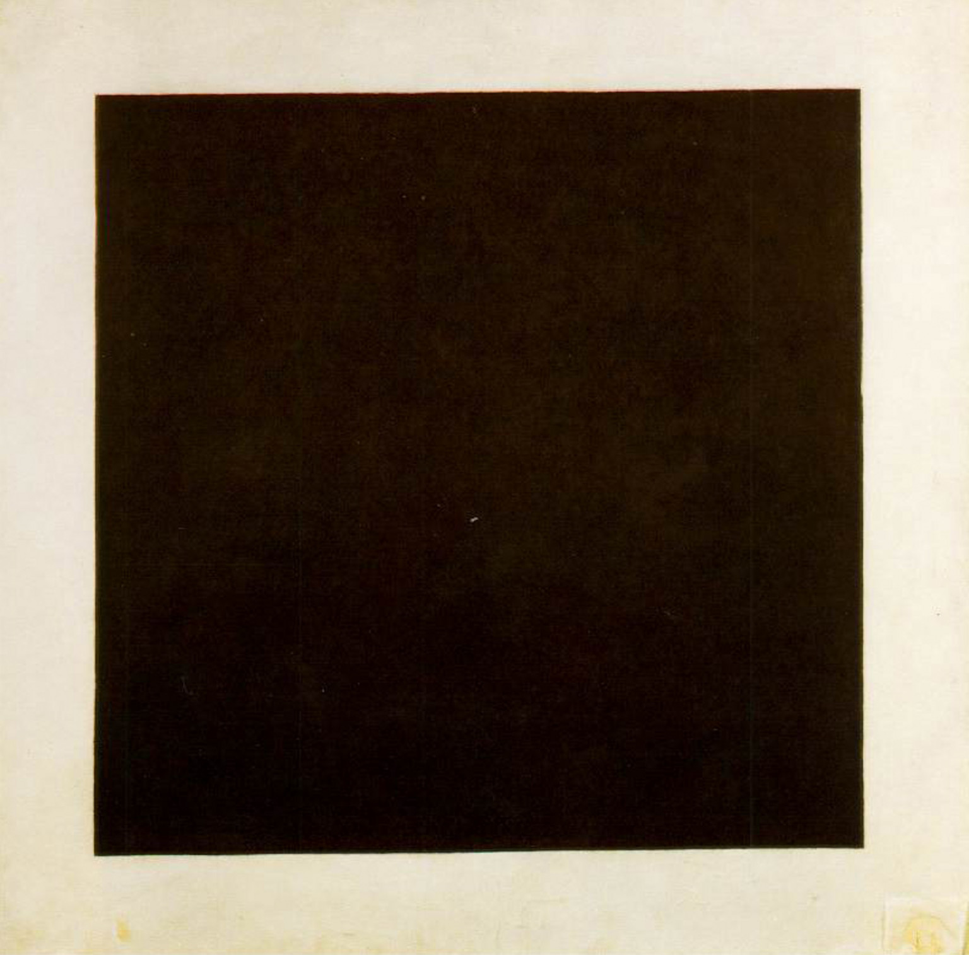
http://www.tate.org.uk/art/images/research/2148_10.jpg

Slide 4
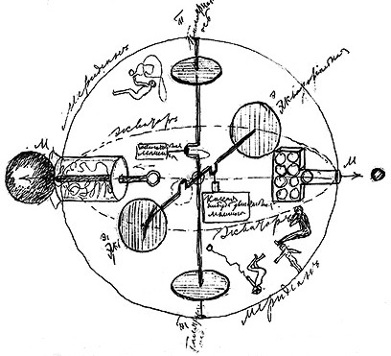
https://en.wikipedia.org/wiki/Konstantin_Tsiolkovsky#/media/File:Chertrg_Tsiolkovsky.jpg

Slide 5
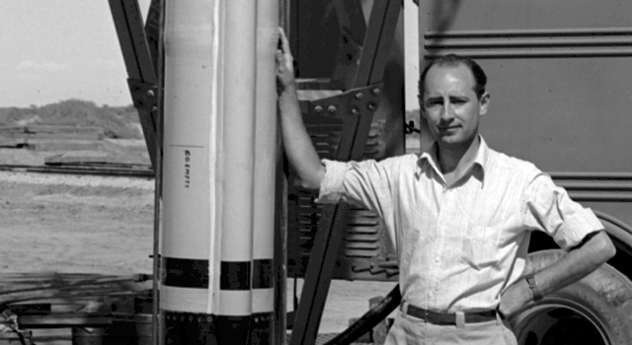
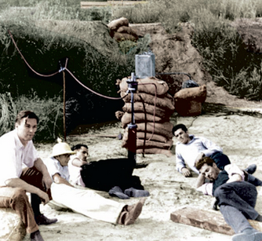
https://commons.wikimedia.org/wiki/File:Frank_Malina_close_up.jpg
http://www.patrickmccray.com/blog/

Slide 6
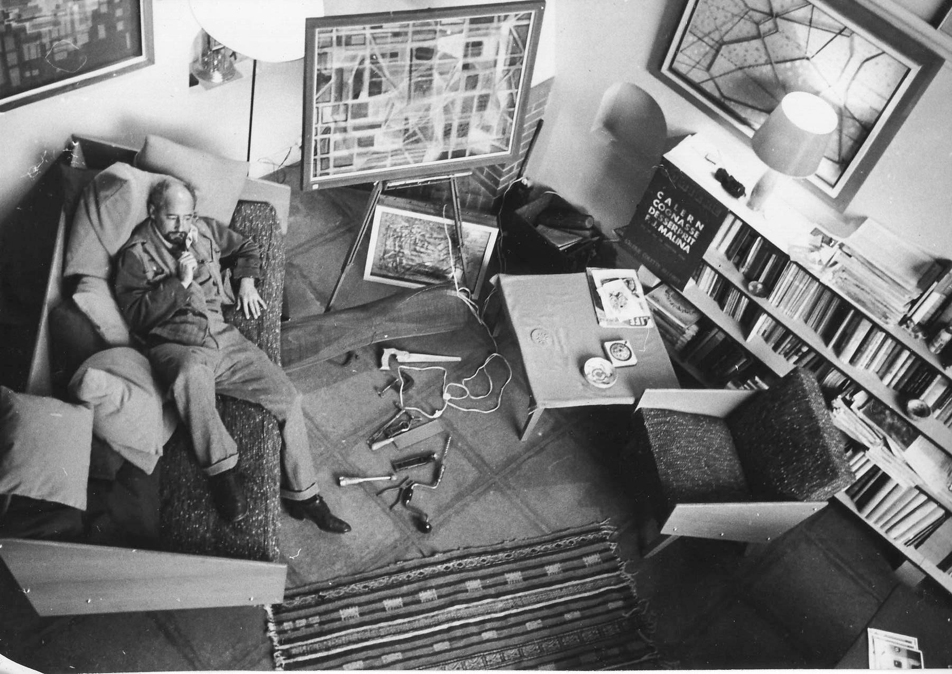
http://www.patrickmccray.com/wp/wp-content/uploads/2015/09/Malina1957_2.jpg

Slide 7
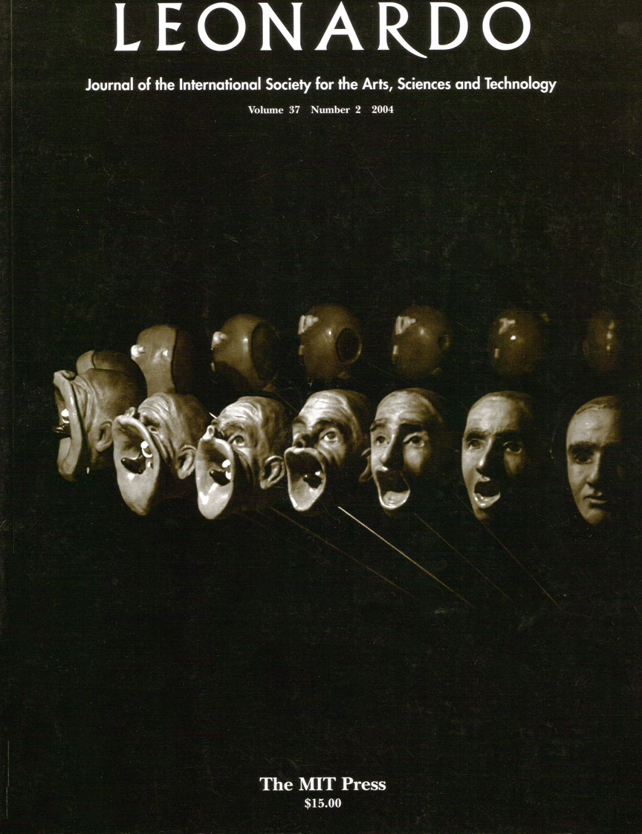

Slide 8
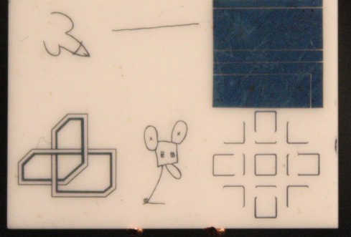
moon museum
Rauschenberg, Novros, Chamberlain, Oldenburg, Myers, Warhol (1969)
https://en.wikipedia.org/wiki/Moon_Museum#/media/File:Moon_Art_PBS.jpg

Slide 9
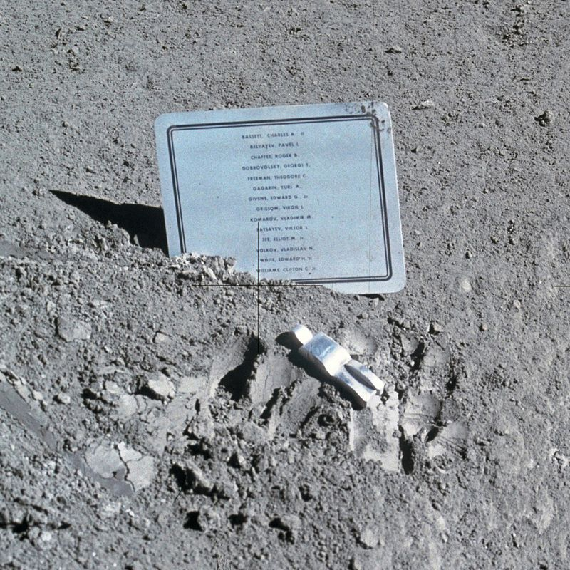
Paul Van Hoeydonck
https://en.wikipedia.org/wiki/Fallen_Astronaut#/media/File:Fallen_Astronaut.jpg

Slide 10
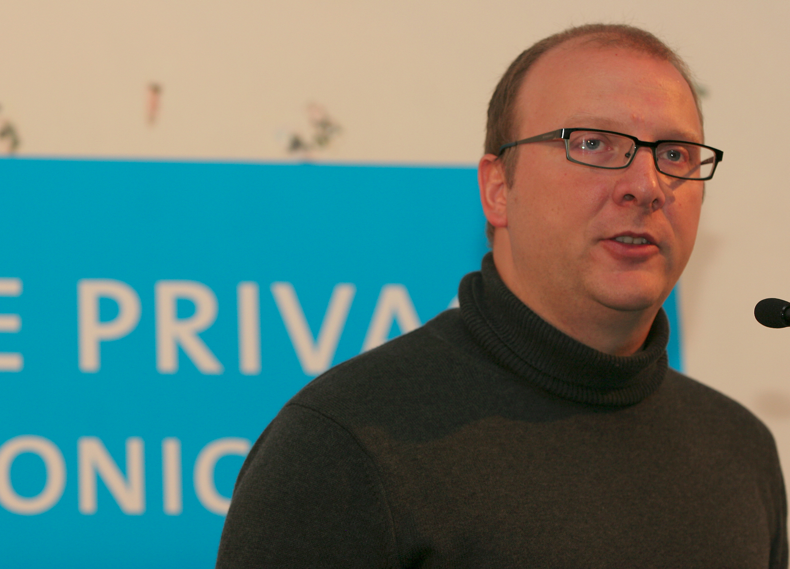
http://90.146.8.18/en/archives/picture_ausgabe_02_new.asp?iAreaID=429&showAreaID=429&page=2&pagesize=10&order=name

Slide 11
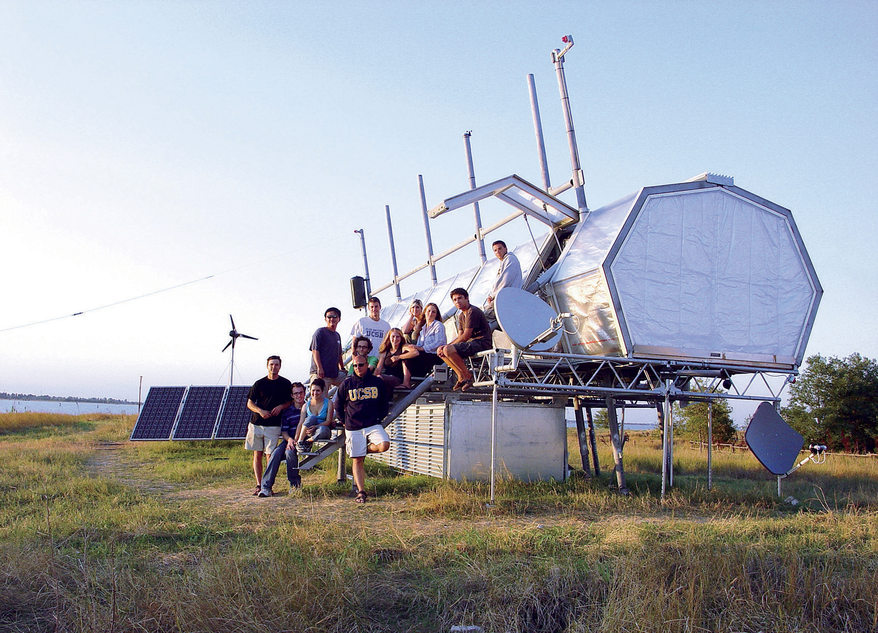
http://90.146.8.18/en/archives/picture_ausgabe_02_new.asp?iAreaID=429&showAreaID=429&page=2&pagesize=10&order=name

Slide 12
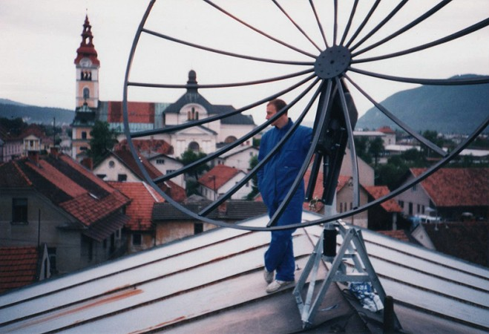
http://www.mgml.si/mestna-galerija-ljubljana/novice-ne-objavi/marko-peljhan-vodstvo-po-razstavi/

Slide 13
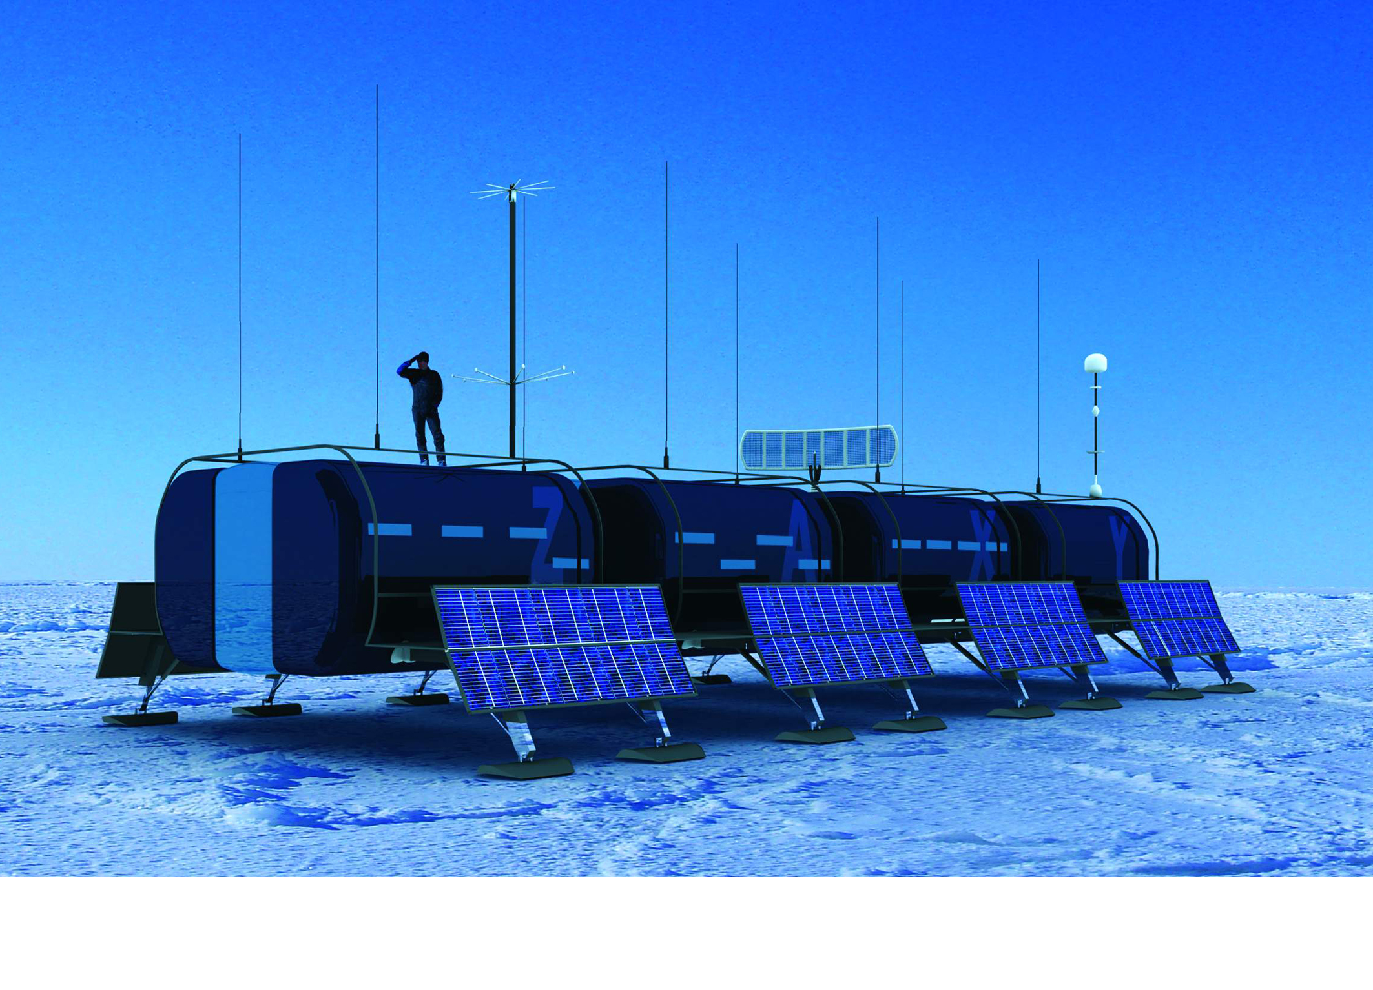
http://90.146.8.18/en/archives/picture_ausgabe_02_new.asp?iAreaID=429&showAreaID=429&page=2&pagesize=10&order=name

Slide 14
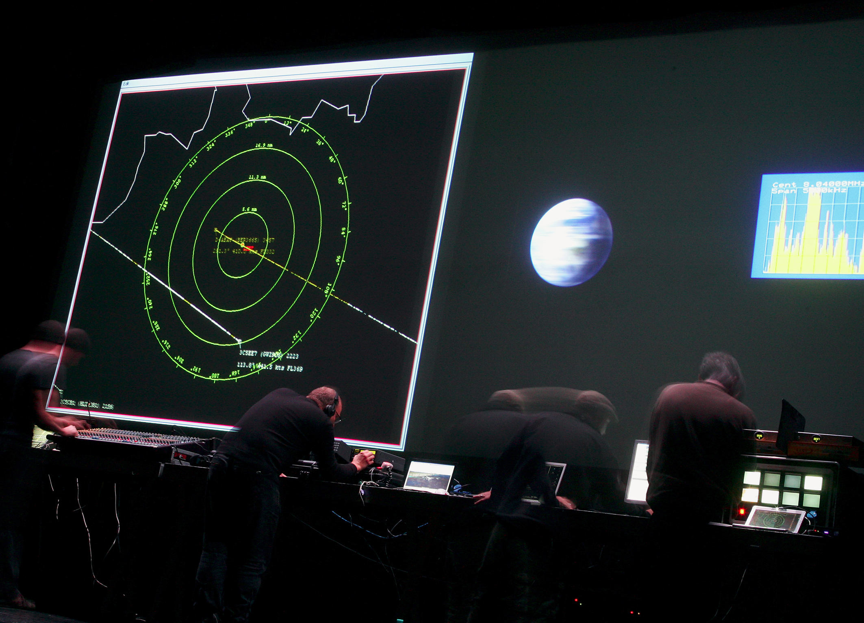
http://90.146.8.18/en/archives/picture_ausgabe_02_new.asp?iAreaID=429&showAreaID=429&page=2&pagesize=10&order=name

Slide 15
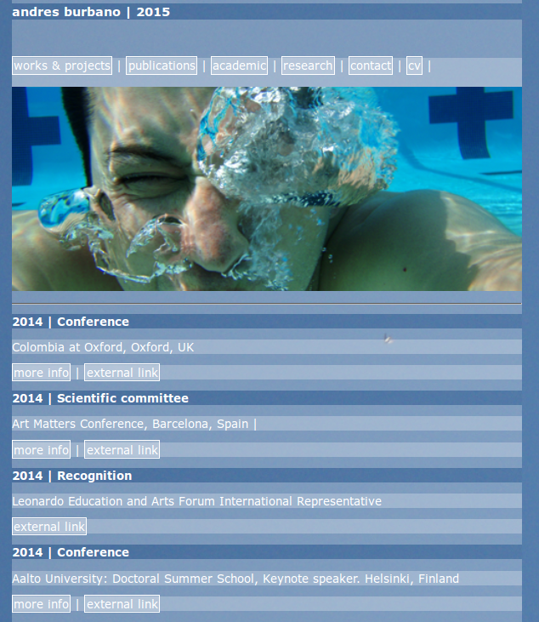
http://www.burbane.net/

Slide 16


Slide 17
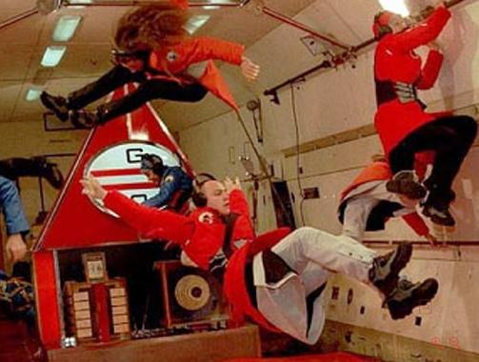
Noordung Biomechanics, Dragan Zivadinov, 1999
http://www.artscatalyst.org/space-art-forum

Slide 18
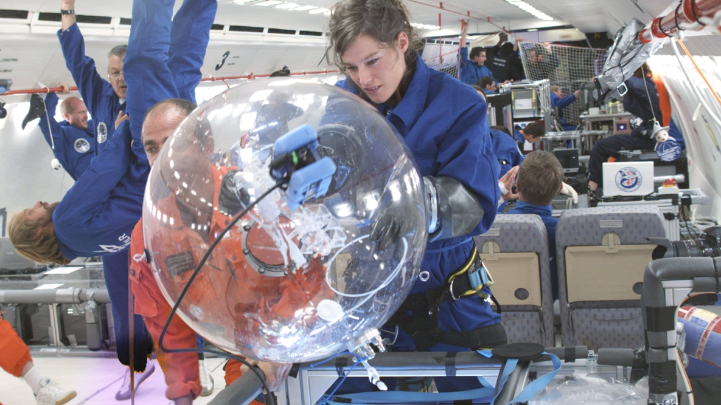
Agnes Meyer-Brandis

Slide 19
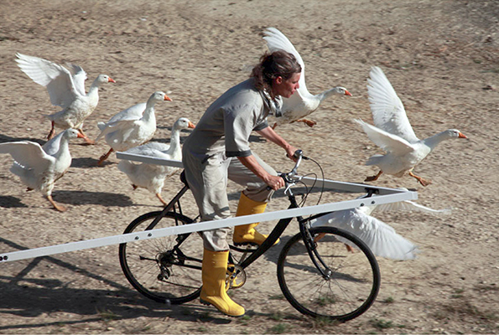
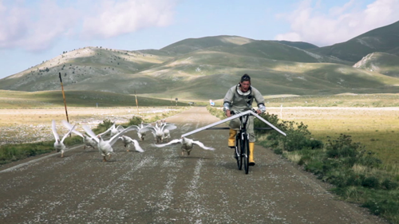
Agnes Meyer-Brandis
http://sites.artsblock.ucr.edu/free-enterprise/agnes-meyers-brandis/

Slide 20
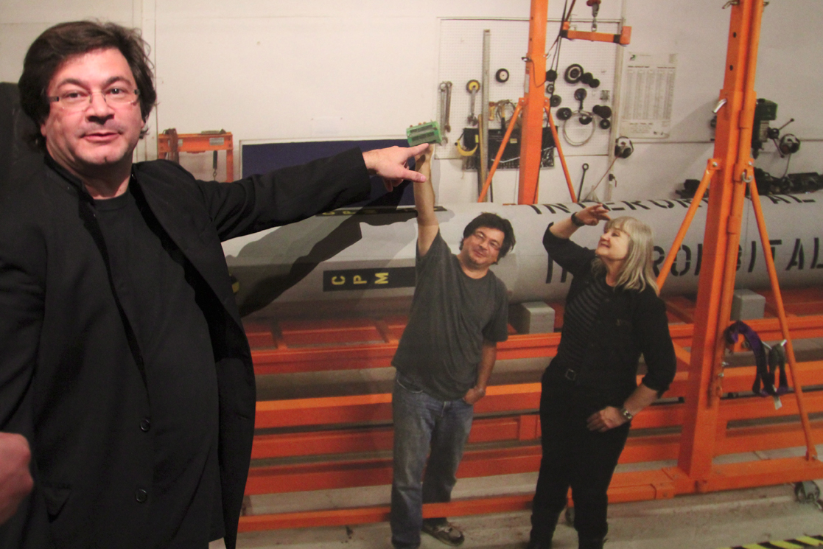
http://cuartoscuro.com.mx/2011/10/lanza-satelite-musical-epson/

Slide 21
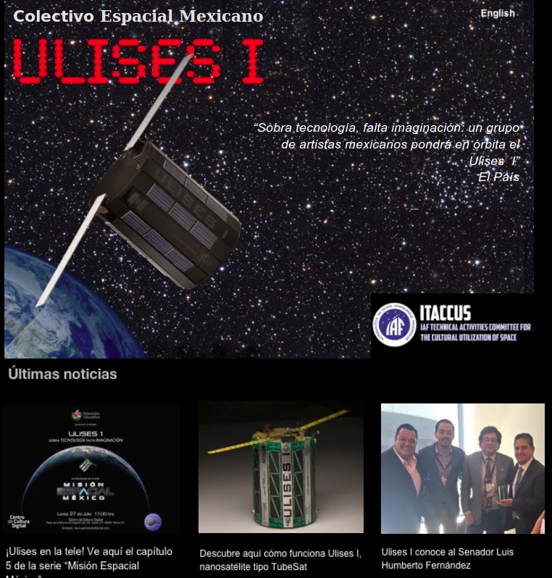
http://www.ulises1.mx/Ulises_1/Inicio.html

Slide 22
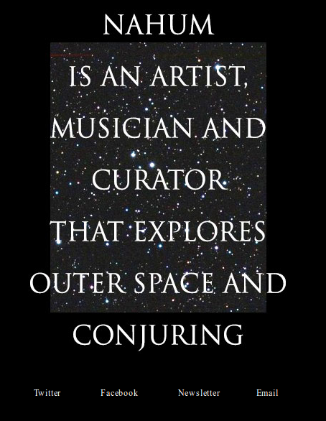

Slide 23
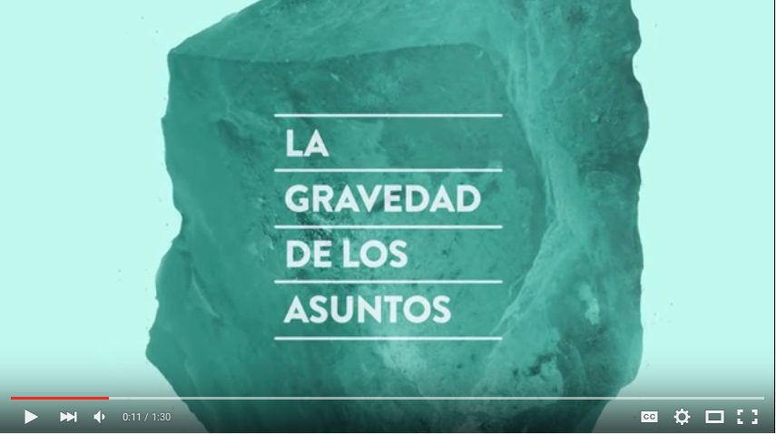
https://www.youtube.com/watch?v=iBy4QRYPUVs

Slide 24
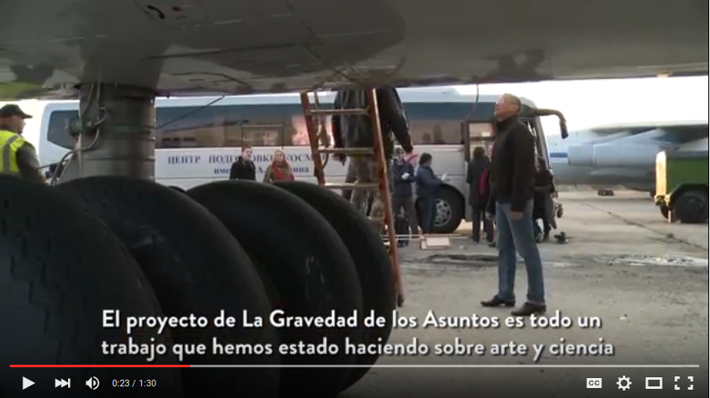
https://www.youtube.com/watch?v=iBy4QRYPUVs

Slide 25
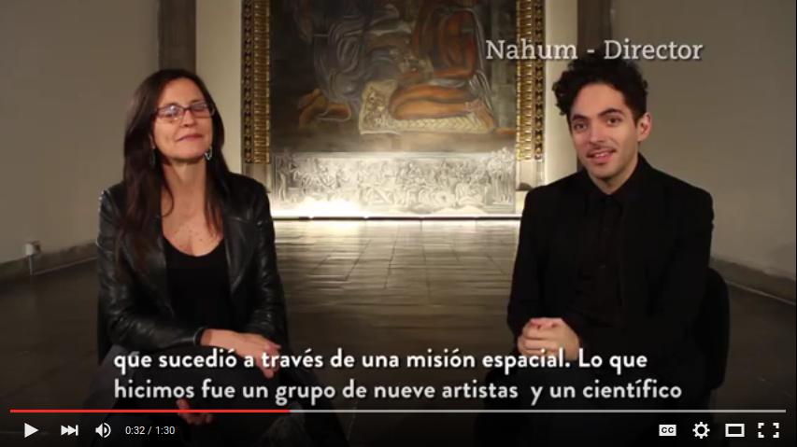
https://www.youtube.com/watch?v=iBy4QRYPUVs

Slide 26
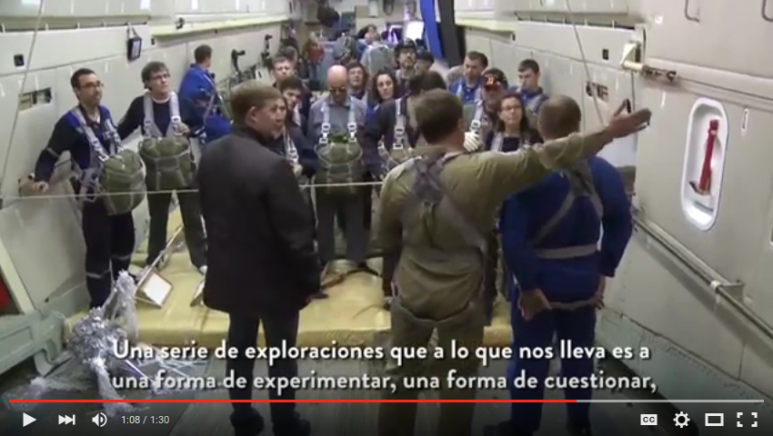
https://www.youtube.com/watch?v=iBy4QRYPUVs

Slide 27
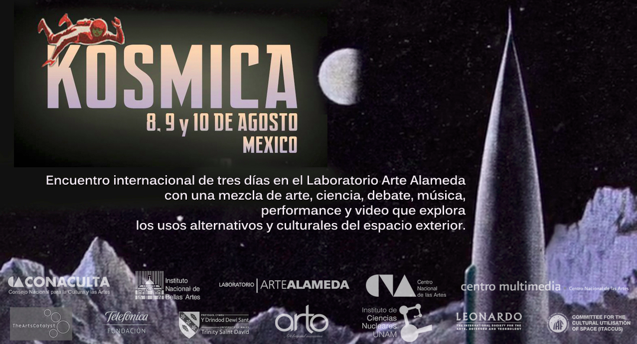

Slide 28

http://www.artscatalyst.org/kosmica-mexico-2014-0

Slide 29
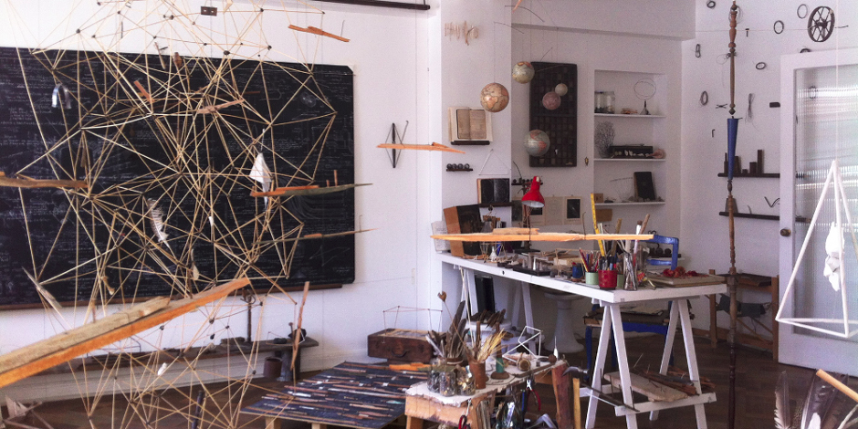
http://www.aec.at/artandscience/artists/mariaignaciaedwards/

Slide 30
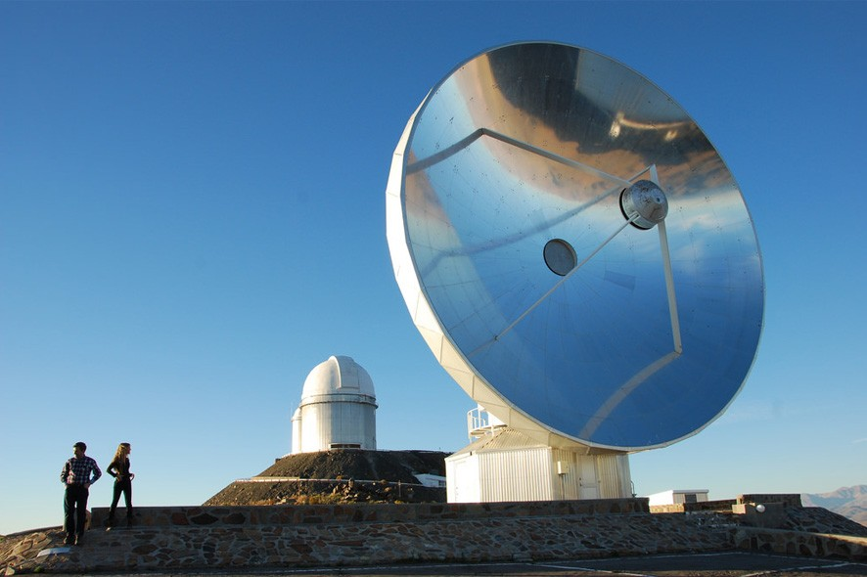
Credit: Claudia Schnugg http://www.aec.at/aeblog/en/2015/10/15/artandsciencejourney/

Slide 31
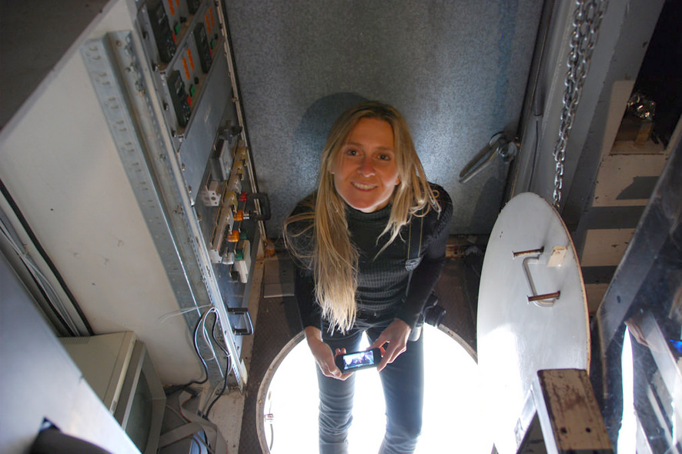
Credit: Claudia Schnugg http://www.aec.at/aeblog/en/2015/10/15/artandsciencejourney/

Slide 32
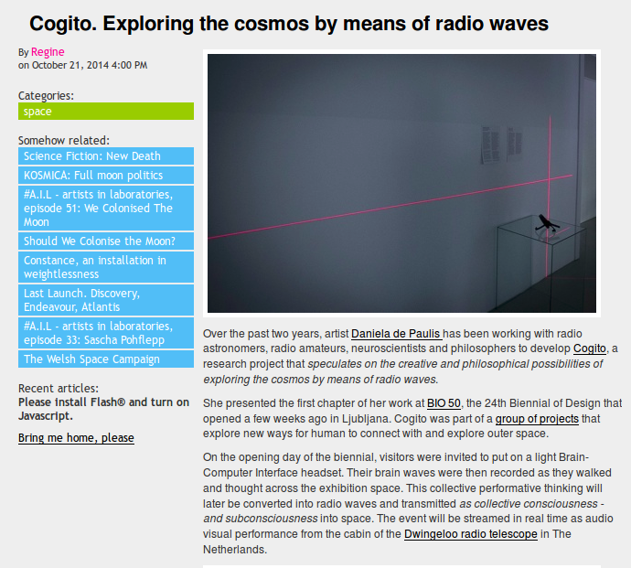
http://we-make-money-not-art.com/archives/2014/10/cogito.php

Slide 33
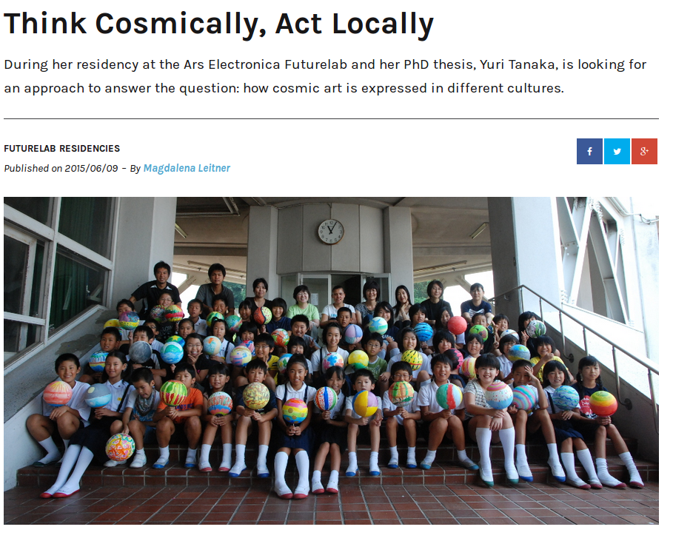
http://www.aec.at/aeblog/en/2015/06/09/think-cosmically-act-locally/

Slide 34
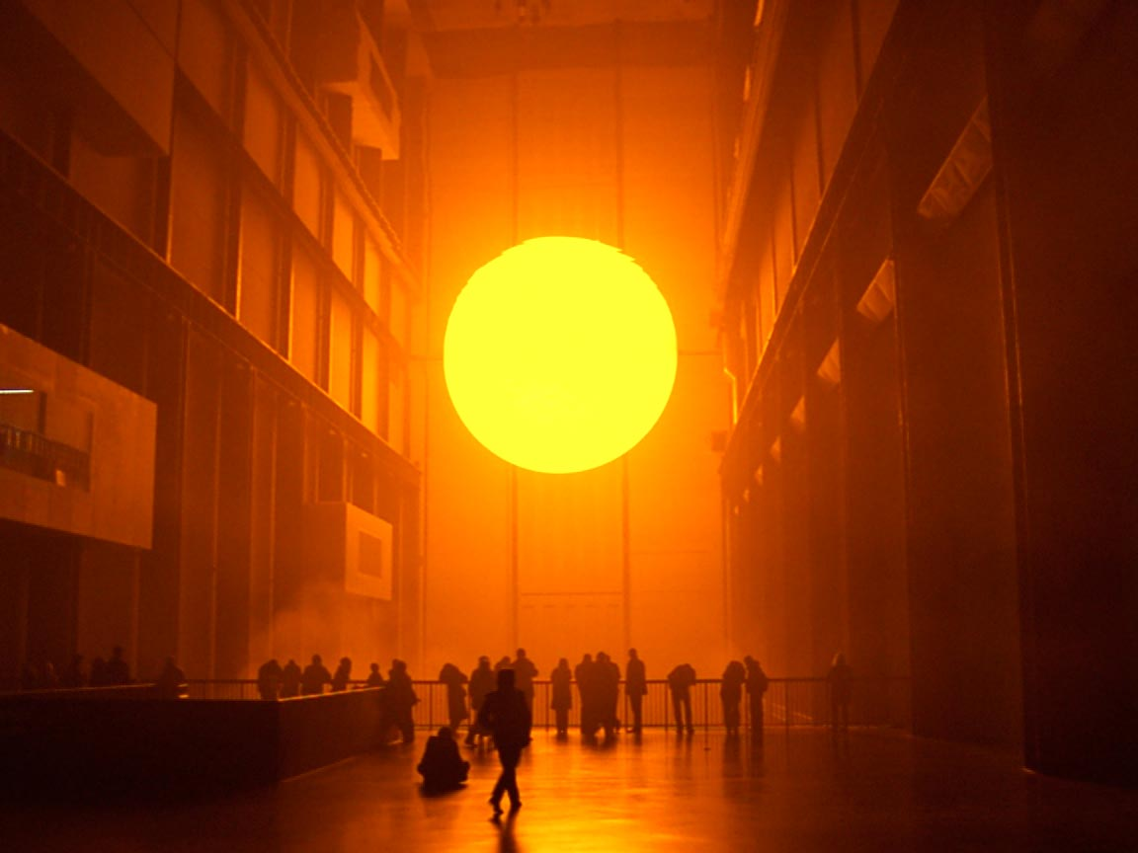
http://www.artists4parisclimate2015.com/en/artists/olafur-eliasson/

Slide 35
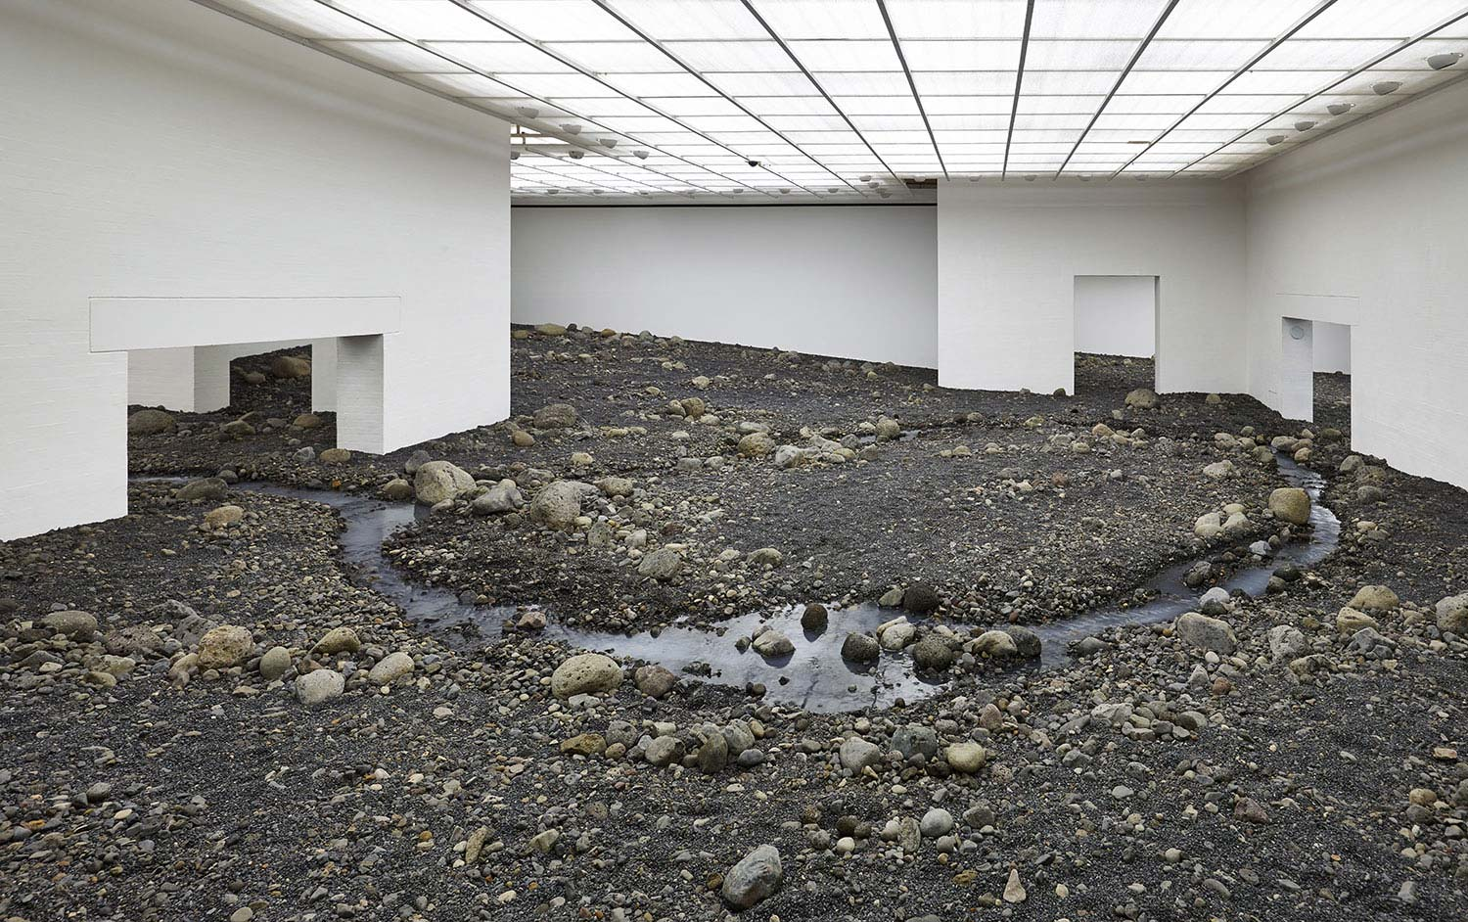
Studio Olafur Eliasson

Slide 36
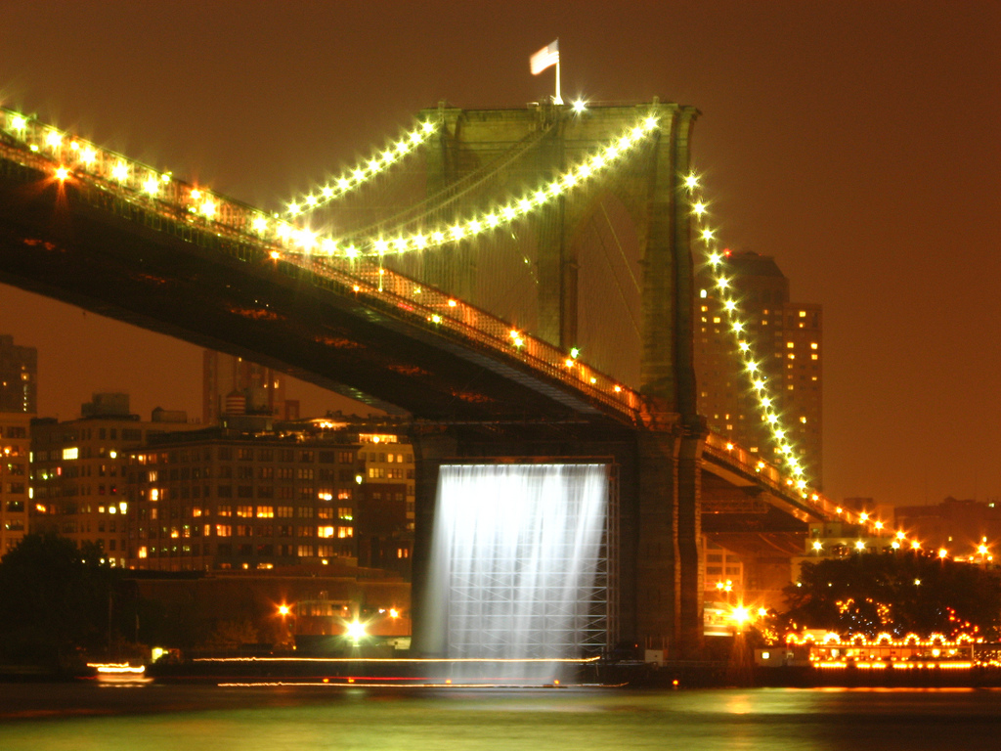
https://commons.wikimedia.org/wiki/File:Olafur_Eliasson's_Waterfalls_under_the_Brooklyn_Bridge.jpg

Slide 37
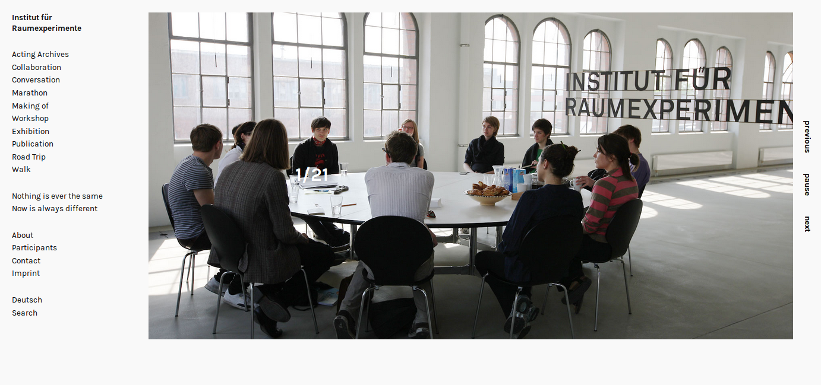
http://raumexperimente.net/en/
http://raumexperimente.net/en/

Slide 38
2012
encuentros arte y ciencia

Slide 39
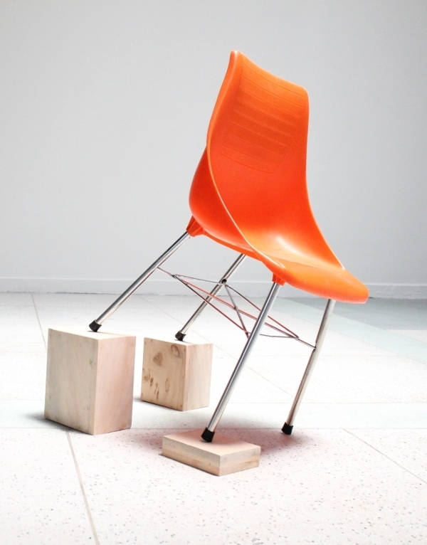

Slide 40
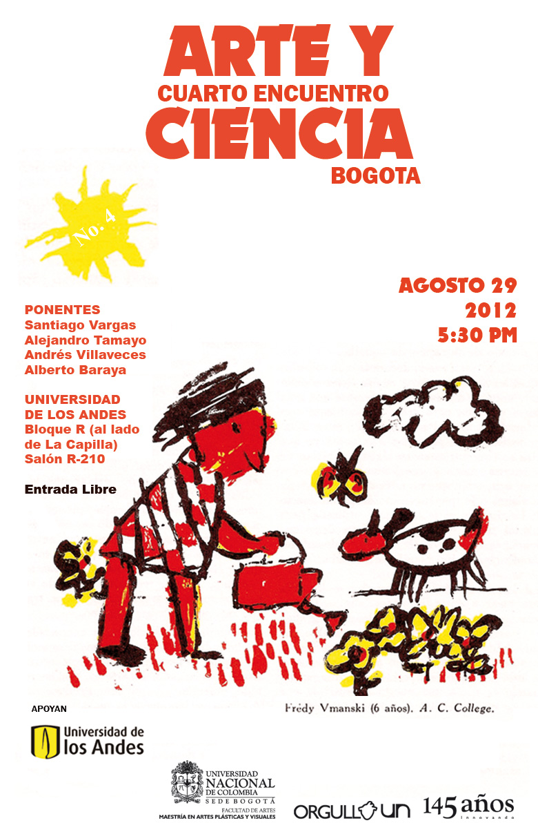

Slide 41
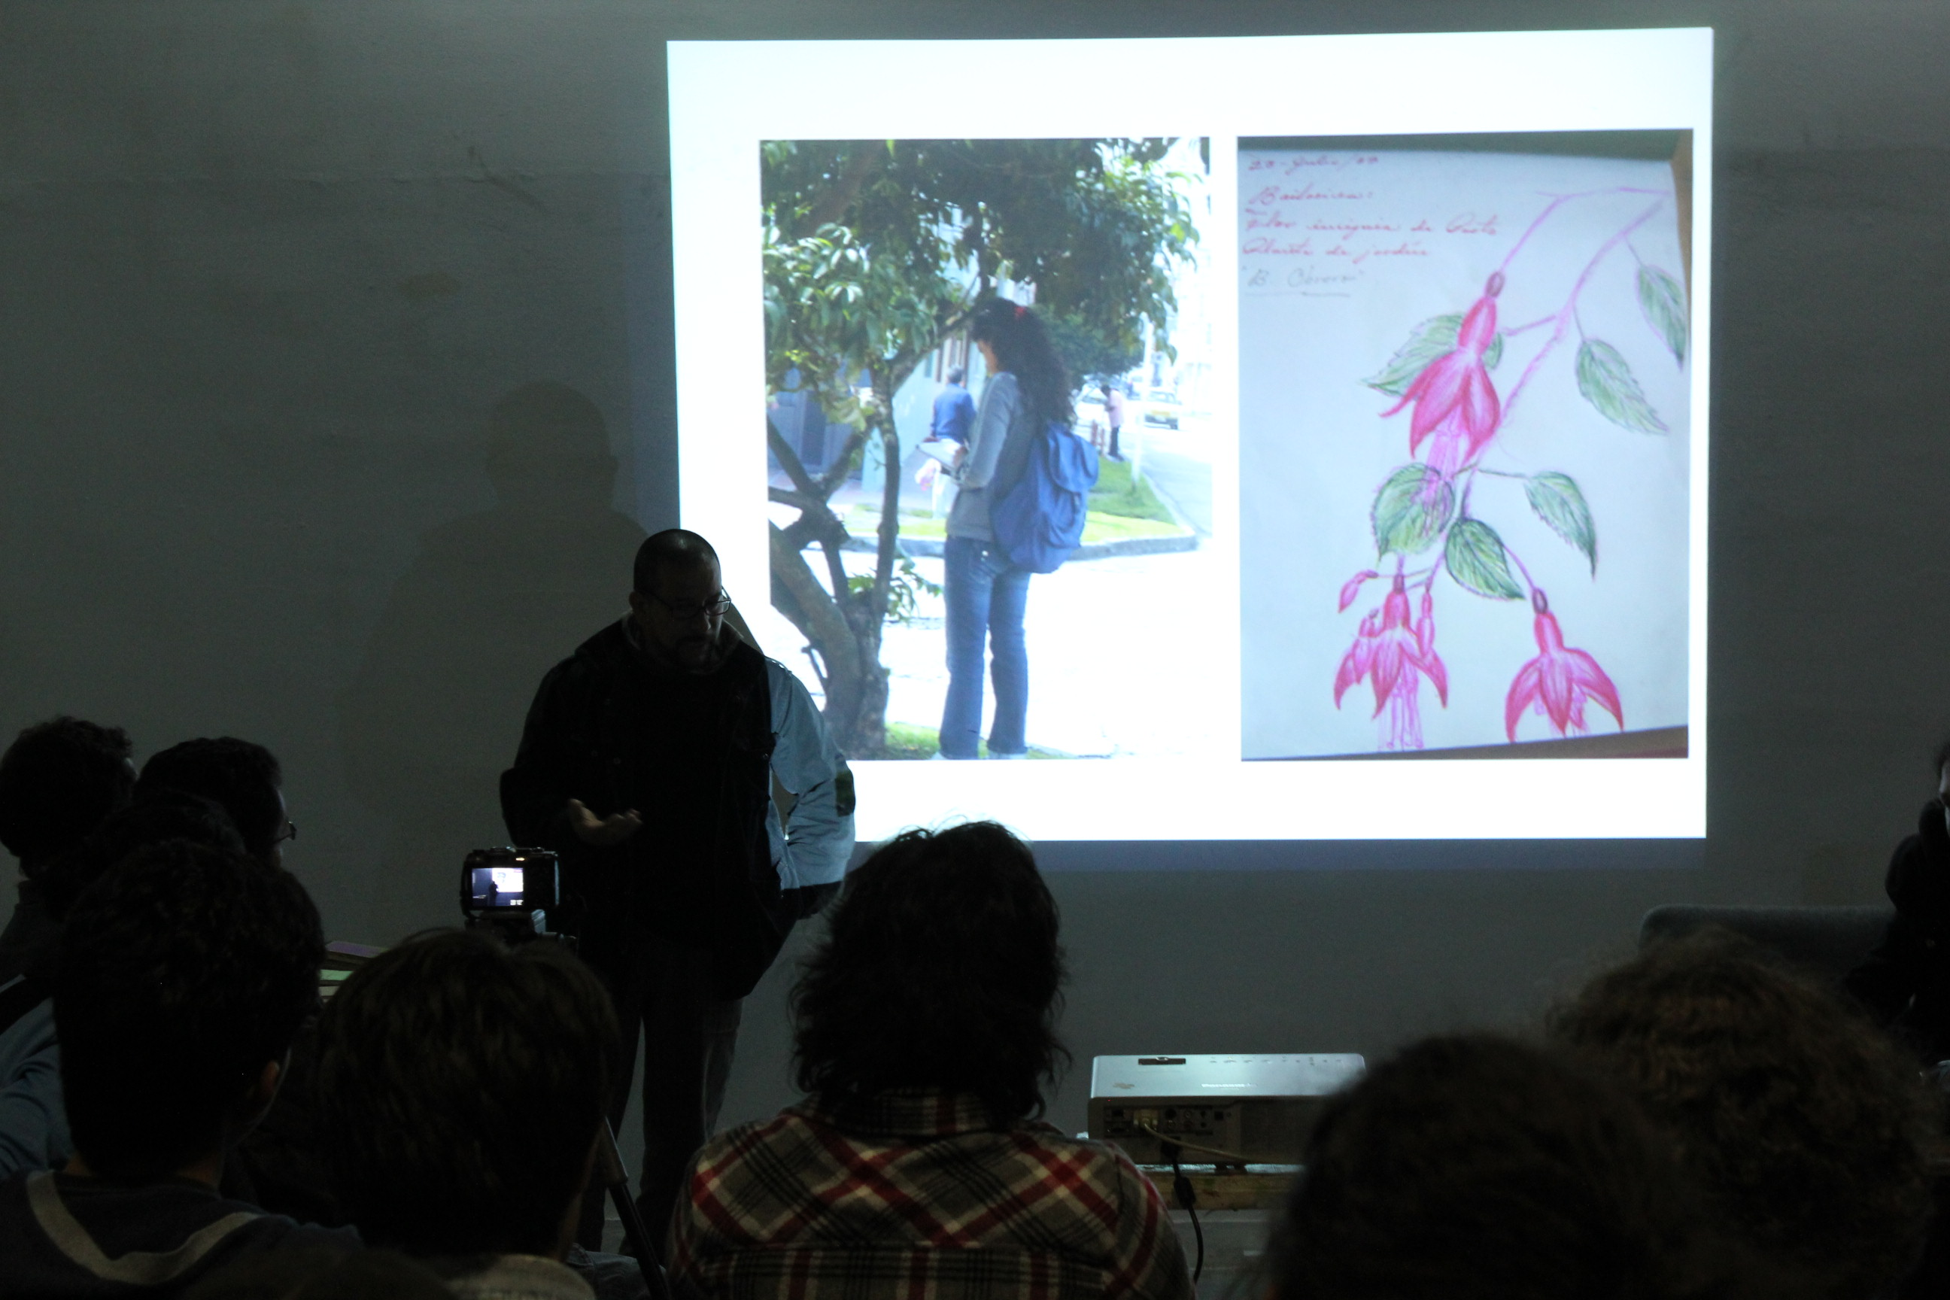

Slide 42
2013
astronomía periférica

Slide 43
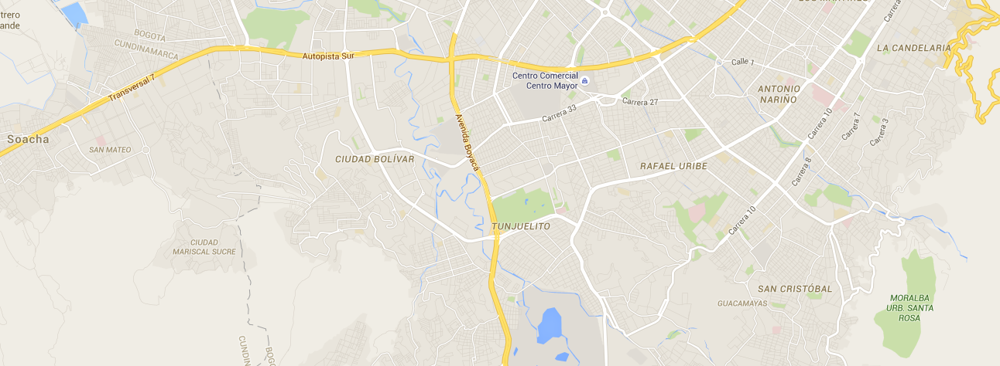

Slide 44
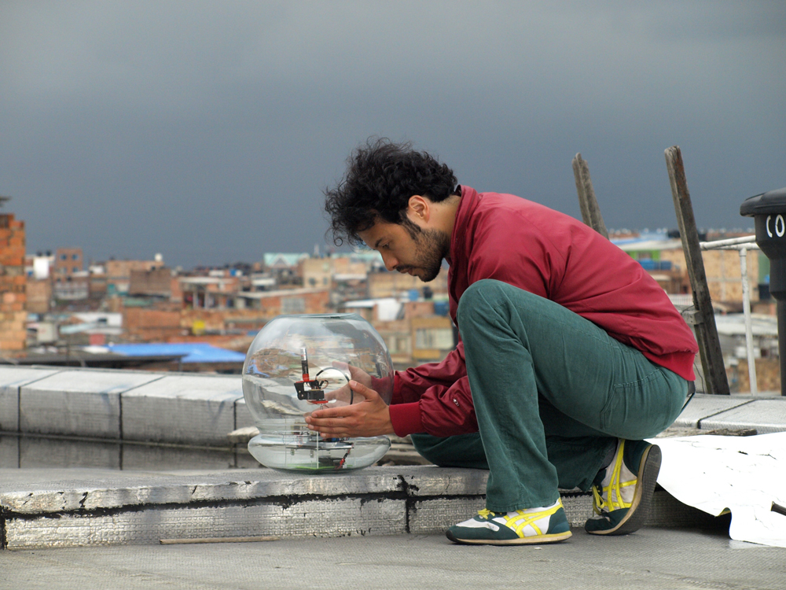

Slide 45
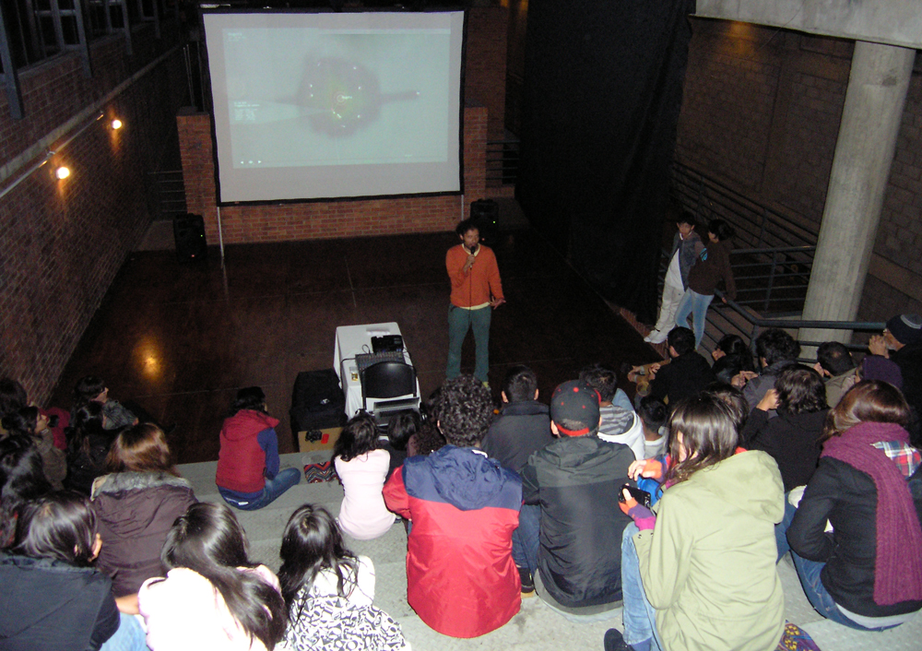

Slide 46
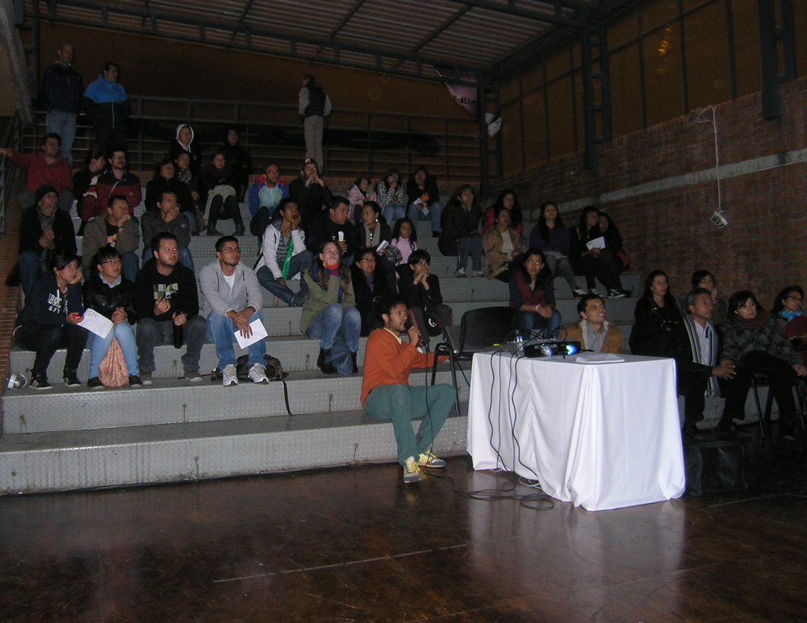

Slide 47
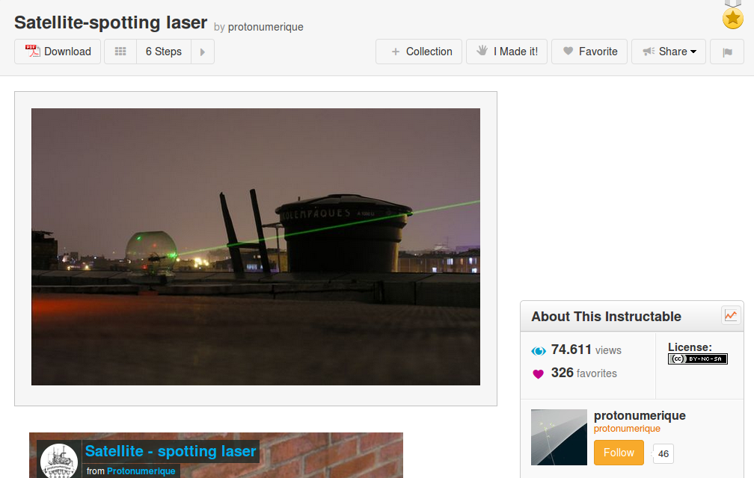
http://www.instructables.com/id/Satellite-laser-cannon/

Slide 48


Slide 49
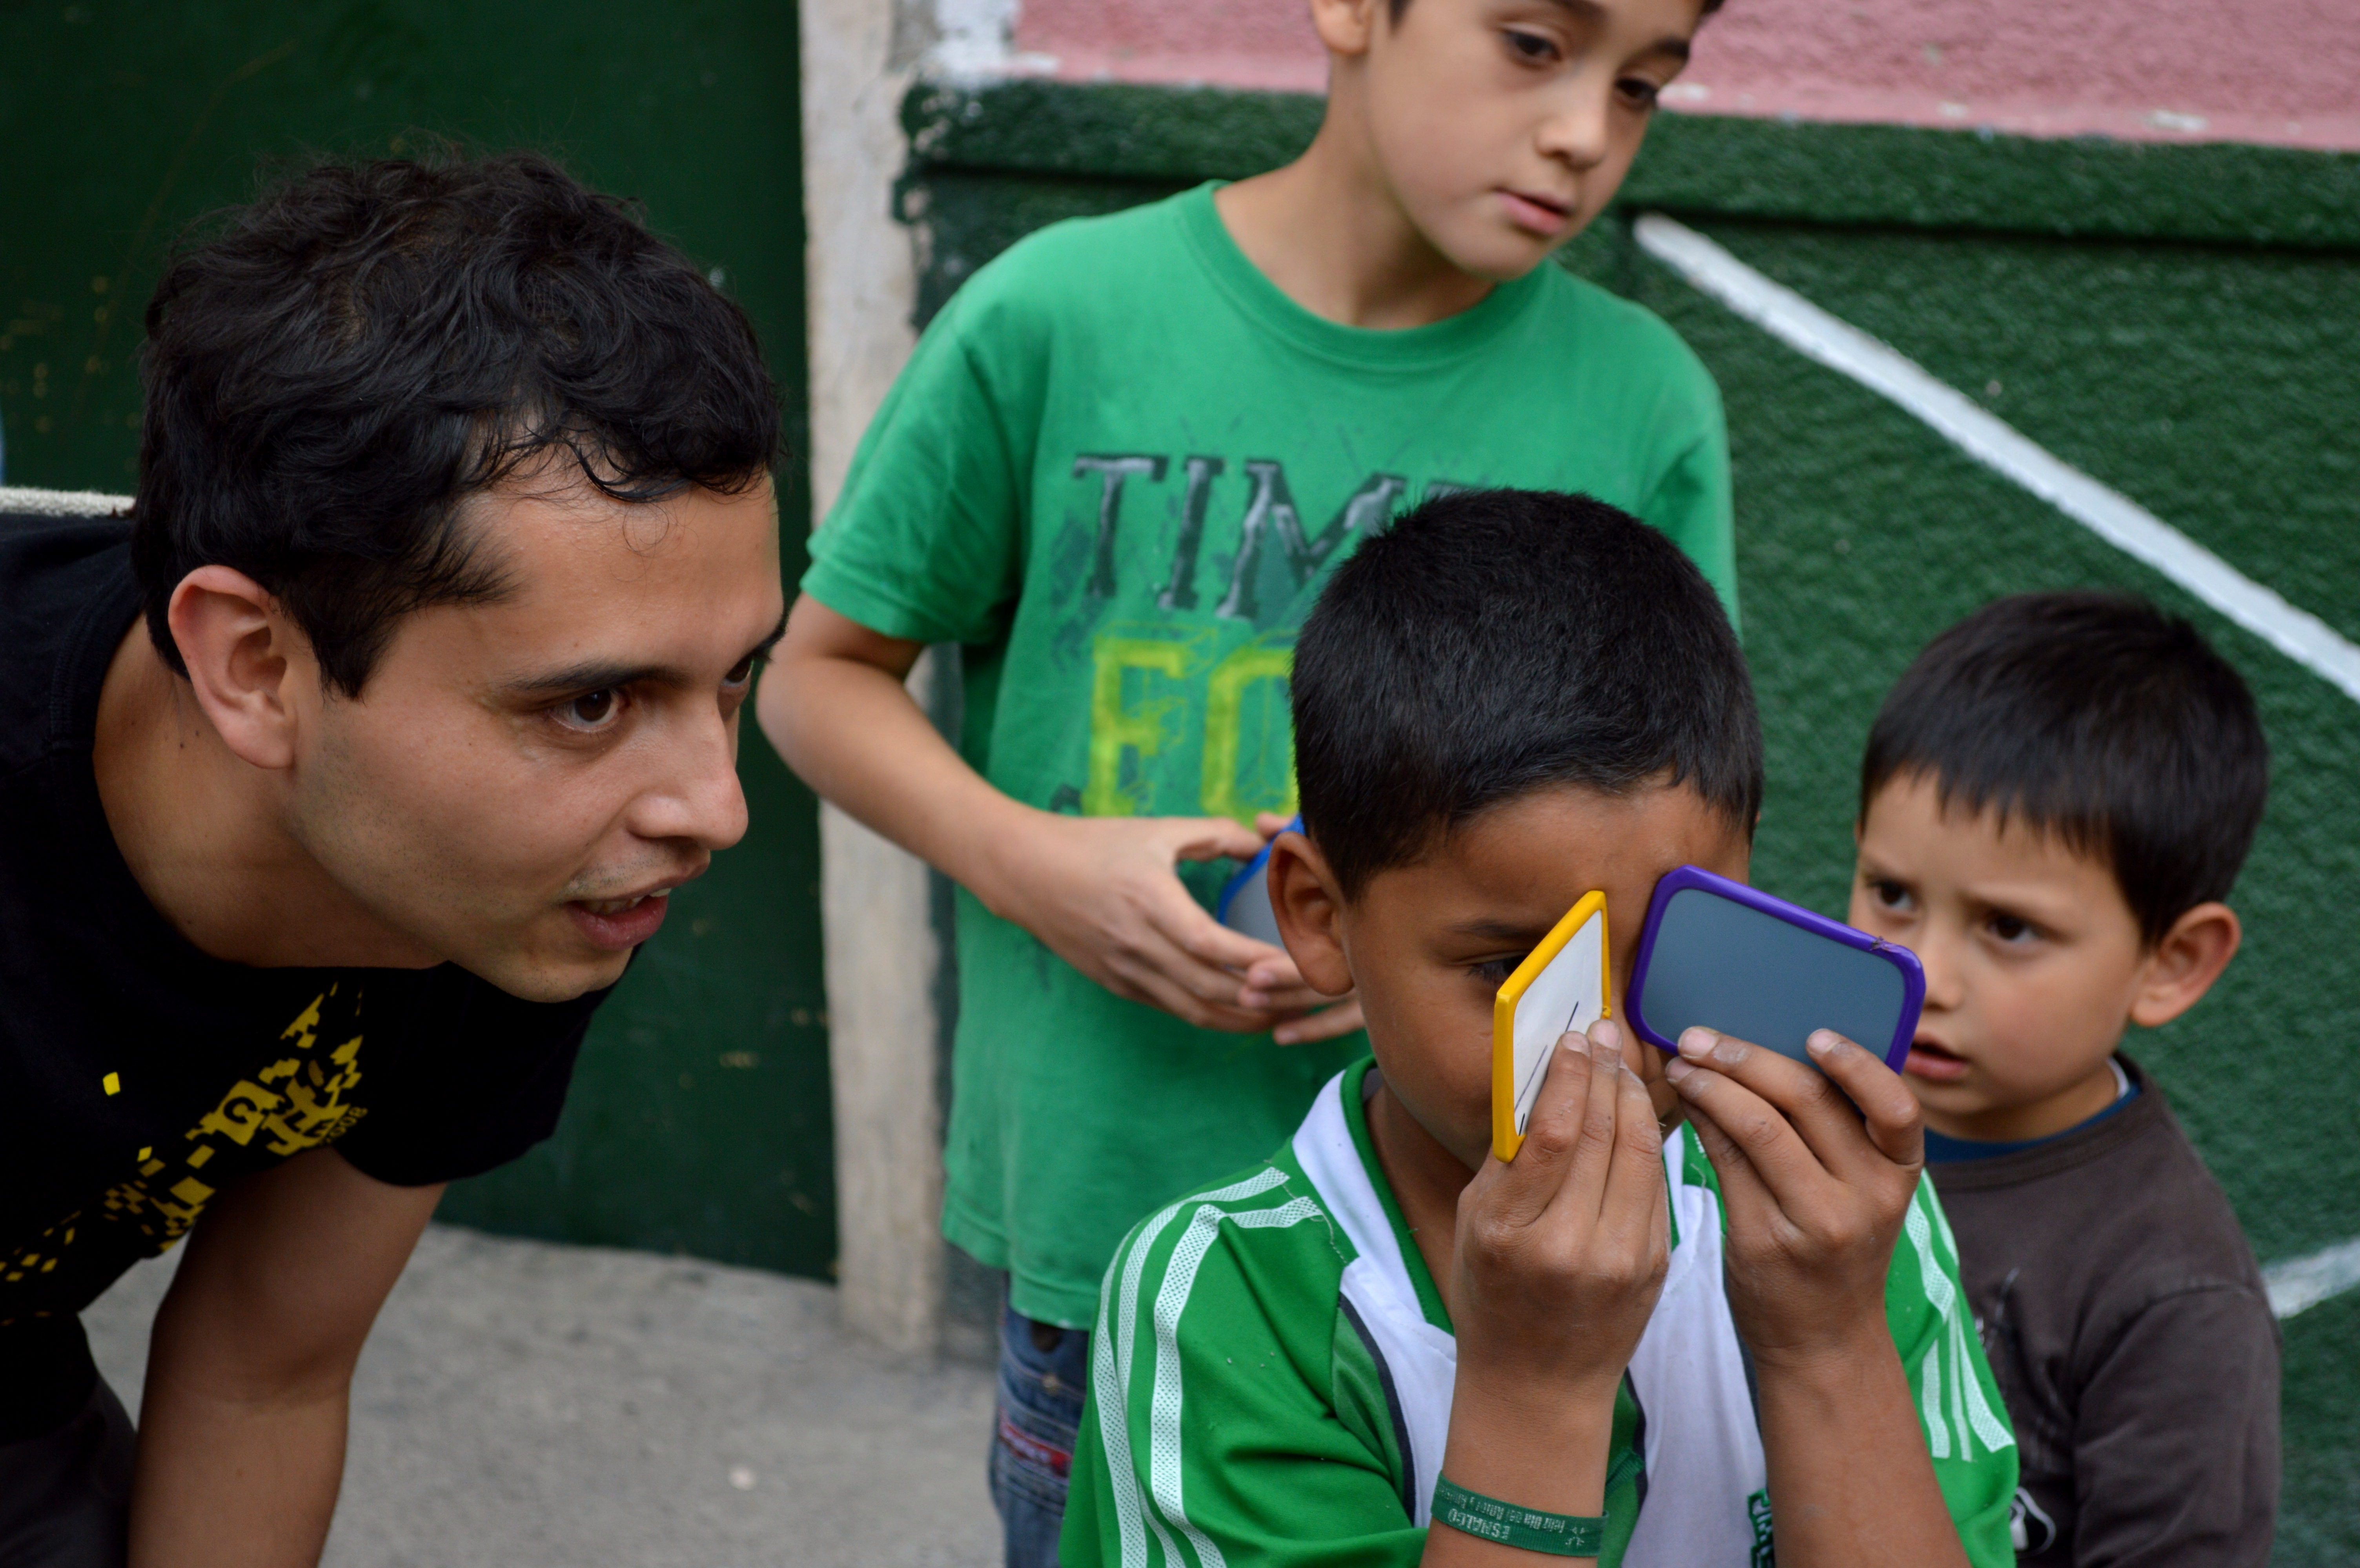

Slide 50
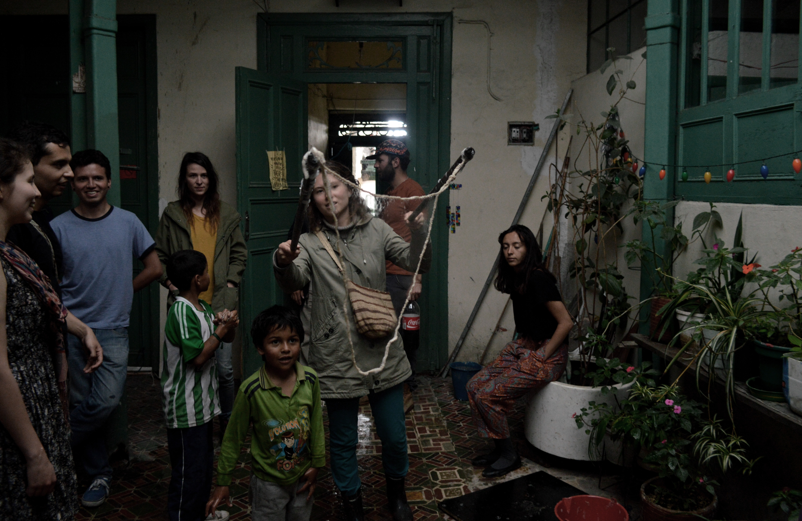

Slide 51
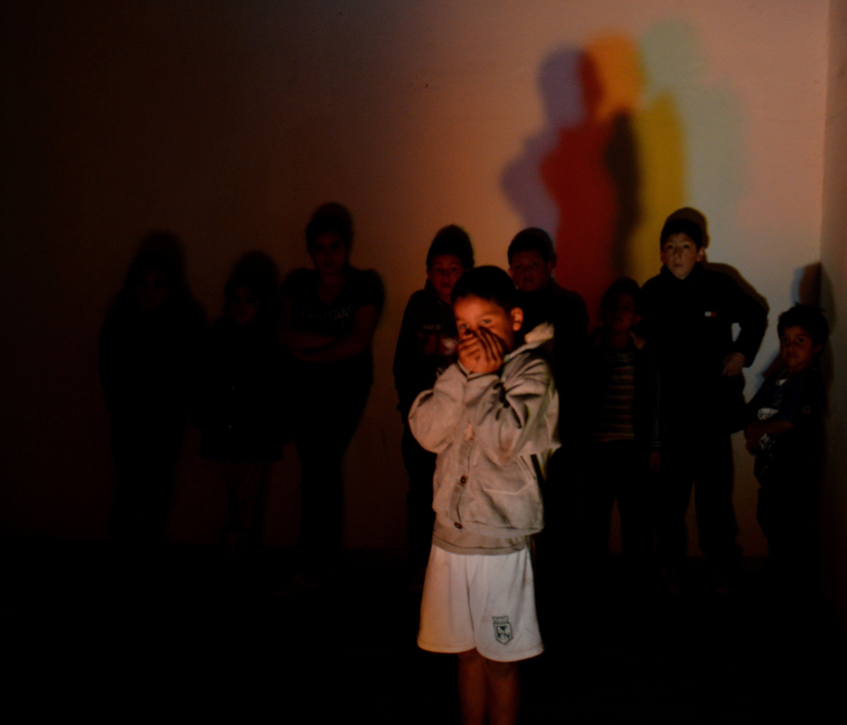

Slide 52
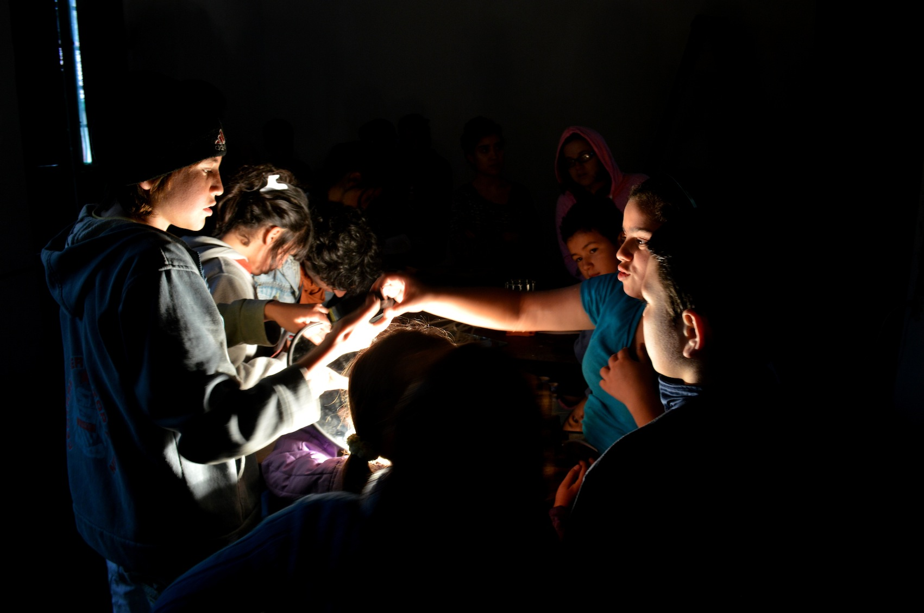

Slide 53
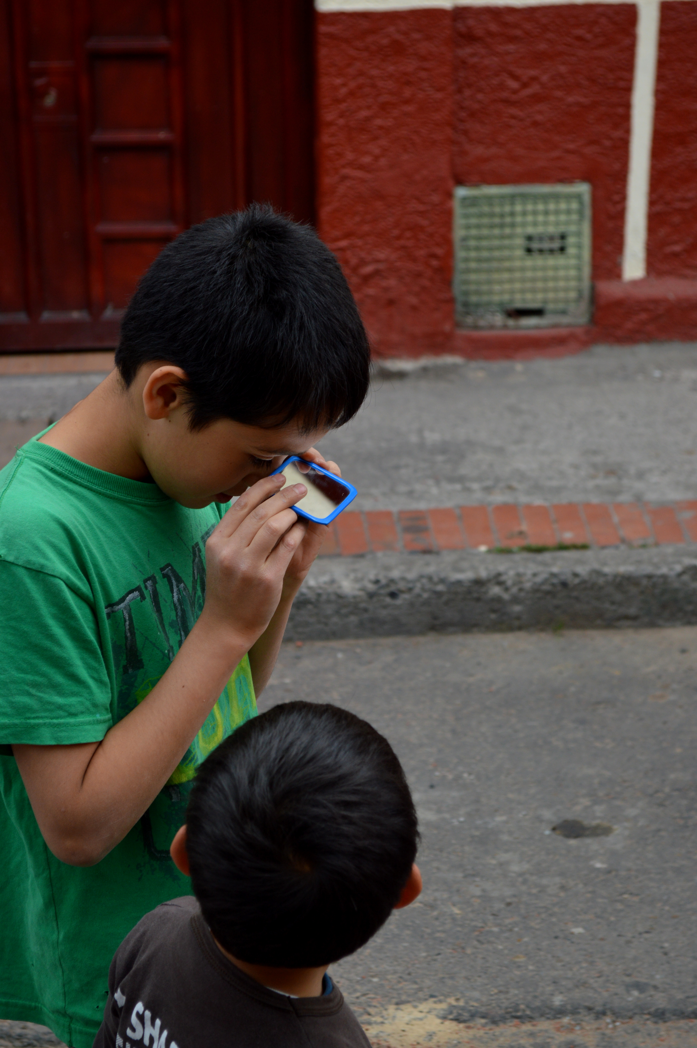

Slide 54
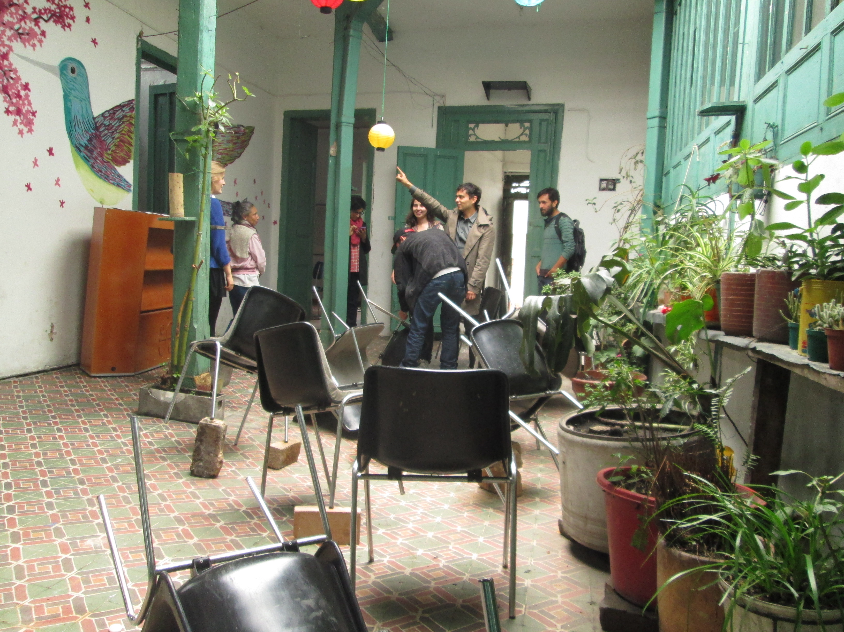

Slide 55


Slide 56


Slide 57
2014
paisajes estereoplanetarios

Slide 58


Slide 59


Slide 60


Slide 61


Slide 62


Slide 63


Slide 64


Slide 65


Slide 66


Slide 67
2015
tiempos cosmológicos

Slide 68


Slide 69


Slide 70

http://raumexperimente.net/en/meta/now-is-always-different/

Slide 71

http://www.aec.at/artandscience/

Slide 72


