Slide 1
El aroma del tiempo cosmológico
Jaime E. Forero Romero
Universidad de los Andes
Octubre 2015

Slide 2
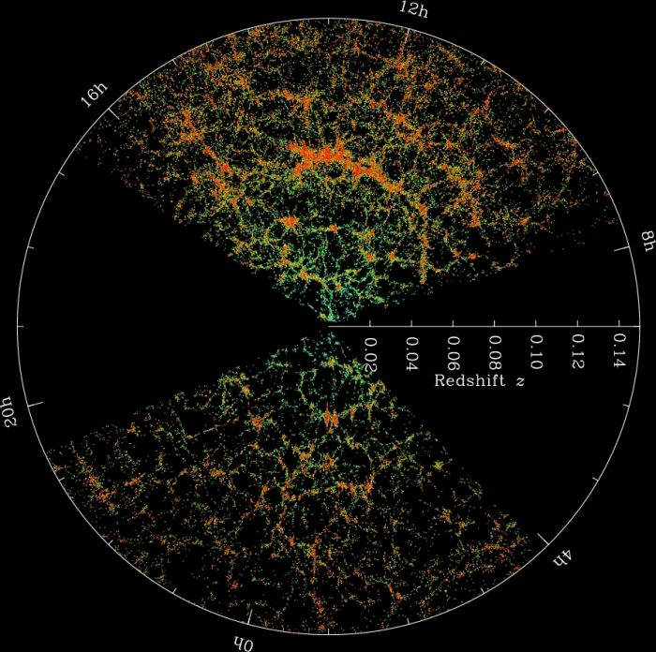

Slide 3
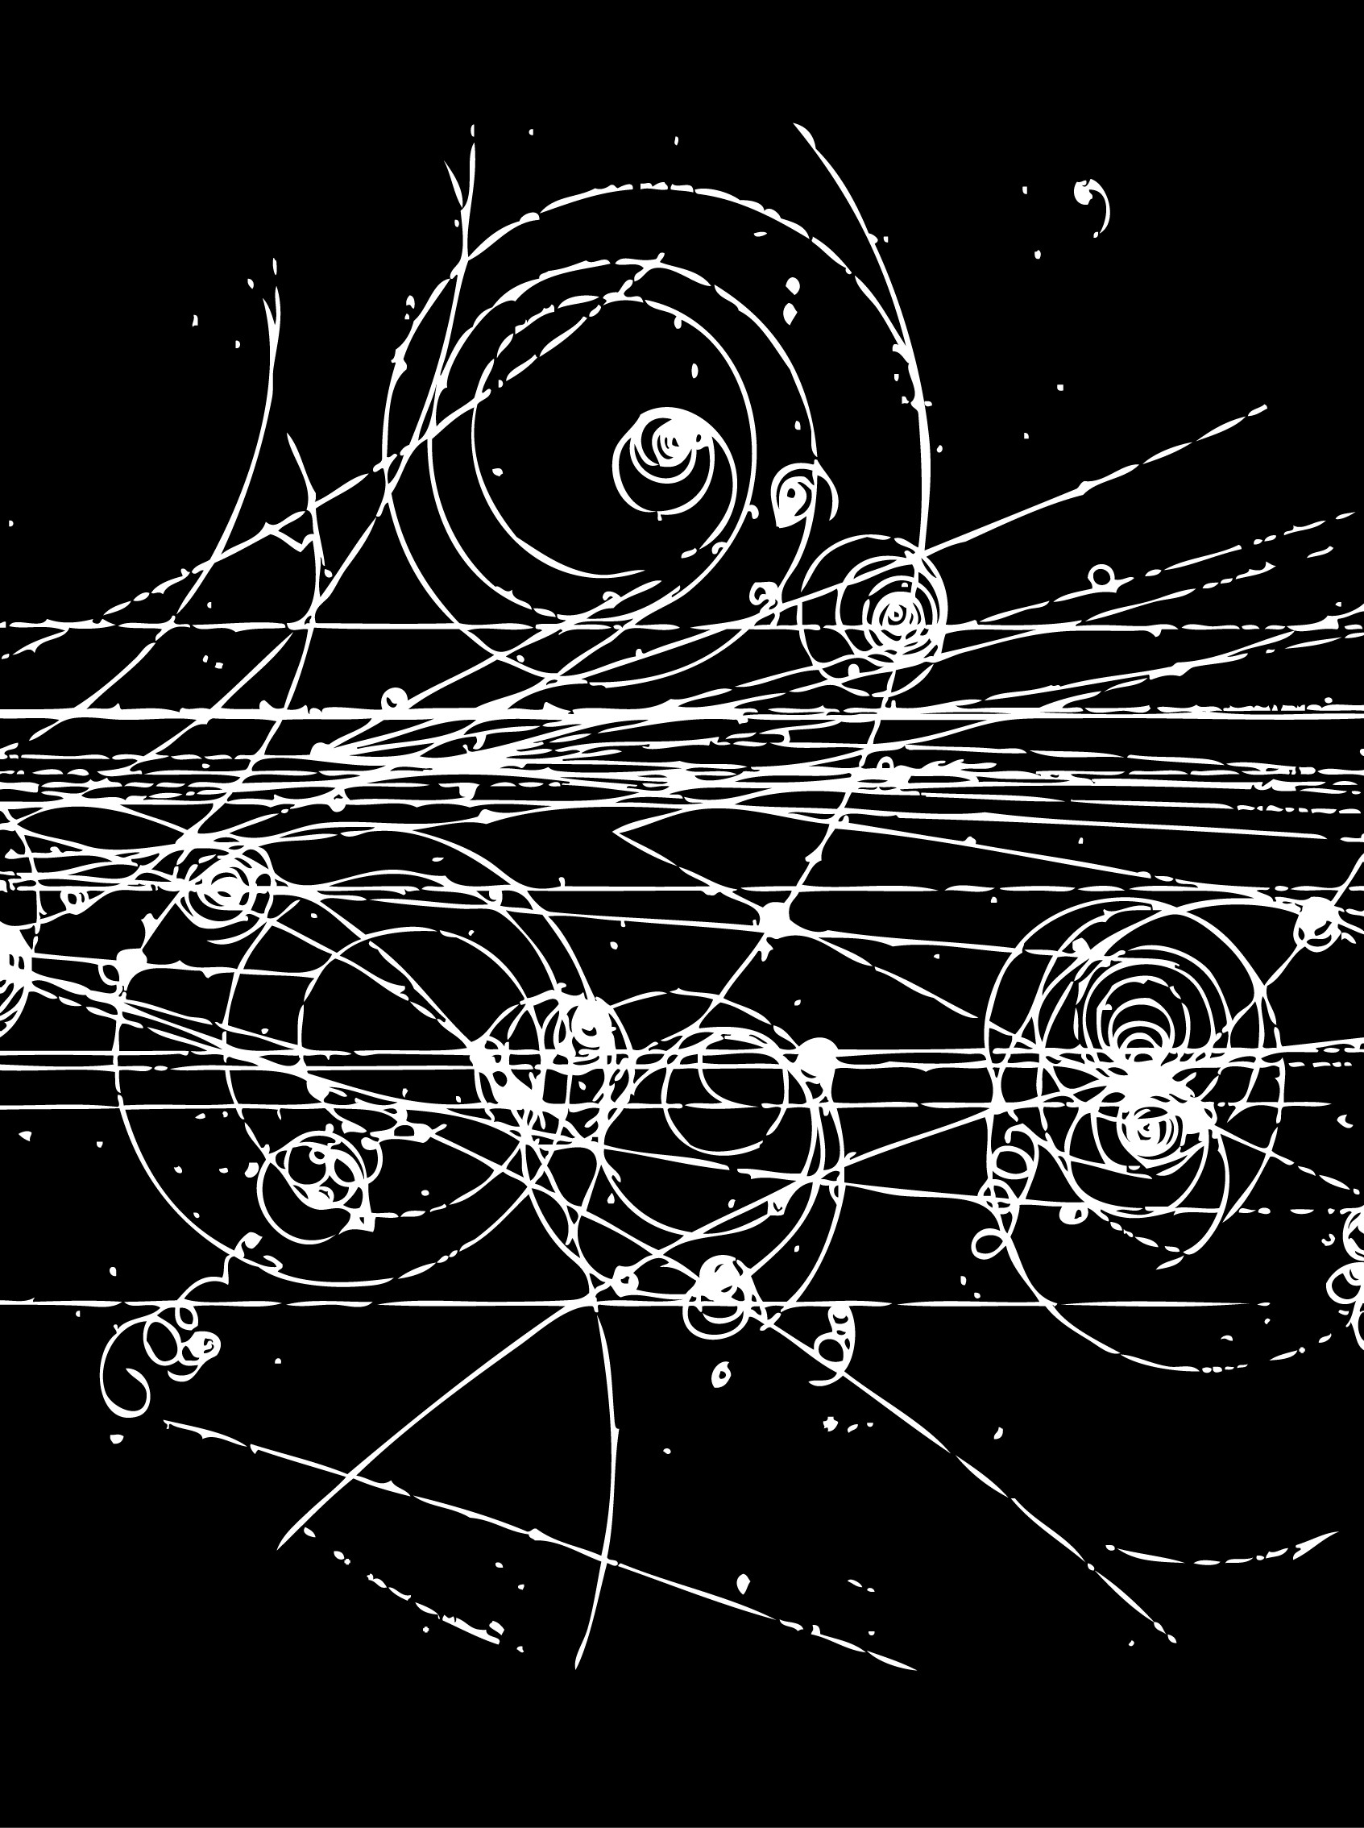

Slide 4
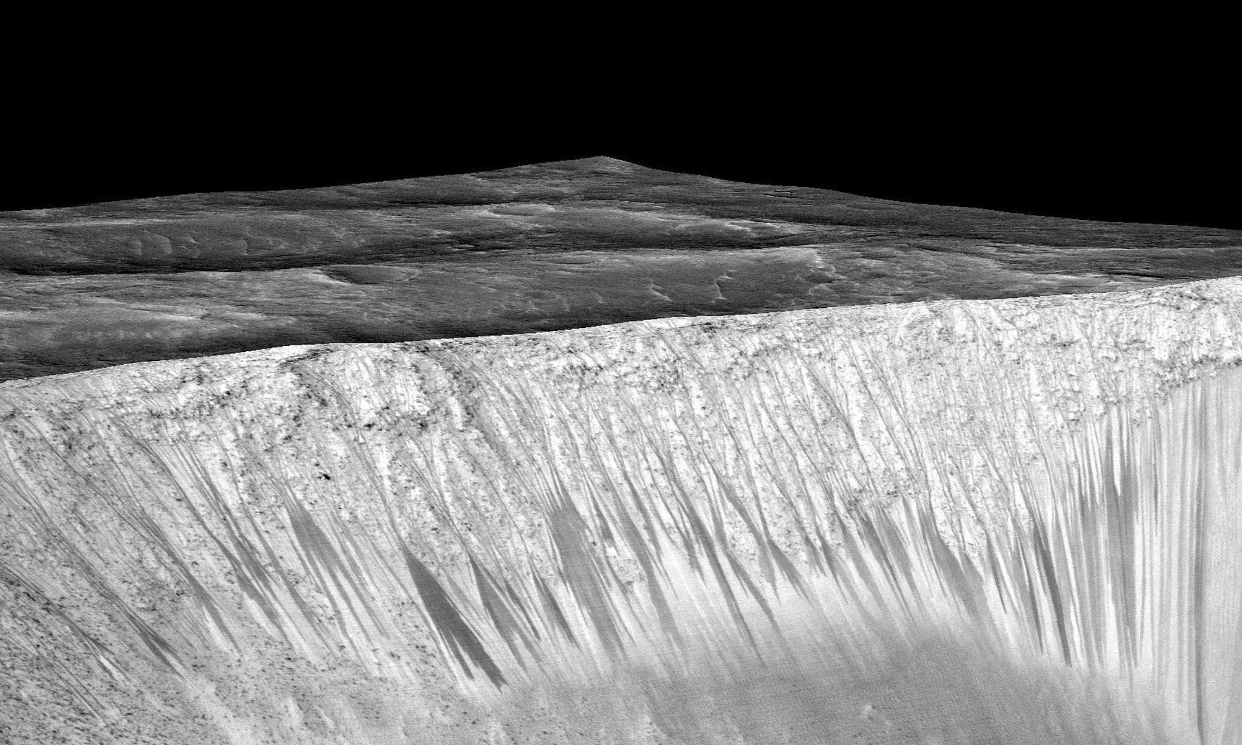
Dark narrow streaks called recurring slope lineae emanate out of the walls of Garni crater on Mars.
Photograph: Nasa/AFP/Getty Images

Slide 5
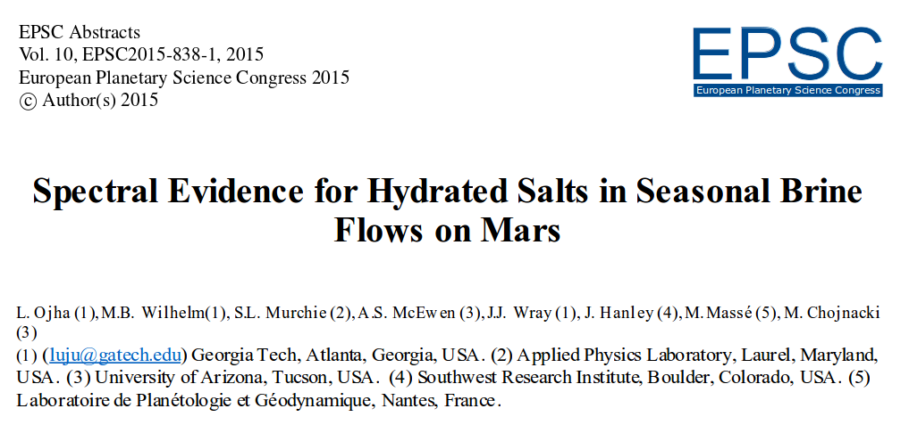
http://meetingorganizer.copernicus.org/EPSC2015/EPSC2015-838-1.pdf

Slide 6


Slide 7
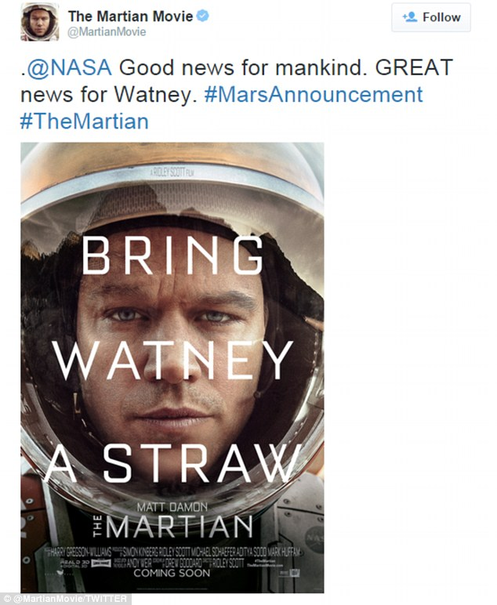

Slide 8
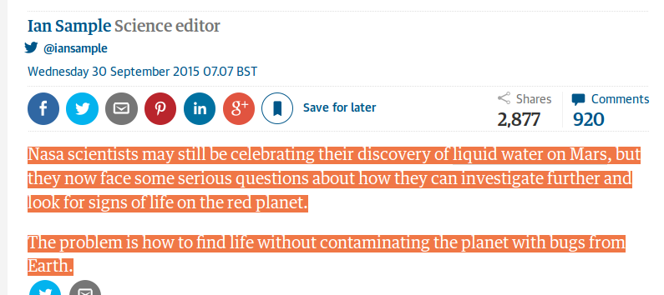

Slide 9


Slide 10


Slide 11
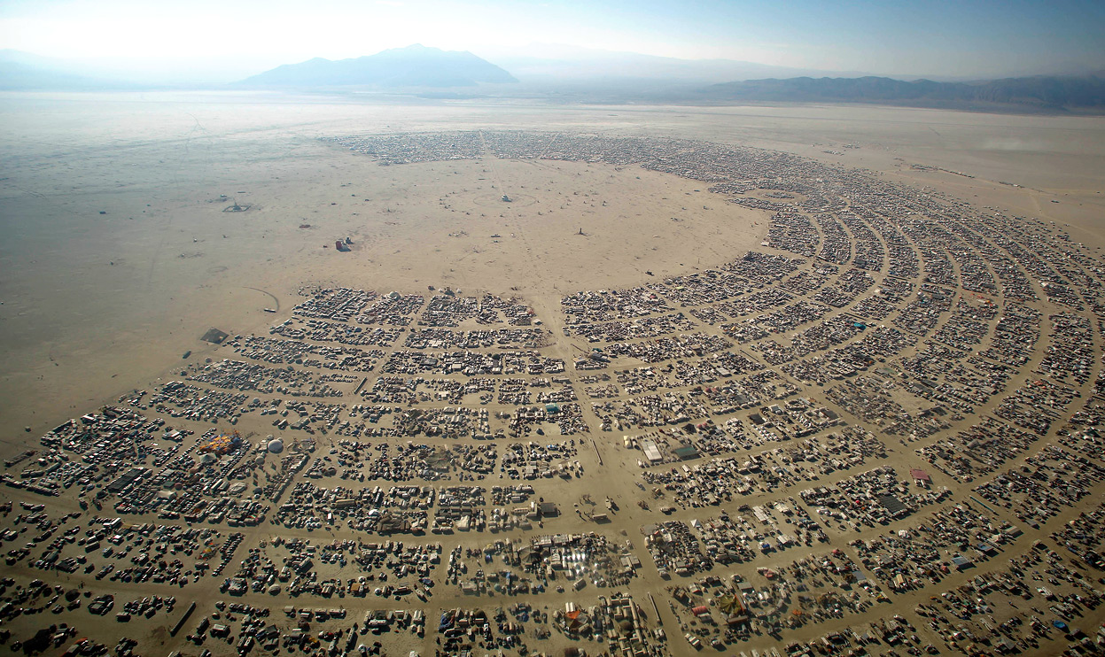
http://www.campawesomeness.org/#

Slide 12
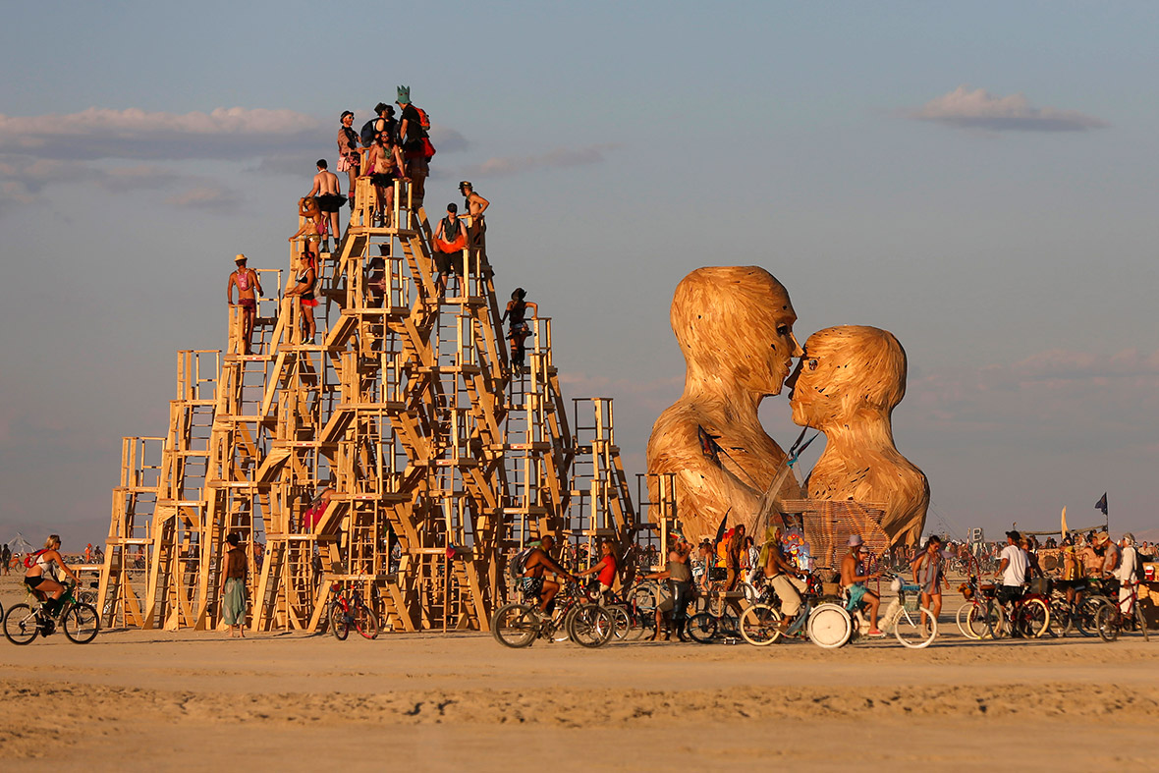
http://www.ibtimes.co.uk/burning-man-2014-spectacular-photos-annual-festival-nevadas-black-rock-desert-1463401

Slide 13
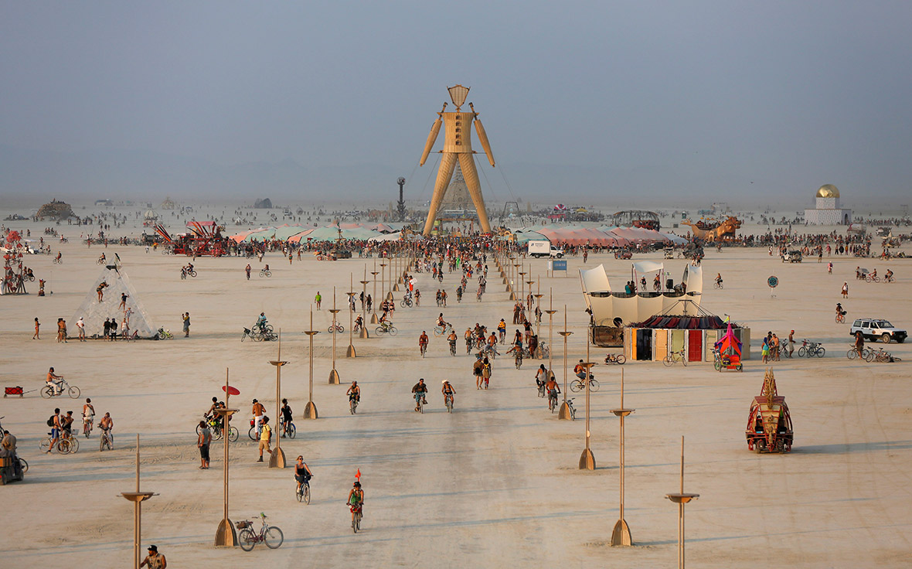
http://www.ibtimes.co.uk/burning-man-2014-spectacular-photos-annual-festival-nevadas-black-rock-desert-1463401

Slide 14
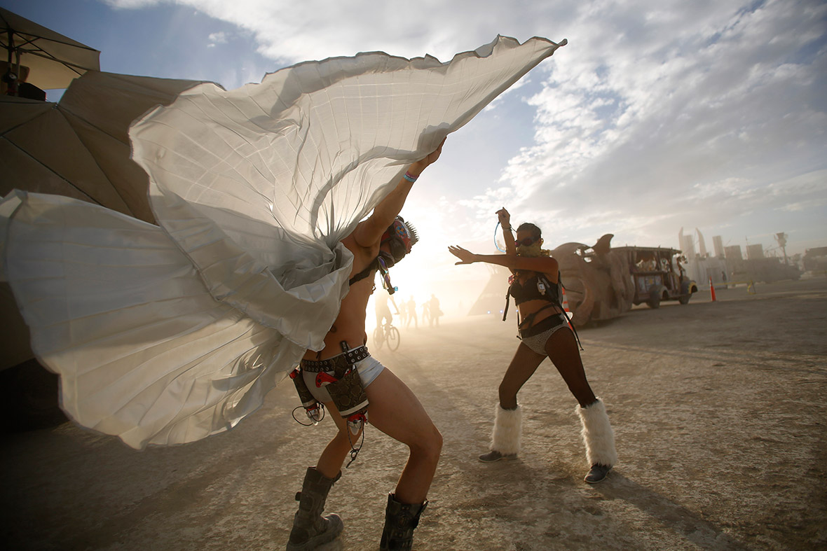
http://www.ibtimes.co.uk/burning-man-2014-spectacular-photos-annual-festival-nevadas-black-rock-desert-1463401

Slide 15

http://www.ibtimes.co.uk/burning-man-2014-spectacular-photos-annual-festival-nevadas-black-rock-desert-1463401

Slide 16
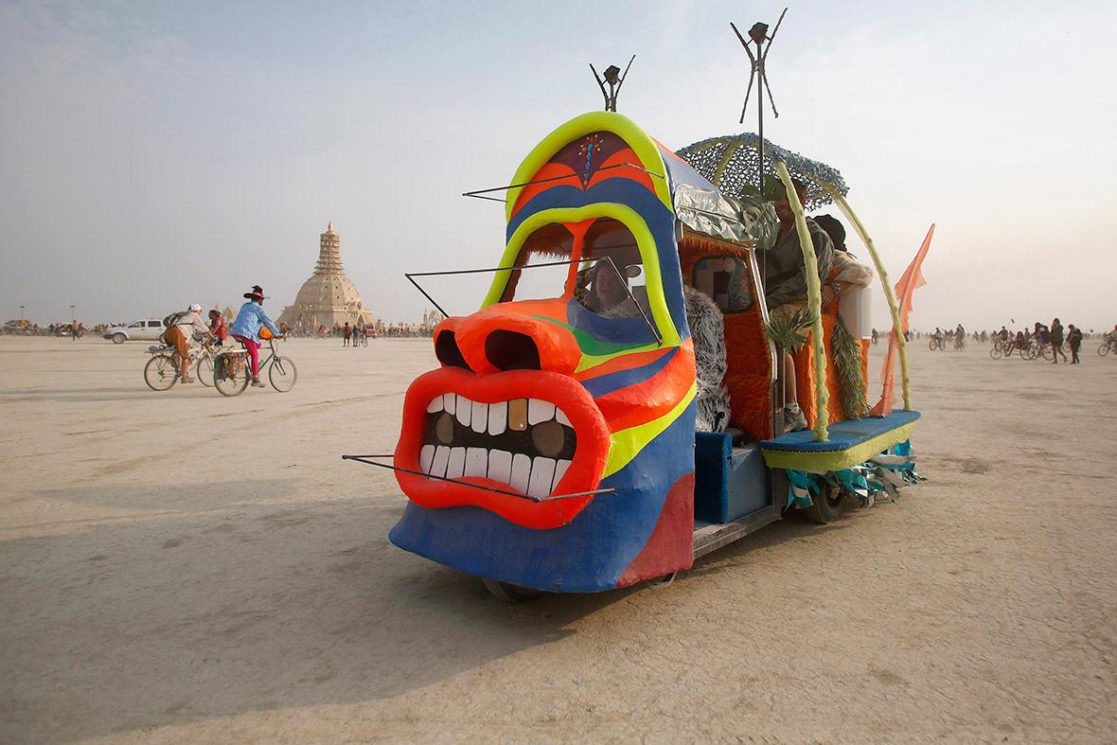
http://www.ibtimes.co.uk/burning-man-2014-spectacular-photos-annual-festival-nevadas-black-rock-desert-1463401
http://www.ibtimes.co.uk/burning-man-2014-spectacular-photos-annual-festival-nevadas-black-rock-desert-1463401

Slide 17

http://www.ibtimes.co.uk/burning-man-2014-spectacular-photos-annual-festival-nevadas-black-rock-desert-1463401

Slide 18
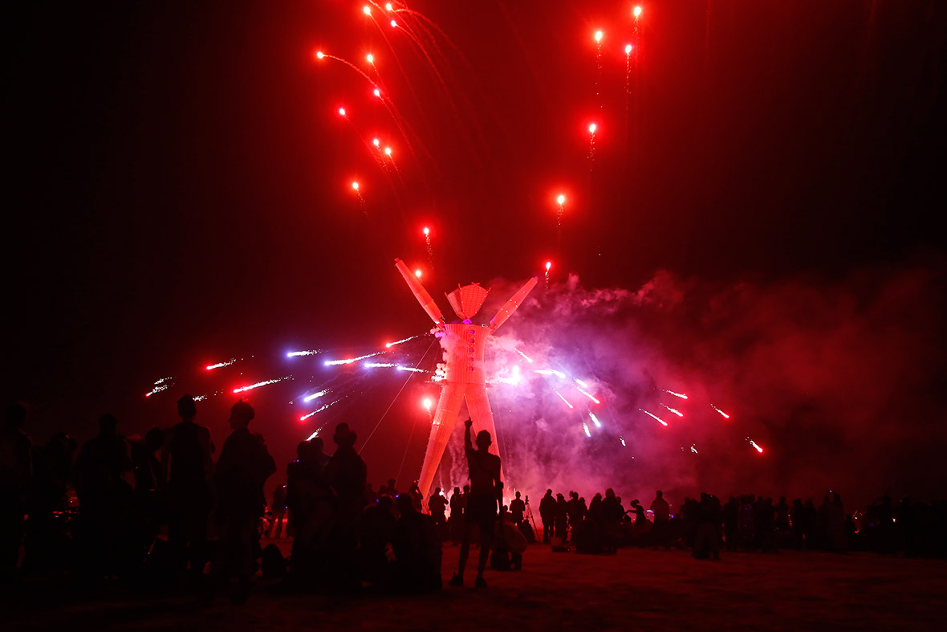
http://www.ibtimes.co.uk/burning-man-2014-spectacular-photos-annual-festival-nevadas-black-rock-desert-1463401

Slide 19
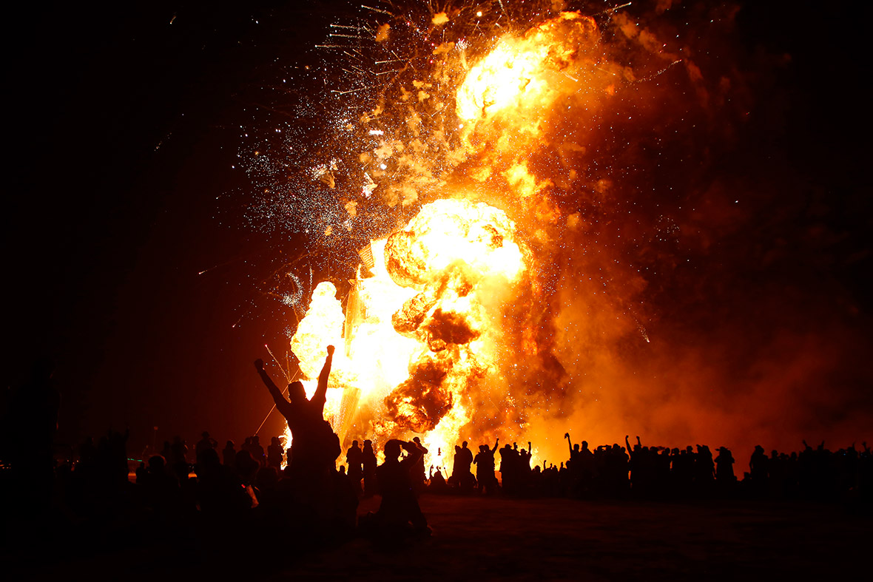

Slide 20
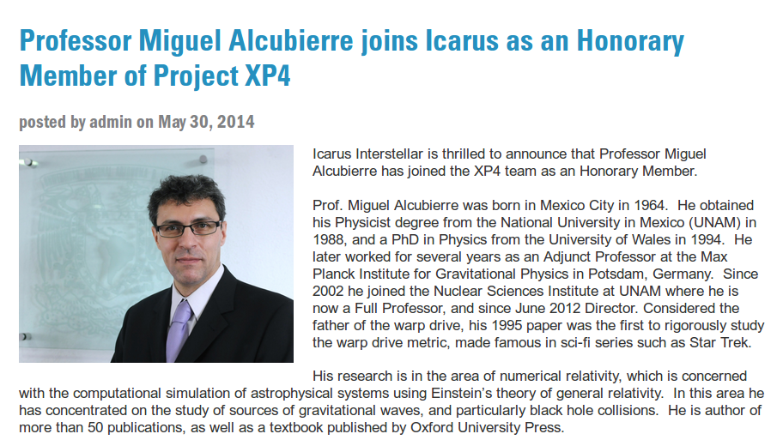

Slide 21
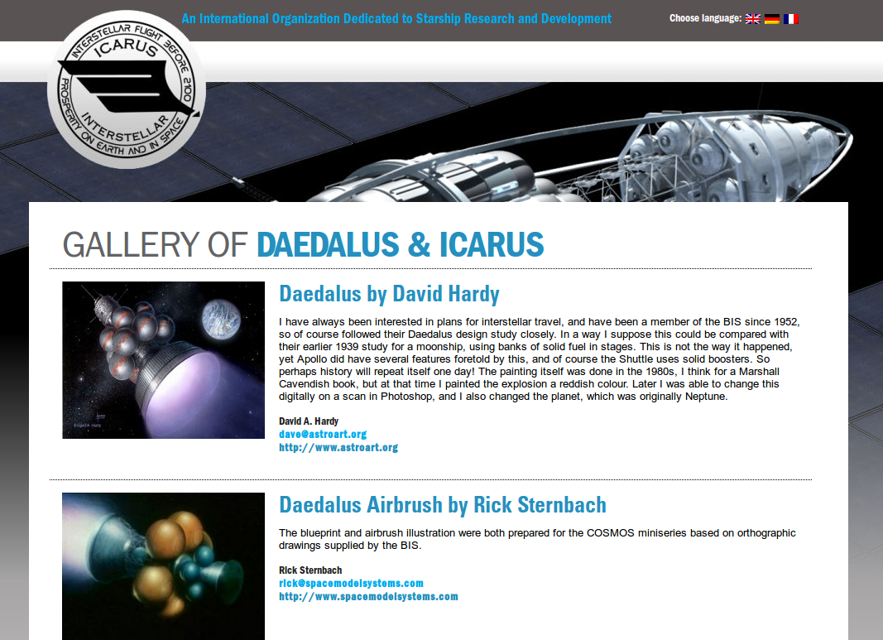
http://www.icarusinterstellar.org

Slide 22
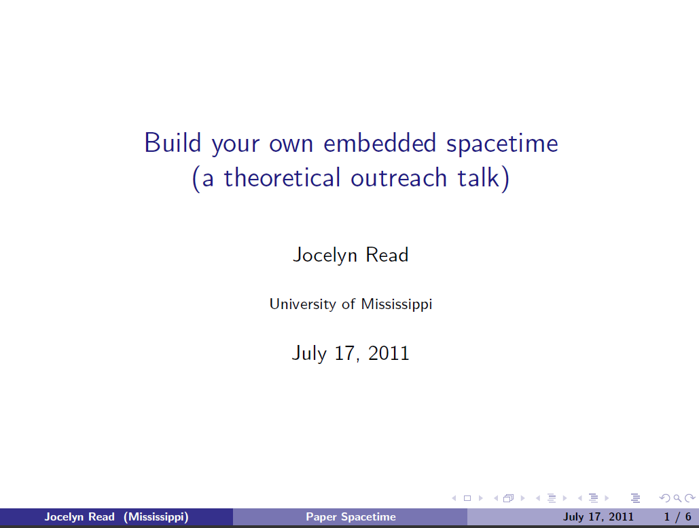
http://www.amaldi9.org/abstracts/123/ConstructingPaperOutreachTalk.pdf

Slide 23
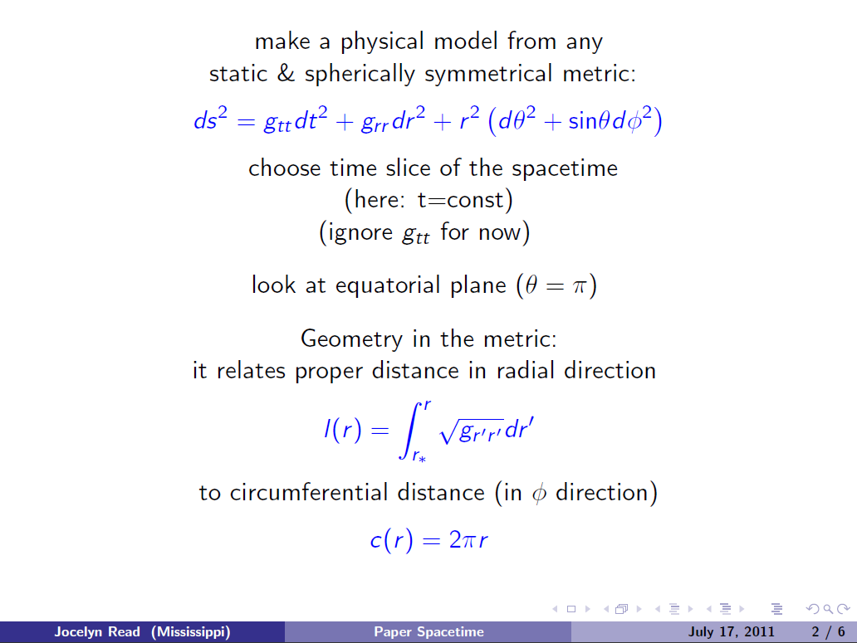
http://www.amaldi9.org/abstracts/123/ConstructingPaperOutreachTalk.pdf

Slide 24
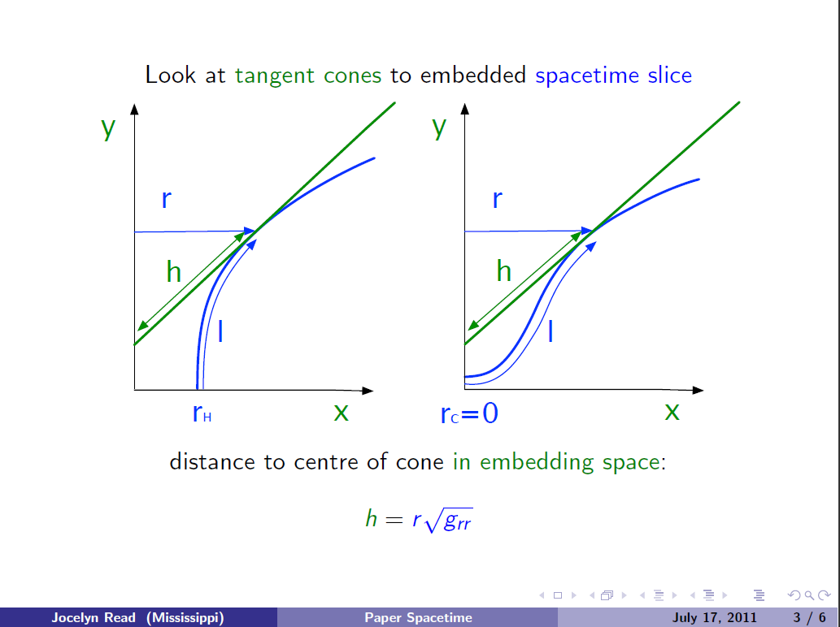
http://www.amaldi9.org/abstracts/123/ConstructingPaperOutreachTalk.pdf

Slide 25
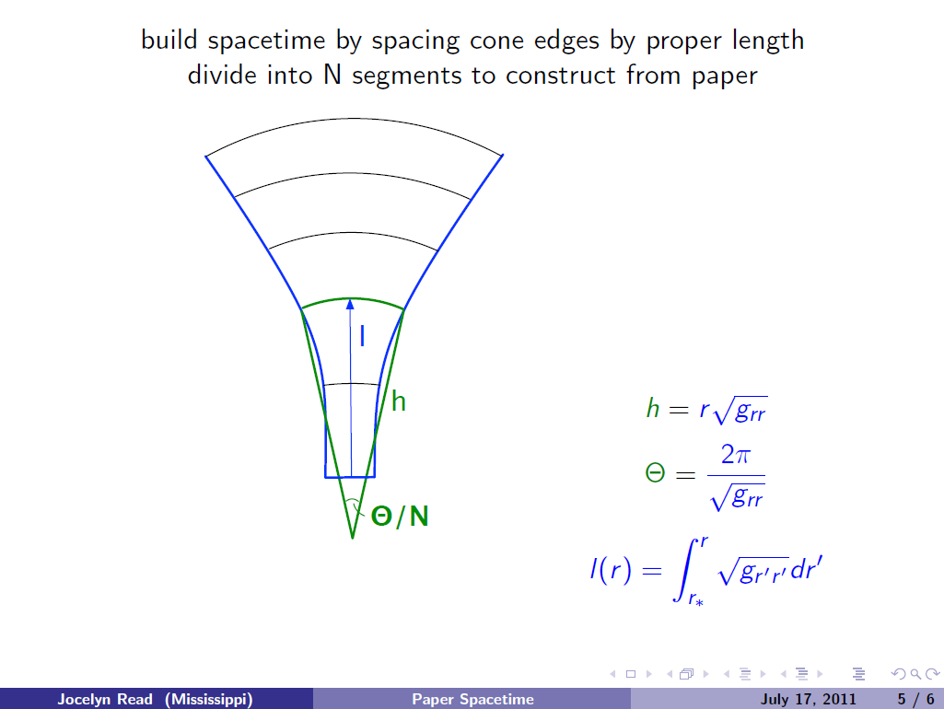
http://www.amaldi9.org/abstracts/123/ConstructingPaperOutreachTalk.pdf

Slide 26
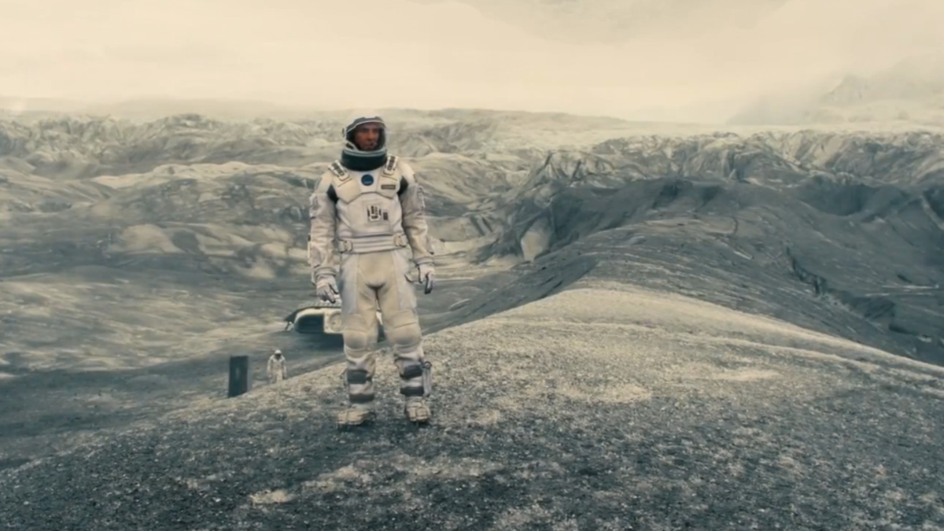
https://en.wikibooks.org/wiki/A_Roller_Coaster_Ride_through_Relativity/Appendix_A
http://www.huffingtonpost.com/brandon-judell/movie-review-interstellar_1_b_6100562.html

Slide 27
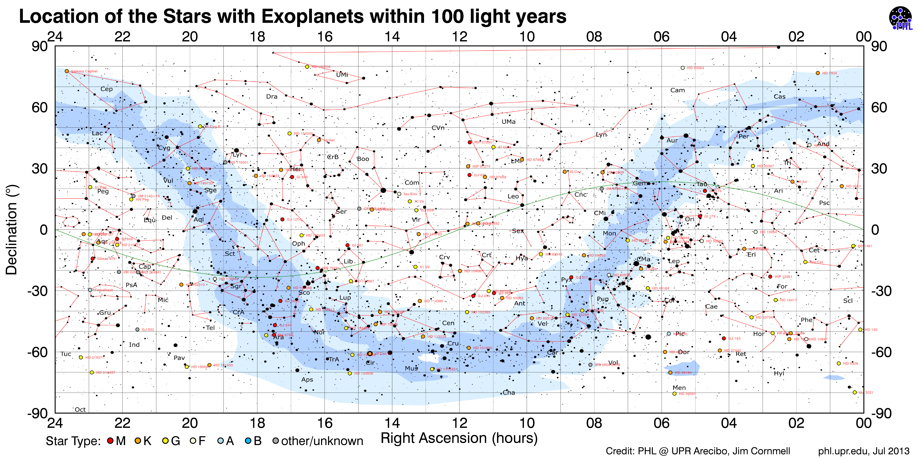
Distancias en el Universo

Slide 28
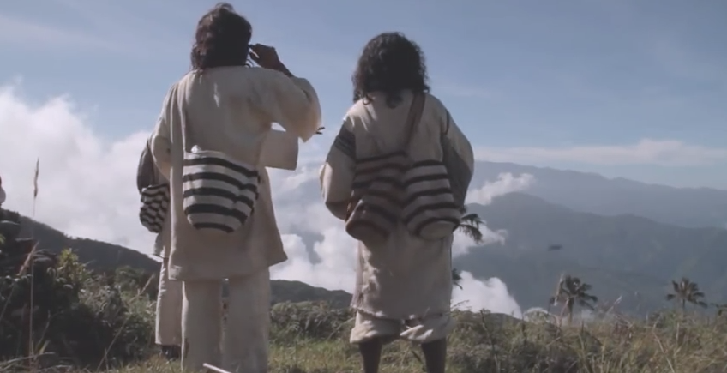
Trailer Aluna: https://www.youtube.com/watch?v=mHQ4FfgBBXI

Slide 29
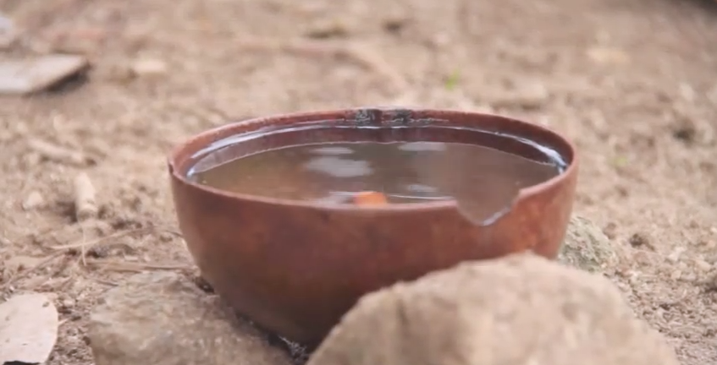
Trailer Aluna: https://www.youtube.com/watch?v=mHQ4FfgBBXI

Slide 30
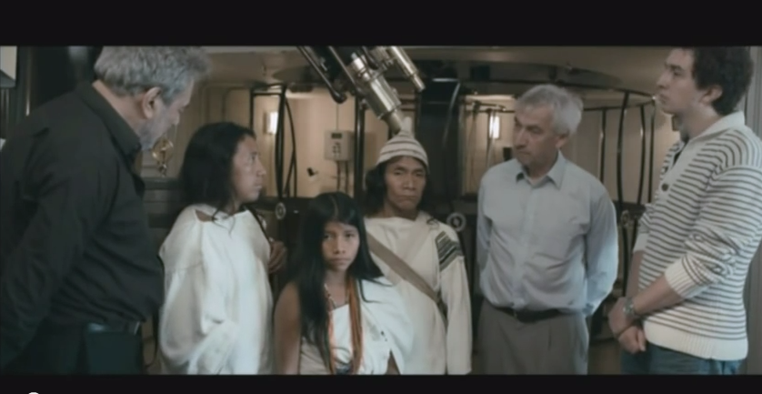
Aluna (fragmento con Richard Ellis)https://www.youtube.com/watch?v=gLiSAKqzTZM

Slide 31
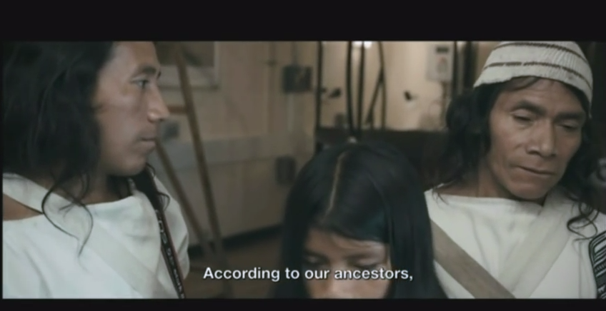
Aluna (fragmento con Richard Ellis)https://www.youtube.com/watch?v=gLiSAKqzTZM

Slide 32
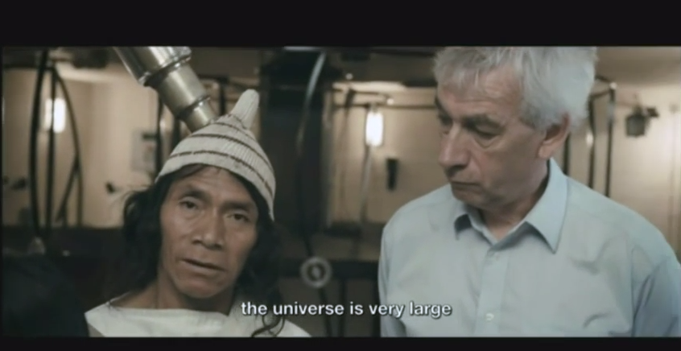
Aluna (fragmento con Richard Ellis)https://www.youtube.com/watch?v=gLiSAKqzTZM

Slide 33
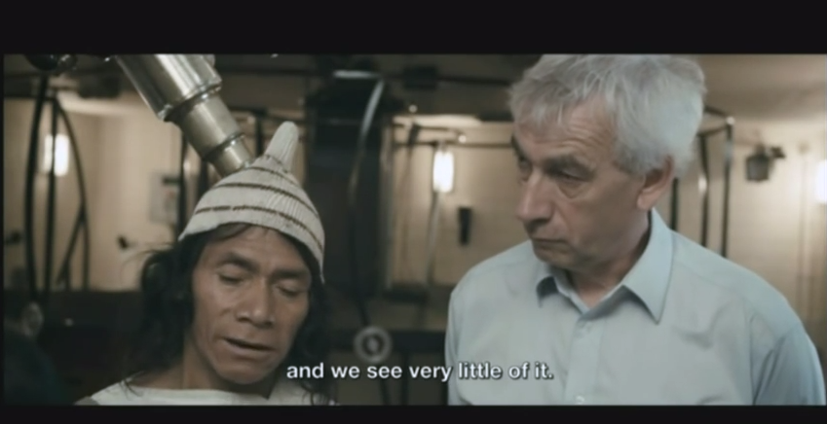
Aluna (fragmento con Richard Ellis)https://www.youtube.com/watch?v=gLiSAKqzTZM

Slide 34
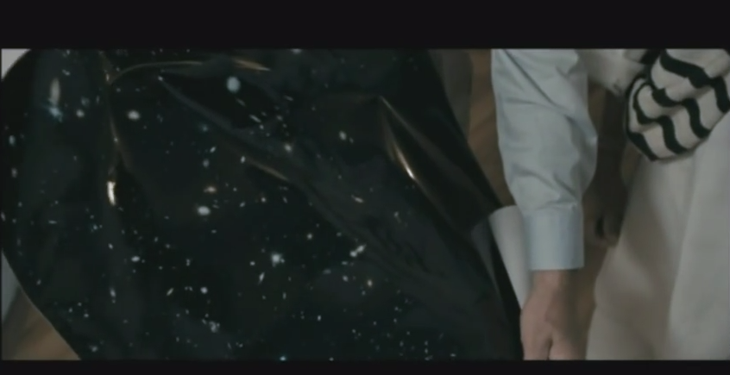
Aluna (fragmento con Richard Ellis)https://www.youtube.com/watch?v=gLiSAKqzTZM

Slide 35
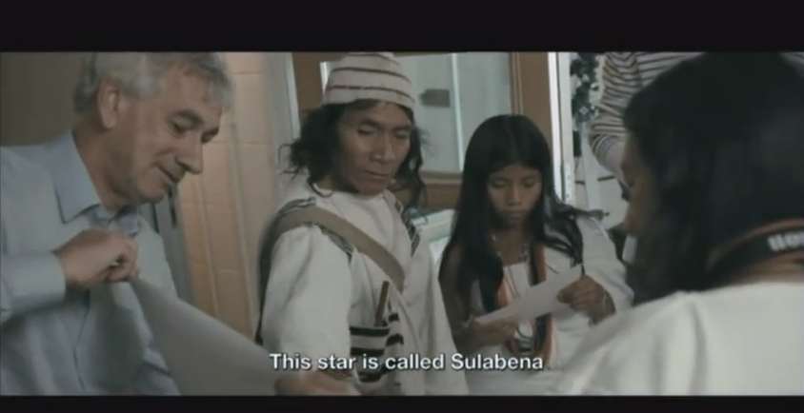
Aluna (fragmento con Richard Ellis)https://www.youtube.com/watch?v=gLiSAKqzTZM

Slide 36
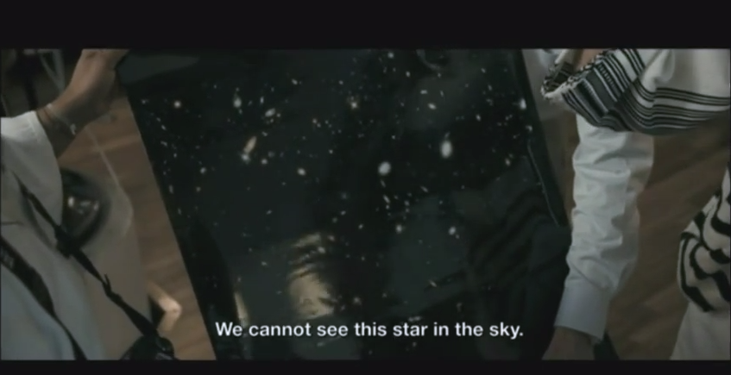
Aluna (fragmento con Richard Ellis)https://www.youtube.com/watch?v=gLiSAKqzTZM

Slide 37
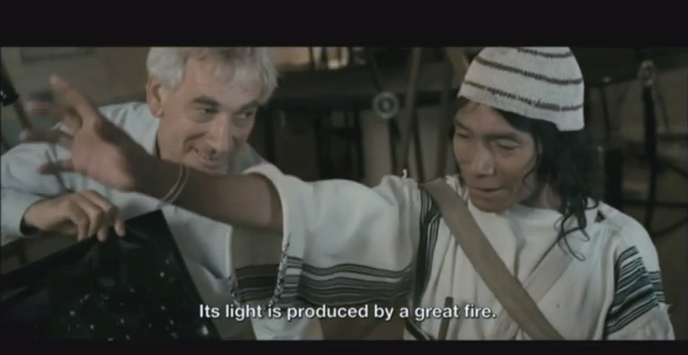
Aluna (fragmento con Richard Ellis)https://www.youtube.com/watch?v=gLiSAKqzTZM

Slide 38
Trailer Aluna: https://www.youtube.com/watch?v=mHQ4FfgBBXI

