Slide 1
Viajes especiales
Jaime E. Forero Romero
Universidad de los Andes
Octubre 2015

Slide 2

http://imgur.com/gallery/2jsfax6

Slide 3

http://mic.com/articles/113598/get-ready-for-more-mulder-and-scully-the-x-files-is-coming-back

Slide 4
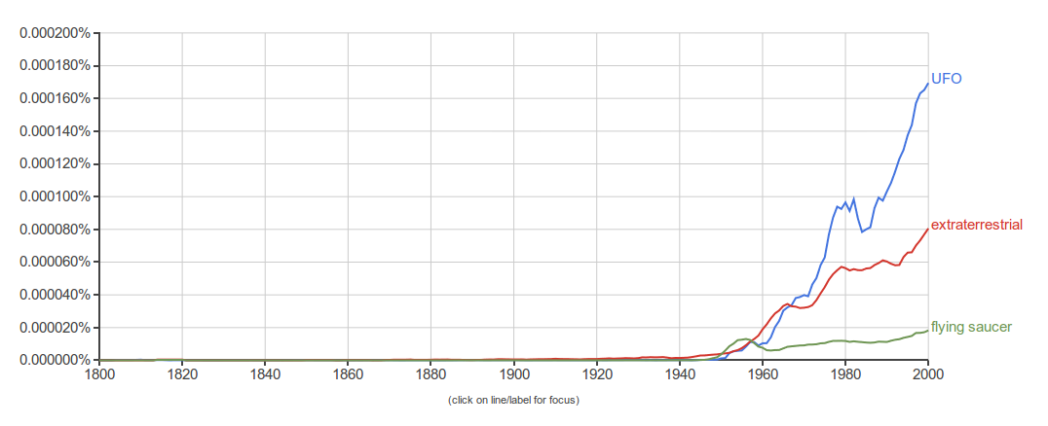
UFO Unidentified Flying Object
OVNI Objeto Volador No Identificado
Google books Ngram viewer

Slide 5
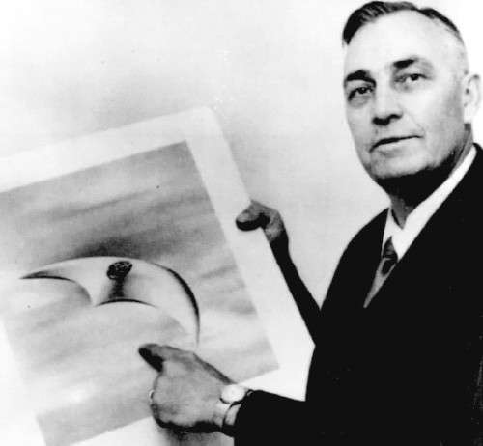
Kenneth Arnold (1947)
http://www.ufoevidence.org/cases/case511.htm

Slide 6
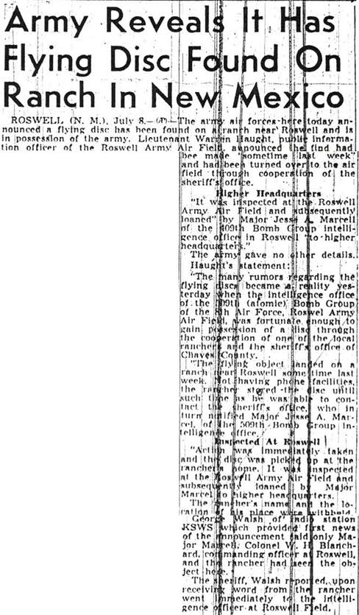
https://en.wikipedia.org/wiki/File:SacramentoBeeArticleJuly8,1947.jpg

Slide 7
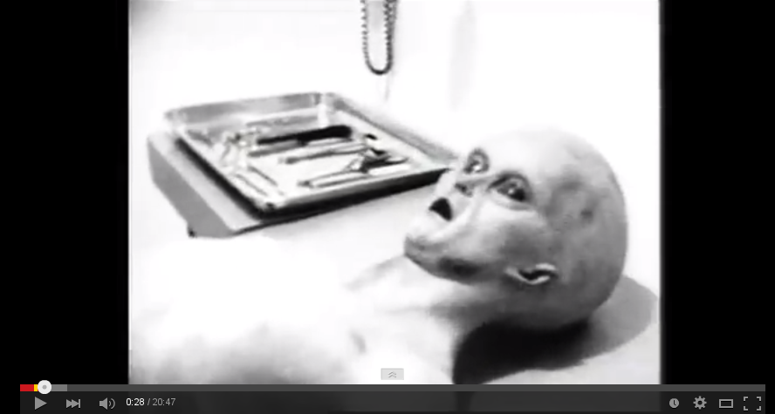
Supuesta autopsia
https://www.youtube.com/watch?v=DhhTo5Ur360

Slide 8
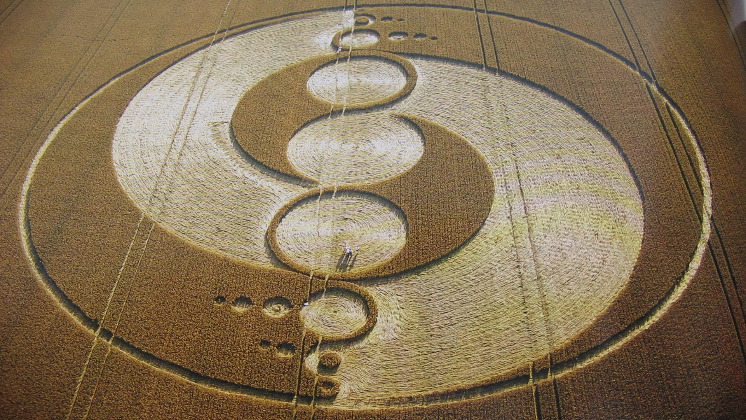
http://7-themes.com/7033818-crop-circles.html

Slide 9
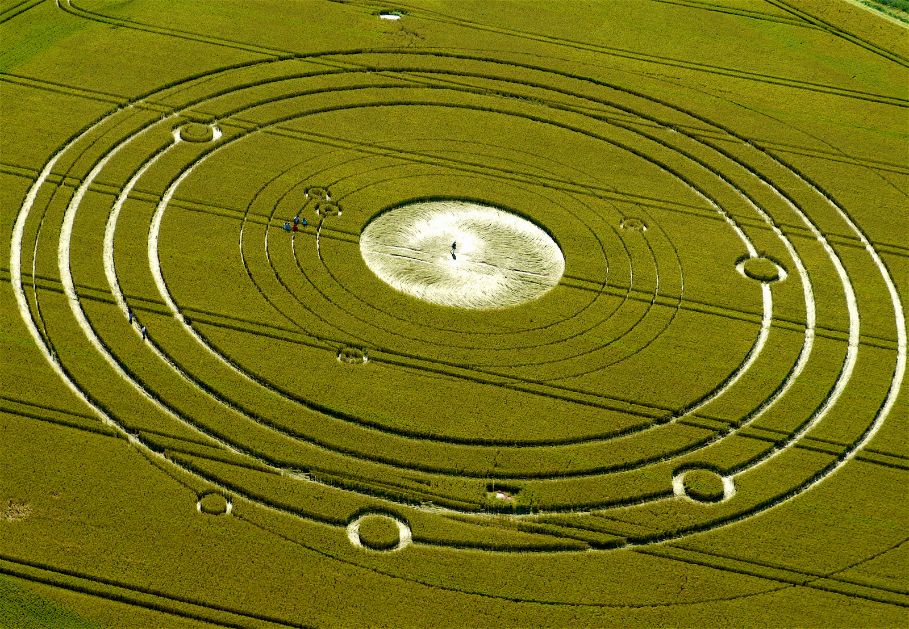
http://eyesontruth.com/2015/04/27/crop-circles/

Slide 10
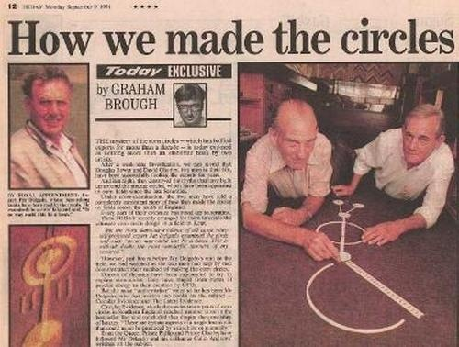
Doug Bouwer & Dave Chorley

Slide 11
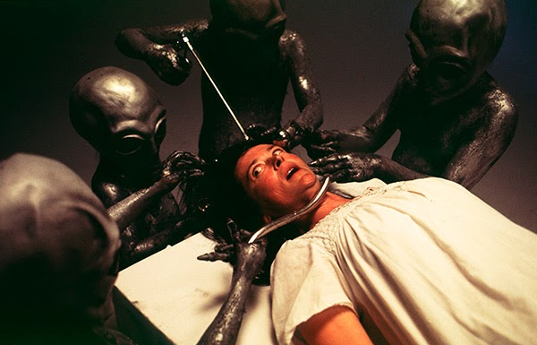
Abducciones
http://www.johnzada.com/blog/2015/alien-abduction-beliefs-explained/

Slide 12

"In the threatening situation of the world today, when people are beginning to see that everything is at stake, the projection-creating fantasy soars beyond the realm of earthly organizations and powers into the heavens, into interstellar space, where the rulers of human fate, the gods, once had their abode in the planets.... Even people who would never have thought that a religious problem could be a serious matter that concerned them personally are beginning to ask themselves fundamental questions. Under these circumstances it would not be at all surprising if those sections of the community who ask themselves nothing were visited by `visions,' by a widespread myth seriously believed in by some and rejected as absurd by others."--C. G. Jung, in Flying Saucers

Slide 13
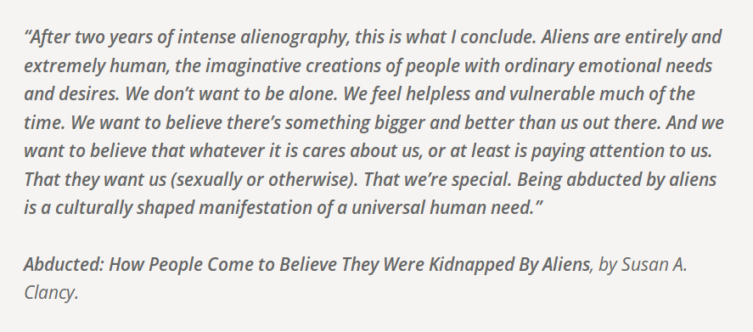
http://www.johnzada.com/blog/2015/alien-abduction-beliefs-explained/

Slide 14

http://www.penguinrandomhouse.com/books/206381/ufo-crash-at-roswell-by-benson-saler-charles-a-ziegler-et-al/#

Slide 15
“Lo único disponible en este caso no es un platillo chocado o los cuerpos de los extraterrestres, sino más bien libros que contienen historias sobre platillos chocados y cuerpos de extraterrestres. Porque son estas historias las que han afectado a nuestra sociedad, son estas historias la que necesitan explicarse.”
Saler, Ziegeler, Moore

Slide 16
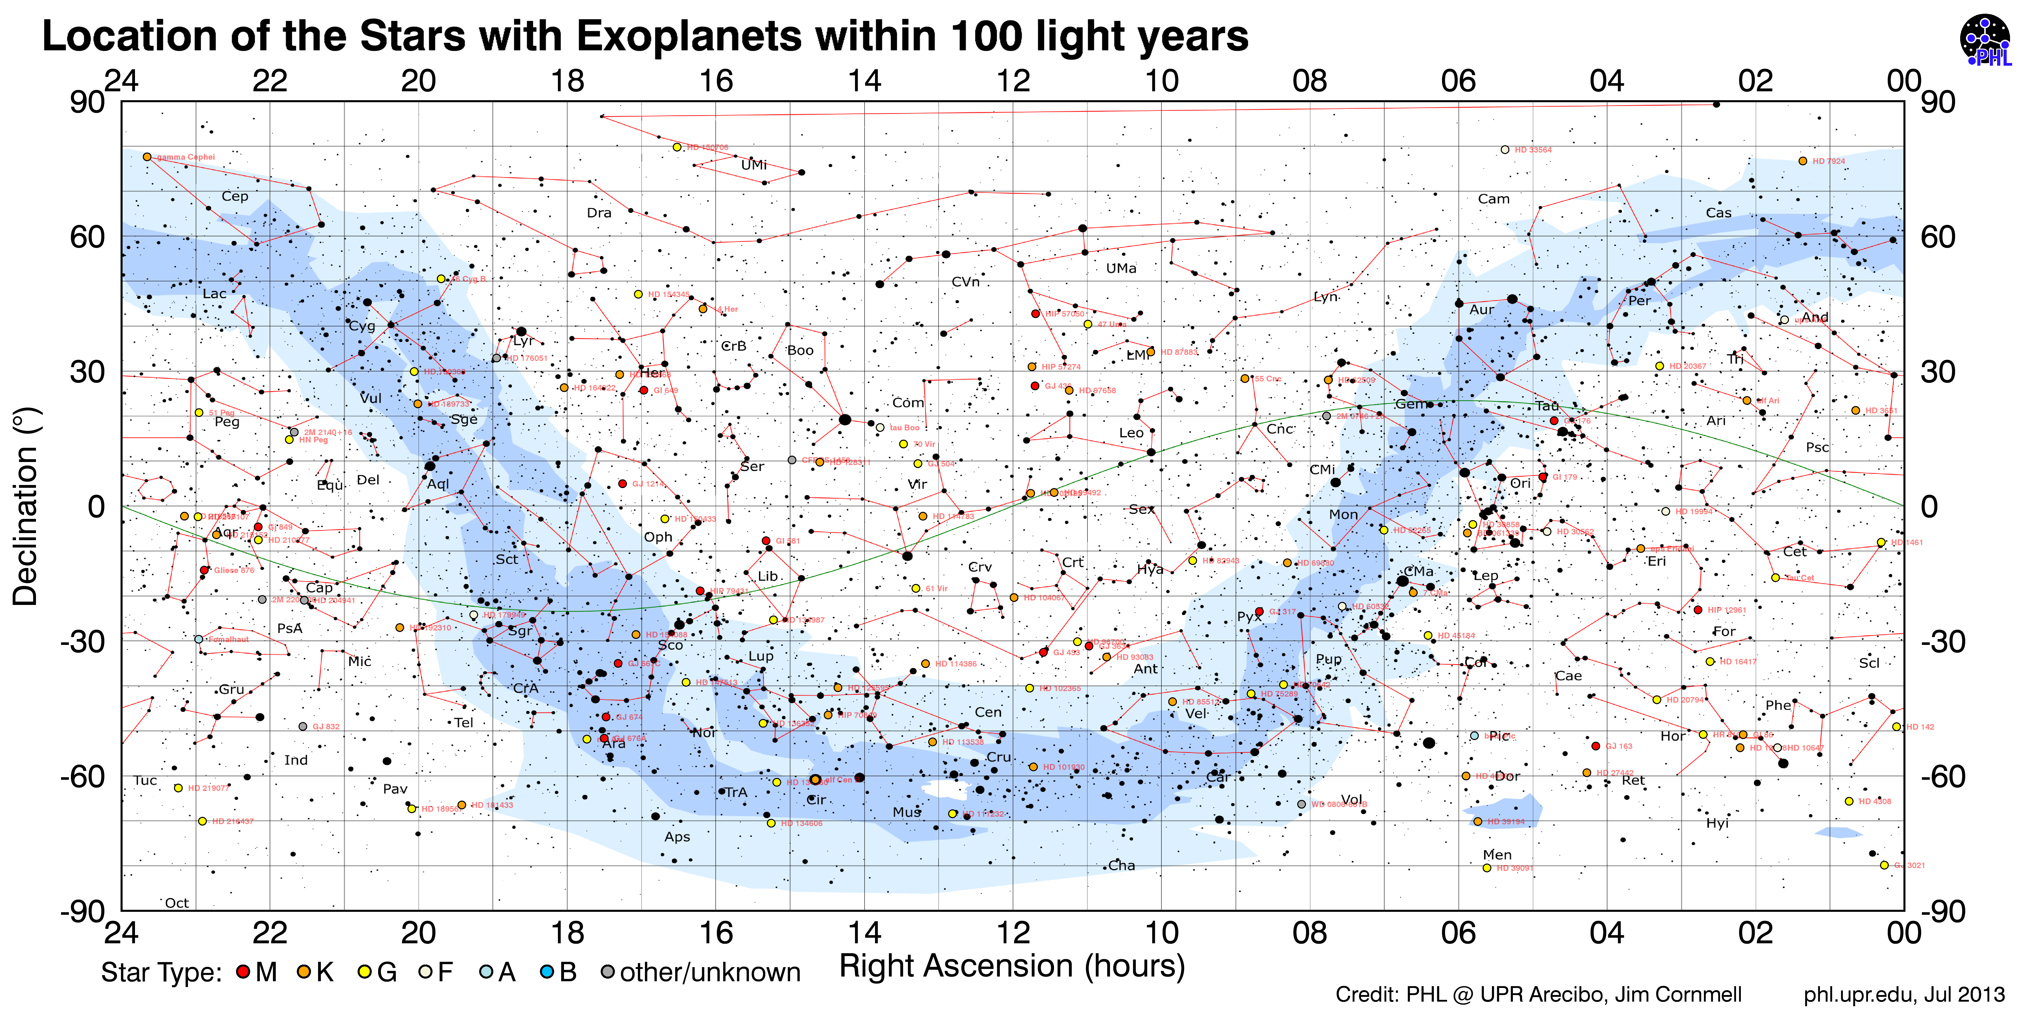
Distancias en el Universo

Slide 17
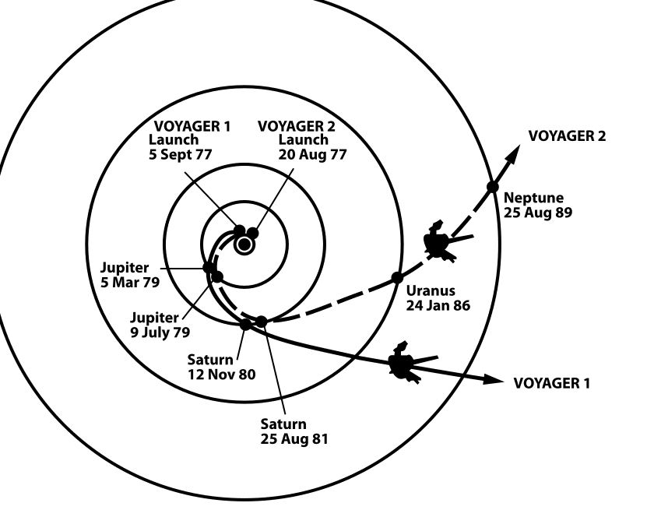
Wikicommons: The trajectories that enabled NASA's twin Voyager spacecraft to tour the four gas giant planets and achieve velocity to escape the Solar System. Source: http://solarsystem.nasa.gov/multimedia/display.cfm?IM_ID=2143

Slide 18
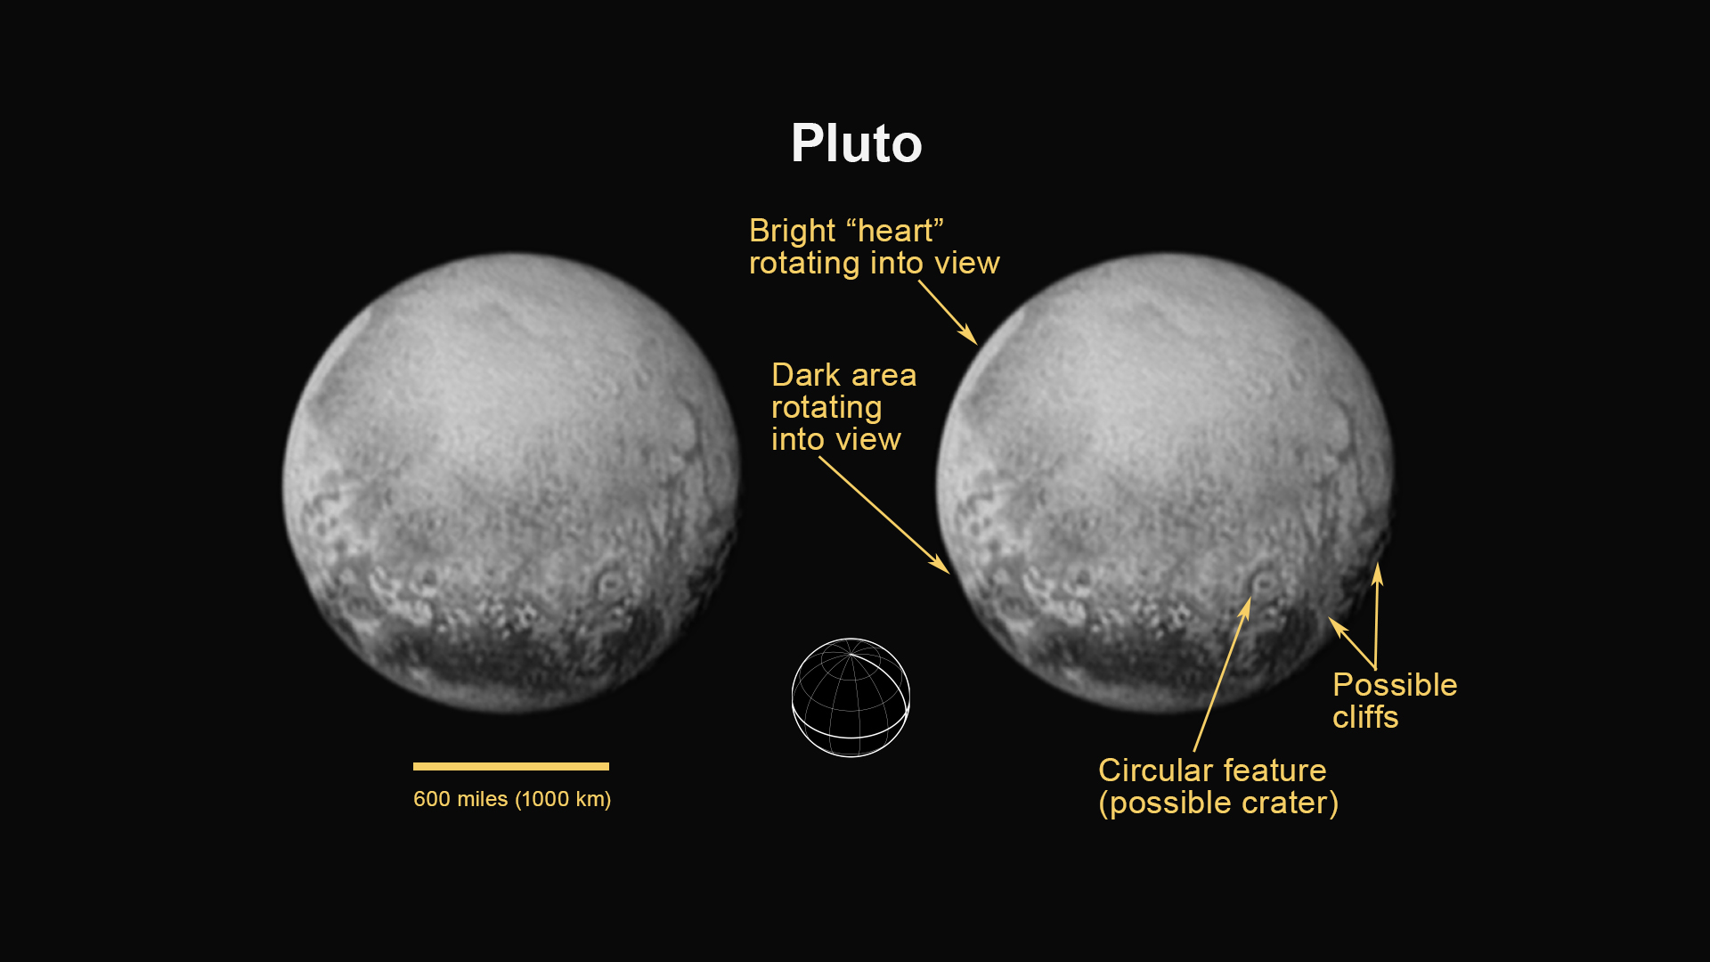
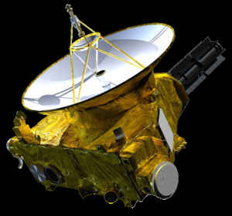
https://www.nasa.gov/mission_pages/newhorizons/main/index.html

Slide 19
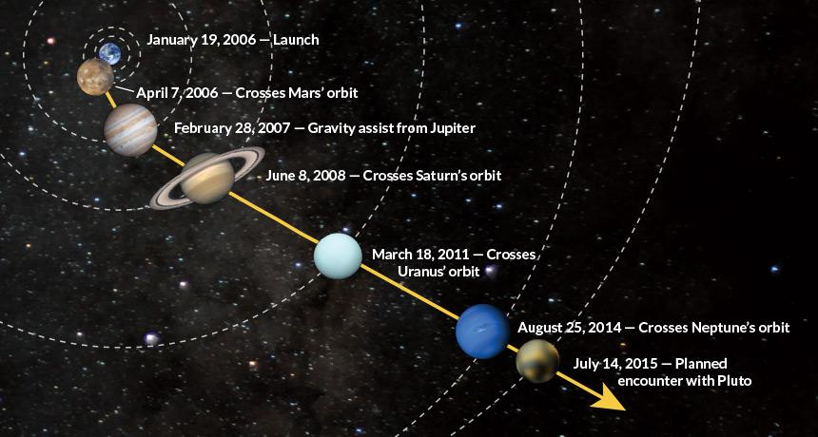
https://www.sciencenews.org/article/rendezvous-pluto?mode=magazine&context=190368

Slide 20
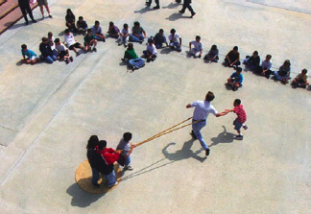
Wikicommons: The trajectories that enabled NASA's twin Voyager spacecraft to tour the four gas giant planets and achieve velocity to escape the Solar System. Source: http://solarsystem.nasa.gov/multimedia/display.cfm?IM_ID=2143

Slide 21
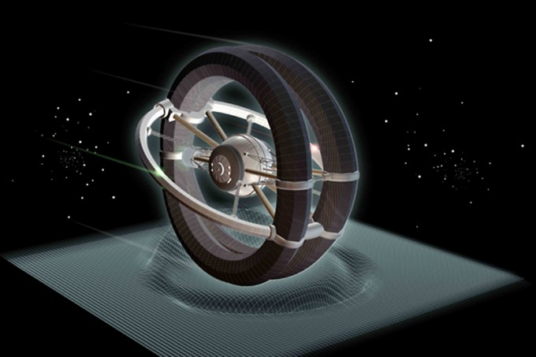
http://www.icarusinterstellar.org

Slide 22
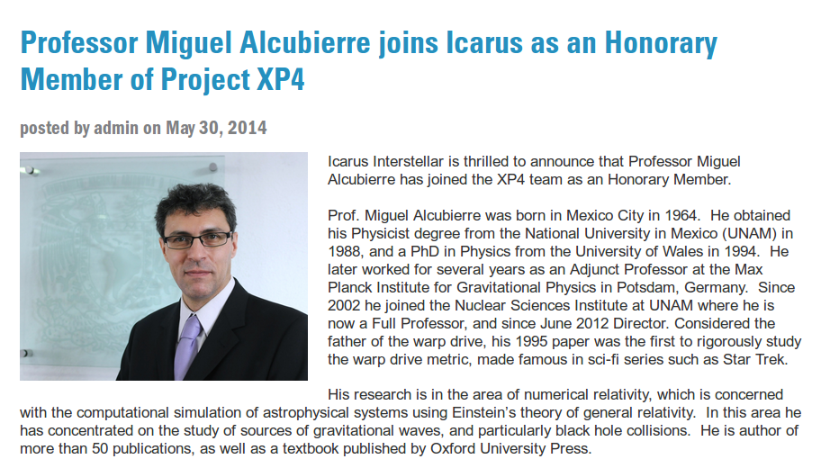

Slide 23
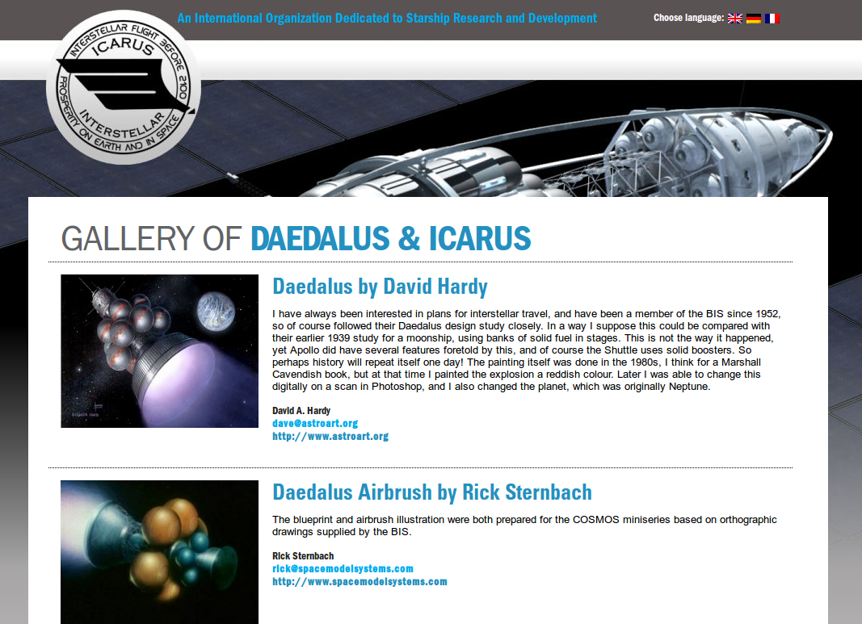
http://www.icarusinterstellar.org

Slide 24
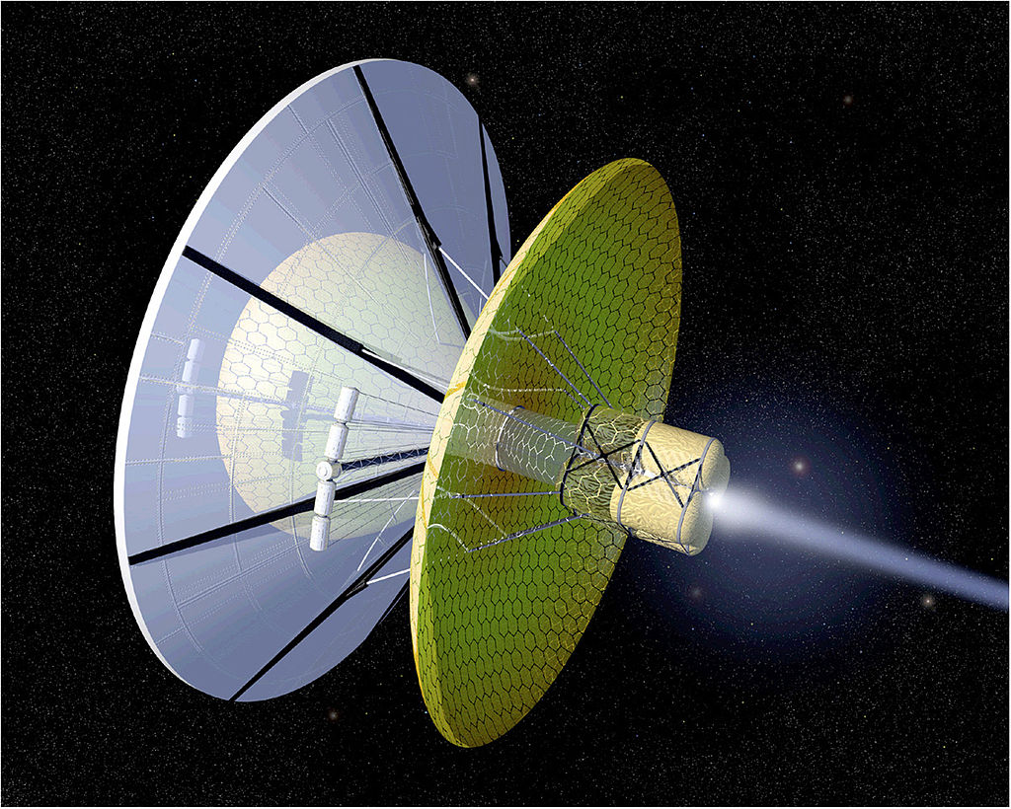
NASA - http://nix.ksc.nasa.gov/info?id=MSFC-9906399&orgid=11

Slide 25
Distancias en el Universo

Slide 26

https://theoryofallthings.wordpress.com/2013/06/06/operation-manual-for-spaceship-earth/

Slide 27
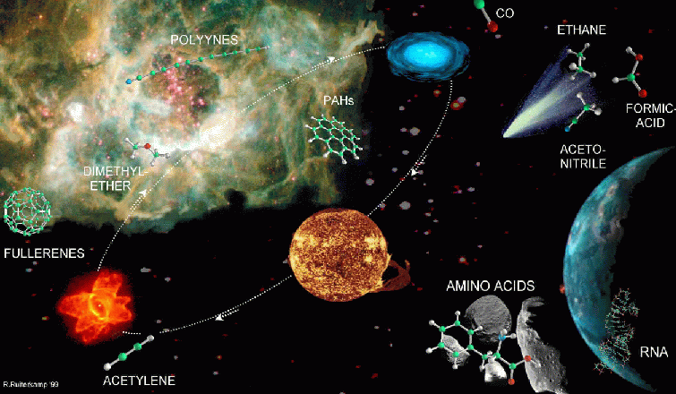
astrobiología

Slide 28
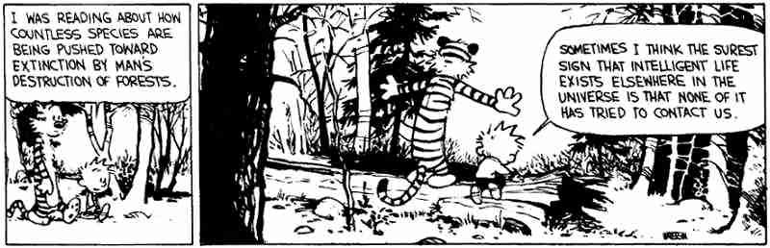
Vida inteligente en el Universo
Library of Bill Watterson's Calvin and Hobbes

Slide 29
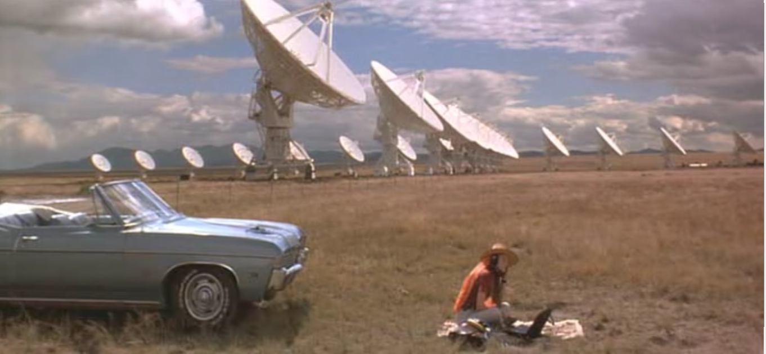
Señales de otras civilizaciones
https://thesouloftheplot.wordpress.com/2012/11/09/contact/

Slide 30
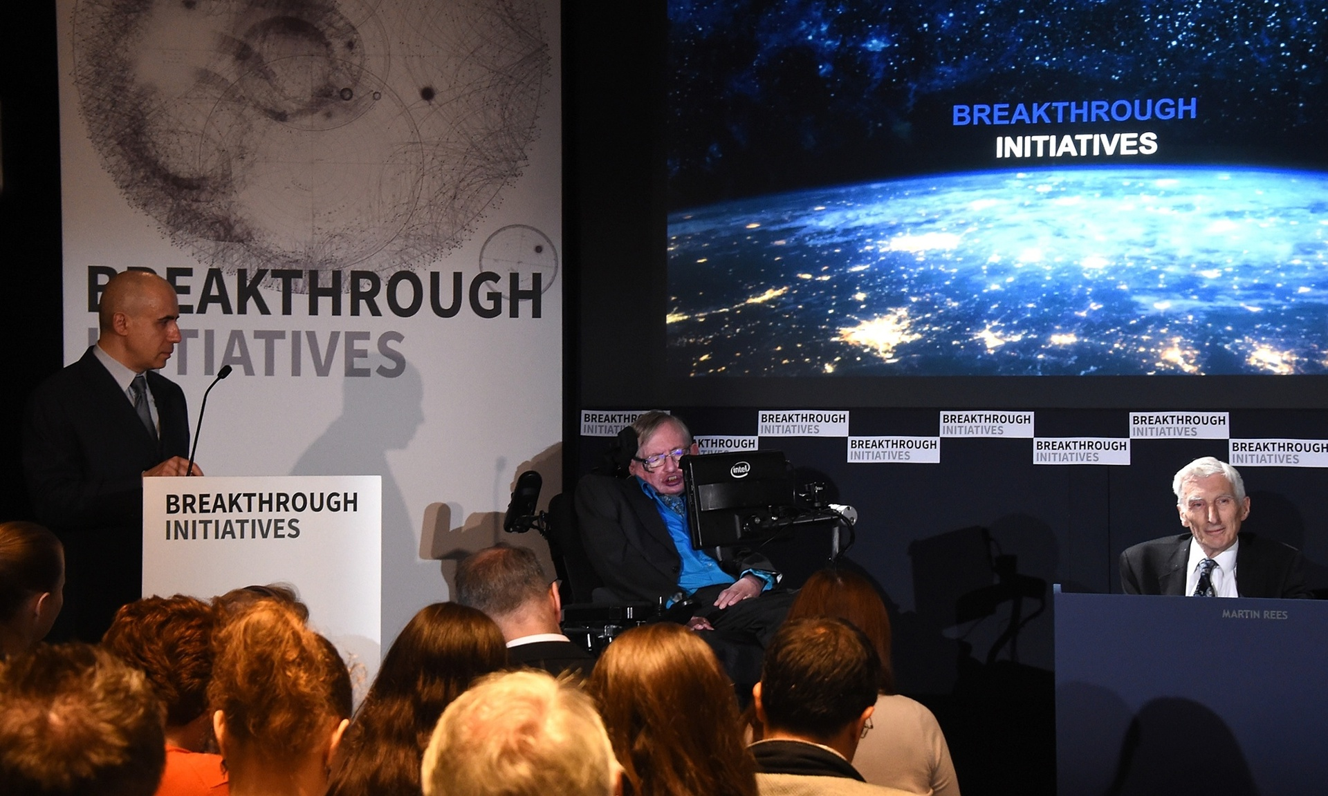
http://www.theguardian.com/science/2015/jul/20/alien-life-breakthough-initiative

Slide 31
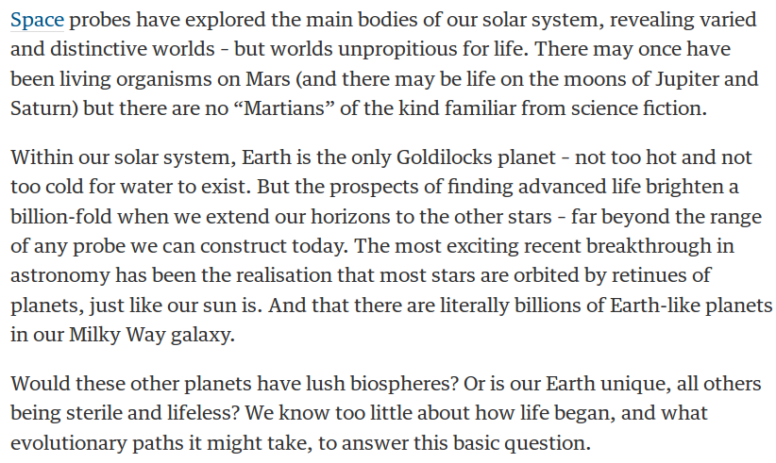
Let's listen out for alien life – and remember we might not understand it
Martin Rees
http://www.theguardian.com/science/2015/jul/20/alien-life-breakthough-initiative

Slide 32
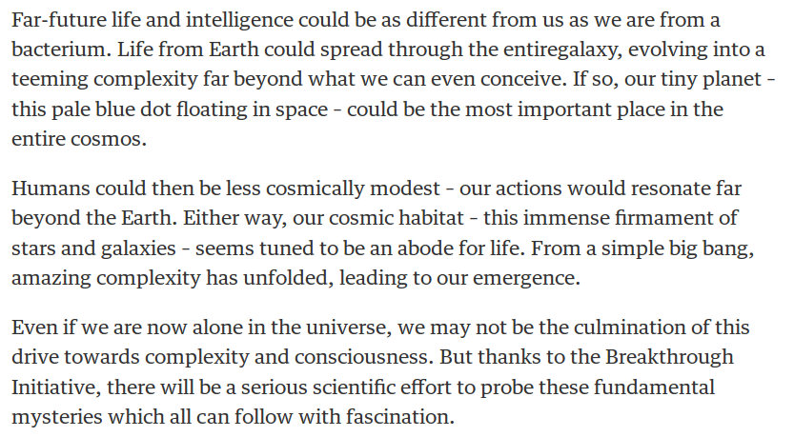
Let's listen out for alien life – and remember we might not understand it
Martin Rees
http://www.theguardian.com/science/2015/jul/20/alien-life-breakthough-initiative

Slide 33
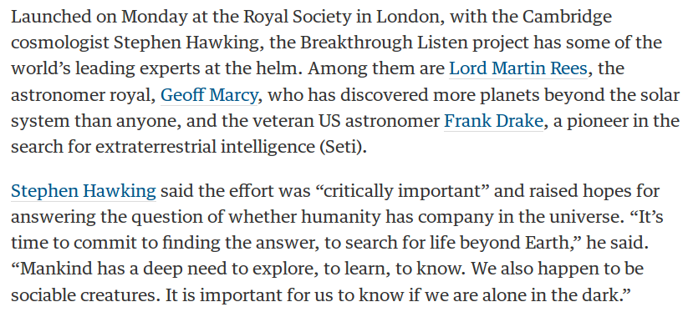
http://www.theguardian.com/science/2015/jul/20/breakthrough-listen-massive-radio-wave-project-scan-far-regions-for-alien-life

Slide 34
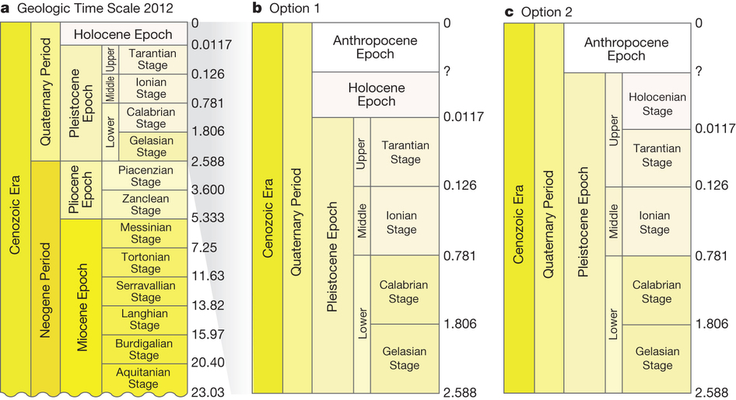
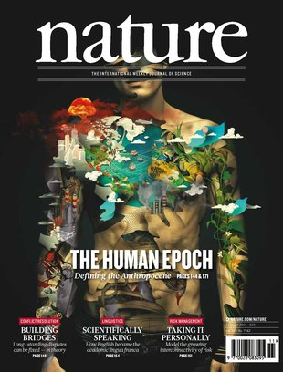
http://www.nature.com/nature/journal/v519/n7542/full/nature14258.html

Slide 35
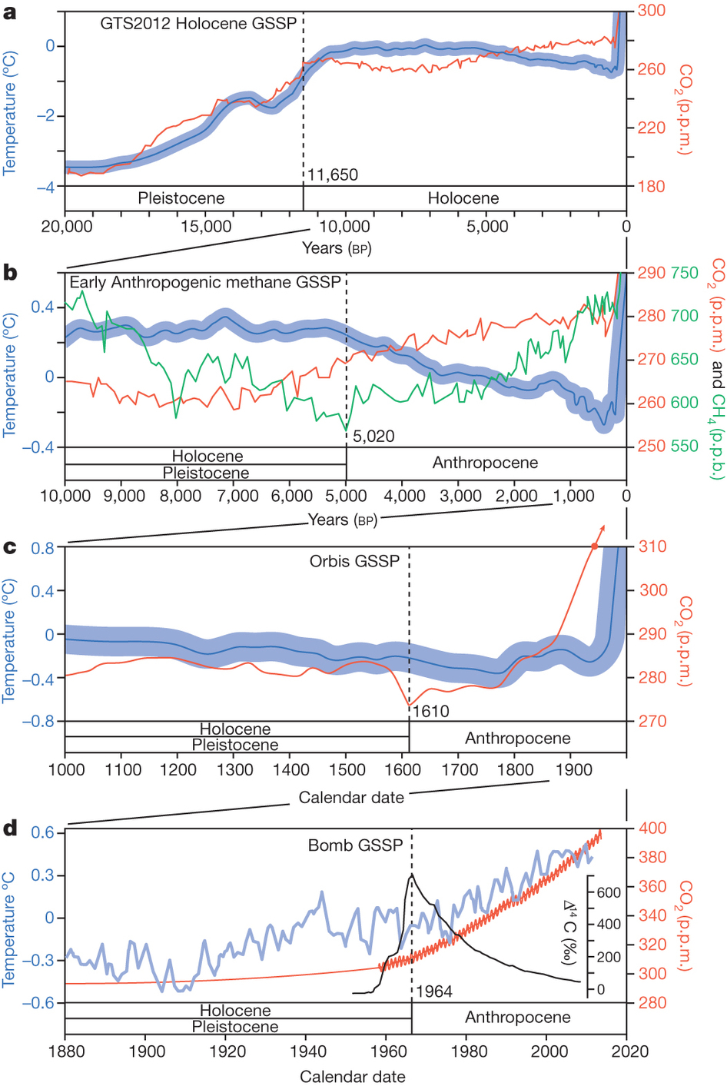
http://www.nature.com/nature/journal/v519/n7542/full/nature14258.html

Slide 36
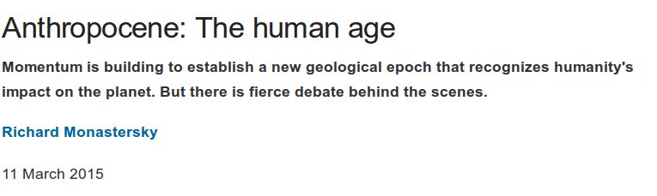
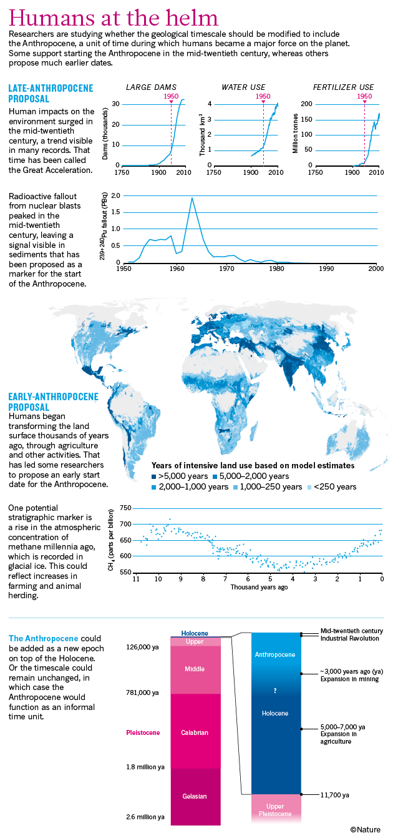
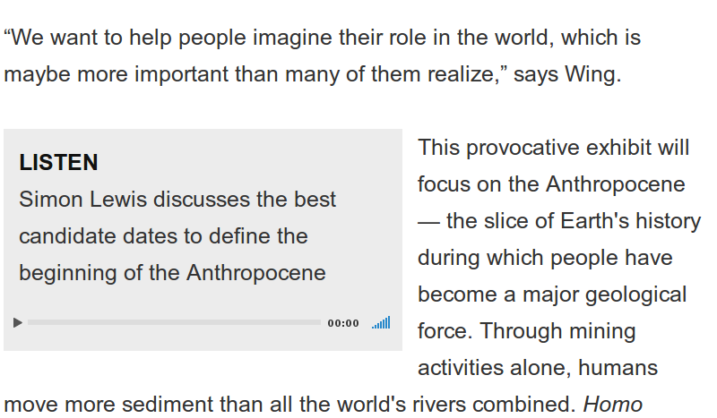
http://www.nature.com/news/anthropocene-the-human-age-1.17085

Slide 37
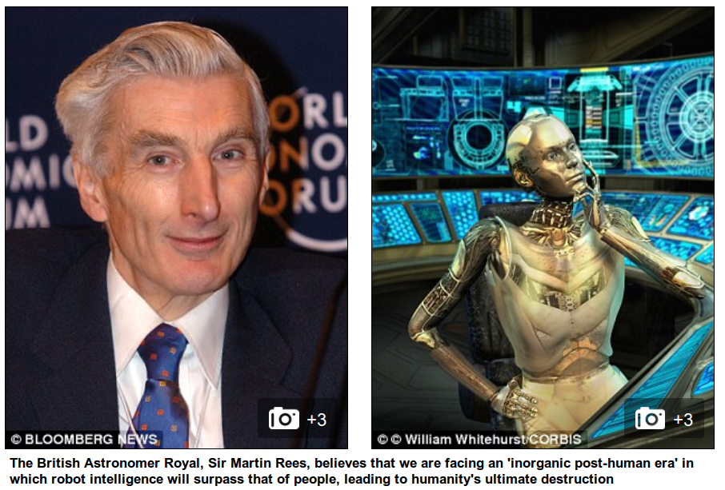
http://www.dailymail.co.uk/sciencetech/article-3091749/Is-world-heading-post-human-future-Sir-Martin-Rees-warns-super-intelligent-robots-wipe-humanity.html

Slide 38
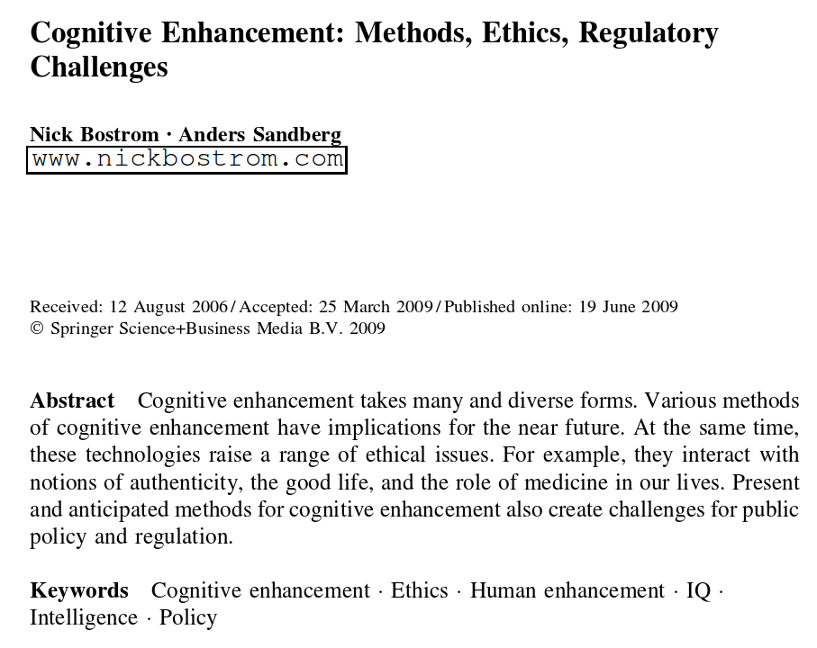
http://www.nickbostrom.com/cognitive.pdf

Slide 39
Methods of Cognitive Enhancement
Education, Enriched Environments and General Health
Mental Training
Drugs
Transcranial Magnetic Stimulation
Genetic Modifications
Prenatal and Perinatal Enhancement
External Hardware and Software Systems
Brain-Computer Interfaces
Collective Intelligence
http://www.nickbostrom.com/cognitive.pdf

Slide 40
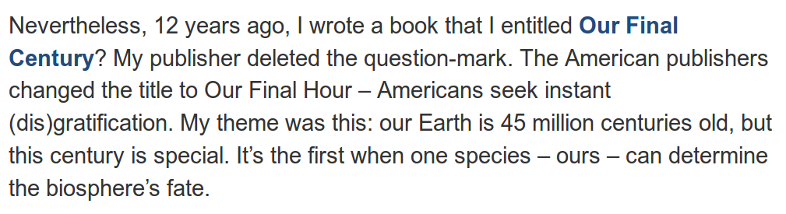
How soon will robots take over the world? de Sir Martin Rees.

Slide 41
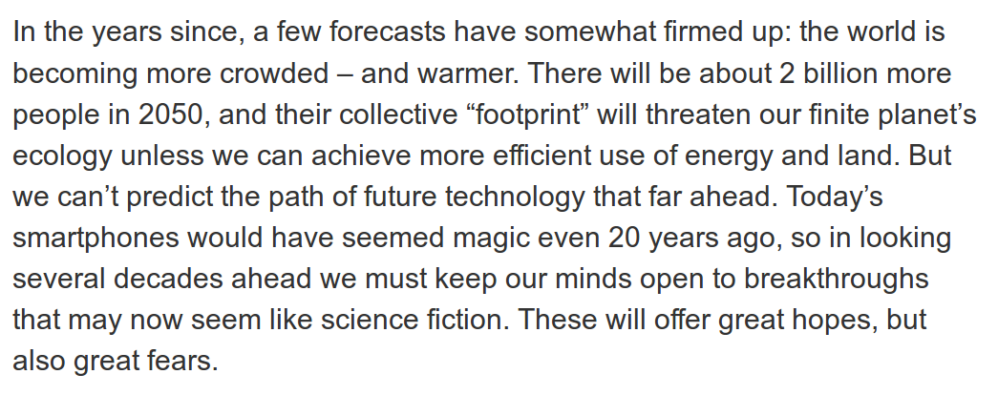
How soon will robots take over the world? de Sir Martin Rees.

Slide 42
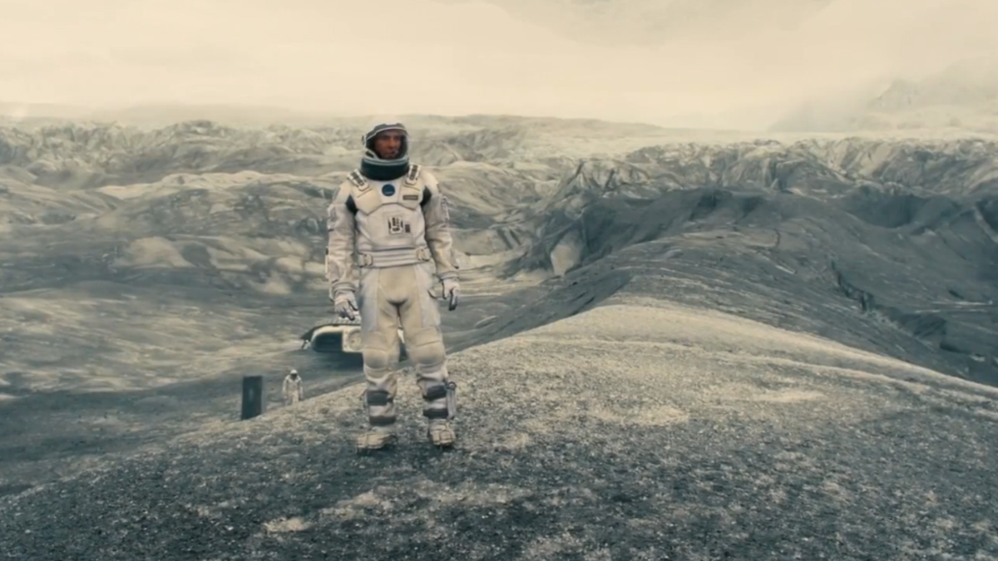
https://en.wikibooks.org/wiki/A_Roller_Coaster_Ride_through_Relativity/Appendix_A
http://www.huffingtonpost.com/brandon-judell/movie-review-interstellar_1_b_6100562.html

Slide 43

http://www.joblo.com/movie-posters/the-martian-2015

Slide 44
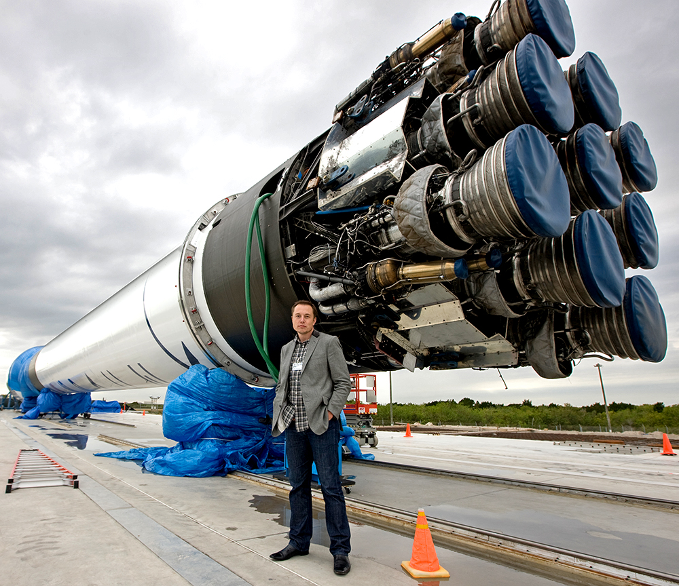

Slide 45
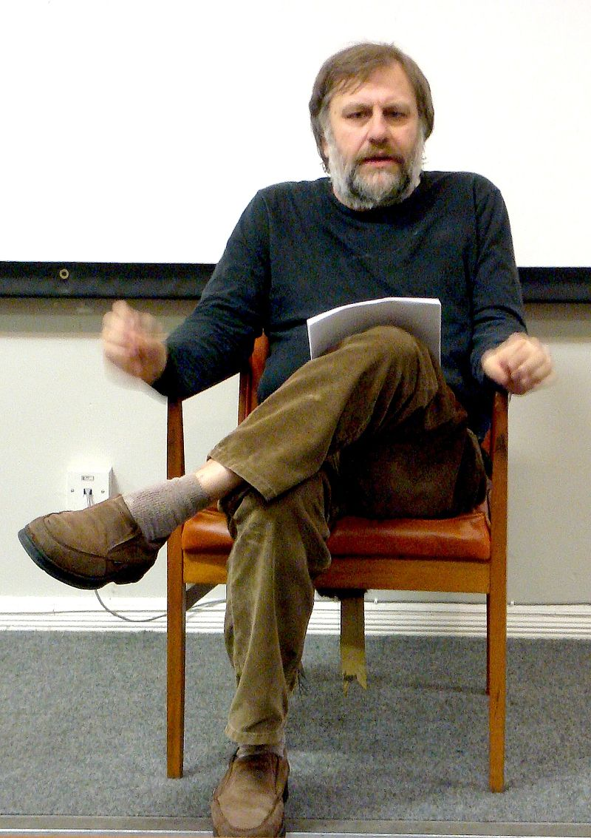
Fuente: Wikimedia Slavoj Zizek in Liverpool, cropped version of Image:Slavoj Zizek in Liverpool.jpg

Slide 46
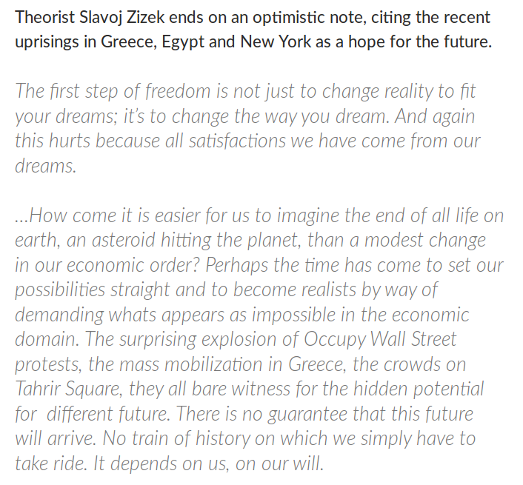
http://www.critical-theory.com/watch-the-final-scene-from-zizeks-perverts-guide-to-ideology/

Slide 47
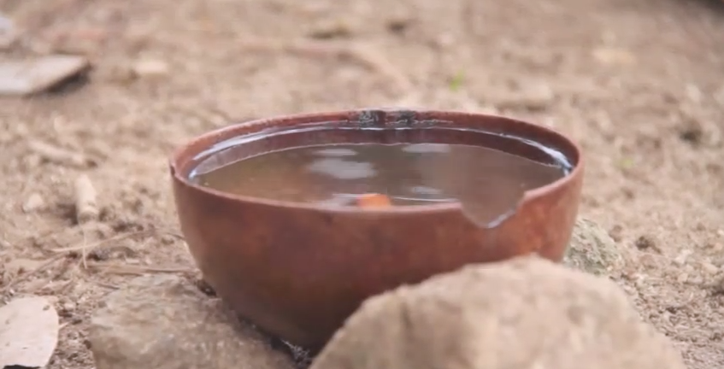
Trailer Aluna: https://www.youtube.com/watch?v=mHQ4FfgBBXI

Slide 48
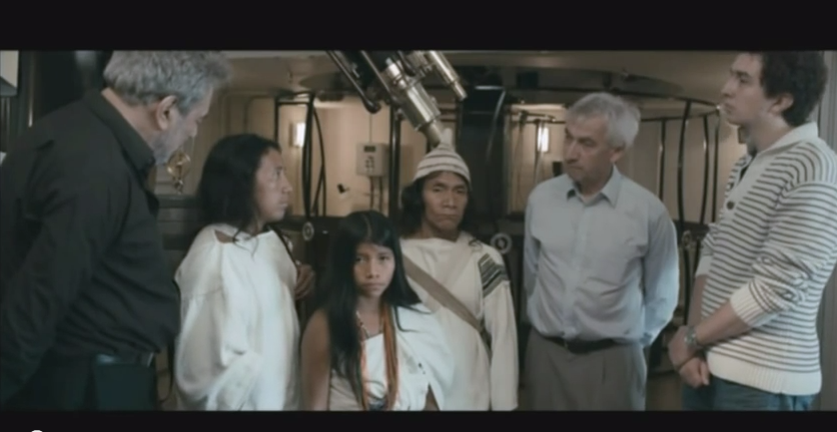
Aluna (fragmento con Richard Ellis)https://www.youtube.com/watch?v=gLiSAKqzTZM

Slide 49
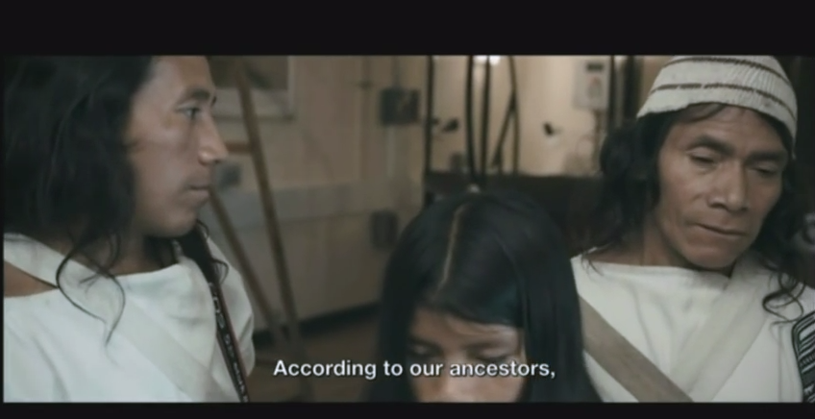
Aluna (fragmento con Richard Ellis)https://www.youtube.com/watch?v=gLiSAKqzTZM

Slide 50
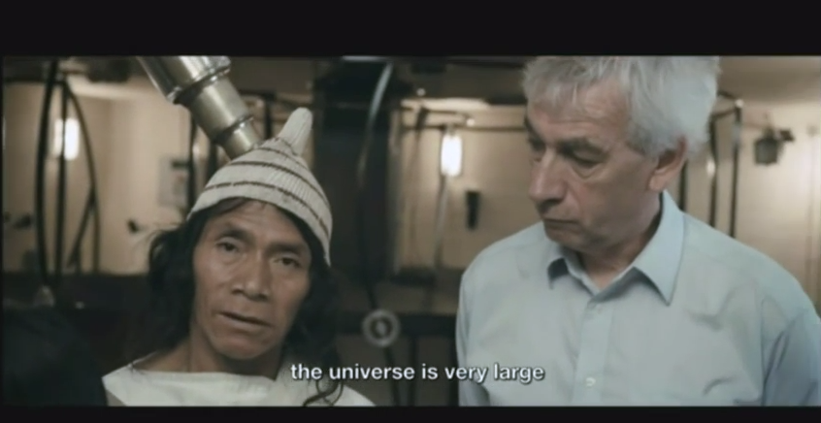
Aluna (fragmento con Richard Ellis)https://www.youtube.com/watch?v=gLiSAKqzTZM

Slide 51
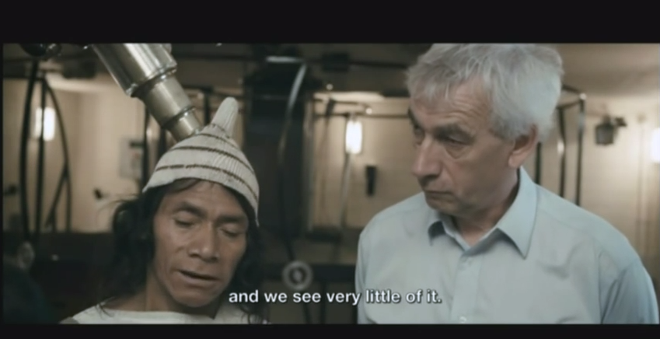
Aluna (fragmento con Richard Ellis)https://www.youtube.com/watch?v=gLiSAKqzTZM

Slide 52
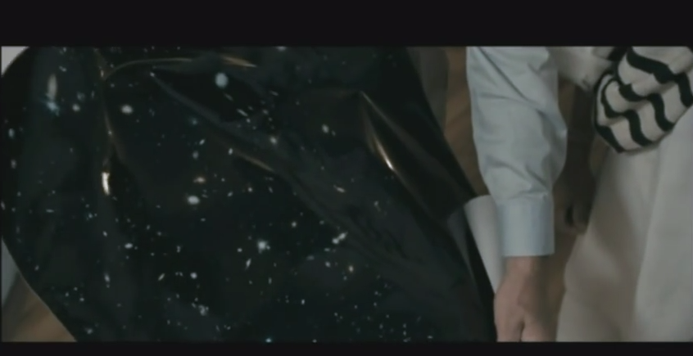
Aluna (fragmento con Richard Ellis)https://www.youtube.com/watch?v=gLiSAKqzTZM

Slide 53
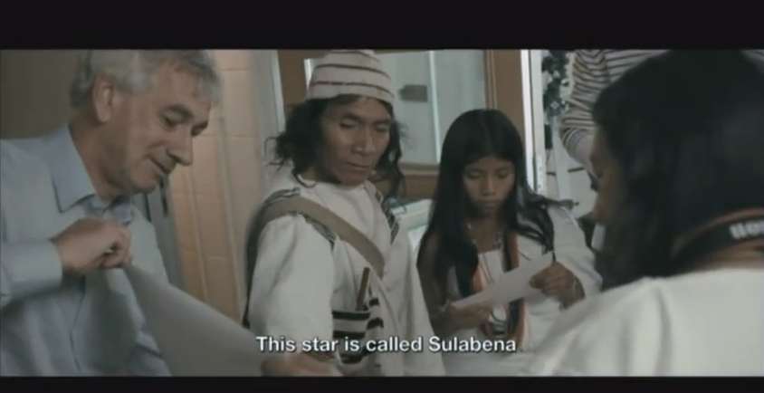
Aluna (fragmento con Richard Ellis)https://www.youtube.com/watch?v=gLiSAKqzTZM

Slide 54
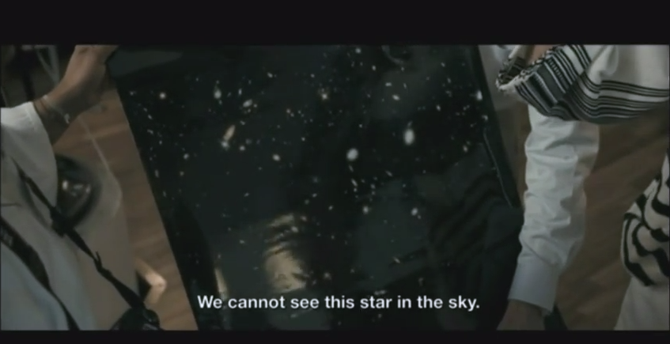
Aluna (fragmento con Richard Ellis)https://www.youtube.com/watch?v=gLiSAKqzTZM

Slide 55
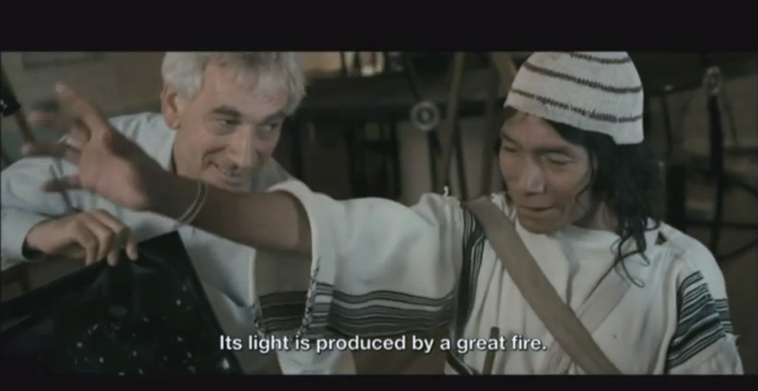
Aluna (fragmento con Richard Ellis)https://www.youtube.com/watch?v=gLiSAKqzTZM

Slide 56

Trailer Aluna: https://www.youtube.com/watch?v=mHQ4FfgBBXI

Slide 57
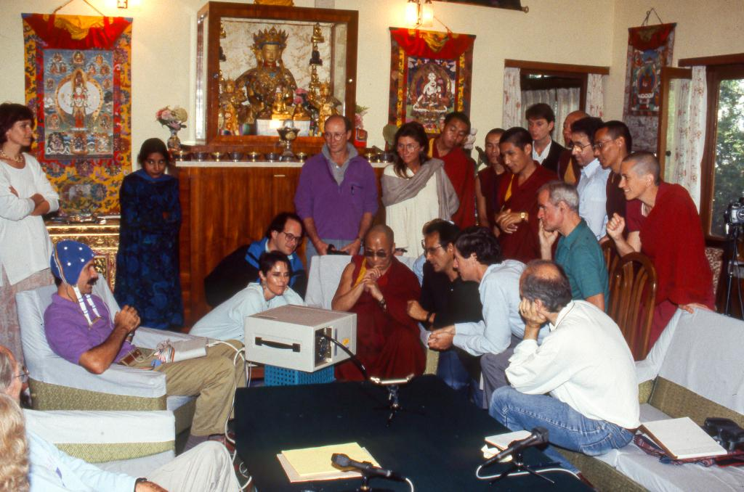
https://twitter.com/jhalifax/status/565502475676164097
Mind and @mindandlifeorg in 1992, with Dalai Lama, Francisco Varela, Thupten Jinpa, Alan Wallace, me and others

Slide 58

http://hipermediaciones.com/2014/12/21/byung-chul-han-filosofia-para-dummies-ii/

Slide 59

https://finnjanning.wordpress.com/2015/04/23/which-dish-of-noodles-is-your-life-worth/

Slide 60

http://hipermediaciones.com/2014/12/21/byung-chul-han-filosofia-para-dummies-ii/

Slide 61


Slide 62
Trailer Aluna: https://www.youtube.com/watch?v=mHQ4FfgBBXI

