Slide 1
Extraterrestres, OVNIS, viajes interestelares y medios.
Jaime E. Forero Romero
Universidad de los Andes
Astronomía Popular

Slide 2

http://imgur.com/gallery/2jsfax6

Slide 3
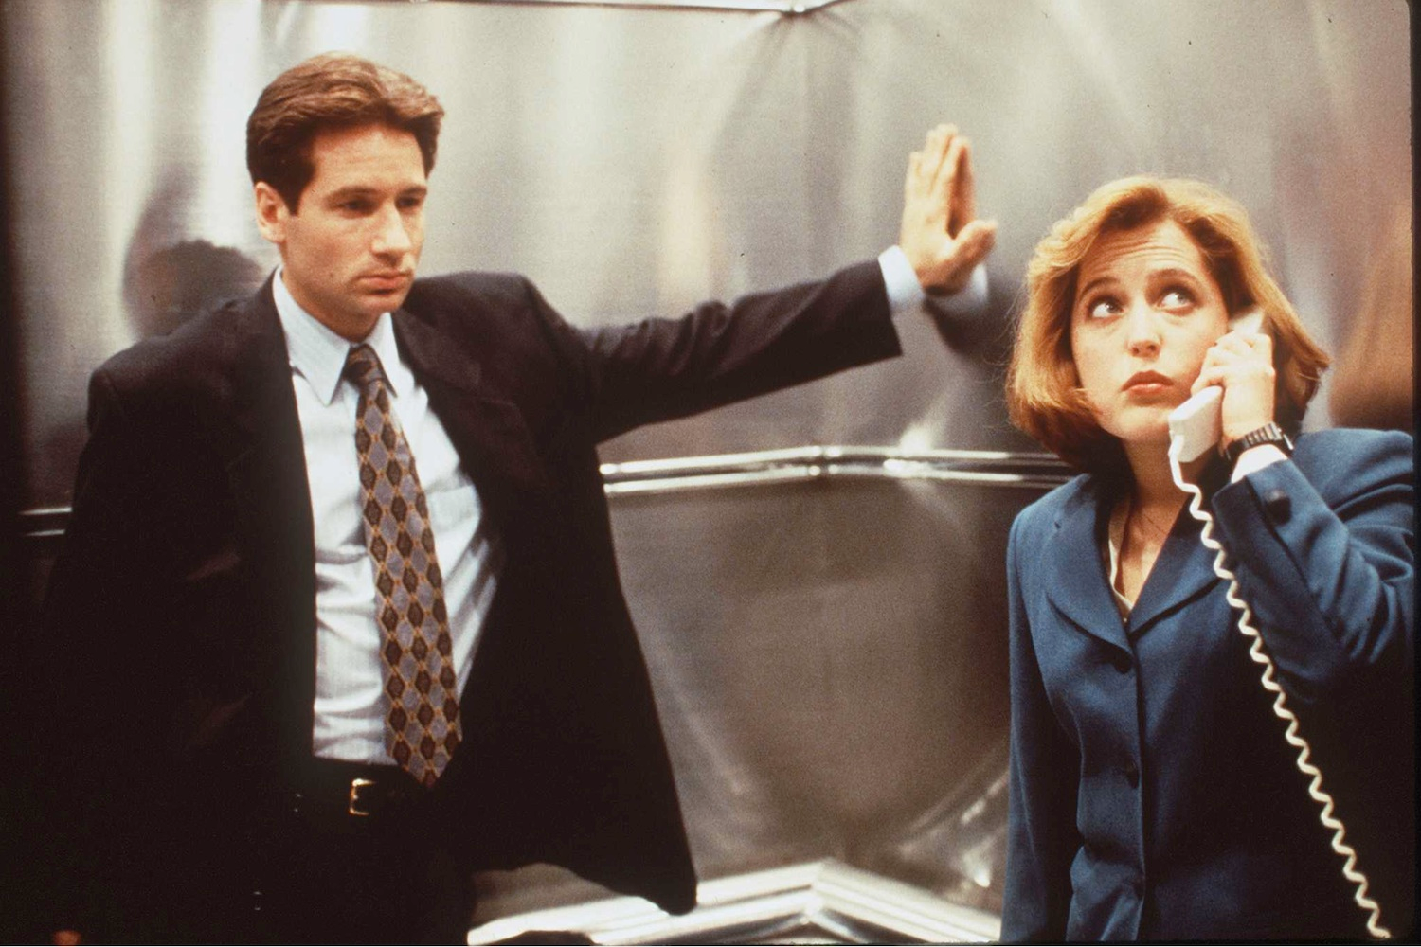
http://mic.com/articles/113598/get-ready-for-more-mulder-and-scully-the-x-files-is-coming-back

Slide 4
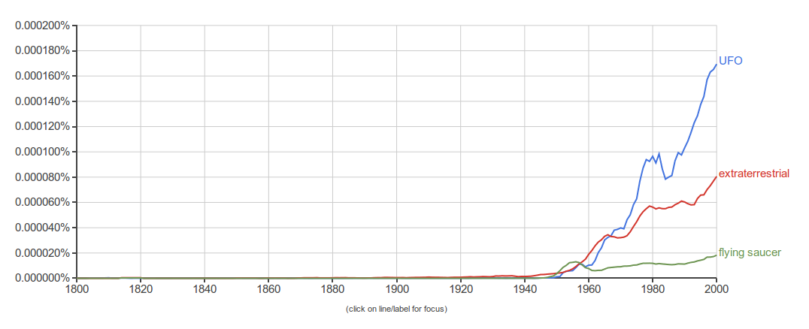
UFO Unidentified Flying Object
OVNI Objeto Volador No Identificado
Google books Ngram viewer

Slide 5
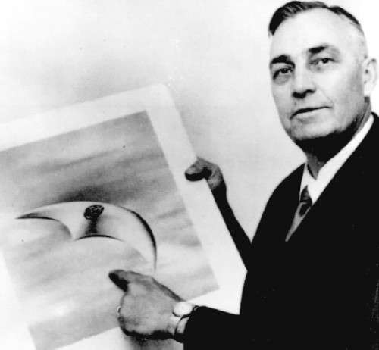
Kenneth Arnold (1947)
http://www.ufoevidence.org/cases/case511.htm

Slide 6
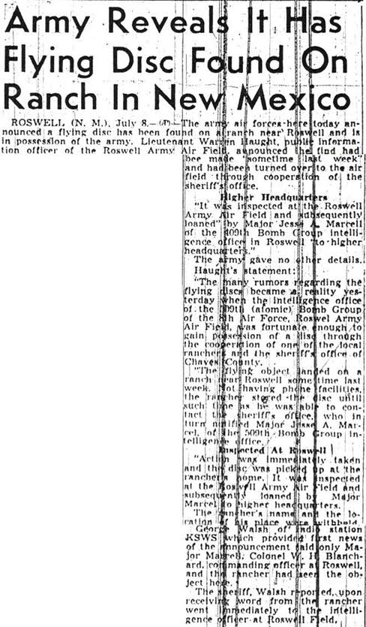
https://en.wikipedia.org/wiki/File:SacramentoBeeArticleJuly8,1947.jpg

Slide 7
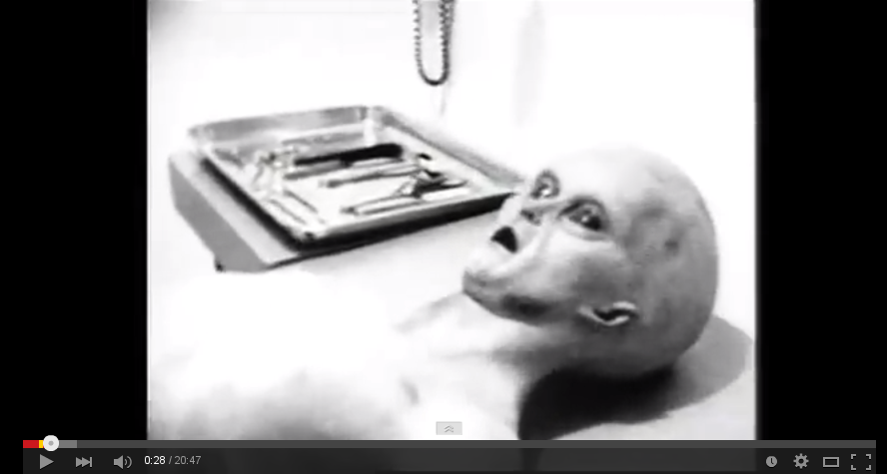
Supuesta autopsia
https://www.youtube.com/watch?v=DhhTo5Ur360

Slide 8
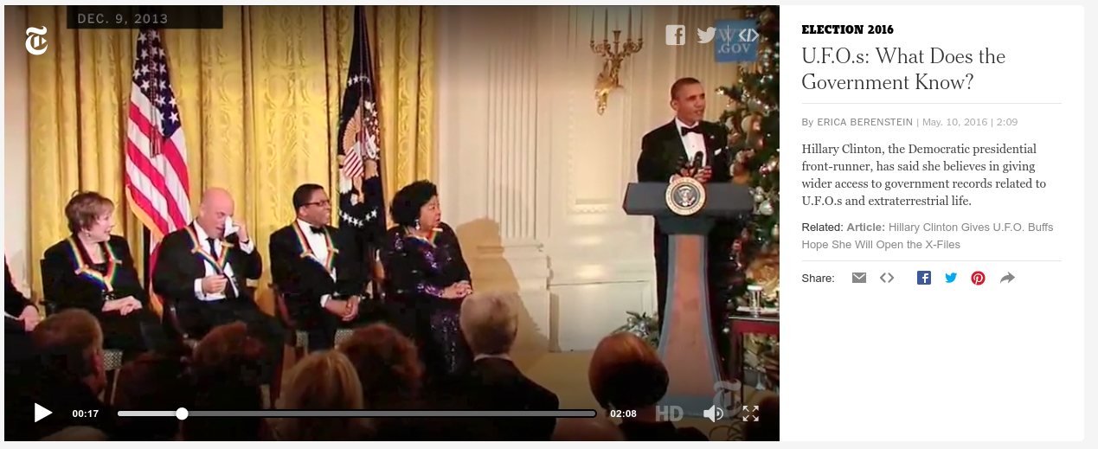
http://www.nytimes.com/video/us/politics/100000004381919/ufos-what-does-the-government-know.html

Slide 9
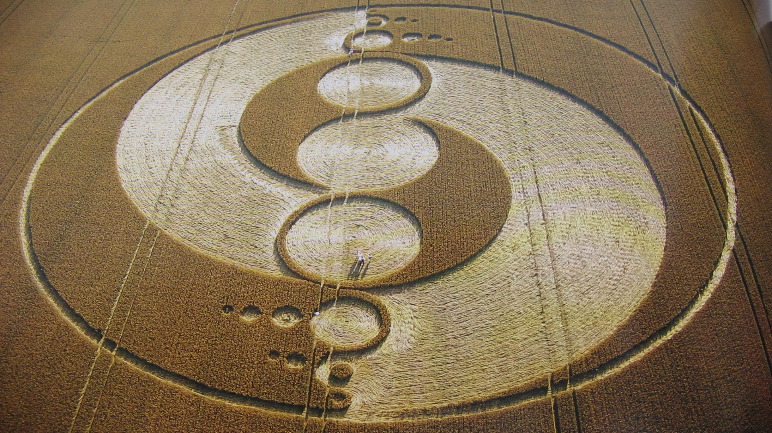
http://7-themes.com/7033818-crop-circles.html

Slide 10
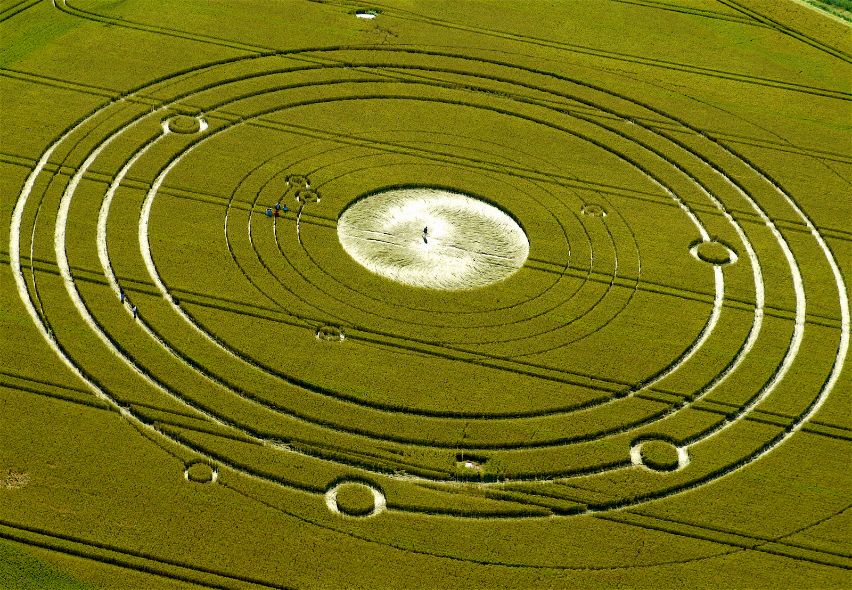
http://eyesontruth.com/2015/04/27/crop-circles/

Slide 11
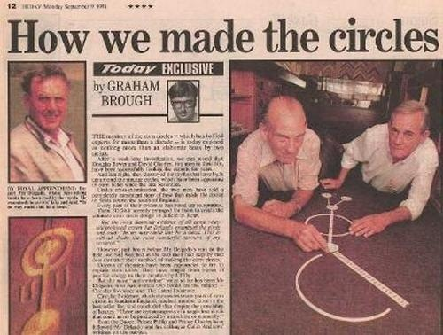
Doug Bouwer & Dave Chorley

Slide 12
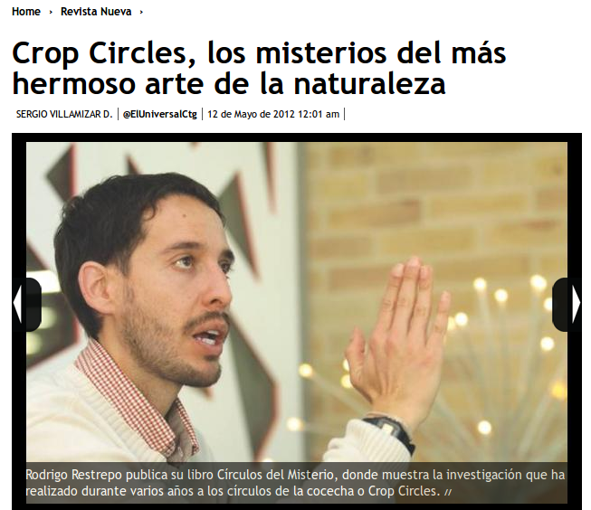
http://www.eluniversal.com.co/circulos-en-las-cosechas-crop-circles/crop-circles-los-misterios-del-mas-hermoso-arte-de-la-naturale

Slide 13
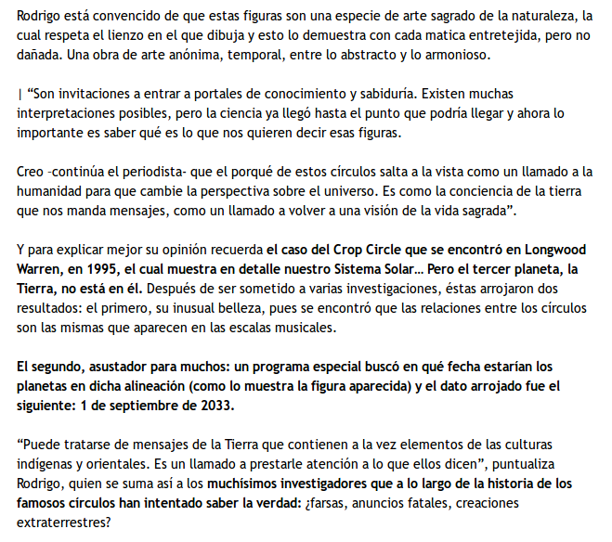
http://www.eluniversal.com.co/circulos-en-las-cosechas-crop-circles/crop-circles-los-misterios-del-mas-hermoso-arte-de-la-naturale

Slide 14
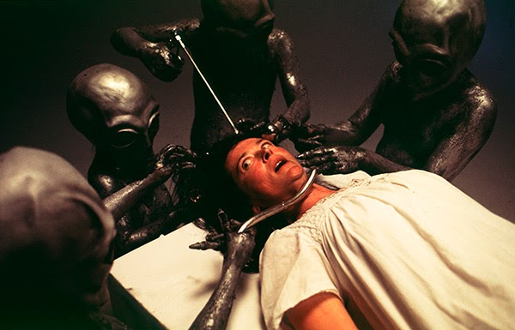
Abducciones
http://www.johnzada.com/blog/2015/alien-abduction-beliefs-explained/

Slide 15
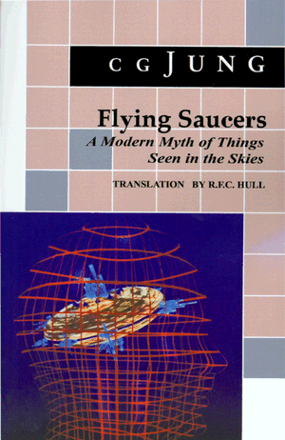
"In the threatening situation of the world today, when people are beginning to see that everything is at stake, the projection-creating fantasy soars beyond the realm of earthly organizations and powers into the heavens, into interstellar space, where the rulers of human fate, the gods, once had their abode in the planets.... Even people who would never have thought that a religious problem could be a serious matter that concerned them personally are beginning to ask themselves fundamental questions. Under these circumstances it would not be at all surprising if those sections of the community who ask themselves nothing were visited by `visions,' by a widespread myth seriously believed in by some and rejected as absurd by others."--C. G. Jung, in Flying Saucers

Slide 16
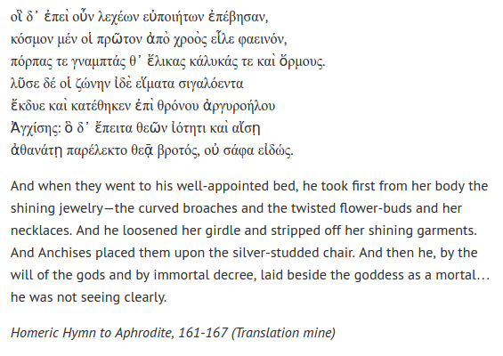
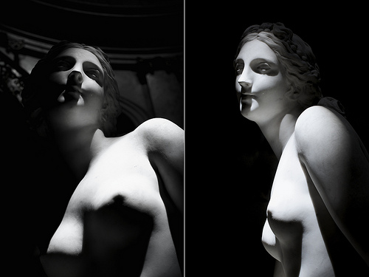
http://sarahveale.com/2014/01/26/the-misfortunes-that-befall-men-who-sleep-with-goddesses/
https://www.flickr.com/photos/nowovyr/9939623075/sizes/m/

Slide 17
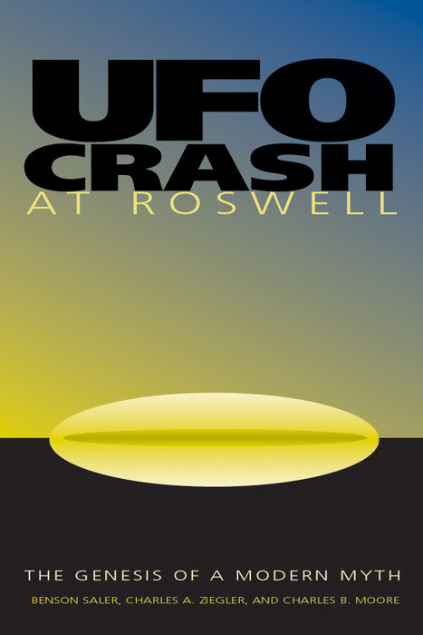
http://www.penguinrandomhouse.com/books/206381/ufo-crash-at-roswell-by-benson-saler-charles-a-ziegler-et-al/#

Slide 18
“Lo único disponible en este caso no es un platillo chocado o los cuerpos de los extraterrestres, sino más bien libros que contienen historias sobre platillos chocados y cuerpos de extraterrestres. Porque son estas historias las que han afectado a nuestra sociedad, son estas historias la que necesitan explicarse.”
Saler, Ziegeler, Moore

Slide 19
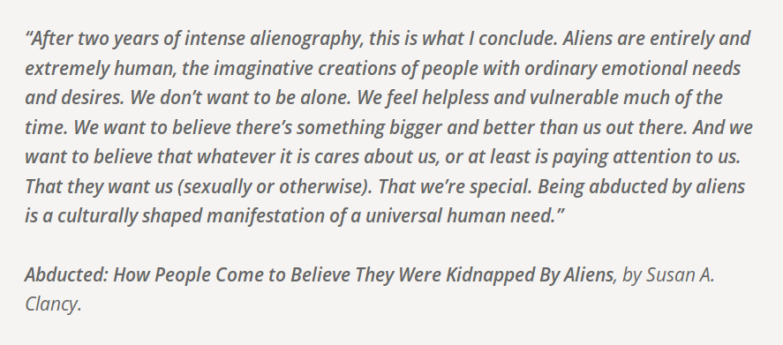
http://www.johnzada.com/blog/2015/alien-abduction-beliefs-explained/

Slide 20
viajes

Slide 21
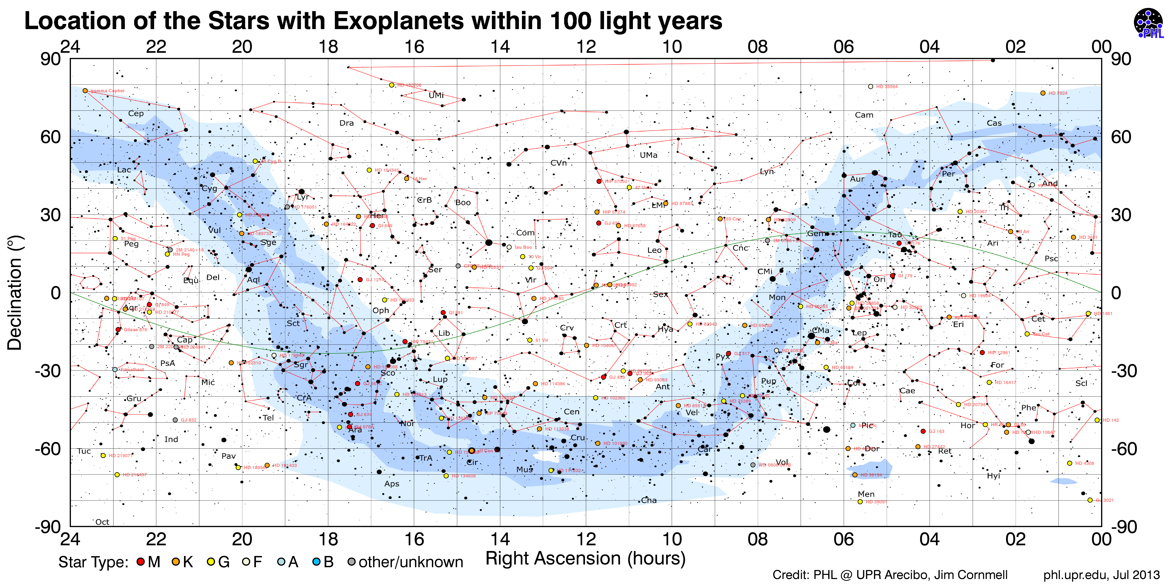
Distancias en el Universo

Slide 22
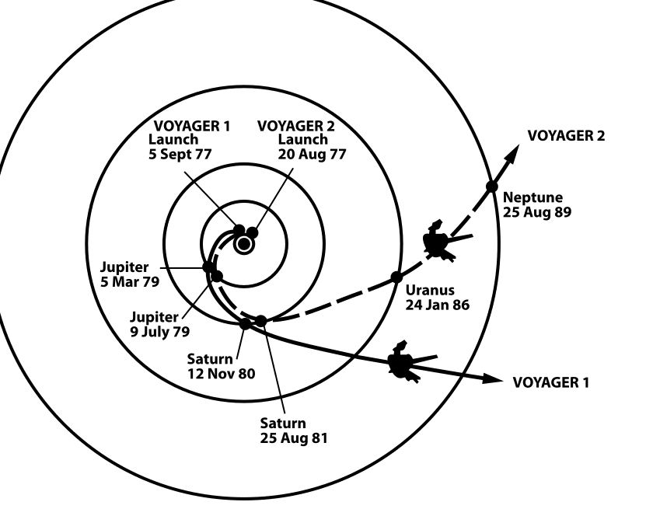
Wikicommons: The trajectories that enabled NASA's twin Voyager spacecraft to tour the four gas giant planets and achieve velocity to escape the Solar System. Source: http://solarsystem.nasa.gov/multimedia/display.cfm?IM_ID=2143

Slide 23
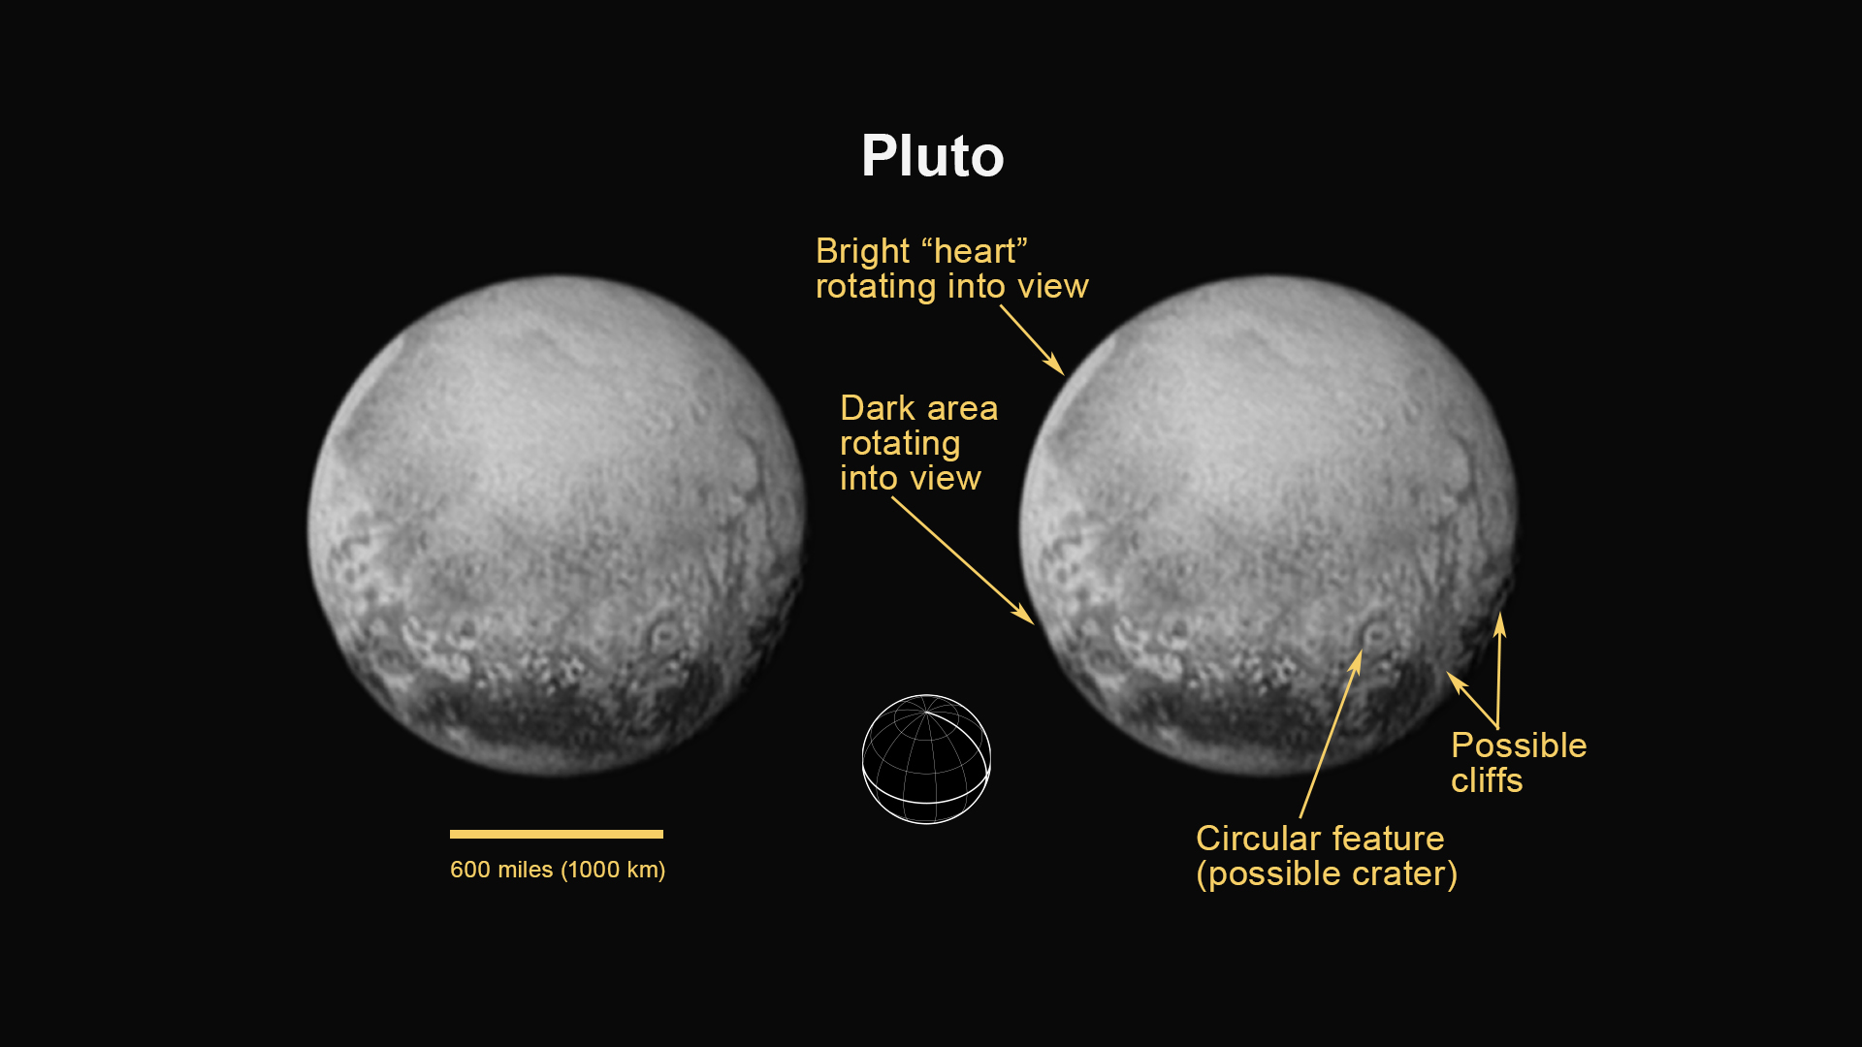
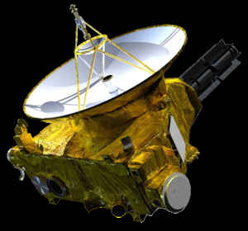
https://www.nasa.gov/mission_pages/newhorizons/main/index.html

Slide 24
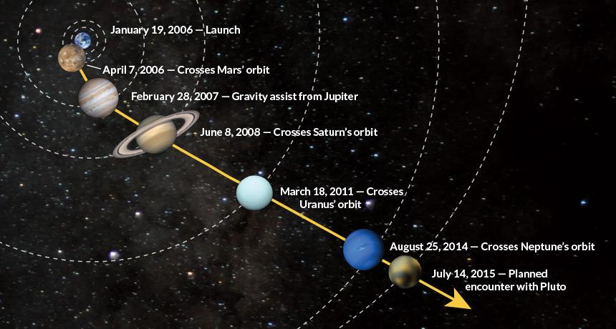
https://www.sciencenews.org/article/rendezvous-pluto?mode=magazine&context=190368

Slide 25
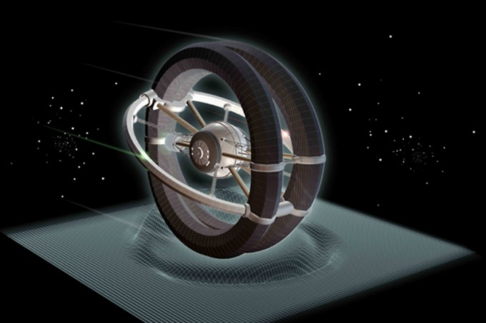
http://www.icarusinterstellar.org

Slide 26
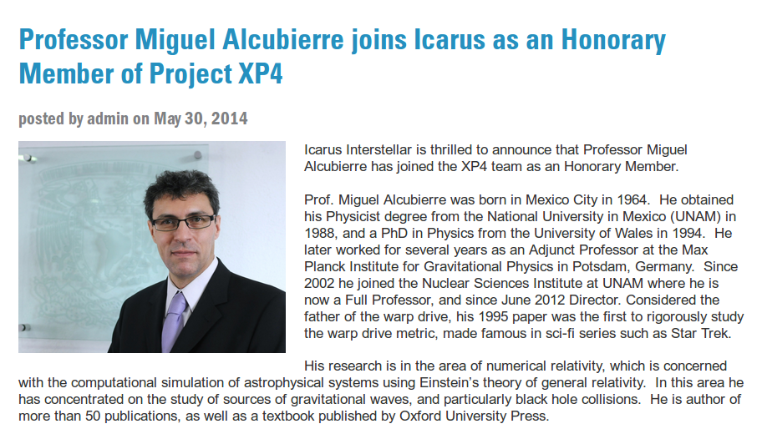

Slide 27
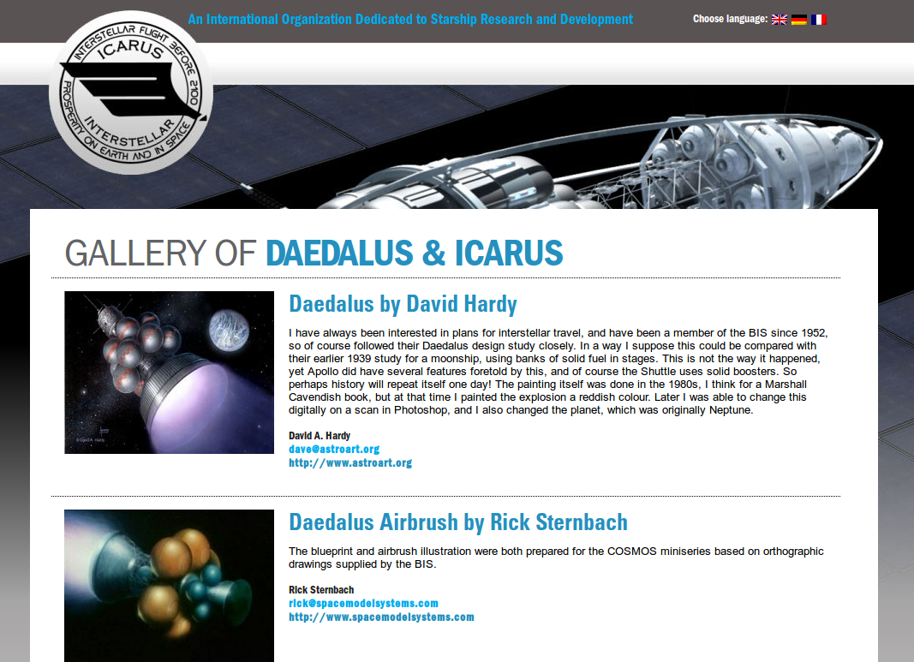
http://www.icarusinterstellar.org

Slide 28
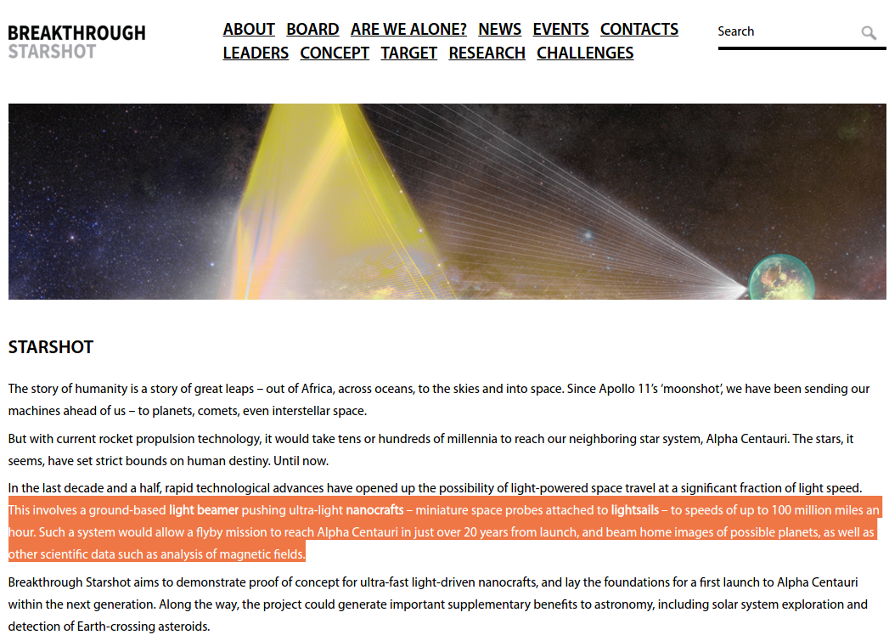
https://breakthroughinitiatives.org/Initiative/3

Slide 29
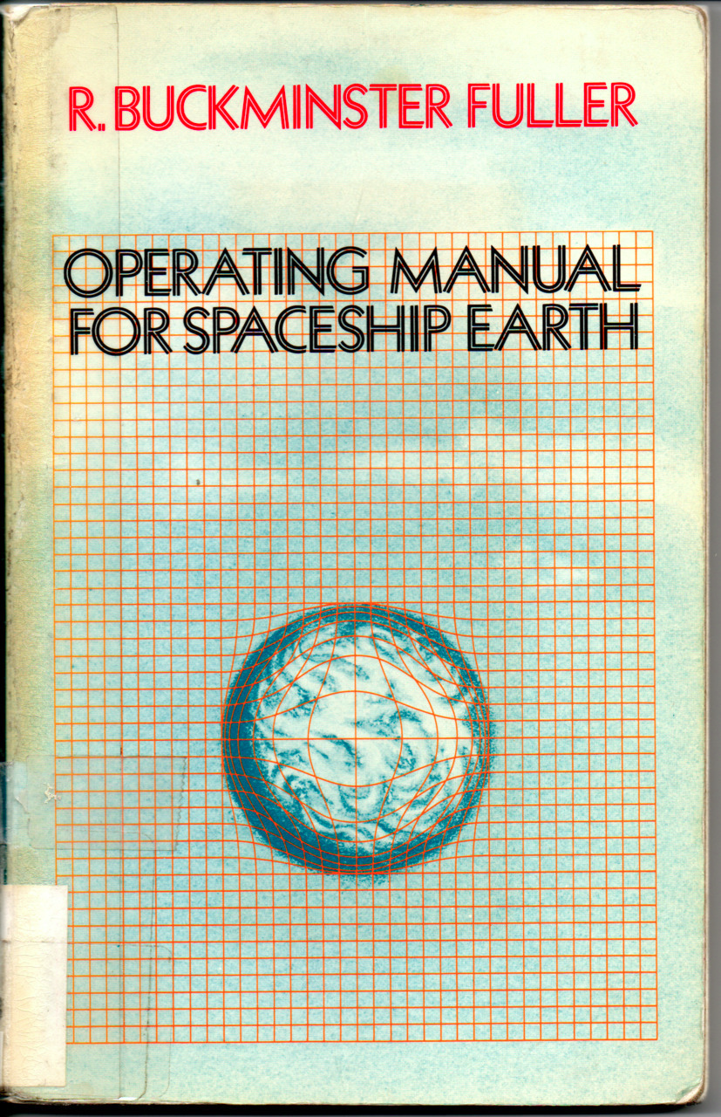
https://theoryofallthings.wordpress.com/2013/06/06/operation-manual-for-spaceship-earth/

Slide 30
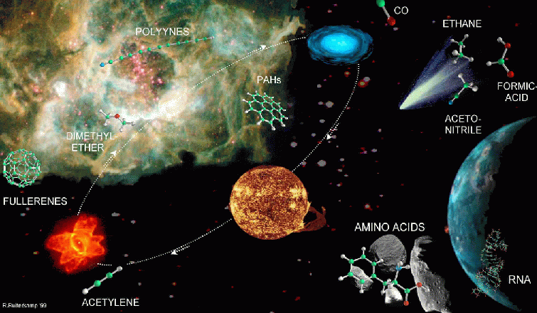
astrobiología

Slide 31
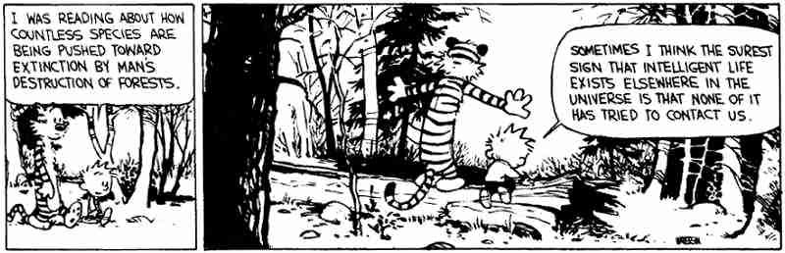
Vida inteligente en el Universo
Library of Bill Watterson's Calvin and Hobbes

Slide 32
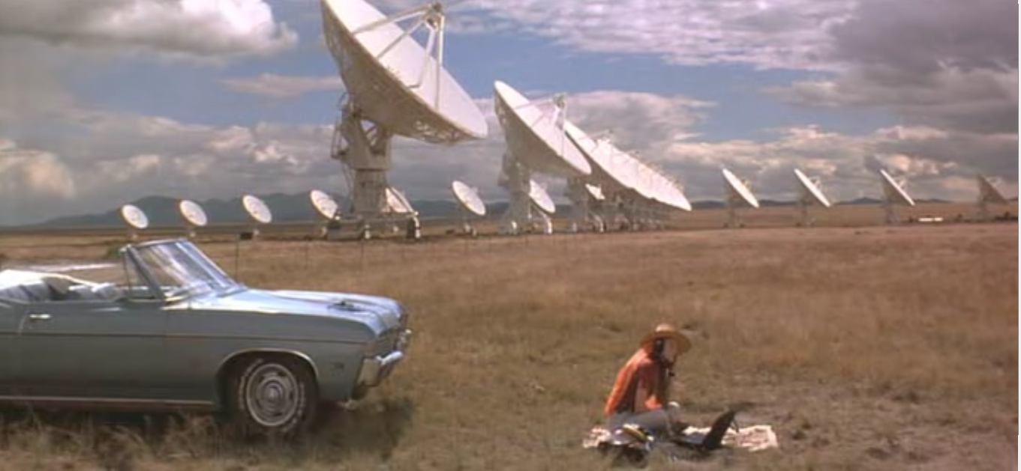
Señales de otras civilizaciones
https://thesouloftheplot.wordpress.com/2012/11/09/contact/

Slide 33
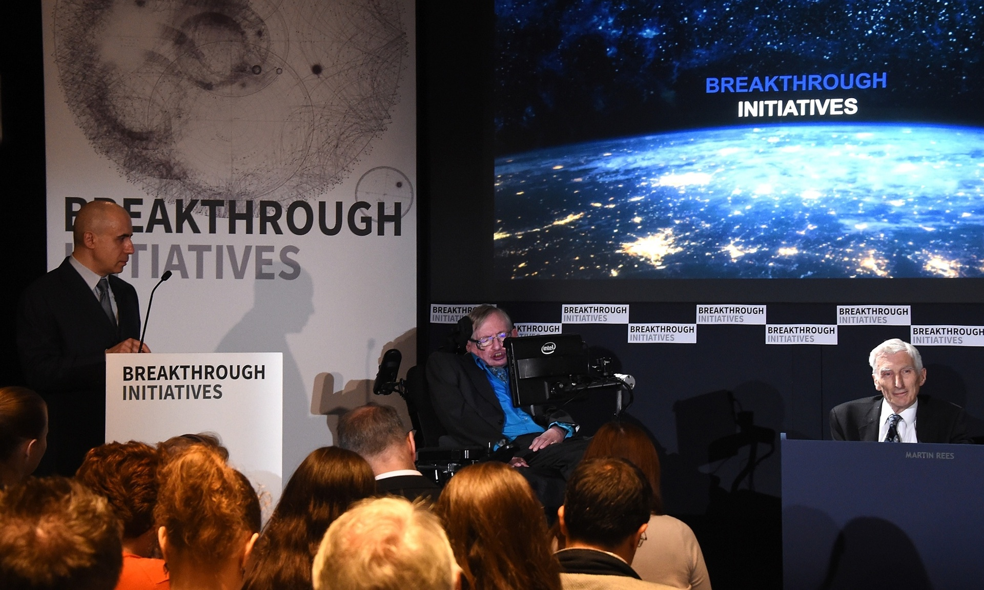
http://www.theguardian.com/science/2015/jul/20/alien-life-breakthough-initiative

Slide 34
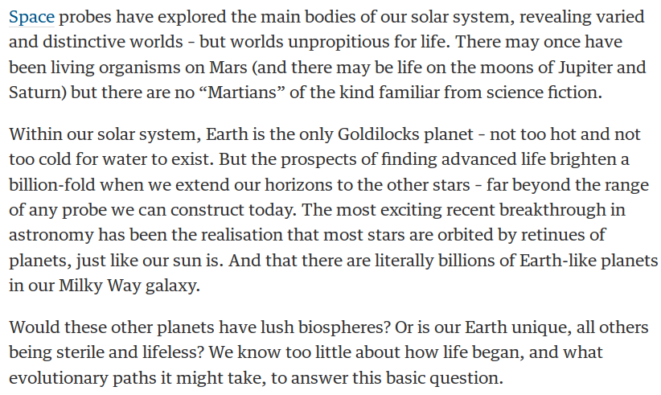
¿Es nuestro planeta único?
Let's listen out for alien life – and remember we might not understand it
Martin Rees
http://www.theguardian.com/science/2015/jul/20/alien-life-breakthough-initiative

Slide 35
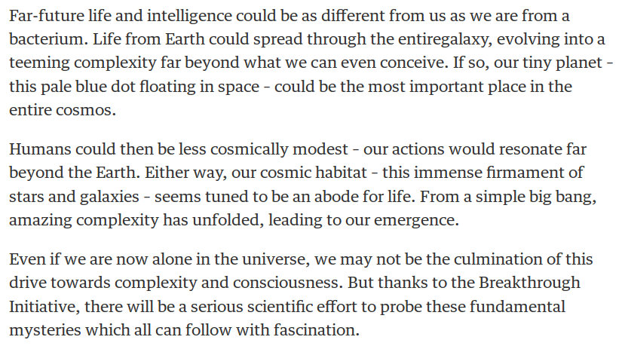
¿reconoceríamos la vida cuando la veamos?
Let's listen out for alien life – and remember we might not understand it
Martin Rees
http://www.theguardian.com/science/2015/jul/20/alien-life-breakthough-initiative

Slide 36
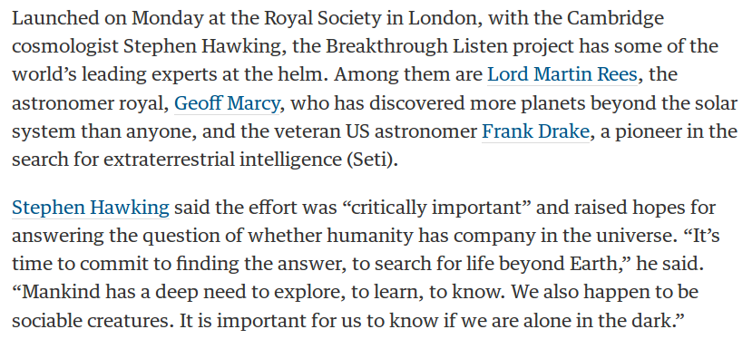
Busquemos las respuestas afuera
http://www.theguardian.com/science/2015/jul/20/breakthrough-listen-massive-radio-wave-project-scan-far-regions-for-alien-life

Slide 37
El mensaje de los medios

Slide 38
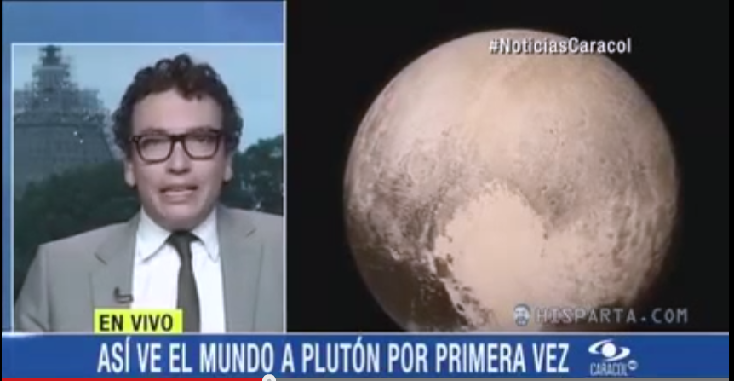
¿Alguien se siente herido?
https://www.youtube.com/watch?v=qgIxsSEx8Yk

Slide 39
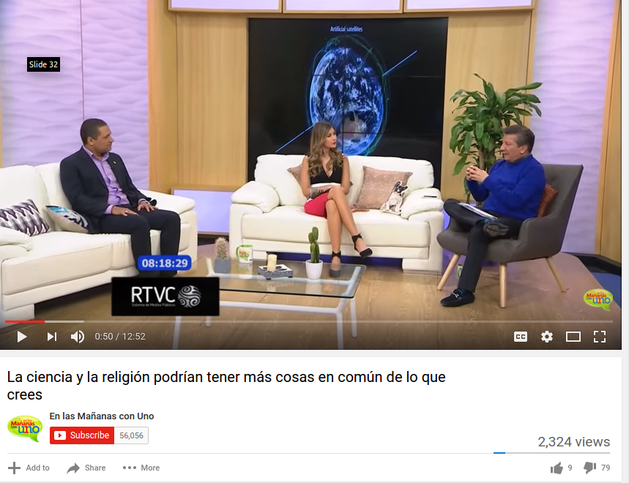
https://www.youtube.com/watch?v=jTuQQDbYqfE

Slide 40
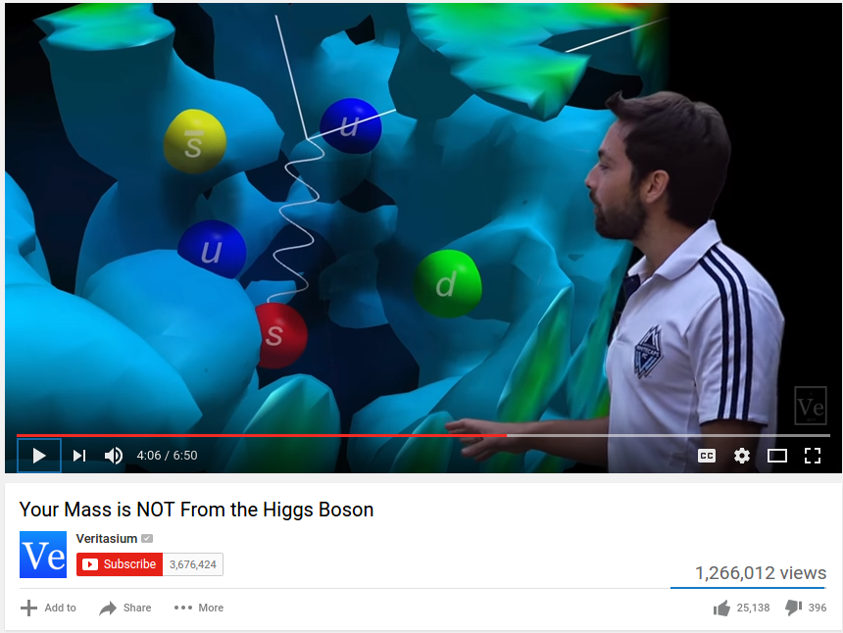
https://www.youtube.com/watch?v=Ztc6QPNUqls

Slide 41
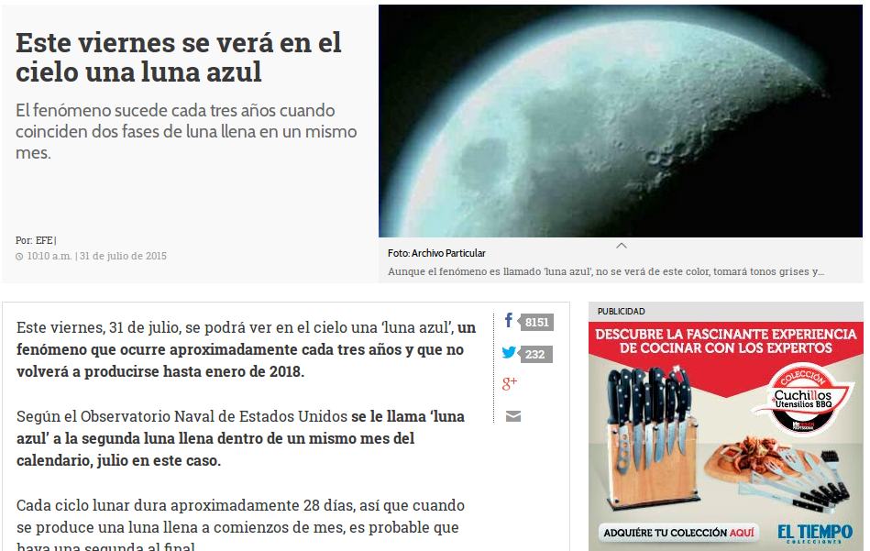
http://www.eltiempo.com/estilo-de-vida/ciencia/luna-azul-viernes-31-de-julio-del-2015/16172636

Slide 42
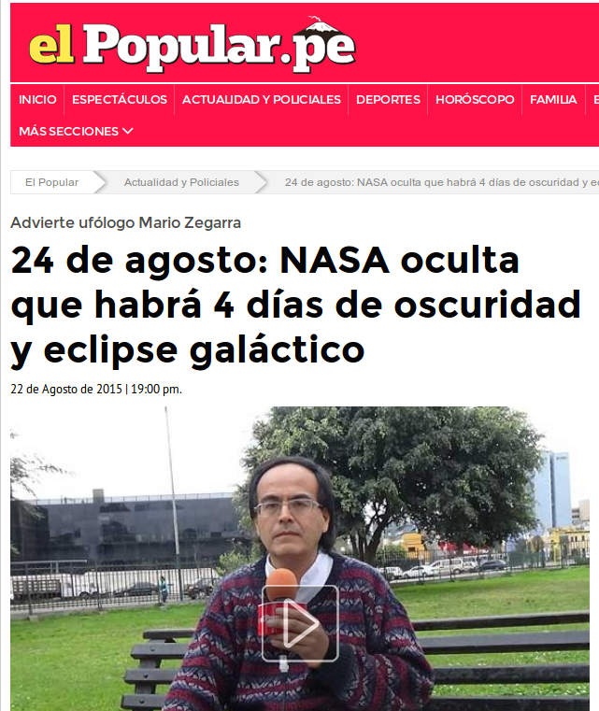
http://www.elpopular.pe/actualidad-y-policiales/2015-08-22-24-de-agosto-nasa-oculta-que-habra-4-dias-de-oscuridad-y-eclipse-galactico

Slide 43
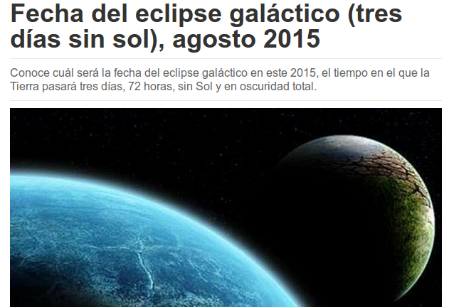
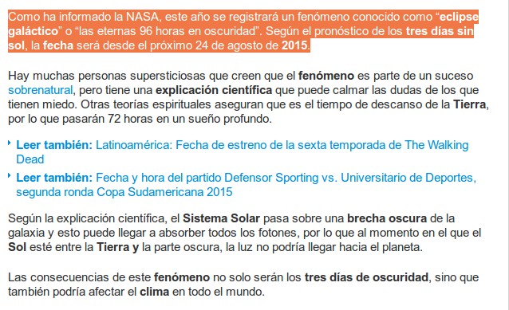
http://www.noticias.com/insolito/fecha-eclipse-galactico-tres-dias-sin-sol-agosto-2015.html

Slide 44
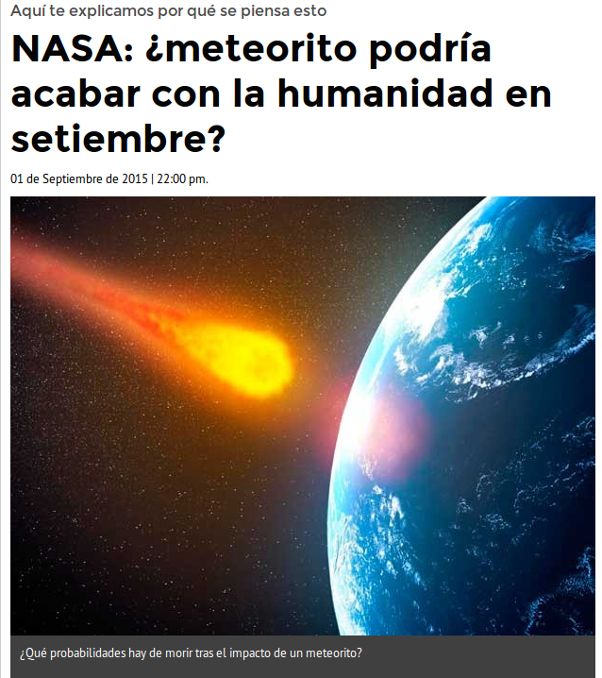
http://www.elpopular.pe/actualidad-y-policiales/2015-06-10-nasa-meteorito-podria-acabar-con-la-humanidad-en-setiembre

Slide 45
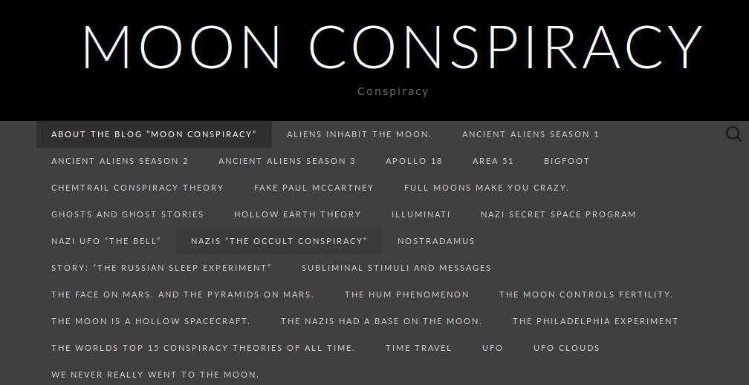
Teorías de conspiración
https://moonconspiracy.wordpress.com/

Slide 46
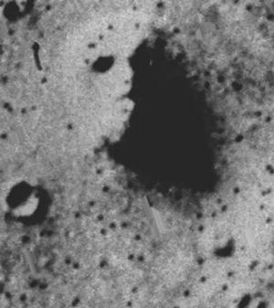
Pareidolia
https://moonconspiracy.wordpress.com/the-face-on-mars-and-the-pyramids-on-mars/

Slide 47
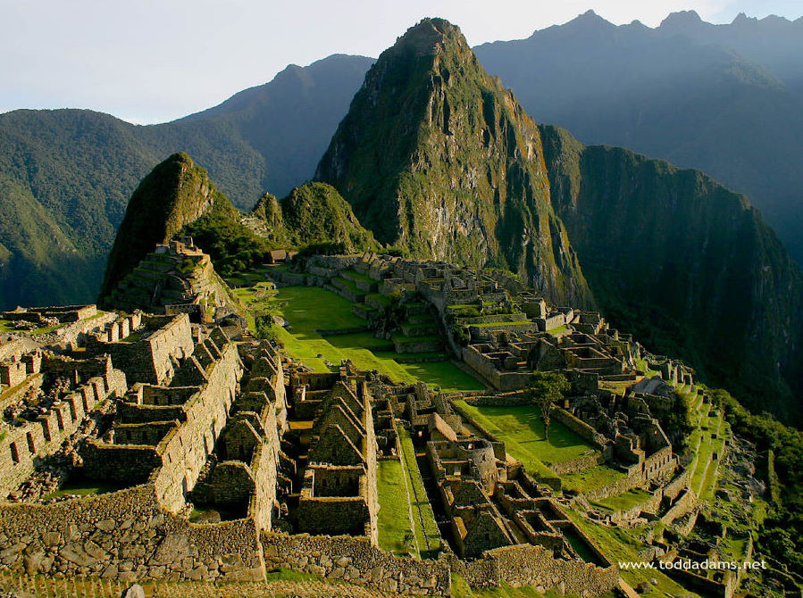
Pareidolia

Slide 49
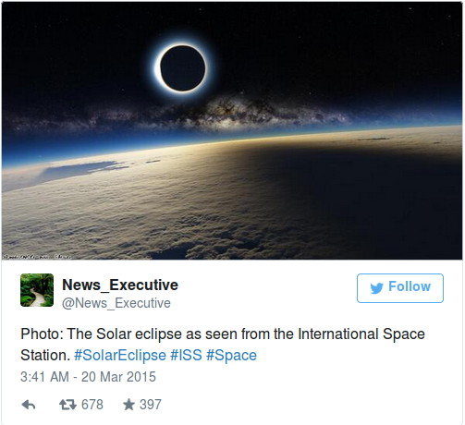
¿Eclipse?
http://www.mirror.co.uk/news/technology-science/science/solar-eclipse-2015-mind-blowing-picture-5368159

Slide 50
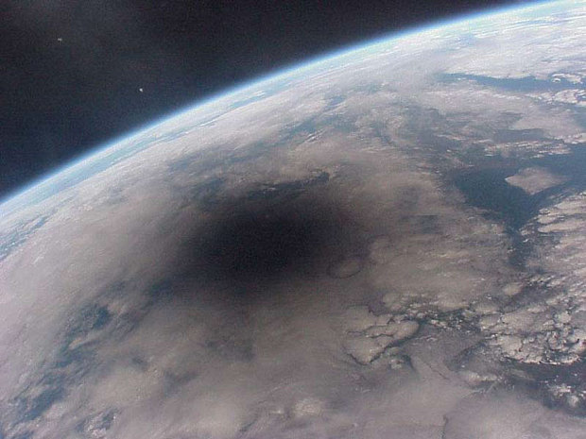
Eclipse
http://www.telegraph.co.uk/news/science/space/11484849/Solar-eclipse-amazing-picture-from-International-Space-Station-was-photoshopped.html

Slide 51
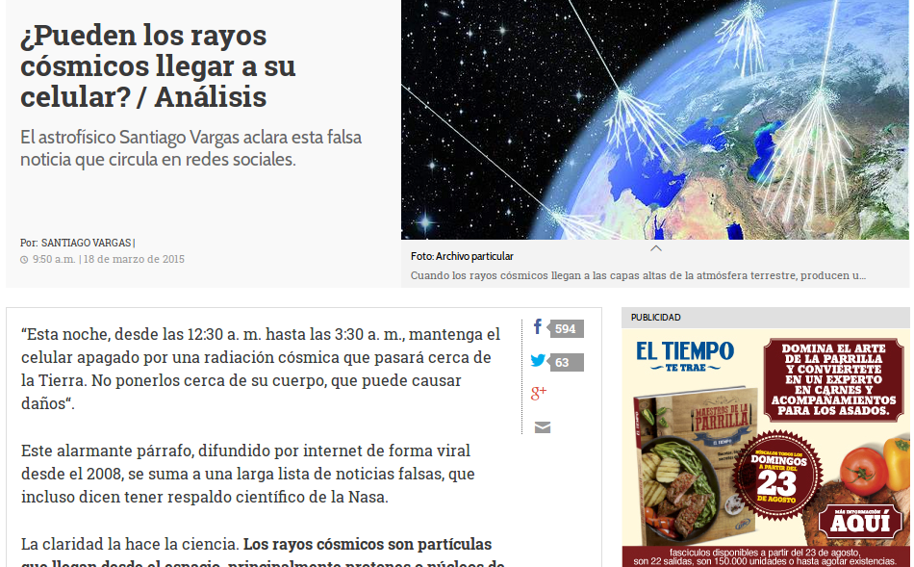
Rayos cósmicos
http://www.eltiempo.com/estilo-de-vida/ciencia/columna-santiago-vargas-falsa-noticia-de-rayos-cosmicos-en-los-celulares/15417691

Slide 52
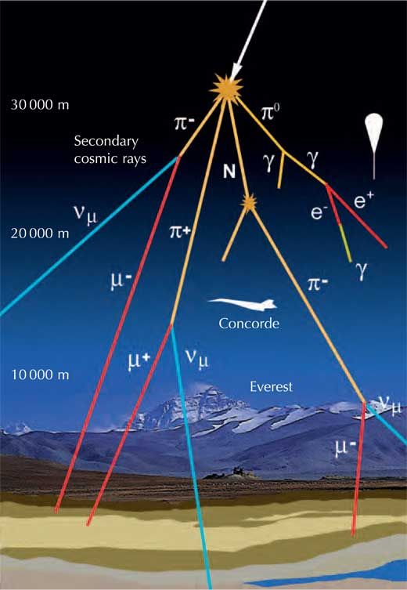
http://www.extremetech.com/extreme/207353-cosmic-ray-induced-radiation-powered-life-in-subsurface-pockets-of-the-universe

Slide 53
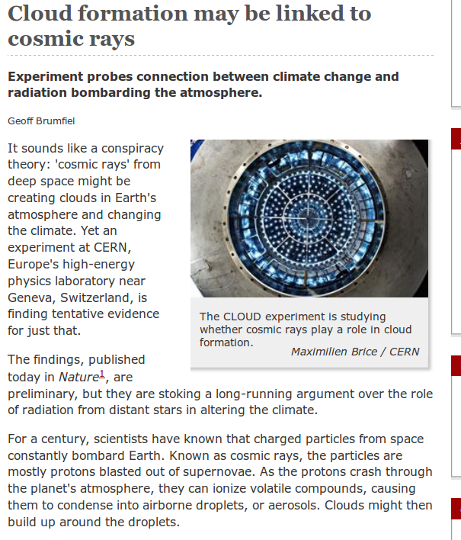
Ciencia en tiempo real

Slide 54

http://www.iau.org/public/themes/citizen-science-projects/

Slide 55

Ciencia ciudadana
http://spacehack.org/

Slide 56

http://sciencehackday.org/

Slide 57

Science Hack Day
https://www.youtube.com/watch?v=Dzb_QCYxi3I

Slide 58

Science Hack Day
http://sciencehackday.org/

Slide 59

El caso Wolfe-Simon
http://www.nasa.gov/topics/universe/features/astrobiology_toxic_chemical.html

Slide 60

NASA-funded astrobiology research has changed the fundamental knowledge about what comprises all known life on Earth.
Researchers conducting tests in the harsh environment of Mono Lake in California have discovered the first known microorganism on Earth able to thrive and reproduce using the toxic chemical arsenic. The microorganism substitutes arsenic for phosphorus in its cell components.
http://www.nasa.gov/topics/universe/features/astrobiology_toxic_chemical.html

Slide 61
"The definition of life has just expanded,"
http://www.nasa.gov/topics/universe/features/astrobiology_toxic_chemical.html

Slide 62

https://www.youtube.com/watch?v=JVSJLUIQrA0

Slide 63

http://sandwalk.blogspot.com/2012/02/arsenic-affair-no-arsenic-in-dna.html

Slide 64

http://www.dailygalaxy.com/my_weblog/2010/12/nasa-science-smackdown-mono-lake-discovery-challenged.html

Slide 65


Slide 66

http://news.sciencemag.org/scientific-community/2014/09/top-50-science-stars-twitter

Slide 67

Indice Kardashian

Slide 68

Indice Kardashian
Twitter followers versus number of scientific citations for a sort-of-random sample of researcher tweeters. Red crosses represent female tweeters and blue crosses represent male tweeters. The black trendline describes the best fit to the data. Those individuals with a highly overinflated number of followers (when compared with the number predicted by the trendline) are highlighted by the area labeled Kardashians. Credit: Hall , Genome Biology 2014 15:424 doi:10.1186/s13059-014-0424-0
Read more at: http://phys.org/news/2014-08-tongue-in-cheek-kardashian-index-awareness-cult-celebrity.html#jCp

Slide 69

http://news.sciencemag.org/scientific-community/2014/09/top-50-science-stars-twitter

Slide 70

El caso del Dr. Cuero
http://www.semana.com/nacion/articulo/la-parabola-de-cuero/362547-3

Slide 71

El caso del Dr. Cuero
http://eticasegura.fnpi.org/2013/10/25/caso-raul-cuero-motivo-de-reflexion-para-el-periodismo-cientifico-colombiano/

