Slide 1
Astronomía en medios masivos de comunicación
Jaime E. Forero Romero
Universidad de los Andes
Curso Astronomía Popular
Septiembre 2015

Slide 2
Errores periodísticos
Mentiras en los medios
Teorías de conspiración
Astrofísicos en los medios
Ciudadanía cercana a la ciencia
Científicos mediáticos
Un triste caso colombiano

Slide 3
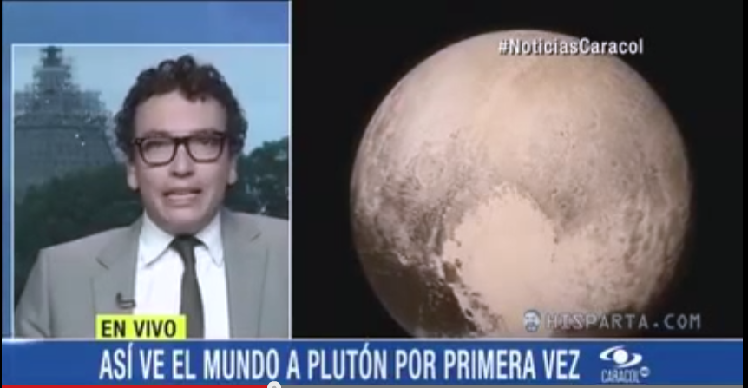
¿Alguien se siente herido?
https://www.youtube.com/watch?v=qgIxsSEx8Yk

Slide 4
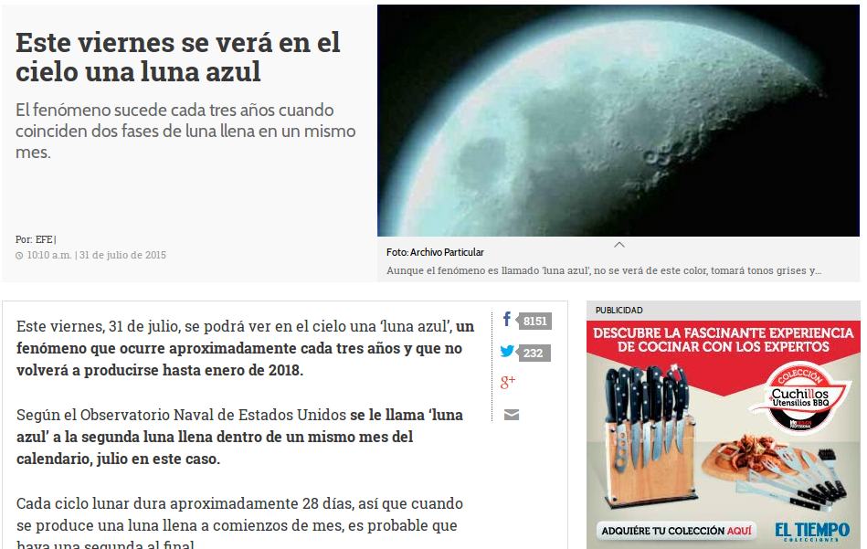
http://www.eltiempo.com/estilo-de-vida/ciencia/luna-azul-viernes-31-de-julio-del-2015/16172636

Slide 5
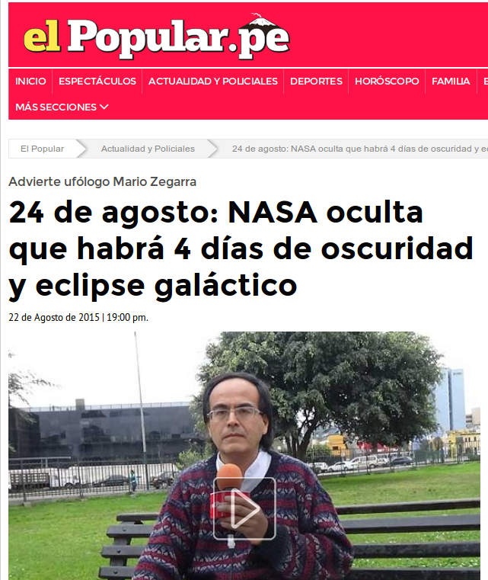
http://www.elpopular.pe/actualidad-y-policiales/2015-08-22-24-de-agosto-nasa-oculta-que-habra-4-dias-de-oscuridad-y-eclipse-galactico

Slide 6
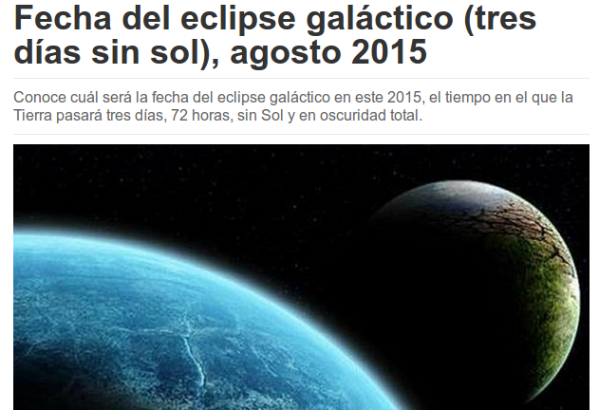
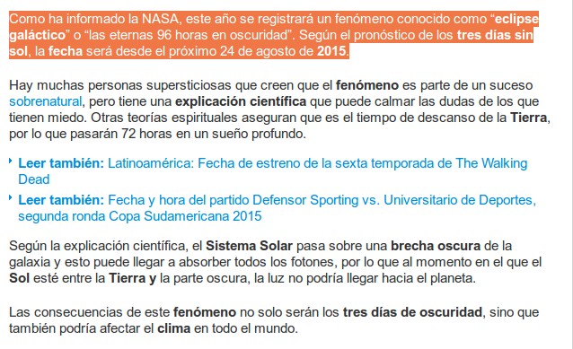
http://www.noticias.com/insolito/fecha-eclipse-galactico-tres-dias-sin-sol-agosto-2015.html

Slide 7
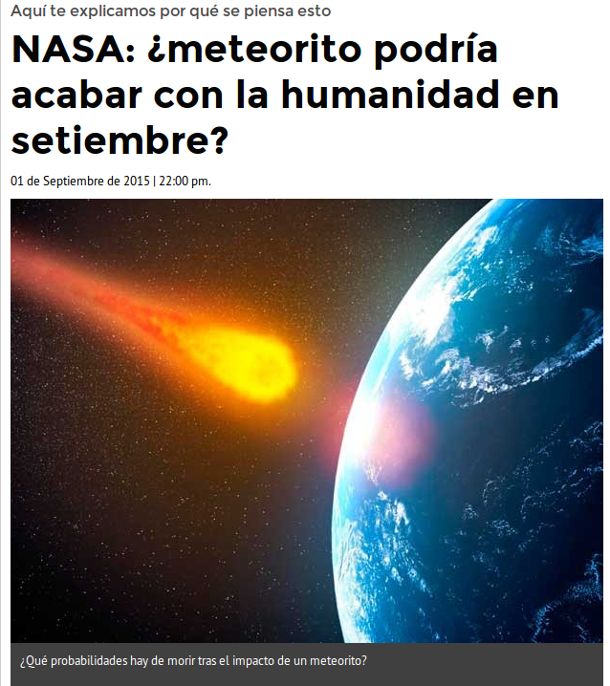
http://www.elpopular.pe/actualidad-y-policiales/2015-06-10-nasa-meteorito-podria-acabar-con-la-humanidad-en-setiembre

Slide 8
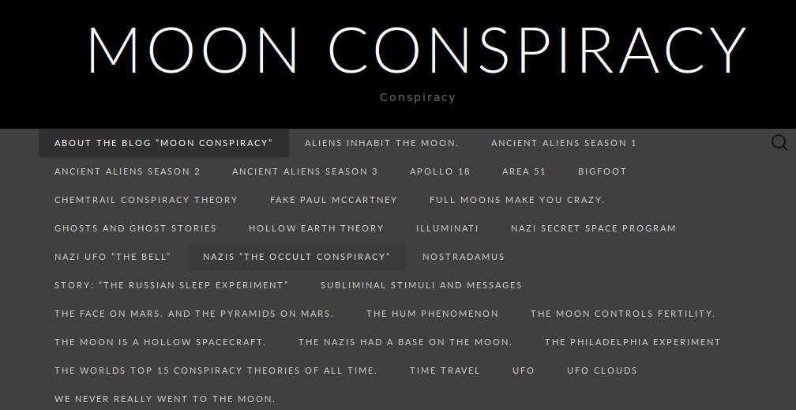
Teorías de conspiración
https://moonconspiracy.wordpress.com/

Slide 9
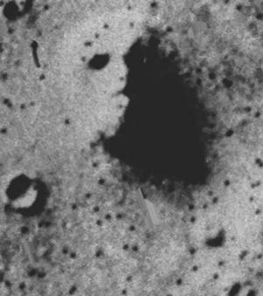
Pareidolia
https://moonconspiracy.wordpress.com/the-face-on-mars-and-the-pyramids-on-mars/

Slide 10
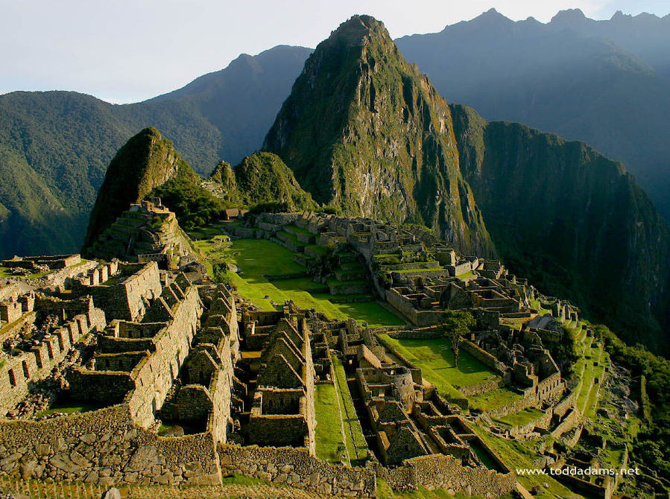
Pareidolia

Slide 12
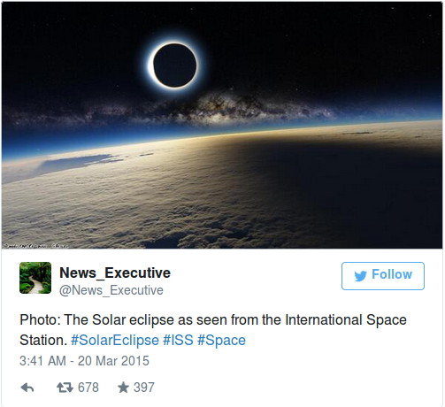
¿Eclipse?
http://www.mirror.co.uk/news/technology-science/science/solar-eclipse-2015-mind-blowing-picture-5368159

Slide 13
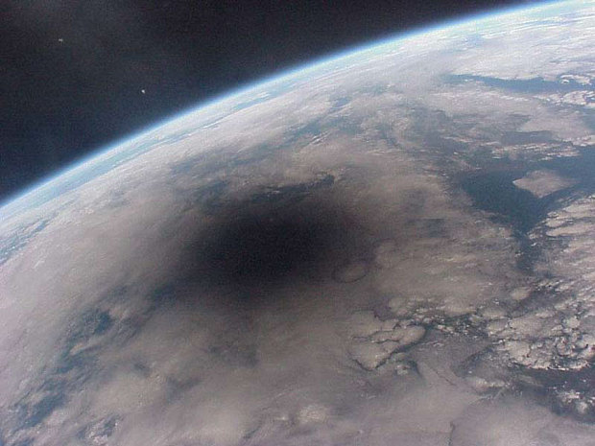
Eclipse
http://www.telegraph.co.uk/news/science/space/11484849/Solar-eclipse-amazing-picture-from-International-Space-Station-was-photoshopped.html

Slide 14
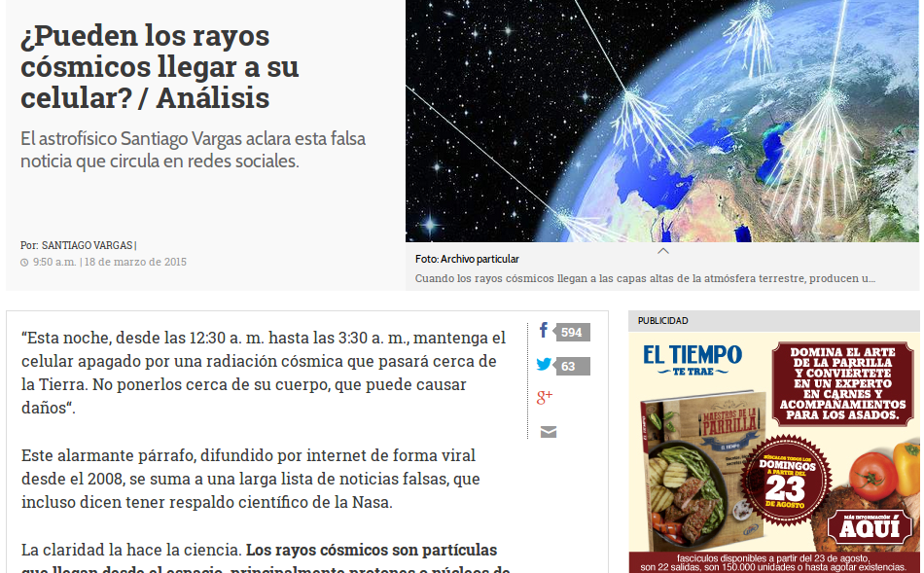
Rayos cósmicos
http://www.eltiempo.com/estilo-de-vida/ciencia/columna-santiago-vargas-falsa-noticia-de-rayos-cosmicos-en-los-celulares/15417691

Slide 15
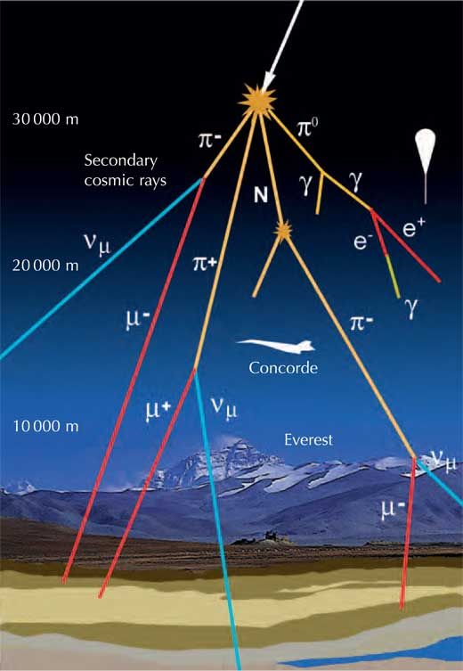
http://www.extremetech.com/extreme/207353-cosmic-ray-induced-radiation-powered-life-in-subsurface-pockets-of-the-universe

Slide 16
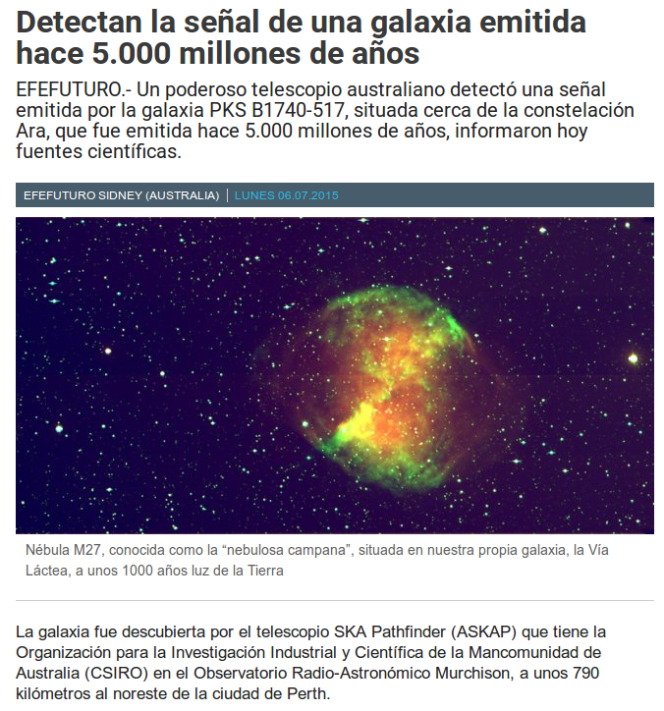
http://www.efefuturo.com/noticia/detectan-senal-de-una-galaxia-emitida-hace-5-000-millones-de-anos/

Slide 17
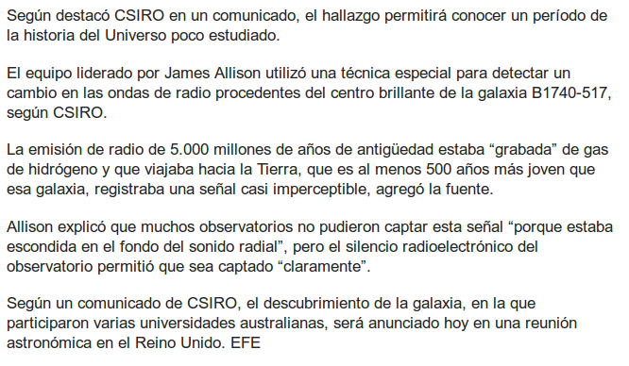
http://www.efefuturo.com/noticia/detectan-senal-de-una-galaxia-emitida-hace-5-000-millones-de-anos/

Slide 18
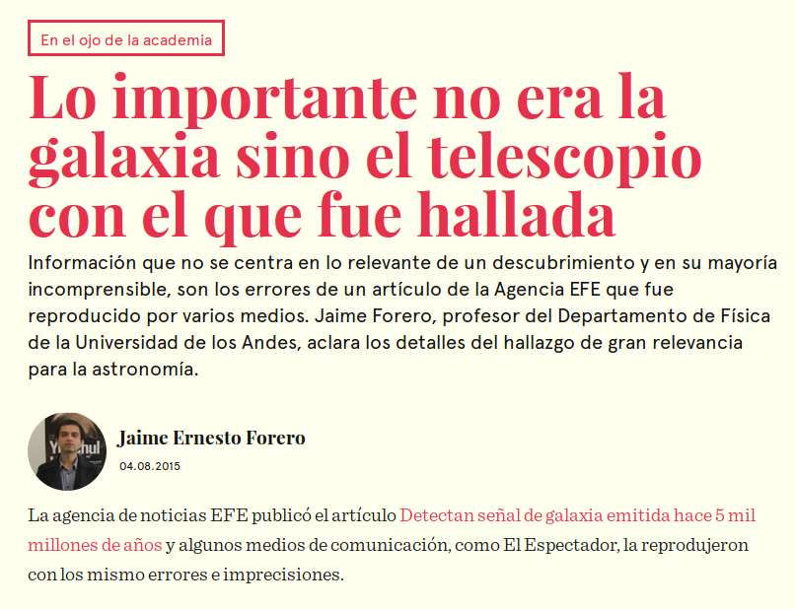
http://cerosetenta.uniandes.edu.co/lo-importante-no-era-la-galaxia-sino-el-telescopio-con-el-que-fue-hallada/

Slide 19
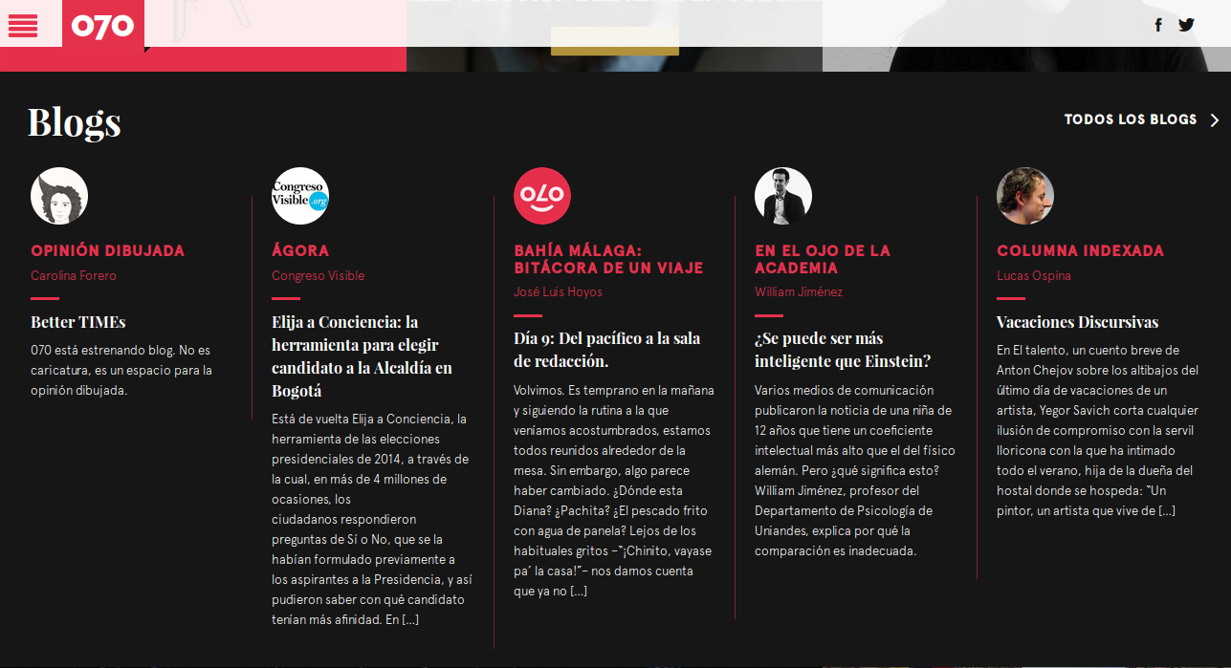
http://cerosetenta.uniandes.edu.co/

Slide 20
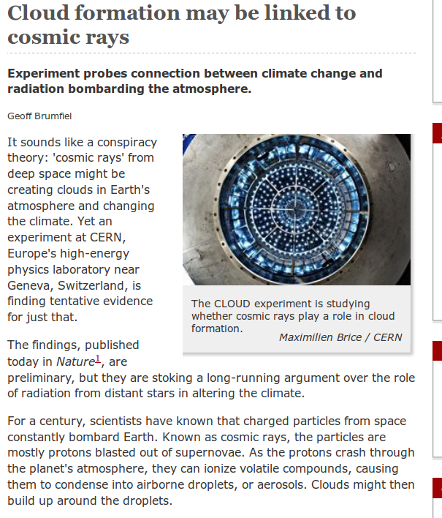
Ciencia en tiempo real

Slide 21
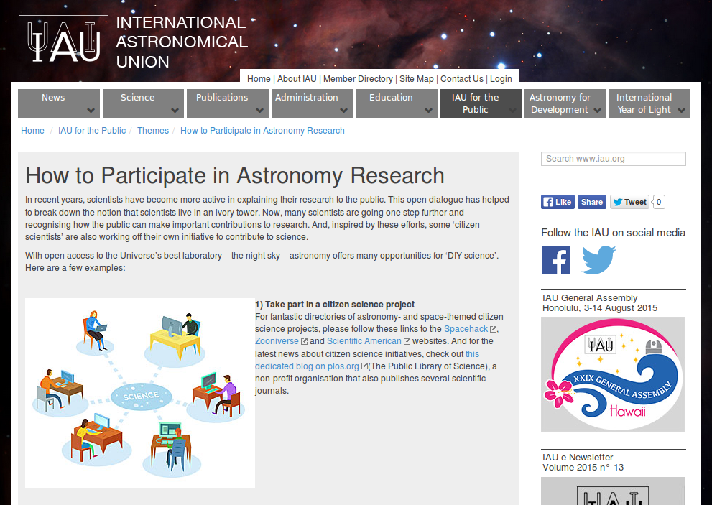
http://www.iau.org/public/themes/citizen-science-projects/

Slide 22
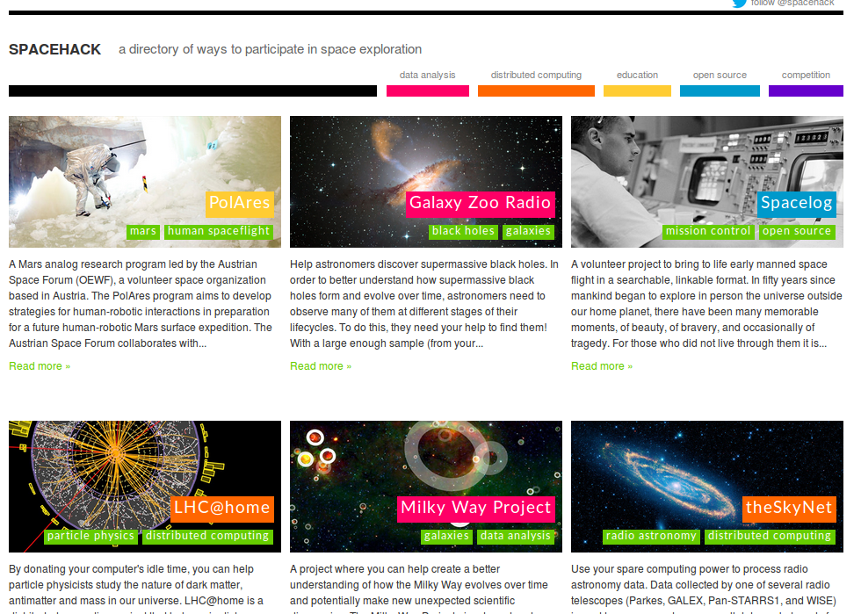
Ciencia ciudadana
http://spacehack.org/

Slide 23
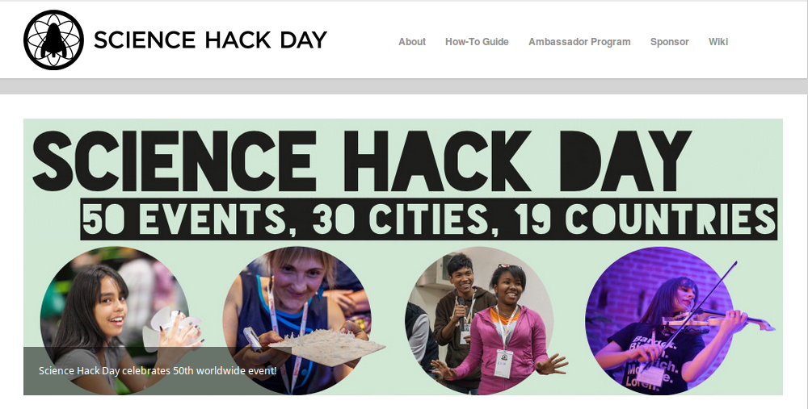
http://sciencehackday.org/

Slide 24
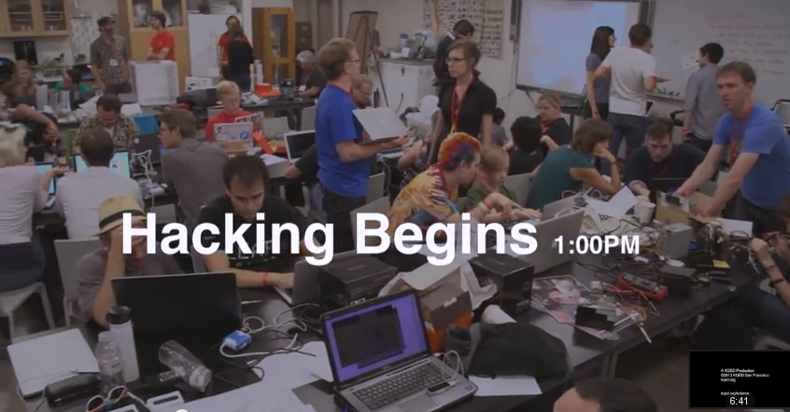
Science Hack Day
https://www.youtube.com/watch?v=Dzb_QCYxi3I

Slide 25
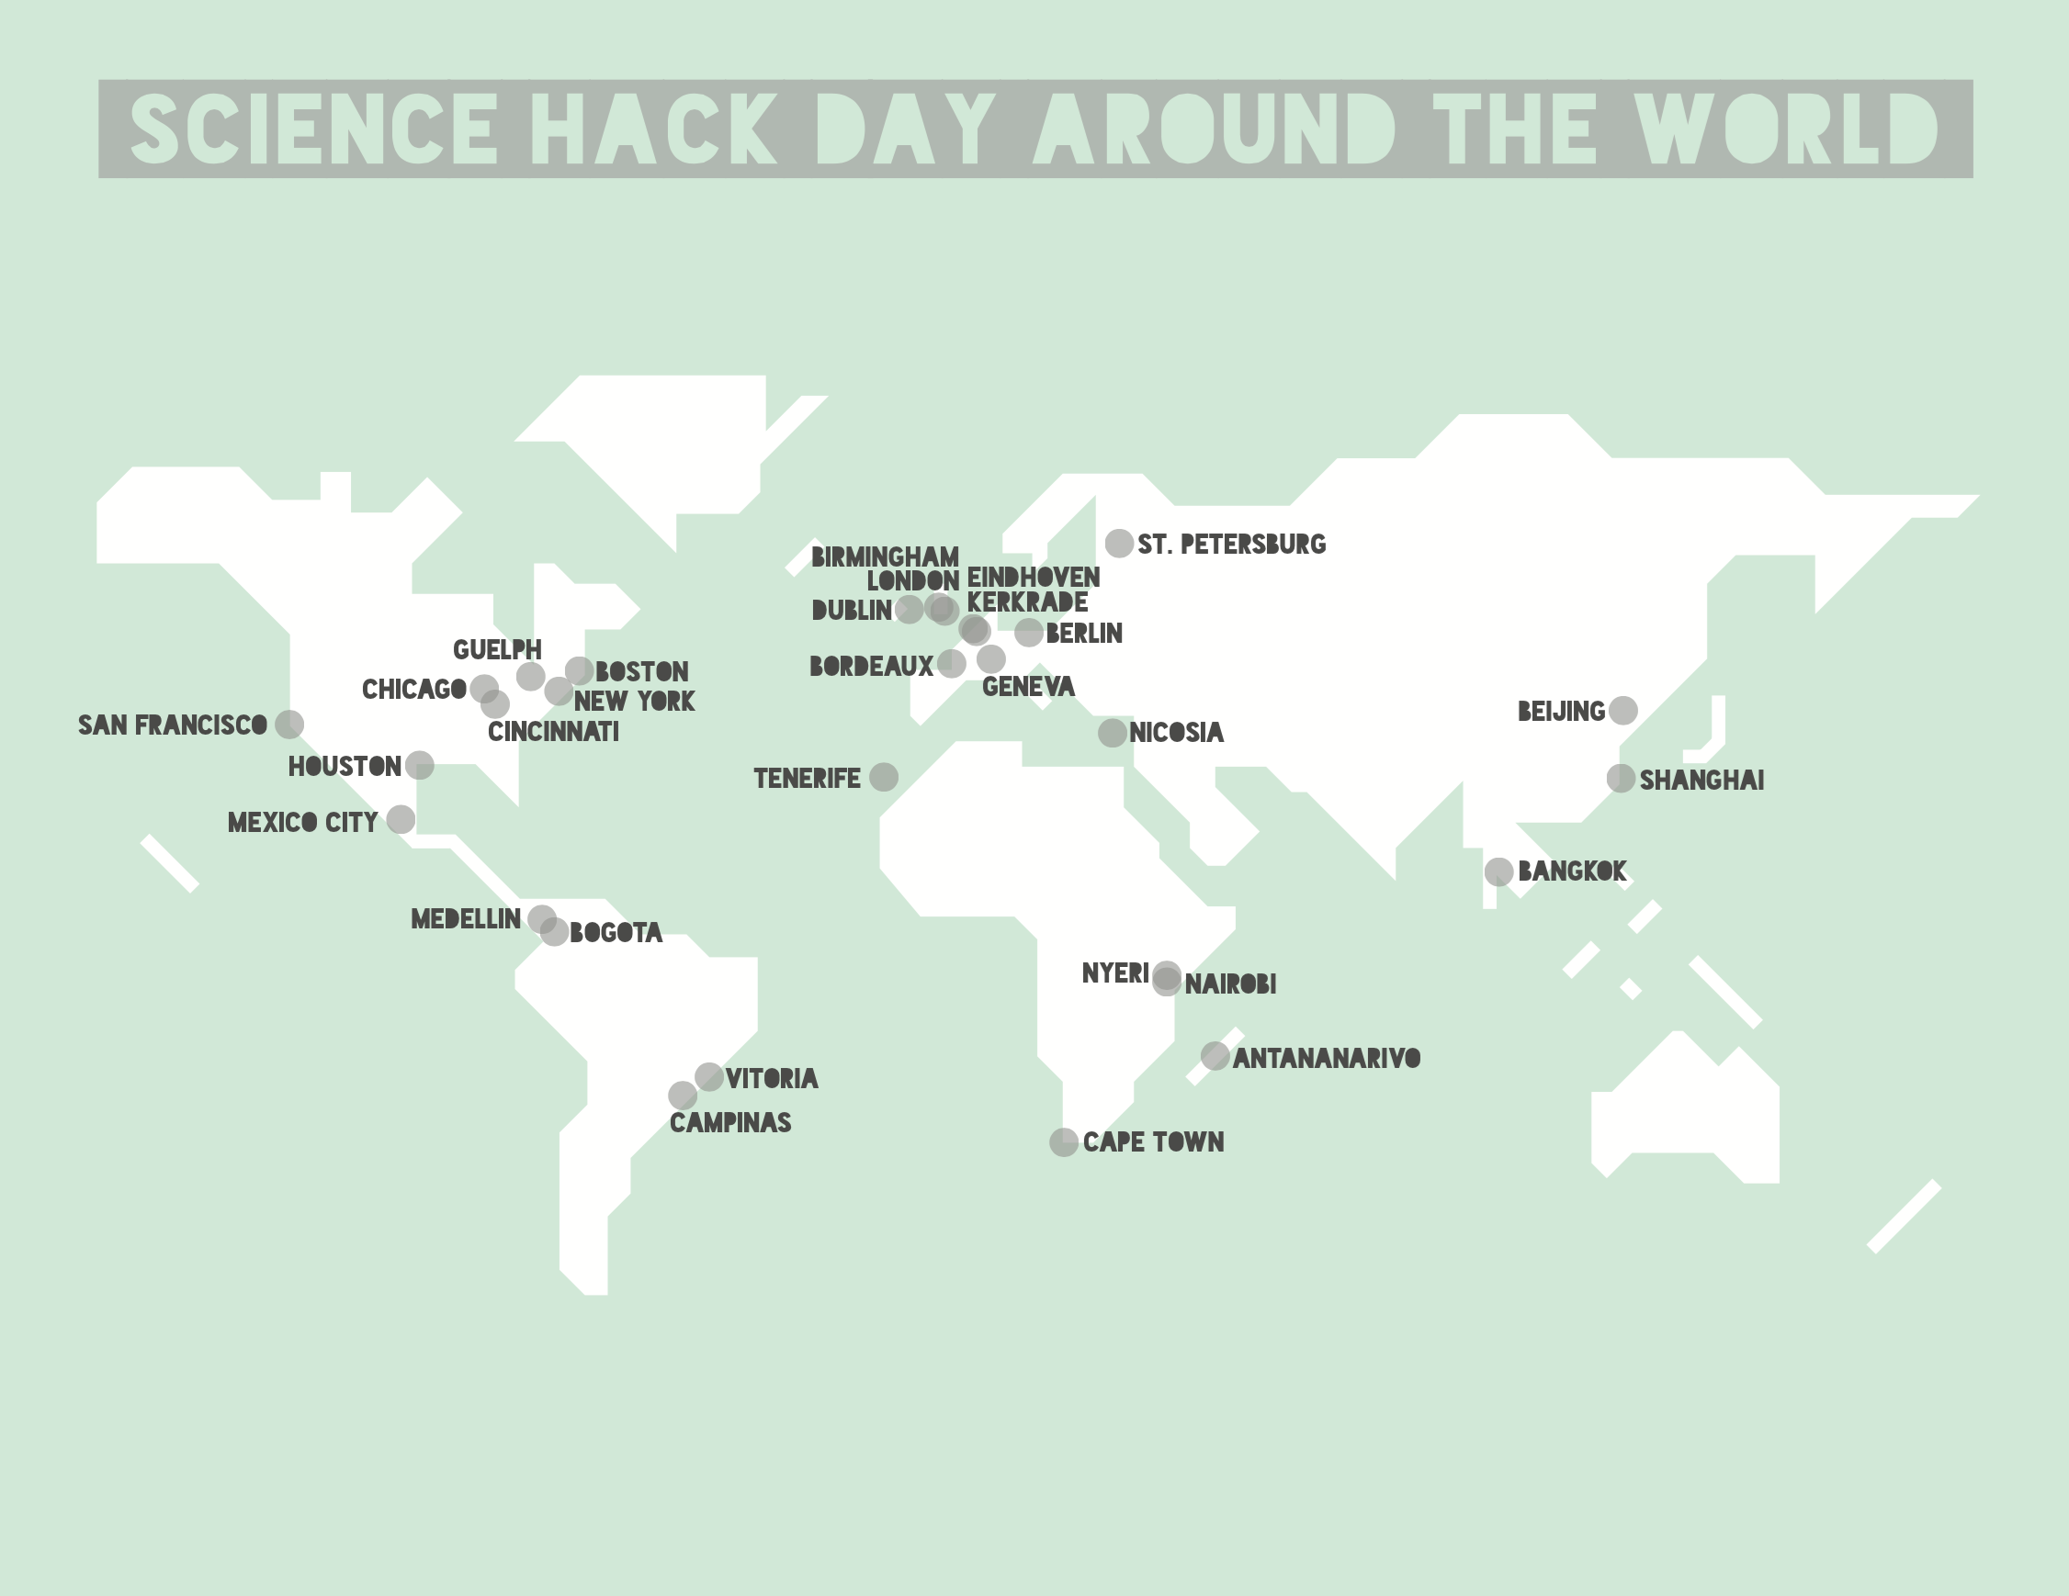
Science Hack Day
http://sciencehackday.org/

Slide 26
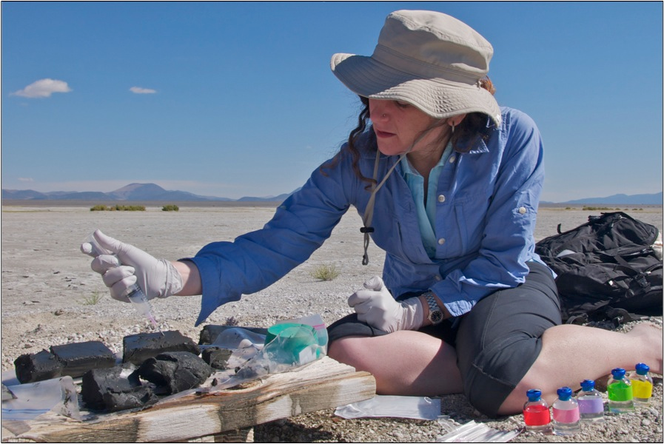
El caso Wolfe-Simon
http://www.nasa.gov/topics/universe/features/astrobiology_toxic_chemical.html

Slide 27
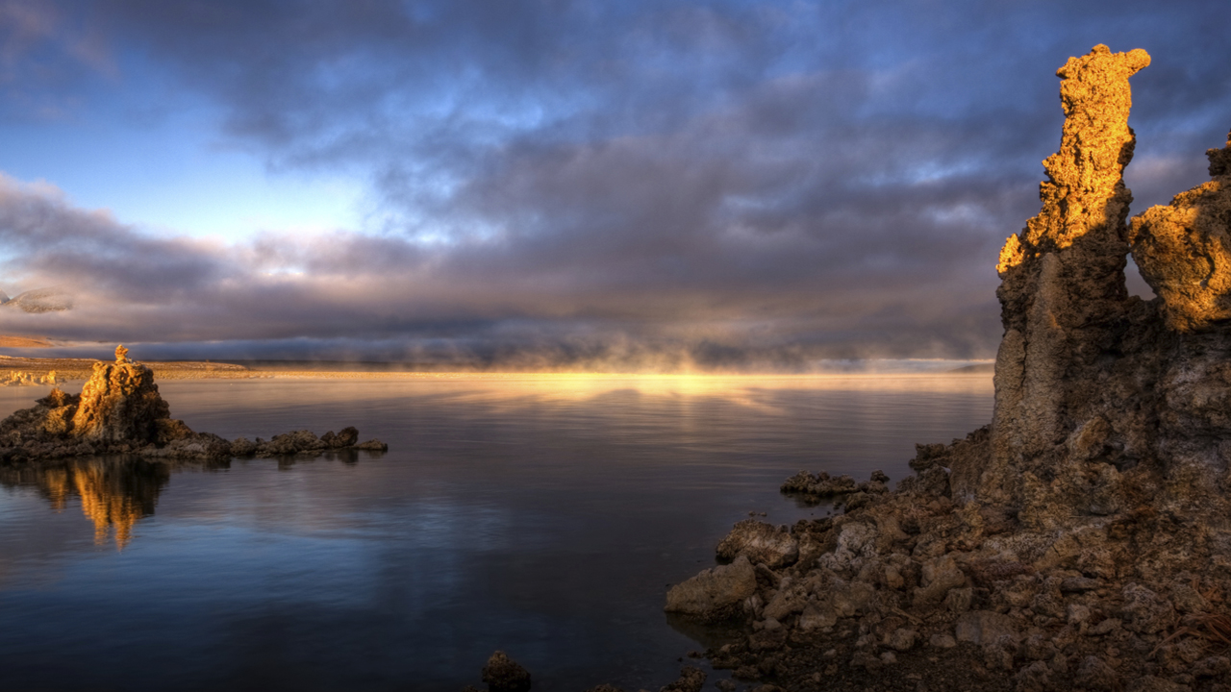
NASA-funded astrobiology research has changed the fundamental knowledge about what comprises all known life on Earth.
Researchers conducting tests in the harsh environment of Mono Lake in California have discovered the first known microorganism on Earth able to thrive and reproduce using the toxic chemical arsenic. The microorganism substitutes arsenic for phosphorus in its cell components.
http://www.nasa.gov/topics/universe/features/astrobiology_toxic_chemical.html

Slide 28
"The definition of life has just expanded,"
http://www.nasa.gov/topics/universe/features/astrobiology_toxic_chemical.html

Slide 29
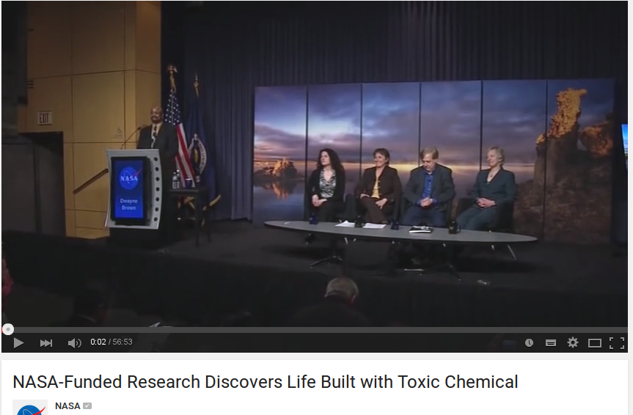
https://www.youtube.com/watch?v=JVSJLUIQrA0

Slide 30
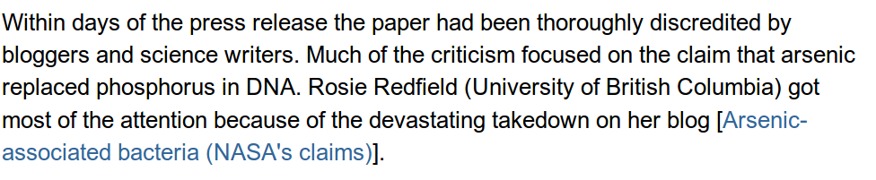
http://sandwalk.blogspot.com/2012/02/arsenic-affair-no-arsenic-in-dna.html

Slide 31
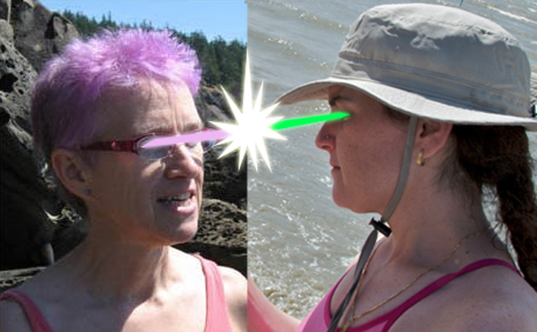
http://www.dailygalaxy.com/my_weblog/2010/12/nasa-science-smackdown-mono-lake-discovery-challenged.html

Slide 32
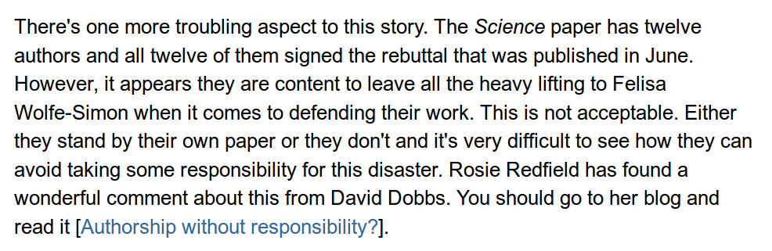

Slide 33
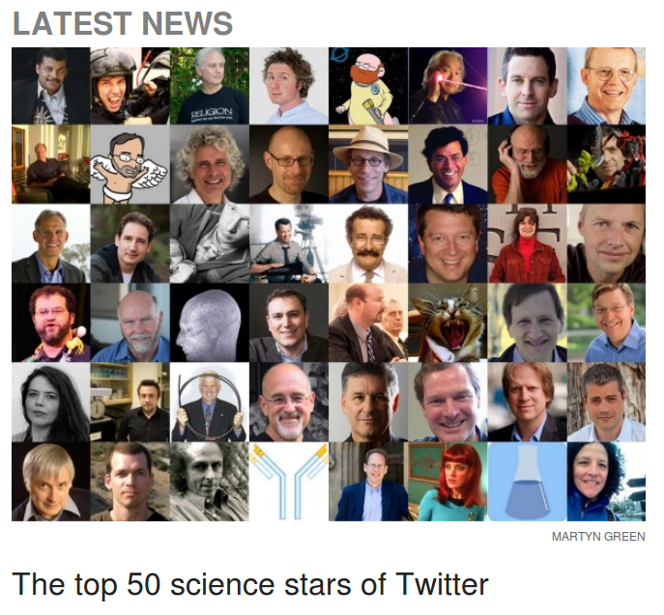
http://news.sciencemag.org/scientific-community/2014/09/top-50-science-stars-twitter

Slide 34
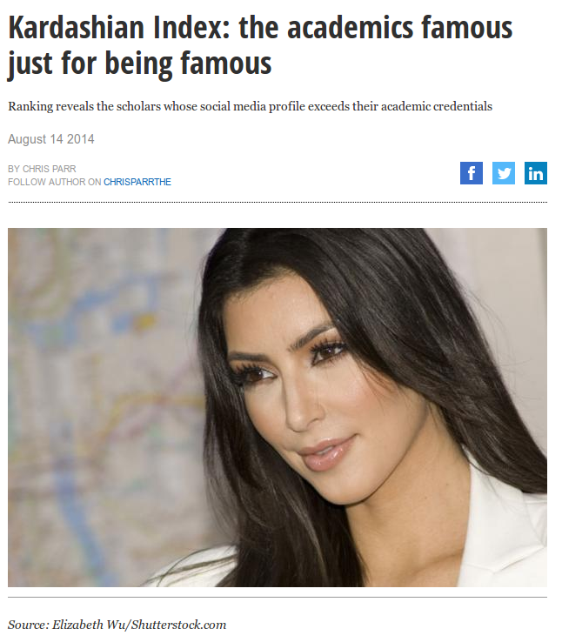
Indice Kardashian

Slide 35
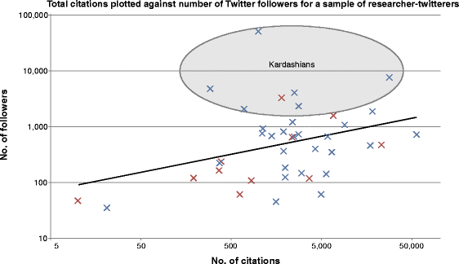
Indice Kardashian
Twitter followers versus number of scientific citations for a sort-of-random sample of researcher tweeters. Red crosses represent female tweeters and blue crosses represent male tweeters. The black trendline describes the best fit to the data. Those individuals with a highly overinflated number of followers (when compared with the number predicted by the trendline) are highlighted by the area labeled Kardashians. Credit: Hall , Genome Biology 2014 15:424 doi:10.1186/s13059-014-0424-0
Read more at: http://phys.org/news/2014-08-tongue-in-cheek-kardashian-index-awareness-cult-celebrity.html#jCp

Slide 36
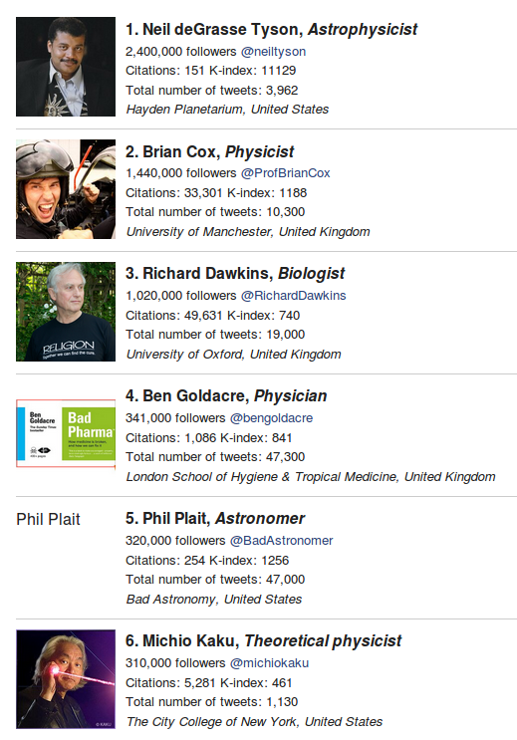
http://news.sciencemag.org/scientific-community/2014/09/top-50-science-stars-twitter

Slide 37
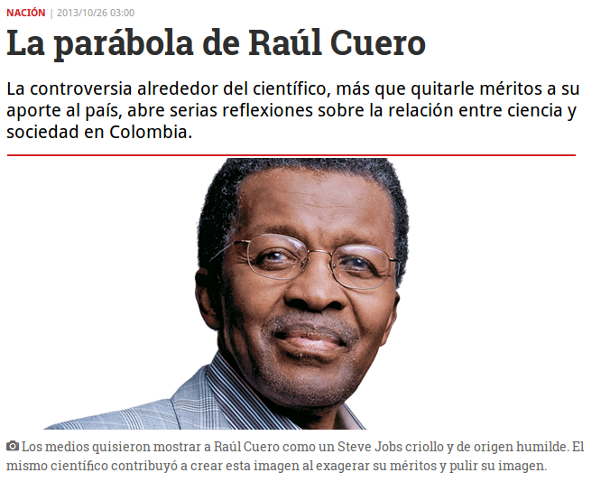
El caso del Dr. Cuero
http://www.semana.com/nacion/articulo/la-parabola-de-cuero/362547-3

Slide 38
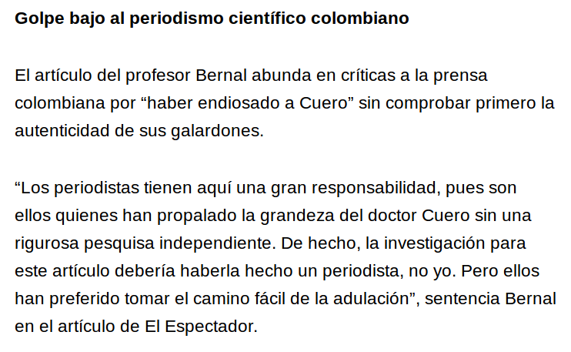
El caso del Dr. Cuero
http://eticasegura.fnpi.org/2013/10/25/caso-raul-cuero-motivo-de-reflexion-para-el-periodismo-cientifico-colombiano/

Slide 39
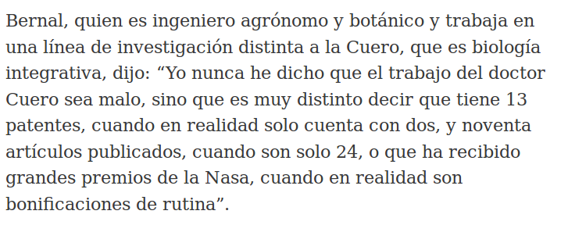
El caso del Dr. Cuero
http://www.eltiempo.com/archivo/documento/CMS-13141962

