Slide 1
Viajes espaciales
Jaime E. Forero Romero
Universidad de los Andes
Curso Astronomía Popular
Septiembre 2015

Slide 2

http://imgur.com/gallery/2jsfax6

Slide 3
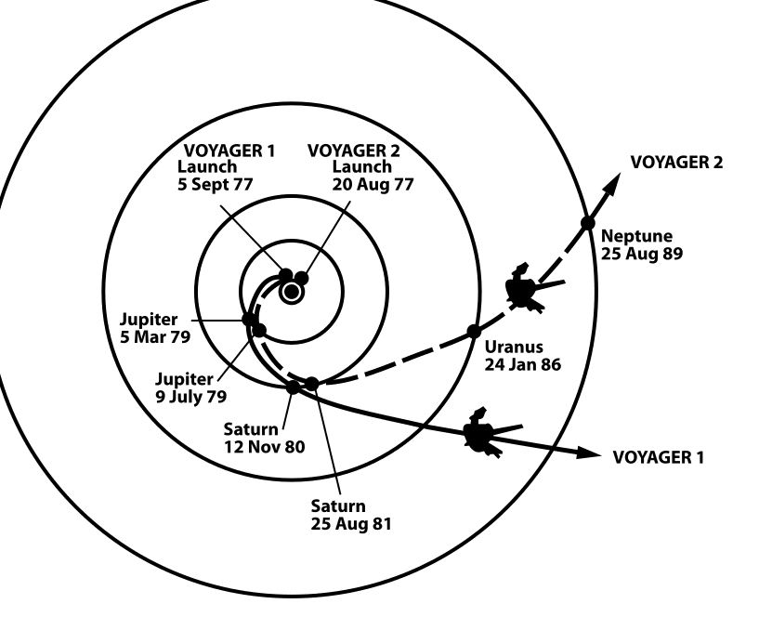
Wikicommons: The trajectories that enabled NASA's twin Voyager spacecraft to tour the four gas giant planets and achieve velocity to escape the Solar System. Source: http://solarsystem.nasa.gov/multimedia/display.cfm?IM_ID=2143

Slide 4
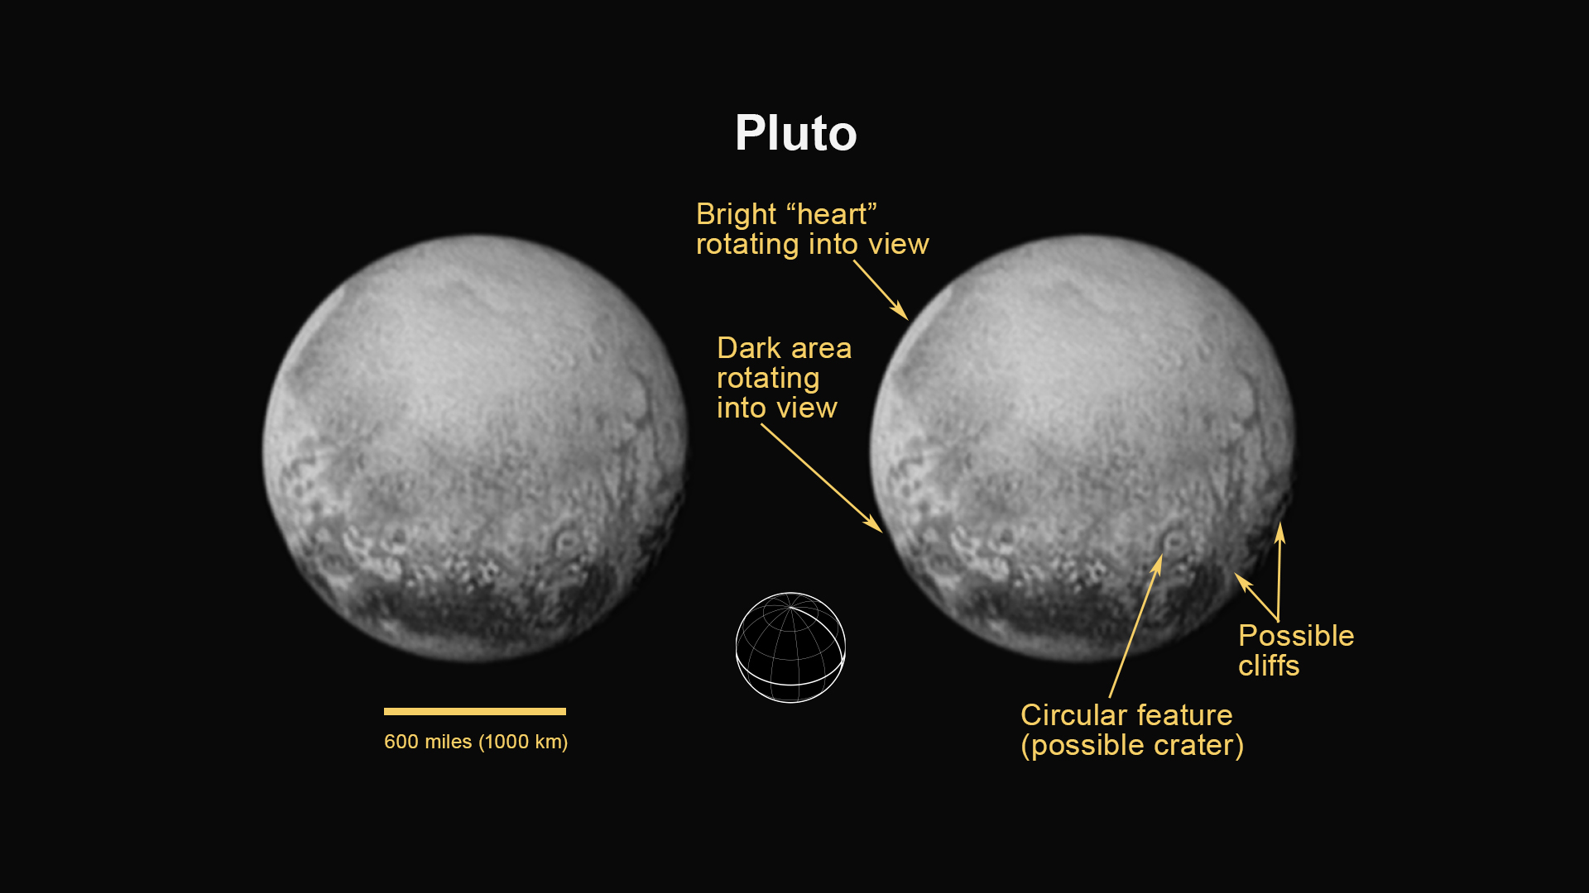
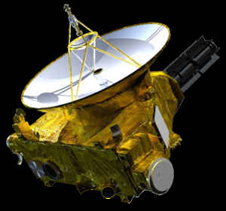
https://www.nasa.gov/mission_pages/newhorizons/main/index.html

Slide 5
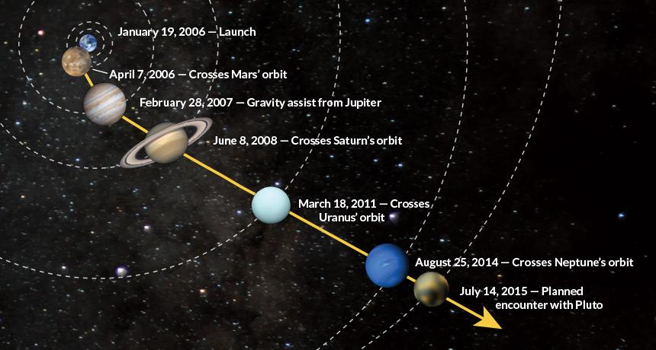
https://www.sciencenews.org/article/rendezvous-pluto?mode=magazine&context=190368

Slide 6
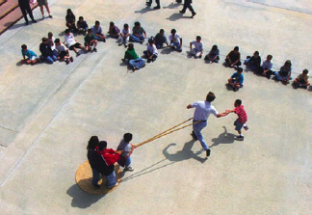
Wikicommons: The trajectories that enabled NASA's twin Voyager spacecraft to tour the four gas giant planets and achieve velocity to escape the Solar System. Source: http://solarsystem.nasa.gov/multimedia/display.cfm?IM_ID=2143

Slide 7
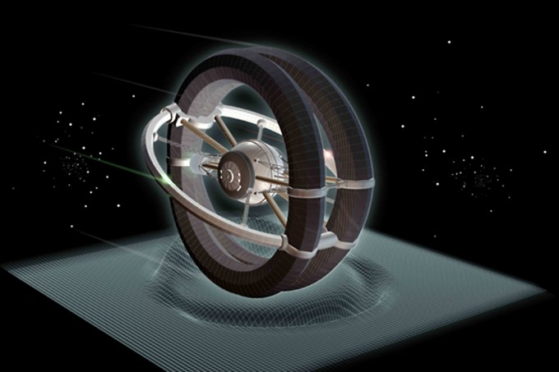
http://www.icarusinterstellar.org

Slide 8
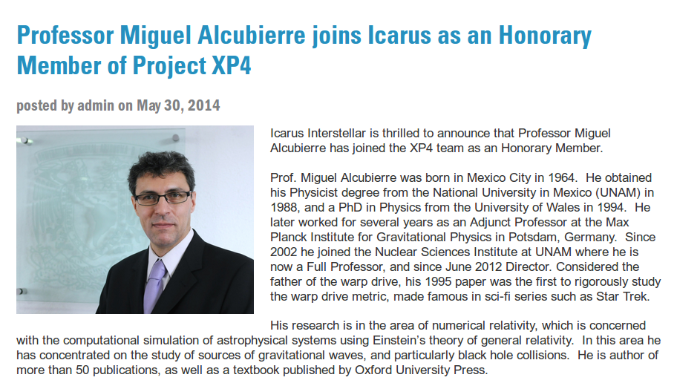

Slide 9
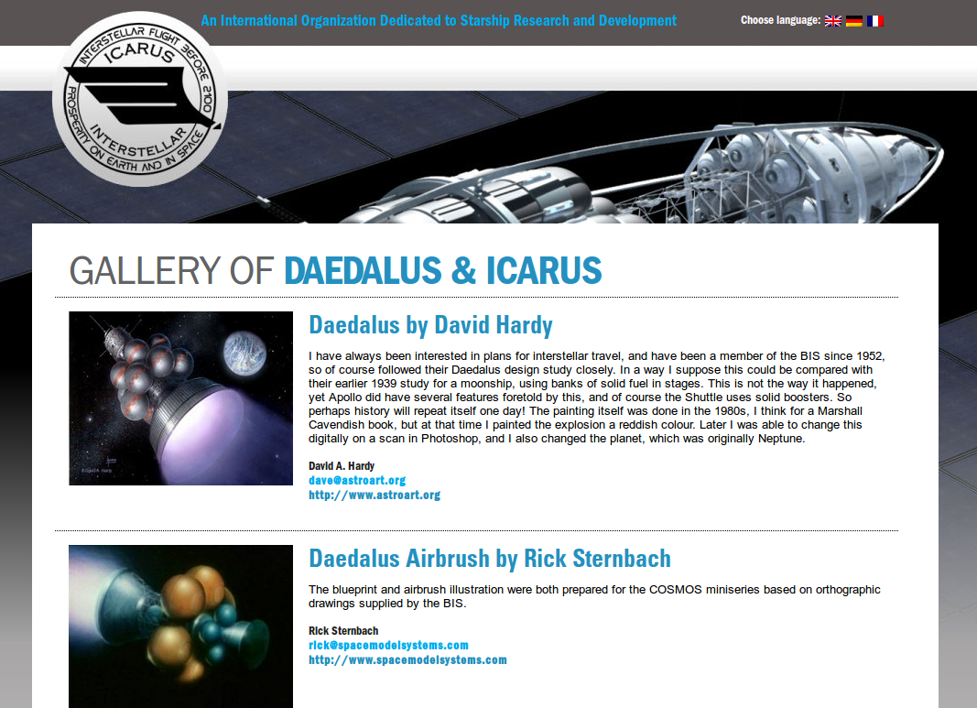
http://www.icarusinterstellar.org

Slide 10
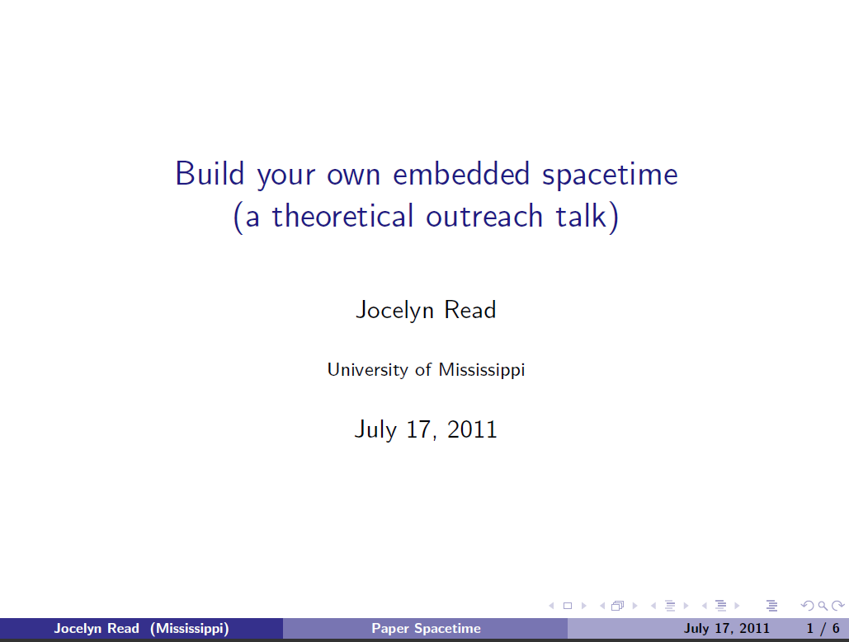
http://www.amaldi9.org/abstracts/123/ConstructingPaperOutreachTalk.pdf

Slide 11
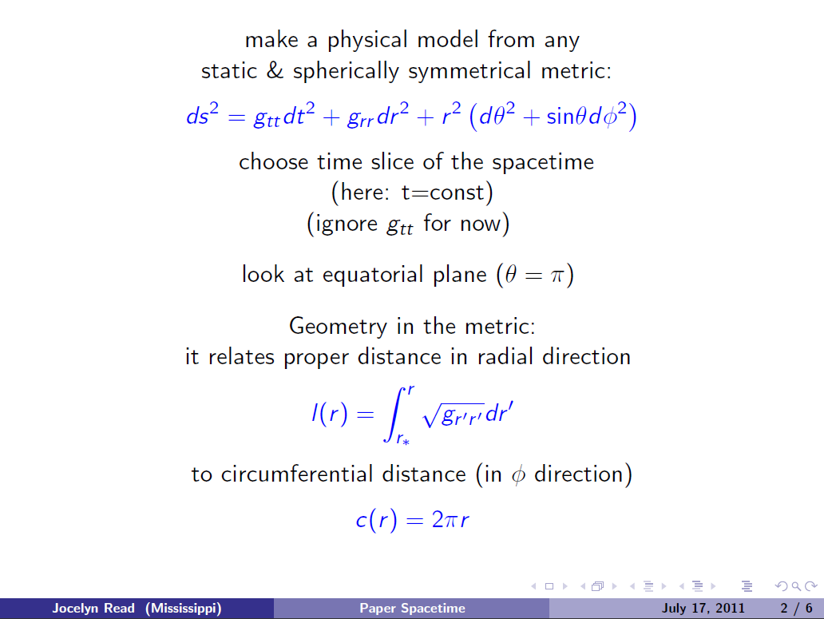
http://www.amaldi9.org/abstracts/123/ConstructingPaperOutreachTalk.pdf

Slide 12
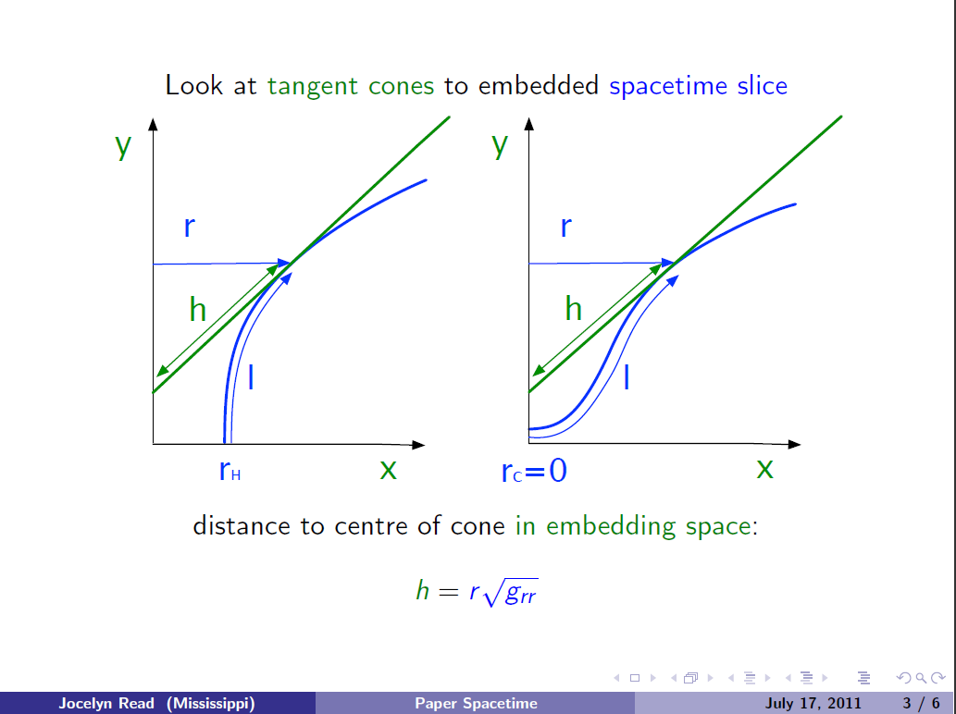
http://www.amaldi9.org/abstracts/123/ConstructingPaperOutreachTalk.pdf

Slide 13
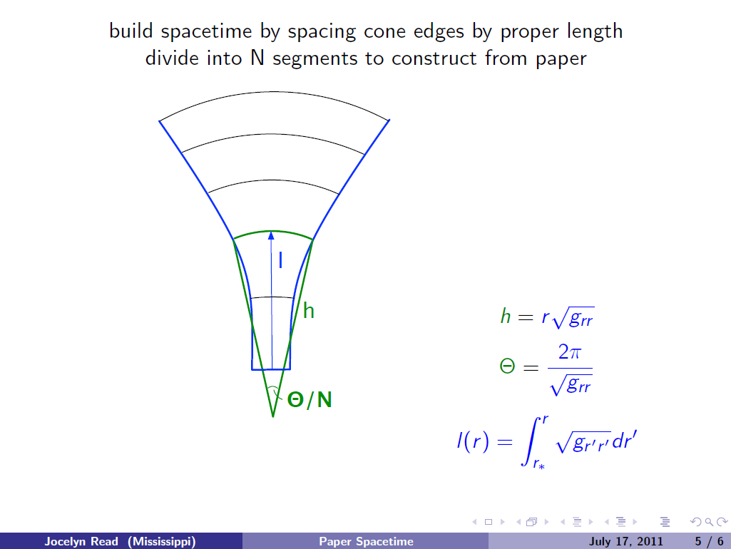
http://www.amaldi9.org/abstracts/123/ConstructingPaperOutreachTalk.pdf

Slide 14
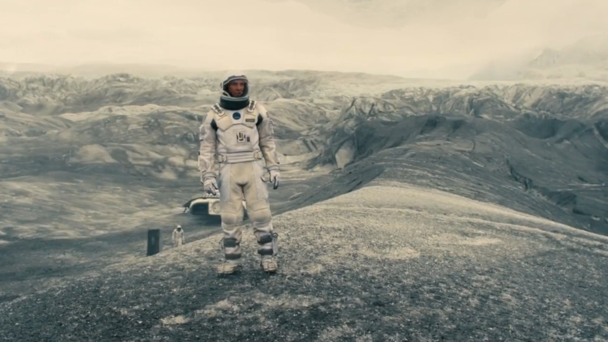
https://en.wikibooks.org/wiki/A_Roller_Coaster_Ride_through_Relativity/Appendix_A
http://www.huffingtonpost.com/brandon-judell/movie-review-interstellar_1_b_6100562.html

Slide 15
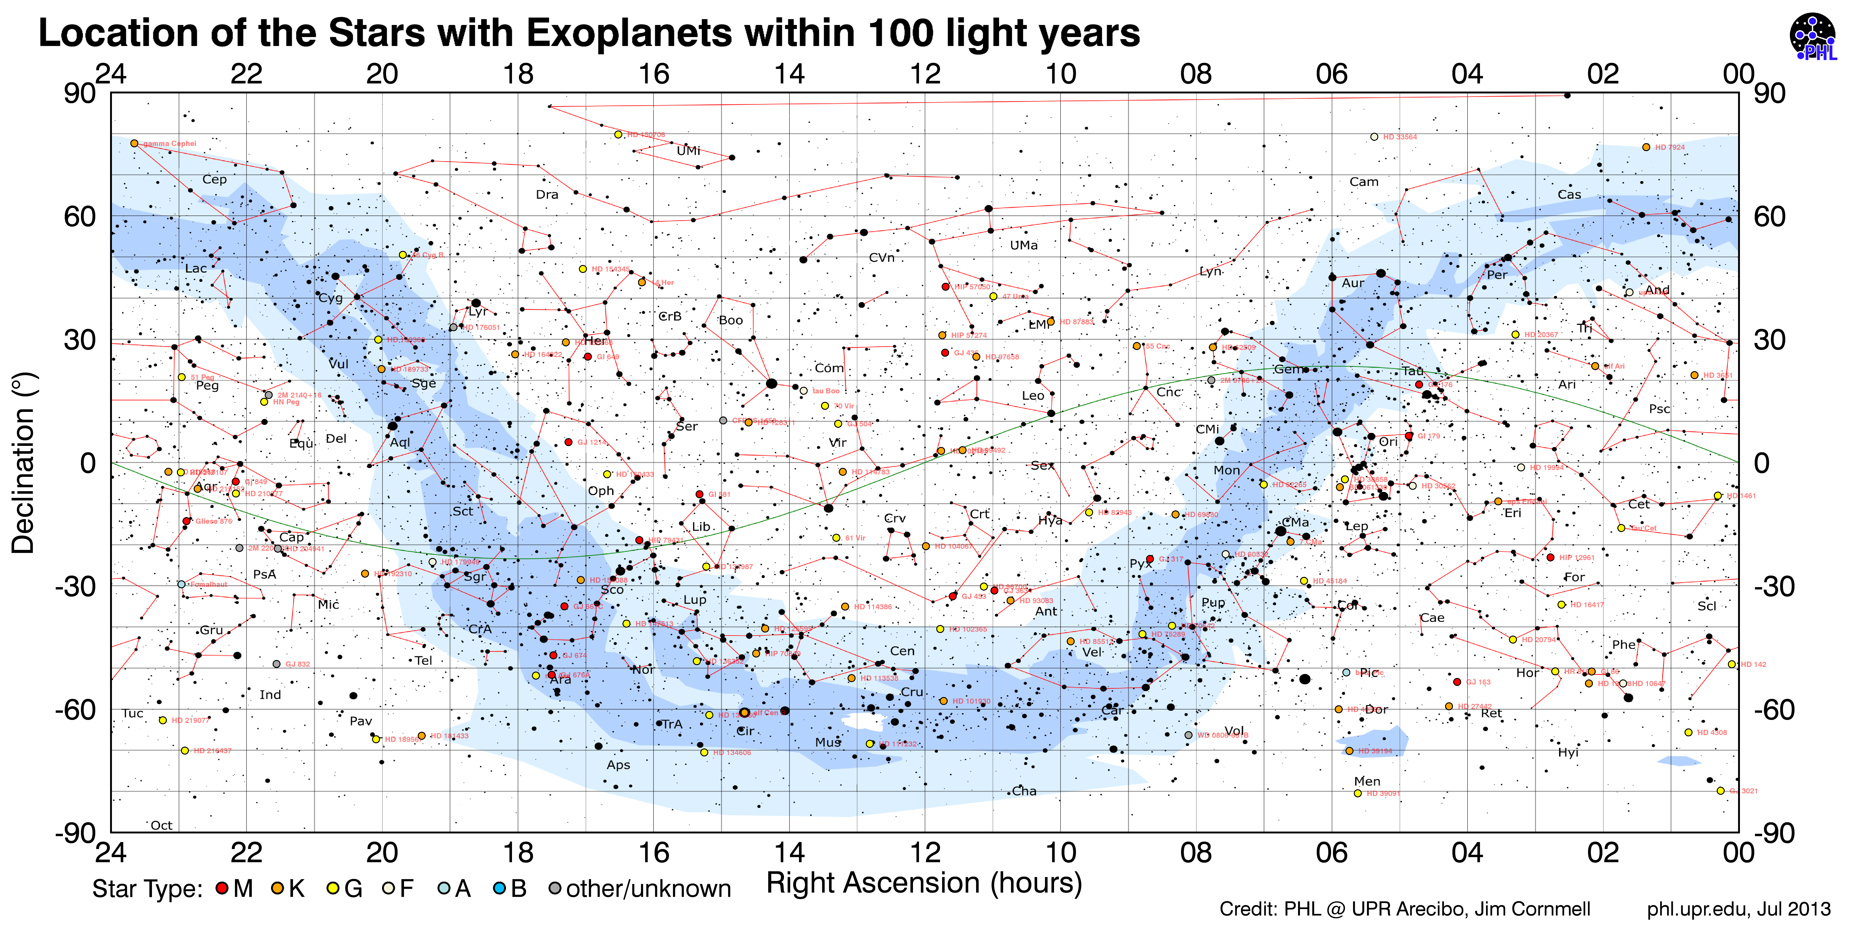
Distancias en el Universo

Slide 16

Trailer Aluna: https://www.youtube.com/watch?v=mHQ4FfgBBXI

Slide 17
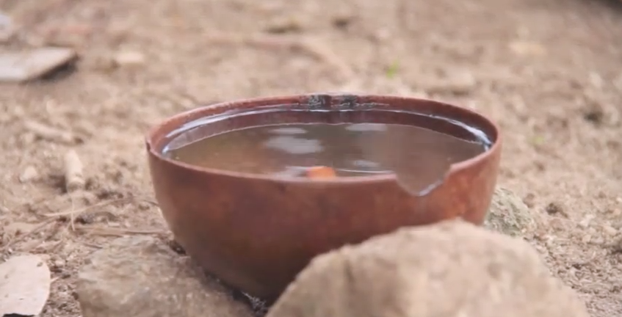
Trailer Aluna: https://www.youtube.com/watch?v=mHQ4FfgBBXI

Slide 18
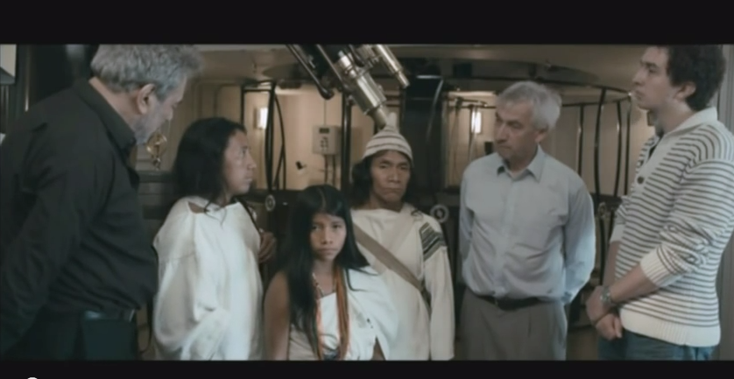
Aluna (fragmento con Richard Ellis)https://www.youtube.com/watch?v=gLiSAKqzTZM

Slide 19
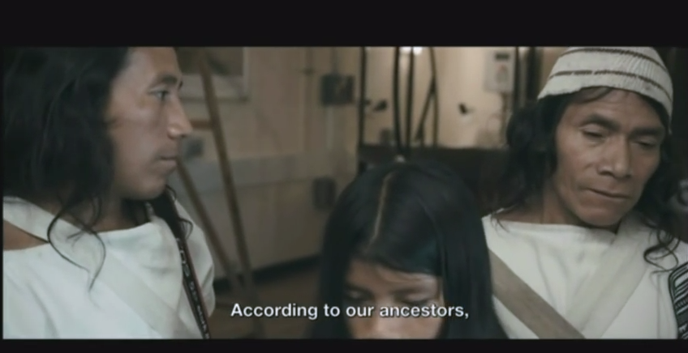
Aluna (fragmento con Richard Ellis)https://www.youtube.com/watch?v=gLiSAKqzTZM

Slide 20
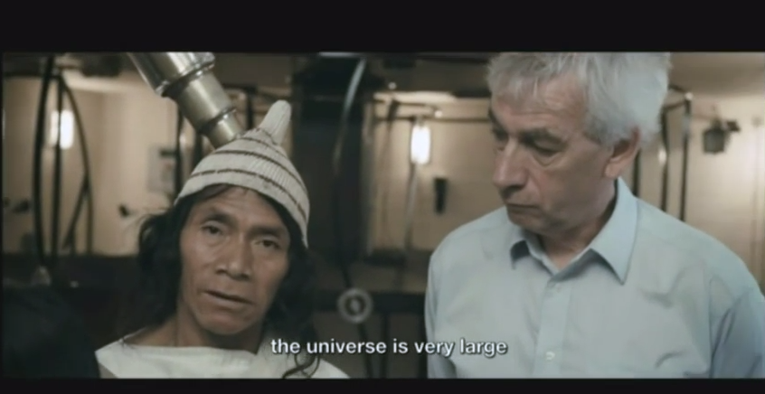
Aluna (fragmento con Richard Ellis)https://www.youtube.com/watch?v=gLiSAKqzTZM

Slide 21
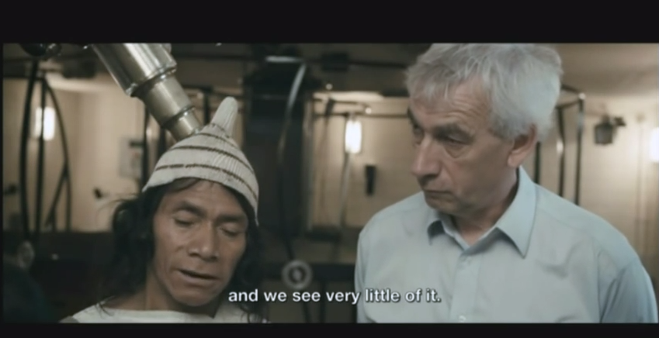
Aluna (fragmento con Richard Ellis)https://www.youtube.com/watch?v=gLiSAKqzTZM

Slide 22
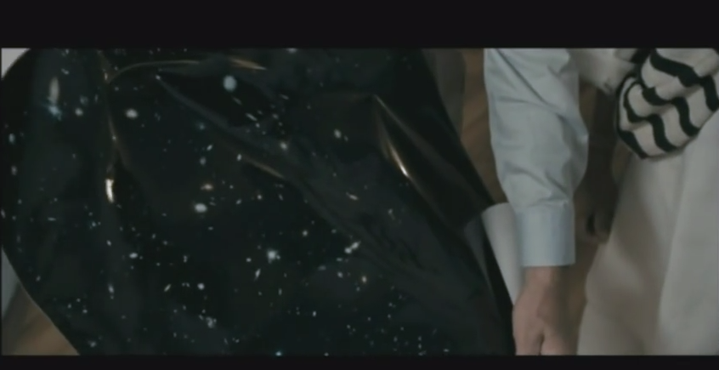
Aluna (fragmento con Richard Ellis)https://www.youtube.com/watch?v=gLiSAKqzTZM

Slide 23
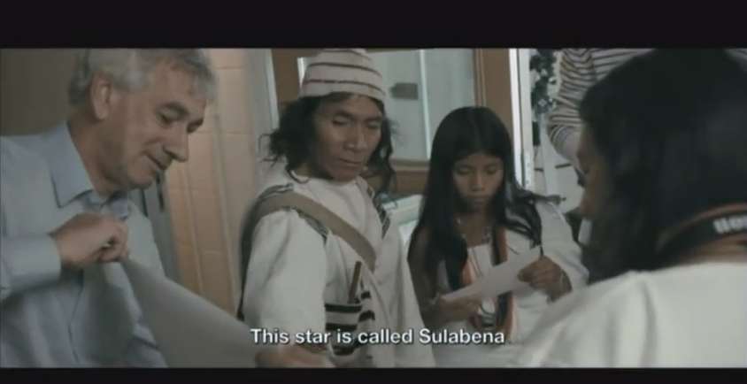
Aluna (fragmento con Richard Ellis)https://www.youtube.com/watch?v=gLiSAKqzTZM

Slide 24
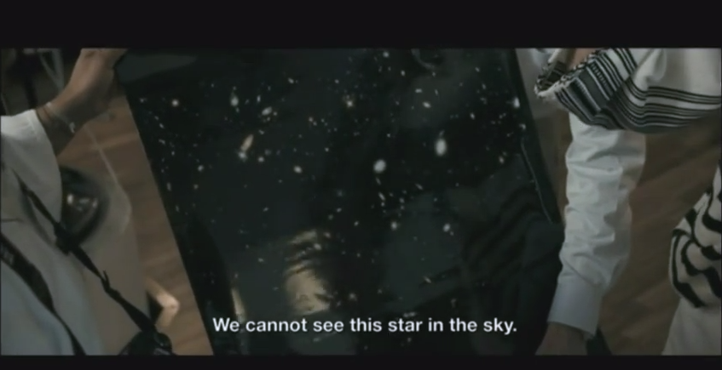
Aluna (fragmento con Richard Ellis)https://www.youtube.com/watch?v=gLiSAKqzTZM

Slide 25
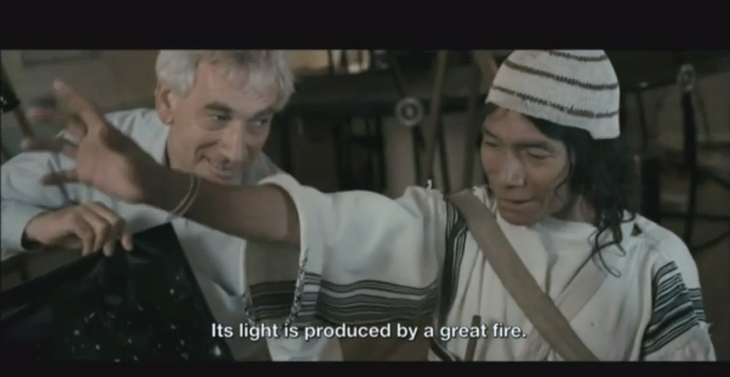
Aluna (fragmento con Richard Ellis)https://www.youtube.com/watch?v=gLiSAKqzTZM

Slide 26
Trailer Aluna: https://www.youtube.com/watch?v=mHQ4FfgBBXI

