Slide 1
Viajes especiales
Jaime E. Forero Romero
Universidad de los Andes
Curso Astronomía Popular
Septiembre 2015

Slide 2
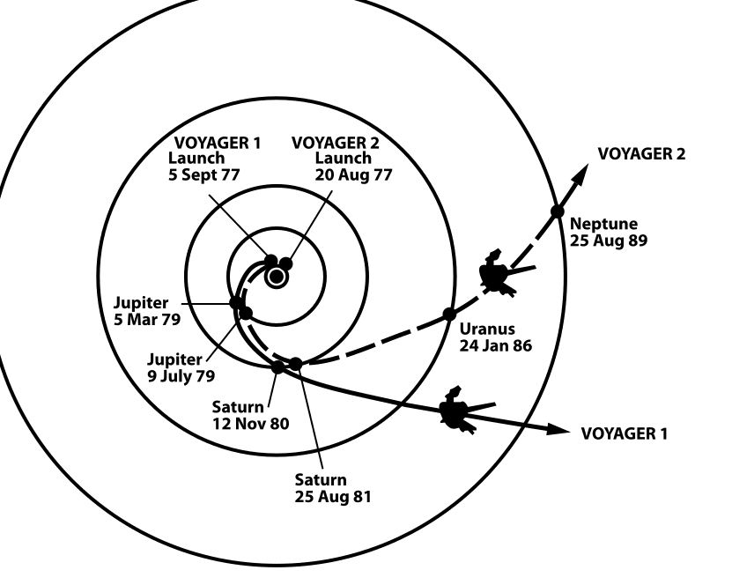
Wikicommons: The trajectories that enabled NASA's twin Voyager spacecraft to tour the four gas giant planets and achieve velocity to escape the Solar System. Source: http://solarsystem.nasa.gov/multimedia/display.cfm?IM_ID=2143

Slide 3
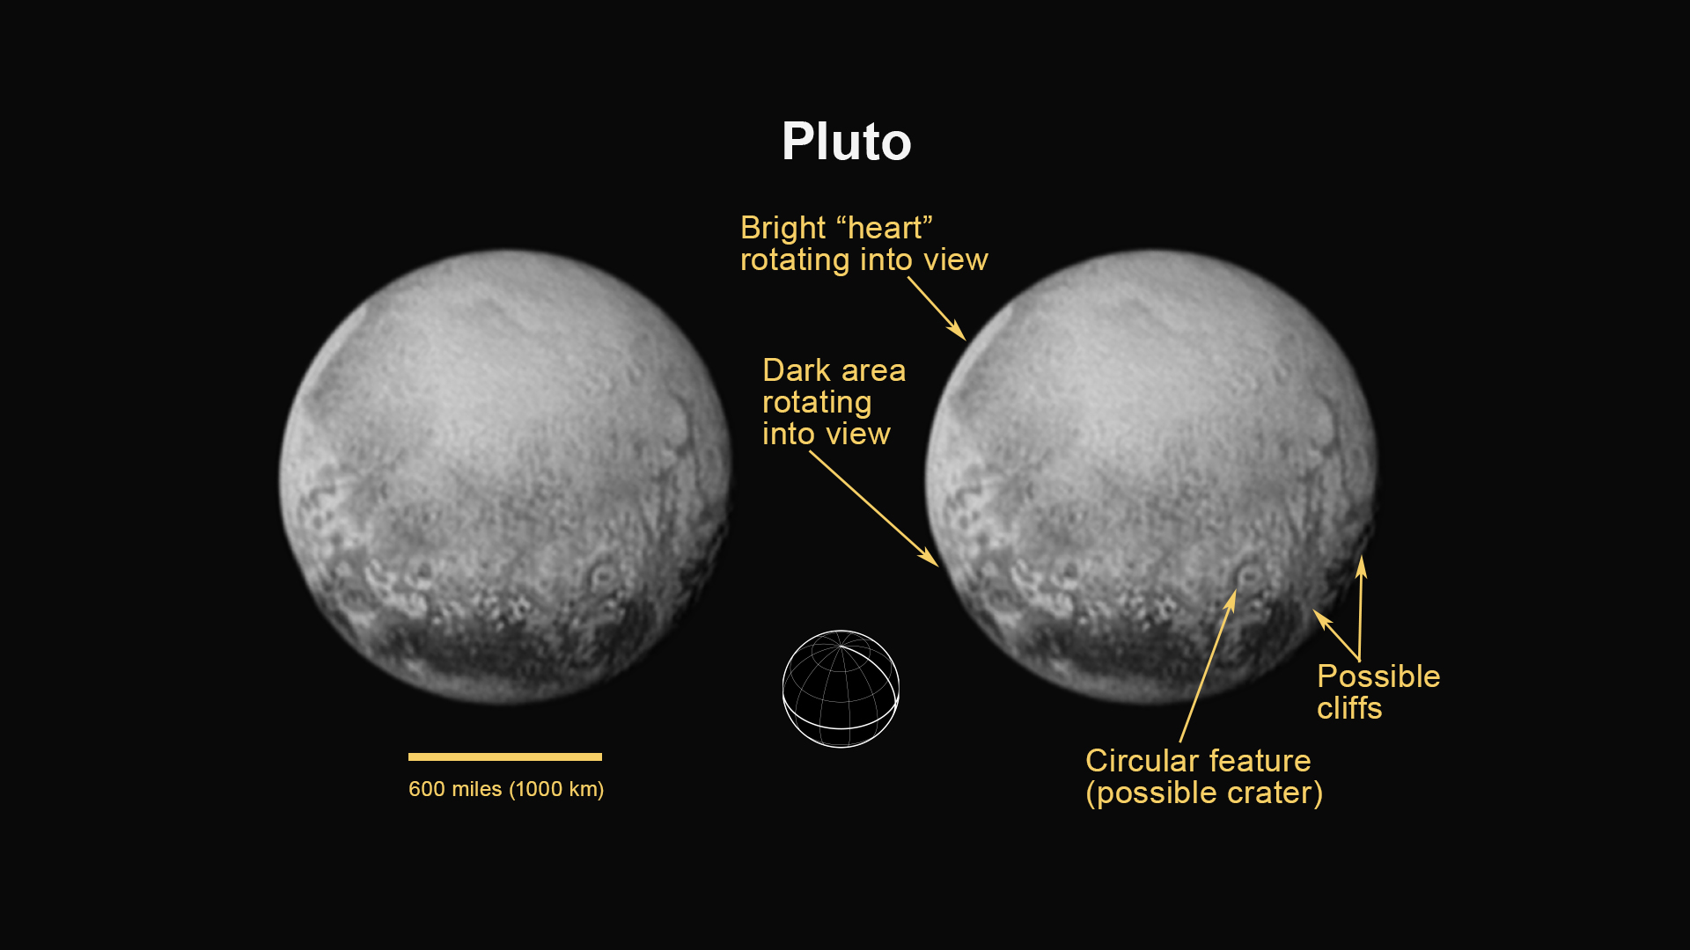
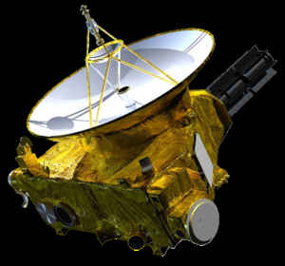
https://www.nasa.gov/mission_pages/newhorizons/main/index.html

Slide 4
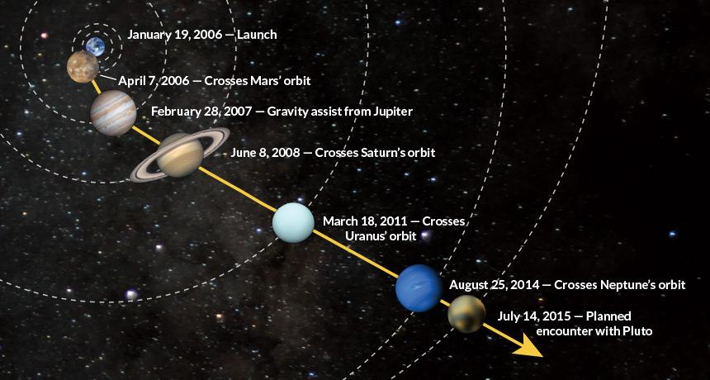
https://www.sciencenews.org/article/rendezvous-pluto?mode=magazine&context=190368

Slide 5
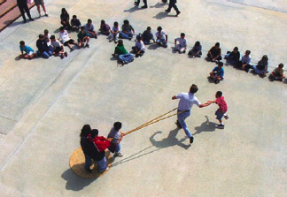
Wikicommons: The trajectories that enabled NASA's twin Voyager spacecraft to tour the four gas giant planets and achieve velocity to escape the Solar System. Source: http://solarsystem.nasa.gov/multimedia/display.cfm?IM_ID=2143

Slide 6
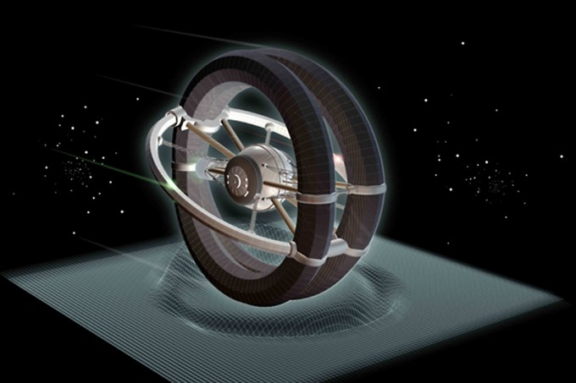
http://www.icarusinterstellar.org

Slide 7
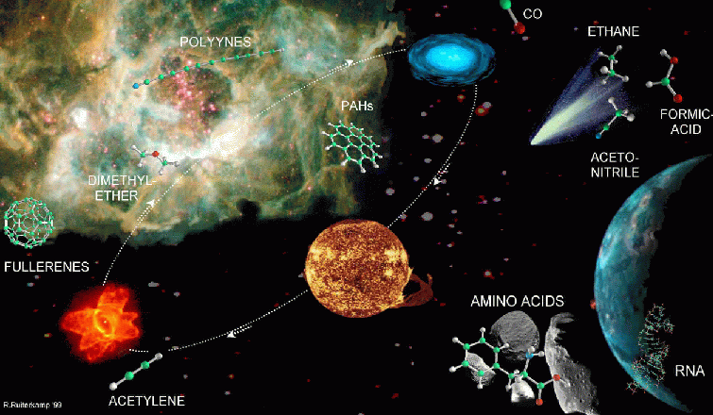
astrobiología

Slide 8
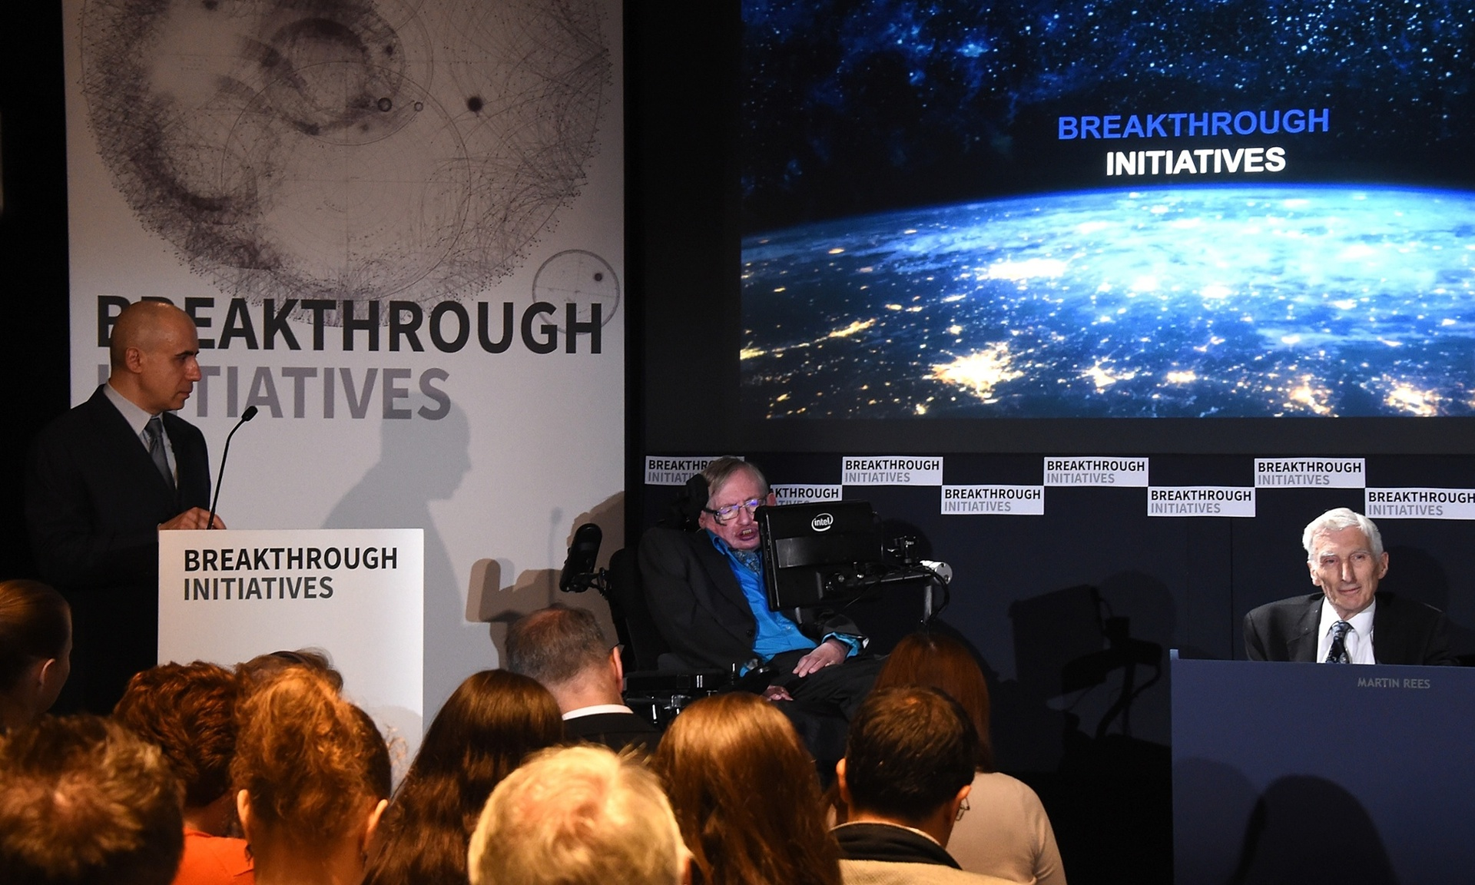
http://www.theguardian.com/science/2015/jul/20/alien-life-breakthough-initiative

Slide 9
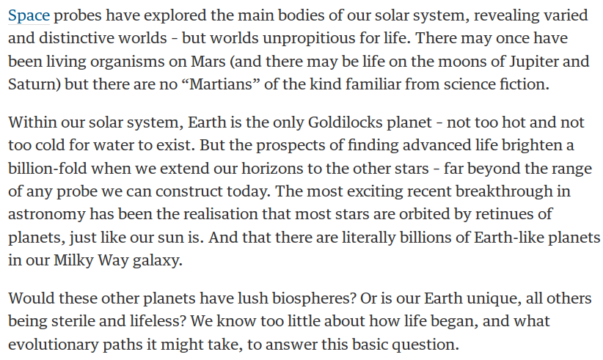
Let's listen out for alien life – and remember we might not understand it
Martin Rees
http://www.theguardian.com/science/2015/jul/20/alien-life-breakthough-initiative

Slide 10
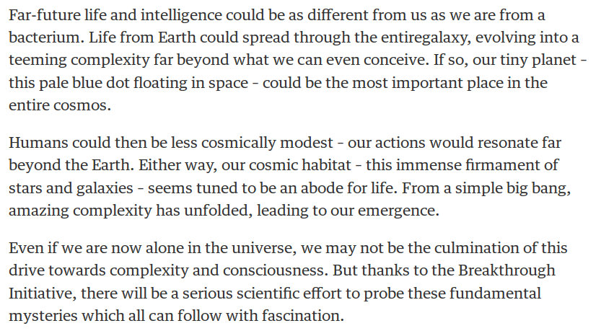
Let's listen out for alien life – and remember we might not understand it
Martin Rees
http://www.theguardian.com/science/2015/jul/20/alien-life-breakthough-initiative

Slide 11
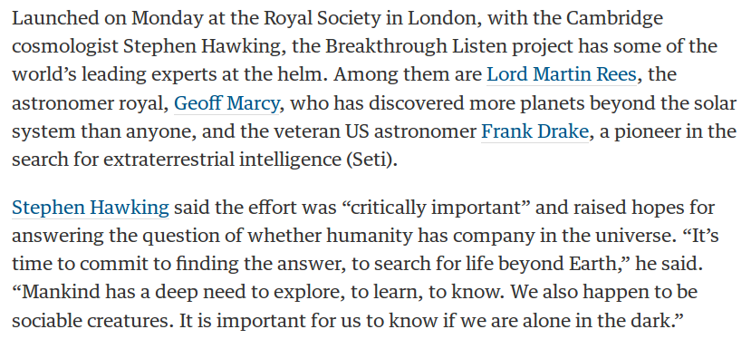
http://www.theguardian.com/science/2015/jul/20/breakthrough-listen-massive-radio-wave-project-scan-far-regions-for-alien-life

Slide 12
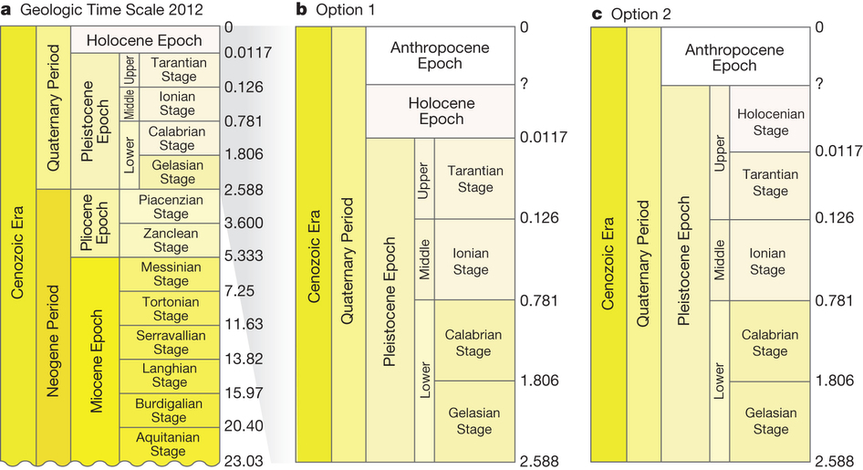
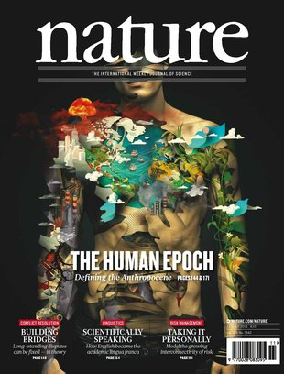
http://www.nature.com/nature/journal/v519/n7542/full/nature14258.html

Slide 13
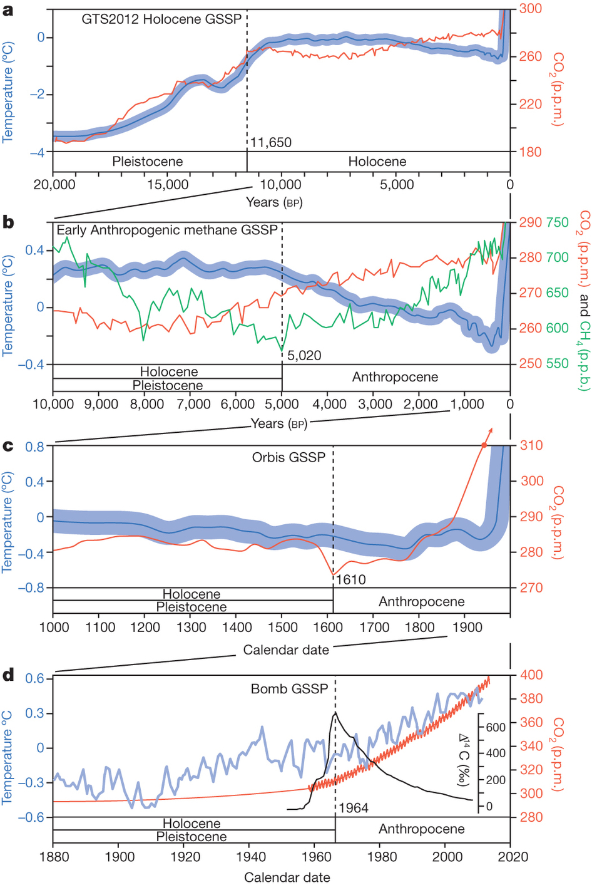
http://www.nature.com/nature/journal/v519/n7542/full/nature14258.html

Slide 14
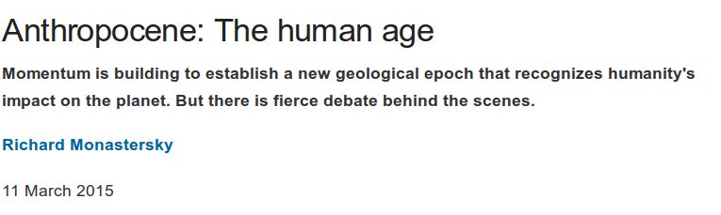
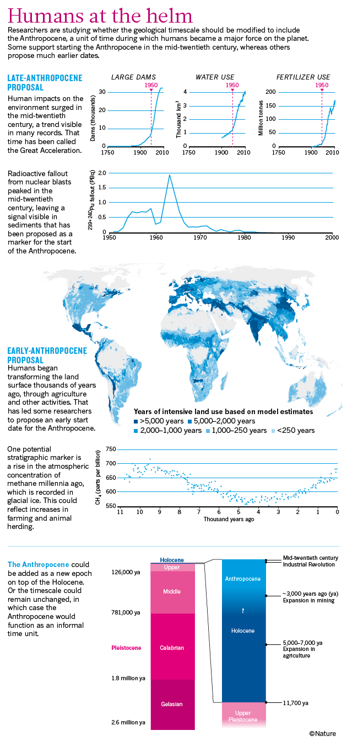
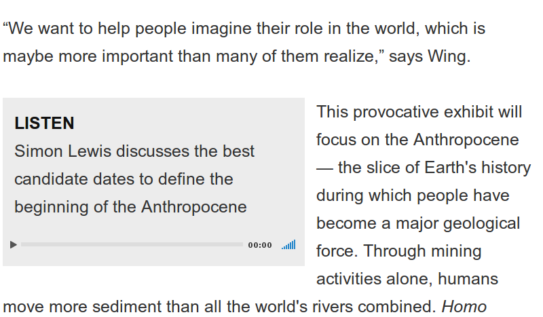
http://www.nature.com/news/anthropocene-the-human-age-1.17085

Slide 15
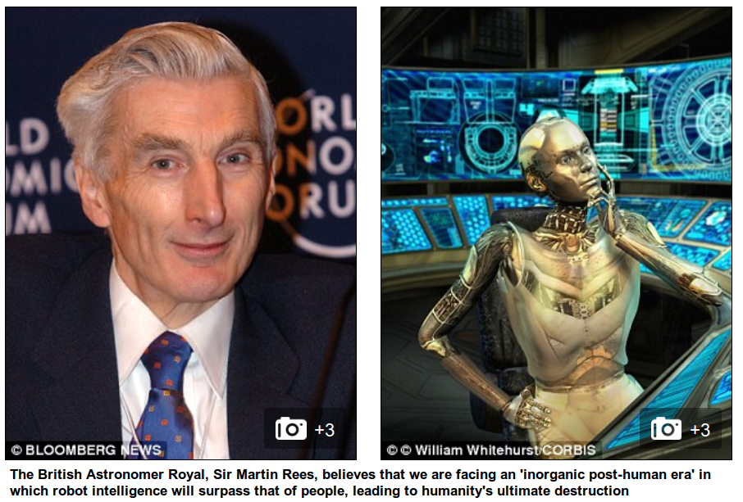
http://www.dailymail.co.uk/sciencetech/article-3091749/Is-world-heading-post-human-future-Sir-Martin-Rees-warns-super-intelligent-robots-wipe-humanity.html

Slide 16
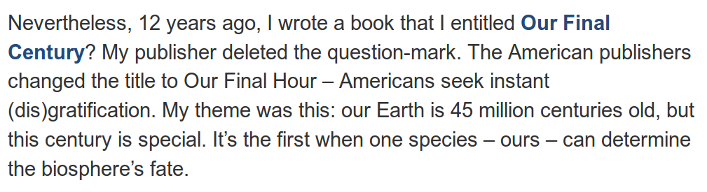
How soon will robots take over the world? de Sir Martin Rees.

Slide 17
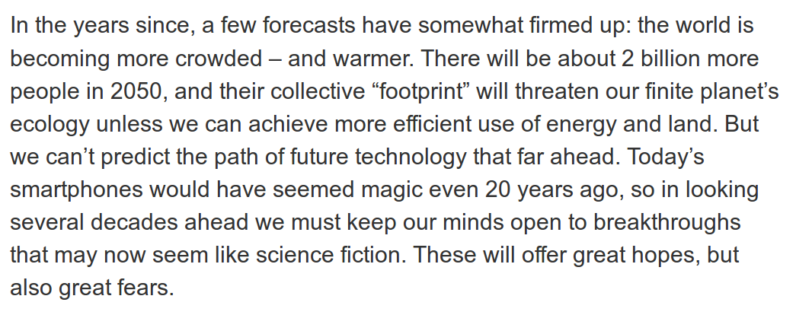
How soon will robots take over the world? de Sir Martin Rees.

Slide 18
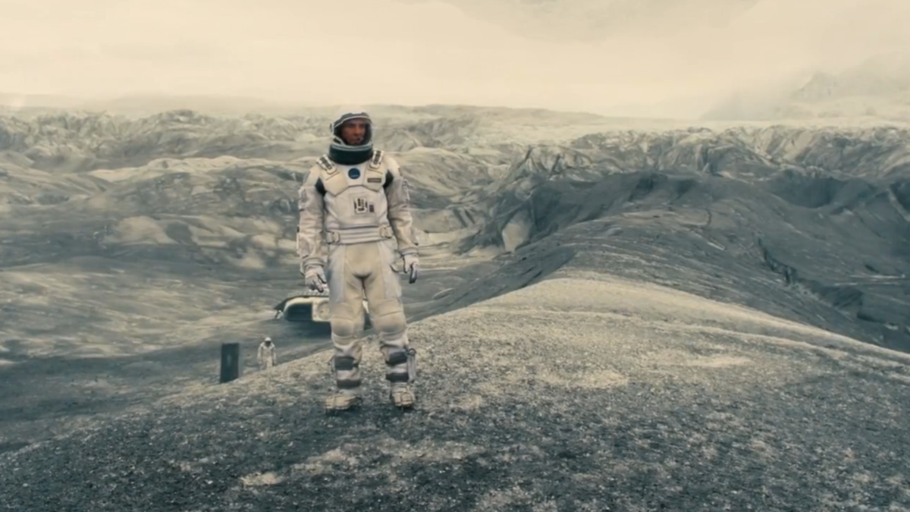
https://en.wikibooks.org/wiki/A_Roller_Coaster_Ride_through_Relativity/Appendix_A
http://www.huffingtonpost.com/brandon-judell/movie-review-interstellar_1_b_6100562.html

Slide 19
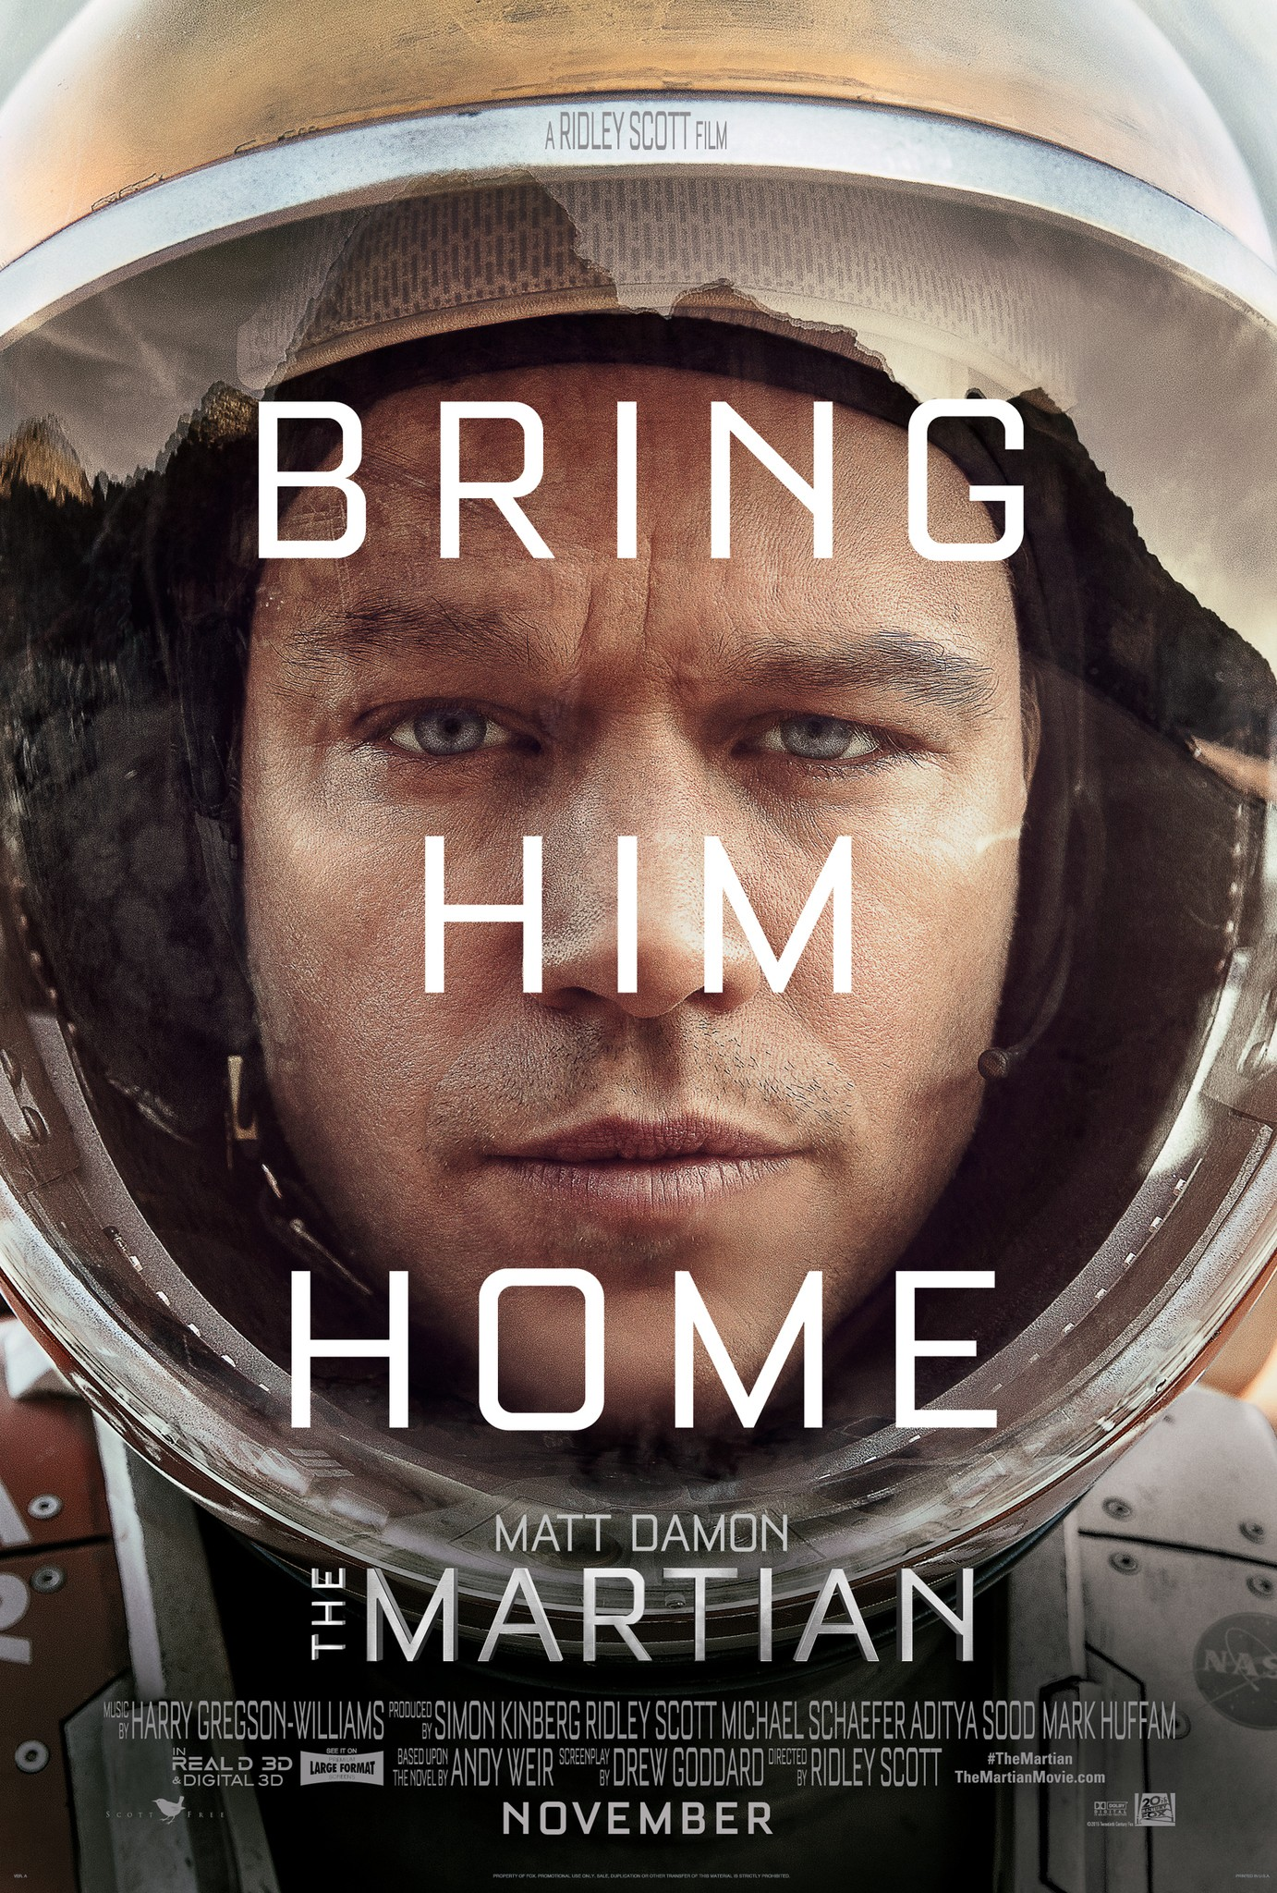
http://www.joblo.com/movie-posters/the-martian-2015

Slide 20
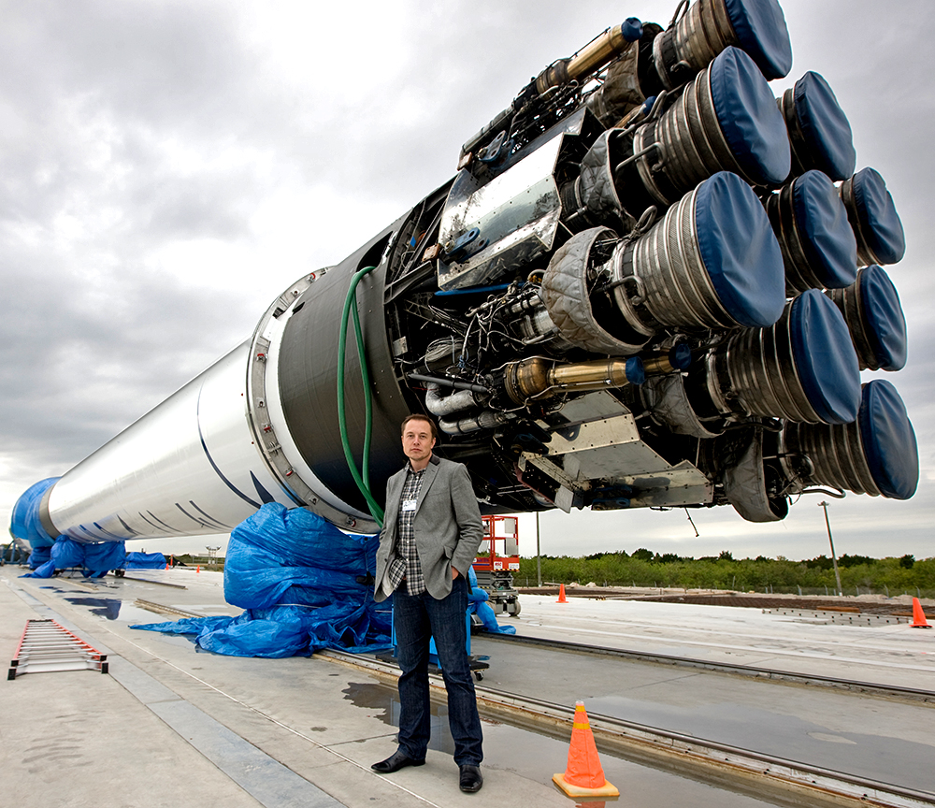

Slide 21
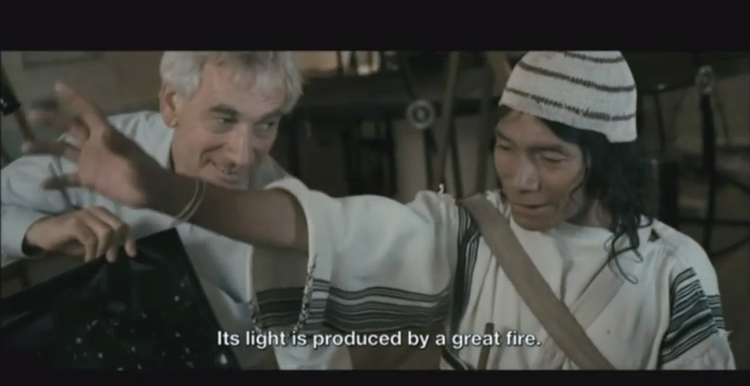
Aluna (fragmento con Richard Ellis)https://www.youtube.com/watch?v=gLiSAKqzTZM

Slide 22
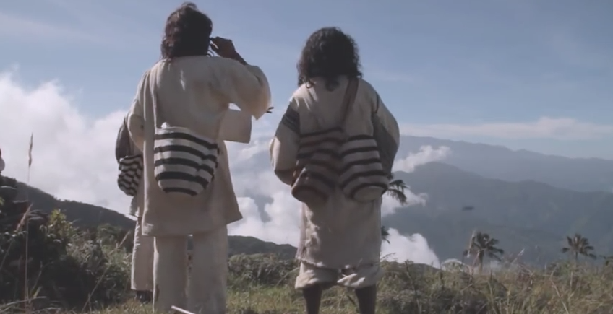
Trailer Aluna: https://www.youtube.com/watch?v=mHQ4FfgBBXI

Slide 23
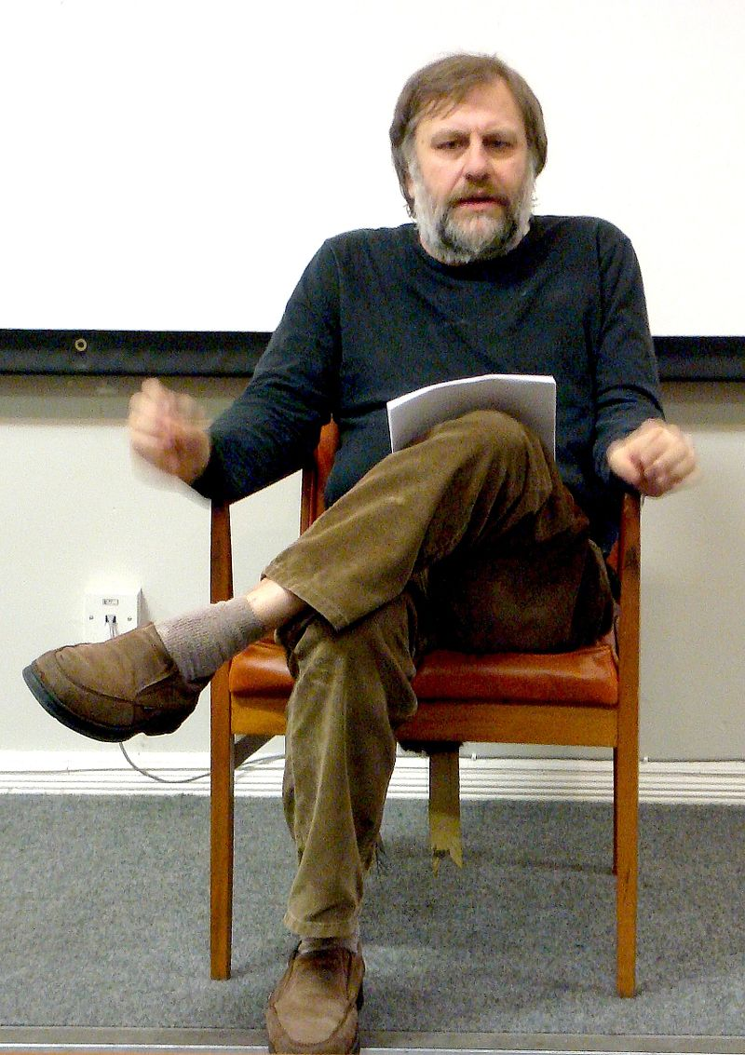
Fuente: Wikimedia Slavoj Zizek in Liverpool, cropped version of Image:Slavoj Zizek in Liverpool.jpg

Slide 24
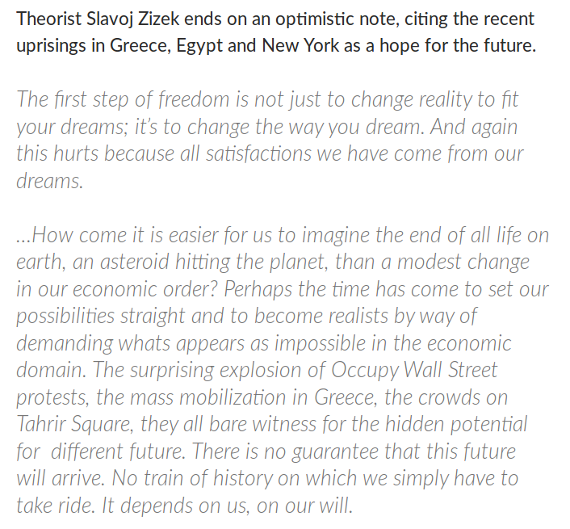
http://www.critical-theory.com/watch-the-final-scene-from-zizeks-perverts-guide-to-ideology/

Slide 25
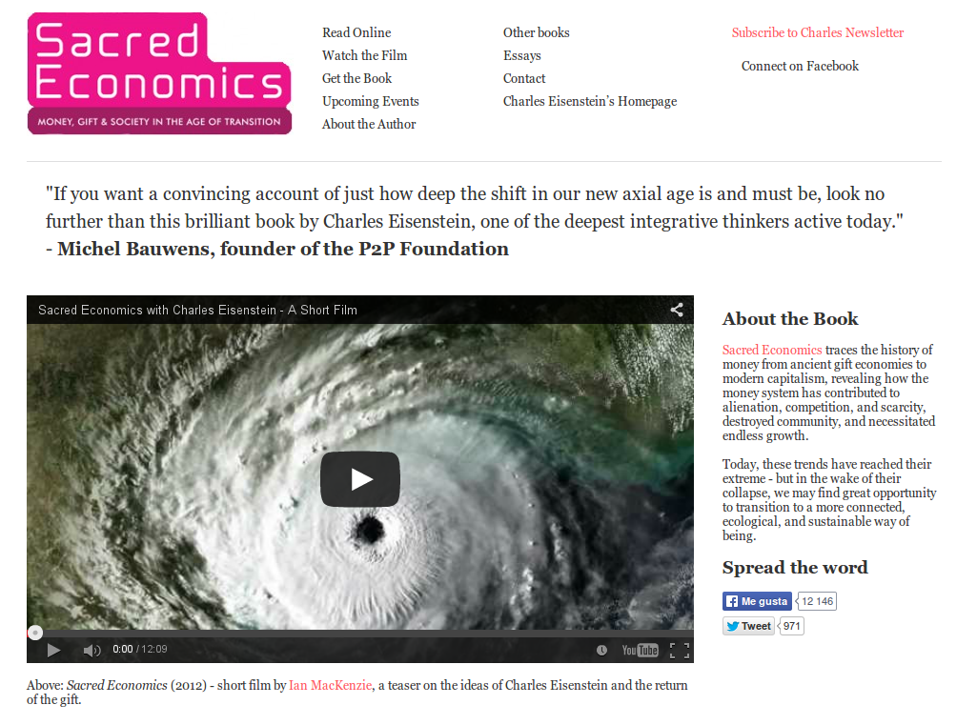

Slide 26
Definiciones de vida

Slide 27
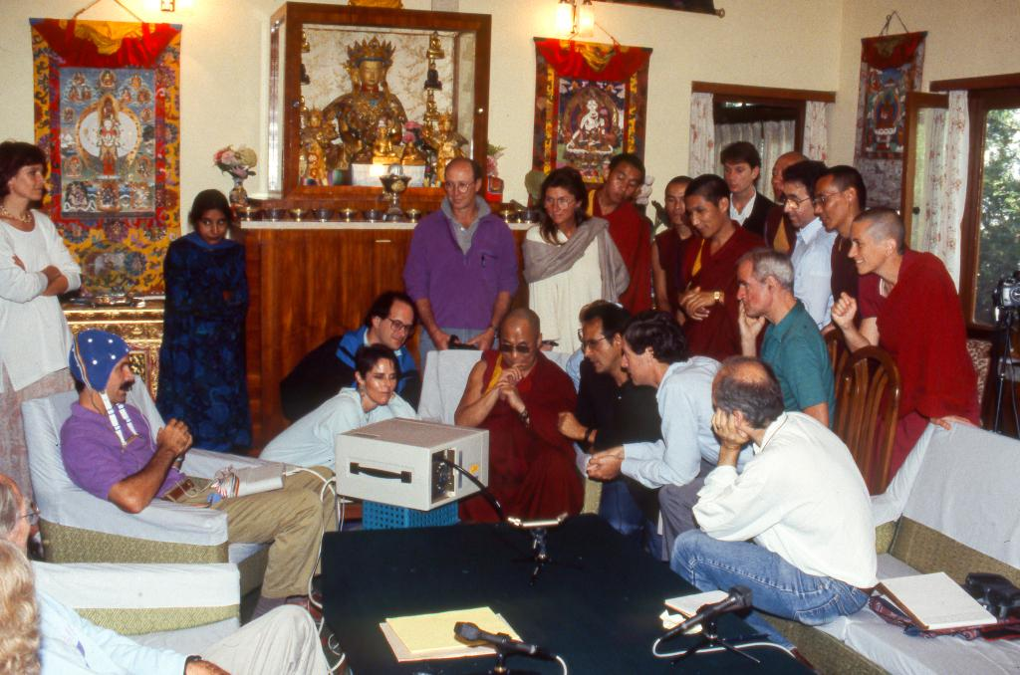
https://twitter.com/jhalifax/status/565502475676164097
Mind and @mindandlifeorg in 1992, with Dalai Lama, Francisco Varela, Thupten Jinpa, Alan Wallace, me and others

Slide 28
Definiciones de vida inteligente

Slide 29
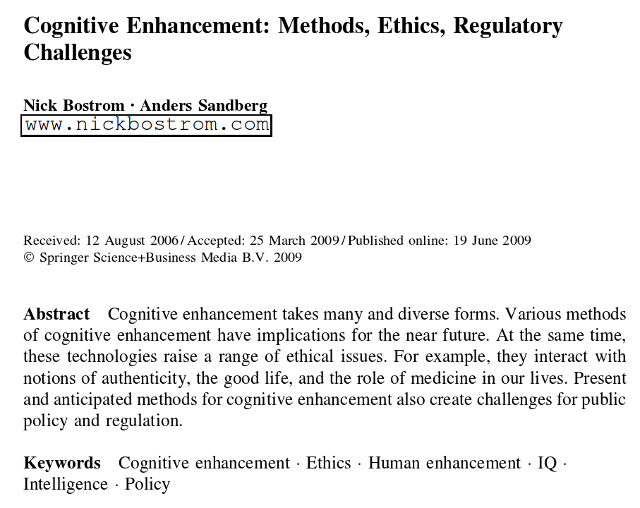
http://www.nickbostrom.com/cognitive.pdf

Slide 30
Methods of Cognitive Enhancement
Education, Enriched Environments and General Health
Mental Training
Drugs
Transcranial Magnetic Stimulation
Genetic Modifications
Prenatal and Perinatal Enhancement
External Hardware and Software Systems
Brain-Computer Interfaces
Collective Intelligence
http://www.nickbostrom.com/cognitive.pdf

Slide 31
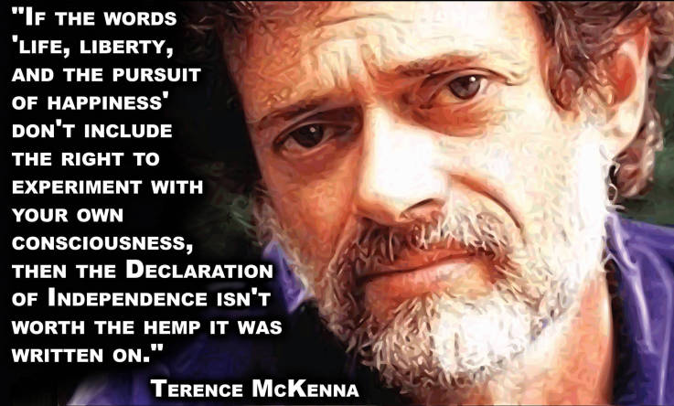
http://likesuccess.com/author/terence-mckenna

Slide 32
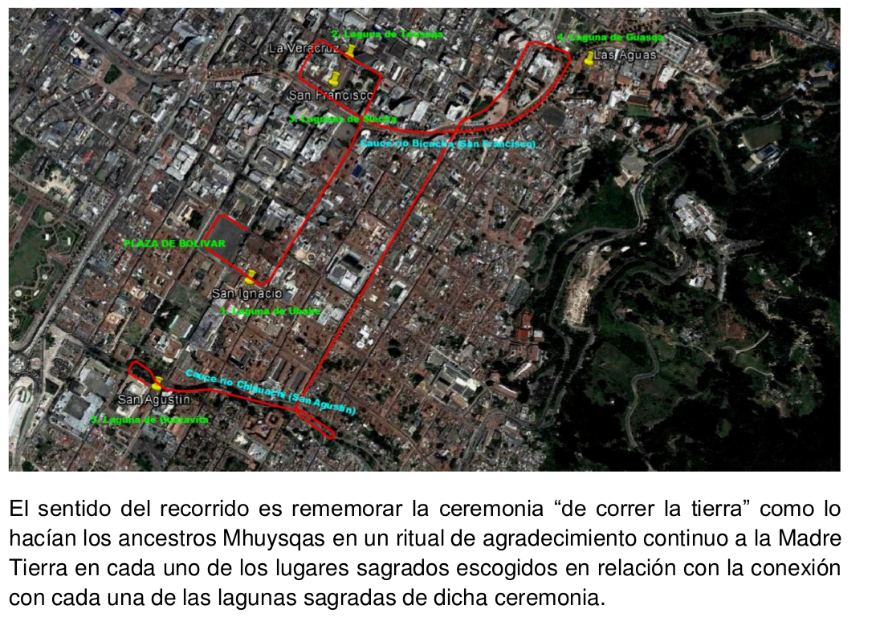
CELEBRACIÓN INDÍGENA DE AGRADECIMIENTO A LA MADRE TIERRA
EQUINOCCIO 20 DE SEPTIEMBRE DE 2015

Slide 33



