Slide 1
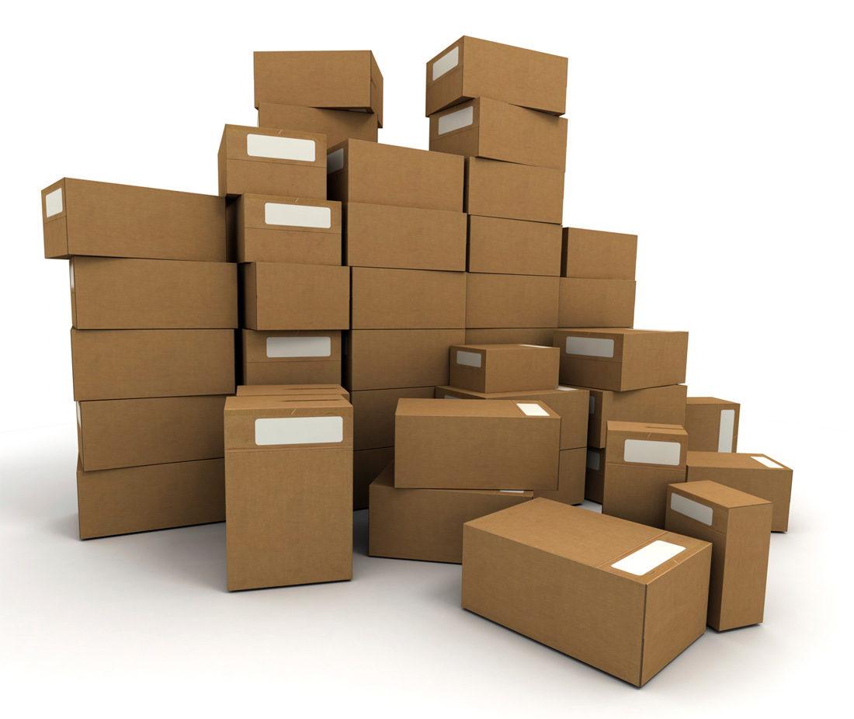
Packing Algorithms
An instance of a packing problem consists of:
Items (associated with sizes, weights, profits).
Bins with limited capacity.
A set of constraints.
General Goal: Place items in the bin, items must not overlap with each other. Bins may not be filled beyond their capacity.

Slide 2
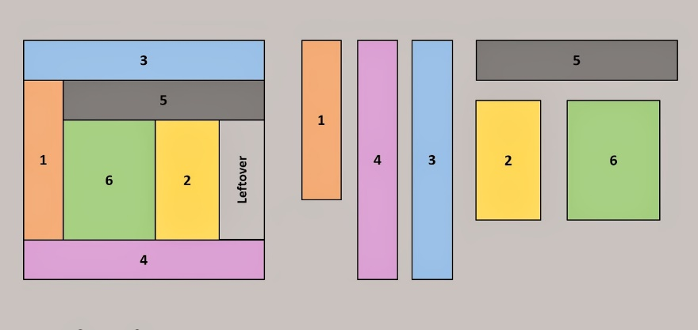
Packing Problems
Variants:
Multi-dimensional items.
Limited number of bins – pack as much as you can.
Unlimited number of bins – pack all items using minimal number of bins.
Conflicting items – cannot be placed together.
Cardinality constraints.
Cutting stock (minimizing wasted material)
Class-constraints.
Online vs. offline
Variable bins.
Many more…

Slide 3
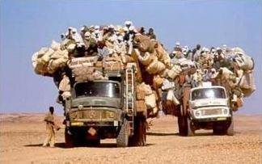
Popular Applications
Physical items → boxes, tracks (shipping, delivery).
Files → disks.
Advertisements → commercial break/ magazines / web-pages.
Orders → limited amount of material
Jobs → processors.

Slide 4
The Knapsack problem
You are about to go to a camp.
There are many items you want to take.
You have one knapsack. The total weight you can carry is at most W.
Item i in your list has weight w_{i}, and value (benefit) b_{i}, that measures how much you really need it.
You need to pack the knapsack in a way that maximizes the total value of the packed items.

Slide 5
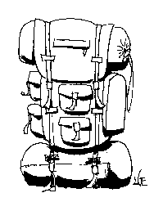
The Knapsack problem
Item # Weight Value
1 1 8
2 3 6
3 5 5
4 4 6
Max weight =8
A possible packing: Items 2 and 3. Value: 11
An optimal packing: Items 1,2,4. Value: 20
The Knapsack problem is NP-hard.

Slide 6
Greedy Algorithm for Knapsack
Consider the items in order of non-increasing b_{i}/w_{i} ratio
b₁/w₁ ≥ b₂/w₂ ≥ … ≥ b_{n}/w_{n}
2. Add items to the knapsack as long as there is space.
Time Complexity:
O(n log n) (for sorting)
O(n) for packing loop.
→ O(n log n)

Slide 7
Greedy Algorithm for Knapsack
Claim: The approximation ratio of Greedy is not bounded.
Proof: To get ratio c, consider the following instance:
There are two items:
b₁= 2, w₁= 1
b₂= 2c, w₂= 2c
Greedy packs only the first item, value = 2.
Optimal: Pack the second item, value=2c
Ratio = c.
The knapsack has volume W = 2c

Slide 8
Improved Algorithm for Knapsack
Take the maximum of Greedy and the most valuable item that fits by itself.
Theorem: The above algorithm is 2-approximation.
Proof: We assume w.l.o.g that no single item has weight more than W (these items can be removed in a preprocessing).
Sort the items such that b₁/w₁ ≥ b₂/w₂ ≥ … ≥ b_{n}/w_{n.}
Let B be the largest value of an item, and let G be the value computed by the greedy algorithm.
Let j be the first item that the greedy algorithm rejects.

Slide 9
Improved Algorithm for Knapsack
ALG = max(B, G) ≥ (B + G)/2
G = (item j is the first to be rejected)
B ≥ b_{j} (B is the most profitable)
G+B ≥ opt <
→ ALG > opt/2
Because the first j items have the largest ‘profit density’

Slide 10
Exact Solution – dynamic programming
Variant 1:
Define a table M of size (n+1)×(W+1), where the (i, x) entry corresponds to the maximal profit that can be obtained from the first i items and a knapsack having capacity x.
The solution to the knapsack problem lies in M(n,W).
Base cases:
If i = 0, then there are no items to pack: M(0, x) = 0.
If x < 0 then M(i, x) = −∞.

Slide 11
Exact Solution – dynamic programming
The DP recursion:
M(i, x) = max { M(i−1, x) , M(i−1, x−w_{i}) + b_{i}}.
We take the maximum of two options:
M(i−1, x): not packing the i-th item.
M(i−1, x−w_{i}) + b_{i} : packing the i-th item.
* |  |  |  |  |  |  |  | n
 |  |  |  |  |  |  |  | …
 |  |  |  |  |  |  |  | i
 |  |  |  |  |  |  |  | i-1
 |  |  |  |  |  |  |  | …
0 | … | 0 | … | 0 | 0 | 0 | 0 | 0
W | … | x | … | 4 | 3 | 2 | 1
The solution lies here

Slide 12
Knapsack DP Example
Assume n=4 and W=17.
Weights:{2, 4, 7, 10} Values: {3, 7, 9, 16}
₄
₃
₂
₁
₀ | 0 | 0 | 0 | 0 | 0 | 0 | 0 | 0 | 0 | 0 | 0 | 0 | 0 | 0 | 0 | 0 | 0
i/x | 1 | 2 | 3 | 4 | 5 | 6 | 7 | 8 | 9 | 10 | 11 | 12 | 13 | 14 | 15 | 16 | 17
In class exercise – complete the table

Slide 13
Knapsack DP Example
Assume n=4 and W=17.
Weights:{2, 4, 7, 10} Values: {3, 7, 9, 16}
₄ | 0 | 3 | 3 | 7 | 7 | 10 | 10 | 10 | 12 | 16 | 16 | 19 | 19 | 23 | 23 | 26 | 26
₃ | 0 | 3 | 3 | 7 | 7 | 10 | 10 | 10 | 12 | 12 | 12 | 12 | 19 | 19 | 19 | 19 | 19
₂ | 0 | 3 | 3 | 7 | 7 | 10 | 10 | 10 | 10 | 10 | 10 | 10 | 10 | 10 | 10 | 10 | 10
₁ | 0 | 3 | 3 | 3 | 3 | 3 | 3 | 3 | 3 | 3 | 3 | 3 | 3 | 3 | 3 | 3 | 3
₀ | 0 | 0 | 0 | 0 | 0 | 0 | 0 | 0 | 0 | 0 | 0 | 0 | 0 | 0 | 0 | 0 | 0
i/x | 1 | 2 | 3 | 4 | 5 | 6 | 7 | 8 | 9 | 10 | 11 | 12 | 13 | 14 | 15 | 16 | 17
M(3,9)= max{M(2,9), M(2,2)+9} = 3+9=12
M(4,12)= max{M(3,12), M(3,2)+16}=3+16=19.

Slide 14
Exact Solution – dynamic programming
Variant 2:
Define a table M of size (n+1)×(Σ_{i}b_{i}), where the (i, v) entry corresponds to the minimum weight of a combination of the first i items with value at least v.
The solution is in the entry with the maximum v where M(n, v) < W. This entry can find by scanning
all entries in the line of i = n.
Base cases:
If M(0, 0) = 0.
If M(0, v) = ∞ for all v > 0.

Slide 15
Exact Solution – dynamic programming
The DP recursion:
M(i, v) = min { M(i−1, v) , M(i−1, v−b_{i}) + w_{i}}.
We take the minimum of two options:
M(i−1, v): not packing the i-th item.
M(i−1, v−b_{i}) + w_{i} : packing the i-th item.
 |  |  |  |  |  |  |  | n
 |  |  |  |  |  |  |  | …
 |  |  |  |  |  |  |  | i
 |  |  |  |  |  |  |  | i-1
 |  |  |  |  |  |  |  | …
0 | … | 0 | … | 0 | 0 | 0 | 0 | 0
Σ_{i}b_{i} | … | v | … | 4 | 3 | 2 | 1
The solution lies in this line

Slide 16
Exact Solution – dynamic programming
The second DP variant is the basis of our next approximation algorithm.
The Knapsack problem is ‘easy to approximate’ – we can get as closer to an optimal solution as required.
Formally, it has a fully polynomial time approximation scheme (FPTAS)

Slide 17
Polynomial Time Approximation Scheme
A polynomial time approximation scheme is an algorithm which takes as input an additional parameter, ε, which determines the desired approximation ratio. This ratio can be arbitrarily close to 1, when ε approaches 0.
The time complexity of the scheme is polynomial in the input size but may be exponential in 1/ε.
For example, the following running times are acceptable for a PTAS:
• O(n²/ε)
• O(n¹⁰⁰2^{1/ε})
• O(n^{2^2^1/ε})

Slide 18
A Fully Polynomial Time Approximation Scheme
A fully polynomial time approximation scheme (FPTAS) is a PTAS with running time polynomial in both n and 1/ε.
The good news: The Knapsack problem has a fully polynomial time approximation scheme.

Slide 19
FPTAS for Knapsack
The DP has size n·Σ_{i}b_{i}
Σ_{i}b_{i} is loosely bounded by n·B, where B = max(b_{i}). Since we must compute every cell in the table, the DP running time is O(n²B), which is pseudo-polynomial.
To construct the FPTAS, we will reduce the number of distinct value categories (columns).
We will have only poly(n)/ε value categories by scaling and rounding each v_{i}
This way, the DP table will have size poly(n,1/ε). As a result the running time will also be poly(n,1/ε).

Slide 20
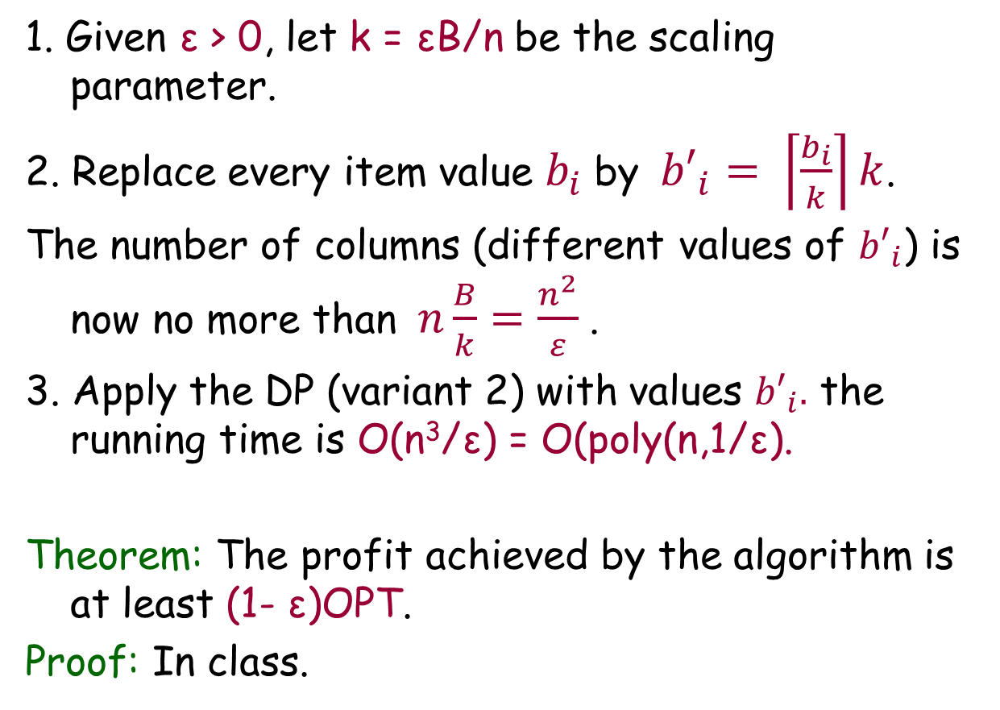
FPTAS for Knapsack
1. Given ε > 0, let k = εB/n be the scaling parameter.
2. Replace every item value $b_{i}$by${b′}_{i}= \left\lceil \frac{b_{i}}{k}\right\rceil k$.
The number of columns (different values of ${b′}_{i}$) is now no more than$n\frac{B}{k}=\frac{n^{2}}{ε}$.
3. Apply the DP (variant 2) with values ${b′}_{i}.$ the running time is O(n³/ε) = O(poly(n,1/ε).
Theorem: The profit achieved by the algorithm is at least (1- ε)OPT.
Proof: In class.

Slide 21
The Bin Packing Problem
Input: Items of sizes 0 < s_{i} < 1
Output: A feasible packing in bins of size 1
Goal: minimize number of bins used.
Example:
Input:
A packing in 3 bins:
0.7
0.45
0.45
0.25
0.3
0.2
0.7
0.45
0.45
0.25
0.3
0.2
0.3
0.3
0.2
0.2

Slide 22
Approximating Bin Packing
Next-fit Algorithm:
1. Open an active bin.
2. For all i=1,2,…,n :
If possible, place a_{i} in the current active bin;
Otherwise, open a new active bin and place a_{i} in it.
Example: The input: {0.3, 0.9, 0.2}.
Next-fit packing (three bins): (0.3), (0.9), (0.2).
Theorem: Next-fit is 2-approximation to BP
Proof: An optimal algorithm must use at least Σ_{i}a_{i} bins (why?).

Slide 23
Approximating Bin Packing
Analysis of Next Fit (cont’): Assume that Next Fit uses h bins. The sum of items sizes in two consecutive bins is greater than 1 (otherwise, we can put them together).
Case 1: h is even:
c(B₁) + c(B₂) > 1
c(B₃) + c(B₄) > 1
c(B_{h-1}) + c(B_{h}) > 1
Σ_{i}a_{i} > h/2
Case 1: h is odd:
c(B₁) + c(B₂) > 1
c(B₃) + c(B₄) > 1
c(B_{h-2}) + c(B_{h-1}) > 1
Σ_{i}a_{i} > (h-1)/2 + c(B_{h})
In both cases, we can obtain h ≤ ⎡2Σ_{i}a_{i}⎤ ≤ 2opt
Remark: it can be shown that h ≤ 2opt-1

Slide 24
Approximating Bin Packing
Is the analysis tight? consider an instance with 4n items {1/2, 1/2n, 1/2, 1/2n, …}.
Next-fit will put any two consecutive items in a bin.
Total number of bin used: 2n.
An optimal packing in n+1 bins: n bins, each with 1/2+1/2, one bin for the tiny items.
The ratio: 2n/(n+1) → 2 as n grows.

Slide 25
Approximating Bin Packing
First fit algorithm: place the next item in the first open bin that can accommodate it. Open a new bin only if no open bin has enough room.
Theorem: h_{ff} ≤ 1.7opt +2 (proof not here)
First fit Decreasing: sort the items from largest to smallest. Run FF according to the resulting order.
Theorem: h_{ffd} ≤ 1.222opt + 3 (proof not here)
No additive-error approximation is known for bin packing. That is, the best known is (1+δ)opt.

Slide 26
Unit Fractions Bin Packing
A Unit Fraction: A fraction of the form 1/i for an integer i.
Input: integers w₁,w₂,…,w_{n}.
Goal: Bin packing of the unit fractions {1/w₁, 1/w₂,…,1/w_{n}}.
Let . Clearly, OPT(W) ≥ H(W).
We will see: An algorithm that uses at most H(W)+1 bins (additive error of one for any input).

Slide 27
Any-fit Decreasing for UFBP
Sort the items such that 1/w₁ ≥ 1/w₂ ≥ ⋅⋅⋅ ≥ 1/w_{n}
Pack the items in this order, each item is placed in any open bin that can accommodate it, or in a new bin, if none exists.
Theorem: The number of bins used is at most
Proof idea: After packing all the items of size at least 1/k : (i) There are at most k-1 non-full bins, and (ii) Each of the non-full bins is at least 1-1/k full.
Details: In Class

Slide 28
Any-fit Decreasing for UFBP
Remark: The analysis is tight (the alg. is not optimal)
Example: - in decreasing order.
- Will be packed in three bins:
- Can be packed in two bins:

Slide 29
Online Bin Packing
The input: A sequence of items (numbers), a₁,a₂,…,a_{n}, such that for all i, 0 < a_{i} <1
The goal: ‘pack’ the items in bins of size 1. Use as few bins as possible.
Example: The input: 1/2, 1/3, 2/5, 1/6, 1/5, 2/5.
Optimal packing in two bins:
(1/2, 1/3, 1/6), (2/5, 2/5, 1/5).
Legal packing in three bins:
(1/2, 1/3), (2/5, 1/6, 1/5), (2/5)
Online BP: a_{i} must be packed before we know a_{i+1},..,a_{n}

Slide 30
The HARMONIC-k Algorithm
Classify items into k intervals according to size
(1/2,1] one item per bin
(1/3,1/2] two items per bin
…
(1/k,1/(k-1)] k-1 items per bin
(0,1/k] use NF
size
0
1/4
1/3
1/2
1
type k
.... 6 5 4 3 2 1

Slide 31
The HARMONIC Algorithm
Each bin contains items from only one class: i items of type i per bin
Items of last type are packed using NEXT FIT: use one bin until next item does not fit, then start a new bin
Keeps k-1 bins open

Slide 32
Analysis of HARMONIC-3
Let X be the number of bins for (1/2,1]
Those bins are full by more than 1/2
Let Y be the number of bins for (1/3,1/2]
Those bins are full by more than 2/3
Let T be the number of bins for (0,1/3]
Those bins are full by more than 2/3
Let W be the total size of all items
Then W>X/2+2Y/3+2T/3

Slide 33
Analysis of HARMONIC-3
Other bounds:
OPT X (items larger than 1/2)
OPT (X+2Y)/2 (items larger than 1/3)
H3 X+Y+T (+2) (3(W+X/6))/2(+2)
3W/2+X/4 (+2) 1.75OPT (+2)
Asymptotically, this is neglected.

Slide 34
Analysis of HARMONIC-4
Let X be the number of bins for (1/2,1]
Those bins are full by more than 1/2
Let Y be the number of bins for (1/3,1/2]
Those bins are full by more than 2/3
Let Z be the number of bins for (1/4,1/3]
Those bins are full by more than 3/4
Let T be the number of bins for (0,1/4]
Those bins are full by more than 3/4
Let W be the total size of all items
Then W>X/2+2Y/3+3Z/4+3T/4

Slide 35
Analysis of HARMONIC-4
Other bounds:
OPT X (items larger than 1/2)
OPT (X+2Y)/2 (items larger than 1/3)
H4 X+Y+Z+T (+3) (4(W+X/4+Y/12))/3(+3)
4·W/3+X/3+Y/9 (+3) =
=4·W/3+(x/18+Y/9)+5·X/18 (+3)
31·OPT /18 (+3) 1.7222·OPT (+3)

Slide 36
Analysis of HARMONIC
Theorem: For any k, Harmonic-k is at most 1.691 competitive.
Proof: C. C. Lee and D. T. Lee. A simple on-line bin-packing algorithm. Journal of the ACM 32 (3) July 1985. (beyond our scope. Available in the course web-page).

