Slide 1
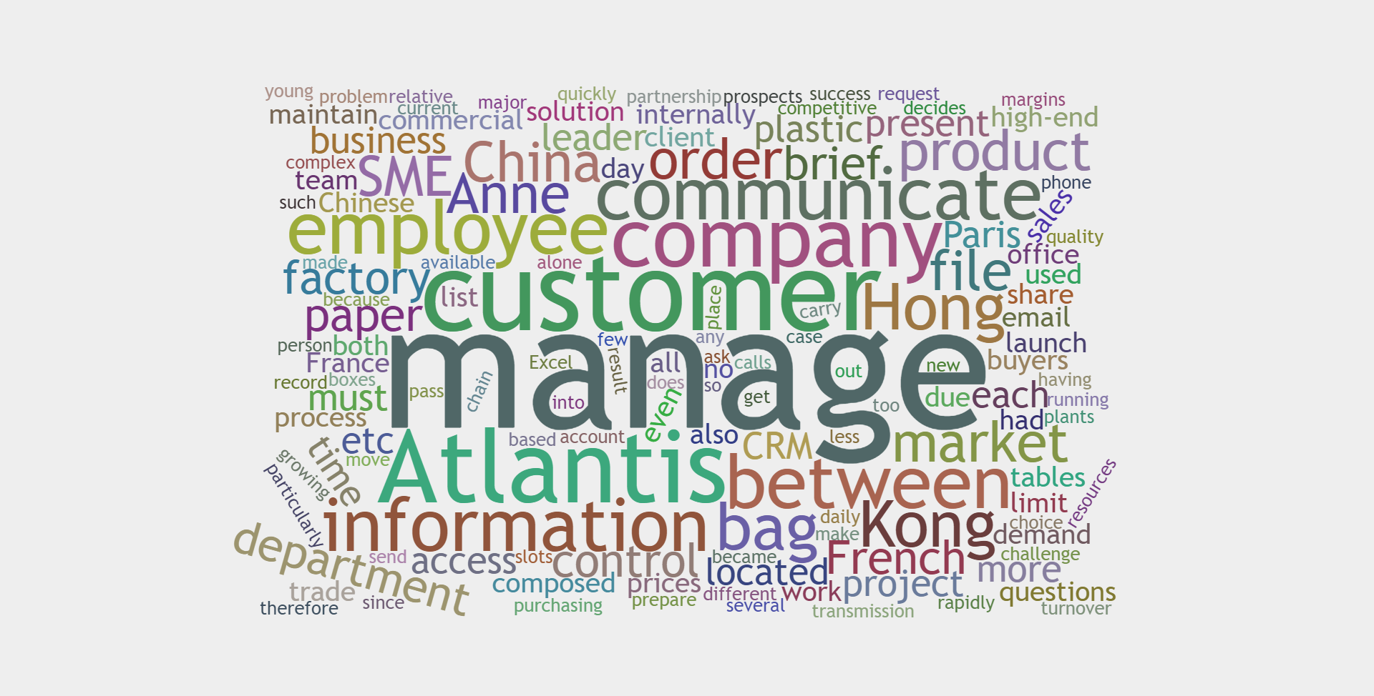
Choosing a CRM Solution For International SMEs
Group 8

Slide 2
1.Introduction and challenges
2.Problem Solution
3.Discussion

Slide 3


Atlantis SME Timeline
1986
2011
Atlantis own factory in China
Atlantis was found
The leader decided to diversify the business to paper bag and high-end boxes production
Atlantis worked in partnership with China
Moving purchase department to Hong Kong
2013
CRM software is in urgent need
Now

Slide 4
Atlantis SME Challenges
Lack of efficient Communication Channels
Telephone communications caused extra costs
Email communication left hiccups
Lack of optimized Information Sharing and Transmission Process
Hong Kong has an isolate server
Records transmission process lack efficiency
Commercial have Limited IT resources
Employees High Turnover

Slide 5
Question 2: What is the CRM solution you propose to the leader of the Atlantis company to solve its problems of communication and collaboration between French and Chinese sites? Present the selection criteria of the solution.

Slide 6
3 Types of CRM Systems
Open source
Freemium
licenced
Open source programs
Source code available
Free + Premium
Basic version of CRM is free
Charges for additional functions
Proprietary software
License agreement

Slide 7
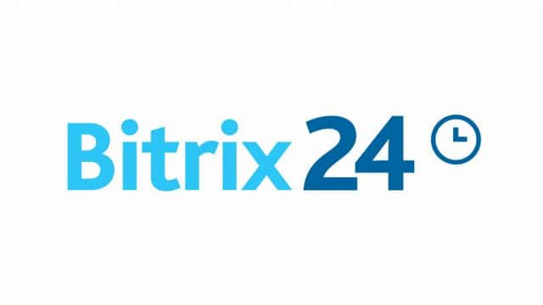

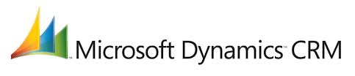



3 Types of CRM Systems-Characteristics
Type | Open Source | Freemium | Licensed
Cost | Free | $39/Month | $242/Month
Access to source
Users | Unlimited | 5 | Unlimited
Technique Required | ($1500 for support)
Cloud

Slide 8
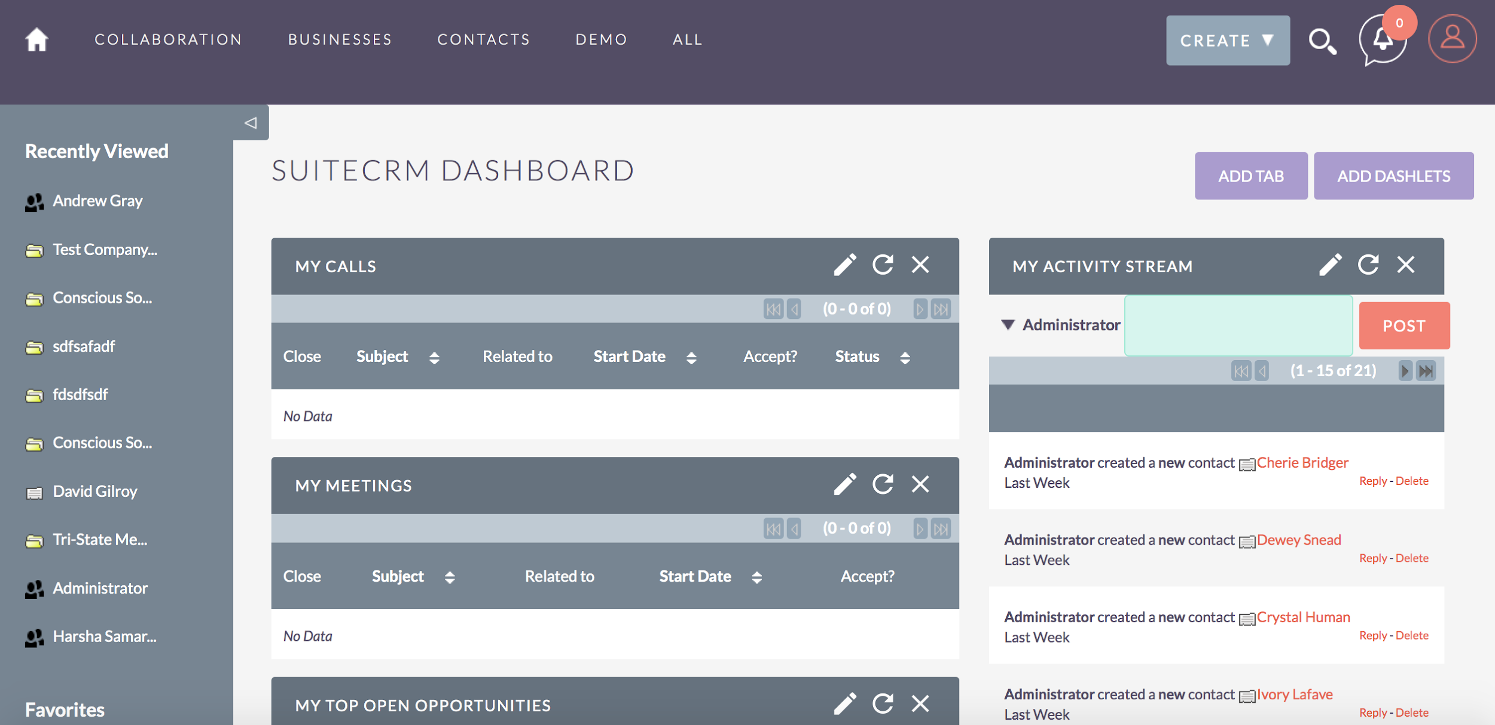
SuiteCRM

Slide 9
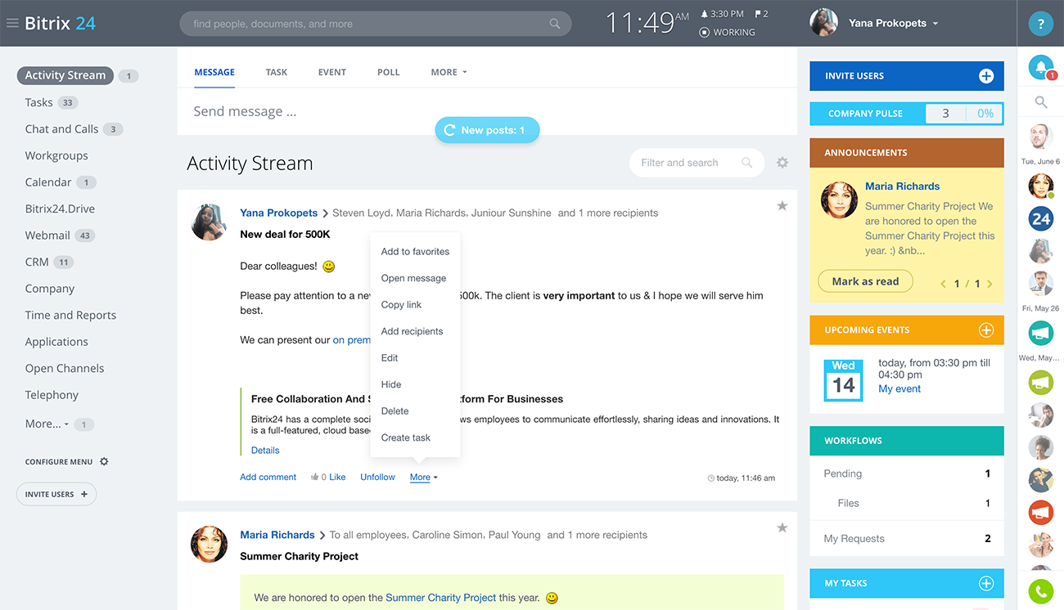
Bitrix24

Slide 10
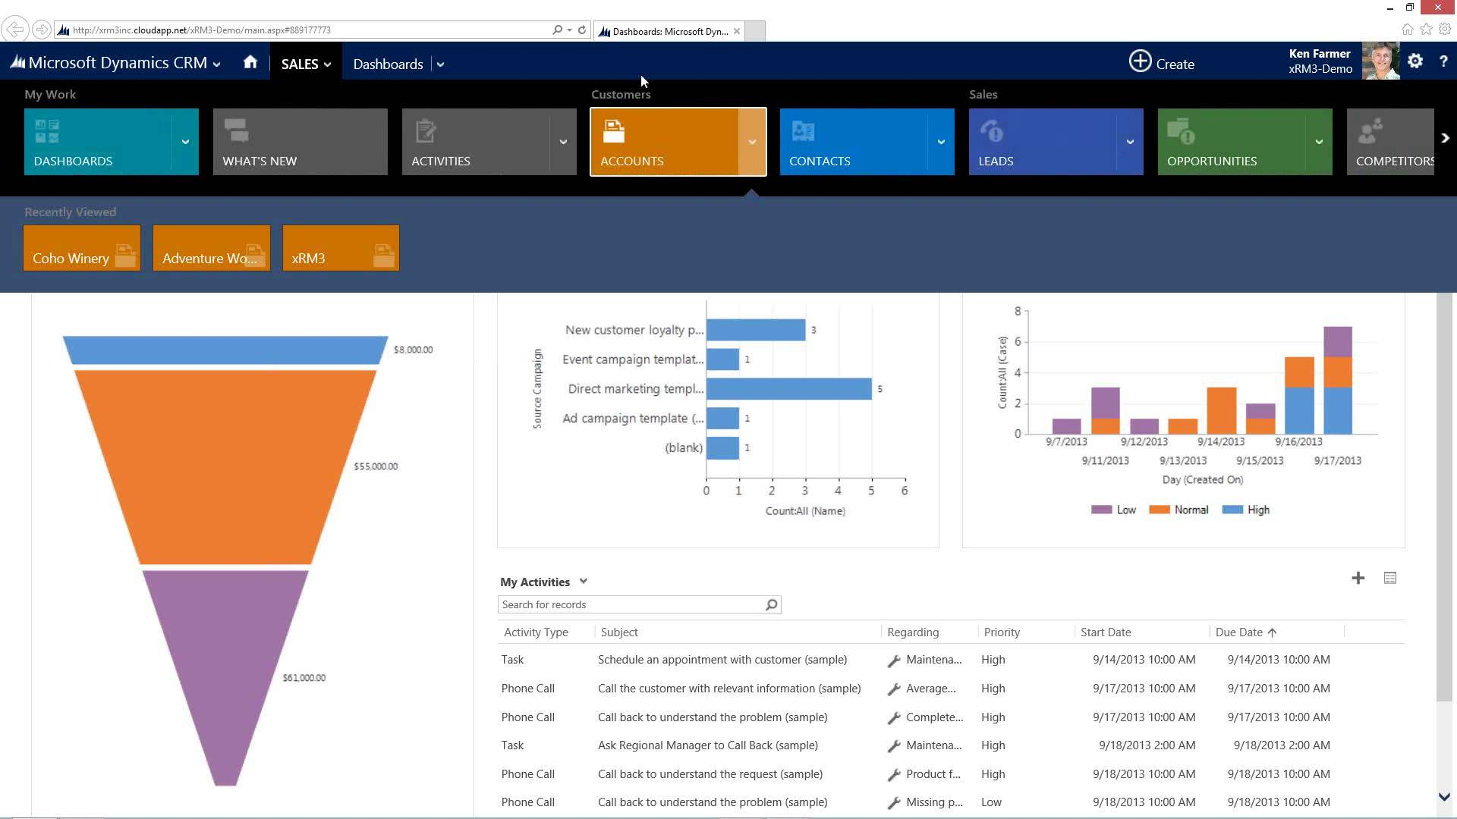
Microsoft Dynamics CRM

Slide 11
3 Types of CRM Solution
Type | Open Source | Freemium | Licensed
Cost/person | Free | $39/ Month per User | $242/ Month per User
Users | Unlimited | 5 | Unlimited
Security
Potential
Total Cost | Free ($1500 if need support) | $1365/Month | $9680/Month

Slide 12
3 Types of CRM Solution
Type | Open Source | Freemium | Licensed
Cost/person | Free | $39/ Month per User | $242/ Month per User
Users | Unlimited | 5 | Unlimited
Security
Potential
Total Cost | Free ($1500 if need support) | $1365/Month | $9680/Month

Slide 13
Question 3: What are the modalities of deployment to provide for a successful CRM project and particularly in this case?

Slide 14



CRM Deployment Modalities
Local Deployment
Cloud Deployment
Pros:
High Security
Data Synchronization
Zero Maintenance
Low Cost
Cons:
Unfamiliar
Low Customizable
Pros:
No access limitation
Quick access
Support both internal and external access
Cons:
Expensive Hardware
High maintenance fee

Slide 15
CRM Deployment Solution
Cloud Deployment
Communication Problem
  Using Email
  Latency of Communication
Small and Medium Enterprise
  Limited Funding
  Lack of Technical team
Pros:
High Security
Data Synchronization
Zero Maintenance
Low Cost

Slide 16





CRM Deployment Cycle
Planning
Deploying
Final Decision
2 Weeks
1 Week
4 Weeks
4 Weeks
TBC
Selecting
Assessing

Slide 17

Q4: The leaders are questioning the utility of social network integration in their business strategy. What recommendations would you make to Anne and his board?
What certain questions that leaders may ask?

Slide 18




“Will the CRM system perform well?”
Cloud Deployment
High Data Consistency
Access to source code
High Maintainability &
High Customizability
Access to all the functions
High Choosability

Slide 19

“How can we check the utility of the CRM system that has been implemented?”
Look at the stats
Check what is it really being used for
Is there conflict?
Data quality
How well is it being used?
How is the reporting performed?
Notes:
Look at the stats
Check what is it really being used for
Is there friction?
How well is it being used?
Data quality
How is reporting performed?

Slide 20

“If there are problems, how can we fix them?”
CM Consultant and Peer advice ties
(Deal with system satisfaction)
Psychological Contract (e.g.Top-down communication)
(Deal with user resistance)
IT Consultant
(Deal with hardware and Software problem)
Keep the flexibility of CRM system
(Deal with the changing business situation)

Slide 21
Reference
A. (2018, May 23). Cloud vs Open Source. Retrieved from https://www.vtiger.com/cloud-vs-open-source/
Free vs. open source software – what's the difference? | IDG Connect. (n.d.). Retrieved from https://www.idgconnect.com/abstract/29146/free-vs-source-software-difference
Microsoft Dynamics CRM Online Price and License Guide | xRM. (n.d.). Retrieved from https://xrm.com/reference/microsoft-dynamics-crm-online/price-and-license-guide/
Software Advisory Service. (n.d.). Open Source vs Licensed Software. Retrieved from https://www.softwareadvisoryservice.com/blog/open-source-vs-licensed-software/
The 8 Best Free and Open Source CRM Software Solutions. (n.d.). Retrieved from https://blog.capterra.com/free-and-open-source-crm/

Slide 22
Discussion

