Slide 1
Multimedia Retrieval
Hongkai Xiong
Department of Electronic Engineering
Shanghai Jiao Tong University

Slide 2
This lecture will cover
Multimedia Retrieval in Databases
Foundations and Index Structures

Slide 3
Overview
Foundations
what is content-based multimedia retrieval?
why do we need new database techniques for accessing media content efficiently?
Multimedia Retrieval
what are current techniques (algorithms and index structures) supporting media retrieval in databases?

Slide 4
Multimedia Data
Typical properties of media data
weakly structured
big size
hard to process automatically

Slide 5
Types of Queries
Focus on approximate queries
Nearest Neighbor Queries (NN): given an example object, find the most similar object in the database
k-Nearest Neighbor Queries (kNN): given an example object, find the k most similar objects in the database
Similarity Join: given two sets of objects, find matching pairs among these (match means: similarity exceeds a fixed threshold)

Slide 6
Similarity and Distance
Problem: how can similarity be measured, especially for complex data?
Similarity measure
the similarity between two objects can be expressed as a function taking the two as input and, e.g., returning a value between 1 (most similar/equal) and 0 (no similarity)
Distance measure
a respective function measuring the difference. e.g. ranging from 0 (no difference) to maximum distance
Usually, one of the two measures can be transferred to the other and vice versa

Slide 7
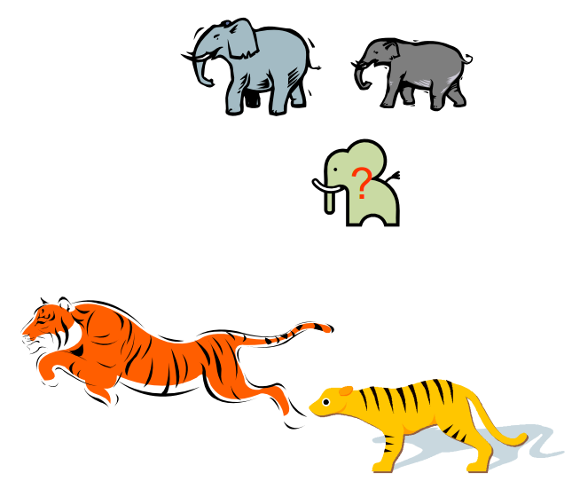
Similarity and Distance
But major problems remain: what exactly does the function do?
What is similar and what is not is in the eye of the beholder?
subjective, application-specific
How to compare similarity efficiently?

Slide 8
Vector Space Model
Working with feature vectors allows to map similarity matching problem to operations in this vector space
Vectors of multimedia objects (stored data as well as query objects) represent points in this space
Dimensionality of the space is defined by vectors dimensionality

Slide 9
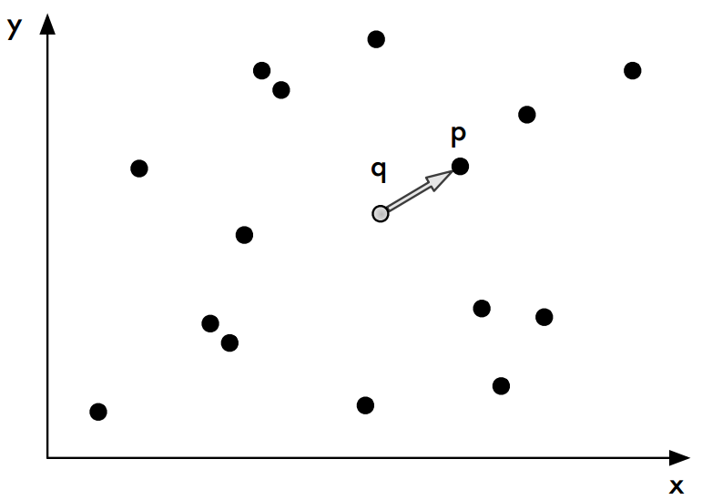
Nearest Neighbor(NN) Queries

Slide 10
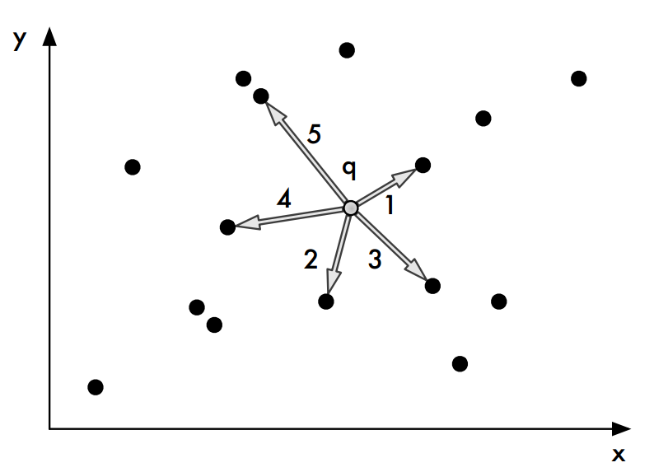
k-Nearest Neighbor(k-NN) Queries

Slide 11
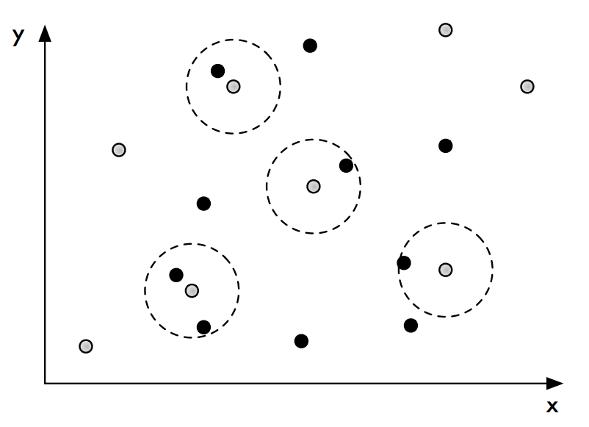
Similarity Join

Slide 12
Distance functions
Retrieval based on distance between points
A simple (but not always the best) distance in Euclidean Space: Euclidean Distance
Other simple distance functions:
Manhattan distance
Minkowski distance of norm p is generalization (p=1 Manhattan, p=2 Euclidean):

Slide 13
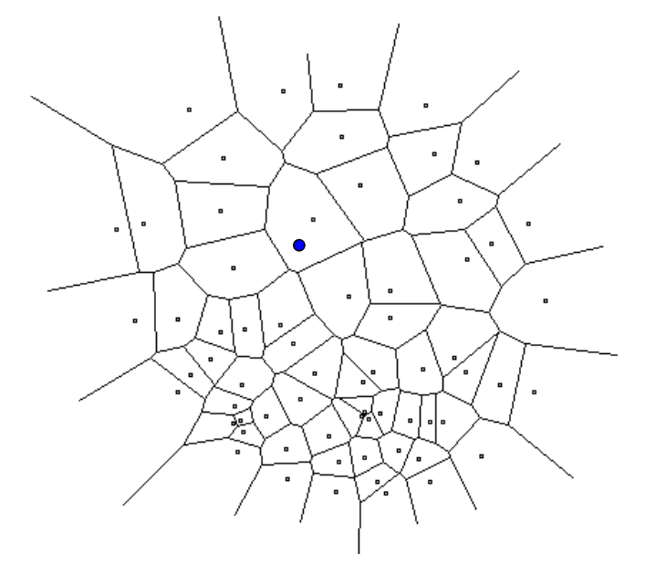
Brief History of NN
The case of d=2: Compute Voronoi diagram
Performance:
Space: O(n)
Query time: O(log n)

Slide 14
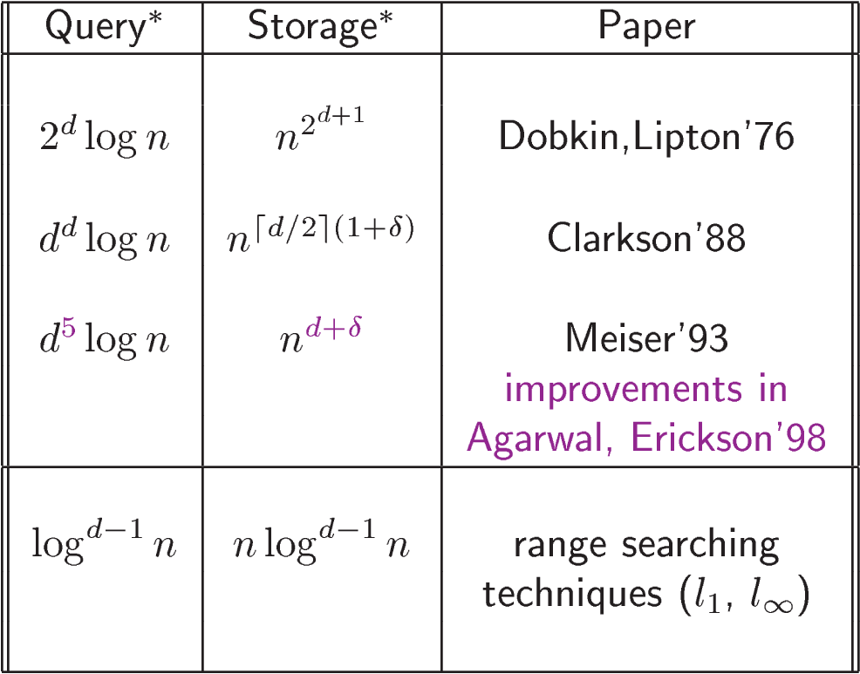
The case of d>2
Exponential dependence on d !

Slide 15
Multimedia Indexing
Finding one (NN) or few (k-NN) objects from a huge set of media objects (e.g. finding images in Flickr, google, or in a police database of possible suspects) can not be done efficiently by comparing query feature vector to all feature vectors in the database (full scan)
Efficient query processing requires indexing of multimedia objects
Because retrieval is based on features, features are indexed
Indexing methods most often based on hierarchical partitioning of the feature vector space

Slide 16
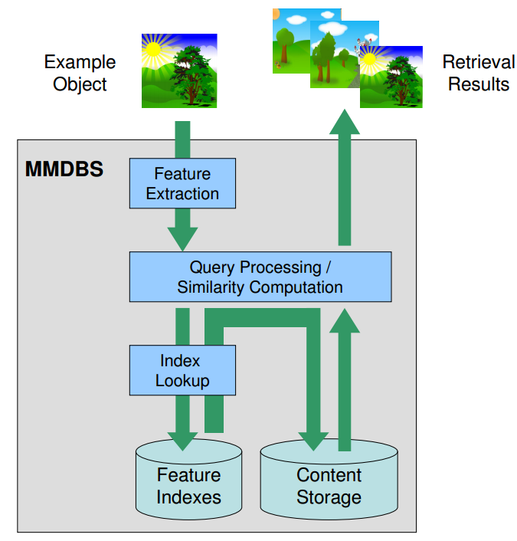
Querying Multimedia Content

Slide 17
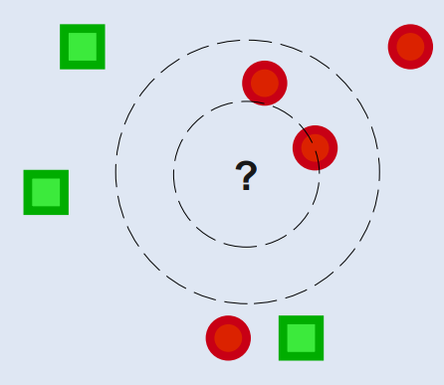
(r, c)-Nearest Neighbor
An approximate nearest neighbor should suffice in most cases.
Definition
If for any query point , there exists a point such that , then return such that
LSH Algorithm could solve this problem!

Slide 18
Searching
Consider the problem of searching an array for a given value
If the array is not sorted, the search requires O(n) time
If the value isn’t there, we need to search all n elements
If the value is there, we search n/2 elements on average
If the array is sorted, we can do a binary search
A binary search requires O(log n) time
About equally fast whether the element is found or not
It doesn’t seem like we could do much better
How about an O(1), that is, constant time search?
We can do it if the array is organized in a particular way

Slide 19
Hashing
Suppose we were to come up with a “magic function” that, given a value to search for, would tell us exactly where in the array to look
If it’s in that location, it’s in the array
If it’s not in that location, it’s not in the array
This function would have no other purpose
This function is called a hash function because it “makes hash” of its inputs

Slide 20
Example (ideal) hash function
Suppose our hash function gave us the following values:
hashCode("apple") = 5 hashCode("watermelon") = 3 hashCode("grapes") = 8 hashCode("cantaloupe") = 7 hashCode("kiwi") = 0 hashCode("strawberry") = 9 hashCode("mango") = 6 hashCode("banana") = 2
0
1
2
3
4
5
6
7
8
9
kiwi
banana
watermelon
apple
mango
cantaloupe
grapes
strawberry

Slide 21
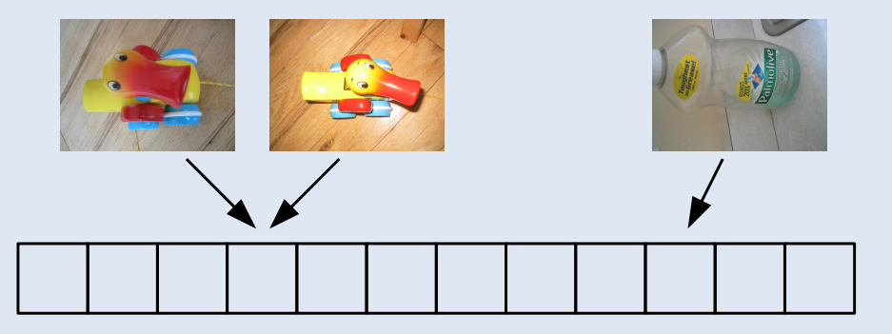
Locality-sensitive Hash Families
Definition
A LSH family , has the following properties for any :
If , then
If , then

Slide 22
The Basic Idea
The idea is to hash points using several hash functions so as to ensure
for each function the probability of collision is much higher for objects that are close to each other.
When two values hash to the same array location, this is called a collision
Then, one can determine near neighbors by hashing the query point and retrieving elements stored in buckets containing that point.
In this case all the searching techniques reduce to linear search, if are being searched for the appropriate answer.

Slide 23
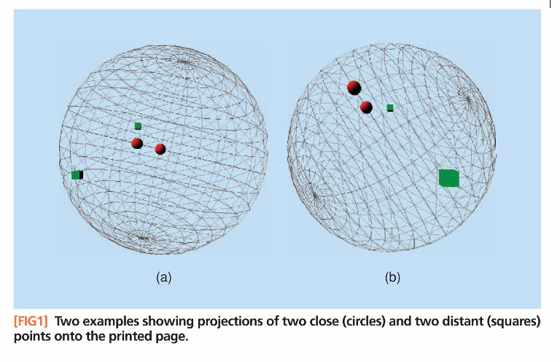
Intuition

Slide 24
Locality-sensitive Hash
We use to denote the Euclidean space under the norm, i.e., when the length of a vector is defined as
Further, denotes the distance between the points and in .
Assumptions:
1. the distance is defined by the norm
2. all coordinates of points in are positive integers.

Slide 25
Hamming Space
Let be the largest coordinate in all points in .
We can embed into the Hamming cube .
with
transforming each point into a binary vector ;
where denotes the unary representation of , i.e., is a sequence of ones followed by zeroes.
For and :
then

Slide 26
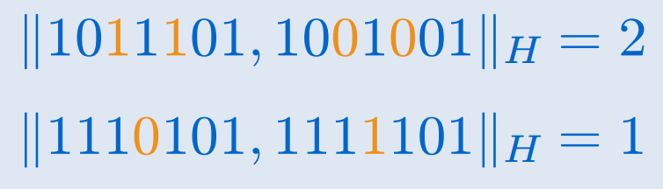
Hamming Space
Hamming space is the set of all binary strings of length .
Definition:
The Hamming distance between two equal length binary strings is the number of positions for which the bits are different.

Slide 27
Hamming Space Properties
Fact 1: For any pair of points and with coordinates in the set
Note
the embedding preserves the distances between the points.
do not need to actually convert the data to the unary representation, which could be expensive when C is large
the unary representation provides us with a convenient framework for description of the algorithms

Slide 28
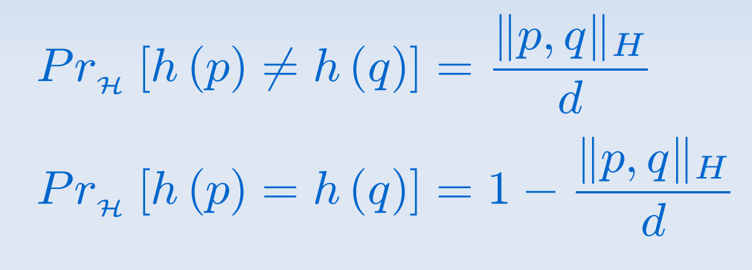
Hamming Space
Let a hashing family be defined as
where is the bit of .
Clearly, this family is locality sensitive.

Slide 29
LSH Preprocessing
For an integer to be specified later, choose subsets of .
Let denote the projection of vector on the coordinate set .
For and :
then
and , .
Hash function .
we store each in the bucket , for .

Slide 30
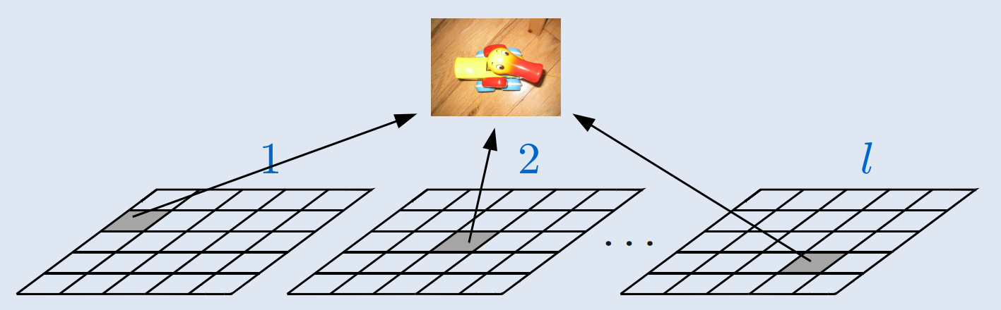
LSH Preprocessing
Each training example is entered into hash tables indexed by independently constructed

Slide 31
Trick
Why do not need to actually convert the data to the unary representation?
For and :
then
and , .
A little trick:
denote, in sorted order, the coordinates in which correspond to the coordinate of
, means the number of elements in the set
then →

Slide 32
Two levels of hashing
As the total number of buckets may be large, we compress the buckets by resorting to standard hashing.
Denote the resulting vector of coordinates by
is the size of the hash table and are random numbers from interval
Thus, we use two levels of hashing:
the LSH function maps a point to bucket
and a standard hash function maps the contents of these buckets into a hash table of size

Slide 33
LSH Querying
To process a query , we search all the indices until we either encounter at least points or use all the indices.
Let be the points encountered in the process.
For the output we return the nearest points, or fewer in case we could not find so many points as a result of the search.

Slide 34
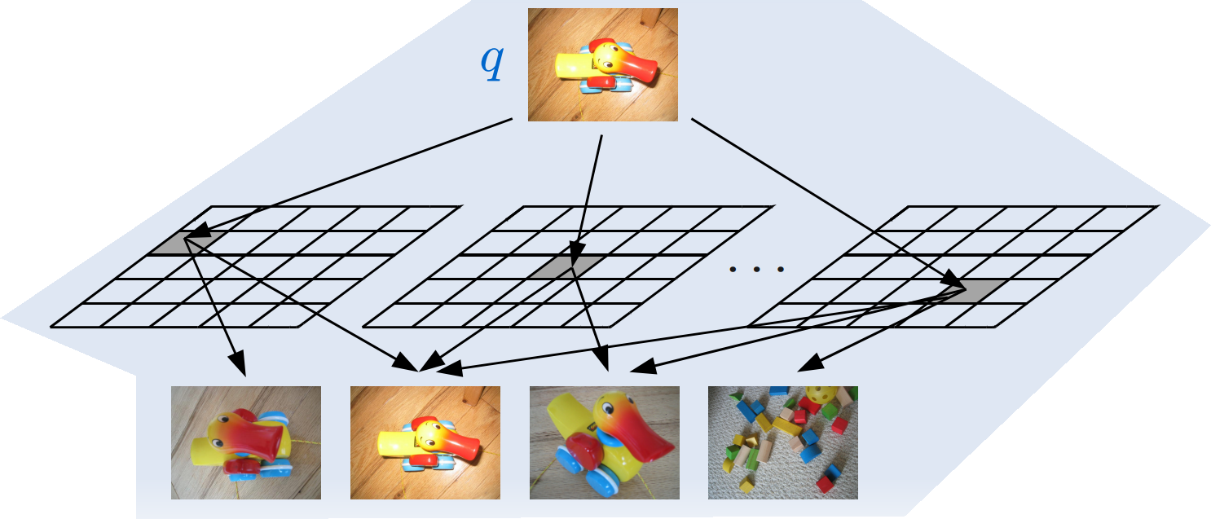
LSH Querying

Slide 35
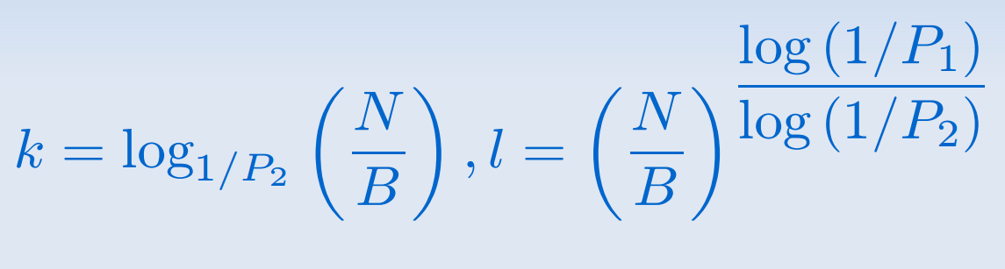
Parameter Selection
Suppose we want to search at most examples. Then setting
ensures that it will succeed with high probability

Slide 36
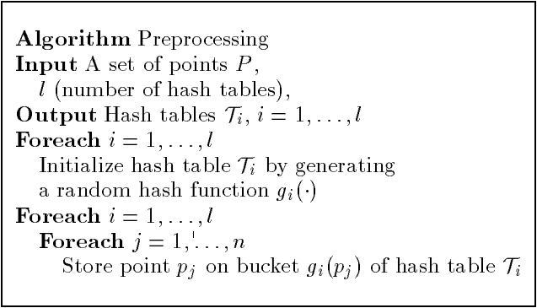
Algorithm
Preprocessing algorithm for points already embedded in the Hamming cube.

Slide 37
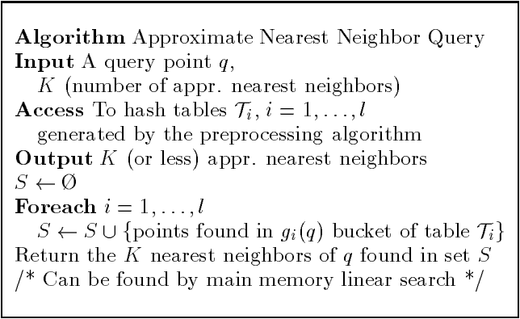
Algorithm
Approximate Nearest Neighbor query answering algorithm.

Slide 38
Conclusion
The principle behind our method is the probability of collision of two points and is closely related to the distance between them.
Especially the larger the distance, smaller the collision property.

Slide 39
References
Shakhnarovich et al., Fast Pose Estimation with Parameter Senative Hashing
Gionis et al., Similarity Search in High Dimensions via Hashing
Andrea Frome and Jitendra Malik, Object Recognition Using Locality-Sensitive Hashing of Shape
Algorithms for Nearest Neighbor Search
http://simsearch.yury.name/tutorial.html
LSH Matlab Toolbox:
http://www.cs.brown.edu/~gregory/code/lsh/

Slide 40

Thank You!

