Slide 1
Merge Tables
Bruno Costa
iBET – Instituto de Biologia Experimental e Tecnológica
www.ibet.pt

Slide 2


Merge Tables
A common problem in science investigation.
How to put together data from mutilipe sources? This solution is for you if you the data has the following:
Columns that link the data
What you need to run this?
Install python on your computer.
Your tables must be in .tsv or .csv export from excel.
Scan to download

Slide 3
Merge Tables
ID | Cell Type | Plant Tissue | Sample weight
Key | Value 1 | Value 2 | Value 3
1 | Somatic Cell | Bark | 10,0
2 | Somatic Cell | endocarp | 0,1
3 | Germline Cell | Plant Ovary | 2,2
4 | Germline Cell | microgamete | 3,4
5 | Somatic Cell | rizhoid | 9,6
6 | Somatic Cell | tricome | 4,3
7 | Somatic Cell | endocarp | 3,5
8 | Somatic Cell | endocarp | 2,4
Table 1. Example table 1

Slide 4
Merge Tables
ID | Accession | Institution | Accuracy (%)
Key | Value 1 | Value 2 | Value 3
3 | 324314 | VIB | 93,00%
5 | 213467 | CIRAD | 32,00%
2 | 234123 | iBET | 58,00%
7 | 567432 | IGC | 33,00%
6 | 545332 | INIAV | 21,00%
8 | 453222 | IGC | 53,00%
1 | 734323 | iBET | 52,00%
4 | 323452 | INRA | 99,00%
Table 2. Example table 2

Slide 5
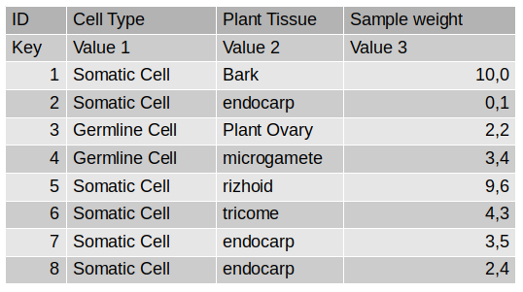
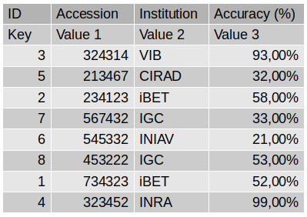
Merge Tables
The key referes to the column that connects to another table.
Values are all other
Table 1
Table 2

Slide 6
Merge Tables

Slide 7
Merge Tables
usage: MergeTables.py
This is used to parse the blast result
[Mandatory arguments]:
--input1 input file
Path to the file with the keys and values
--input2 input file
Path to the file with the key to which the values should be appended
--output output file
Path where the file with the values appended should be Stored
--col_key_num_input1 column key number. (Starts at 0)
--col_key_num_input2 column key number. (Starts at 0)
[Optional]
-h, --help show this help message and exit
--col_value_num_input2 column value number. (Starts at 0)
--sep1 seperation string
Set the seperation string for input 1. Default is tab
--sep2 seperation string
Set the seperation string for input 2. Default is tab
--log log file Path where the log file should be stored with the
information abount which keys wheren't found

Slide 8
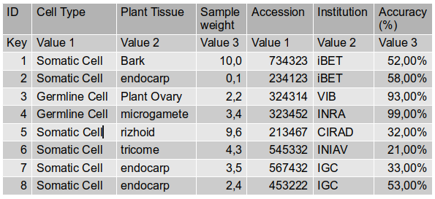
Merge Tables
Example usage: MergeTables.py --input1 table1.tsv --input2 table2.tsv --output mergedtables.tsv –col_key_num_input1 0 --col_key_num_input2 0

Slide 9
Merge Tables
Key
Table 1
Table 2
Table 1
ID | Cell Type | Plant Tissue | Sample weight | Accession | Institution | Accuracy (%)
Key | Value 1 | Value 2 | Value 3 | Value 1 | Value 2 | Value 3
1 | Somatic Cell | Bark | 10,0 | 734323 | iBET | 52,00%
2 | Somatic Cell | endocarp | 0,1 | 234123 | iBET | 58,00%
3 | Germline Cell | Plant Ovary | 2,2 | 324314 | VIB | 93,00%
4 | Germline Cell | microgamete | 3,4 | 323452 | INRA | 99,00%
5 | Somatic Cell | rizhoid | 9,6 | 213467 | CIRAD | 32,00%
6 | Somatic Cell | tricome | 4,3 | 545332 | INIAV | 21,00%
7 | Somatic Cell | endocarp | 3,5 | 567432 | IGC | 33,00%
8 | Somatic Cell | endocarp | 2,4 | 453222 | IGC | 53,00%

Slide 10
Scan to download
goo.gl/zwJ501
Bruno Costa

