Slide 1
What's inside my thesis
Lin Cheng
May11th, 2014

Slide 2
Introduction
Implementing and Accelerating HMMER3 Protein Sequence Search on CUDA-Enabled GPU
Chapter 1 Background of Bioinformatics
Chapter 2 Dynamic programming in Bioinformatics
Chapter 3 CUDA accelerated sequence alignment
Chapter 4 A CUDA accelerated HMMER3 protein sequence search tool
Chapter 5 Benchmark results and discussion
Chapter 6 Conclusions and recommendations

Slide 3
Chapter 1
Background of Bioinformatics
Cells, amino acids and proteins
Sequence alignment
Bioinformatics databases

Slide 4
Chapter 2 Dynamic programming in Bioinformatics
The Smith-Waterman algorithm
HMMER
  HMM and profile HMM
  Viterbi algorithm in HMMER2
  MSV algorithm in HMMER3

Slide 5
Chapter 3 CUDA accelerated sequence alignment
Overview of CUDA programming model
  Streaming Multiprocessors
  CUDA thread hierarchy
  CUDA memory hierarchy
CUDA accelerated Smith-Waterman
  7 papers 2008 - 2013
CUDA accelerated HMMER
  5 papers 2009 - 2012

Slide 6
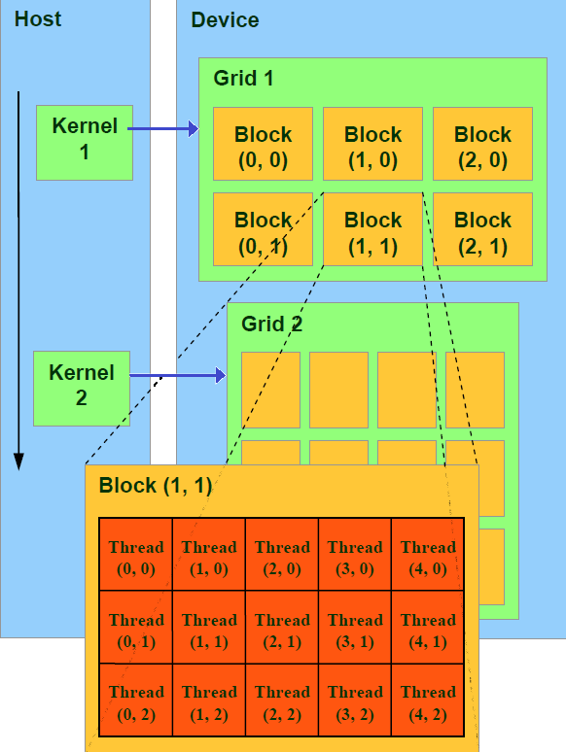
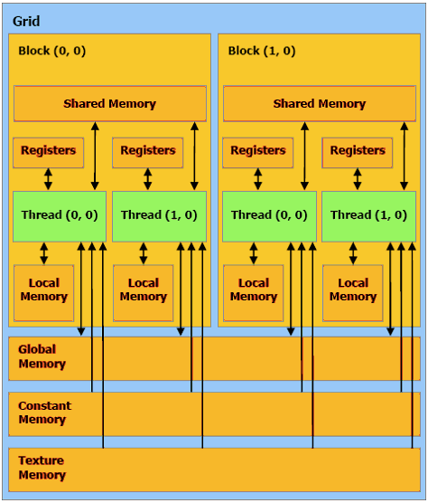
Chapter 3 CUDA accelerated sequence alignment
CUDA thread hierarchy CUDA memory hierarchy

Slide 7
Chapter 4 A CUDA accelerated HMMER3 protein sequence search tool
Requirements and design decisions
A straightforward implementation
Optimizing the implementation
  Global Memory Accesses
    Access frequency
    128bit uint4, ulong2
struct __device_builtin__ uint4
{ unsigned int x, y, z, w;
}

Slide 8
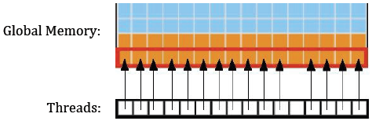
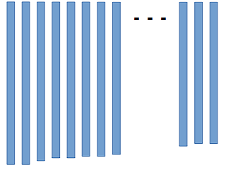
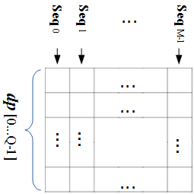
Chapter 4 A CUDA accelerated HMMER3 protein sequence search tool
Global Memory Accesses
    coalescing access
Alignment of target sequences
dp matrix in global memory

Slide 9
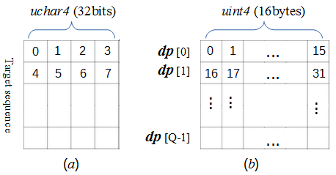
Chapter 4 A CUDA accelerated HMMER3 protein sequence search tool
Optimizing the implementation
  texture memory
  Virtualized SIMD vector programming model
  SIMD Video Instructions

Slide 10
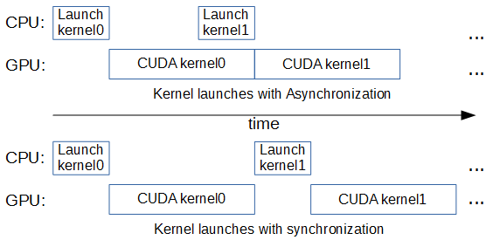
Chapter 4 A CUDA accelerated HMMER3 protein sequence search tool
Optimizing the implementation
  Pinned (non-pageable) Memory
  Asynchronous memory copy and Streams

Slide 11
Chapter 4 A CUDA accelerated HMMER3 protein sequence search tool
Optimizing the implementation
  Database sorted
    nvprof
  Workload distribution

Slide 12
Chapter 4 A CUDA accelerated HMMER3 protein sequence search tool
Miscellaneous consideration
  Data type for register memory
  Branch divergence
  Constant memory
  shared memory

Slide 13
Chapter 4 A CUDA accelerated HMMER3 protein sequence search tool
6 steps to better performance
  Assessing the application
  Application Profiling
  Optimizing memory usage
  Optimizing instruction usage
  Maximizing parallel execution
  Considering the existing libraries

Slide 14
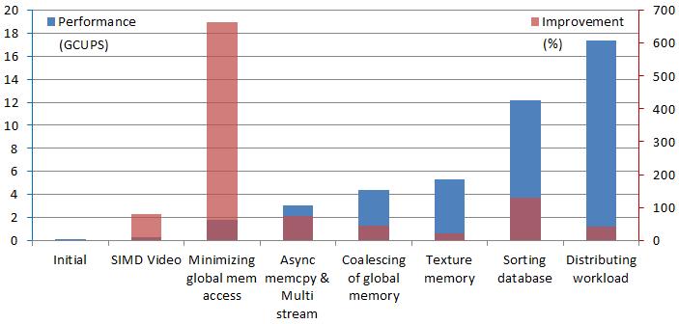
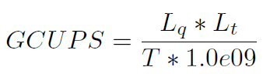
Chapter 5 Benchmark results and discussion
Benchmarking environment
  Kronos machine
Performance Results
  Comparison with less optimized approaches

Slide 15
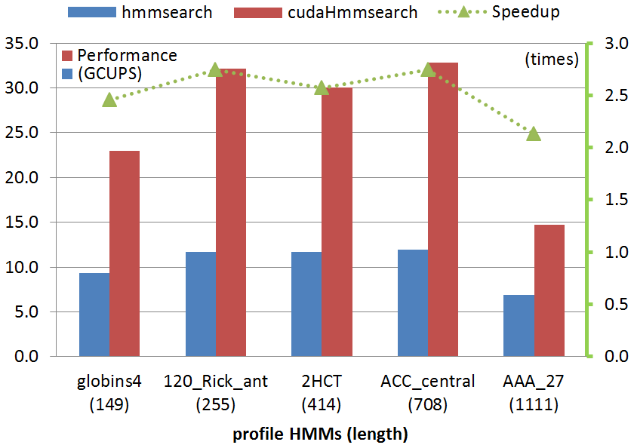
Chapter 5 Benchmark results and discussion
Practical benchmarks

Slide 16
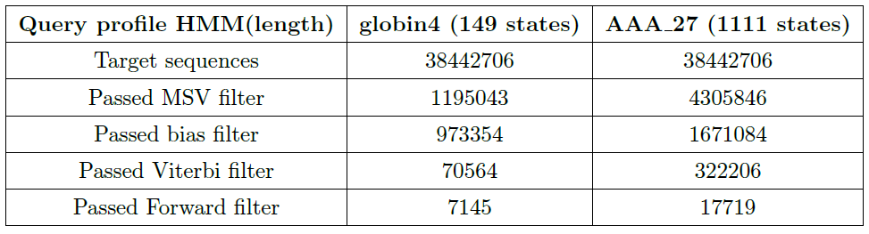
Chapter 5 Benchmark results and discussion
Practical benchmarks
Internal pipeline statistics summary

Slide 17
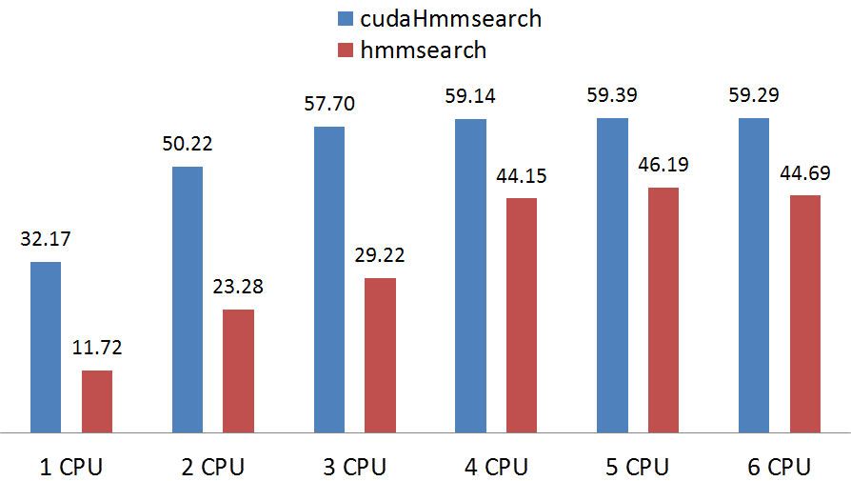
Chapter 5 Benchmark results and discussion
Comparison with multicore CPU

Slide 18
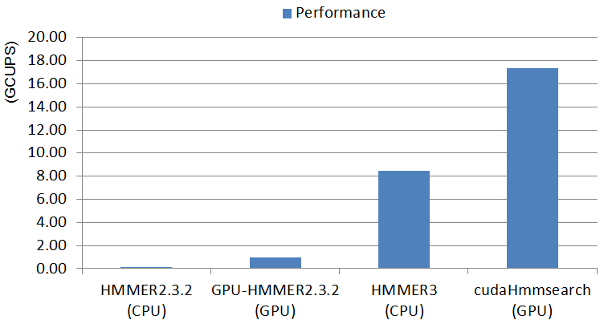
Chapter 5 Benchmark results and discussion
Comparison with other implementations

Slide 19
Chapter 6 Conclusions and recommendations
Conclusions of current work
Recommendations for further research
  Forward filter for no threshold
  Multiple GPUs approach

Slide 20

Thanks !

