Slide 1
Implementing and Accelerating
HMMER3 Protein Sequence Search on CUDA-Enabled GPU
Lin Cheng
May11th, 2014

Slide 2
Introduction
Implementing and Accelerating HMMER3 Protein Sequence Search on CUDA-Enabled GPU
Problem Statement
Background
Solution to the problem
Benchmark results and discussion
Conclusions
Notes:
HMMER is … CUDA is ...
What's the problem I need to solve in my research
HMMER related algorithms and CUDA programming model

Slide 3
Problem Statement
HMMER protein sequence search tool
hmmsearch
Viterbi algorithm
MSV algorithm

Slide 4
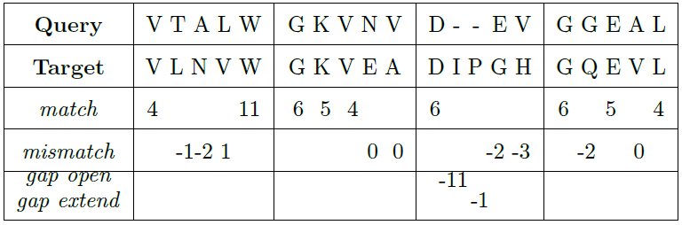
Background
Cells, amino acids and proteins
Sequence alignment
sum of match: +51
sum of mismatch: -9
sum of gap penalties: -12
total raw score: 51 - 9 -12 = 30

Slide 5
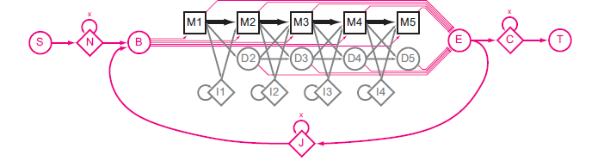
Background
HMMER
  HMM and profile HMM
  Viterbi algorithm in HMMER2
  MSV algorithm in HMMER3

Slide 6
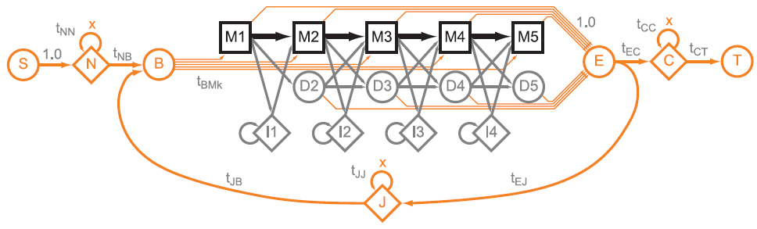
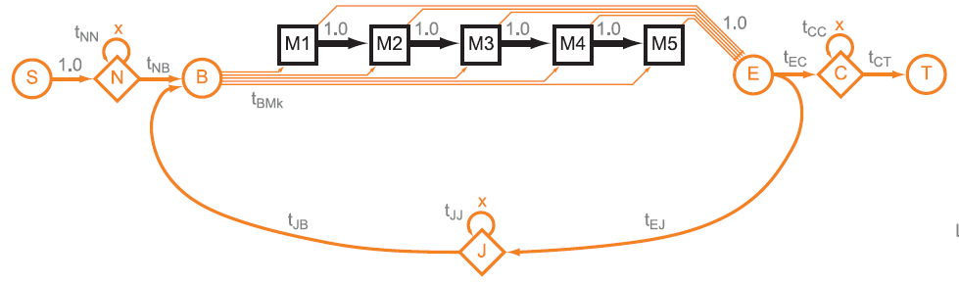
Background
HMMER
  Viterbi algorithm in HMMER2
  MSV algorithm in HMMER3

Slide 7
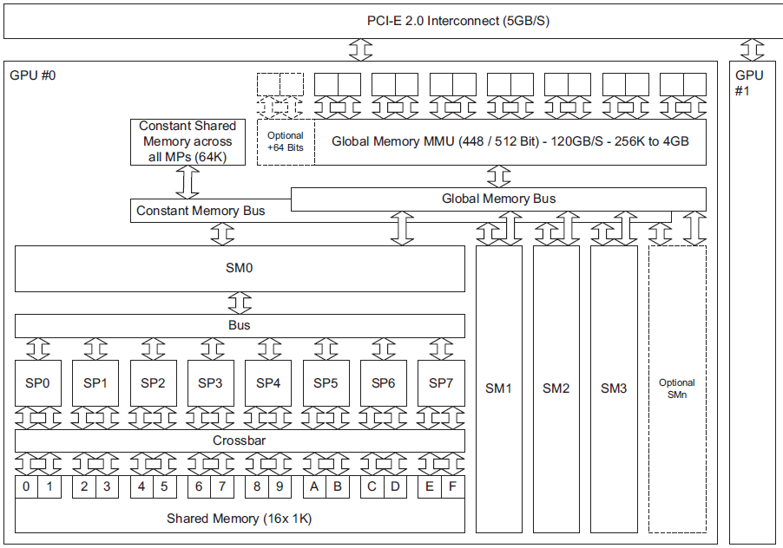
Background
Block diagram of a GPU(G80/GT2000) card
Notes:
A computer can install 1 or more GPU cards in PCI-E socket. GPU card has 2 main components: SM Streaming.. and memory. G80 has 4 SM and each SM has 8 SP. Each SM has a separate shared mem inside and a separate bus into the texture memory, constant memory, and global memory spaces.

Slide 8
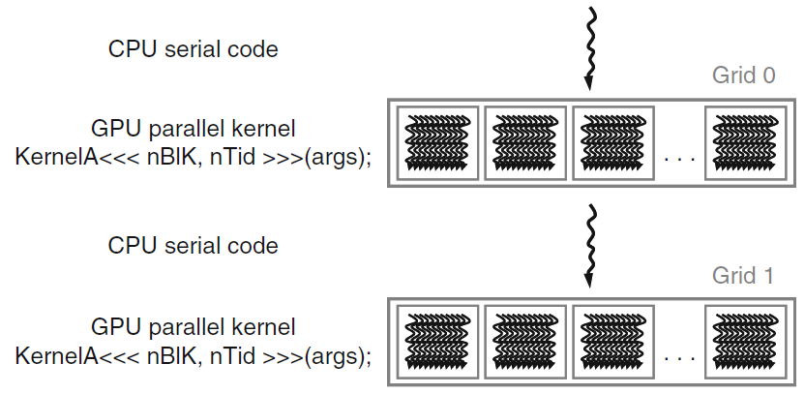
Background
CUDA program
Notes:
This is a typical execution of CUDA program. The CPU host launches a GPU kernel with the triple angle-bracket syntax. The kernel generates many threads according to the parameters Nblk and Ntid. Normally there are Nblk*Ntid threads. All threads are organized into a grid.

Slide 9
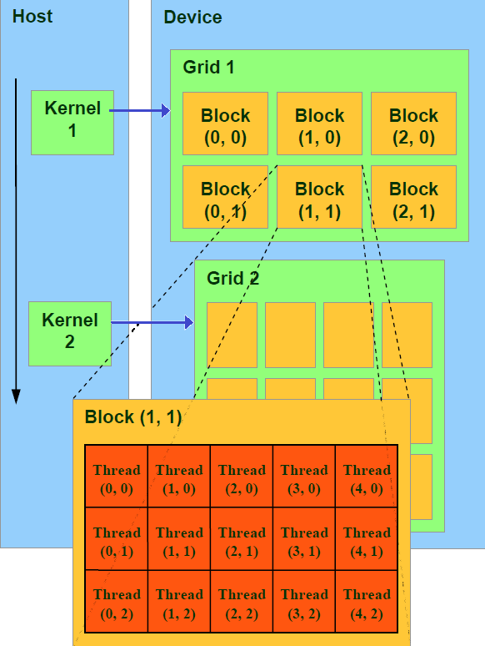
Background
CUDA thread hierarchy
Notes:
Threads in a grid are organized into a two-level hierarchy.
At the top level, each grid consists of one or more thread blocks. The second level is block level. All blocks in a grid have the same number of threads. The block and thread structure can be organized into a one, two, or three dimension. Each block can be scheduled on any of the available multiprocessors.

Slide 10
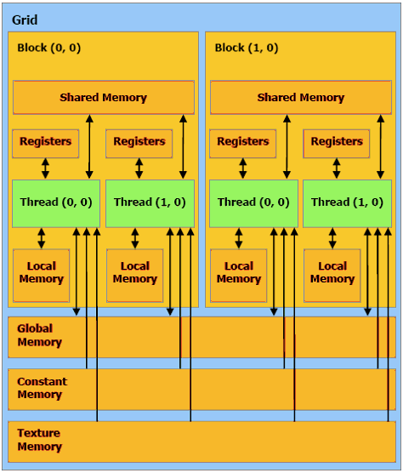
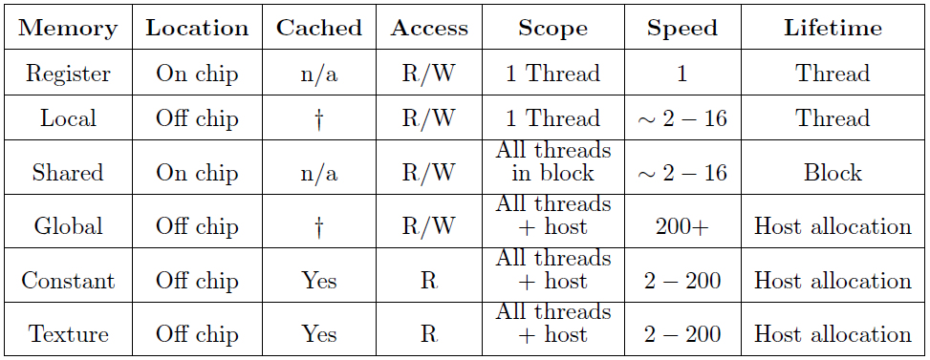
Background
CUDA memory hierarchy
Notes:
Besides the thread model, another thing that makes CUDA programming different
from CPU is its memory spaces. From bottom to top, they're... the table shows their specific features. The bottom 3 tex, cont and global can be allocated by CPU host. Shared mem can only be shared and accessed by threads in a block. Registers and local mem are for 1 thread.
Speed is the relative speed in number of instructions. Register is fastest and global is slowest. Since these memories have different features, one important thing of CUDA programming is how to combine these memories to best suit the application.

Slide 11
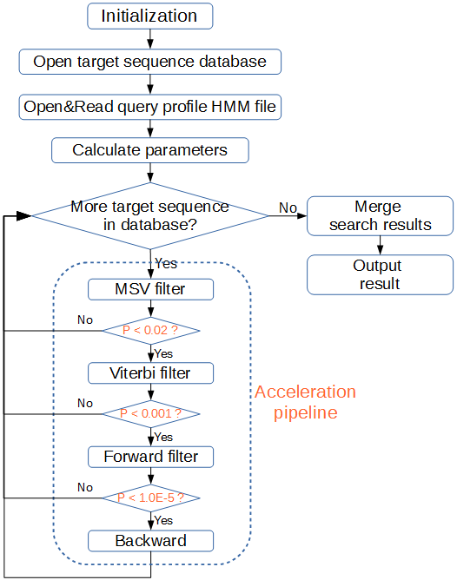
Solution to the problem
Hotspot
  MSV filter
Parallelism strategy
  Task-based parallelism
  Data-based parallelism

Slide 12
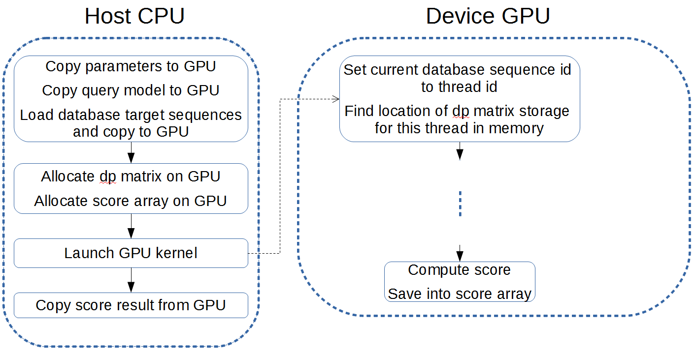
A CUDA accelerated HMMER3 protein sequence search tool
A straightforward implementation
Notes:
A basic implementation
the code must be split up into two parts, with the left host part running on CPU and the right device part running on GPU. Some redundancy as data needed by GPU to compute will be copied around the memories in host and device.
The CPU code mainly concerns about allocating data structures on GPU, loading data,
copying them to GPU, launching the GPU kernel and copying back the result for further
steps.

Slide 13
Optimizing the implementation
Global Memory Accesses
  Access frequency
    128bit uint4, ulong2
struct __device_builtin__ uint4
{ unsigned int x, y, z, w;
}
Notes:
The global memory is used to store most of data on GPU. A primary in the optimization is to improve the efficiency of accessing global memory as much as possible. One way of course is to reduce the frequency of access. Another way is coalescing access.
The elements of the dp matrix and the query profile matrix are 8-bit value. The uint4 and ulong2 are 128-bit CUDA built-in vector types. So the access
frequency would be decreased 16 times by using uint4 or ulong2 to fetch the 8-bit value residing in global memory, compared with using 8-bit char type.
This approach resulted in increased register pressure and gained a huge speed boost of
almost 8 times in total.

Slide 14
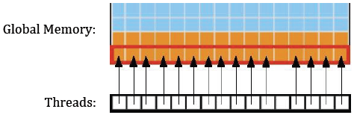
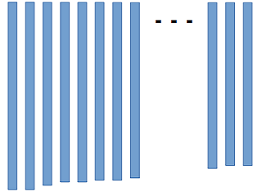
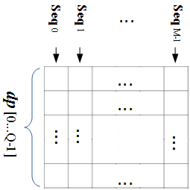
Optimizing the implementation
Global Memory Accesses
    coalescing access
Alignment of target sequences
The dp matrix in global memory
Notes:
Coalescing access is one of the most important performance consideration in CUDA programming. It is a technique to combine non-contiguous and small reads/writes of global memory, into the single and more efficient contiguous and large memory reads. A prerequisite for coalescing is that the words accessed by all threads in a warp must lie in the same segment.
The memory spaces are referred to by the same variable names, not referring to same addresses for all threads in a warp. They have to be allocated in the form of an array to keep them contiguous in address.
For coalescing access, data often need to be allocated in a special pattern. The target sequences are arranged in a matrix like an upside-down bookcase, where all residues of a sequence are restricted to be stored in the same column from top to bottom. Similarly, the dp matrix is arranged in this pattern.
And all sequences are arranged in decreasing length order from left to right in the array, which is explained later.

Slide 15
Optimizing the implementation
Optimizing the implementation
  texture memory

Slide 16
Optimizing the implementation
SIMD Video Instructions for GPU
  uint v, v1, v2;
  /* Adds the 4 unsigned 8-bit integers and saturates
  v[z] = v1[z] + v2[z] (z = 0,1,2,3) */
  asm(“vadd4.u32.u32.u32.sat %0, %1, %2, %3;” : “=r”(v) : “r”(v1), “r”(v2), “r”(0));
Intel SSE2 intrinsics for CPU
  __m128i v, v1, v2;
  /* Adds the 16 unsigned 8-bit integers and saturates
  v[z] = v1[z] + v2[z] (z = 0,...,15)*/
  v = _mm_adds_epu8(v1, v2)
Notes:
Single-Instruction Multiple-Data (SIMD) instruction is able to perform the same operation on multiple pieces of data in parallel. The first widely-deployed SIMD was with Intel's MMX instruction. Then they're upgraded to SSE2. CUDA also provides the SIMD video instructions. Here I list both of them for comparison. We can see the difference. SSE2 is more convenient to use. They have built-in data type m128i for 128-bit variable and the direct instruction. While CUDA must use assemble language asm to embed in C. The most important is the performance difference. The CPU register is 128bit and GPU is only 32bit. So SSE2 can add 16 pieces of 8-bit integer while CUDA only 4. it's 4 times difference.

Slide 17
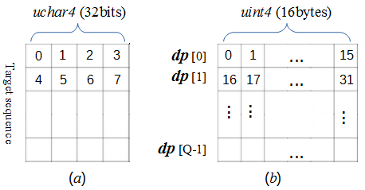
Optimizing the implementation
Virtualized SIMD vector programming model
Notes:
Vector programming model plays important role in operations of array or matrix. On one side, it can reduce greatly the frequency of memory access; on the other side, it can utilize the SIMD vector instructions for parallel computing both on CPU and GPU.
In order to use the vector programming model, the target sequence is re-organized using a packed data format. Four consecutive residues are packed together and represented using the uchar4 vector data type, instead of the char scalar data type.
Similarly, in the dp array, 16 bytes are also packed together to use int4 data type.
The reason why target sequence only use 32bit, not 128bit as the dp array is because it'll increase greatly register pressure. And the dp array has been packed this way in HMMER3.

Slide 18
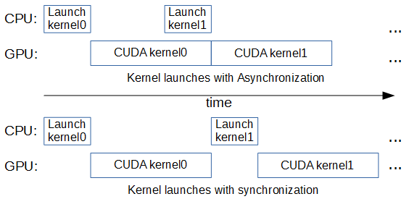
Optimizing the implementation
Pinned (non-pageable) Memory
Asynchronous memory copy and Streams

Slide 19
Optimizing the implementation
Sorting database
  Nvprof
Distributing workload

Slide 20
Optimizing the implementation
Miscellaneous consideration
  Data type for register memory
    8-bit char → 32-bit int
  Branch divergence
    if () then … else ...
  Constant memory
    parameters: base, tjb, tec
  shared memory
    Per-block visibility
    Global → shared memory
    Inter-thread
    cudaFuncSetCacheConfig(msvSIMDKernel, cudaFuncCachePreferL1);
Notes:
Here's miscellaneous consideration for the implementation, small-scale optimization and some limitations not suited to our case.
At the beginning, I used 8-bit char type to save register space. In fact, CUDA use 32-bit register to implement char type. And this involves extra instructions to shift and mask data. This is totally unnecessary. I changed char to int type.
In programming, we often use if.then.else. CUDA kernel can realize full efficiency when all threads in a block agree on the same execution path. If divergence occurs, kernel will execute then for some threads and else for other threads. It will result in some slowdown. It's better to avoid the branch statement. In our case, Since the implementation has changed char to int, the test for the overflow condition is not necessary any more. This not only saves several instructions, but also avoids the issue of branch divergence.
Constant memory is read-only. It's faster than global memory. Its limitation is it can not be allocated dynamically, like global memory. If global memory is fully coalesced access, the performance will be same as constant memory. Constant
memory is fast, but only if all threads read the same address. So in our case, only parameters, like .. use constant mem.
Shared has some limitations. duplicate the data for every block. Data must be loaded from global to shared memory in kernel and can not be uploaded to shared memory directly from the host memory. Shared memory is well suited to exchange data between CUDA threads within a block. As I talked before, we use task-based parallelism which doesn't need inter-thread communications. So... And we use this kernel launch configure command to prefer more L1 cache.

Slide 21
Optimizing the implementation
Conclusion of optimization approaches
6 steps to better performance
  Assessing the application
  Application Profiling
  Optimizing memory usage
  Optimizing instruction usage
  Maximizing parallel execution
  Considering the existing libraries
Notes:
I've presented many optimization approaches for my CUDA implementation. Here are 6 steps to gain better performance for CUDA programming in conclusion.

Slide 22
Benchmark results and discussion
Benchmarking environment
  Kronos machine
    Intel Core i7-3960X with 6 cores
    NVIDIA Quadro K4000 with 3 GB global memory
    Ubuntu 64 bit Linux v12.10
  Target sequences database
    Swiss-Prot 540,958 sequences with length 2 ~ 35,213
    NCBI NR 38,442,706 sequences with length 6 ~ 41,943
Notes:
This the benchmarking environment which I used to test my implementation.
I used a machine named as Kronos. It has Intel and GPU is. OS is.
I used two protein databases for experiment, because of their big difference in size. One is smaller Swiss-Prot with half a million sequences and another is much huge NCBI with more than 38M sequences. Their sequences lengths are very various, from single digit to around 40 thousands.

Slide 23
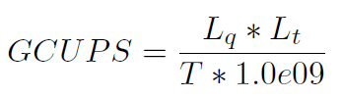
Benchmark results and discussion
Benchmarking environment
  Query profile HMMs
  Measure performance
Name | Globin4 | 120_Rick_ant | 2HCT | ACC_central | AAA_27
Accession number | - | PF12574.3 | PF03390.10 | PF08326.7 | PF13514.1
Length | 149 | 255 | 414 | 708 | 1111
Notes:
I used 5 query profile HMMs for testing. Globin4 is from HMMER source and other 4 are taken from pfam database. Their lengths vary from 149 to 1111.
The performance was measured in unit GCUPS(Giga Cell Units Per Second) with this formular. Lq is the length of query profile HMM,
Lt is the total residues of target sequences in the database, T is the execution time in second.

Slide 24
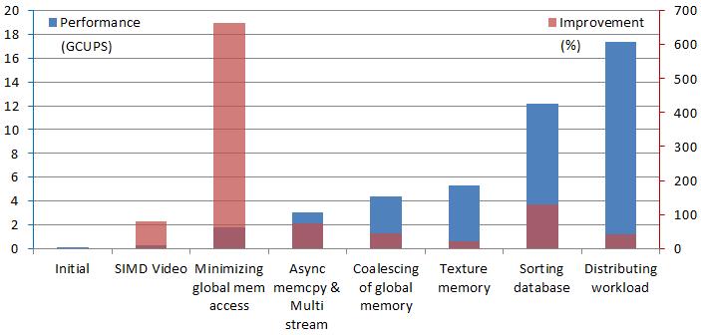
Benchmark results and discussion
Performance Results
  Comparison with less optimized approaches

Slide 25
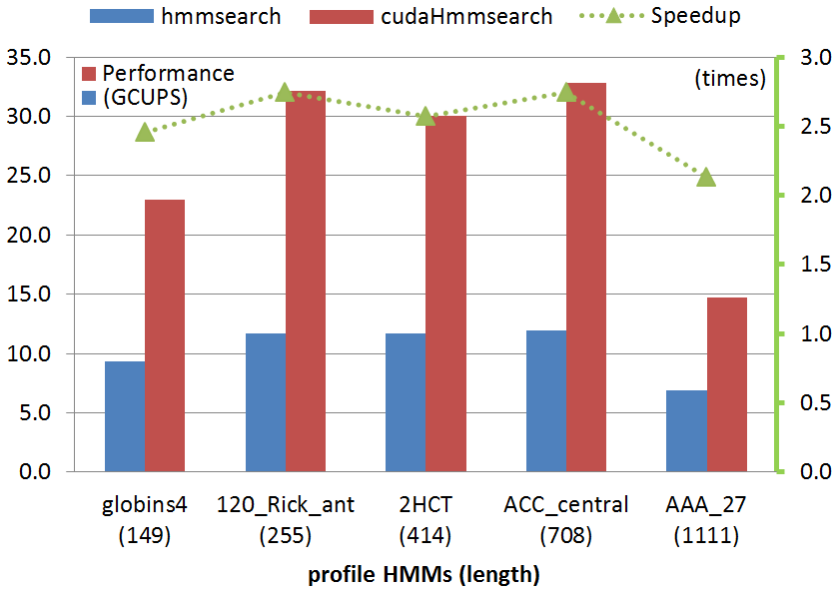
Benchmark results and discussion
Practical benchmarks

Slide 26
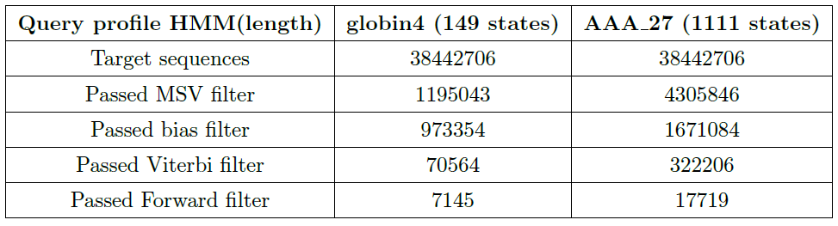
Benchmark results and discussion
Practical benchmarks
Internal pipeline statistics summary

Slide 27
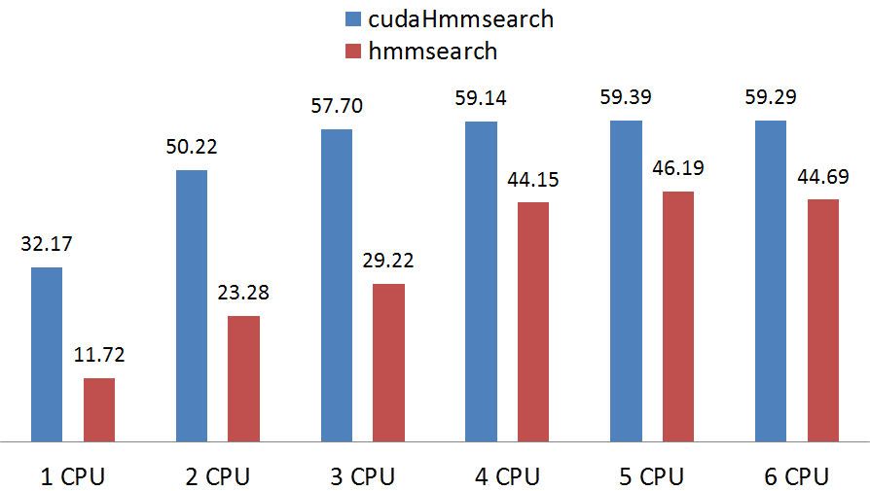
Benchmark results and discussion
Comparison with multicore CPU
Notes:
Since multicore processors were developed in the early 2000s by Intel, AMD and others, nowadays CPU has become multicore with two cores, four cores, six cores and more. The Kronos experiment system has CPU with six cores. This benchmark is to test cudaHmmsearch running with multiple CPU cores.
The benchmark has not been used in the articles I found related to my research. The purpose of this benchmark is to show how the performance increase or decrease with more CPU cores involved in computing.
The number above each bar is the Performance in GCUPS. We can see, from 1 to 4 CPU cores, both cudaHmmsearch performance and hmmsearch performance go up almost linearly.
From then on, due to complex schedule among CPU cores, the extra CPU core will not contribute much to both cudaHmmsearch and hmmsearch execution. Even worse, it will
have negative effect as shown clearly in the `6 CPU core'.

Slide 28
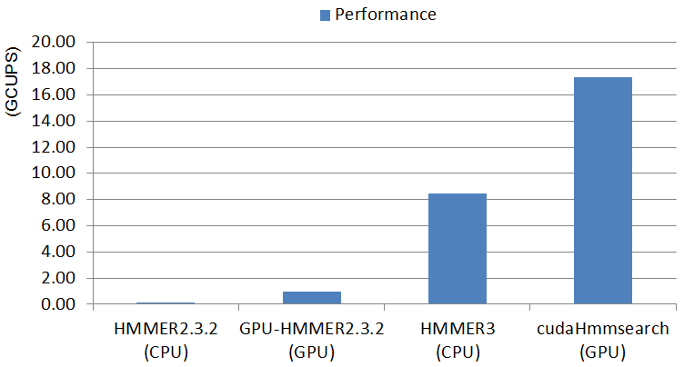
Benchmark results and discussion
Comparison with other implementations
Notes:
It was also compared to the previous HMMER solutions: HMMER2.3.2, GPU-HMMER2.3.2 and HMMER3. It's to search the globin4 profileHMM against the Swiss-Prot database. From here, we can see since the release of HMMER2.3.2 in 2003, researches on accelerating hmmsearch for both CPU and GPU have achieved excellent improvement.

Slide 29
Conclusions
Contributions
  Implement and accelerate MSV on CUDA-enabled GPU
  Demonstrate and summarize many optimization approaches
Limitations
  Presorting database
  Block reading a fixed number of sequences
  CUDA-enabled GPU
Recommendations for further research
  Forward filter for no threshold
  Multiple GPUs approach
Notes:
Limitation
A little distance to a production level program
CUDA-enabled GPU
Make a test of GPU device. To test if it can run the program. Get the GPU compute capability

Slide 30

Thanks !

