Slide 1
Implementing and Accelerating
HMMER3 Protein Sequence Search on CUDA-Enabled GPU
Lin Cheng
June, 2014

Slide 2
Outline
Implementing and Accelerating HMMER3 Protein Sequence Search on CUDA-Enabled GPU
Problem Statement
Background
Solution to the problem
Benchmark results and discussion
Conclusions
Notes:
HMMER is a set of wildly used Bioinformatics applications for sequence analysis based on profile HMM. Now, HMMER has been developed to version 3.
CUDA is in 2006, NVIDIA
introduced CUDA(Compute Unified Device Architecture), a parallel computing platform and programming model that enables users to write multi-threaded programs in NVIDIA GPUs....
What's the problem I need to solve in my research
HMMER related algorithms and CUDA programming model
I'll focus on the solution to …

Slide 3
Problem Statement
HMMER protein sequence search tool
hmmsearch
  Profile HMM (hidden Markov Model)
Implementing and accelerating hmmsearch on CUDA-enabled GPU
Notes:
HMMER is based on profile hidden Markov model (HMM) model. Profile HMM is a probabilistic finite state machine, and can be constructed by HMMER to model a protein sequence family.
hmmsearch is used to search one profile HMM against a sequence database and output ranked list of the sequences with the most significant matches to the profile.
Since HMMER2 was released in 2003, many researchers have been studying on accelerating hmmsearch on CPU or GPU. Even hmmsearch in version 3, it's still time-consuming. To search a normal size profile against a large database, it takes tens minutes.
On GPU, CUDA is the most widely used and more mature parallel computing model.
So, my research focus on how to utilize the extra GPU computing resource to accelerate hmmsearch on CUDA-enabled GPU.
A group of homologous protein sequences is called a protein family, and a profile HMM is typically constructed from a multiple alignment of those sequences.

Slide 4
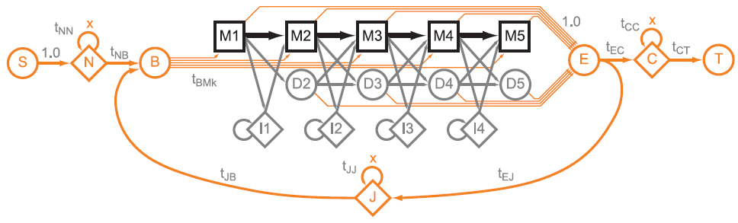
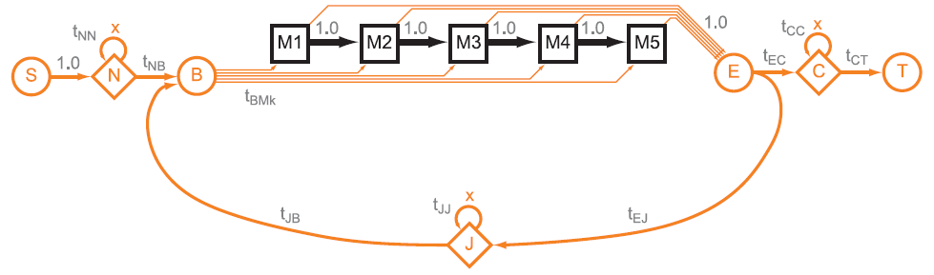
Background
The profile HMM structure used in Viterbi algorithm
The profile HMM structure used in MSV algorithm
Notes:
To find whether a sequence is member of the family described by a profile HMM, hmmsearch compare the sequence with the profile. Viterbi is used to find one path that has the maximum probability of the HMM generating the sequence. The above is the typical structure of the profile HMM.
Homologous regions are represented by M consensus positions and a set of match, delete, and insert states. Match and Insert states emit residues with emission probabilities. N, C, and J emit zero or more residues modeling nonhomologous regions. These states are connected by transition probabilities.
The below is MSV profile used by HMMER3 to accelerate hmmsearch. MSV - Multiple Segment Viterbi. MSV profile corresponds to the virtual removal of the delete and insert states. All match-match transition probabilities are treated as 1.0. The rest of the profile stays the same.

Slide 5
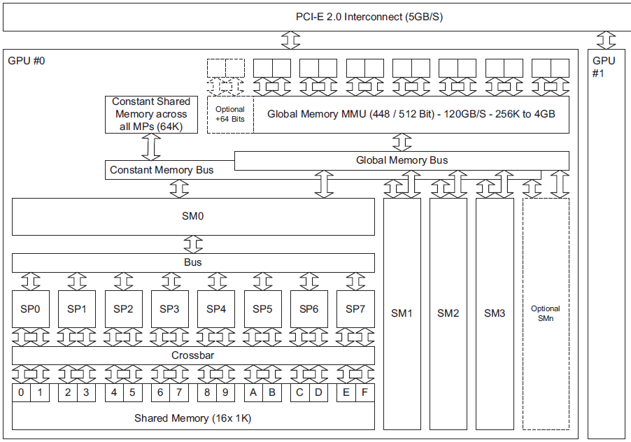
Background
Block diagram of a GPU(G80) card
Notes:
A computer can install 1 or more GPU cards in PCI-E socket. GPU card has 2 main components: SM Streaming.. and memory. G80 has 4 SM and each SM has 8 SP. Each SM has a separate shared mem inside and a separate bus into the texture memory, constant memory, and global memory spaces.

Slide 6
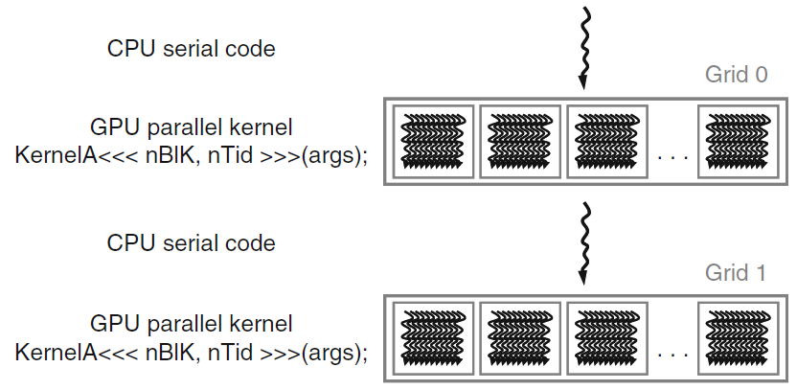
Background
CUDA program
Notes:
This is a typical execution of CUDA program. The CPU host launches a GPU kernel with the triple angle-bracket syntax. The kernel generates many threads according to the parameters Nblk and Ntid. Normally there are Nblk*Ntid threads. All threads are organized into a grid.

Slide 7
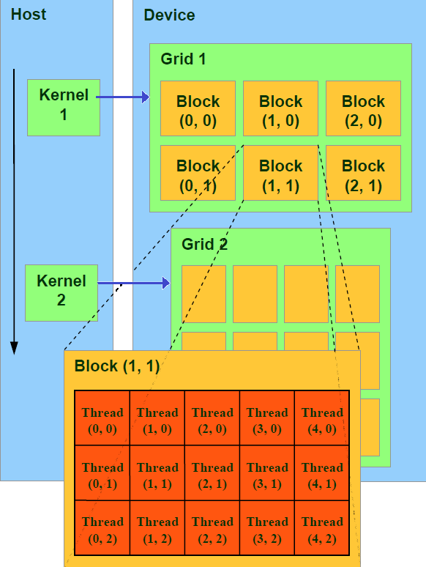
Background
CUDA thread hierarchy
Notes:
Threads in a grid are organized into a two-level hierarchy.
At the top level, each grid consists of one or more thread blocks. The second level is block level. All blocks in a grid have the same number of threads. The block and thread structure can be organized into a one, two, or three dimension. Each block can be scheduled on any of the available multiprocessors.

Slide 8
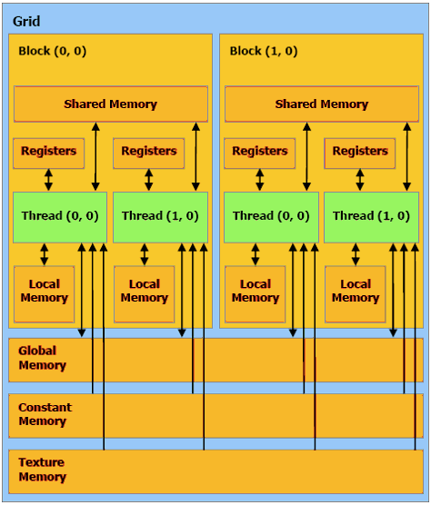
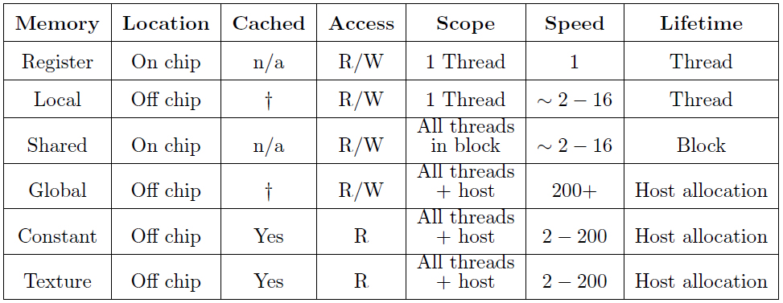
Background
CUDA memory hierarchy
Notes:
CUDA has special memory spaces. It has 6 sorts of memories. the table shows their specific features. The bottom 3 tex, cont and global can be allocated by CPU host. Shared mem can only be shared and accessed by threads in a block. Registers and local mem are for 1 thread.
Register is fastest and global is slowest. Since these memories have different features, one important thing of CUDA programming is how to combine these memories to best suit the application.
Speed is the relative speed in number of instructions.

Slide 9
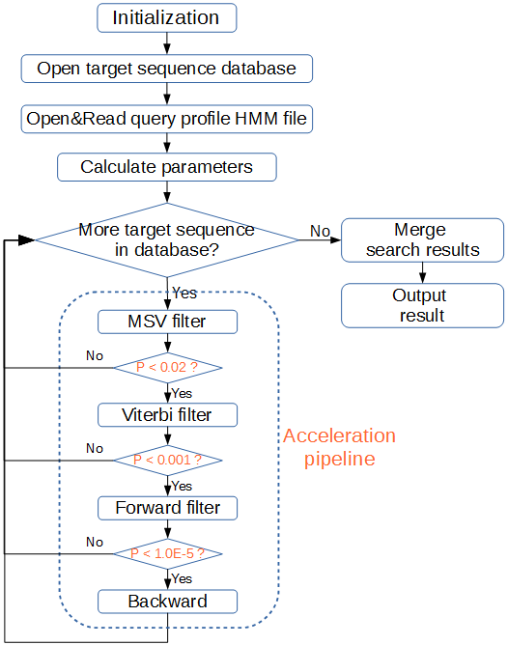
Solution to the problem
Hotspot
  MSV filter
Parallelism strategy
  Task-based parallelism
  Data-based parallelism
9
Notes:
Now, I'll talk about the solution to my problem. The first step is to assess the hmmsearch application to identify the hotspots. The flow chart is the CPU version of hmmsearch in HMMER3. The MSV and Viterbi are implemented in the so-called “acceleration pipeline”.
Whether a sequence can pass a filter is dependent on whether the score is less than P-value. Only about 2% of the top-scoring sequences are expected to pass and need further computing. So, the comparison is accelerated. Thus, the first MSV filter is the hotspot for hmmsearch.
Before multi-thread programming, we need consider parallelism strategy. 2 strategies: task-based and data-based. In Task-based, a task is assigned to exactly one thread, and all threads perform independent tasks in parallel. In Data-based, a task is assigned to many threads and some/all threads cooperate to perform the task in parallel.
Task-based has some advantages over data-based. It doesn't need for inter-thread communicating or, take time on synchronizing and cooperating among threads.
Every thread is doing the exact same thing independently. This also simplifies implementation and testing. A study shows that task-based parallelism can achieve better performance.
Data-based parallelism is suited to long sequences. However, we applied a special strategy to work around this problem. So, the task-based parallelism is taken.
and more efforts are put on optimizing CUDA kernel execution.

Slide 10
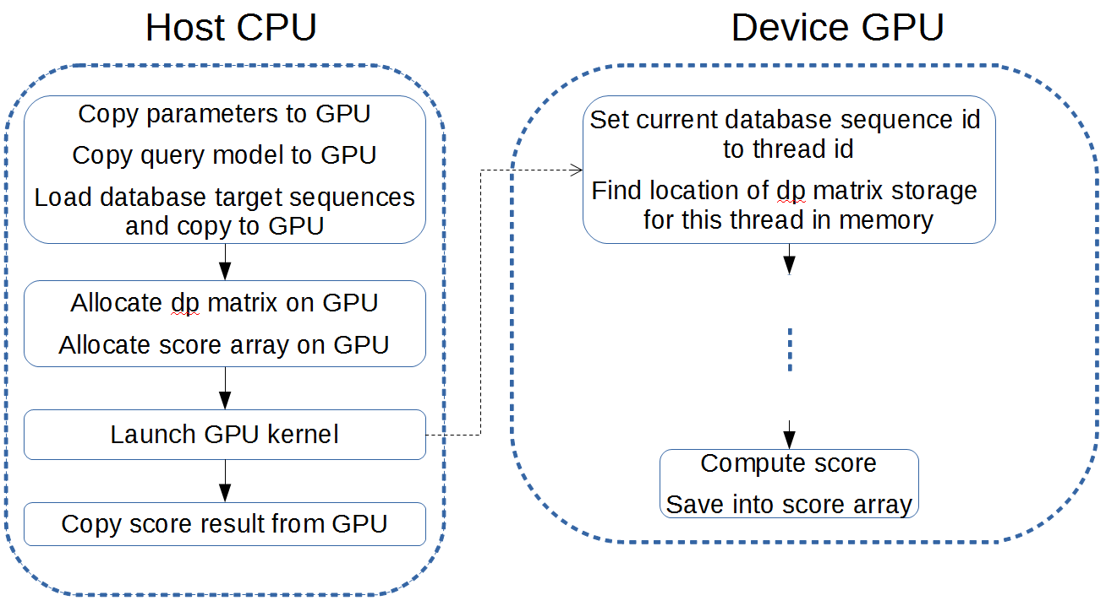
A CUDA accelerated HMMER3 protein sequence search tool
A straightforward implementation
Notes:
Here's the basic implementation.
The code must be split up into two parts, with the left host part running on CPU and the right device part running on GPU.
The CPU code mainly concerns about allocating data structures on GPU, loading data, copying them to GPU, launching the GPU kernel and copying back the result for further steps.

Slide 11
Optimizing the implementation
Global Memory Accesses
  Reducing access frequency
  the dp matrix and the query profile matrix
  char 8bit
  uint4 128bit
  texture memory
    target sequences, the query profile matrix
struct __device_builtin__ uint4
{ unsigned int x, y, z, w;
}
Notes:
The global memory is used to store most of data on GPU. A primary in the optimization is to improve the efficiency of accessing global memory as much as possible. The most effective way of course is to reduce the frequency of access.
The elements of the dp matrix and the query profile matrix use 8-bit char type. By switching to 128-bit uint4, the access frequency would decrease 16 times.
Although this approach resulted in increased register pressure, it gained a huge speed boost of almost 8 times in total.
The read-only texture memory space is a cached window into global memory. If there is no cache miss, the performance of texture will be 100 times over the normal global memory access.
We use texture memory to store …
that offers much lower latency.

Slide 12
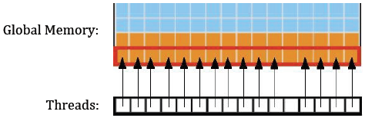
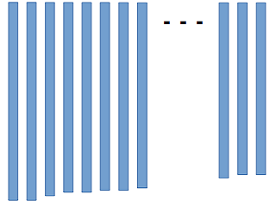
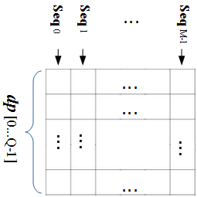
Optimizing the implementation
Global Memory Accesses
  coalescing access
Alignment of target sequences
The dp matrix in global memory
Notes:
Coalescing access is another important technique to improve global memory performance. It is to combine several small and non-contiguous access of global memory, into a single large and more efficient contiguous memory access. A prerequisite for coalescing is that the memory accessed by all threads in a block must lie in the same segment and have to be allocated in the form of an array to keep them contiguous in address.
For coalescing access, data often need to be allocated in a special pattern. The target sequences are arranged in a matrix like an upside-down bookcase, where all residues of a sequence are restricted to be stored in the same column from top to bottom. And each thread is in charge of a sequence in a column. Similarly, the dp matrix is arranged in this pattern.
And all sequences are arranged in decreasing length order from left to right in the array, which is explained later.

Slide 13
Optimizing the implementation
SIMD Video Instructions for GPU
  uint v, v1, v2;
  /* Adds the 4 unsigned 8-bit integers and saturates
  v[z] = v1[z] + v2[z] (z = 0,1,2,3) */
  asm(“vadd4.u32.u32.u32.sat %0, %1, %2, %3;” : “=r”(v) : “r”(v1), “r”(v2), “r”(0));
Intel SSE2 intrinsics for CPU
  __m128i v, v1, v2;
  /* Adds the 16 unsigned 8-bit integers and saturates
  v[z] = v1[z] + v2[z] (z = 0,...,15)*/
  v = _mm_adds_epu8(v1, v2)
Notes:
Single-Instruction Multiple-Data (SIMD) instruction is able to perform the same operation on multiple pieces of data in parallel. The first widely-deployed SIMD was with Intel's MMX instruction. Then they're upgraded to SSE2. CUDA also provides the SIMD video instructions. Here I list both of them in C for comparison. We can see SSE2 is more convenient to use. They have built-in data type and the direct instruction. While CUDA must use assemble language asm to embed in C. The most important is the performance difference. The CPU register is 128bit and GPU is only 32bit. it's 4 times difference.
So SSE2 can add 16 pieces of 8-bit integer while CUDA only 4.

Slide 14
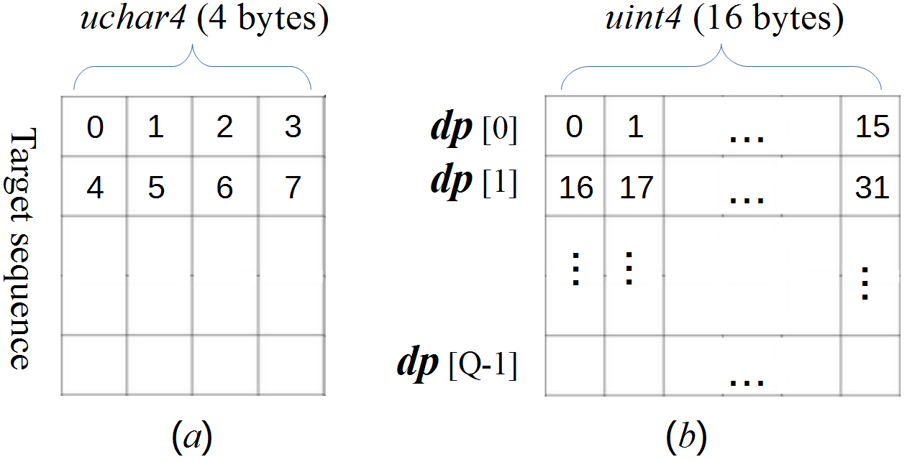
Optimizing the implementation
Virtualized SIMD vector programming model
Notes:
Vector programming model plays important role in operations of array or matrix. On one side, it can reduce greatly the frequency of memory access; on the other side, it can utilize the SIMD vector instructions for parallel computing on CPU or GPU.
In order to use the vector programming model, the target sequence is re-organized using a packed data format. Four consecutive residues are packed together and represented using the uchar4 vector data type, instead of the char scalar data type.
Similarly, in the dp array, 16 bytes are also packed together to use int4 data type.
The reason why target sequence only use 4bytes, not 16bytes as the dp array is because it'll increase greatly register pressure. And the dp array has been packed this way in HMMER3.

Slide 15
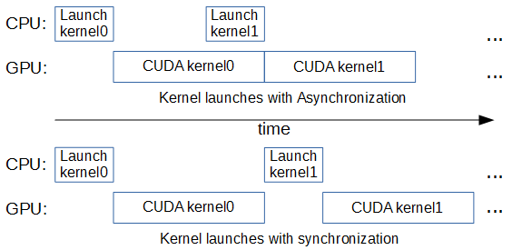
Optimizing the implementation
Pinned (non-pageable) Memory
Asynchronous memory copy and CUDA streams
Notes:
In order to transfer data to GPU more efficiently, we need to use Pinned memory, which is the host memory that cannot be paged (swapped) out to disk by the virtual memory management of the OS.
The pinned memory can be used for asynchronous memory copy to enable the CPU and GPU running concurrently and improve performance.
A CUDA stream represents a queue of GPU operations that get executed in a specific
order. By using multiple streams, we can break the kernel computation into chunks and overlap the asynchronous memory copies with kernel execution.

Slide 16
Optimizing the implementation
Sorting database
  Descending order
  Block reading
Distributing workload to CPU
Notes:
In order to achieve high efficiency for task-based parallelism, the run time of all threads in a block should be roughly identical. MSV filter is sensitive to the length of a sequence. Therefore the database is sorted by sequence length. Thus, for threads in a block, the sequence length difference is minimized, and their workload are balanced.
The memory pools for database sequences are dynamically allocated at run time. If the pool allocated at the first time is the largest one during execution, then the overhead of reallocation will be saved. So, the descending order is used for sorting the database.
The sequence database is getting larger and larger. NCBI database is more than 24GB and it's too large to load into GPU memory. For practical reason, every time, we read a block from database and the block size is dependent on GPU global memory.
After launching GPU kernel, CPU must wait for the GPU to finish before copying back the result. We can get further improvement by distribute some work from GPU to CPU while CPU is waiting. In protein database, the very long sequences are very few. And we sort the database by descending order. We can assign the first part of data with longer lengths to CPU. By this way, we can save both the GPU global memory allocated for sequences and the overheads of memory transfer.
I use this formula to calculate the ratio R of the number of database sequences assigned to GPU. NG is the number of GPU Multiprocessors, fG and fC are the core frequencies of GPU and CPU.

Slide 17
Optimizing the implementation
Miscellaneous consideration
  Data type for register memory
    8-bit char → 32-bit int
  Branch divergence
    if () then … else ...
  Constant memory
    parameters: base, tjb, tec
  shared memory
    Per-block visibility
    Global → shared memory
    Inter-thread
    cudaFuncSetCacheConfig(msvSIMDKernel, cudaFuncCachePreferL1);
Notes:
Here's miscellaneous consideratio, including small-scale optimization and some limitations not suited to our case.
At the beginning, I used 8-bit char type to save register space. In fact, CUDA use 32-bit register to implement char type. And this involves extra instructions to shift and mask data. This is entirely unnecessary. I changed char to int type.
In programming, we often use if.then.else. CUDA kernel can realize full efficiency when all threads in a block agree on the same execution path. If divergence occurs, kernel will execute then for some threads and else for other threads. It will result in some slowdown. It's better to avoid the branch statement. In our case, since the above data type has changed from char to int, the test for the overflow condition is not necessary any more. This not only saves several instructions, but also avoids the issue of branch divergence.
Constant memory is read-only. It's faster than global memory, but only if all threads read the same address. Its limitation is it can not be allocated dynamically. So in our case, only parameters, like .. use constant mem.
Shared has some limitations. It must duplicate the data for every block. Data must be loaded from global to shared memory in kernel and can not be uploaded directly from the host memory. Shared memory is well suited to exchange data between threads. As I talked before, we use task-based parallelism which doesn't need inter-thread communications. So... And we use this kernel launch configure command to prefer more L1 cache.

Slide 18
Optimizing the implementation
Conclusion of optimization approaches
  Assessing the application
  Application Profiling tools and CUDA dev tools
  Visual Profiler, Nsight Ecipse Edition, Nsight Visual Studio Edition
  Optimizing memory usage
  Optimizing instruction usage
  Maximizing parallel execution
  Considering the existing libraries
  cuBLAS, MAGMA, ArrayFire, Thrust
Notes:
I've presented many optimization approaches for my CUDA implementation. Here are 6 steps to gain better performance for CUDA programming in conclusion.
The first step is to assess the application to identify the hotspots and which type of parallelism is better suited to the application.
CUDA has many excellent profiling tools and developing tools. The 2nd step is to use these tools to make a list of candidates for parallelization or optimization.
CUDA has specific memory hierarchy. 3Rd step is to make full and best use of these different memories.
Then 4th step is to utilize the CUDA built-in instructions, like SIMD video instructions. Particular attention should be paid to control flow instructions for Branch divergence problem.
5th step is to maximize parallel execution between CPU host and GPU device, to use techniques, like asynchronous memory copy and multiple streams.
The last step is to consider using the existing GPU-optimized libraries, such as cuBLAS, MAGMA, ArrayFire, or Thrust. They can make the expression of parallel code as simple as possible.

Slide 19
Benchmark results and discussion
Benchmarking environment
  Kronos machine
    Intel Core i7-3960X with 6 cores
    NVIDIA Quadro K4000 with 3 GB global memory
    Ubuntu 64 bit Linux v12.10
  Target sequences database
    Swiss-Prot 540,958 sequences with length 2 ~ 35,213
    NCBI NR 38,442,706 sequences with length 6 ~ 41,943
Notes:
This the benchmarking environment which I used to test my implementation.
I used a machine named as Kronos. It has Intel and GPU is. OS is.
I used two protein databases for experiment, because of their big difference in size. One is smaller Swiss-Prot with half a million sequences and another is much huge NCBI with more than 38M sequences. Their sequences lengths are very various, from single digit to around 40 thousands.

Slide 20
Benchmark results and discussion
Benchmarking environment
  Query profile HMMs
  Measure performance
Name | Globin4 | 120_Rick_ant | 2HCT | ACC_central | AAA_27
Accession number | - | PF12574.3 | PF03390.10 | PF08326.7 | PF13514.1
Length | 149 | 255 | 414 | 708 | 1111
Notes:
I used 5 query profile HMMs for testing. Globin4 is from HMMER source and other 4 are taken from pfam database. Their lengths vary from 149 to 1111.
The performance was measured in unit GCUPS(Giga Cell Units Per Second) with this formula. Lq is the length of query profile HMM,
Lt is the total residues of target sequences in the database, T is the execution time in second.

Slide 21
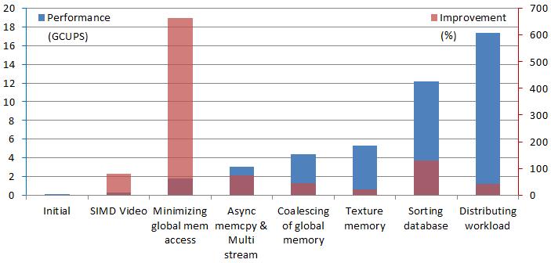
Benchmark results and discussion
Performance Results
  Comparison with less optimized approaches
Notes:
Here's benchmark for comparison with less optimized approaches. The blue bar is the accumulated performance of several selected optimization approaches, corresponding to the left Y axis. The red bar is Improvement of each approach compared with that of previous approach, corresponding to the right Y axis.
We can see that several factors are related to global memory accesses, including the highest 663% minimizing global memory access, coalescing of global memory and texture memory. So the global memory optimizations are the most important area for performance. To make all threads in a block take similar workload, the sorting database also plays important role in optimizations.

Slide 22
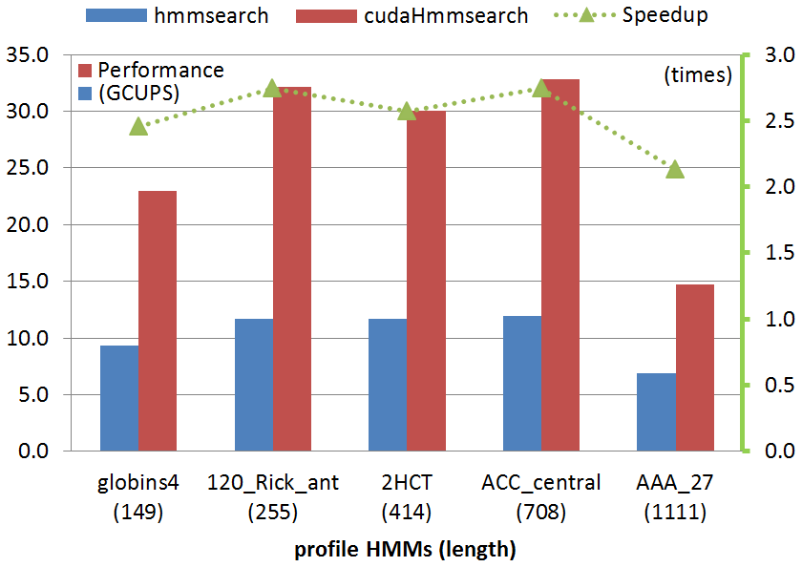
Benchmark results and discussion
Practical benchmarks
Notes:
The final cudaHmmsearch implementation was compared to hmmsearch. This was done by searching the much large NCBI database for the 5 profile HMMs with various lengths.
The blue and red bar is Performance (in GCUPS), corresponding to the left Y axis. The green dot line is Speedup (in times) of cudaHmmsearch performance over that of hmmsearch, corresponding to the right Y axis.
The whole performance of cudaHmmsearch is stable with various lengths of query HMMs. On average, cudaHmmsearch has a speedup of 2.5x than hmmsearch.
And we can see the performance of both GPU and CPU searching for AAA 27 dropped greatly.

Slide 23
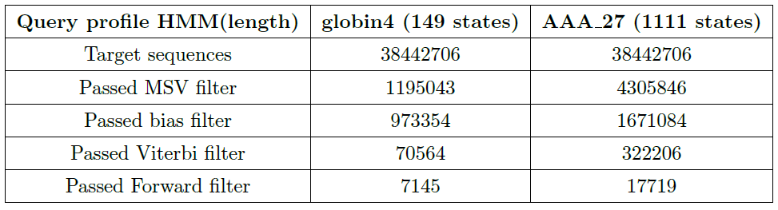
Benchmark results and discussion
Practical benchmarks
Internal pipeline statistics summary
Notes:
The reason can be seen from the table listing the internal pipeline statistics summary for searching globin4 and AAA 27. For every filter, the count of
passed sequences for searching AAA 27 is much more than that of globin4. This means that for searching AAA 27, much more sequences are needed computing after MSV filter. And at the same time, each filter is more time-consuming than MSV. So, this is why AAA 27 performance dropping greatly.

Slide 24
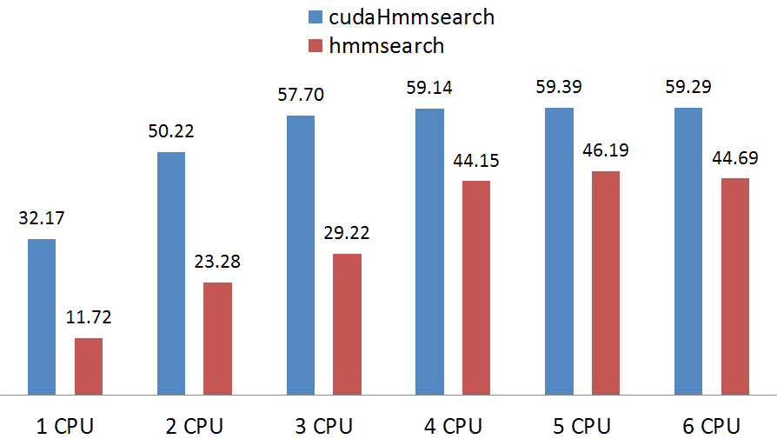
Benchmark results and discussion
Comparison with multicore CPU
Notes:
Since multicore processors were developed in the early 2000s by Intel, AMD and others, nowadays CPU has become multicore with two, four, six cores and more. The Kronos experiment system has six cores. This benchmark is to test cudaHmmsearch running with multiple CPU cores.
The benchmark has not been used in the articles I found related to my research. The purpose of this benchmark is to show how the performance increase or decrease with more CPU cores involved in computing.
The number above each bar is the Performance in GCUPS. We can see, from 1 to 4 CPU cores, both cudaHmmsearch performance and hmmsearch performance go up almost linearly.
From then on, due to complex schedule among CPU cores, the extra CPU core will not contribute much to both cudaHmmsearch and hmmsearch execution. Even worse, it will have negative effect as shown clearly in the `6 CPU core'.

Slide 25
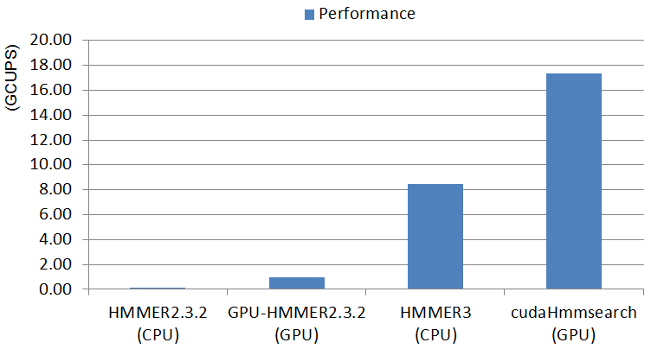
Benchmark results and discussion
Comparison with other implementations
Notes:
It was also compared to the previous HMMER solutions: HMMER2.3.2, GPU-HMMER2.3.2 and HMMER3. It's to search the globin4 profileHMM against the Swiss-Prot database. From here, we can see since the release of HMMER2.3.2 in 2003, researches on accelerating hmmsearch for both CPU and GPU have achieved excellent improvement.

Slide 26
Conclusions
Contributions
  Implement and accelerate hmmsearch on CUDA-enabled GPU
  Demonstrate and summarize many optimization approaches
  Analyze the GPU limitations
Limitations
  CUDA-enabled GPU
  Block reading a fixed number of sequences
  Presorting database
Recommendations for further research
  Forward filter for no threshold: --max option
  Multiple GPUs approach
Notes:
Limitation
A little distance to a production level program
CUDA-enabled GPU
Make a test of GPU device. To test if it can run the program.
Hmmsearch also provides max option to make a more sensitive search and get maximum expected results. The option causes all filters except forward filter to be bypassed. So it's worth working on forward for no threshold.
And due to our machine limitation, we can not do multiple GPUs approach. But it's worth.

Slide 27

Thanks !

Slide 28
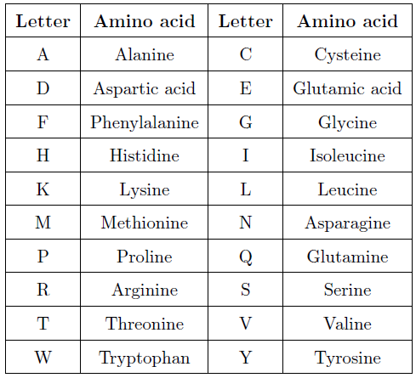
Background
Cells, amino acids and proteins

Slide 29
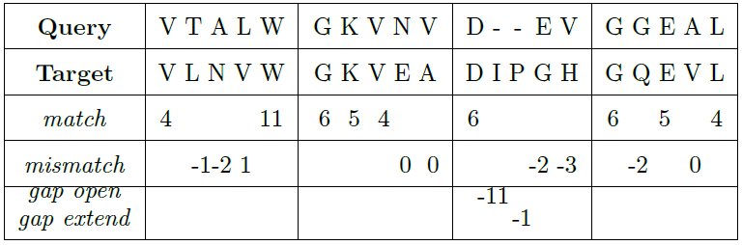
Background
Cells, amino acids and proteins
Sequence alignment
sum of match: +51
sum of mismatch: -9
sum of gap penalties: -12
total raw score: 51 - 9 -12 = 30

