Slide 1
Learning to Answer Questions from Image Using Convolutional Neural Network
Lin Ma, Zhengdong Lu, and Hang Li
Huawei Noah’s Ark Lab, Hong Kong
http://www.ee.cuhk.edu.hk/~lma/

Slide 2
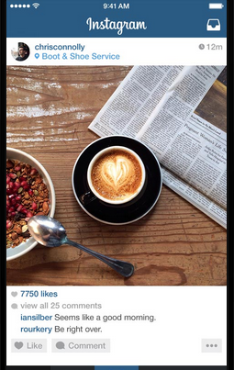
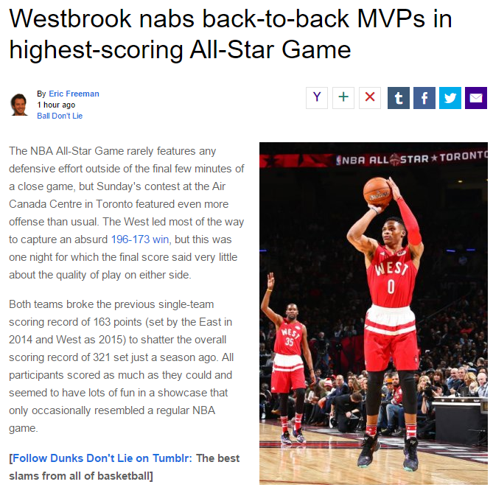
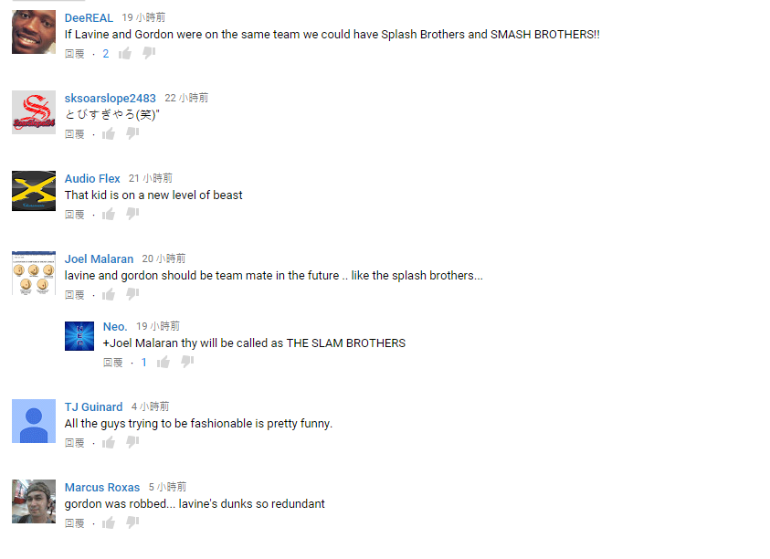
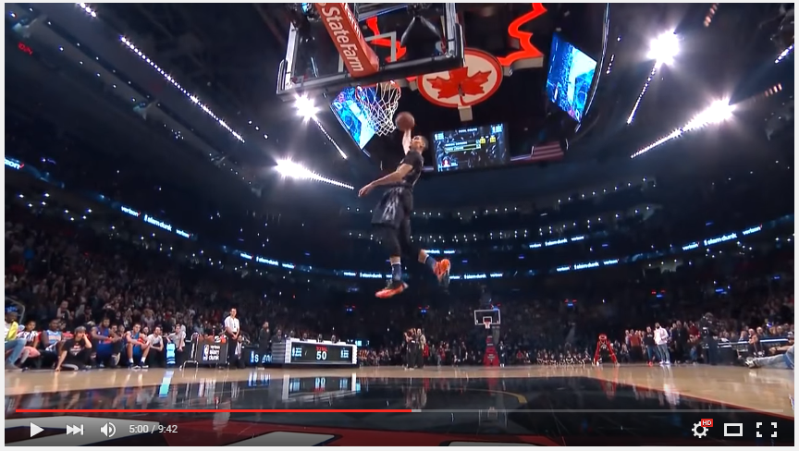
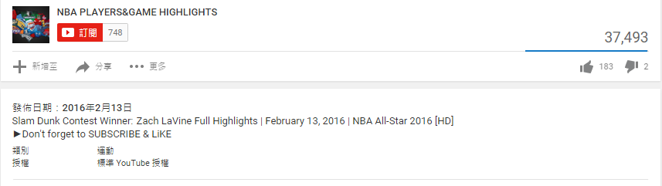
Multiple Modalities
Multiple modalities always accompany with each other
Video, audio, and text (movies, TV programs)
Image and text (Instagram, news)
Image and text and meta data (YouTube)
Mine the relationships between multiple modalities
Association different modalities
Interpretation one modality using another modality
Image /video captioning
Visual question answering
We focus on image question answering

Slide 3
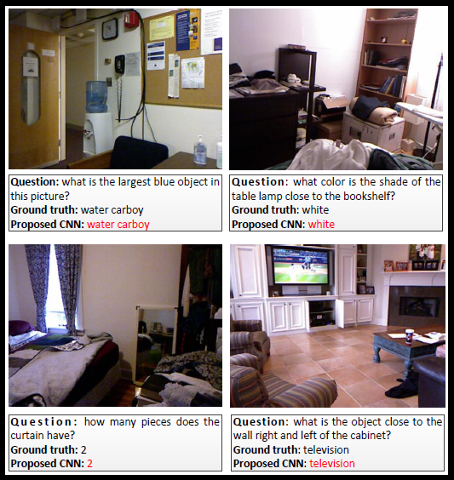
Image Question Answering
Image question answering
Input: image and natural-language like question
Output: answer
AI in general problem

Slide 4
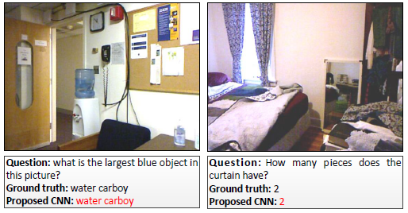
Image Question Answering
Challenges
Image contents are complicated
Question appears to be specific

Slide 5
Image Question Answering
Multimodal learning between image and language
Image and sentence association
Automatic image captioning
Image question answering
Image
Text
Question
Answer
Notes:
Image question answering requiring more interactions between human and computer, which needs to be paid more attentions.

Slide 6
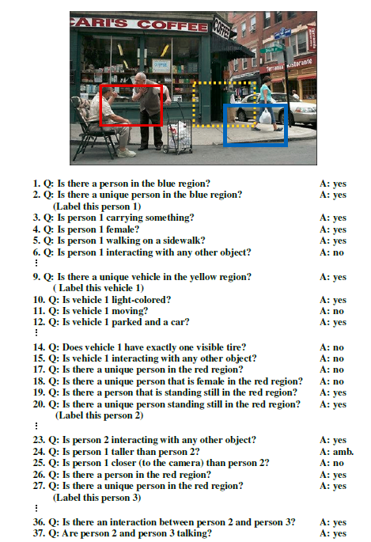
Related Work
Visual Turing Test¹
Binary questions for a given test image
Neural Image question answer
LSTM (Long short term memory) for multimodal learning [Ren et al. Malinowski et al.]
Multimodal recurrent neural network [Gao et al.]
1. D. Geman, S. Geman, N. Hallonquist, and L. Younes, A visual Turing testing for computer vision systems, PNAS, Mar. 2015.
Notes:
Image question answering resembles the visual Turing test.

Slide 7

Problem Formulation
Image question answering
the problem is to predict the answer given the question and the related image

Slide 8
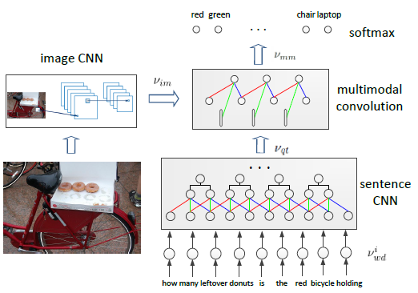
CNN for Image Question Answering
CNN model for image question answering
Notes:
The softmax layer can be realized as a multi-class logistic regression model can handle the multiple-word answers.

Slide 9
CNN for Image Question Answering
Image CNN: generates image representation.
Sentence CNN: composes words to sentence representation.
Multimodal convolution: let the image and question interact with each other to learn the joint representation.
Softmax: predict the answer based on the joint representation.

Slide 10

Image CNN: image representation
VGG encodes the image content:
The dimension is reduced from 4096 to d.
Total number of parameters is greatly reduced.
Image is mapped to a new space for fusing the question representation.

Slide 11



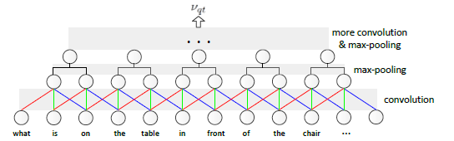
Sentence CNN: question representation
Convolution: compose the words
Max-pooling: remove unreliable compositions

Slide 12
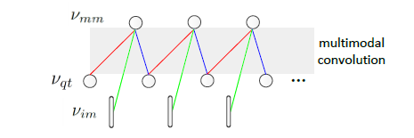

Multimodal Convolution
Let image interact with question
Fuse image and question representations together to generate their joint representation

Slide 13
LSTM vs. CNN
LSTM: appending the image representation to the beginning or ending position of the question
the effect of image will vanish at each time step of LSTM
LSTM tends to lean an abstractive representation of the sentence
CNN: adaptively capture the relations between image and question

Slide 14
Experimental Results
Activation function throughout CNN
ReLU
Stochastic gradient descent (SGD)
Minibatch
Learning rate
Handling overfitting
Dropout

Slide 15
Experimental Results
Database
DAQUAR-ALL
6,795 training and 5,673 testing samples
DAQUAR-Reduced
3,876 training and 297 testing samples
COCO-QA
79,100 training and 39.171 testing samples
Evaluation measurements
Accuracy
Wu-Palmer similarity (WUPS)
Similarity between two words based on their common subsequence in the taxonomy tree.

Slide 16
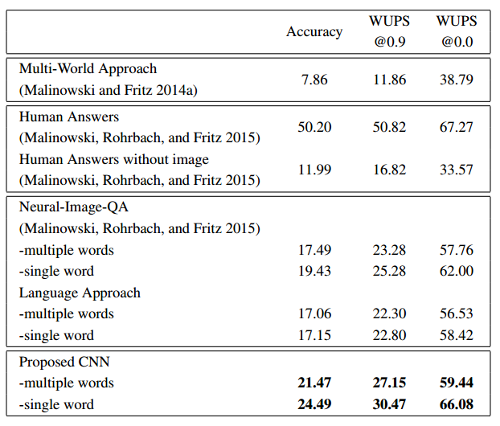
Experimental Results
DAQUAR-All
20%+ improvement over Neural-Image_QA method in terms of accuracy.

Slide 17
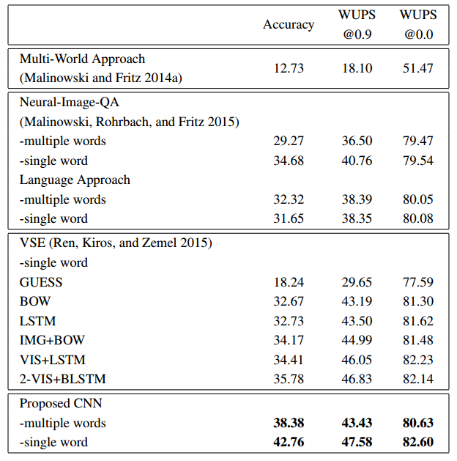
Experimental Results
DAQUAR-Reduced
20% improvement in terms of accuracy over 2-VIS+BLSTM.

Slide 18
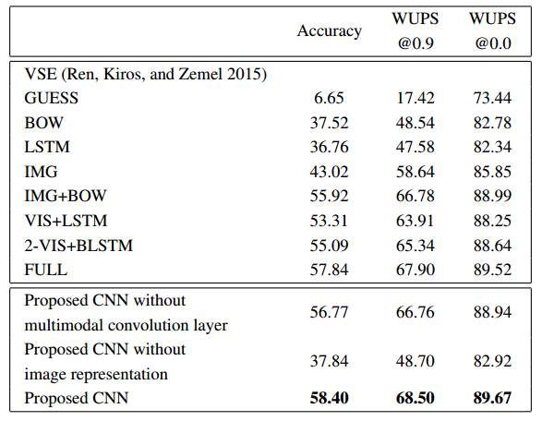
Experimental Results
COCO-QA
Outperform all the competitor models, including the “Full” model.

Slide 19
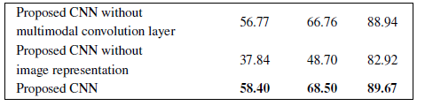
Experimental Restuls
Influence of multimodal convolution layer
Influence of image CNN
Effectiveness of sentence CNN

Slide 20
Databases
DAQUAR
https://www.mpi-inf.mpg.de/departments/computer-vision-and-multimodal-computing/research/vision-and-language/visual-turing-challenge/
COCO-QA
http://www.cs.utoronto.ca/~mren/imageqa/data/cocoqa/

Slide 21
Conclusion
Convolutional neural network (CNN) is employed to learn the interactions and relationships between image and text.
Our proposed CNN models achieves the state-of-the-art performances on the task of image question answering.

Slide 22
Thanks!
Q&A

