Slide 1
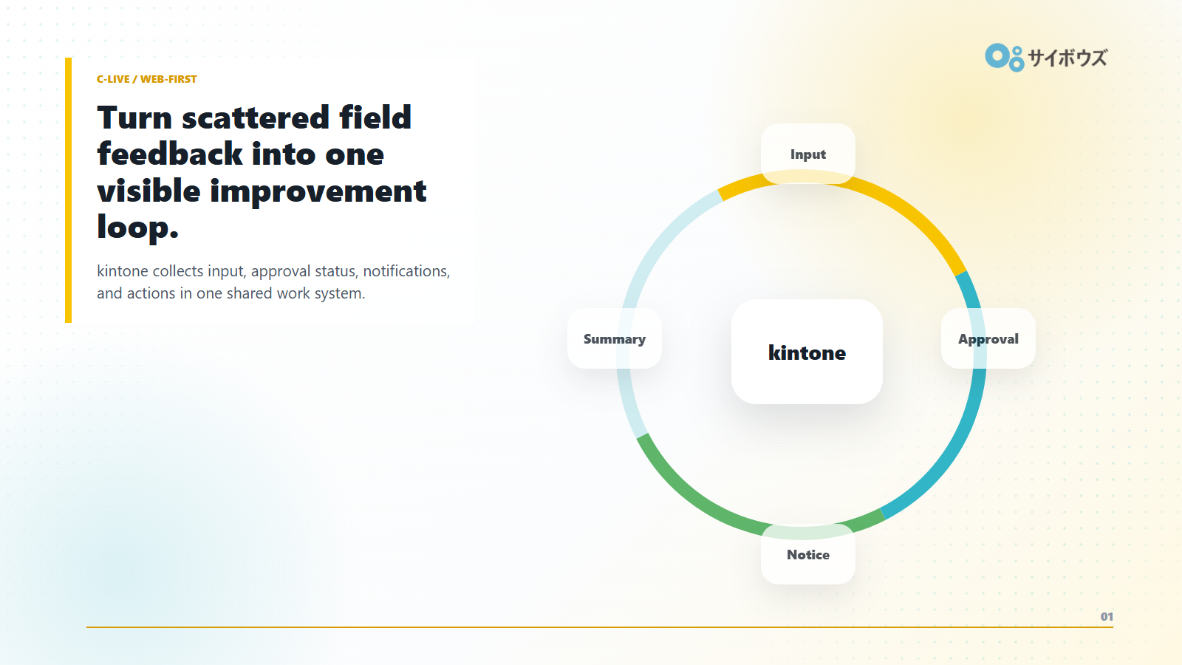
Notes:
C-export: full-slide screenshot from the Reveal.js field feedback deck.

Slide 2
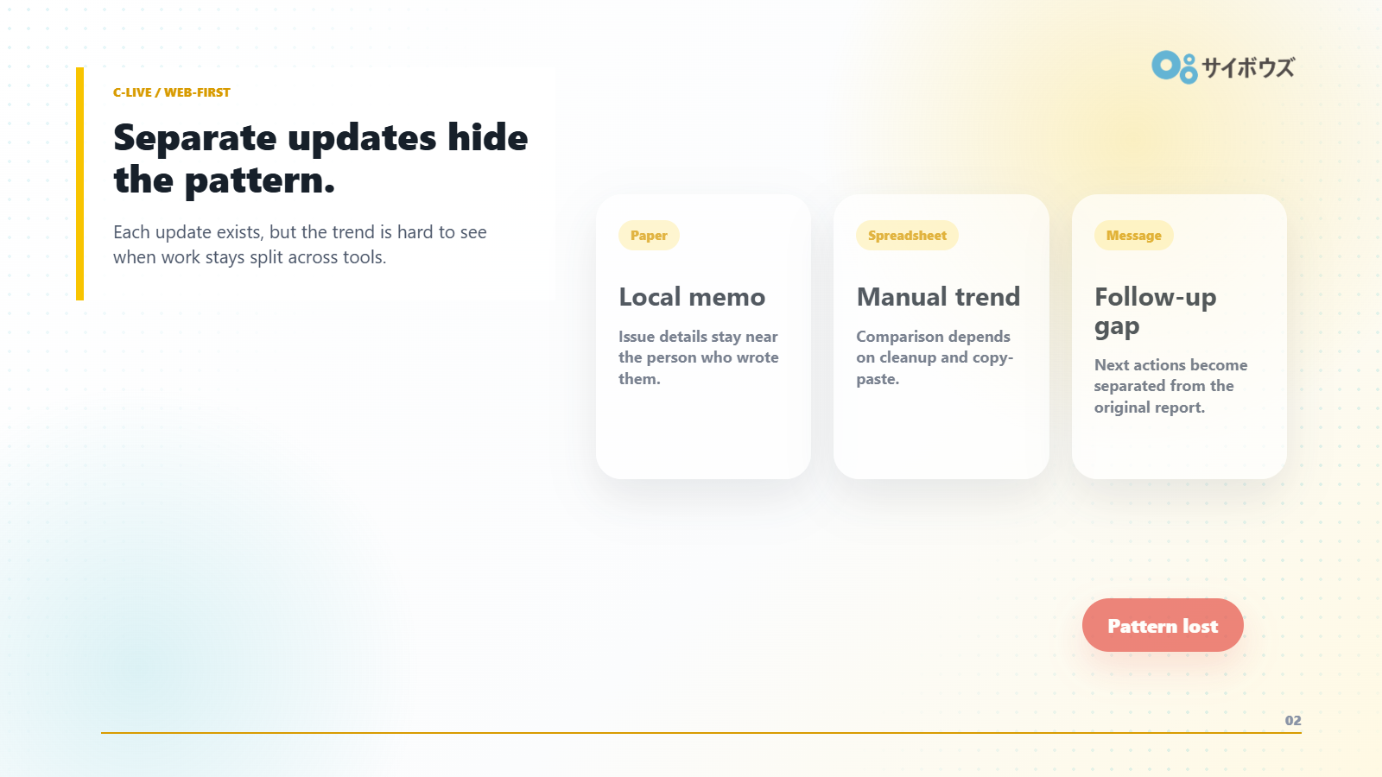
Notes:
C-export: full-slide screenshot from the Reveal.js field feedback deck.

Slide 3
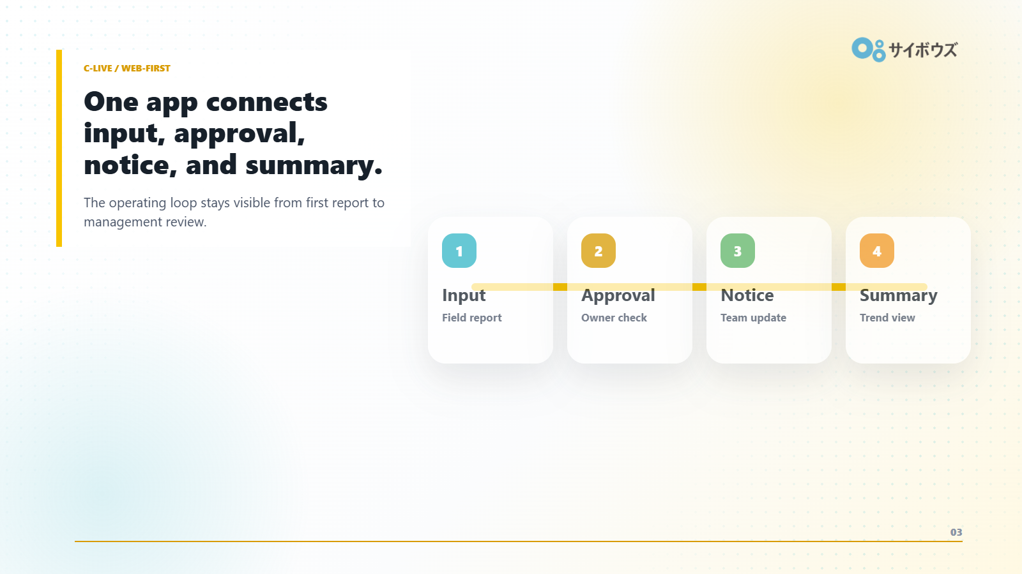
Notes:
C-export: full-slide screenshot from the Reveal.js field feedback deck.

Slide 4
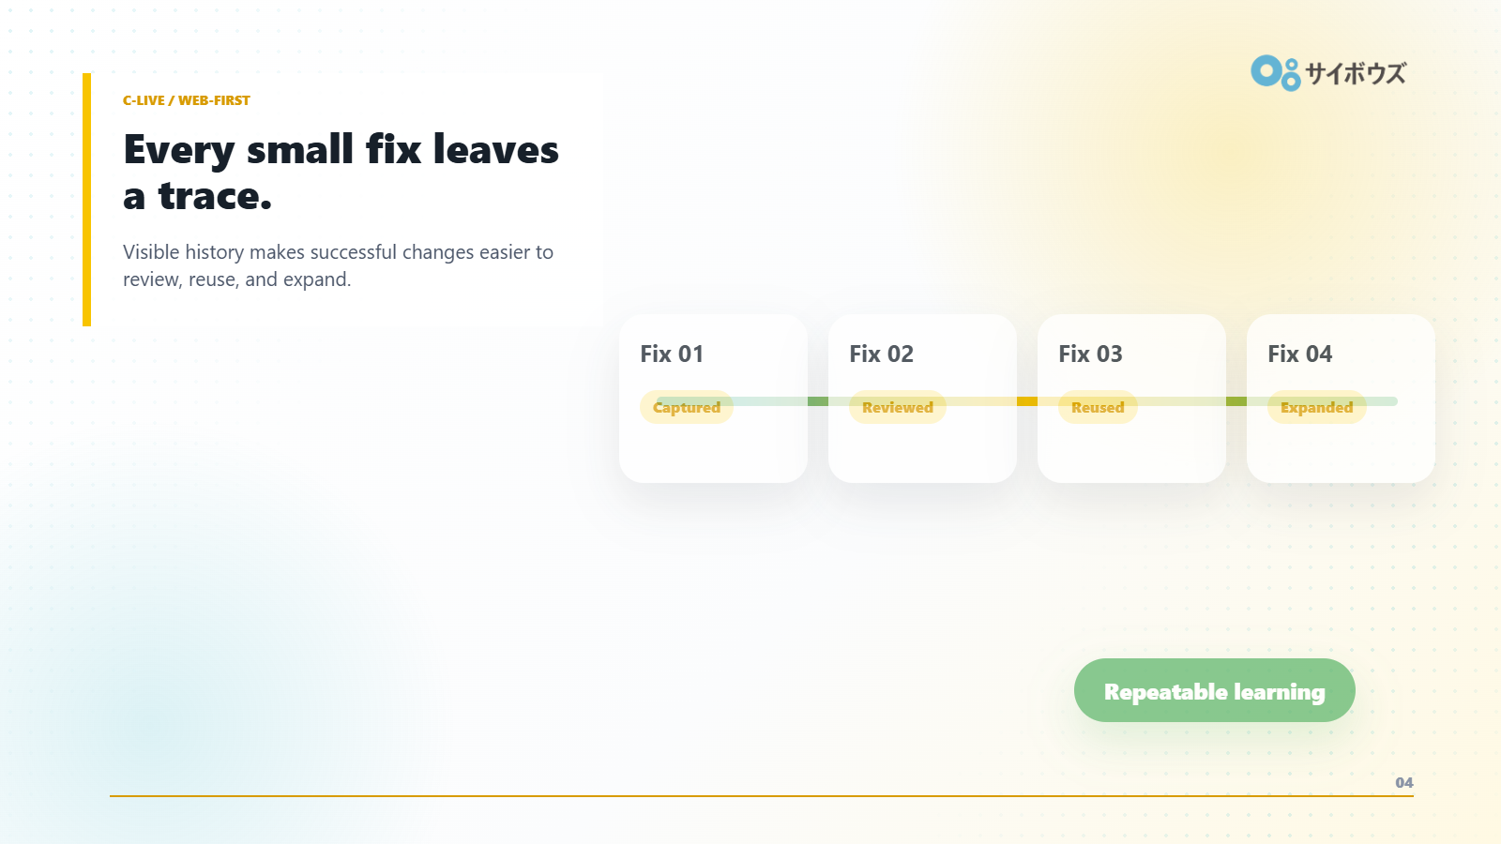
Notes:
C-export: full-slide screenshot from the Reveal.js field feedback deck.

