Slide 1
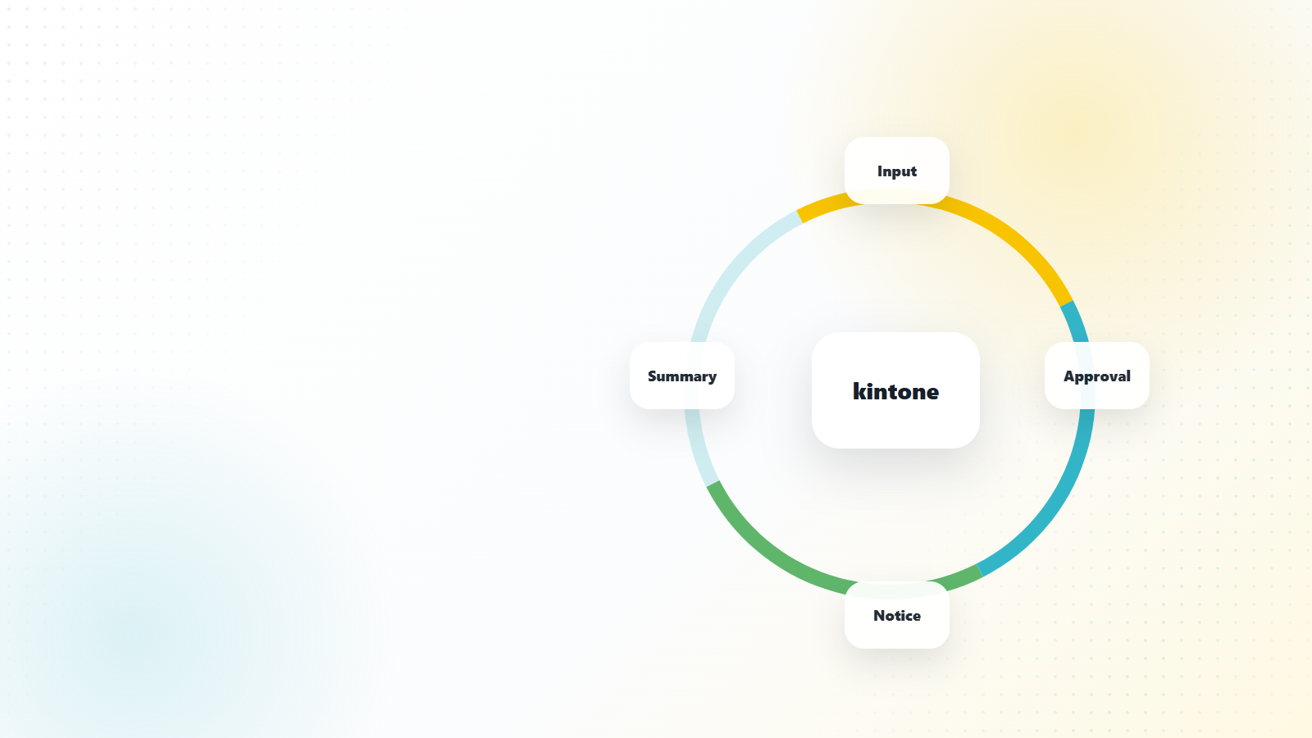

Turn scattered field feedback into one visible improvement loop.
kintone collects input, approval status, notifications, and actions in one shared work system.
C-HYBRID 01
Notes:
C-hybrid-export: web-rendered background plus editable PPT title/logo/page overlays.

Slide 2
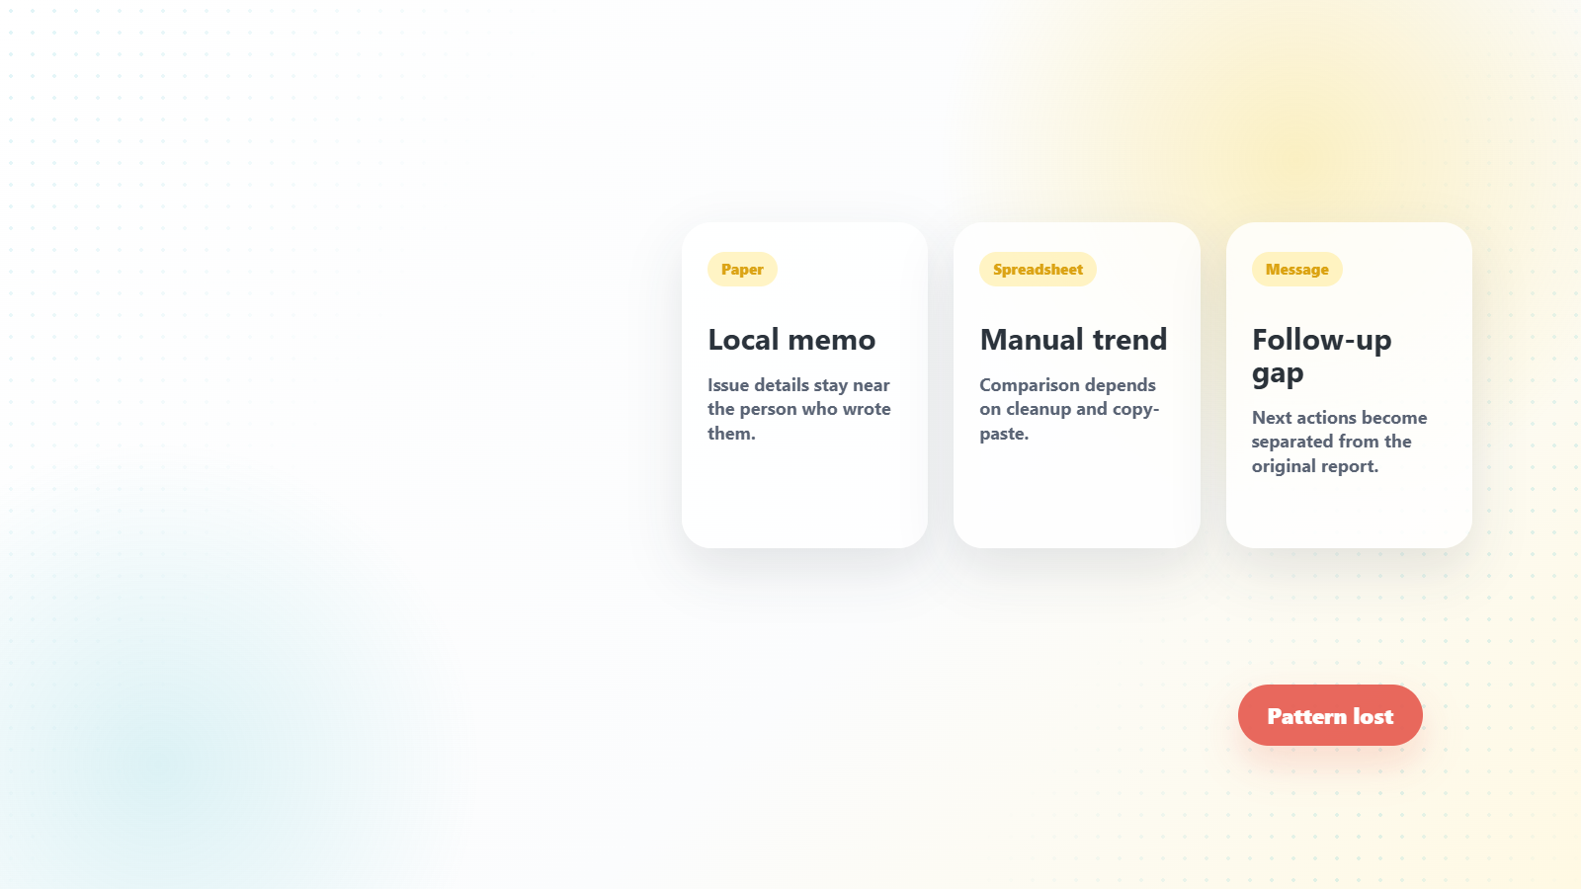
Separate updates hide the pattern.
Each update exists, but the trend is hard to see when work stays split across tools.
C-HYBRID 02
Notes:
C-hybrid-export: web-rendered background plus editable PPT title/logo/page overlays.

Slide 3
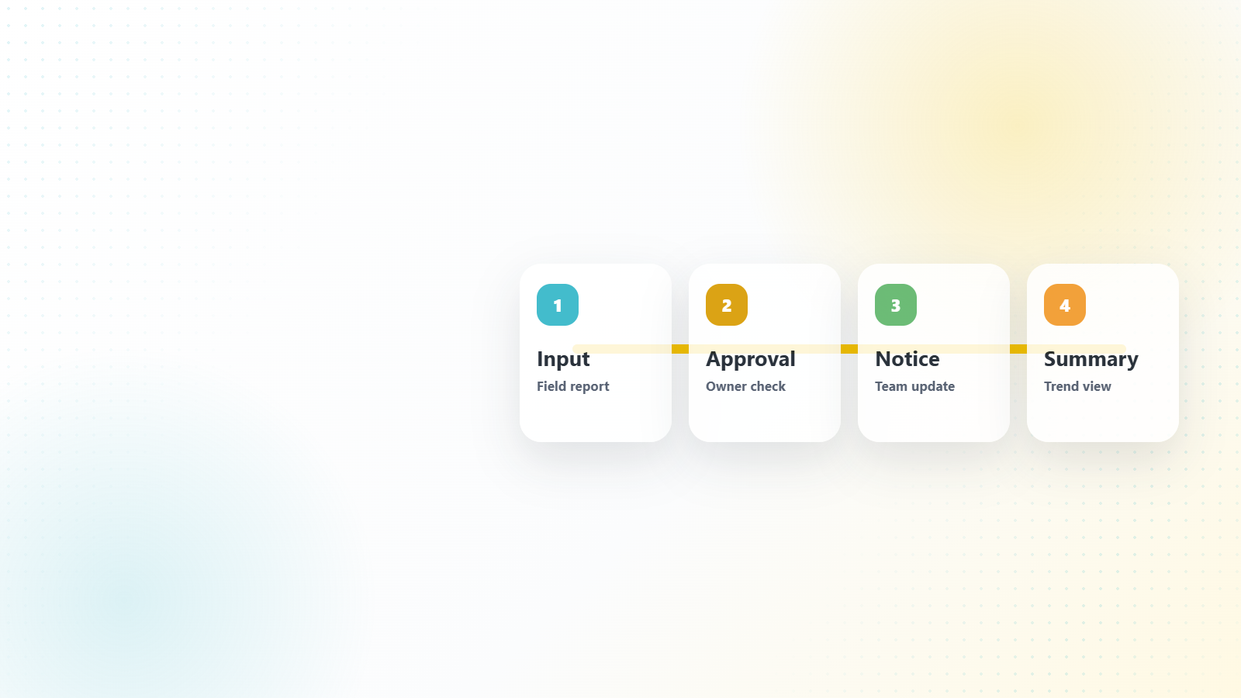
One app connects input, approval, notice, and summary.
The operating loop stays visible from first report to management review.
C-HYBRID 03
Notes:
C-hybrid-export: web-rendered background plus editable PPT title/logo/page overlays.

Slide 4
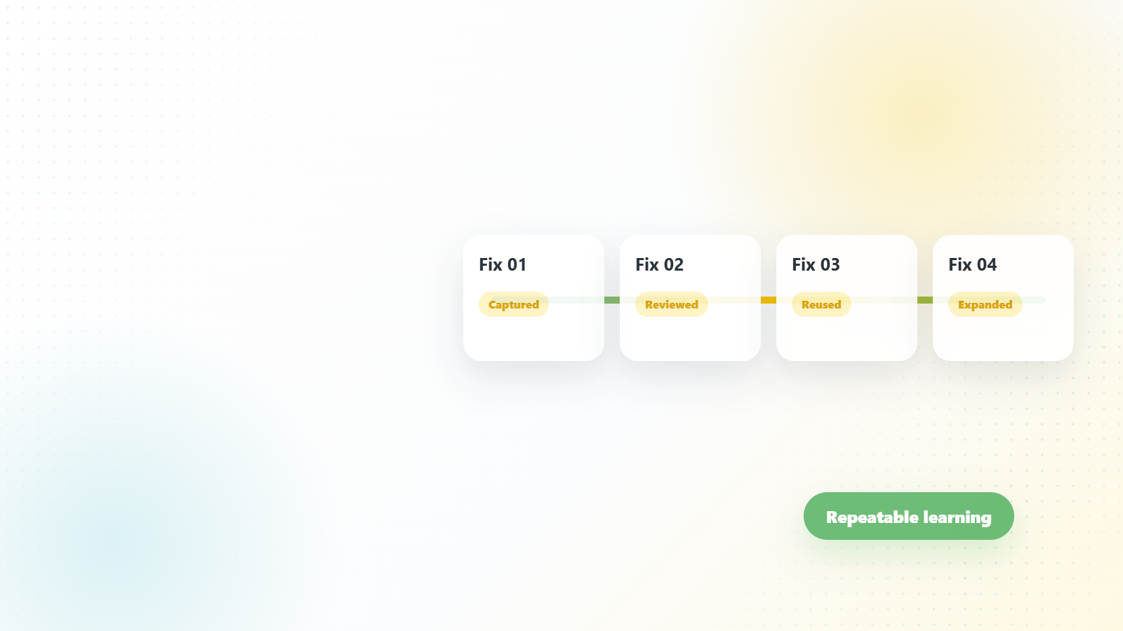
Every small fix leaves a trace.
Visible history makes successful changes easier to review, reuse, and expand.
C-HYBRID 04
Notes:
C-hybrid-export: web-rendered background plus editable PPT title/logo/page overlays.

