Slide 1

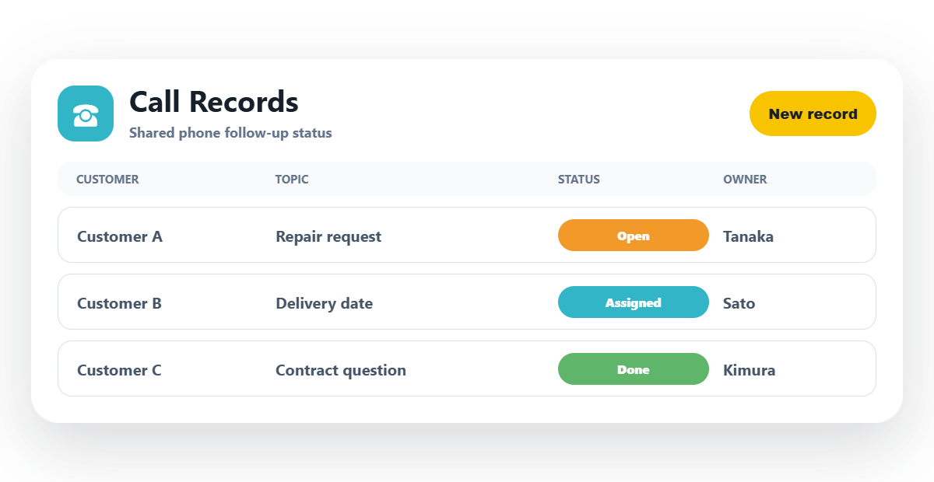
Web-rendered component inside a native PPT page
The board is a PNG component rendered from HTML/CSS; title, logo, and explanatory copy stay native.
Notes:
C-component-export: web-rendered call record board inserted as a component PNG inside a mostly native PPT page.

