Slide 1

Notes:
C-export: this slide is a full-slide screenshot from the Reveal.js browser deck.

Slide 2

Notes:
C-export: this slide is a full-slide screenshot from the Reveal.js browser deck.

Slide 3
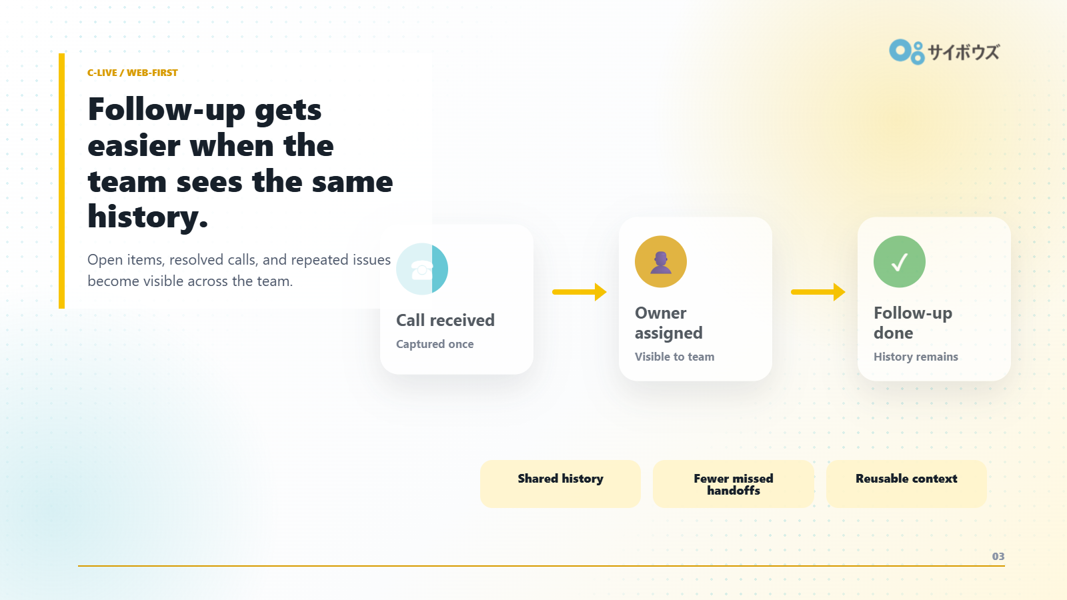
Notes:
C-export: this slide is a full-slide screenshot from the Reveal.js browser deck.

