Slide 1
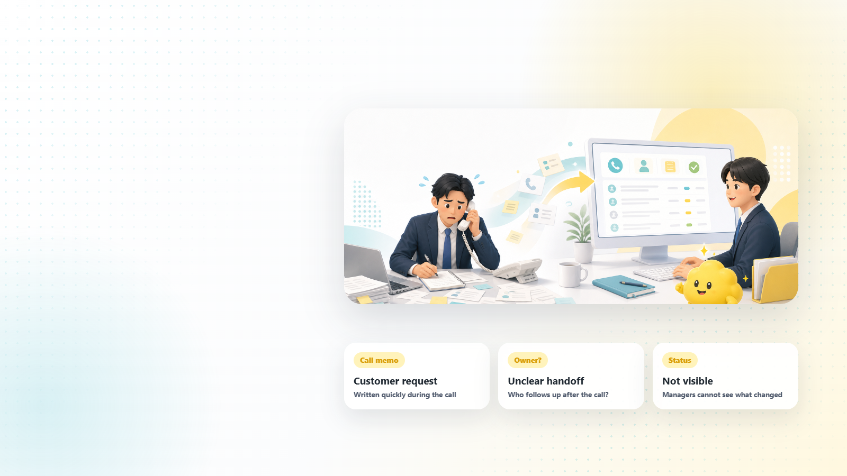

Phone calls disappear when records stay on paper.
Details are written quickly, follow-up is handled by memory, and managers cannot see the trend.
C-HYBRID 01
Notes:
C-hybrid-export: screenshot background from Reveal.js plus editable PPT title/logo/page overlays.

Slide 2
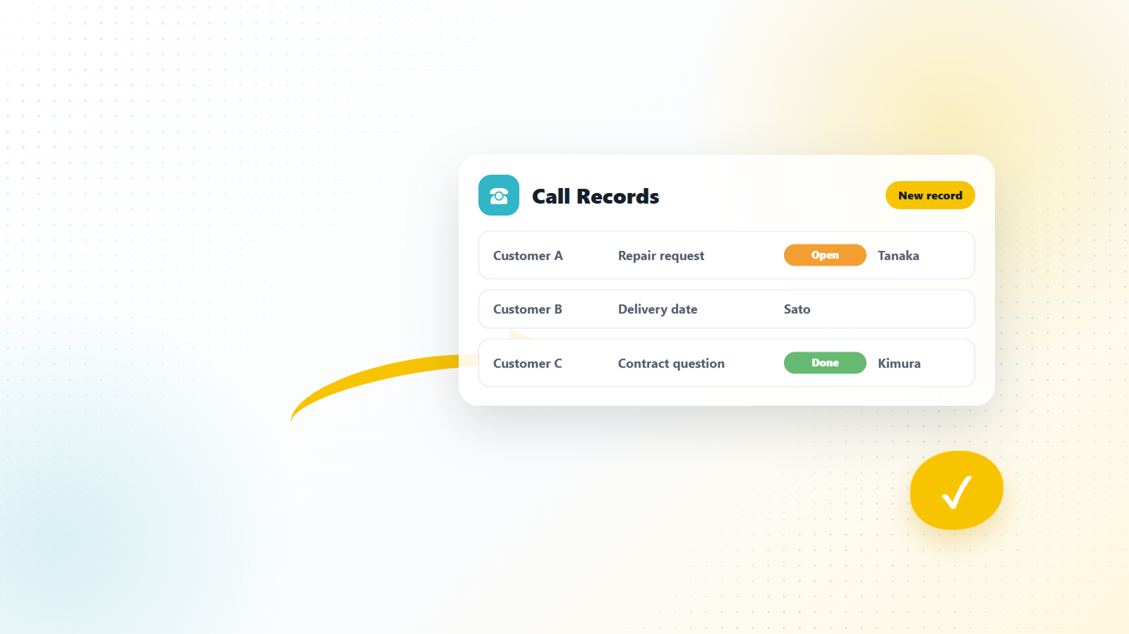
kintone turns every call into a shared record.
Caller, topic, status, owner, and next action sit in one visible table.
C-HYBRID 02
Notes:
C-hybrid-export: screenshot background from Reveal.js plus editable PPT title/logo/page overlays.

Slide 3
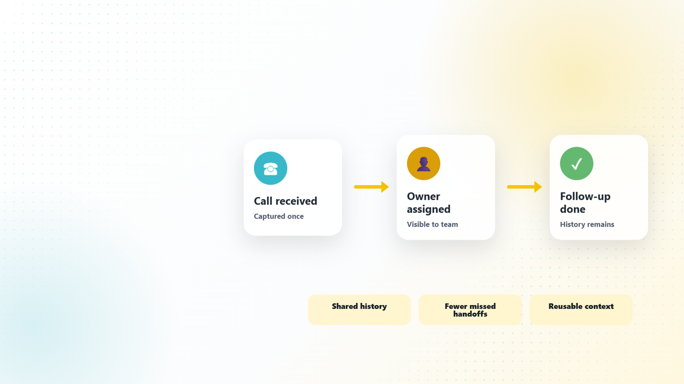
Follow-up gets easier when the team sees the same history.
Open items, resolved calls, and repeated issues become visible across the team.
C-HYBRID 03
Notes:
C-hybrid-export: screenshot background from Reveal.js plus editable PPT title/logo/page overlays.

