Slide 1
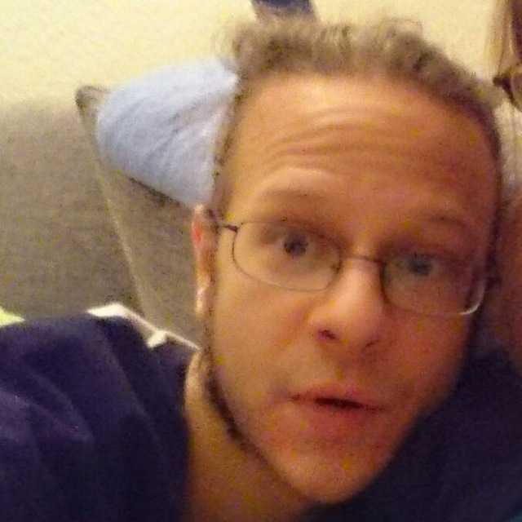
25th of April
Speaker spotlight
The Daemonset in the Details
Christopher Olsen
Software Engineer
Adobe

Slide 2
The Daemonset in the Details
Pitfalls of OpenTelemetry Collector Deployments
Christopher Olsen
KCD ROMANIA 2024
Notes:
Hello and welcome to the daemonset in the details
Pitfalls of opentelemetry collector deployments
My name is Chris and I’m a SRE at Adobe

Slide 3
THE SCENE
Hundreds of K8S Clusters
ArgoCD & Helm
OpenTelemetry Collectors
You are the OpenTelemetry Operator
Notes:
Your company has hundreds of K8s clusters, deployed with ArgoCD using Helm charts. You are responsible for deploying Otel collectors on all clusters. You use the Otel Operator. You ARE the Otel Operator.
The repository is at the bottom left of the screen throughout the presentation if you want to try or look at the full code locally.
If you want run it you’ll need at least golang and make. The make targets are not guaranteed to work with mac.

Slide 4
WEEK ONE
Collection Helm Chart v1
Deployment with Argo
Guarantees of Helm & Kubernetes
Notes:
Where we create our collection helm chart
We hook up to argocd and attempt our first deployment
Where we learn about the guarantees of helm and k8s

Slide 5
WEEK ONE – The Chart
1 # chart-v1/values.yaml
2 ---
3 replicas: 2
1 # chart-v1/templates/collector.yaml
2 ---
3 apiVersion: opentelemetry.io/v1alpha1
4 kind: OpenTelemetryCollector
5 metadata:
6 name: collection
7 namespace: '{{ .Release.Namespace }}'
8 spec:
9 mode: deployment
10 replicas: {{ .Values.replicas | int }}
11 config: |
12 receivers:
13 otlp:
14 protocols:
15 grpc:
16 http:
17 processors:
18
19 exporters:
20 debug:
21
22 service:
23 pipelines:
24 trace:
25 receivers: [otlp]
26 processors: []
27 exporters: [debug]

Slide 6
WEEK ONE – Deployment
...
Notes:
Demo time fake argo
Or run manifests
And kubectl apply TODO make a new target for kubectl apply

Slide 7
WEEK ONE – Validations
Basic
kubeconform – Core K8s APIs LINK
kubectl-validate – Excellent for CRDs LINK
Deep
terratest – Helm Module with Go Unit Tests LINK
Notes:
Quick point about basic validation you all should all be doing at the very least. I won’t won’t demo them but there’s examples in the repository
Kubeconform is great and kinda the standard tool
But validating CRDs is a pain and not straightforward and requires custom code or relying on tools that are no longer maintained like openapi2jsonschema
Instead for CRDs use the new kubectl-validate it works like a tool for this should
Fine but these tool do not allow for introspection
Take a leap of faith with me and lets write deep validation with golang unit-tests

Slide 8
WEEK ONE – Enter Unit Tests
...
Notes:
Describe using the terratest render
Test object
Explain unmarshaling into the otelcollector and inspection using assert/testify
Run the broken tests
Fix and run again

Slide 9
WEEK TWO
OpenTelemetryCollector Configuration & the Operator Guarantees
The Problem of Distributions
Validation & Introspection
Notes:
Where we learn about configuring the collector and what can go wrong
About otel collector distrobutions
And how we can validate and introspect collector configuration with unit-tests

Slide 10
WEEK TWO – More Failure
...
Notes:
Where we learn about configuring the collector and what can go wrong
About otel collector distrobutions
And how we can validate and introspect collector configuration with unit-tests

Slide 11
WEEK TWO - Distributions
1 package main
2
3 // See https://github.com/open-telemetry/opentelemetry-collector-contrib/blob/main/cmd/otelcontribcol/components.go
4
5 import (
6 ...
7 )
8
9 func components() (otelcol.Factories, error) {
10 var err error
11 factories := otelcol.Factories{}
12
13 factories.Extensions, err = extension.MakeFactoryMap(
14 zpagesextension.NewFactory(),
15 ballastextension.NewFactory(),
16 basicauthextension.NewFactory(),
17 bearertokenauthextension.NewFactory(),
18 headerssetterextension.NewFactory(),
19 healthcheckextension.NewFactory(),
20 httpforwarder.NewFactory(),
21 )
22 if err != nil {
23 return otelcol.Factories{}, err
24 }
25
26 factories.Receivers, err = receiver.MakeFactoryMap(
27 otlpreceiver.NewFactory(),
28
The Collector is
Composable
Various Distros:
aws, splunk,
contrib…
Not compatible

Slide 12
WEEK TWO – Leg Work
Components
TestConfigProvider – In-Memory Configuration Provider
TestCollector
...
Notes:
As an aside a basic validation you can do is the otel collector itself. It has a validation sub-command. Much of this code is stolen from it.

Slide 13
WEEK THREE
The Business Comes to Call
Open Telemetry Transformation Language (OTTL)
Dreams of Promotion

Slide 14
WEEK THREE – OTTL in Practice
1 receivers:
2 ...
3 processors:
4 transform:
5 trace_statements:
6 - context: span
7 statements:
8 - replace_pattern(attributes["http.url"], "/(pvd|provider-godzilla|login|restart)/(.*)\\?.*", "/$1/$2")
9 - set(status.code, 1) where attributes["http.path"] == "/health"
10 - set(name, attributes["http.route"])
11 - replace_match(attributes["http.target"], "/user/*/list/*", "/user/{userId}/list/{listId}")
12 - limit(attributes, 100, [])
13 - truncate_all(attributes, 4096)
14 exporters:
15 debug:
16 service:
17 pipelines:
18 traces:
19 ...
20

Slide 15
WEEK THREE – Did you test it?
How?

Slide 16
WEEK THREE – The Point of no Return
You build a DSL
...

Slide 17
CONCLUSIONS
Know the Language of the Technology you already support
Know the Limitations of your Tools
OpenTelemetry Engineering makes this possible
Deep testing is not intuitive or easy
– How can OpenTelemetry improve this? Can it?
Teach them to Fish

Slide 19
PREAMBLE
Testing
Know the language
Tool Guarantees
Validation – Simple vs Deep
Notes:
This talk is about Unit-Testing.
It's specific to Helm, K8S and Otel but it should have lessons for anyone doing SRE.
It is a lesson of why you must learn the language of the technology you are using to be able to do your job effectively.
Our tools only guarantee so much, we cannot over trust them

