Slide 1

Testing the correlation between population age and national economic growth
Presenter: Forest Kingfisher
Presented at Texas Tech University: Department of Industrial Engineering

Slide 2

Population Age hypothesis
“Most of the spending a person does occurs between the ages of fifteen and forty-five– that’s the life window when people are buying cars and homes and raising children and seeking higher education. Such consumption-led activity is what drives an economy forward …” (Zeihan, 2022, p. 54)
“A central factor in every growth story that accompanies industrialization is that much of the economic growth comes from a swelling population.” (Zeihan, 2022, p.56)

Slide 3
The Italian “Post-World War II economic miracle” 1960-2007 (World Bank, 2021)

Slide 4
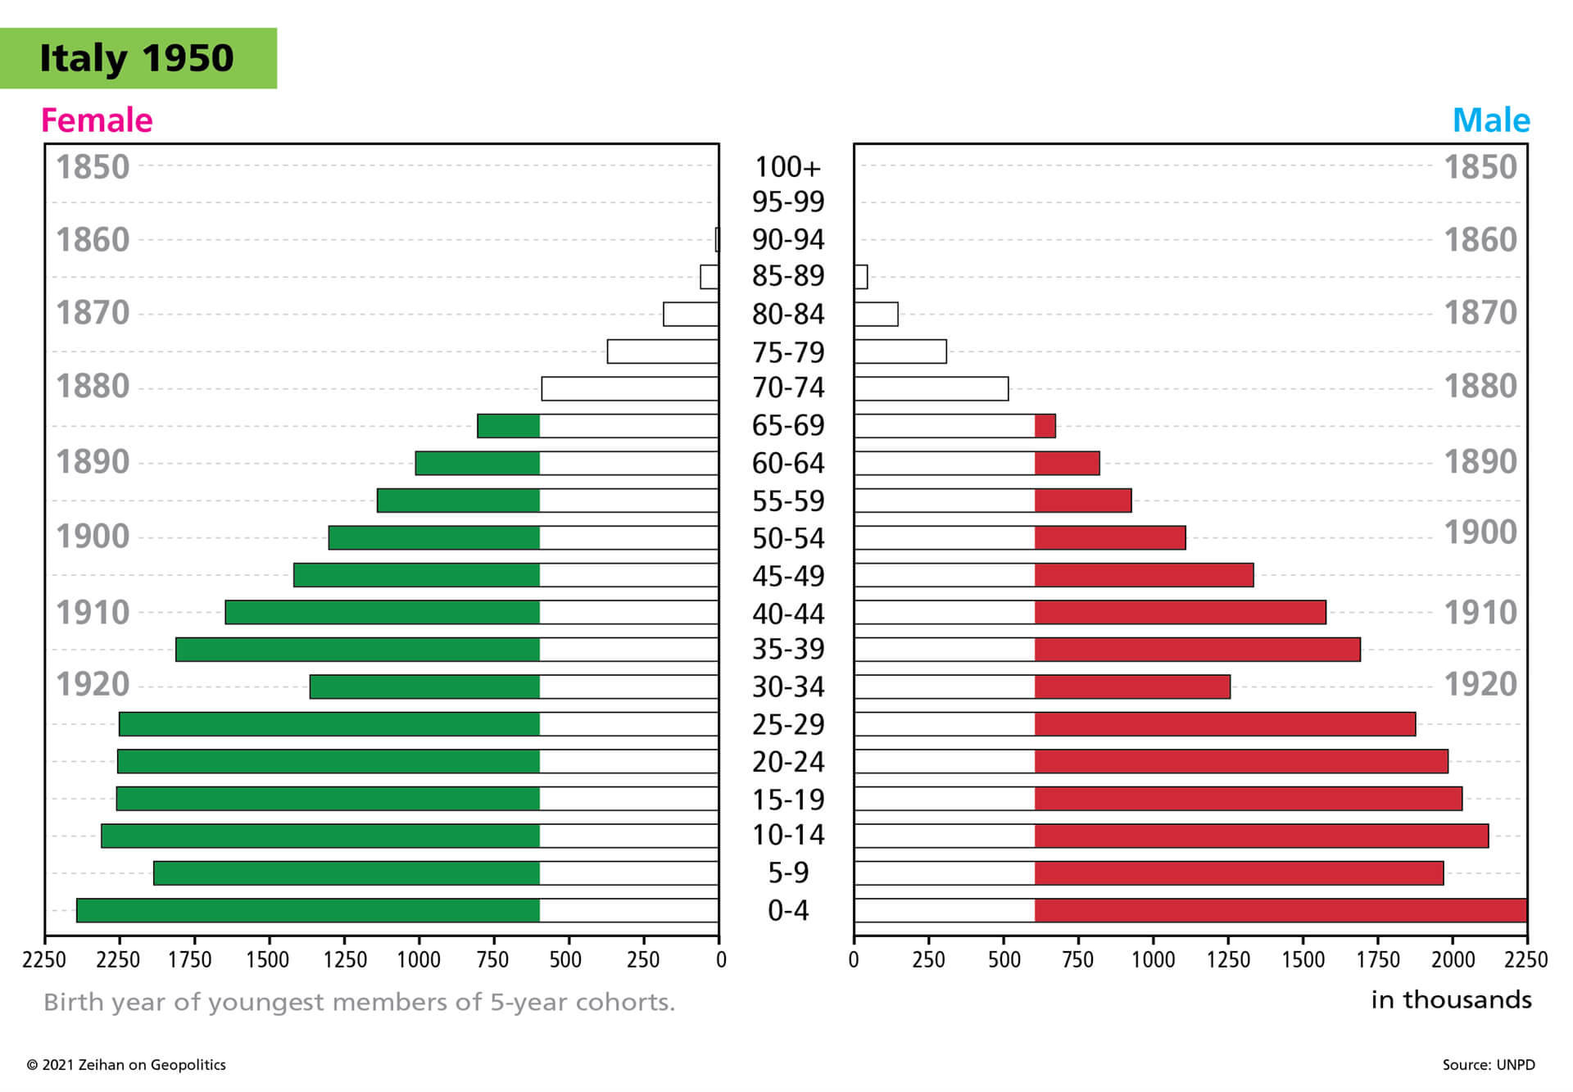
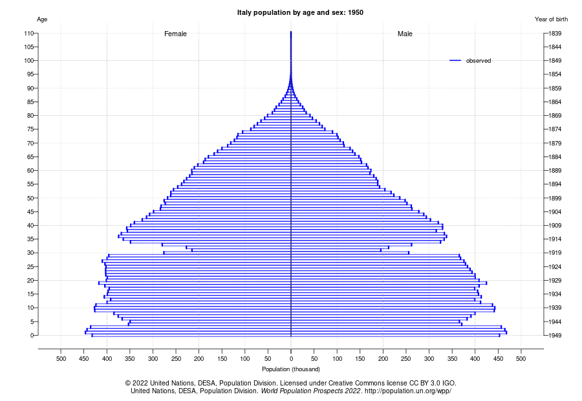




Ideal age demographics for economic growth, Italy 1950 Mean age: 31 Median age: 28
Zeihan’s chart
UN Population Division chart

Slide 5
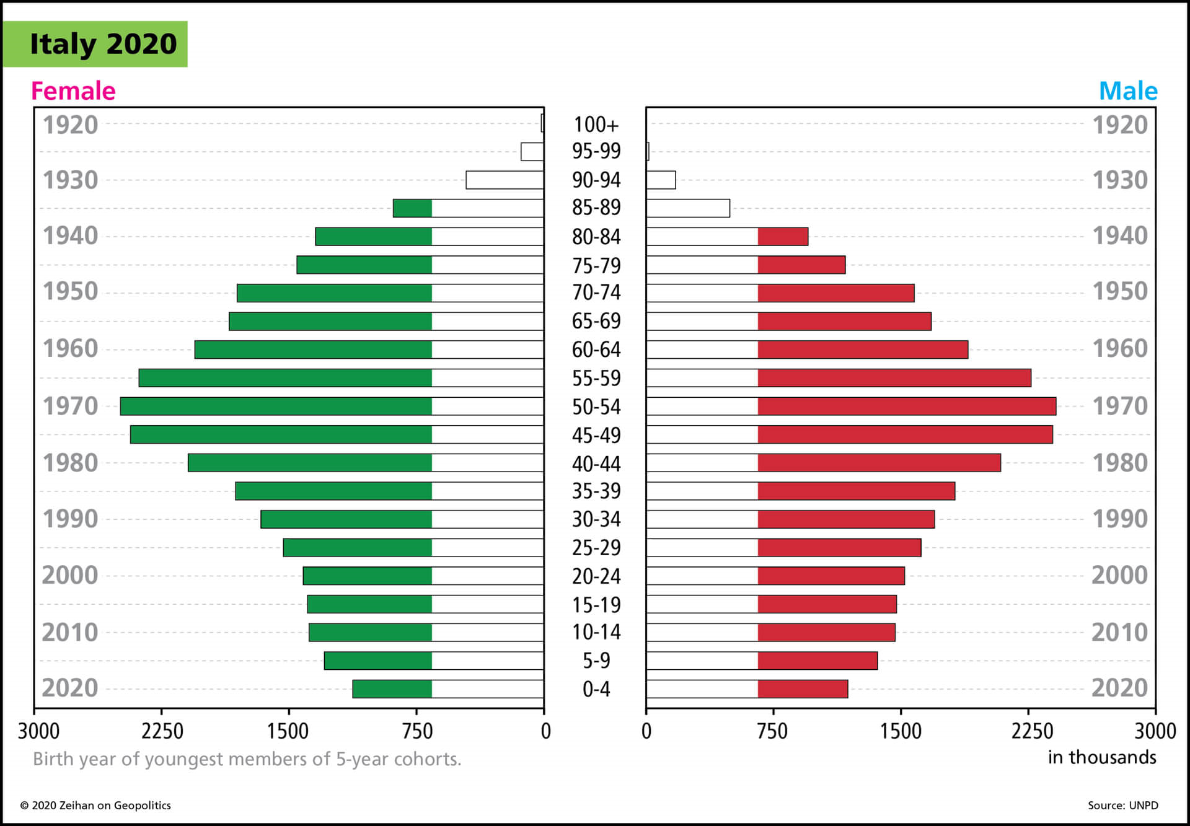
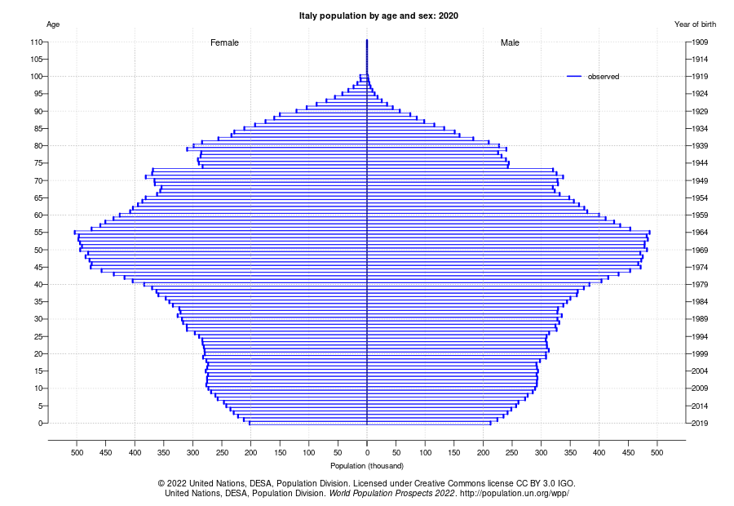




Age demographics that cannot predict growth, Italy 2020 Mean age: 45 Median age: 46
Zeihan’s chart
UN Population Division chart

Slide 6
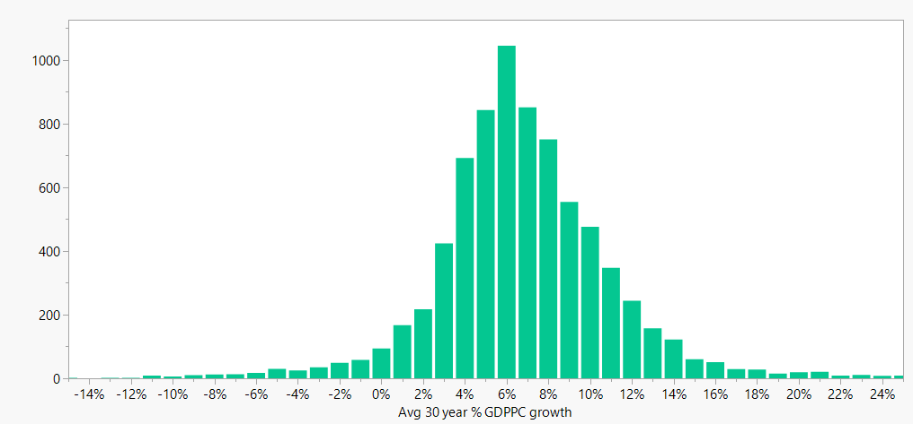
How to lie with statistics, part 1: Determining above average growth
>6.4%

Slide 7
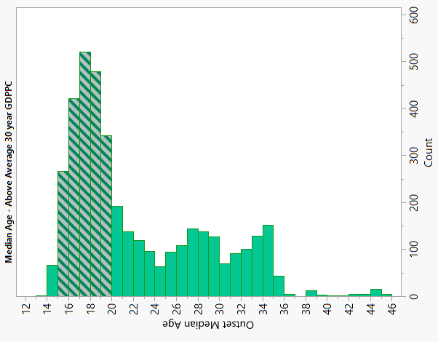
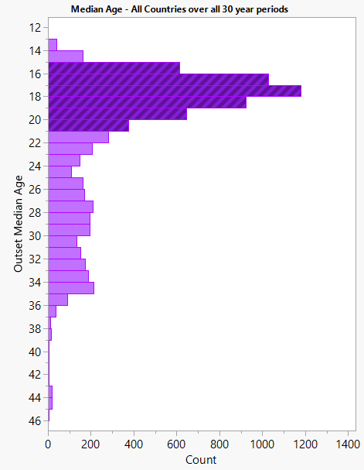
How to lie with statistics, part 2: younger median ages means above average growth!
(false)

Slide 8
% GDPPC change per year - vs. - % population change
Not significant
No factors p < 0.15
R-Squared < 0.001 for all linear fits

Slide 9
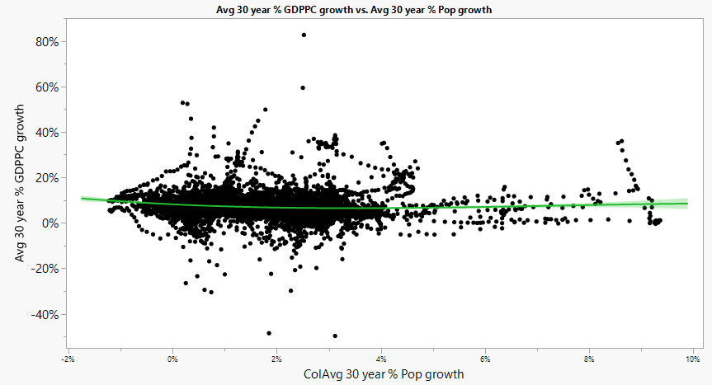
Average GDPPC % growth vs. avg % population growth, all 30 year spans in all countries
R-squared: 0.012
1.2% determination
All factors significant

Slide 10
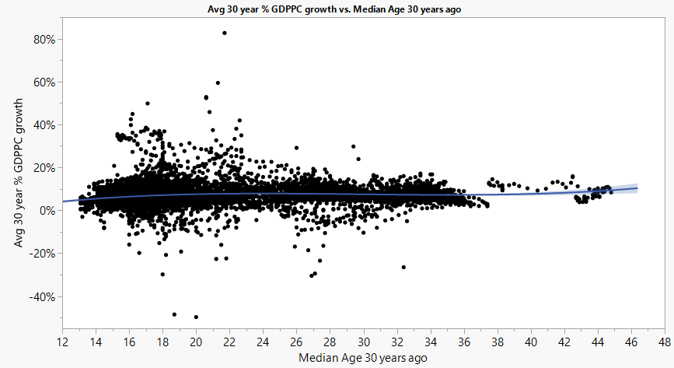
Cubic Linear Fit: all countries each year 1960-2021 Average 30 year growth %, given median age
R-squared: 0.013
1.3% determination
All factors significant

Slide 11
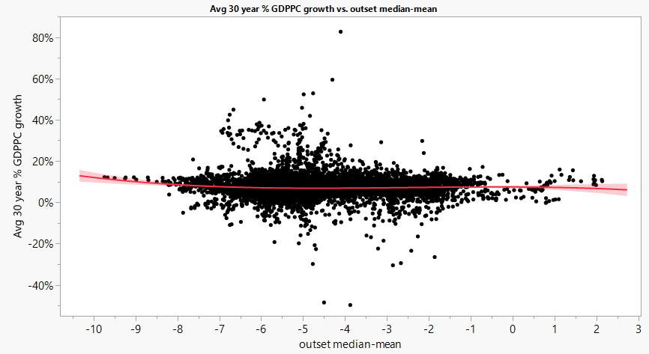
Cubic Linear Fit: all countries each year 1960-2021 Average 30 year GDPPC growth %, by mean-median age
R-squared: 0.005
0.5% determination
All factors significant

Slide 12
References
World Bank (2021)., GDP per Capita https://data.worldbank.org/indicator/NY.GDP.PCAP.CD?view=chart (download links are on the right)
Maddison Project (2022). Comparative Economic Growth statistics https://www.rug.nl/ggdc/historicaldevelopment/maddison/releases/maddison-project-database-2020
United Nations’ Department of Social and Economic Affairs, Population Division (2022), Demographic Indicators dataset from World Population Prospects 2022 https://population.un.org/wpp/Download/Standard/MostUsed/
United Nations’ Department of Social and Economic Affairs, Population Division (2022). Total population (both sexes combined) by single age from World Population Prospects 2022 https://population.un.org/wpp/Download/Standard/Population/

