Slide 1
CARBON PLACES KIT
PROJECT CONCEPT / OCTOBER 2026
REAL PLACE
Carbon Places Kit
Reusable infrastructure for place-based carbon and ecosystem information
Turning complex carbon-relevant geodata into understandable, reusable and traceable local information.
OPEN-SOURCE • CARBON-RELEVANT • AREA-FIRST
TRACEABLE INFORMATION
ILLUSTRATIVE LANDSCAPE • NOT ENVIRONMENTAL DATA
01 / 11

Slide 2
CARBON PLACES KIT
MOTIVATION / CARBON MEETS PLACE
Carbon is discussed in numbers. Places ask concrete questions.
Forests, wetlands and restoration sites turn carbon data into local questions.
What is here?
Why does it matter?
LOCAL STEWARDS
What can we show responsibly?
ILLUSTRATIVE USER SCENARIO • TO BE VALIDATED WITH LOCAL ORGANISATIONS
02 / 11

Slide 3




CARBON PLACES KIT
MOTIVATION / THE TRANSLATION GAP
Open environmental data is abundant. Local understanding is not.
Open Data
The Translation Gap
Local Stewards
Hard to connect datasets to what is happening in a specific place.
Need information they can understand, explain, update and reuse.
Land cover, forests, wetlands, protected areas.
GAP
GAP
Files, codes & portals
Context gets lost
Not one-off maps
The missing layer is between open data and local understanding.
DESIGN HYPOTHESIS • THE FRICTION LIES BETWEEN DATA PRODUCTS AND PLACE-BASED QUESTIONS
03 / 11

Slide 4
CARBON PLACES KIT
CONCEPT / THE PLACE-BASED TRANSLATION LAYER
What if place became the translation layer?
Carbon-relevant open data
Place-based maps
Local context
Local knowledge
Traceable sources
CARBON PLACES KIT
PROPOSED INFRASTRUCTURE • SOURCES, CONTEXT AND LOCAL KNOWLEDGE MEET AROUND ONE AREA
04 / 11

Slide 5
CARBON PLACES KIT
CONCEPT / WHY CARBON, WHY PLACES
Start where carbon becomes tangible.
Forests
Wetlands
Restoration sites
Make carbon-relevant context understandable.
Keep claims grounded in the evidence.
FIRST USE CASES • CARBON-RELEVANT CONTEXT, NOT CARBON-CREDIT ACCOUNTING
05 / 11

Slide 6
CARBON PLACES KIT
INNOVATION / REUSABLE INFRASTRUCTURE
Not another carbon dashboard. A reusable foundation.
Forest group
Wetland project
Restoration initiative
Data connectors
Place-based processing
Evidence + outputs
BUILD ONCE • ADAPT LOCALLY
TARGET ARCHITECTURE • REUSE MUST BE DEMONSTRATED IN REAL INTEGRATIONS
06 / 11

Slide 7
CARBON PLACES KIT
INNOVATION / TRUST BY DESIGN
Every result keeps its evidence and limits.
EVIDENCE
Source
Date
Method
Local records stay under local control.
Publish by choice.
Limits
Make information reusable without losing its evidence.
DESIGN PRINCIPLE • TRACEABLE OUTPUTS, NOT UNQUALIFIED ENVIRONMENTAL CLAIMS
07 / 11

Slide 8
CARBON PLACES KIT
SIGNIFICANCE / EXPECTED PUBLIC VALUE
One shared capability. Three forms of public value.
Local organisations
The public
Use & maintain
Understand & inspect
Open-source community
Reuse & extend
INTENDED EFFECTS • TO BE TESTED THROUGH REAL-DATA VALIDATION AND PILOTS
09 / 11

Slide 9
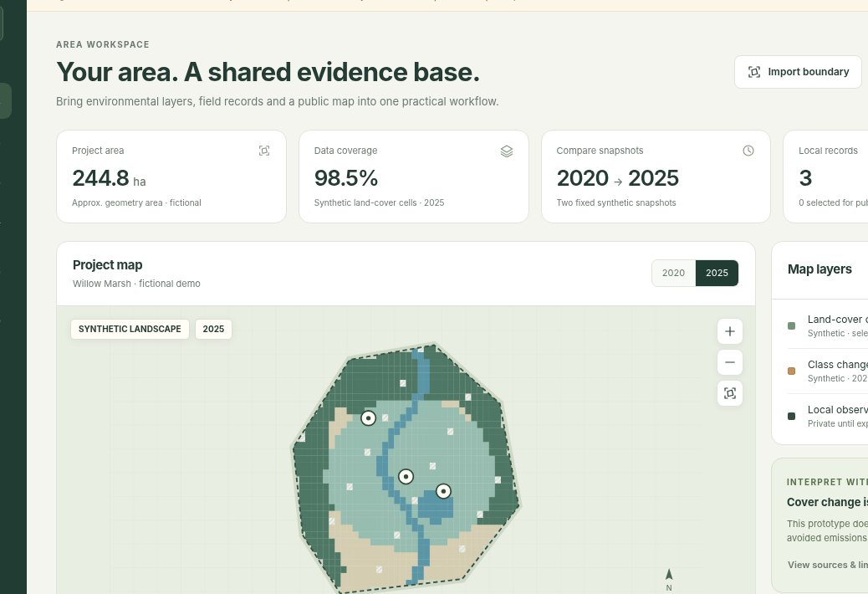
CARBON PLACES KIT
CREDIBILITY / FROM CONCEPT TO PROOF
A concept today. Real-data integration comes next.
01
Concept exploration
Make the concept visible and testable.
02
Real-data module
One dataset. One real area. Verified outputs.
03
Integration pilot
Test reuse in an existing workflow.
EXISTING CONCEPT PROTOTYPE
CURRENT GUI DEMONSTRATES THE INTERFACE AND WORKFLOW • REAL-DATA INTEGRATION COMES NEXT
10 / 11

Slide 10
CARBON PLACES KIT
CARBON PLACES KIT
Make carbon-relevant open data
useful where it matters.
Carbon-relevant ecosystems.
Real places.
Shared capability.
Carbon Places Kit
AREA FIRST. SOURCES ATTACHED. LOCAL CONTROL.
11 / 11

