Slide 1
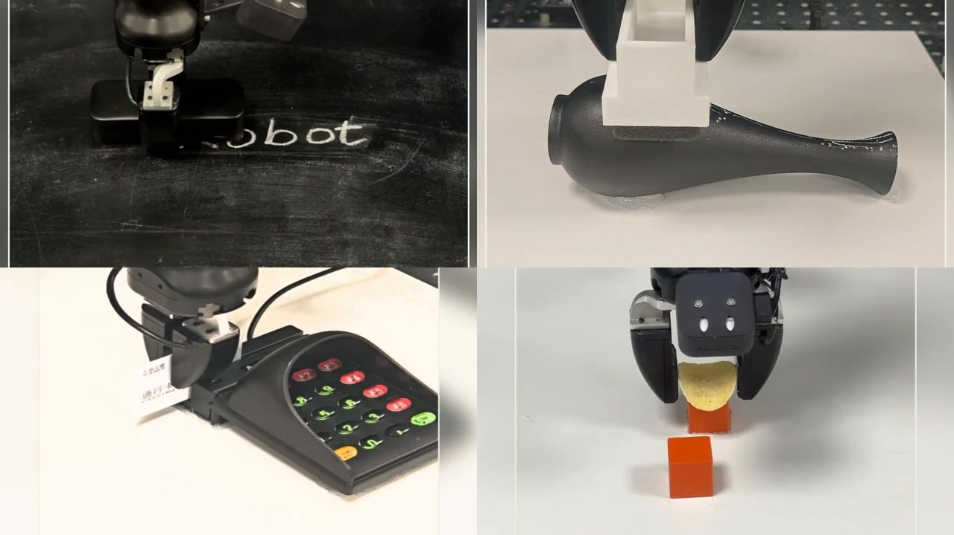
Notes:
Overview film interval: 0-5 seconds. Headings and metrics are editable text. Figures remain image assets; movie content remains embedded video. This deck is not a single embedded film.

Slide 2
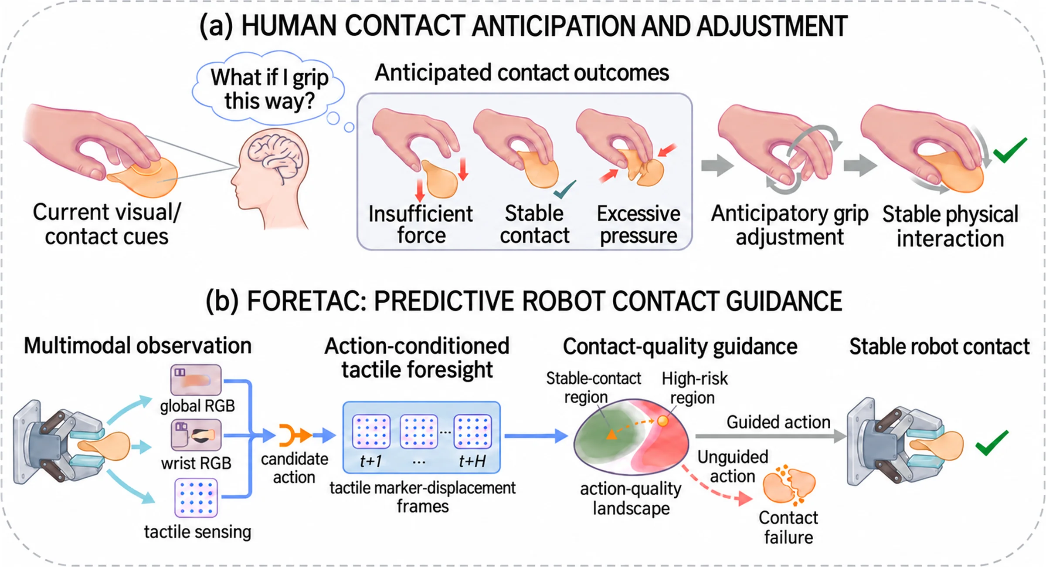
Predict the contact before it happens
Anticipate the tactile consequence of a candidate action
Notes:
Overview film interval: 5-11 seconds. Headings and metrics are editable text. Figures remain image assets; movie content remains embedded video. This deck is not a single embedded film.

Slide 3
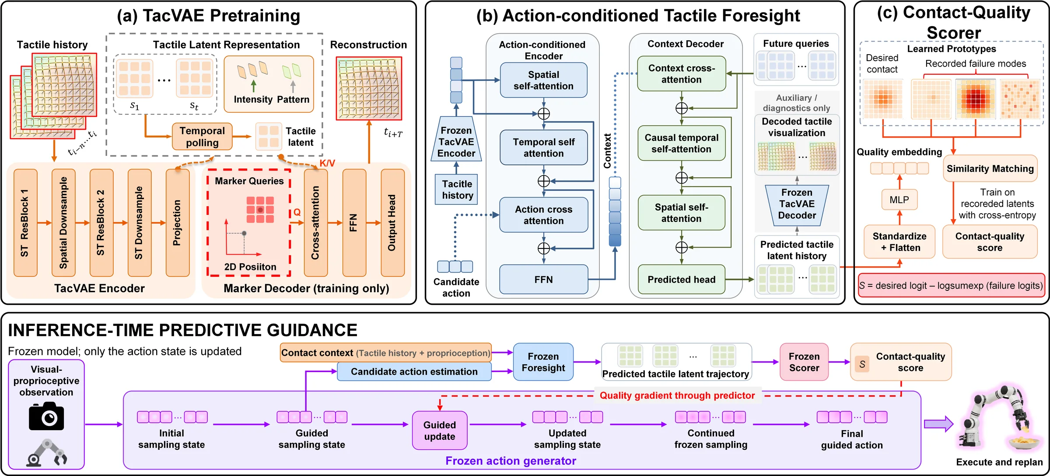
Represent - predict - evaluate - guide
Frozen models guide the evolving generative sampling state
Notes:
Overview film interval: 11-19 seconds. Headings and metrics are editable text. Figures remain image assets; movie content remains embedded video. This deck is not a single embedded film.

Slide 4
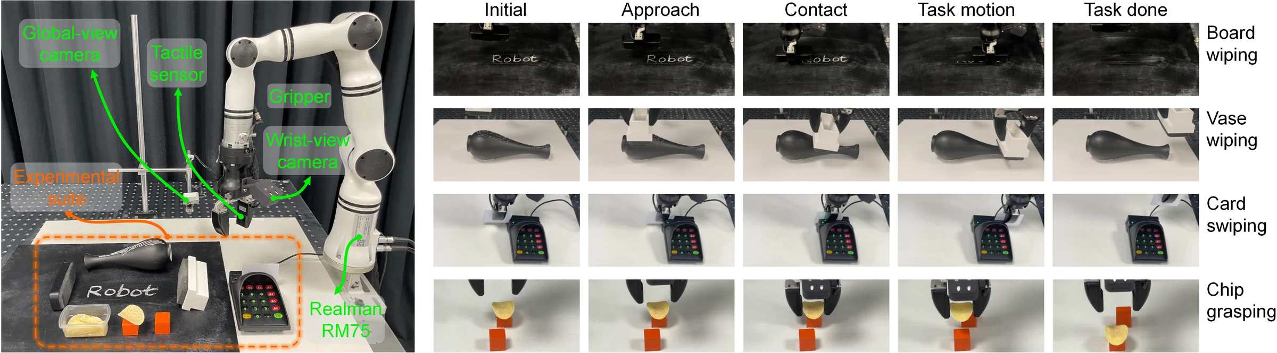
Four real-robot contact regimes
Board wiping - vase wiping - card swiping - fragile chip grasping
Notes:
Overview film interval: 19-25 seconds. Headings and metrics are editable text. Figures remain image assets; movie content remains embedded video. This deck is not a single embedded film.

Slide 5
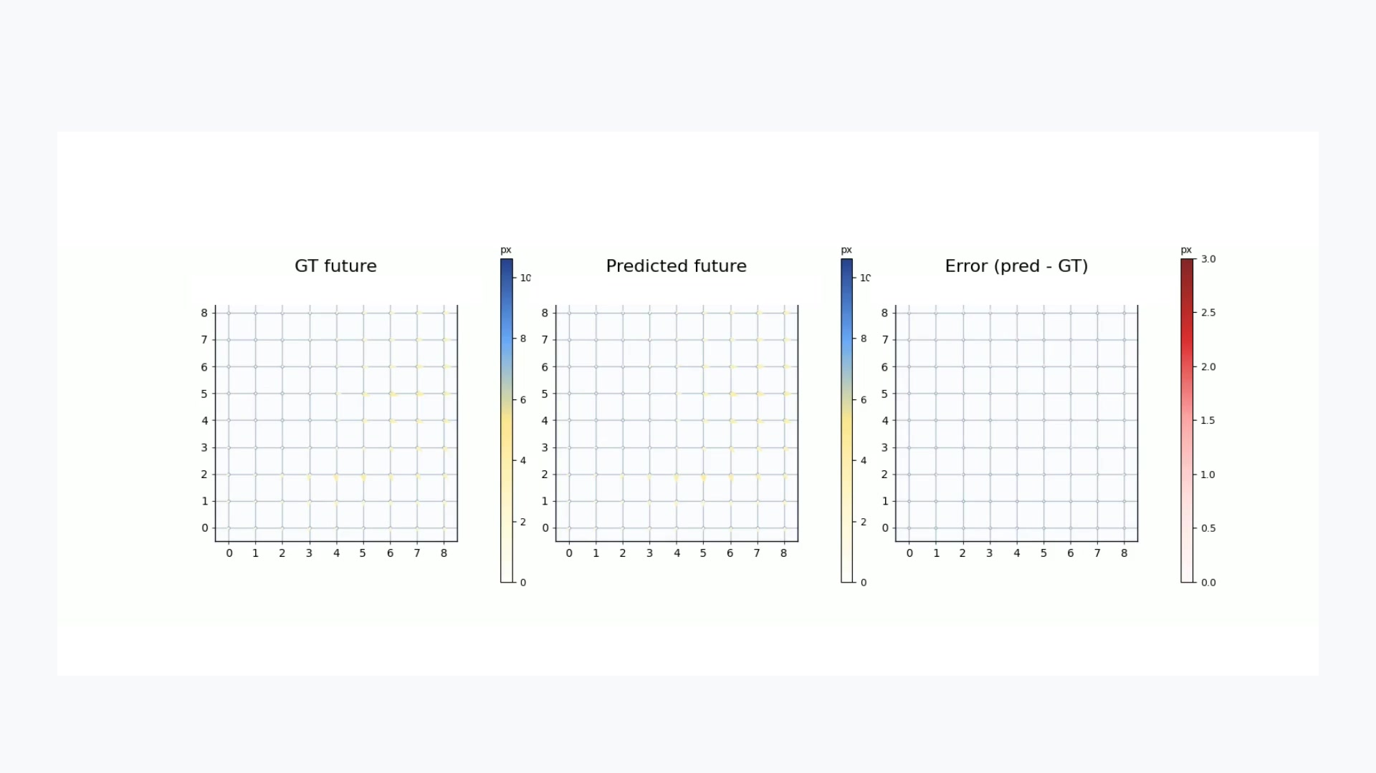
Action-conditioned tactile foresight
Ground-truth future - predicted future - error (qualitative, H=16)
Notes:
Overview film interval: 25-32 seconds. Headings and metrics are editable text. Figures remain image assets; movie content remains embedded video. This deck is not a single embedded film.

Slide 6
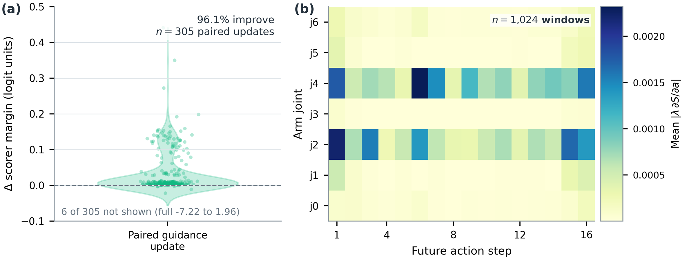
Offline guidance diagnostics
Scorer-margin changes and scaled quality gradients
Notes:
Overview film interval: 32-38 seconds. Headings and metrics are editable text. Figures remain image assets; movie content remains embedded video. This deck is not a single embedded film.

Slide 7
ForeTac on four real-robot tasks
DP 36.3 / 20.0 → DP + ForeTac 71.3 / 66.3 (SR / CSR)
20 trials per task; averages over four tasks
Average task success rate (SR)
Average contact success rate (CSR)
71.3%
66.3%
vs RDP +12.5 / +17.5 pp (SR / CSR)
pi0.5 46.3 / 36.3 → + ForeTac 67.5 / 62.5 (SR / CSR)
Diffusion Policy and flow-matching backbones
Predict contact. Guide action. Execute and replan.
Notes:
Overview film interval: 38-45 seconds. Headings and metrics are editable text. Figures remain image assets; movie content remains embedded video. This deck is not a single embedded film.

