Slide 1
WIP project:Open door by smartphone
Snipper
Mentor: spider

Slide 2
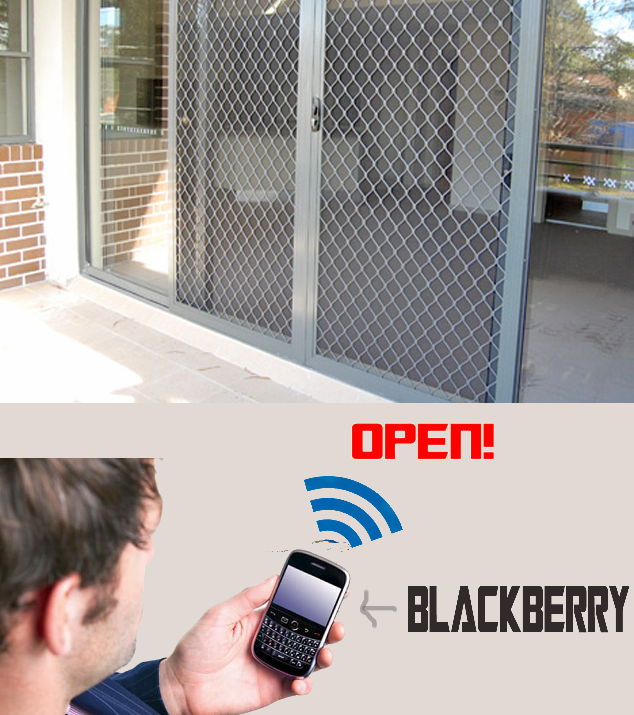
Abstract
Use smartphone to open/close the door

Slide 3
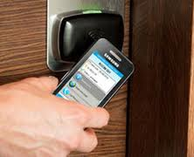
Scenario
Smartphone diffusion in the world
Use smartphone as a key to open/close the door

Slide 4
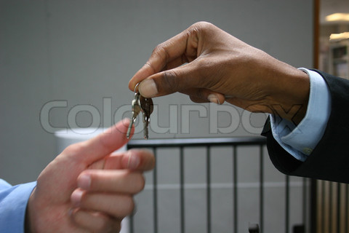
Problem
With a traditional key
when you lost the key, you need to buy new one.
When you permit someone to go into your house, you must give them your key

Slide 5
Approach
Use smartphone to open/close the door
When near
Depend on direction
You can permit their smartphone to entry to your home in fixed time

Slide 6
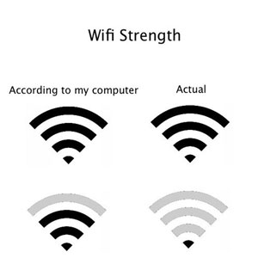
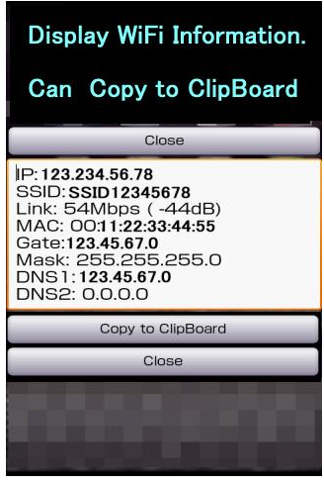
Approach-Auto open
If you bring suitable smartphone, when you go near the door, it is automatically opened
Use wifi signal strength to identify whether there is a smart phone near the door

Slide 7
Approach – Auto open
Depend on direction of user, decide whether open/close the door
Use Kalman filter to
Use digital compass(gyroscopic sensor) and accelerator sensor
Door
Not open
Open

Slide 8
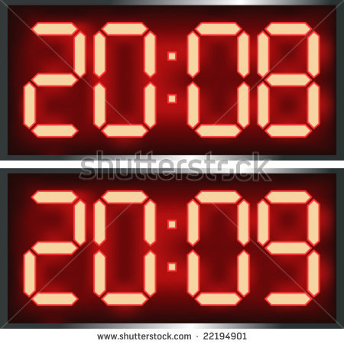
Approach – Share key
Use limited time key
The guest can only entry to your house in fixed time

Slide 9
Related research
Access door with face recognition
Use cameras to capture the image of user’s face and then uses face detection algorithm to match faces stored in the database.
Voice recognition door access system

Slide 10
Security Problem
About share key
When the host want to send key to the guest, the server will receive message from the host’s smartphone and send back to the host’s and the guest’s smartphone the key which encrypted.

Slide 11
Security Problem
When user go to area which wifi signal strength of the host’s wifi spot is strong enough, the user’s smartphone will send key to the server.
Use number of wifi spot and base on strength of recived wifi signal to detect whether from user’s location user can control the door or not

