Slide 1
관계대수 추가: Aggregation Function

Slide 2
Additional Relational Operations: Aggregate Functions and Grouping
A type of request that cannot be expressed in the basic relational algebra is to specify mathematical aggregate functions on collections of values from the database.
Examples of such functions include retrieving the average or total salary of all employees or the total number of employee tuples.
These functions are used in simple statistical queries that summarize information from the database tuples.
Common functions applied to collections of numeric values include
SUM, AVERAGE, MAXIMUM, and MINIMUM.
The COUNT function is used for counting tuples or values.

Slide 3
Aggregate Function Operation
Use of the Aggregate Functional operation ℱ
ℱ_{MAX Salary} (EMPLOYEE) retrieves the maximum salary value from the EMPLOYEE relation
ℱ_{MIN Salary} (EMPLOYEE) retrieves the minimum Salary value from the EMPLOYEE relation
ℱ_{SUM Salary} (EMPLOYEE) retrieves the sum of the Salary from the EMPLOYEE relation
ℱ_{COUNT SSN, AVERAGE Salary} (EMPLOYEE) computes the count (number) of employees and their average salary
Note: count just counts the number of rows, without removing duplicates

Slide 4
Using Grouping with Aggregation
The previous examples all summarized one or more attributes for a set of tuples
Maximum Salary or Count (number of) Ssn
Grouping can be combined with Aggregate Functions
Example: For each department, retrieve the DNO, COUNT SSN, and AVERAGE SALARY
A variation of aggregate operation ℱ allows this:
Grouping attribute placed to left of symbol
Aggregate functions to right of symbol
_{DNO} ℱ_{COUNT SSN, AVERAGE Salary} (EMPLOYEE)
Above operation groups employees by DNO (department number) and computes the count of employees and average salary per department

Slide 5
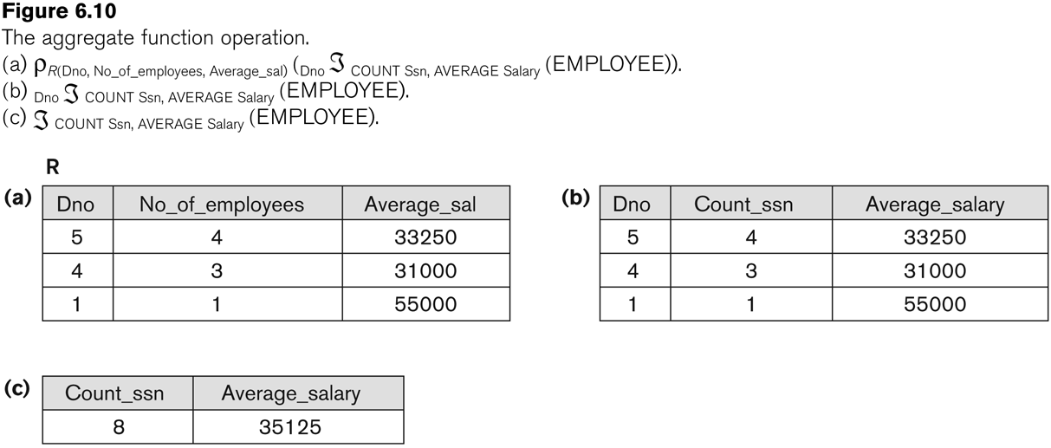
Examples of applying aggregate functions and grouping

Slide 6
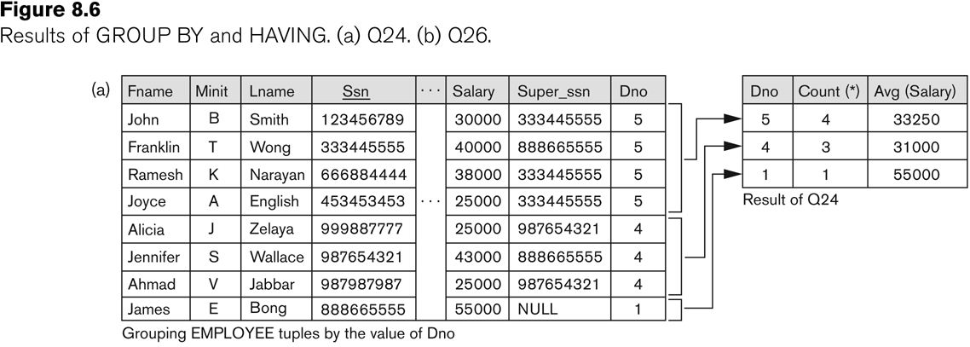
Illustrating aggregate functions and grouping

