Slide 1
SH transition to PPDS SCHEDULING
June 2018

Slide 2
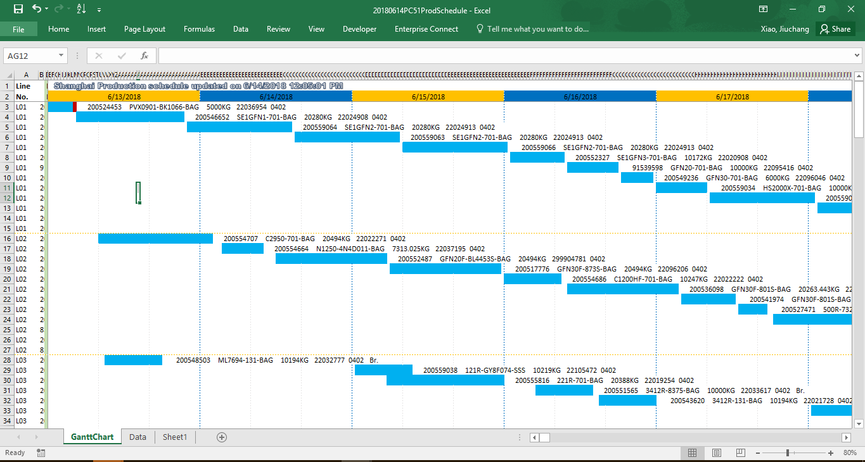
NEW FORMAT OF PRODUCTION SCHEDULE
File Name: YYYYMMDDPC51ProdSchedule.XLSB

Slide 3
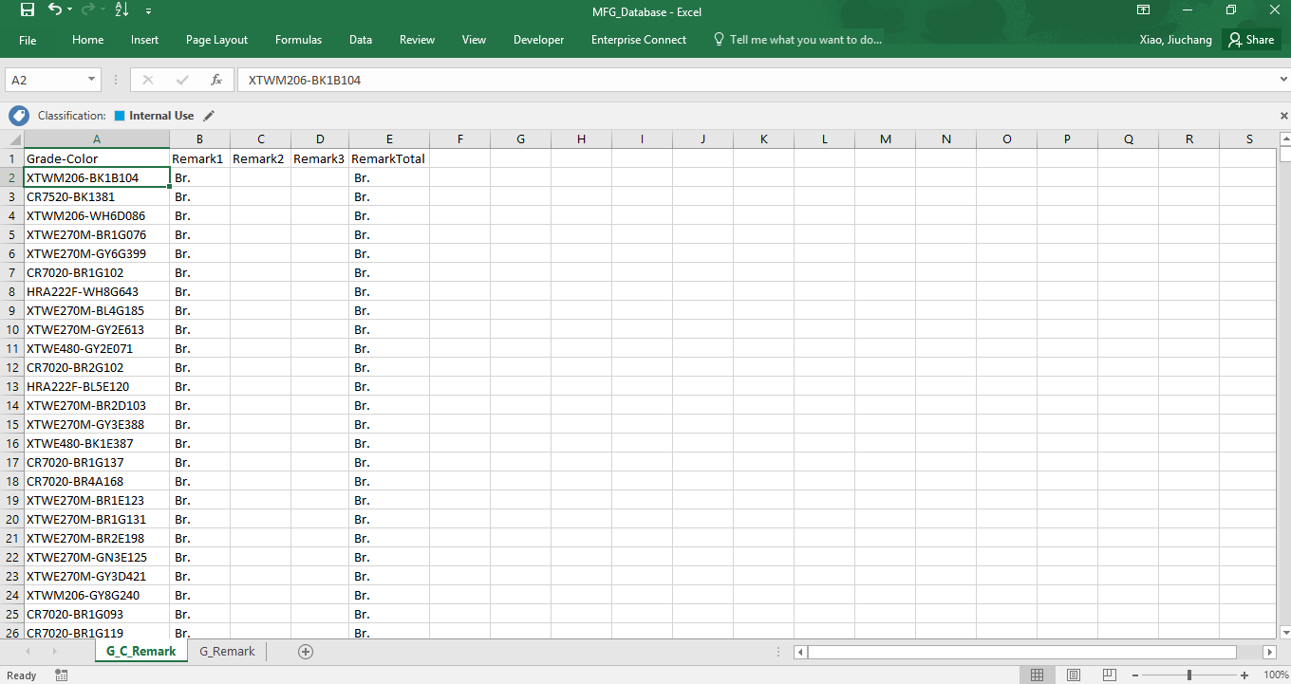
MFG database
File Name: MFG_Database.XLSX with aligned layout

Slide 4
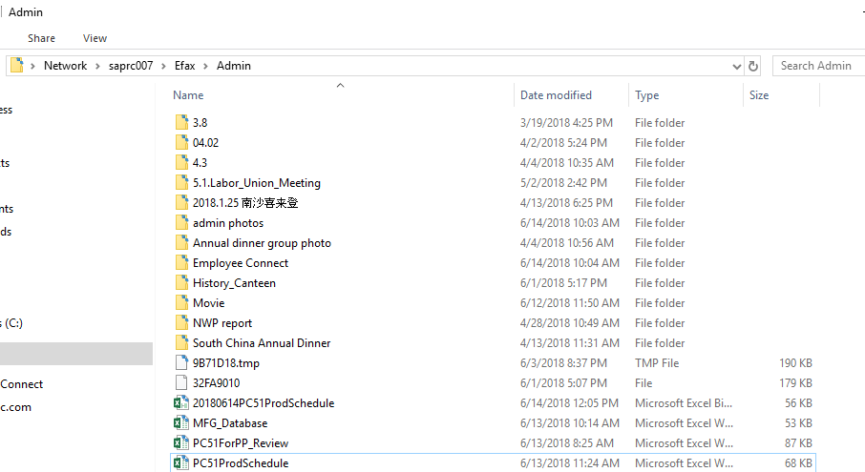
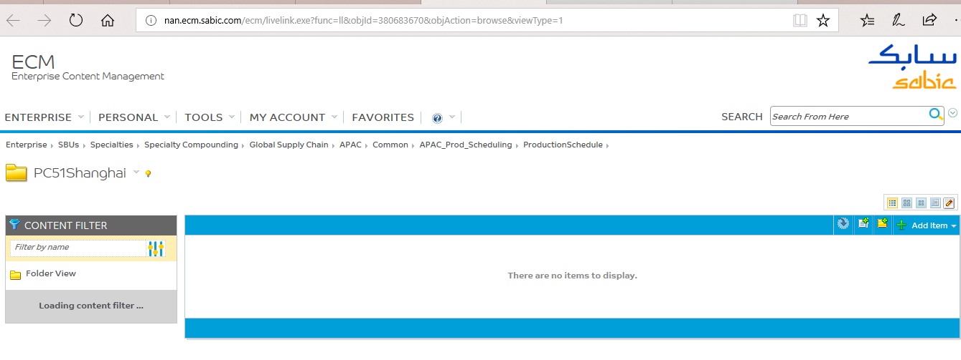
STORAGE LOCATION
1, Public folder to store the latest production schedule file. \\saprc00X\XXXX\XXXX
MFG_database file is put in public folder with server located in Shanghai
2. ECM folder to store historical production schedule file.
http://ecm.sabic.com/ecm/livelink.exe/app/nodes/380683670

