Slide 1
Agentic Portal Agent Workflow & Dataflow

Slide 2
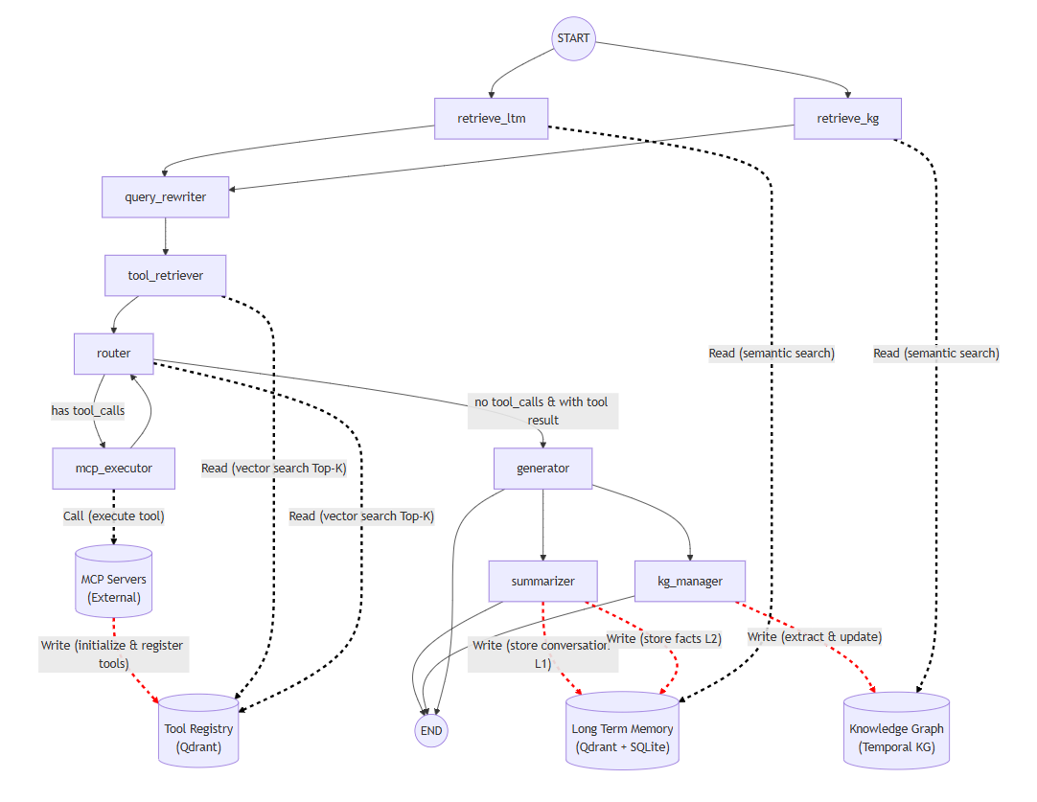
Black solid line: Workflow Dash line: Dataflow
- red dash line: Writing action
- black dash line: Reading action

Slide 3
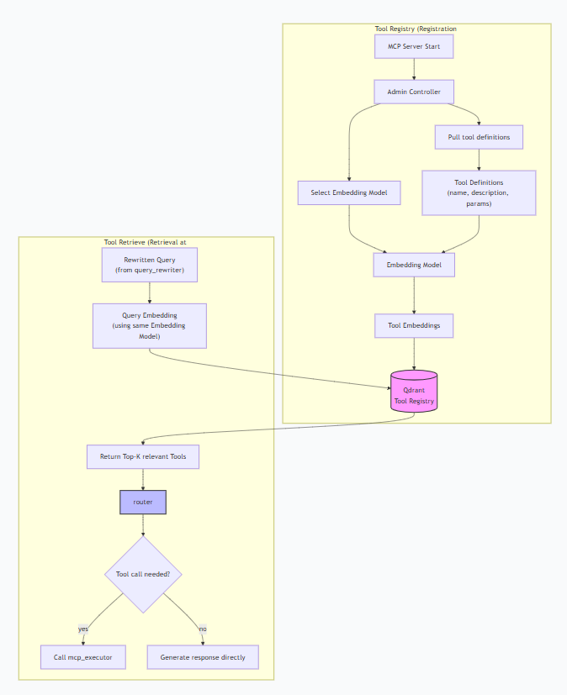
Tool Registry & Tool Retrieve
Tool Registry
Tool Retrieve
Tool Execution

Slide 4
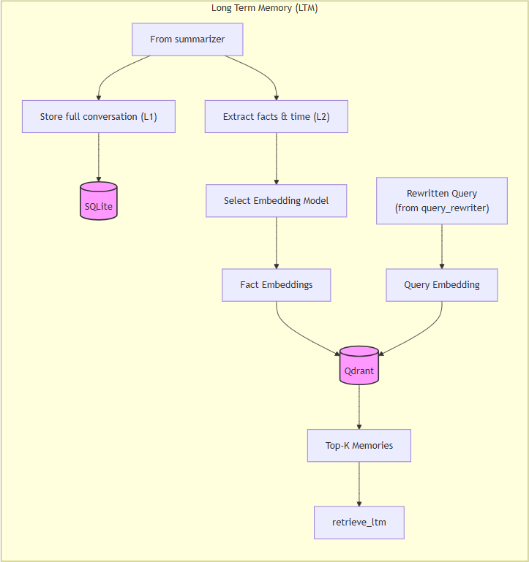
Long Term Memory
Memory write
Memory retrieve

Slide 5
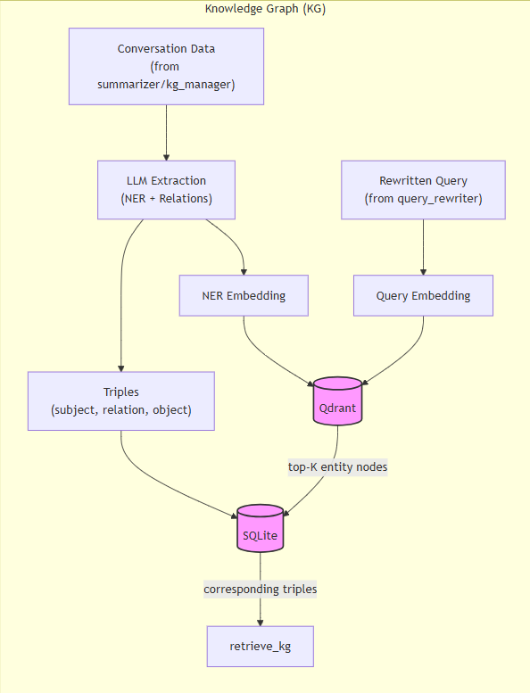
Long Term Memory – Knowledge Graph
KG Build
KG Retrieve

Slide 6
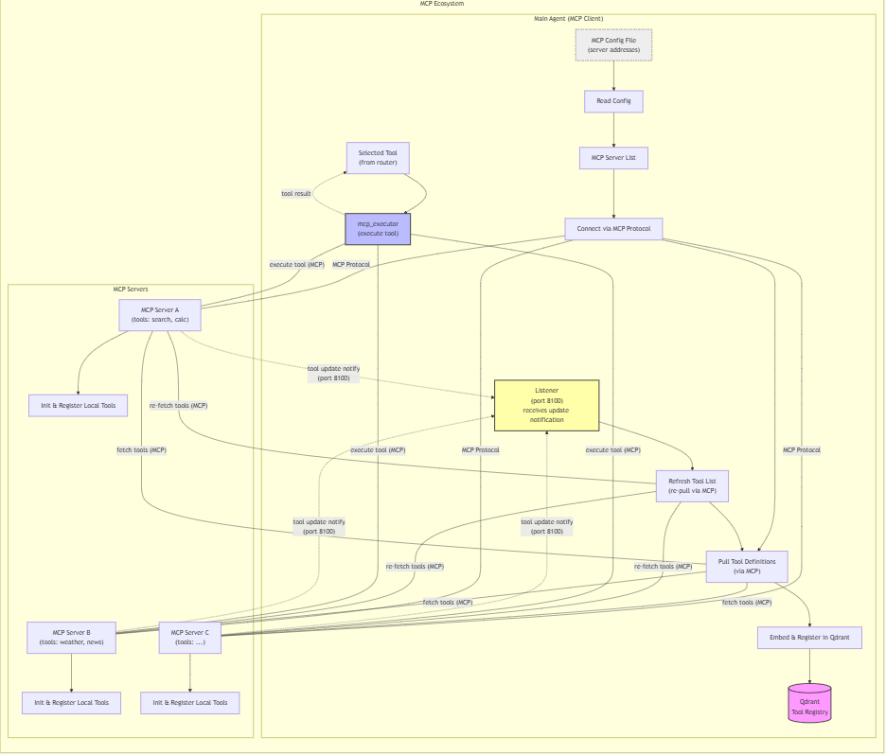
MCP ecosystem
MCP tool execution
MCP tool fetch
MCP tool update
Tool Registry

