Slide 1
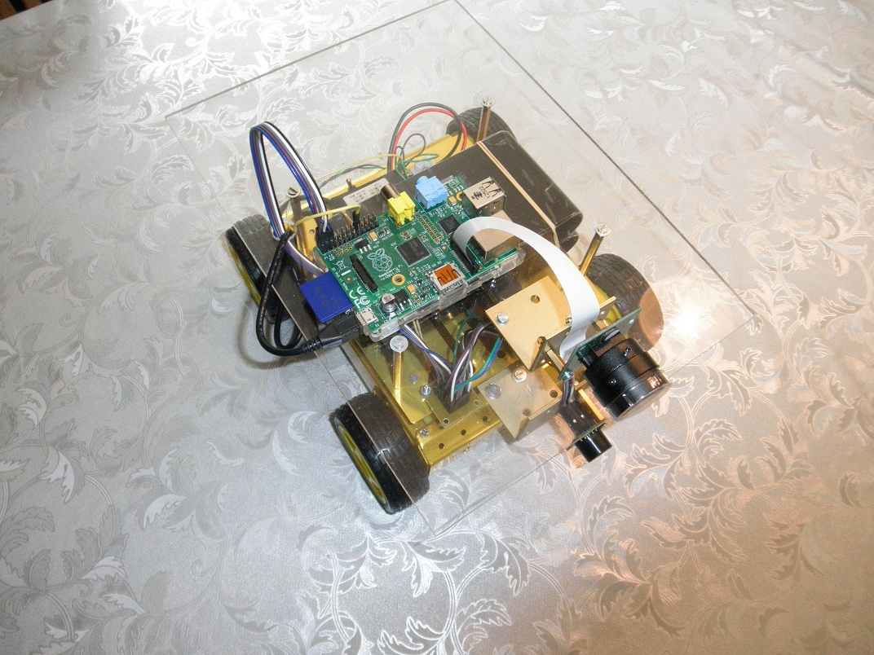
Robot car introduction

Slide 2
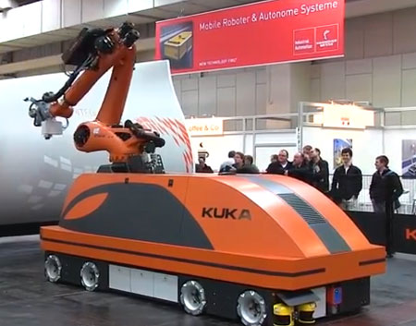
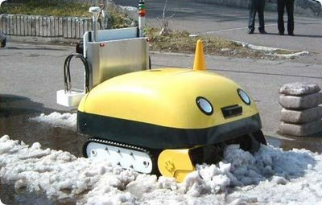
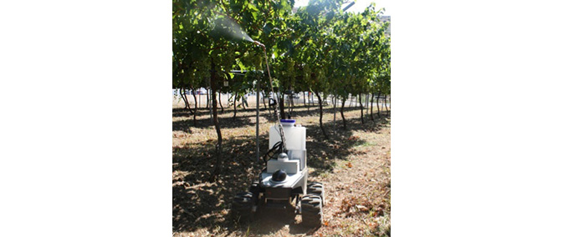
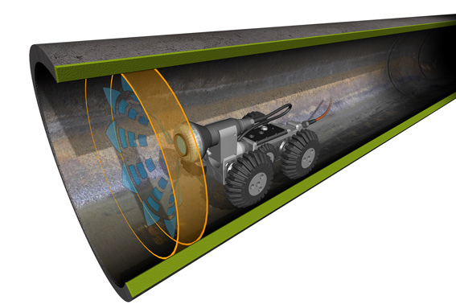
Mobile Robots and applications
http://www.robotnik.eu/videos/

Slide 3
Mobile Robots and applications
Petrobot project – inspecting vessels with robots:
http://petrobotproject.eu/
Bionic inspector:
http://www.shell.com/inside-energy/a-bionic-inspector-rolls-in.html
bottom inspection

Slide 4
Mobile Robots - Diagram
2 wire bus system (i2c, spi, can bus)
Microcontroller Board (wifi, usb)
Display
Sensors
Motor control board

Slide 5
Robot car components
I2C PWM Controller BV4604 - Byvac
Wheel encoder HC-020K
Ultrasonic distance sensor SRF02
Raspberry Pi 5Mpixel camera with 6 mm and 12 mm lens
HMC5883L GY-273 Triple Axis magnetometer [Honeywell]
Servo motor MG90S
Step down dc dc converter 8V-40V → 5V
Raspberry pi 3.0 [onboard wifi and onboard ble]

Slide 6
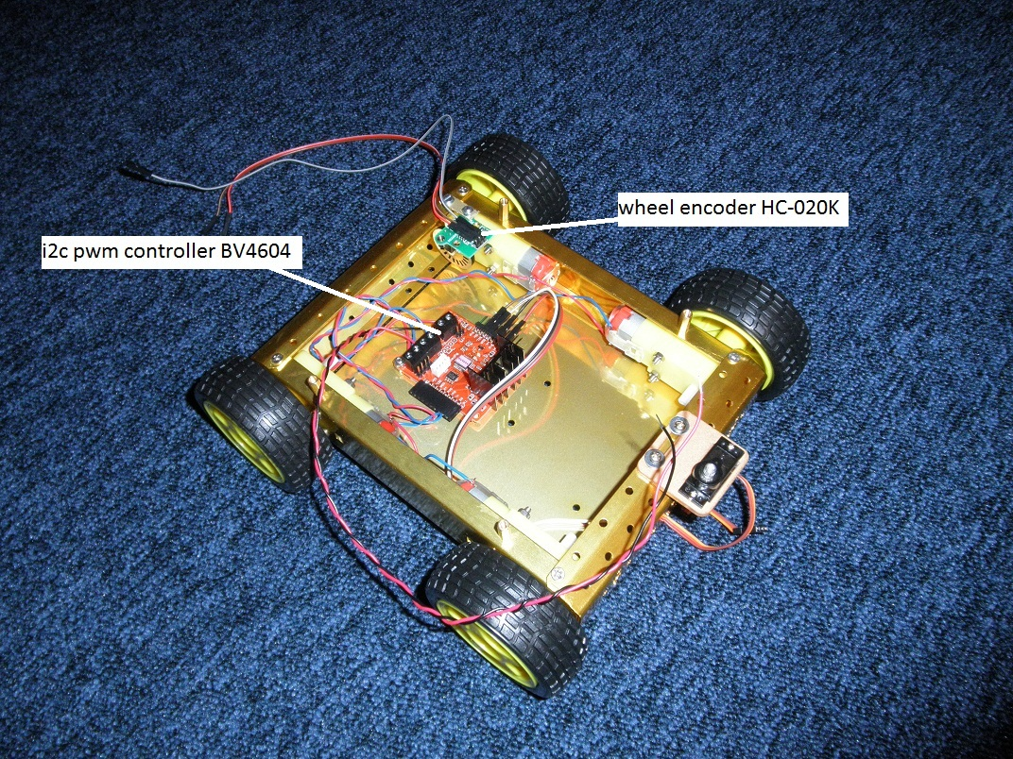
Motor controller and wheel encoder

Slide 7
Controlling motorspeed - PWM
To change the motor speed we have to change the supply Voltage
How to do that in an energy-efficient manner?
Solution: PWM = Pulse Width Modulation
PWM idea: switching on/off the supply voltage and change the average voltage. The motor speed is proportional to the average voltage.
Main application of PWM:
Energy efficient power control

Slide 8
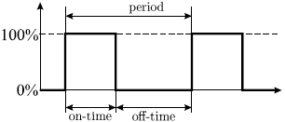
Controlling motorspeed by PWM
Duty Cycle: D = on-time / period; 0≤ D ≤1
Average Voltage is controlled by varieing the duty cycle D:

Slide 9
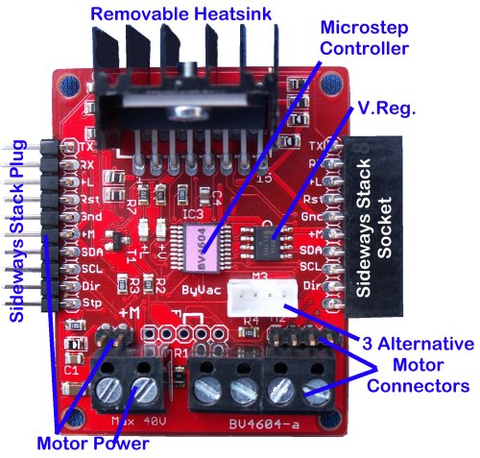
I2c pwm motor controller BV4604
pwm signal motor 1
BV4603
Commands from rasp pi [via i2c interface]
pwm signal motor 2
Microcontroller generates pwm signal

Slide 10
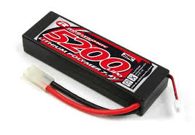
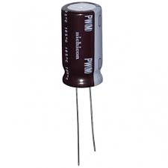
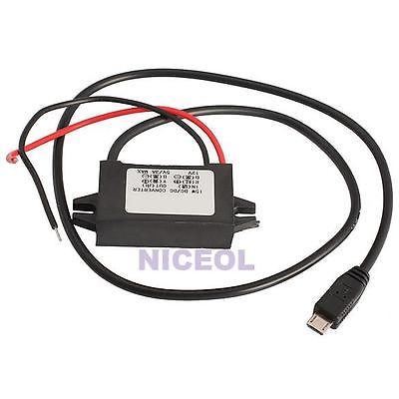
Power supply robot car
DC DC convertor
5 V to rasp. pi
11 V to motor unit
Lipo accu

Slide 11
LIPO - accu
https://nl.wikipedia.org/wiki/Lithium-ion-polymeer-accu

Slide 12
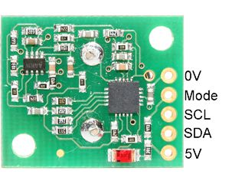
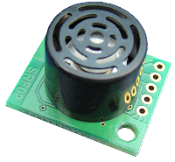
Ultrasonic distance sensor srf02
I2C: scl and sda
Ultrasonic signal reflects
Distance = 0,5 x flight time x 340 m/s
Distance is calculated in the firmware of the sensor

Slide 13
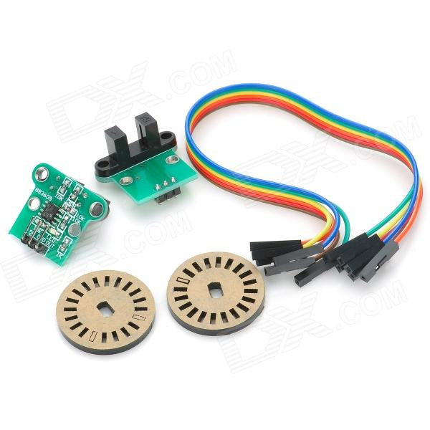
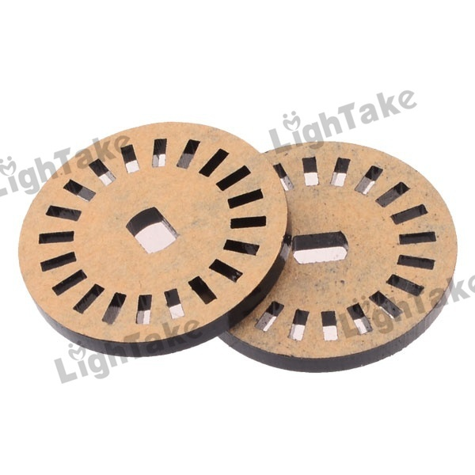
Rotary encoder
Light from LED
Light to photo diode
Light blocked or passed by the encoder disc
Encoder disc is mounted on the motor shaft
Device generates pulses while the motor is turning
Raspberry pi must process the pulses of the encoder on interrupt basis; why?

Slide 14
I2c = iic = Inter-Integrated Circuit
Motor controller
Raspberry pi
Distance sensor
Magnetometer
data
clock
Raspberry pi communicates with other devices via i2c; the devices have different addresses.
I2c: 2 wires [clock wire SCL and data wire SDA]
Clock signal is generated by the master (rasp. pi).

Slide 15
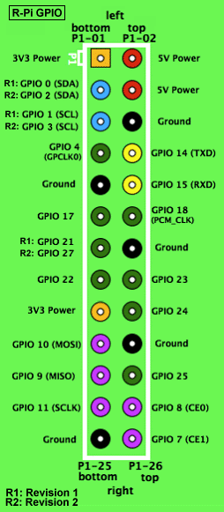
I2c – Raspberry pi
SDA I2C-data
SCL I2C- clock
Raspberry pi i2c:
I2c drivers standard not installed
I2c detect tool standard not installed
(I did this already for you).
Study this description:
http://skpang.co.uk/blog/archives/575

Slide 16
i2C addresses of the Robotcar
Command on rasp. pi to find active i2c addresses:
I2cdetect –y 1
I2c pwm controller: 0x32
srf02 distance sensor: 0x70
GY273 5883L compass: 0x1e

Slide 17
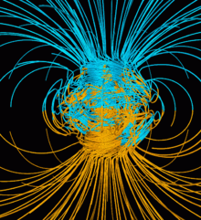
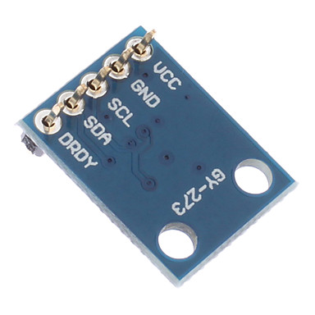
Magnetometer - HMC5883L
-Electronic compass
-based on earth magnetic field
used in robot car to determine direction
with the x- and y-value of the sensor the angle between the magnetic north and the robot car can be calculated; see datasheet
of the magnetometer The z-component can be discarded.

Slide 18
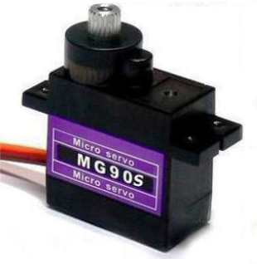
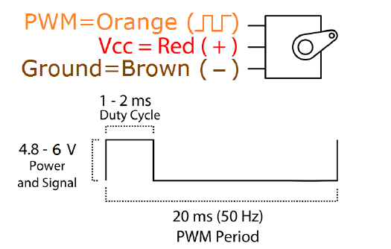
Servo motor MG90S [1]
Angle range: [0 – 180 degrees]
Angle controlled by a pwm signal

Slide 19
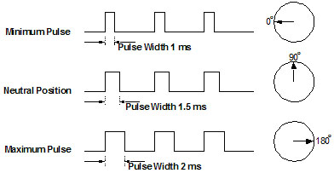
Servo control MG90S [2]
Period: 20 ms
Pulse width 1ms [0 degrees] to 2 ms [180 degrees]

Slide 20
Sockets Raspberry pi
http://www.binarytides.com/socket-programming-c-linux-tutorial/
http://www.linuxhowtos.org/C_C++/socket.htm
http://cs.smith.edu/dftwiki/index.php/Tutorial:_Client/Server_on_the_Raspberry_Pi

Slide 21
Wiring PI - Library
GPIO+Interrupts+I2C+PWM http://wiringpi.com/
The wiring Pi library is already installed on the micro sd-card
http://www.raspberry-projects.com/pi/programming-in-c/i2c/using-the-i2c-interface

Slide 22
Raspberry pi – i2c without wiringpi
http://www.raspberry-projects.com/pi/programming-in-c/i2c/using-the-i2c-interface.
Or programming with the broadcom BCM2837 library
[The raspberry pi 3 contains the Soc [System on Chip] bcm 2537 chip].
https://www.raspberrypi.org/magpi/raspberry-pi-3-specs-benchmarks/
https://groups.google.com/forum/#!topic/bcm2835/rencLf-Rl2o

Slide 23
Robot PROGRAM on SD-CARD: pr.c
Source code in de directory /home/pi/robot: pr.c
Change the source code:
sudo nano pr.c
Building the executable:
sudo make
// uses the makefile: Makefile
Running the executable:
sudo ./pr
Stopping the proces:
control z
Killing background process:
sudo killall pr

Slide 24
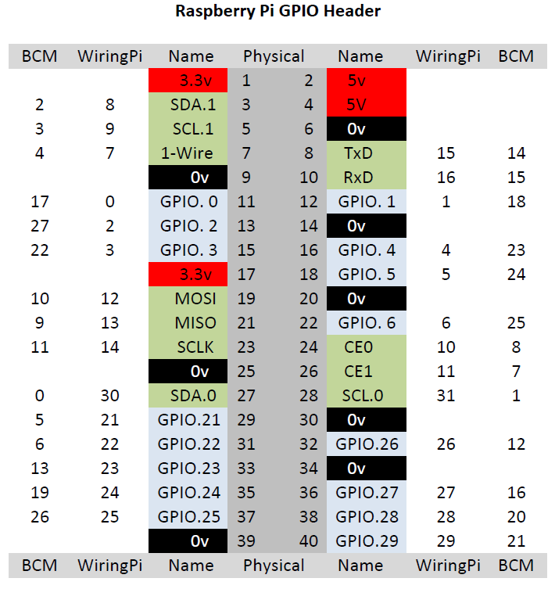
WiRING pi Library – pin numbering
pwm output
Interrupts wheel encoder

Slide 25
Auto RUN script
Autorunscript:
Why?
-To set the i2c clock speed on the right value (to avoid clock stretching)
-To start the program as a background proces
#!/bin/bash
# Script to start our application
echo "Doing autorun script ..."
echo "Autorun script sets clockfreq i2c on a low value to avoid clock stretching"
sudo modprobe -r i2c_bcm2708
sudo modprobe i2c_bcm2708 baudrate=4000
echo "executing /home/pi/row/pr is now turned off"
#turn auto executing on by removing the # sign in the next rule
#sudo /home/pi/row/pr

Slide 26
ASSIGNMENTS/ Questions [1]
1.
Which pins of the raspberry pi are used ? Describe the function of each used i/o pin.
2.
Study the makefile in /home/pi/robot
a) Which static library is linked into the executable? What is the file-location of that library?
b) How can you place a commend in a makefile?
c) The makefile contains the target “all”. What are targets in a makefile and what is an all-target?
d) What is the meaning of the “–lm” flag?
3.
Which linux-file calls the autorunscript?
How do you run a program in the background?
4.
In the given wheezy linux image – auto logon – is enabled. How is that accomplished?

Slide 27
ASSIGNMENTS/ Questions [2]
5.
Study the datasheet of the BV4604 i2c-pwm controller
a) Describe the function of the +L pin of the interface.
b) Which bytes must be sent to the the controller to change the i2c-address in 0x34?
c) The controller can operate in two modes; which modes?
6.
Calculate the speed in m/s of the car if the rasp. pi receives 112 interrupts in a period of 0,67 seconds.
7.
What is the main advantage of a step down convertor compared to a voltage regulator?

