Slide 1
Rescue on Wheels Workshop – week 2 Ruud Slokker

Slide 2
topics
Raspberry pi camara
Pull down and pull up resistors

Slide 3
Pi –Camera - raspistill
Pictures: raspistill
Example:
raspistill -w 640 -h 480 -q 5 -o /tmp/pic.jpg &
-q: quality range [0, 100]
&: running in the background
Video: raspivid
example:
raspivid -fps 25 -o myvideo.h264 -t 10000
This will record 10 seconds of video.

Slide 4
Pi –Camera – raspistill [2]
raspistill
raspistill –t 1000 mypicture.jpg
-t is the delay in milliseconds before the image is taken after you press Enter.
To take a sequence of pictures as a timelapse sequence the command is:
raspistill -t 900000 -tl 30000 -o mypicture%d.jpg
-t total time for sequence, 90000 ms = 15 min
-tl how often to take a picture. 30000 ms = 30 seconds
%d = picture number. output would be mypicture1.jpg mypicture2.jpg mypicture3.jpg

Slide 5
Pi –Camera – raspistill [3]
raspistill
raspistill –ss 300 -n mypicture.jpg
-ss = shutter speed; max = 6000
-n = no preview
raspistill –ex sports mypicture.jpg
-ex = exposure mode //sports : fast shutter
raspistill –md 2 mypicture.jpg
-md = mode
mode 2: 2592x1944; mode 6: 640x480

Slide 6
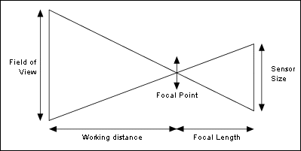
Field of view
Describe the relation between the field of view and the focal length of the camera lens.

Slide 7
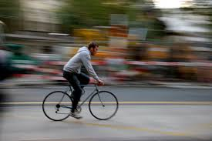
MOTIONBLUR
How can motion blur be reduced?

Slide 8
ASSIGNMENTS
Make use of:
http://www.raspberrypi.org/wp-content/uploads/2013/07/RaspiCam-Documentation.pdf
1a Make a picture of an object with the rasp. pi camera.
1b Make a video of an object with the rasp. pi camera.
Take a picture of a moving object. Reduce the motion blur of the pi-camera by reducing the
shutter time.
Take a picture of some text and apply the ocr-function on the
raspberry pi on the image:
http://www.instructables.com/id/BrickPi-Bookreader-Digitize-Books-With-Mindstorms-/step7/Installing-the-Optical-Character-Recognition-OCR-E/

Slide 9
PULL UP/ Down resistors
Problem without pull up / down resistor
input pin
noise source
gnd
microcontroller
noise voltage on the input pin

Slide 10
PULL UP resistors
Internal pull up resistor
input pin
external pull up resistor
gnd
microcontroller
Wiring pi library:
pullUpDnControl(0,PUD_UP);
input pin
gnd
microcontroller

Slide 11
PULL DOWN resistors
Internal pull down resistor
input pin
noise source
gnd
microcontroller
Wiring pi library:
pullUpDnControl(0,PUD_DOWN);
Noise voltage on the input pin is strongly reduced by a pull down
(or pull up) resistor.

