Slide 1
ANDROID DEVELOPMENT

Slide 2
ToC
1
INTRO
2
ANATOMY OF AN APPLICATION
3
USER INTERFACE
4
ADDITIONAL API FEATURES
5
DEBUGGING
6
OPTIMISATIONS

Slide 3
Intro | quick start
Android SDK (Software Development Kit)
JDK
ADT (Android Development Tools, Eclipse IDE plug-in)

Slide 4

Intro | platform overview

Slide 5
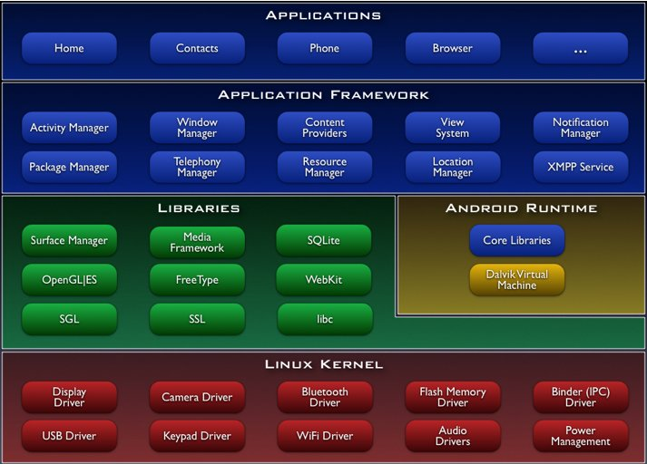
Intro | platform overview

Slide 6
Intro | platform overview
Dalvik VM
  optimised to run on slow-cpu, low-ram, low-power devices
  runs .dex files (not .class/.jar)
  Multiple instances of DVM can run in parallel

Slide 7
Intro | dvm vs. jvm
register-based vs. stack-based
  register-based VMs allow for faster execution times, but
  programs are larger when compiled.
execution environment - multiple vs. single instance

Slide 8
Intro | java vs. android api
Since it uses Java compiler, it implicitly supports a set of Java commands
Compatible with Java SE5 code
A subset of Apache Harmony (open source, free Java implementation)
Multithreading as time-slicng.
Dalvik implements the keyword synchronized and java.util.concurrent.* package
Supports reflexion and finalizers but these are not recomended
Does not support
  awt, swing, rmi, applet, ...

Slide 9
1
INTRO
2
ANATOMY OF AN APPLICATION
3
USER INTERFACE
4
ADDITIONAL API FEATURES
5
DEBUGGING
6
OPTIMISATIONS

Slide 10
Apps | activity
Base class mostly for visual components
  extends Activity
  override onCreate

Slide 11
Apps | activity
/* Example.java */
package uk.ac.ic.doc;
import android.app.Activity;
import android.os.Bundle;
public class Example extends Activity {
@Override
public void onCreate(Bundle icicle) {
super.onCreate(icicle);
setContentView(R.layout.interface);
}
}

Slide 12
Apps | activity
/* interface.xml */
<?xml version=“1.0” encoding=“utf-8”?>
<LinearLayout
xmlns:android=“http://schemas.android.com/apk/res/android”
android:orientation=“vertical”
android:layout_width=“fill_parent”
android:layout_height=“fill_parent”>
<TextView
android:id=“@+id/componentName”
android:layout_width=“fill_parent”
android:layout_height=“wrap_content”
android:text=“Text that will be displayed.”
/>
</LinearLayout>

Slide 13
Apps | activity
/* Example.java */
package uk.ac.ic.doc;
import android.app.Activity;
import android.os.Bundle;
public class Example extends Activity {
@Override
public void onCreate(Bundle icicle) {
super.onCreate(icicle);
setContentView(R.layout.interface);
TextView text_view = (TextView)findViewById(R.id.componentName);
}
}

Slide 14
Apps | activity
/* interface.xml */
[...]
<TextView
android:id=“@+id/componentName”
android:layout_width=“fill_parent”
android:layout_height=“wrap_content”
android:text=“@string/textRefName”
/>
/* strings.xml */
<?xml version=“1.0” encoding=“utf-8”?>
<resources xmlns:android=“http://schemas.android.com/apk/res/android”>
<string name=“textRefName”>Text that will be displayed</strings>
</resources>

Slide 15
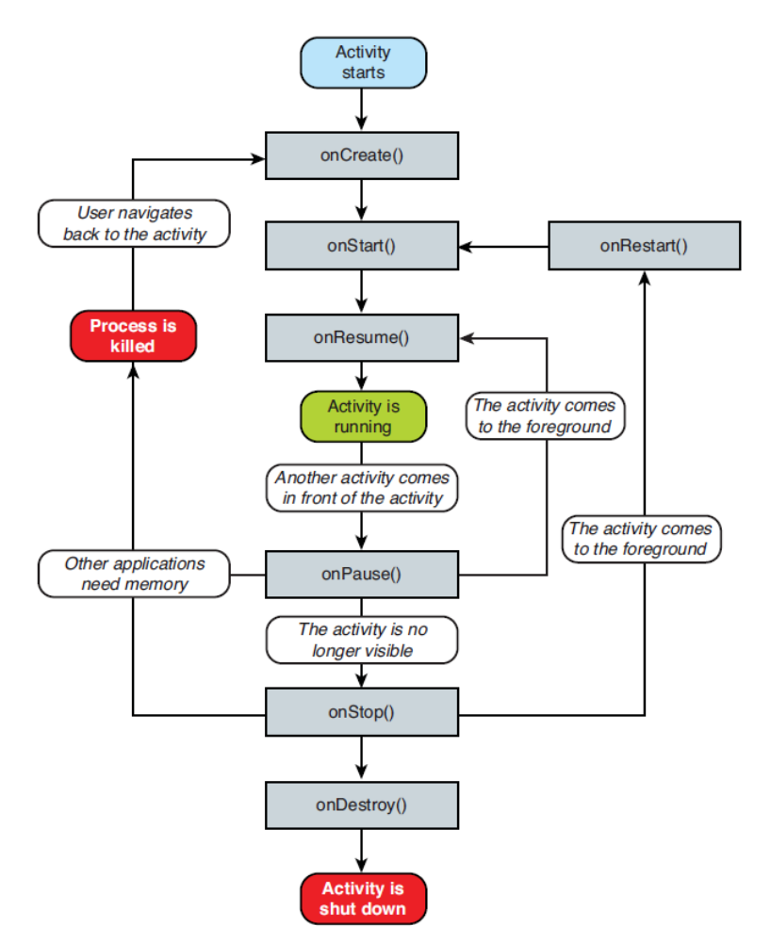
Apps | activity

Slide 16
Apps | activity
@Override
protected void onSaveInstanceState(Bundle outState) {
super.onSaveInstanceState(outState);
outState.putString(“key”, value);
outState.putFloatArray(“key2”, value2);
}
@Override
public void onRestoreInstanceState(Bundle savedInstanceState) {
super.onRestoreInstanceState(savedInstanceState);
value = savedInstanceState.getString(“key”);
value2 = savedInstanceState.getFloatArray(“key2”);
}

Slide 17
Apps | intent
Allows communication between components
  Message passing
  Bundle
Intent intent = new Intent(CurrentActivity.this, OtherActivity.class);
startActivity(intent);

Slide 18
Apps | intent
@Override
public void onCreate(Bundle savedInstanceState) {
super.onCreate(savedInstanceState);
setContentView(R.layout.main);
// Button listener
Button btnStart = (Button) findViewById(R.id.btn_start);
btnStart.setOnClickListener(new View.OnClickListener() {
public void onClick(View view) {
Intent intent =
new Intent(CurrentActivity.this, OtherActivity.class);
startActivity(intent);
}
});
}

Slide 19
Apps | thread
Button btnPlay = (Button) findViewById(R.id.btnPlay);
btnPlay.setOnClickListener(new View.OnClickListener() {
public void onClick(View view){
// Main Thread blocks
Thread backgroundMusicThread = new Thread(
new Runnable() {
public void run() {
playMusic();
}
}
);
backgroundMusicThread.start();
}
});

Slide 20
Apps | handler
Communication between tasks running in parallel

Slide 21
Apps | handler
private Handler mHandler = new Handler();
private Color mColor = Color.BLACK;
private Runnable mRefresh = new Runnable() {
public void run() {
mTextViewOnUI.setBackgroundColor(mColor)
}};
private Thread mCompute = new Thread(Runnable() {
public void run() {
while(1){
mColor = cpuIntensiveColorComputation(...);
mHandler.post(mRefresh);
}
}});
public void onCreate(Bundle savedInstanceState) {
mCompute.start();
}

Slide 22
Apps | service
Base class for background tasks
  extends Service
  override onCreate
It’s not
  a separate process
  a separate thread
It is
  part of the main thread
  a way to update an application when it’s not active

Slide 23
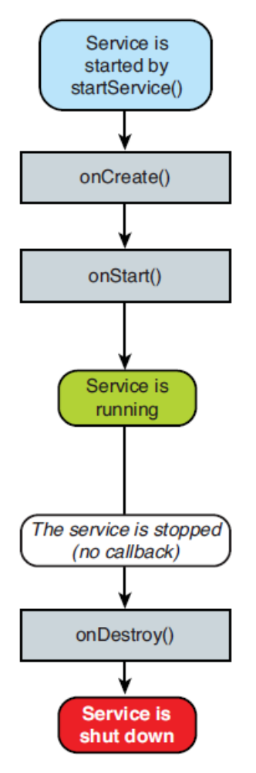
Apps | service

Slide 24
Apps | broadcast receiver
extends BroadcastReceiver
implements onReceive()
Waits for a system broadcast to happen to trigger an event
OS-generated
  Battery empty
  Camera button pressed
  New app installed
  Wifi connection established
User-generated
  Start of some calculation
  End of an operation

Slide 25
Apps | broadcast receiver
public class BRExample extends BroadcastReceiver {
@Override
public void onReceive(Context rcvCtx, Intent rcvIntent) {
if (rcvIntent.getAction().equals(Intent.ACTION_CAMERA_BUTTON)) {
rcvCtx.startService(new Intent(rcvCtx, SomeService.class));
}}}
public class SomeService extends Service {
@Override
public IBinder onBind(Intent arg0) { return null; }
@Override
public void onCreate() {
super.onCreate();
Toast.makeText(this,“Camera...”, Toast.LENGTH_LONG).show();}
@Override
public void onDestroy() {
super.onDestroy();
Toast.makeText(this, “Service done”, Toast.LENGTH_LONG).show();}
}

Slide 26
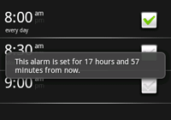
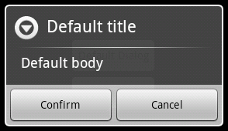
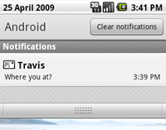
Apps | notifications
Toast
AlertDialog
Notification
Toast.makeText(this, “Notification text”, Toast.LENGTH_SHORT).show();

Slide 27
Apps | manifest
<?xml version=“1.0” encoding=“utf-8”?>
<manifest xmlns:android=“http://schemas.android.com/apk/res/android”
package=“uk.ac.ic.doc” android:versionCode=“1”
android:versionName=“1.0”>
<application android:icon=“@drawable/icon”
android:label=“@string/app_name”>
<activity android:name=“.SampleActivity”
android:label=“@string/activity_title_text_ref”>
<intent-filter>
/* ... */
</intent-filter>
</activity>
</application>
<uses-sdk android:minSdkVersion=“3” />
</manifest>

Slide 28
Apps | resources
/res
  anim
  drawable
    hdpi
    mdpi
    ldpi
  layout
  values
    arrays.xml
    colors.xml
    strings.xml
  xml
  raw

Slide 29
Apps | R.java
Autogenerated, best if not manually edited
gen/

Slide 30
1
INTRO
2
ANATOMY OF AN APPLICATION
3
USER INTERFACE
4
ADDITIONAL API FEATURES
5
DEBUGGING
6
OPTIMISATIONS

Slide 31
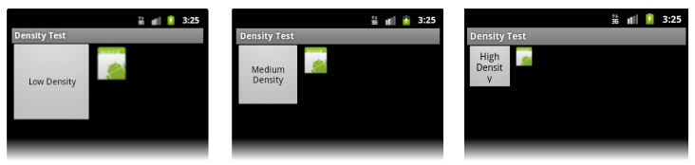
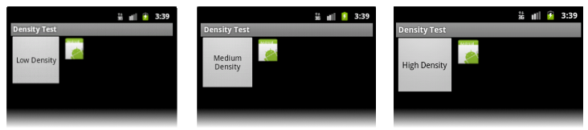
Elements and layouts
dip vs. px
Component dimesions
  wrap_content
  fill_parent

Slide 32
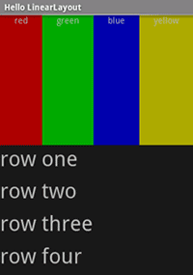
Elements and layouts
Linear Layout
  Shows nested View elements
/* linear.xml */
<?xml version=“1.0” encoding=“utf-8”?>
<LinearLayout android:orientation=“horizontal”
android:layout_width=“fill_parent”
android:layout_height=“fill_parent”
android:layout_weight=“1”>
<TextView android:text=“red” />
<TextView android:text=“green” />
</LinearLayout>
<LinearLayout android:orientation=“vertical”
android:layout_width=“fill_parent”
android:layout_height=“fill_parent”
android:layout_weight=“1”>
<TextView android:text=“row one” />
</LinearLayout>

Slide 33
Elements and layouts
Lineair Layout example:
http://www.mkyong.com/android/android-linearlayout-example/

Slide 34
Elements and layouts
Relative Layout

Slide 35
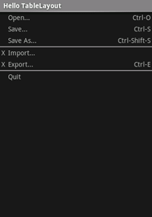
Elements and layouts
Table Layout
  Like the HTML div tag
/* table.xml */
<?xml version=“1.0” encoding=“utf-8”?>
<TableLayout android:layout_width=“fill_parent”
android:layout_height=“fill_parent”
android:stretchColumns=“1”>
<TableRow>
<TextView android:layout_column=“1”
android:text=“Open...”
android:padding=“3dip” />
<TextView android:text=“Ctrl-O”
android:gravity=“right”
android:padding=“3dip” />
</TableRow>
</TableLayout>

Slide 36
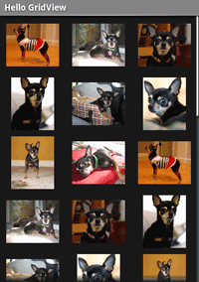
Elements and layouts
Grid View
/* grid.xml */
<?xml version=“1.0” encoding=“utf-8”?>
<GridView
android:id=“@+id/gridview”
android:layout_width=“fill_parent”
android:layout_height=“fill_parent”
android:columnWidth=“90dp”
android:numColumns=“auto_fit”
android:verticalSpacing=“10dp”
android:horizontalSpacing=“10dp”
android:stretchMode=“columnWidth”
android:gravity=“center”
/>

Slide 37
Elements and layouts
Grid View
/* GridExample.java */
public void onCreate(Bundle savedInstanceState) {
super.onCreate(savedInstanceState);
setContentView(R.layout.grid);
GridView gridview = (GridView) findViewById(R.id.gridview); gridview.setAdapter(new AdapterForGridView(this));
gridview.setOnItemClickListener(
new OnItemClickListener() {
public void onItemClick(AdapterView<?> parent, View v,
int pos, long id) {
Toast.makeText(
GridPrimer.this, "" + pos, Toast.LENGTH_SHORT).show();
}});
}

Slide 38
Elements and layouts
Grid View
/* AdapterForGridView.java */
public class AdapterForGridView extends BaseAdapter {
private Context mContext;
public AdapterForGridView(Context c) { mContext = c; }
public int getCount() { return mThumbIDs.length; }
public Object getItem(int position) { return null;}
public long getItemId(int position) { return 0; }
// bad getView implementation
public View getView(int pos, View convertView, ViewGroup parent) {
ImageView imageView = new ImageView(mContext);
imageView.setImageResource(mThumbIDs[pos]);
return imageView;
}
private Integer[] mThumbIDs =
{ R.drawable.img1, R.drawable.img2 /*...*/ };
}

Slide 39
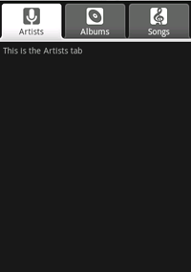
Elements and layouts
Tab Layout
/* tab.xml */
<?xml version=“1.0” encoding=“utf-8”?>
<TabHost android:id=“@android:id/tabhost”
android:layout_width=“fill_parent”
android:layout_height=“fill_parent”>
<LinearLayout android:orientation=“vertical”
android:layout_width=“fill_parent”
android:layout_height=“fill_parent”>
<TabWidget android:id=“@android:id/tabs”
android:layout_width=“fill_parent”
android:layout_height=“wrap_content”/>
<FrameLayout
android:layout_width=“fill_parent”
android:layout_height=“fill_parent”/>
</LinearLayout>
</TabHost>

Slide 40
Elements and layouts
Tab Layout
/* selector1.xml */
<?xml version=“1.0” encoding=“utf-8”?>
<selector xmlns:android=“http://schemas.android.com/apk/res/android”>
<!– Tab is selected -->
<item android:drawable=“@drawable/ic_tab_1_selected”
android:state_selected=“true” />
<!– Tab not selected -->
<item android:drawable=“@drawable/ic_tab_1_not_selected” />
</selector>
/* selector2.xml */
/* selector3.xml */

Slide 41
Elements and layouts
Tab Layout
/* Tab1.java */
public class Tab1 extends Activity {
public void onCreate(Bundle savedInstanceState) {
super.onCreate(savedInstanceState);
TextView textview = new TextView(this);
textview.setText(“This is the Artists tab”);
setContentView(textview);
}
}
/* Tab2.java */
/* Tab3.java */

Slide 42
Elements and layouts
Tab Layout
/* TabExample.java */
public class TabExample extends TabActivity {
public void onCreate(Bundle savedInstanceState) {
super.onCreate(savedInstanceState);
setContentView(R.layout.tab);
TabHost tabHost = getTabHost();
//--- tab 1 ---
Intent intent = new Intent().setClass(this, Tab1.class);
TabHost.TabSpec spec = tabHost.newTabSpec(“tab1”).setIndicator(
“Artists”, getResources().getDrawable(R.drawable.selector1))
.setContent(intent);
tabHost.addTab(spec);
//--- tab 1 ---
tabHost.setCurrentTab(2);
}

Slide 43
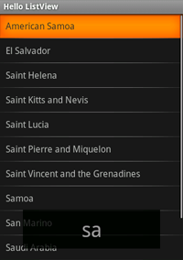
Elements and layouts
List View
/* list_item.xml */
<?xml version=“1.0” encoding=“utf-8”?>
<TextView
android:layout_width=“fill_parent”
android:layout_height=“fill_parent”
android:padding=“10dp”
android:textSize=“16sp” />

Slide 44
Elements and layouts
List View
/* ListViewExample.java */
public class ListViewExample extends ListActivity {
@Override
public void onCreate(Bundle savedInstanceState) {
super.onCreate(savedInstanceState);
setListAdapter(new ArrayAdapter<String>(this, R.layout.list_item, COUNTRIES));
ListView lv = getListView();
lv.setTextFilterEnabled(true);
lv.setOnItemClickListener(new OnItemClickListener() {
public void onItemClick(AdapterView<?> parent, View view,
int position, long id) {
Toast.makeText(getApplicationContext(),
((TextView) view).getText(), Toast.LENGTH_SHORT).show();
}});
}

Slide 45
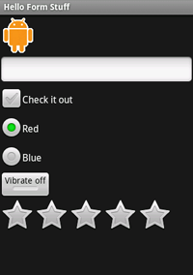
Elements and layouts
Button
ImageButton
EditText
CheckBox
RadioButton
ToggleButton
RatingBar

Slide 46
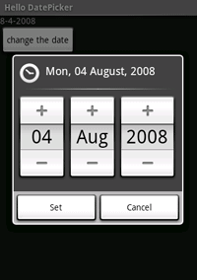
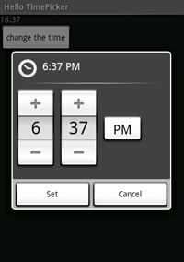
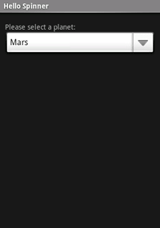
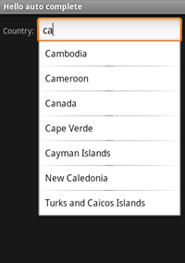
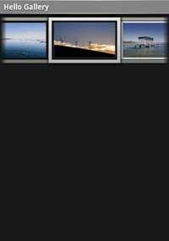
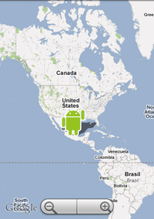
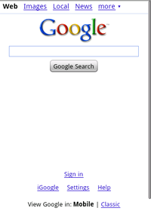
Elements and layouts
DatePicker
TimePicker
Spinner
AutoComplete
Gallery
MapView
WebView

Slide 47
Events
Event Handler
  Hardware buttons
Event Listener
  Touch screen

Slide 48
Events
KeyEvent is sent to callback methods
  onKeyUp(), onKeyDown(), onKeyLongpress()
  onTrackballEvent(), onTouchEvent()
public boolean onKeyDown(int keyCode, KeyEvent event) {
if (keyCode == KeyEvent.KEYCODE_CAMERA) {
return true; // consumes the event
}
return super.onKeyDown(keyCode, event);
}
Button button = (Button) findViewById(R.id.button);
button.setOnClickListener(new View.OnClickListener() {
public void onClick(View view) { /* ... */ }
});

Slide 49
Events
public class TouchExample extends Activity {
@Override
public void onCreate(Bundle savedInstanceState) {
super.onCreate(savedInstanceState);
setContentView(R.layout.main);
Button button = (Button) findViewById(R.id.button);
button.setOnClickListener(new OnClickListener() {
public void onClick(View v) { /*...*/ }
});
button.setOnLongClickListener(new OnLongClickListener() {
public boolean onLongClick(View v) {
// ...
return true;
}
});
}
}

Slide 50
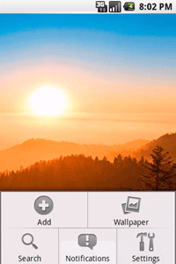
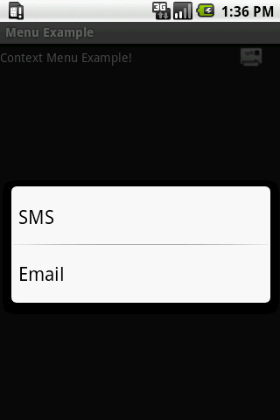
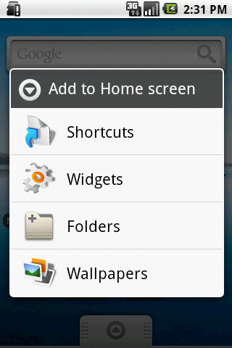
Menus
Options Menu: MENU button, tied to an Activity
Context Menu: View LongPress
Submenu
public boolean onCreateOptionsMenu(Menu menu) {
menu.add(0, MENU_ADD, 0, “Add”)
.setIcon(R.drawable.icon);
menu.add(0, MENU_WALLPAPER, 0, “Wallpaper”);
return super.onCreateOptionsMenu(menu);
}
public boolean onOptionsItemSelected(MenuItem item) {
switch(item.getItemId()) {
case MENU_ADD: //... ; return true;
case MENU_WALLPAPER: //... ; return true;
default: return false;
}
}
public void onCreate(Bundle savedInstanceState) {
registerForContextMenu((View)findViewById(/*...*/));
}
public void onCreateContextMenu(ContextMenu menu, View v, ContextMenuInfo menuInfo){
super.onCreateContextMenu(menu, v, menuInfo);
menu.add(0, MENU_SMS, 0, “SMS”);
menu.add(0, MENU_EMAIL, 0, “Email”);
}
public boolean onContextItemSelected(MenuItem item) {
switch(item.getItemId()) { case MENU_SMS: /*...*/ }
}

Slide 51
Widget
XML Layout
AppWidgetProvider gets notified
Dimensions and refresh frequency

Slide 52
1
INTRO
2
ANATOMY OF AN APPLICATION
3
USER INTERFACE
4
ADDITIONAL API FEATURES
5
DEBUGGING
6
OPTIMISATIONS

Slide 53
More on API | 2D
Bitmap image;
image = BitmapFactory.decodeResource(getResources(),R.drawable.image1);
// getPixel(), setPixel()
image = BitmapFactory.decodeFile(“path/to/image/on/SDcard”);
// Environment.getExternalStorageDirectory().getAbsolutePath()

Slide 54
More on API | 2D
public class MyGUIcomponent extends View {
private Paint paint;
public MyGUIcomponent(Context c){
paint = new Paint();
paint.setColor(Color.WHITE);
paint.setTextSize(25);
}
@Override
protected void onDraw(Canvas canvas) {
super.onDraw(canvas);
canvas.drawText(“some text”, 5, 30, paint);
}
@Override
protected void onMeasure(int w, int h){
// w = ...; h = ...;
setMeasuredDimension(w, h);
}
}

Slide 55
More on API | 3D
OpenGL library
Camera, matrices, transformations, ...
View animation

Slide 56
More on API | audio/video
<uses-permission android:name=“android.permission.RECORD_VIDEO” />

Slide 57
More on API | hardware
Camera
Phone
Sensors
WiFi
Bluetooth
GPS (Location services/Maps)

Slide 58
More on API | sensors
Accelerometer
Thermometer
Compass
Light sensor
Barometer
Proximity sensor

Slide 59
More on API | sensors
A list of all sensors
  getSensorList()
Control class
  SensorManager
Callback methods
  onSensorChanged()
  onAccuracyChanged()

Slide 60
More on API | sensors
private void initAccel(){
mSensorManager = (SensorManager) getSystemService(SENSOR_SERVICE);
mSens = mSensorManager.getDefaultSensor(Sensor.TYPE_ACCELEROMETER);
mSensorManager.registerListener(this, mSens,
SensorManager.SENSOR_DELAY_GAME);
}
@Override
public void onSensorChanged(SensorEvent event) {
if (event.sensor.getType() == SensorManager.SENSOR_ACCELEROMETER) {
float x = event.values[SensorManager.DATA_X];
float y = event.values[SensorManager.DATA_Y];
float z = event.values[SensorManager.DATA_Z];
}
}

Slide 61
More on API | wifi
<uses-permission android:name=“android.permission.ACCESS_NETWORK_STATE” />
private BroadcastReceiver mNetworkReceiver = new BroadcastReceiver(){
public void onReceive(Context c, Intent i){
Bundle b = i.getExtras();
NetworkInfo info =
(NetworkInfo) b.get(ConnectivityManager.EXTRA_NETWORK_INFO);
if(info.isConnected()){
//...
}else{
// no connection
}
}
};
this.registerReceiver(mNetworkReceiver,
new IntentFilter(ConnectivityManager.CONNECTIVITY_ACTION));

Slide 62
More on API | internet
Social network apps
Cloud apps
Sockets, Datagrams, Http, ...

Slide 63
More on API | sms
<uses-permission android:name=“android.permission.SEND_SMS” />
<uses-permission android:name=“android.permission.RECEIVE_SMS” />
SmsManager mySMS = SmsManager.getDefault();
String to_whom = “+4475...”;
String message_text = “...”;
mojSMS.sendTextMessage(to_whom, null, message_text, null, null);
ArrayList<String> multiSMS = mySMS.divideMessage(poruka);
mySMS.sendMultipartTextMessage(to_whom, null, multiSMS, null, null);

Slide 64
More on API | sms
BroadcastReceiver receiver = new BroadcastReceiver() {
@Override
public void onReceive(Context c, Intent in) {
if(in.getAction().equals(RECEIVED_ACTION)) {
Bundle bundle = in.getExtras();
if(bundle!=null) {
Object[] pdus = (Object[])bundle.get(“pdus”);
SmsMessage[] msgs = new SmsMessage[pdus.length];
for(int i = 0; i<pdus.length; i++) {
msgs[i] = SmsMessage.createFromPdu((byte[])pdus[i]);
}
// reply();
}
}
}};

Slide 65
More on API | sms
public class ResponderService extends Service {
private static final String RECEIVED_ACTION =
“android.provider.Telephony.SMS_RECEIVED”;
@Override
public void onCreate() {
super.onCreate();
registerReceiver(receiver, new IntentFilter(RECEIVED_ACTION));
}
@Override
public void onStart(Intent intent, int startId) {
super.onStart(intent, startId); }
@Override
public void onDestroy() {
super.onDestroy(); unregisterReceiver(receiver); }
@Override
public IBinder onBind(Intent arg0) { return null; }
}

Slide 66
More on API | sharedPreferences
Interface for easy storage of key-value pairs
Mostly used for saving user settings (language, etc.)
  e.g. username/pass combination for auto-login
Access to file
  MODE_PRIVATE
  MODE_WORLD_READABLE
  MODE_WORLD_WRITEABLE

Slide 67
More on API | sharedPreferences
SharedPreferences prefs = getSharedPreferences(“Name”, MODE_PRIVATE);
Editor mEditor = prefs.edit();
mEditor.putString(“username”, username);
mEditor.putString(“password”, password);
mEditor.commit();
SharedPreferences prefs = getSharedPreferences(“Name”, MODE_PRIVATE);
String username = prefs.getString(“username”, “”);
String password = prefs.getString(“password”, “”);

Slide 68
More on API | sqlite
Each application has its own DB (can be shared)
/data/data/<you_package>/databases
Can
  Create a db
  Open a db
  Create tables
  Insert data into tables
  Fetch data from tables
  Close a db
Basically, SQL syntax

Slide 69
More on API | contentProvider
Since every application is sandboxed, this is Androids mechanism which relates data across apps
Required access privileges must be declared in Manifest and approved by user during installation

Slide 70
More on API | java.io.File
FileInputStream fis = openFileInput(“some_file.txt”);
FileOutputStream fos = openFileOutput(“some_file.txt”,
Context.MODE_WORLD_WRITEABLE);
Bitmap slika;
FileOutputStream new_profile_image = openFileOutput(“new_image.png”,
Context.MODE_WORLD_WRITEABLE);
slika.compress(CompressFormat.PNG, 100, new_profile_image);
out.flush();
out.close();
InputStream is = this.getResource().openRawResource(R.raw.some_raw_file);

Slide 71
1
INTRO
2
ANATOMY OF AN APPLICATION
3
USER INTERFACE
4
ADDITIONAL API FEATURES
5
DEBUGGING
6
OPTIMISATIONS

Slide 72
Debugging
gdb
  Since it’s based on Linux, similar command-set
DDMS through ADT
  Dalvik Debug Monitoring Service
  Android Developer Tools plugin for Eclipse
  Using breakpoints
Android SDK Debug tools
  ADB (Android Debug Bridge)
  LogCat
  HierarchyViewer

Slide 73
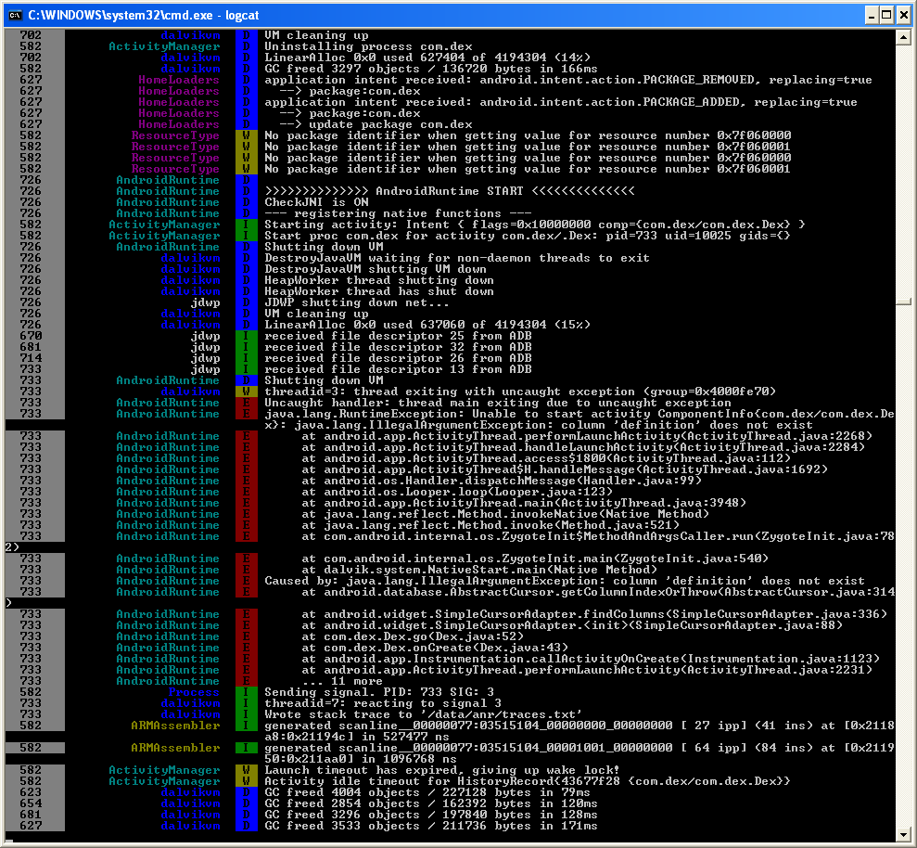
Debugging | gdb
> adb shell top
> adb shell ps
> gdb mojprogram
> adb logcat

Slide 74
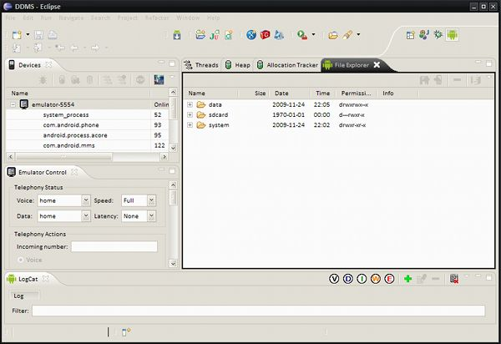
Debugging | ddms

Slide 75
Debugging | android debug bridge
Controlling an emulator instance
> adb start-server
> adb stop-server

Slide 76
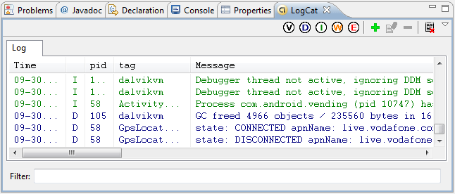
Debugging | LogCat
Logging app execution
Real-time logging tool
Works with tags, priorities and filters

Slide 77
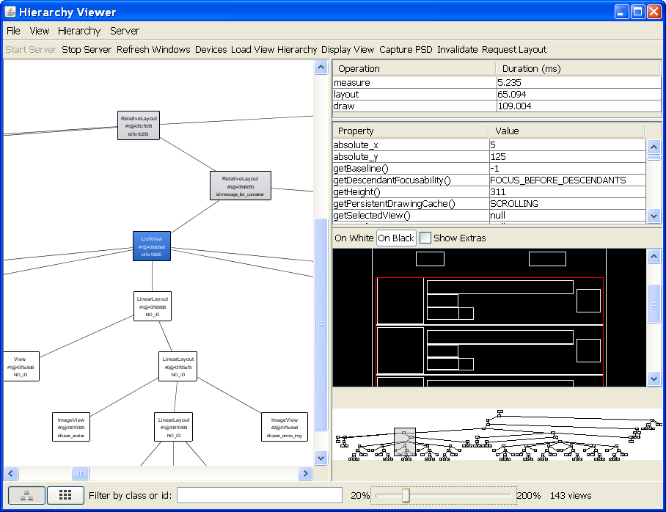
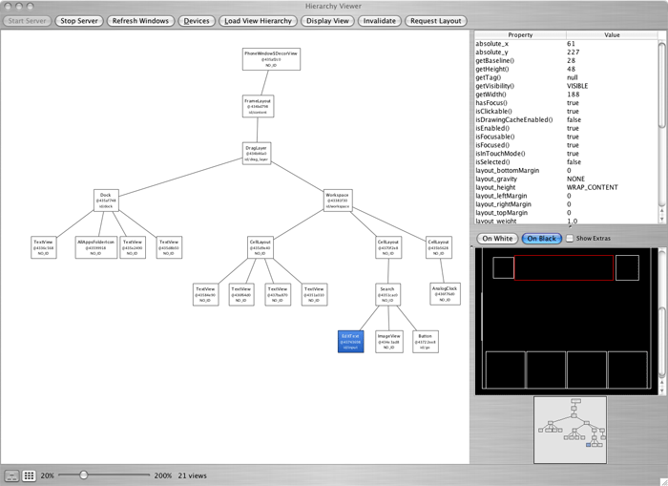
Debugging | hierarchy viewer
For “interface debugging”

Slide 78
1
INTRO
2
ANATOMY OF AN APPLICATION
3
USER INTERFACE
4
ADDITIONAL API FEATURES
5
DEBUGGING
6
OPTIMISATIONS

Slide 79
Optimisations | in general
Instancing objects is expensive, avoid if possible
  Overhead from creating, allocation and GC-ing
Use native methods
  written in C/C++
  around 10-100x faster than user-written in Java by user
Calls through interfaces are up to 2x slower than virtual
Declare methods as static if they don’t need access to object’s fields
Caching field access results
  counters, etc.
Map myMapa = new HashMap();
HashMap myMapa = new HashMap();

Slide 80
Optimisations | getView()
Implemented in Adapter
Used for:
  Fetching elements from XML
  Their creation in memory (inflate)
  Filling them with valid data
  Returning a ready View element
private static class SomeAdapter extends BaseAdapter {
public SomeAdapter(Context context) {}
public int getCount() { /*...*/ }
public Object getItem(int position) { /*...*/ }
public long getItemId(int position) { /*...*/ }
public View getView(int p, View cv, ViewGroup p) {
// this implementation directly impacts performace
}
}

Slide 81
Optimisations | getView()
public View getView(int p, View cv, ViewGroup p) {
View element = //... make a new View
element.text = //... get element from XML
element.icon = //... get element from XML
return element;
}
Creation of a new element gets called each time, and that is the single most expensive operation when dealing with UI

Slide 82
Optimisations | getView()
public View getView(int p, View cv, ViewGroup p) {
if (cv == null) {
cv = //... make a new View
}
cv.text = //... get element from XML
cv.icon = //... get element from XML
return cv;
}
New element get created only a couple of times
Performance is acceptable

Slide 83
Optimisations | getView()
static class ViewHolder {
TextView text;
ImageView icon;
}
public View getView(int p, View cv, ViewGroup p) {
ViewHolder holder;
if (cv == null) {
cv = //... make a new View
holder = new ViewHolder();
holder.text = //... get element from XML
holder.icon = //... get element from XML
cv.setTag(holder);
} else {
holder = (ViewHolder) cv.getTag();
}
return cv;
}

Slide 84
Hands on
Study the Android example on:
http://www.mkyong.com/android/android-activity-from-one-screen-to-another-screen/
Try to get this code running on your phone or on an Android emulator.

